Slide 1
Straight and Balanced
The Life of Jesus
(Luke 3:4-6)
#1 – Simeon & Anna Seek, See, & Speak (Luke 2:22-40)
#2 – No Guile Nathanael (John 1:43-51)
#3 – Woman and wine (John 2:1-11)
OT: Ps 5:8, Pr 4:25-27
Amos 7:7-8
NT: Mt 3:3, Acts 9:11
Hebrews 12:13
OT: Deut 25:13-16
Daniel 5:25-28
NT: Hebrews12:1
1 Cor 3:11-15
Fellowship Church, July 26, 2023, by Bill Heath

Slide 2
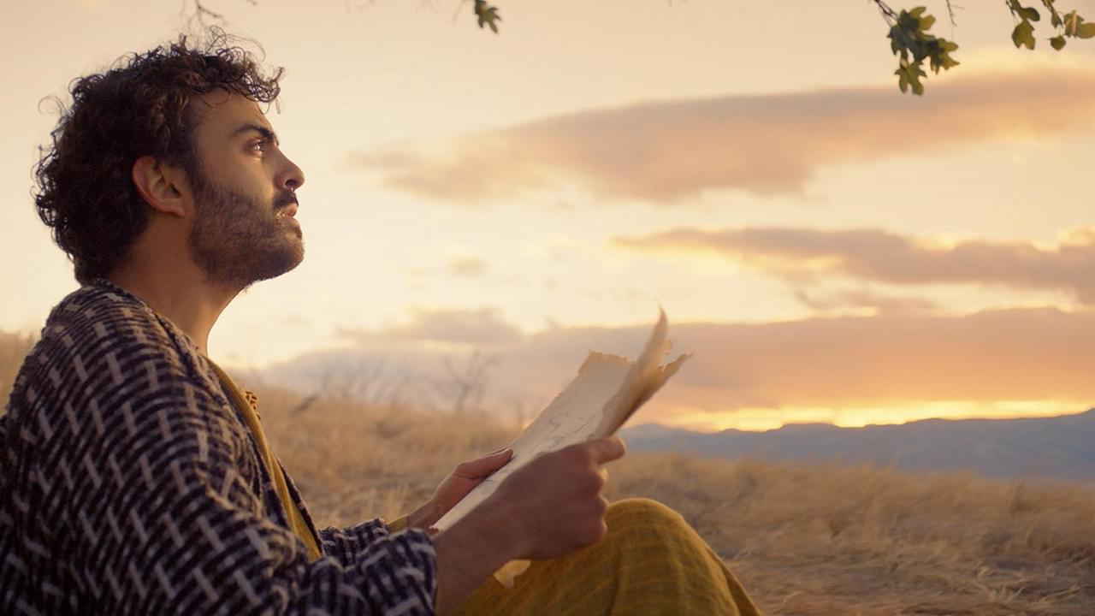
No Guile Nathanael (John 1:43-51) 1. Jesus finds Philip and says, “follow me.” Philip finds Nathaniel & says we (John, Andrew & Peter the day before, 1:35-42) found Jesus. 2. Philip says to Nathaniel, “come & see.” Jesus says Nathaniel has “no guile” Ro 11:26, Rev 14:5 Jesus sees Nathaniel under the fig tree seeking God 3. Nathaniel believes calls Jesus - Rabbi, Son of God, King of Israel Promise: Ye shall see heaven open and the angels of God ascending and descending upon the Son of man. (Genesis 28:12, God’s children have continual access) Decision: Have you believed? Are you totally surrendered to God? (Genesis 32:24-30)
Photo from “The Chosen” at BYU site
straight & balanced:
Jesus saves and sanctifies
Understanding:
Jesus sees us as God sees us.
and when it is His time.

