Slide 1
Straight and Balanced
The Life of Jesus
(Luke 3:4-6)
#1 – Simeon & Anna Seek, See, & Speak (Luke 2:22-40)
#2 –
OT: Ps 5:8, Pr 4:25-27
Amos 7:7-8
NT: Mt 3:3, Acts 9:11
Hebrews 12:13
OT: Deut 25:13-16
Daniel 5:25-28
NT: Hebrews12:1
1 Cor 3:11-15
Fellowship Church, July 5, 2023, by Bill Heath

Slide 2
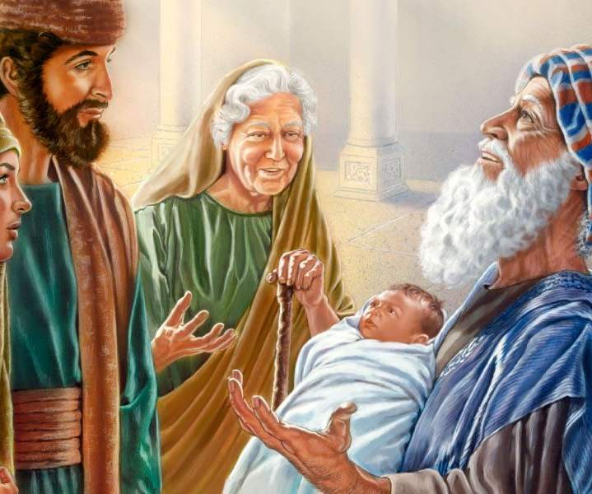
Simeon & Anna Seek, See, Speak (Luke 2:22-40) 2:22-24 Mary is purified & Jesus is presented 2:25-35 Simeon seeks, sees, and speaks 2:36-38 Anna seeks, sees, and speaks 2:39-40 Jesus’ body, spirit, & mind grow with God’s grace upon Him straight: led of the Holy Spirit by balanced: Scripture (Simeon) & prayer (Anna) Key understanding: seek (includes wait), see, speak (we hear them speak in our language the wonderful works of God – Matthew 6:33, John 16:13 – speaking to the 11 Apostles, 16:25, 17:13; Acts 1:8, 2:11, 6:4; Romans 1:8, 12:3; 1 Corinthians 14:1, 14:21; Ephesians 1:15-23, 3:14-21, 6:19-20, 1 Thessalonians 1:8)
Application
1st coming – prophet (Simeon & Anna) Seek, See, Speak
Today – priest (all believers)
Jesus is our Great High Priest
2nd coming – king (all believers) Seek, See, Speak

