Slide 1
Part 3 – The Work of the Holy Spirit
Fellowship Church, May 25, 2022 by Bill Heath
Part 1 - Prosper Your Soul with Your Time, Talents, and Treasure (3 John 2)
Part 2 – No Regret Parenting

Slide 2
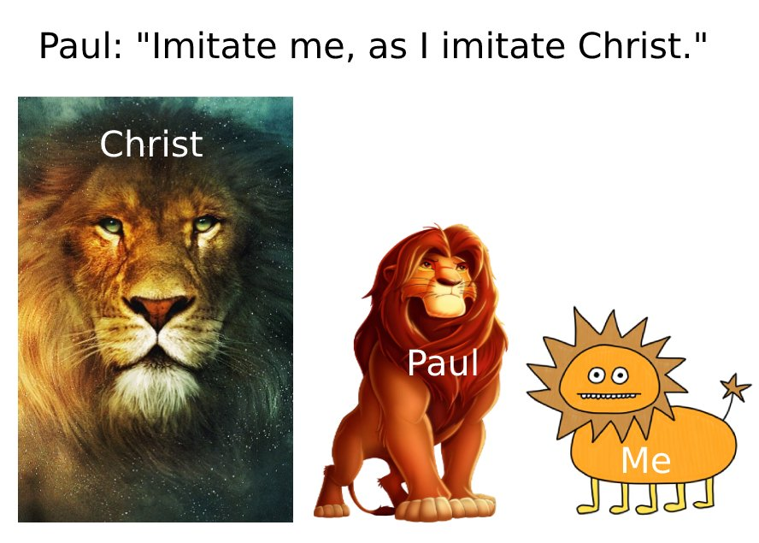
The Work of the Holy Spirit
Give us the ability to do what is right by the power of the risen Christ
2. Seven baptisms
3. Eight things happen in every believer (and more)
Five choices about the Holy Spirit
Future: Prayer and Witnessing

