Slide 1
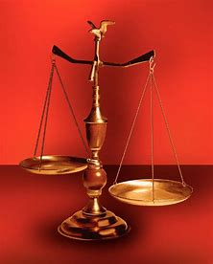
Treasure New and Old #1
Fellowship Church, September 7, 2022 by Bill Heath
Following Christ in a
Balanced and Straight Way
OT: Deuteronomy 25:13-16,
Daniel 5:25-28
NT: Hebrews12:1,
1 Corinthians 3:11-15
OT: Ps 5:8, Pr 4:25-27,
Amos 7:7-8
NT: Mt 3:3, Acts 9:11,
Heb 12:13

Slide 2
Sexual orientation / Gender Identity
What God says
In the Scriptures; Old Testament and New Testament
(OT: Gen 1:27, Lev 18:22, Lev 20:13 NT: Rom 1:26-28, Mt 11:23-24, 1 Cor 6:9-11)
What man says
History in the U.S.A. : A.P.A., DSM-5 of 2013, -TR 2022, UCMJ, VA, Gender Dysphoria
Today in churches around Maryland and county schools & universities
Tomorrow nationally legislated and required for all federally funded schools
Dept of Education, Title 12, Public Comment due by sept 12, 100+ pages (handout)
What should the Bible Believer do? Personal, Family, work, friends, church, Community. Jeremiah 12:5, James I:5-7, 4:7-10, Personal Revival.

