Slide 1
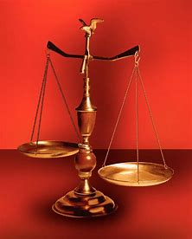
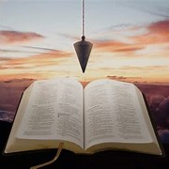
Treasure New and Old #6
Fellowship Church, November 30, 2022 by Bill Heath
Following Christ in a
Balanced and Straight Way
Precept upon precept,
line upon line, here a little,
there a little (Isaiah 28:10,13)
#1 – Sex in Education
#2 – The Wheel of Life
#3 – Listening to God (Phil 4:8)
#4 – Let’s Follow Jesus (Neh 3)
#5 – Brotherly Love (Philemon)
#6 – End Strong (2 Tim 4:7)
#7 – Not my will, way, or time
#8 – God’s High Calling for 2023
OT: Deut 25:13-16
Daniel 5:25-28
NT: Hebrews12:1
1 Cor 3:11-15
OT: Ps 5:8, Pr 4:25-27
Amos 7:7-8
NT: Mt 3:3, Acts 9:11
Hebrews 12:13

Slide 2
End strong 1st Paul to Timothy 1Ti 6:12 Fight the good fight of faith, lay hold on eternal life, whereunto thou art also called, and hast professed a good profession before many witnesses. 2nd Paul for Himself 2 Timothy 4:7 I have fought a good fight, I have finished [my] course, I have kept the faith: “Paul put other believers first”
Five Groups of Eternal Souls
1. Begin Strong – Always Strong (obedience)
- God & his angels, Jesus Christ, the Holy Spirit
2. Begin Strong – Fell (sin)
- Lucifer and his angels (Gen 3, Is 14, Ez 28, Rev 12:4, )
3. Never begin strong – all mankind (sin)
- Genesis 3, Judas, Romans 1-3, Rev 20:7-15
4. Begin strong – End Weak (sin)
- OT: King Solomon, Asa, Jehosophat, Hezekiah, Josiah
- NT: Ananias & Sapphira, Demas, Church of Laodicea
Begin Strong – End Strong (obedience)
- OT: Noah, Daniel, Job-family (Ez14:14); John, Hebrews 11
- NT: 12 Apostles, Paul, Mark, Gaius, Elect lady

