Slide 1
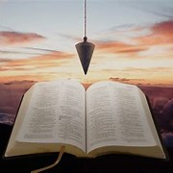
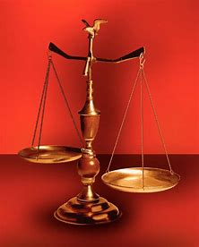
Fellowship Church, June 7, 2023
by Bill Heath
Straight and Balanced
John 3:4-6
#1 – Daily Scripture & Prayer Plan
#2 – Worldly Sin (Romans1:18-3)
#3 – God’s Salvation (Romans 4-5)
#4 – Who am I Connected to? (Ez 37)
#5 – Life ain’t what it use to be (1Cor 13:11)
#6 – Amos the Master Worker (Amos)
#7 – Jesus in the Tabernacle (Heb 9:23-24)
#8 – Hungry for the Bread of Life (Luke 5:33-39)
#9 – Foundation Mysteries Revealed! (Eph 3:9)
#10 – Women’s Hall of Fame (Romans 16)
#11 –
#12 –
OT: Ps 5:8, Pr 4:25-27
Amos 7:7-8
NT: Mt 3:3, Acts 9:11
Hebrews 12:13
OT: Deut 25:13-16
Daniel 5:25-28
NT: Hebrews12:1
1 Cor 3:11-15

Slide 2
Women’s Hall of Fame, Romans 16:1-16
Phebe 16:1-2, 27
our sister, servant, business, strength of many - also Paul
2. Priscilla (wife) 16:3-5a
Acts 18:1-3, 18, 24-28, 1 Corinthians 16:19, 2 Timothy 4:19
my helpers, laid down their necks, Paul & churches thanks
3. Mary 16:6
bestowed much labor on us
Junia (wife) 16:7
fellow prisoners, noted among Apostles, in Christ before Paul
5. Tryphena & Tryphosa (sisters) 16:12
labor in the Lord
6. Persis 16:12
the beloved, labored much in the Lord
7. his (mother) & mine 16:13
8. Julia (wife) 16:15
his sister 16:15
The God Squad or 9 Commanding Officers (CO)
Leader in front: Jesus Christ with binoculars & a pistol
Fire Team #1: Doctrine (by faith, from a pure heart)
1st: Content – all (read)
2nd: Context – most (study)
3rd: Concise – some (study)
4th: Concept – many (meditate)
Fire Team #2: Practice (obey or disobey)
1st: COnfirm or COnvict
2nd: COmfort or COnfess
& &
3rd: COnverse or COnsult
4th: COnduit and COnduit
Help as needed from behind: Medic & grenadier
Goal: COnsistently, COnsumed for the glory of God
Inductive Bible Study
(passage based)
Observations
Interpretations
What? What?
Application
WWJD
WDJD
WMID

