Slide 1

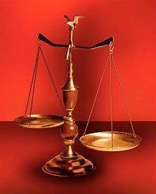
Straight and Balanced
(Luke 3:4-6)
The Faith, a noun, G3982, pis’-tis, 244x, Hebrews 11-11x (11:1-3, 6, 38-40, 12:1-4; Romans 15:23, Jude 1:3)
Fellowship Church, Mar 25, 2026 B. Heath
Old Testament: True Prophets of the Faith
#13 – Samuel: Lifelong Shining Faith (Heb 11:32f, 1 Sam)
#14 – Nathan & Gad: The Comforter’s Faith (Heb 11:32g)
#15 – Man of God & the Old Prophet: Weak Prophets of the Faith
#16 – Azariah & Hanani: Two Prophets and Two Effects of Truth
#17 – Jehu, a Prophet, & Micaiah: Little-Known Prophets
#18 – Elijah: The Past, Present, and Future Prophet of the Faith (Heb 11:35)
#19 – Elisha: Prophet of Power and Water (Heb 11:35)
#20 – Jonah & Nahum: God’s Mercy & Judgment on Nineveh
#21 – Hosea, Joel, & Amos: Future Judgments and Blessings
#22 – Obadiah, Jonah, & Micah: Fight with Hate, Anger, & Darkness
#23 – Isaiah: Prophet of Majesty and Royalty (Heb 11:37)
#24 – Nahum, Habakkuk, & Zephaniah: God the Loving-Holy Judge
#25 – Huldah: Prophetess of Anomaly & Conformity of the Faith
#26 – Jeremiah & Lamentations: Speak, Weep, and Turn unto the LORD
#27 – Ezekiel: Watchman on a Short Leash
#28 – Daniel: Prophet of Self-control and Godliness
#29 – Haggai, Zechariah, & Malachi: Revival, Prophecy, & Transition
#30 – True Prophets in the New Testament: Limited & Temporary
#31 – False Prophets in the Old Testament and the New Testament
OT: Ps 5:8, Pr 4:25-27
Amos 7:7-8, Is 28:13, 17
NT: Mt 3:3, Acts 9:11
Hebrews 12:13, Jude 3
1 Cor 15:1-4, 2 Tim 3:10
John 7:16
OT: Deut 25:13-16
Pr 20:10, Dan 5:25-28
NT: Hebrews 12:1
1 Cor 3:11-15
Philippians 4:5
James 3:17

Slide 2
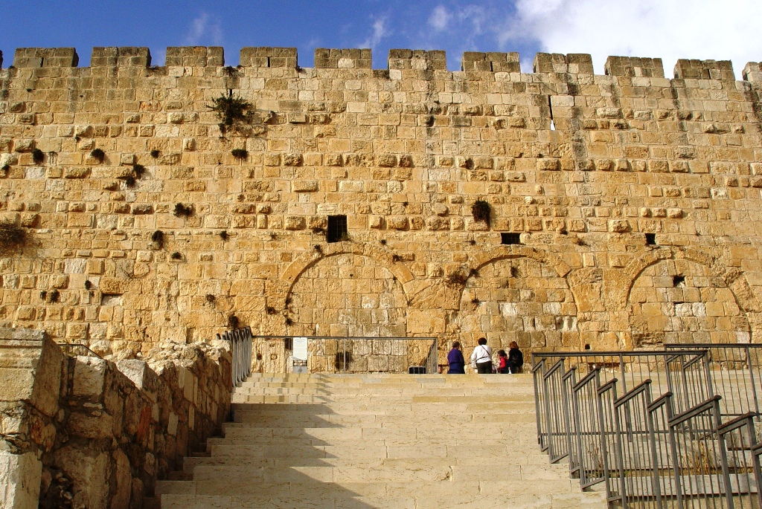
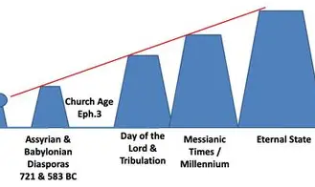
Malachi, The Way of Transition (Malachi = messenger)
Time: c. 415 BC Place: Israel 5x To: the priests 3x (1:1-2:9)
Transition from Old Testament to New Testament for Israel
For Israel/Jerusalem – not the Church/body of Christ/Bride/House
1-2 God’s last words for the sins of Israel
3-4 God’s last words before the 400 silent years
a. John the Baptist: 3:1a, 4:5-6 (Mt 11:10)
b. Jesus’ 2nd Coming: 3:1b-6, 3:16-4:3
c. Israel and Moses’ law: 3:7-15; 4:4
Decision: Are you ready to transit to Jesus?
J2
J1
Tr

Slide 3
Old Testament True Prophets chart Hebrews 1:1-2, 11:32-40, 12:1-2
# | Name/ Scripture | Suffer-Persecute /Scripture | King (Saul to Zedekiah) | Public/ Private | Prophecy - Near/Far or None | Nation | Bless/ Curse | Vision/ Dream | Miracle Prophet or God | Notes | Heb 11
1 | Samuel | No /1 Sam 1-28 | Saul | Private | Near/for Saul | Israel | B/C | 0 | 0 | after death | 32c
2 | Gad | No/1 Sam 22:25 | David | Public | Near/for David | Israel | B/C | 0 | 0 | Book | 32d
3 | Nathan | No/2 Sam 7. 12. | David - | Private | Near/Far-seed of David | Israel | B/C/B | 0 | 0 | Solomon | 32d
4 | Asaph | No/Psalms 50, 73-83 | David | Public | Far/Tribulation and 1000-year reign | Israel | C/B | 0 | 0 | Revelation 6-20
5 | Ahijah | No/1 Ki 11:29-39 | Jeroboam - 1st | Private | Near/Jeroboam’s reign-son | N-Israel | B/C | 0 | 0 | 1 Ki 14:1-26 | 32d
6 | Shemaiah | No/1 Ki 12:22-24 | Rehoboam - 1st | Private | Near/for Rehoboam | S-Judah | B | 0 | 0 | Book 931 BC | 32d
7 | Iddo | No/2 Chr 9:29 | Jeroboam - 1 ^{st} | Private | Seer for Jeroboam | N-Israel | C | 1 Vision | 0 | Records 931 BC | 32d
8 | man of God | No/1 Kings 13 | Jeroboam – 1st | Private | Far/King Josiah by name, c. 300 yrs., 13:2 | N-Israel | C | 0 | Heal hand | Judah, 2 Ki 23:15 | 32d
9 | old prophet | No/1 Kings 13 | Jeroboam – 1st | Private | Near/for man of God, lion and donkey | N-Israel | C | 0 | 0 | Liar-like Lot | 32d
10 | Azariah | No/2 Chr 15:1-7 | Asa – 3rd | Public | None | S-Judah | B | 0 | 0 | war w/Ethiopia
11 | Hanani | No/2 Chr 16:7-10 | Asa – 3rd | Private | Near/ | S-Judah | C | 0 | 0 | war w/Israel-Syria
12 | Jehu | No/1 Ki 16:1-13, | Baasha-3rd | Private | Near/2 Chr 19:1-4 | N-Israel | C/B | 0 | 0 | Son of Hanani
13 | Prophet - | No/1 Ki 20:13-36 | Ahab-7th | Private | Near/Syria/man of God | N-Israel | B/B/C | 0 | Lion | Son of prophet
14 | Micaiah | Yes/1 Ki 22:1-28 | Ahab-death | Private | Near/400 to 1, 2 Chr 18:1-27 | N-Israel | C | 0 | 0 | Lying spirit | 33a
15 | Elijah | Yes/1 Ki 17-2 Ki 2 | Omri, Ahab – 7th | Public | Near/3 ½ years draught, 450 to 1 | N-Israel | B5/C3 | 0 | 8 | Gentile widow | 35
16 | Elisha | No/2 Ki 3-13 | Joram, Jehu – 8th, | Public | None/gentile general, Lu 4:27 | N-Israel | B11/C5 | 0 | 16 | Jezebel-death | 35
17 | Eliezer | No/2 Chronicles 20:37 | Jehosophat -4th | Private | Near/alliance with Ahaziah | S-Israel | C | 0 | 0 | Fleet destroyed
18 | Joel | No/2 Kings 11-15 | Joash -11th | ? | Far/ | S-Israel | C-B | 0 | 0
19 | Jonah | No/Jonah 1-4 | Jehoash - 11th | Public | Near/40 days – repent | Nineveh | B | 0 | 9 by God | Angry-carnal
20 | Amos | No/2 Kings 14-15 | Jeroboam II – 13th | Public | Near/c 45 yrs | N-Israel | C/B | 5 Visions | 0 | Exile Assyria 722
21 | Hosea | No/2 Kings 15-18 | Jeroboam II – 13th | Public | Near/c 40 yrs, Far/2700+ yrs (7x) | N-Israel | C-B | 0 | 0 | Gomer/3 children
 | Oded | No/2 Chr 28:6-15 | Ahaz-12th | Public | Near/ | S-Judah | B | 0 | 0 | War victory
22 | Micah | Yes/rejection | Jotham-Hezekiah | Public | Near Assyria & Babylon, Far Jesus 1st 5:2 | N-S Israel | C-B | Visions | 0 | that day 25%, hear
23 | Isaiah | Yes/sawn in half? | Uzziah-Hezekiah | Public | Near and Far/more than other prophets | S-Judah | C-B | Visions | 3/time-185 | Majesty, Royalty | 34
24 | Nahum | No/Nahum 1-3 | Hezekiah-13th | Personal | Near/30 -50 years | Nineveh | C | 1 vision | 0 | Israel, 722 BC | 33a
25 | Habakkuk | No/ | Zedekiah-20th | Personal | Near/ Babylon-Nebuchadnezzar | S-Judah | C-B | Vision | 0 | Trial to Triumph
26 | Zephaniah | No/ | Josiah-16th | Personal | Near-Babylon/Far 2nd coming of Jesus | S-Judah | C-B | 0 | 0 | Trib & 1000
27 | Huldah | No/2 Kings 22:11-20 | Josiah-16th | Private | Near/13 years, Josiah’s grave 2 Ki 23:27 | S-Judah | C-B | 0 | 0 | 2 Chr 34:18-28
28 | Jeremiah | Yes/no wife, pit, etc | Josiah-Zedekiah | Public | Near-Babylon, 586 BC/70-year captivity | S-Judah | C-B | Visions | 0 | Exile Babylon 586 | 36
30 | Ezekiel | No/not from people | Nebu – Babylon | Public | Near, 586 BC/Far , 37-39 ,40-48 1000 yr | S-Judah | C-B | 13 vision | 0 | 18 signs, 8 parables
29 | Daniel | Yes/furnace & lions | Nebu to Cyrus | Public | Near/Far, 1st and 2nd coming, Times of Gentiles | S-Judah | Prophecy | 2 D, 3 V | 4 | Control & Godliness | 33
31 | Obadiah | No/ | Zedekiah-20th |  |  | Edom
32 | Haggai | No/ | Zerubbabel-Gov | Public | Near/Far-2nd coming & 1000 , 2:6-9, 20-23 | Israel | C2-B3 | 0 | 0 | 5 prophecy-113 days
33 | Zechariah | Yes/btwn temple-altar | Zerubbabel | Public | Near Greece/Far 1st & 2nd coming, 9-14 | Israel | B | 8 visions | 0 | Mt 23:35 death | 37
34 | Malachi | No/ | Zerubbabel? | Public | 1-2, Near-priests/3-4, Far 1st & 2nd coming | Israel | C-B | 0 | 0 | John the Baptist
Before Samuel
Enoch
Genesis 5:24
Jude 1:14
Moses
Exodus 7:1 Deut 34:10
Acts 3:22,
7:37
Miriam
Exodus 15:20
Deborah
Judges 4:9
During & after Samuel
1 Samuel
19:18-24
2 Ki 4:38-41
Sons of the prophets-9x
Updated: 8 Mat 2026
W.H.

Slide 4
Malachi, The Way of Transition (Malachi = messenger)
Time: c. 415 BC Place: Israel 5x To: the priests 3x (1:1-2:9)
Transition from Old Testament to New Testament for Israel
For Israel/Jerusalem – not the Church: body of Christ/Bride/Household (fullness of the gentiles)
1-2 God’s last words for the sins of Israel by priests & men w/divorce (going to Gentiles, 1:11)
1:2-3 loved Jacob & hated Esau (Romans 9:13, blessed both in Heb 11:20) Heavenly eternal plan and purpose.
3-4 God’s last words before the 400 silent years
a. John the Baptist: 3:1a, 4:5-6 (Elijah, Mt 11:10)
b. Jesus’ 2nd Coming: 3:1b-6, 3:16-4:3 (4:5-6, both?)
c. Israel and Moses’ law: 3:7-15; 4:4
Past: 3:7a your fathers, 4:4-remember ye the law of Moses.
Present: 3:7b -10, 3:13-15 your, ye, we. /no church – mystery/
Future-1000: 13:11-12 fruitful and all nations /New Covenant, Jer 31:31
* Mystery of the Church: Mt 4:11 parable, Ro 11:25, 16:25 secret, 1 Cor 2:7, 15:51,
Eph 1:9, 3:3-4, 3:9, 5:32 Christ-Church, 6:19, Col 1:26-27, 2:2, 4:3, 2 Thes 2:7,
1 Tim 3:9 Godliness, 3:16, Rev 1:20. Mystery of Tribulation: Rev 10:7, 17:5, 17:7
Other transitions: Ark, Exodus, Judges, Acts, Church, Tribulation
Decision: Are you ready to transit to Jesus?

Slide 5
New Testament True Prophets
Chart
in the Gospels
Acts
Romans to Jude
Revelation
# | Name/ Scripture | Suffer-Persecute /Scripture | King (Saul to Zedekiah) | Public/ Private | Prophecy - Near/Far or None | Nation | Bless/ Curse | Vision/ Dream | Miracle Prophet or God | Notes | Heb 11
New Testament True Prophets in the Gospels
 | John the Baptist
 | Jesus
 | Matthew 21:33-46
 | Anna
New Testament True Prophets in Acts
 | 4 daughters of | Phillip the evangelist
 | Agabus | With Paul
New Testament True Prophets after the book of Acts (Romans to Revelation)
 | 1 Cor 12
 | 1 Cor 13
 | 1 Cor 14
 | Ephesians 2:20
 | Ephesians
New Testament True Prophets in Revelation
 | Revelation 11
 | Revelation 19:
Updated: 8 Mar 2026
W.H.

Slide 6
Old Testament False Prophets chart Failure of prediction (Deut 18:21-22) Lead to Idolatry (Deut 13:1-3) Message source (Eze 13:2, Jer 14:14) Greed (Micah 3:11)
# | Name/ Scripture | Suffer-Persecute /Scripture | King (Saul to Zedekiah) | Public/ Private | Prophecy - Near/Far or None | Nation | Bless/ Curse | Vision/ Dream | Miracle Prophet or God | Notes
1 | Hananiah | Opposed Jeremiah | Jeremiah 28
5 | Zedekiah | Misled Ahab | 1 Kings 22
6 | 450 prophets of Baal | Challenged Elijah | 1 Kings 18
7 | Balaam |  | Numbers 22-24 | Jude
8 | Shemaiah | Opposed Jeremiah
 | False prophetesses |  | Ezekiel 13:17-23
22
24 | Old Testament False prophets
25
32
# | Name/ Scripture | Suffer-Persecute /Scripture | King (Saul to Zedekiah) | Public/ Private | Prophecy - Near/Far or None | Nation | Bless/ Curse | Vision/ Dream | Miracle Prophet or God | Notes
New Testament False Prophets in the Gospels
 | Matthew 24
28 | New Testament | Matthew 7:15-20 | 28
29 | Mark 13 | False Christs – False prophets | 29
28 | New Testament | Matthew 7:15-20 | 28
New Testament False Prophets in Acts
 | Simon the Sorcer
New Testament False Prophets after the book of Acts (Romans to Revelation)
 | 1 Cor 14
 | 2 Peter 2 | False teachers | 22 attributes
 | 2 Cor | False apostles
New Testament False Prophets in Revelation
30 | Beast of the earth | Revelation
New Testament False Prophets
CHART
2 Peter 2
Updated: 8 Mar 2026
W.H.

