Slide 1
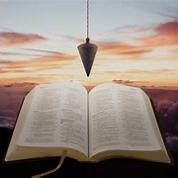
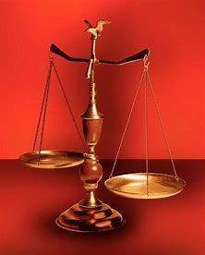
Fellowship Church, Oct 23, 2024 B. Heath
Straight and Balanced
(Luke 3:4-6)
Biblical characters (Hebrews 11:1-3, 6, 39-40)
#1 – Abel’s Faith & Innocent Blood (Heb 11:4, Gen 4)
#2 – Walking with God & with Enoch (Heb 11:5-6, Gen 5)
#3 – Secure on the Ark with Noah (Heb 11:7, Gen 6-11)
#4a – Faith with Abraham (Heb 11:8-19, Gen 12-23)
#4b – Faith with Sarah (Heb 11:11-12, 1 Peter 3:6)
#4c – OT & NT Strangers & Pilgrims (Heb 11:13-16, 1 Pe 2:11)
#5 – Faith & Laughter with Isaac (Heb 11:17-19, Gen 18-24)
#6 – Faith with Jacob/Israel (Heb 11:20-21, Gen 25-36)
#7 – Faith with Joseph beyond Death (Heb 11:22, Gen 37- 50)
#8 – Faith with Moses the Deliverer (Heb 11:23-29, Exo-Deu)
#9 – A Battleplan for Victory with Joshua (Heb 11:30, Joshua 6)
#10 – Faith with Rahab (Heb 11:31, Joshua 2, 6)
#11 – Faith with the Judges (Heb 11:32, Judges)
#12 – Faith with David (Heb 11:32, 2 Samuel, 1 Chr)
#13 – Faith with Samuel (Heb 11:32, 1 Samuel)
#14 – Faith with the Prophets (Heb 11:32-38, Is-Malachi)
#15 – Faith for All (Heb 11:39-40, Old Testament saints)
OT: Ps 5:8, Pr 4:25-27
Amos 7:7-8, Is 28:13, 17
NT: Mt 3:3, Acts 9:11
Hebrews 12:13, Jude 3
1 Cor 15:1-4, 2 Tim 3:10
John 7:16
OT: Deut 25:13-16
Pr 20:10, Dan 5:25-28
NT: Hebrews12:1
1 Cor 3:11-15,
Philippians 4:5,
James 3:17

Slide 2
A Battleplan for Victory with Joshua (Hebrews 11:30)
Text: Heb 11:30 By faith the walls of Jericho fell down,
after they were compassed about seven days.
Joshua 6:
1 Narrative of the siege of Jericho (they begin with man’s standard battleplan)
- The enemy is a stronghold and well protected by this world’s standards. Joshua’s faith and obedience are for our learning (Romans 15:4).
- Victory is not by philosophy, psychology, tradition, religious belief system, oratory skills (i.e., TD Jakes), or business management skills (i.e., Andy Stanley).
2-5 The LORD gives directions to Joshua (God ‘s battleplan ensures His victory)
- Men of war go around the city 1x a day for 6 days. In front of the ark are 7 priests blowing ram’s horns.
- The long blow of the rams’ horn initiates a great shout from all the men of war. The city walls fall flat for battle & victory.
6-14 6 days (Israel marches one time around Jericho each day)
- Joshua directs the people. Men of war march before and after the ark and priests.
- Joshua, the priests, and the army rise early. They return to camp each day. Not one word is spoken by people for 6 days.
15-26 7th day (Israel marches seven times around Jericho)
- Joshua, priests, and the army rise early about the dawning of the day. The priests carry the ark (not the Kohathites) and march around Jericho 7x.
- The great shout of 600K men lowers the wall. Every living thing is slain by the sword and the rest burned by fire. Silver, gold, brass, and iron consecrated unto the LORD.
- Jericho is accursed/cursed (6:17-19, 26, 5x). Trouble if not destroyed. Destroy all living things in Canaan as commanded in Numbers 33:50-56.
27 Narrative of Joshua’s fame spread throughout Canaan (like the Thessalonians in the New Testament)
The next message is from Hebrews 11:31 about the woman Rahab’s faith because she hid the messengers (Joshua 2 and 6:7b, 22-23, 25).

Slide 3
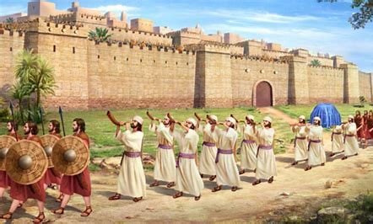
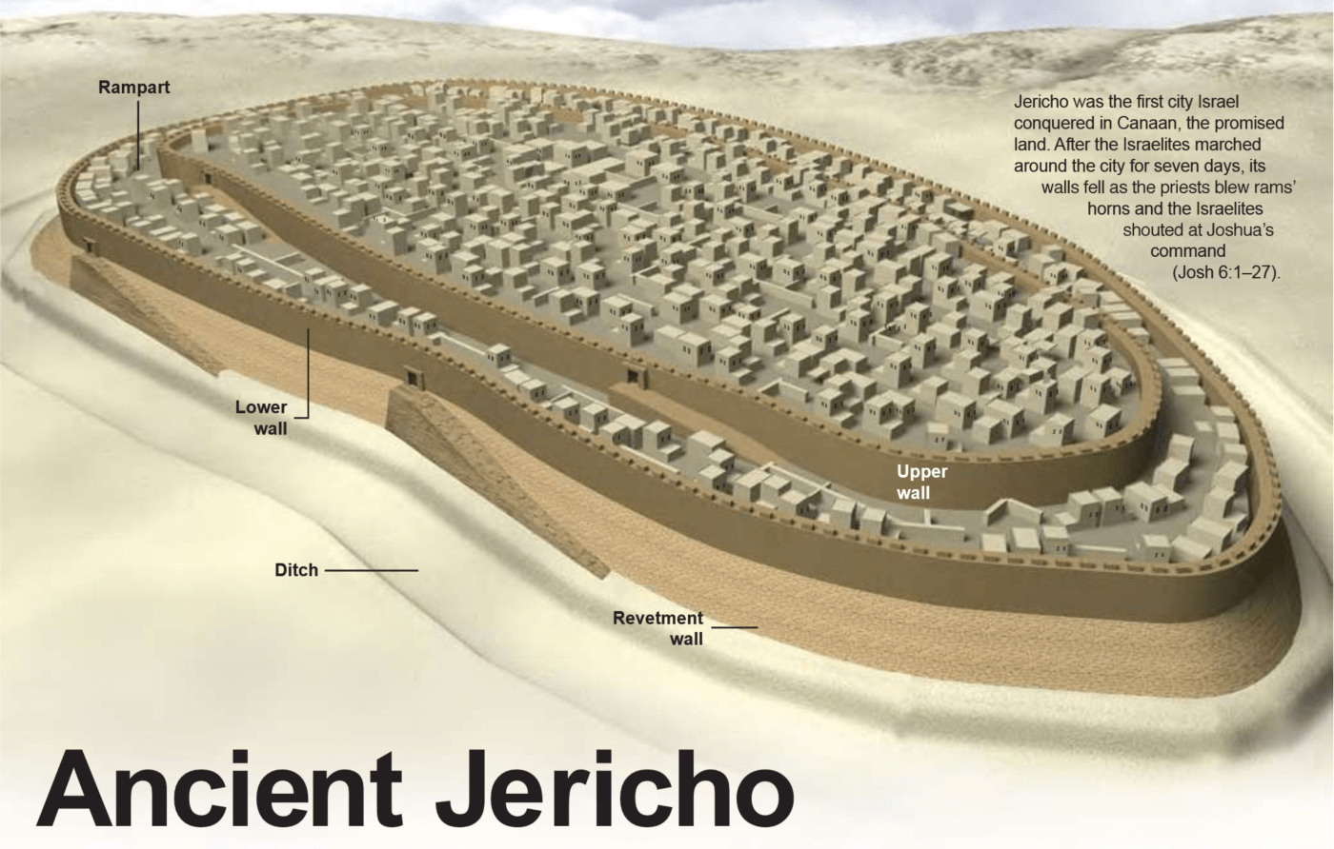
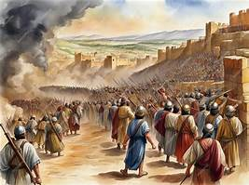
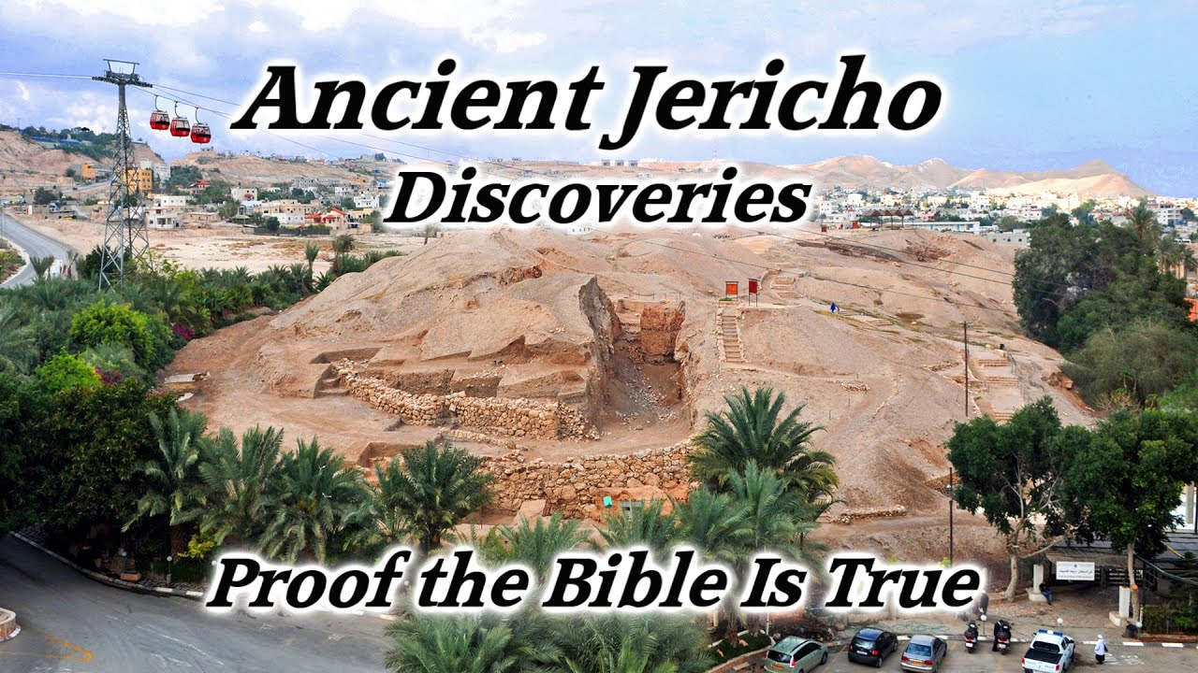
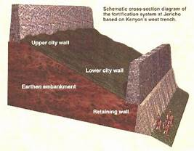
A Battleplan for Victory with Joshua (Hebrews 11:30)
Walk around the walls with the ark 1x for six days. There is complete silence except for the 7 priests blowing ram’s horns.
Walk around 7x on the 7th day, and a great shout brings down the walls.
Ancient Jericho Discoveries, Proof Bible is True,
Tell Es Sultan, Joshua, Jericho Walls Fall Down

