Slide 1
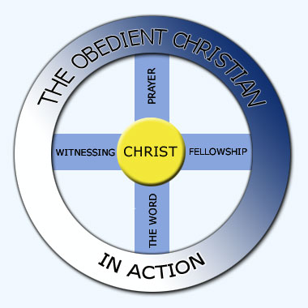
The Wheel of Eternal Life for the Christ Follower
Conception to born again
1st Salvation is unconditional
2nd Sanctification is conditional
The Judgment Seat of Christ
1 Corinthains 3:11-15
2 Corinthians 5:10-11
2 Timothy 2:19-21
2 Timothy 4:7
3rd Glory is unconditional
Sep 15, 2026, Fellowship Church, White Plains, W. Heath

Slide 2


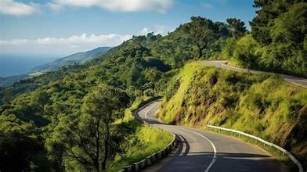
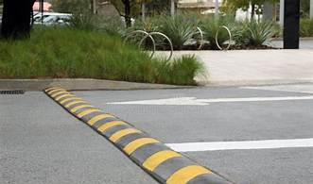
Born again
John 3:3-8
Temptations
1 Cor 10:13, Heb 4:14-16
1st
2nd
Trials
1 Peter, Job 13:15, James 5:11
Turns
Psalm 119:105, John 21:18
3rd
4th

