Slide 1

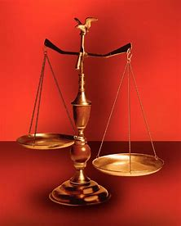
Straight and Balanced
Contend for the Faith
Jude
half-brother of Jesus Christ
to the “called”
Church and Tribulation saints
OT: Ps 5:8, Pr 4:25-27
Amos 7:7-8, Is 28:13, 17
NT: Mt 3:3, Acts 9:11
Hebrews 12:13
OT: Deut 25:13-16
Daniel 5:25-28
NT: Hebrews12:1
1 Cor 3:11-15
Fellowship Church, June 3, 2026, by Bill Heath

Slide 2
Straight
Good – verses 1-3, 20-25. Doctrine.
Evil – verses 4-19, 18 traits. Reprove.
Genesis, Exodus, and Numbers (the law and Old Testament saints)
Egypt, fallen angels, Sodom & Gomorrah /
Archangel Michael, the devil, Moses /
Cain, Balaam, Korah /
Enoch, Adam, saints
Balanced
be wise unto that which is good,
and simple concerning evil (Romans 16:19)

