Slide 1

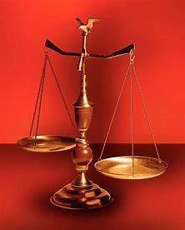
Straight and Balanced
(Luke 3:4-6)
The Faith, a noun, G3982, pis’-tis, 244x, Hebrews 11-11x (11:1-3, 6, 38-40, 12:1-4; Romans 15:23, Jude 1:3)
Fellowship Church, Feb 25, 2026 B. Heath
Old Testament: True Prophets of the Faith
#13 – Samuel: Lifelong Shining Faith (Heb 11:32f, 1 Sam)
#14 – Nathan & Gad: The Comforter’s Faith (Heb 11:32g)
#15 – Man of God & Old Prophet: Weak Prophets of the Faith
#16 – Azariah & Hanani: Two Prophets and Two Effects of Truth
#17 – Jehu, a Prophet, & Micaiah: Little-Known Prophets
#18 – Elijah: The Past, Present, and Future Prophet of the Faith (Heb 11:35)
#19 – Elisha: Prophet of Power and Water (Heb 11:35)
#20 – Jonah & Nahum: God’s Mercy & Judgment on Nineveh
#21 – Hosea, Joel, & Amos: Future Judgments and Blessings
#22 – Obadiah, Jonah, & Micah: Fight with Hate, Anger, & Darkness
#23 – Isaiah: Prophet of Majesty and Royalty (Heb 11:37)
#24 – Nahum, Habakkuk, & Zephaniah: God the Loving-Holy Judge
#25 – Huldah: Prophetess of Anomaly & Conformity of the Faith
#26 – Jeremiah & Lamentations: Speak, Weep, and Turn unto the LORD
#27 – Ezekiel: Watchman on a Short Leash
#28 – Daniel: Prophet of Self-control and Godliness
#29 – Haggai, Zechariah, & Malachi: Revival,
#30 – True Prophets in the New Testament
#31 – False Prophets in the Old Testament and the New Testament
OT: Ps 5:8, Pr 4:25-27
Amos 7:7-8, Is 28:13, 17
NT: Mt 3:3, Acts 9:11
Hebrews 12:13, Jude 3
1 Cor 15:1-4, 2 Tim 3:10
John 7:16
OT: Deut 25:13-16
Pr 20:10, Dan 5:25-28
NT: Hebrews 12:1
1 Cor 3:11-15
Philippians 4:5
James 3:17

Slide 2
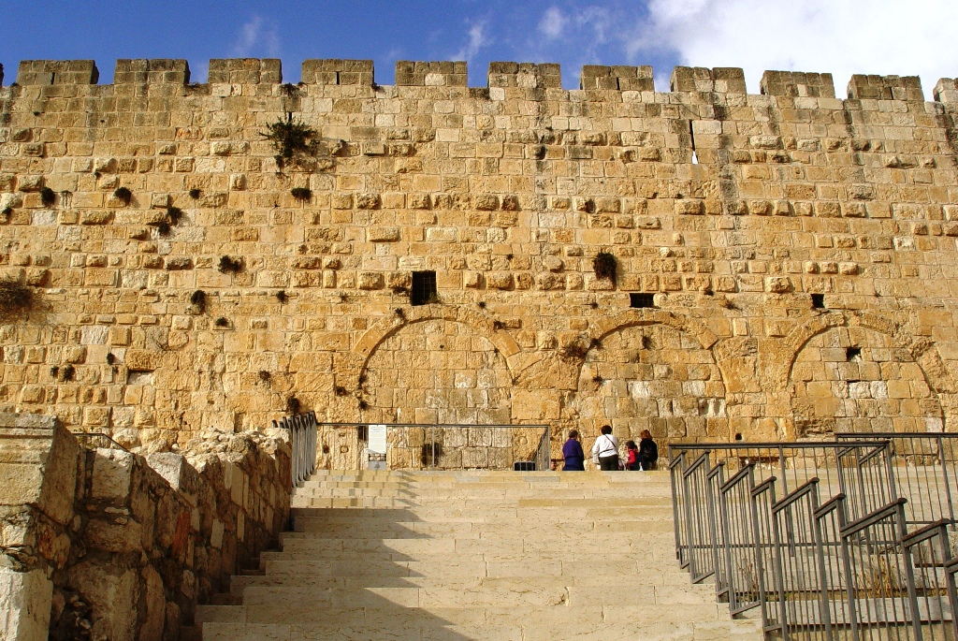
Title: The Way of True Revival Haggai in Hebrew “My festival”
Time: 520 BC > 4 months. Past-present-future, 3500 yrs.
Place: Jerusalem, Temple built “from this day upward”
Old Testament Temple New Testament Temple
Moses (the lawgiver) 1. Jesus (better than Moses)
Jew (until the birth of Jesus) 2. Gentiles (all people)
One nation (Israel) 3. All nations (the world)
Physical (seen) 4. Spiritual (unseen)
External (Jesus concealed) 5. Internal (Jesus revealed)
Temporary (in time) 6. Eternal (outside of time)
7. Little temples (in Babylon) 7. My body and the Body of Christ
Application: Quit ye like men, 1 Cor 16:13-14 (3rd of 5 parts)
Day by day, hour by hour, in 2026

Slide 3
OT True Prophets chart in respect to Hebrews 11:1-3, 11:6, 11:32-40, 12:1
# | Name/ Scripture | Suffer-Persecute /Scripture | King (Saul to Zedekiah) | Public/ Private | Prophecy - Near/Far or None | Nation | Bless/ Curse | Vision/ Dream | Miracle Prophet or God | Notes | Heb 11
1 | Samuel | No /1 Sam 1-28 | Saul | Private | Near/for Saul | Israel | B/C | 0 | 0 | after death | 32c
2 | Gad | No/1 Sam 22:25 | David | Public | Near/for David | Israel | B/C | 0 | 0 | Book | 32d
3 | Nathan | No/2 Sam 7. 12. | David - | Private | Near/Far-seed of David | Israel | B/C/B | 0 | 0 | Solomon | 32d
4 | Asaph | No/Psalms 50, 73-83 | David | Public | Far/Tribulation and 1000-year reign | Israel | C/B | 0 | 0 | Revelation 6-20
5 | Ahijah | No/1 Ki 11:29-39 | Jeroboam - 1st | Private | Near/Jeroboam’s reign-son | N-Israel | B/C | 0 | 0 | 1 Ki 14:1-26 | 32d
6 | Shemaiah | No/1 Ki 12:22-24 | Rehoboam - 1st | Private | Near/for Rehoboam | S-Judah | B | 0 | 0 | Book 931 BC | 32d
7 | Iddo | No/2 Chr 9:29 | Jeroboam - 1 ^{st} | Private | Seer for Jeroboam | N-Israel | C | 1 Vision | 0 | Records 931 BC | 32d
8 | man of God | No/1 Kings 13 | Jeroboam – 1st | Private | Far/King Josiah by name, c. 300 yrs., 13:2 | N-Israel | C | 0 | Heal hand | Judah, 2 Ki 23:15 | 32d
9 | old prophet | No/1 Kings 13 | Jeroboam – 1st | Private | Near/for man of God, lion and donkey | N-Israel | C | 0 | 0 | Liar-like Lot | 32d
10 | Azariah | No/2 Chr 15:1-7 | Asa – 3rd | Public | None | S-Judah | B | 0 | 0 | war w/Ethiopia
11 | Hanani | No/2 Chr 16:7-10 | Asa – 3rd | Private | Near/ | S-Judah | C | 0 | 0 | war w/Israel-Syria
12 | Jehu | No/1 Ki 16:1-13, | Baasha-3rd | Private | Near/2 Chr 19:1-4 | N-Israel | C/B | 0 | 0 | Son of Hanani
13 | Prophet - | No/1 Ki 20:13-36 | Ahab-7th | Private | Near/Syria/man of God | N-Israel | B/B/C | 0 | Lion | Son of prophet
14 | Micaiah | Yes/1 Ki 22:1-28 | Ahab-death | Private | Near/400 to 1, 2 Chr 18:1-27 | N-Israel | C | 0 | 0 | Lying spirit | 33a
15 | Elijah | Yes/1 Ki 17-2 Ki 2 | Omri, Ahab – 7th | Public | Near/3 ½ years draught, 450 to 1 | N-Israel | B5/C3 | 0 | 8 | Gentile widow | 35
16 | Elisha | No/2 Ki 3-13 | Joram, Jehu – 8th, | Public | None/gentile general, Lu 4:27 | N-Israel | B11/C5 | 0 | 16 | Jezebel-death | 35
17 | Eliezer | No/2 Chronicles 20:37 | Jehosophat -4th | Private | Near/alliance with Ahaziah | S-Israel | C | 0 | 0 | Fleet destroyed
18 | Joel | No/2 Kings 11-15 | Joash -11th | ? | Far/ | S-Israel | C-B | 0 | 0
19 | Jonah | No/Jonah 1-4 | Jehoash - 11th | Public | Near/40 days – repent | Nineveh | B | 0 | 9 by God | Angry-carnal
20 | Amos | No/2 Kings 14-15 | Jeroboam II – 13th | Public | Near/c 45 yrs | N-Israel | C/B | 5 Visions | 0 | Exile Assyria 722
21 | Hosea | No/2 Kings 15-18 | Jeroboam II – 13th | Public | Near/c 40 yrs, Far/2700+ yrs (7x) | N-Israel | C-B | 0 | 0 | Gomer/3 children
 | Oded | No/2 Chr 28:6-15 | Ahaz-12th | Public | Near/ | S-Judah | B | 0 | 0 | War victory
22 | Micah | Yes/rejection | Jotham-Hezekiah | Public | Near Assyria & Babylon, Far Jesus 1st 5:2 | N-S Israel | C-B | Visions | 0 | that day 25%, hear
23 | Isaiah | Yes/sawn in half | Uzziah-Hezekiah | Public | Near and Far/more than other prophets | S-Judah | C-B | Visions | 3/time-185 | Majesty, Royalty | 34
24 | Nahum | No/Nahum 1-3 | Hezekiah-13th | Personal | Near/30 -50 years | Nineveh | C | 1 vision | 0 | Israel, 722 BC | 33a
25 | Habakkuk | No/ | Zedekiah-20th | Personal | Near/ Babylon-Nebuchadnezzar | S-Judah | C-B | Vision | 0 | Trial to Triumph
26 | Zephaniah | No/ | Josiah-16th | Personal | Near-Babylon/Far 2nd coming of Jesus | S-Judah | C-B | 0 | 0 | Trib & 1000
27 | Huldah | No/2 Kings 22:11-20 | Josiah-16th | Private | Near/13 years, Josiah’s grave 2 Ki 23:27 | S-Judah | C-B | 0 | 0 | 2 Chr 34:18-28
28 | Jeremiah | Yes/no wife, pit, etc | Josiah-Zedekiah | Public | Near-Babylon, 586 BC/70-year captivity | S-Judah | C-B | Visions | 0 | Exile Babylon 586 | 36
30 | Ezekiel | No/not from people | Nebu – Babylon | Public | Near, 586 BC/Far , 37-39 ,40-48 1000 yr | S-Judah | C-B | 13 vision | 0 | 18 signs, 8 parables
29 | Daniel | Yes/furnace & lions | Nebu to Cyrus | Public | Near/Far, 1st and 2nd coming, Times of Gentiles | S-Judah | Prophecy | 2 D, 3 V | 4 | Control & Godliness | 33
31 | Obadiah | No/ | Zedekiah-20th |  |  | Edom
32 | Haggai | No/ | Zerubbabel-Gov | Public | Near/Far-2nd coming & 1000 , 2:6-9, 20-23 | Israel | C2-B3 | 0 | 0 | 5 prophecy-113 days
33 | Zechariah | Yes/ | Zerubbabel |  |  | Israel
34 | Malachi |  | Zerubbabel |  |  | Israel
Before Samuel
Enoch
Genesis 5:24
Jude 1:14
Moses
Exodus 7:1 Deut 34:10
Acts 3:22,
7:37
Miriam
Exodus 15:20
Deborah
Judges 4:9
During & after Samuel
1 Samuel
19:18-24
2 Ki 4:38-41
Sons of the prophets-9x
Updated: 22 Feb 2026
W.H.

