Slide 1
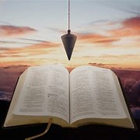
Fellowship Church, Jan 15, 2025 B. Heath
Straight and Balanced
(Luke 3:4-6)
Biblical characters (Hebrews 11:1-3, 6, 39-40)
#1 – Abel’s Faith & Innocent Blood (Heb 11:4, Gen 4)
#2 – Walking with God & with Enoch (Heb 11:5-6, Gen 5)
#3 – Secure on the Ark with Noah (Heb 11:7, Gen 6-11)
#4a – Faith with Abraham (Heb 11:8-19, Gen 12-23)
#4b – Faith with Sarah (Heb 11:11-12, 1 Peter 3:6)
#4c – OT & NT Strangers & Pilgrims (Heb 11:13-16, 1 Pe 2:11)
#5 – Faith & Laughter with Isaac (Heb 11:17-19, Gen 18-24)
#6 – Faith with Jacob/Israel (Heb 11:20-21, Gen 25-36)
#7 – Faith with Joseph beyond Death (Heb 11:22, Gen 37- 50)
#8 – Faith with Moses the Deliverer (Heb 11:23-29, Exo-Deu)
#9 – A Battleplan for Victory with Joshua (Heb 11:30, Joshua 6)
#10 – Faith then Works with Rahab (Heb 11:31, Joshua 2, 6)
#11 – Faith in the Flesh with the Judges (Heb 11:32a, Judges)
#12 – Faith of a changing heart with David (Heb 11:32b, 1-2 Sam)
#13 – Lifelong Shining Faith with Samuel (Heb 11:32c, 1 Sam)
#14 – Faith with the Prophets (Heb 11:32-38, Isaiah-Malachi)
#15 – Faith for All (Heb 11:39-40, Old Testament saints)
OT: Ps 5:8, Pr 4:25-27
Amos 7:7-8, Is 28:13, 17
NT: Mt 3:3, Acts 9:11
Hebrews 12:13, Jude 3
1 Cor 15:1-4, 2 Tim 3:10
John 7:16
OT: Deut 25:13-16
Pr 20:10, Dan 5:25-28
NT: Hebrews 12:1
1 Corinthians 3:11-15
Philippians 4:5,
James 3:17

Slide 2
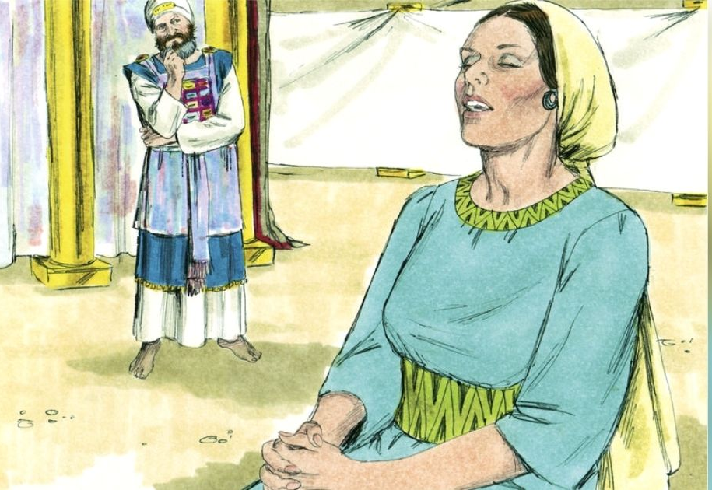
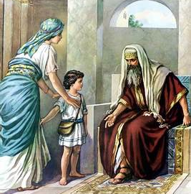
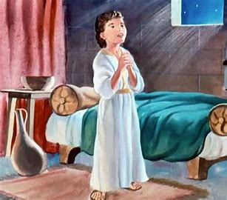
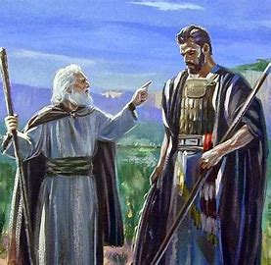
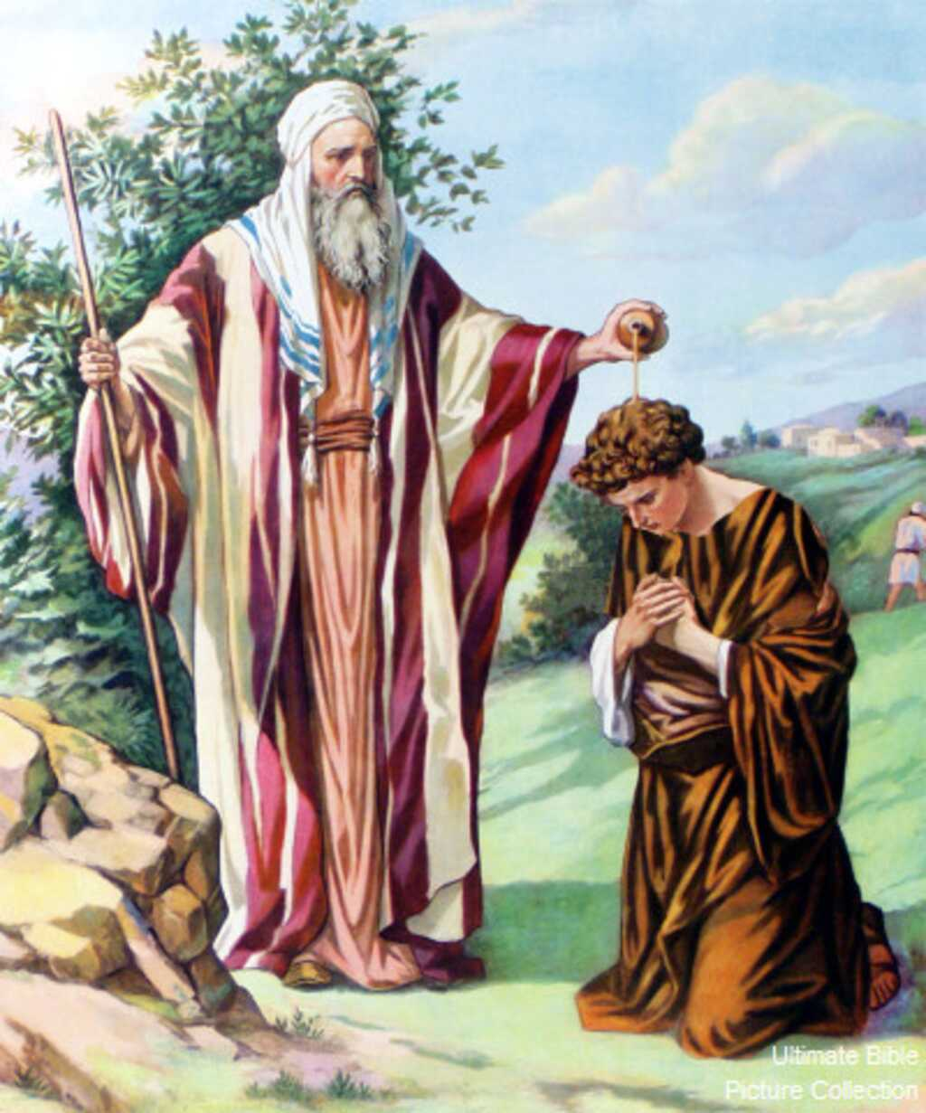
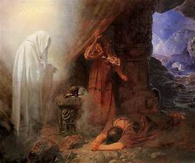
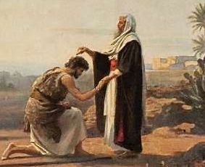
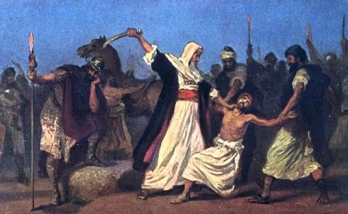
Lifelong Shining Faith with Samuel
1
2
3
5
7
4
6
8

Slide 3
Lifelong Shining Faith with Samuel
Hebrews 11:32 And what shall I more say? for the time would fail me to tell of Gideon, and [of] Barak, and [of] Samson, and [of] Jephthae; [of] David also, and Samuel, and [of] the prophets:
Time: circa 1070-1012 BC Places: Ramah, Shiloh (the ark & tabernacle), and Bethlehem Tribe: Levi
Characters: Samuel’s family: mother - Hannah, Father - Elkanah, and his other wife, Peninnah (with their sons and daughters). Samuel’s 2 sons – Joel and Abiah were evil (1 Samuel 8: 1-7)
Eli the high priest, and his 2 sons Hophni and Phinehas were sons of Belial (1 Samuel 2:12-25)
Prophet/Seer: A man who sees and speaks the mind of God for the present and immediate future (1 Samuel 3:19-21). Samuel is over the first school of prophets (1 Samuel 19:20). Samuel does no miracles like Elijah and Elisha, nor far future prophecy like Isaiah, Jeremiah, Ezekiel, Daniel, and Zechariah.
Purpose: Encourage us to shine by faith and obedience when government/Saul, religion and family/Eli’s and Samuel’s sons; sin against God.
New Testament:
Acts 3:24 Yea, and all the prophets from Samuel and those that follow after, as many as have spoken, have likewise foretold of these days. (Peter’s 2nd inspired and written message to the Jews in Jerusalem)
Acts 13:20 And after that he gave [unto them] judges about the space of four hundred and fifty years, until Samuel the prophet. (Paul’s 1st inspired and written message to the Jews in the synagogue at Antioch in Pisidia)

Slide 4
12 Steps in a Pathway to Lifelong Shining Faith with Samuel (1 John 2:12-14)
I’ll shine before God as Scripture
Part 1 Little Children (Samuel is the central character, chapters 1-7) 1 Samuel
1) I grow in age and in favor both with the LORD, and also with men. 2:26
2) I continue to listen and answer the LORD, Speak; for your servant hears. 3:10
3) I grow, and the LORD is with me, and lets none of my words fall to the ground. 3:19
Part 2 Young Men
4) I speak, If ye do return to the LORD with all your hearts, then put away the strange gods from among you,
and prepare your hearts unto the LORD, and serve him only: and He will deliver you. 7:3
5) I do not go off course, even though my sons walk not in the ways of the LORD. 8:3
6) I warn other believers not to follow man’s governmental systems. 8:4-22
Part 3 Fathers (Saul enters the stage, chapters 8-15)
7) I am old and gray-headed; and the LORD and you are my witnesses of a life of righteousness. 12:1-5
8) I pray and the LORD’s reply causes God’s people to fear the LORD and confess their sins. 12:18
9) I don’t sin against the LORD by ceasing to pray for you: but I will teach you the good and the right way:
Only fear the LORD, and serve him in truth with all your heart: for consider the great things he has done for you.
But if ye shall still do wickedly, ye shall be consumed, both ye and your king 12:23-25
(10) I obey rather than sacrifice. Rebellion is as the sin of witchcraft, and stubbornness is as iniquity and idolatry.
If I reject the word of the LORD, he will also reject me from being king. 15:22-23
Part 4 Death and after (David enters the stage, chapters 16-28)
11) I die, others will remember my life. 25:1
12) After I die, others will desire my counsel. 28:155

