Slide 1
Fellowship Church, May 25, 2025 B Heath
Straight & Balanced
(Luke 3:4-6)
Expository Teaching
God’s Design for Woman series
The Kind, Virtuous Lady
(Ruth and Boaz)
types of the saint and Jesus, past-present-future
1st: Psalm 68, the ark goes to Jerusalem (2 Sam 6-7, 1 Chronicles 13-16)
2nd: How to Keep on the Armor of God (sit, walk, and stand)
3rd: The Elect Lady, an example for all Christian Women (2 John)
4th: The Kind, Virtuous Lady (Ruth and Boaz)
5th: Esther and the King
OT: Ps 5:8, Pr 4:25-27
Amos 7:7-8
Isaiah 28:13, 17
NT: Mt 3:3, Acts 9:11
Hebrews 12:13, Jude 3
1 Corinthians 15:1-4
2 Timothy 3:10, John 7:16
OT: Deut 25:13-16
Proverbs 20:10
Daniel 5:25-28
NT: Hebrews 12:1
1 Cor 3:11-15
Philippians 4:5
James 3:17

Slide 2
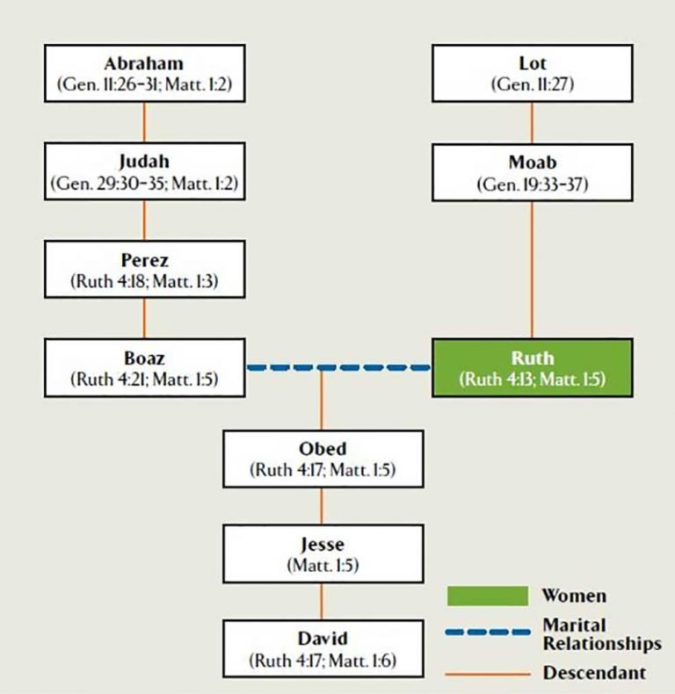

Slide 3
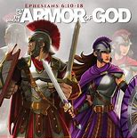
Ephesians
1-3 SIT, 4:1-6:9 WALK
6:10-20 STAND
Be STRONG in the Lord,
STAND against
the wiles of the devil (6:11)
withSTAND in the evil day (6:13a)
having done all, to STAND (6:13b)
STAND therefore (6:14a)
Armor of God (6:14b-17)
1st Loins – Truth
2nd Breastplate – Righteousness
3rd Feet – Gospel of Peace
4th Shield – of Faith
5th Helmet – Salvation
6th Sword – Word of God
7th Prayer (6:18-20)
The Kind, Virtuous Lady
(Ruth and Boaz)
Types of the saints and Jesus, past-present-future
Time: Judges Place: Bethlehem-Moab-Bethlehem
(Jesus was born in the town of Bethlehem, Micah 5:2)
1. TRIALS (not sins)
Family: husband, wife, children – mother, daughter
Your people are my people. Marah.
Moabite Stone, King Mesha, Ahab, Elisha (2 Kings 3)
2. PROVIDENCE (right place & time)
Women’s work ethics. Moabite stranger. Happened.
Glean & beat the grain. Handfuls of purpose.
3. KINSMAN (Jachin & Boaz-in His strength)
Kinsman redeemer – shoe (Deut 25:5-10).
Grain and chaff (Mt 3:12). Feet- garment. he/she Bible.
4. REDEEMER (God’s sovereignty)
Ruth – the church. Naomi – Israel. Boaz – Jesus.
Judah, Tamar, Pharez (Gen 38:12-24, 49:10, Deut 23:2-3)
Self-assessment: sons of God (1 Jn 3:2)
How am I obeying Ephesians 5:21-33?
Same armor and different roles
of men and women, and husbands and wives, in spiritual warfare since the
Garden of Eden
Next Sunday
Esther & the King

Slide 4
Sunday School Through the Bible (2023 - 2025)
Grow in grace, and in the knowledge of our Lord and Savior Jesus Christ
2 Peter 3:18
COMPLETED books of the Bible
Old Testament: Genesis (4), Exodus (4), Leviticus (2), Numbers (3), Deuteronomy (5), Psalms (4), Psalm 68 (2), Proverbs, Ecclesiastes, Amos, Obadiah, Malachi
New Testament: Mark, Colossians, 1-2 Thessalonians (10), Ephesians, Philemon, James,
2 Peter (4), 2 John, Jude
Next Sunday: read-ahead Esther
New: use index cards to present Sunday School questions
to answer for all to hear.
Invitation to Fellowship Church 2025 daily schedule for Bible and prayer
March 19-25. 2 Kings 15:1-17:41 (Mon-Sat) & Psalm 73 (Sunday)
Notes:
-

