Slide 1

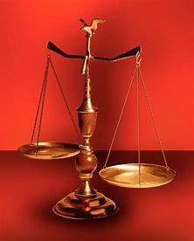
Straight and Balanced
(Luke 3:4-6)
Faith the Noun (Hebrews 1:1-3, 11:1-3, 6, 38-40, 12:1-4; Romans 15:23)
Fellowship Church, May 7, 2025 B. Heath
Old Testament: True Prophets of the Faith
#13 – Samuel: Lifelong Shining Faith (Heb 11:32f, 1 Sam)
#14 – Nathan & Gad: The Comforter’s Faith (Heb 11:32g)
#15 – Man of God & Old Prophet: Weak Prophets of the Faith
#16 – Azariah & Hanani: Two Prophets and Two Sides of Truth
#17 – Jehu, a Prophet, & Micaiah: Little-Known Prophets
#18 – Elijah: The Past, Present, and Future Prophet of the Faith
#19 – Jonah & Obadiah: God’s Mercy & Judgment on Nineveh
#20 – Hosea, Joel, & Amos: Future Judgments and Blessings
#21 – Obadiah, Jonah, & Micah:
#22 – Isaiah:
#23 – Nahum, Habakkuk, & Zephaniah:
#24 – Jeremiah & Lamentations:
#25 – Ezekiel:
#26 – Daniel:
#27 – Haggai, Zechariah, & Malachi:
#28 –
#29 –
#30 –
#31 –
OT: Ps 5:8, Pr 4:25-27
Amos 7:7-8, Is 28:13, 17
NT: Mt 3:3, Acts 9:11
Hebrews 12:13, Jude 3
1 Cor 15:1-4, 2 Tim 3:10
John 7:16
OT: Deut 25:13-16
Pr 20:10, Dan 5:25-28
NT: Hebrews 12:1
1 Cor 3:11-15
Philippians 4:5
James 3:17

Slide 2
OT True Prophets chart in respect to Hebrews 11:1-3, 32-40
# | Name/ Scripture | Suffer-Persecute /Scripture | King | Public/ Private | Prophecy - Near/Far or None | Nation | Bless/ Curse | Vision/ Dream | Miracle | Notes | Heb 11
1 | Samuel | No /1 Sam 1-28 | Saul | Private | Near/for Saul | Israel | B/C |  |  | after death | 32c
2 | Gad | No/1 Sam 22:25 | David | Public | Near/for David | Israel | B/C |  |  | Book | 32d
3 | Nathan | No/2 Sam 7. 12. | David - | Private | Near/Far-seed of David | Israel | B/C/B |  |  | Solomon | 32d
4 | Ahijah | No/1 Ki 11:29-39 | Jeroboam - 1st | Private | Near/Jeroboam’s reign-son | N-Israel | B/C |  |  | 1 Ki 14:1-26 | 32d
5 | Shemaiah | No/1 Ki 12:22-24 | Rehoboam - 1st | Private | Near/for Rehoboam | S-Judah | B |  |  | Book 931 BC | 32d
6 | Iddo | No/2 Chr 9:29 | Jeroboam - 1 ^{st} | Private | Seer for Jeroboam | N-Israel | C | 1 Vision |  | Records 931 BC | 32d
7 | man of God | No/1 Kings 13 | Jeroboam – 1st | Private | Far/King Josiah, 270 yrs. | N-Israel | C |  | Hand | sick-heal | 32d
8 | old prophet | No/1 Kings 13 | Jeroboam – 1st | Private | Near/for man of God | N-Israel | C |  |  | Liar | 32d
9 | Azariah | No/2 Chr 15:1-7 | Asa – 3rd | Public | Near/ | S-Judah | B |  |  | war w/Ethopia
10 | Hanani | No/2 Chr 16:7-10 | Asa – 3rd | Private | N | S-Judah | C |  |  | war w/Israel-Syria
11 | Jehu | No/1 Ki 16:1-13, | Baasha-3rd | Private | Near/2 Chr 19:1-4 | N-Israel | C/B |  |  | Son of Hanani
12 | Prophet - | No/1 Ki 20:13-36 | Ahab-7th | Private | Near/Syria/man of God | N-Israel | B/B/C |  | Lion | Son of prophet
13 | Micaiah | Yes/1 Ki 22:1-28 | Ahab-death | Private | Near/400 to 1, 2 Chr 18:1-27 | N-Israel | C |  |  | Lying spirit | 33a
14 | Elijah | Yes/1 Ki 17-2Ki 2 | Ahab – 7th, Joram | Public | Near/3 ½ years draught, 450 to 1 | N-Israel | B5/C3 |  | 8 | Gentile widow | 35
15 | Elisha | No/2 Ki 3-13 | Jehu – 8th, | Public | None/gentile general, Lu 4:27 | N-Israel | B11/C5 |  | 16 | Jezebel-death | 35
16 | Eliezer | No/2 Chronicles 20:37 | Jehosophat -4th | Private | Near/alliance with Ahaziah | S-Israel | C |  |  | Fleet destroyed
17 | Joel | No/2 Kings 11-15 | Joash ? |  | Far/ | S-Israel | C-B
18 | Jonah | No/Jonah 1-4 | Jehoash ? | Public | Near/40 days – repent | Nineveh | B |  | 12
19 | Amos | No/2 Kings 14-15 | Jeroboam II | Public | Near/c 45 yrs | N-Israel | C/B 9:11 | 5 visions |  | Exile Assyria 722
20 | Hosea | No/2 Kings 15-18 | Jeroboam II |  | Near/c 40 yrs, Far/2700+ yrs (7x) | N-Israel | C-B |  |  | Gomer/3 children
21 | Isaiah | Yes/ | Uzziah-Manasseh |  |  | S-Judah
22 | Micah | No/ | Jotham-Hezekiah |  |  | S-Judah
23 | Nahum | No/Nahum 1-3 | Hezekiah | ? | Near/30 -50 years | Nineveh | C | 1 vision |  | 722 BC | 33a
24 | Habakkuk | No/ | Jehoiakim |  |  | S-Judah |  |  |  | Jehoiachin
25 | Zephaniah |  | Josiah |  |  | S-Judah
26 | Huldah |  | Josiah |  |  | S-Judah
27 | Jeremiah | Yes/ | Josiah-Zedekiah |  |  | S-Judah |  |  |  | Exile Babylon 586
28 | Daniel | Yes/ | Josiah-Babylon |  |  | S-Judah
29 | Ezekiel |  | Josiah-Babylon |  |  | S-Judah
30 | Obadiah | No/ | Zedekiah |  |  | Edom
31 | Haggai | No/ | Zerubbabel |  |  | Israel
32 | Zechariah | Yes/ | Zerubbabel |  |  | Israel
33 | Malachi |  | Zerubbabel |  |  | Israel
OT True ProphetsBefore Samuel
Enoch
Gen 5:24
Jude 1:14
Moses
Exodus 7:1 Deut 34:10
Acts 3:22,
7:37
None since John in Revelation
Updated: 23 April 2025
W.H.

Slide 3
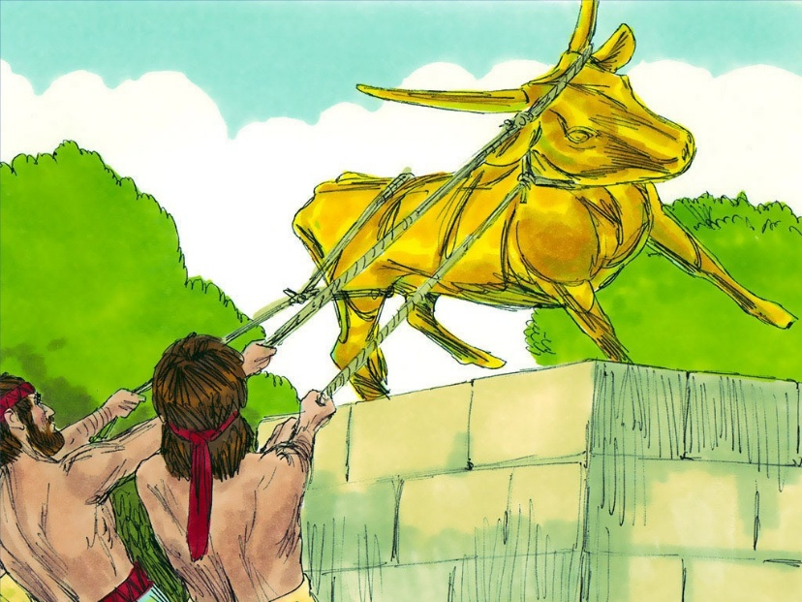
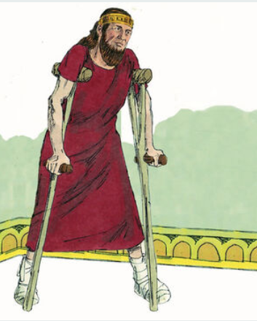
Azariah and Hanani: Two Prophets and Two Sides of Truth
Text: 2 Chronicles 14-16 (John 14:6)
Date: 911-870 BC. King Asa reigned for 41 years.
Key person: King Asa, the 1st good king of Judah. King Baasha, the enemy and 3rd evil king of Israel.
Prophet Azariah’s Truth Builds Up King Asa (2 Chronicles 15:1-7)
David-REL except Uriah (2 Chr 15:5) Asa-REL (2 Chr 14:2) Jehoshaphat-1st acts of David (2 Chr 17:3)
Why? Asa is already doing right by obeying the law, and Azariah strengthened Asa to continue even more.
When I seek God, I find God. I do what is right in God’s eyes. Spiritual warfare victory.
Replace idols from the culture and people in our time and place, our family. God is first! Revival-faithful-peace
NT application: Matthew 6:33, James 4:7-10, Philippians 3:9-17, crowns/rewards/
Prophet (Seer) Hanani’s Truth Tears Down King Asa (2 Chronicles 16:7-9)
King Asa-he did right in his own eyes (Proverbs 3:7, 16:2, 21:2) Reversal-failure-war
Why? Asa stops doing right by seeking man’s ways and help with fighting the enemy, Israel. Why?
When I leave God, God leaves me. I do what is right in my eyes. Spiritual warfare defeat. Psalm 68-Ephesians.
Replace seeking God with self. King Asa gets angry at the truth, puts prophet in jail, and dies of foot disease.
NT application: Acts 5:1-11 (Ananias and Sapphira), 1 Corinthians 5:1-6 (fornication), 2 Timothy 4:10 (Demas)
Today, God‘s written plan & purpose
God - Hebrews 11:1-3, 6. Jesus - Hebrews 11:40-41, Hebrews 1:1-3. You & I - Hebrews 12:1-2. 2 Peter 3: (difficult things
Next: Obadiah, Jonah, and Micah:
(holy prophets – Lu 1:70, Acts 3:21, Eph 3:5, 2 Pe 3:12, Rev 18:29, 22:8)

