Slide 1
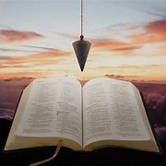
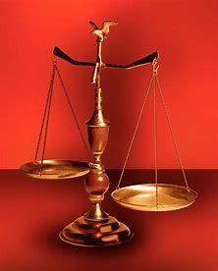
Fellowship Church, Feb 15, 2026 2 Peter 3:18 Sunday School Bill Heath
Music: Parables in Blues
Straight & Balanced
(Luke 3:4-6)
Jesus Teaches in Parables
11. The Prodigal Steward (Luke 16:1-13)
12. The Wedding Supper (Luke 14:7-24)
13. The Rich Man and Lazarus (Luke 16:19-31)
14. The Widow’s Persistent Prayers (Luke 18:1- 8)
15. The Pharisee & the Publican (Luke 18:9-14)
16. The Ten Pounds (Luke 19:10-28)
17.
18.
19.
20.
21.
22.
OT: 2 Kings 21:13, Ps 5:8 Pr 4:25-27, Amos 7:7-8 Isaiah 28:13, 17
NT: Mt 3:3, Acts 9:11
Hebrews 12:13, Jude 3
1 Corinthians 15:1-4
2 Timothy 3:10, John 7:16
OT: Deut 25:13-16
Proverbs 20:10
Daniel 5:25-28
NT: Hebrews 12:1
1 Cor 3:11-15
Philippians 4:5
James 3:17

Slide 2
Last Sunday
Today
A parable is a temporary earthly story with an eternal heavenly truth.

Slide 3
Parable: The Pharisee and the Publican Luke 18:9-14
 | Two men 18:9-10 One prayed to self 18:11-12 One prayed to God 18:13 One is abased – one is exalted 18:14 Children > the Kingdom of God 18:15-17 (17) Rich ruler > heard & very sorrowful 18:18-30 (29-30) The twelve > understood not, hid 18:31-34 (34-OT) Application: To whom, and how, and why do you pray?

Slide 4
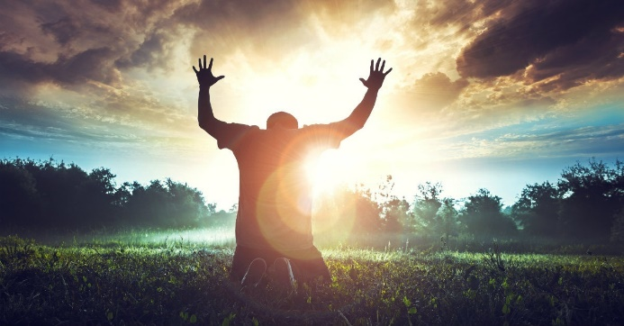
Sunday School Through the Bible (2019 - 2026)
Grow in grace, and in the knowledge of our Lord and Savior Jesus Christ
2 Peter 3:18
COMPLETED books of the Bible
Old Testament: Genesis (4), Exodus (4), Leviticus (2), Numbers (3), Deuteronomy (5),
1-2 Kings (12), Ruth, Esther, Psalms (4), Psalm 68 (3), Asaph (12), Proverbs, Ecclesiastes, Daniel (12), Hosea (9), Amos, Obadiah, Malachi
New Testament: Mark, Parables (24), Colossians, 1-2 Thessalonians (10), Ephesians, Philemon, Hebrews, James, 2 Peter (4), 1 John (13), 2 John, 3 John, Jude, Revelation (22)
Wednesdays: Judges (15), Song of Songs (15),
Topics: Prayer (15), Hebrews 11/prophets-Jonah, Micah,
Isaiah, Nahum, Habakkuk, Zephaniah, Jeremiah, Ezekiel,
(36), various (40)
Invitation to Fellowship Church 2026 daily schedule for Bible and prayer
1 Corinthians – January and February 2026 (60-day daily word & prayer)

Slide 5
Parable: The Pharisee and the Publican 18:9-14
 | One day in time and place in the life of Jesus (17:11-18:34) Two men 18:9-10 Last trip to Jerusalem (9:51-set His face toward Jerusalem) Pharisees: (1) Trusted in themselves, (2) righteous, (3) despised others. A Pharisee & a publican: went up into the temple to pray. (the same God, same religious system-Old Testament law, the same time, same place, and same purpose) One prayed to self 18:11-12 (Matthew 6:1-18, $-prayer-fasting. Diff btwn OT and NT.) Pharisee: (1) Stood & prayed with himself, thanked God, not as other men: extortioners, unjust, adulterers, or even this publican, (2) I fast 2x a week, (3) I give tithes of all that I possess. One prayed to God 18:13 (OT: Salvation before the cross. John the Baptist. Law of Moses, Abraham’s bosom.) Publican: (1) Standing afar off, (2) not lift up his eyes unto heaven, (3) smote his breast – Luke 23:48, Zechariah “God be merciful to me a sinner. “ God’s action to appease His wrath. reconcile/propicio, Heb 2:17, 2x, not routine mercy/compassion. One is abased – one is exalted 18:14 (NT: Sanctification: James 4:7-10, Romans 7:1-6, 7-21, 22-25, 8:1-17) Publican: this man went down to his house justified, because he that humbles himself shall be exalted. Pharisee: everyone that exalts himself shall be abased. //Exalted-know wicked, unworthy, gift. Abased-think good, worthy, earned.// 18:15-34 Little children-the Kingdom of God (17). Rich ruler-very sorrowful (19-20). The twelve-understood not (34-OT) Application: Prayer: To whom (self or God), and how, and why? Prayer in the tribulation, Rev 8:3-4 18:1-8 Prayer: When and where, and to whom (unjust judge or just God?) 2 Thes 2:7 (2:1-12) church > H.S./prayer

