Slide 1

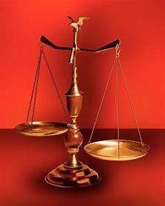
Straight and Balanced
(Luke 3:4-6)
The Faith, a noun, G3982, pis’-tis, 244x, Hebrews 11-11x (11:1-3, 6, 38-40, 12:1-4; Romans 15:23, Jude 1:3)
Fellowship Church, Apr 22, 2026 B. Heath
Psalm 23 Piano
Old Testament: True Prophets of the Faith
#13 – Samuel: Lifelong Shining Faith (Heb 11:32f, 1 Sam)
#14 – Nathan & Gad: The Comforter’s Faith (Heb 11:32g)
#15 – Man of God & the Old Prophet: Weak Prophets of the Faith
#16 – Azariah & Hanani: Two Prophets and Two Effects of Truth
#17 – Jehu, a Prophet, & Micaiah: Little-Known Prophets
#18 – Elijah: The Past, Present, and Future Prophet of the Faith (Heb 11:35)
#19 – Elisha: Prophet of Power and Water (Heb 11:35)
#20 – Jonah & Nahum: God’s Mercy & Judgment on Nineveh
#21 – Hosea, Joel, & Amos: Future Judgments and Blessings
#22 – Obadiah, Jonah, & Micah: Fight with Hate, Anger, & Darkness
#23 – Isaiah: Prophet of Majesty and Royalty (Heb 11:37)
#24 – Nahum, Habakkuk, & Zephaniah: God the Loving-Holy Judge
#25 – Huldah: Prophetess of Anomaly & Conformity of the Faith
#26 – Jeremiah & Lamentations: Speak, Weep, and Turn unto the LORD
#27 – Ezekiel: Watchman on a Short Leash
#28 – Daniel: Prophet of Self-control and Godliness
#29 – Haggai, Zechariah, & Malachi: Revival, Prophecy, & Transition
#30 – Hebrews 11 Finale (The Way of the Faith)
OT: Ps 5:8, Pr 4:25-27
Amos 7:7-8, Is 28:13, 17
NT: Mt 3:3, Acts 9:11
Hebrews 12:13, Jude 3
1 Cor 15:1-4, 2 Tim 3:10
John 7:16
OT: Deut 25:13-16
Pr 20:10, Dan 5:25-28
NT: Hebrews 12:1
1 Cor 3:11-15
Philippians 4:5
James 3:17

Slide 2
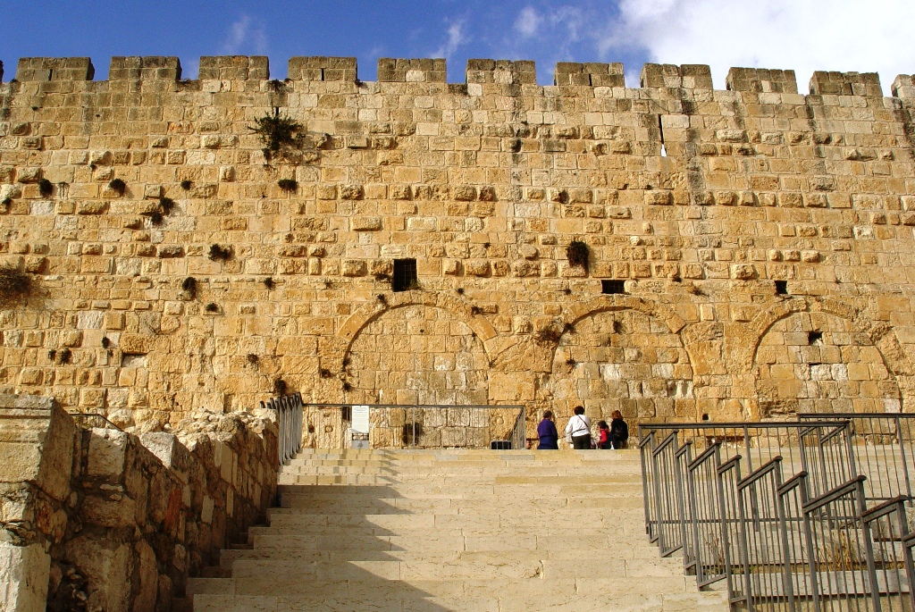
Hebrews who Refuse “the Way of the Faith”
Danger of Apostasy
1. Hear not (2:1-3)
2. Rest not (3:7-11, 4:5-11)
3. Repent not (6:4-8)
4. Reject grace (10:26-29, 38-39)
5. Rejected Esau (12:15-17)
6. Refuse Jesus (12:25-27)
Decision: If you died tonight, would you go to heaven?

Slide 3
Hebrews who refuse the Way of the Faith 1-12 doctrine, 13 practice (look around). Jesus is better 13x.
LOOK BACK
Danger of Apostasy verses Words
1. Hear not (2:1-3, 4) 3. (+) 1:1-14, 2:5-3:6 we – all Hebrews, nation. Slip, How shall we escape,
*1:1-2 prophets-Son (prophets & angels) ANGELS John 10:3, 5, 16. My sheep hear my voice and I hear
2. Rest not (3:7-11, 4:5-11) 12. (+) 4:1-4, 4:12-5:10 Harden not your heart, not enter into rest (Mt 11:28-30)
4:1 and 4:11 “let us” 2 of 13x “us” MOSES Evil heart of unbelief, err in heart, (-) ye, you, your- they, them
3. Repent not (6:4-8) 5. (+) 5:11-6:3, 6:9 -10:23 they, them, those (+) teachers, babe, beloved, brethren
(priesthood, 4:14-10:37) PRIESTS 1 John 2:18-19 antichrists, They went out from us, not of us
4. Reject grace (10:26-29, 38-39) 6. (+) 10:24-25, 30-37 Decision: Moses law or the Son of God, 32-34 persecuted
(26-29 knowledge, 38-39 faith) SACRIFICES sorer punishment, Matthew 11:23-24, Sodom & Gomorrah
5. Rejected Esau (12:15-17) 3. (+) 11:1-12:14, 12:18-24 FAITH, Abel to John the Baptist. we, us, our
Discipline by the Father, children, sons, church of the firstborn
LOOK UP Malachi 1:1-3, Romans 9:10-23
6. Refuse Jesus (12:25-27) 3. (+) 12:28-13:25 we, us, our, brotherly love, heart established with grace
shake earth (Mt Sinai, Moses) SHAKABLE/UNSHAKABLE (Mt Zion, Jesus) shake heaven
(-) 32 verses of 303 verses = 10% (+) 90% to edify the Hebrew saints
Decision: If you died tonight, would you go to heaven?
Acts 1:8 > Acts 10 (Cornelius) > Acts 15 (Jerusalem) > Acts 28:28 (Gentiles) > Galatians > 2 Corinthians 10-13 (13:5, examine yourselves, whether
ye be in the faith; prove your own selves. Know ye not your own selves, how that Jesus Christ is in you, except ye be reprobates). Hebrews.

Slide 4
Early church historian Eusibius, 300s AD, records Clement of Alexandria, who believes Paul wrote Hebrews in the Hebrew language (Acts 21:40, 22:, 26:14, Philippians 3:5, and Romans 9:1-5), then Luke translated the epistle into Greek. Timothy and Paul are in prison in Rome, Philemon 1:1. All 14 of Paul’s letters end with grace.
Note: Arminians focus on anyone, anytime can make the choice to be saved, then personal holiness and perseverance to stay saved. Calvinists focus on initial salvation being real and forever, as God draws people to Himself, which produces personal holiness for the growing believer
3. Eternal Salvation cannot be lost (the unbelieving Hebrews in the Church)
Hebrews 3:14 For we are made partakers of Christ, if we hold the beginning of our confidence stedfast unto the end. Note: One has to be a believer to hold fast and not fall away.
Hebrews 6:6 If they shall fall away, to renew them again unto repentance; seeing they crucify to themselves the Son of God afresh, and put [him] to an open shame. Note: A good analogy would be the difference between marrying someone and just dating or living with them.
John Calvin addresses this problem of “falling away” in his Institutes of the Christian Religion. He writes, “experience shows that the reprobate are sometimes affected in a way so similar to the Elect.” In fact, they can “truly feel the efficacy of the Gospel,” and there is no reason why the Lord could not allow the reprobate “some taste of His grace,” or “irradiate their minds with some sparks of His light.”However, this is only what is called a “temporary faith.”Calvin writes further, “Not that they truly perceive the power of spiritual grace and the sure light of faith; but the Lord--the better to convict them, and leave them without excuse--instills into their minds such a sense of His goodness as can be felt without the Spirit of adoption.” Calvin states that the unsaved person in this situation lays hold to the “shadow” instead of the “substance.”
Matthew Henry and William MacDonald write the same in their commentaries. Matthew Henry was the teacher of George Whitfield.

