Slide 1

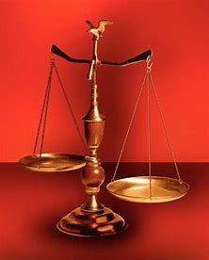
Fellowship Church, Nov 5, 2025 B. Heath
Straight and Balanced
(Luke 3:4-6)
The Faith, a noun, G3982, pis’-tis, 244x (Hebrews 1:1-3, 11-23x, 11:1-3, 6, 38-40, 12:1-4; Romans 15:23, Jude 1:3)
Old Testament: True Prophets of the Faith
#13 – Samuel: Lifelong Shining Faith (Heb 11:32f, 1 Sam)
#14 – Nathan & Gad: The Comforter’s Faith (Heb 11:32g)
#15 – Man of God & Old Prophet: Weak Prophets of the Faith
#16 – Azariah & Hanani: Two Prophets and Two Effects of Truth
#17 – Jehu, a Prophet, & Micaiah: Little-Known Prophets
#18 – Elijah: The Past, Present, and Future Prophet of the Faith
#19 – Elisha: Prophet of Power and Water
#20 – Jonah & Nahum: God’s Mercy & Judgment on Nineveh
#21 – Hosea, Joel, & Amos: Future Judgments and Blessings
#22 – Obadiah, Jonah, & Micah: Fight with Hate, Anger, & Darkness
#23 – Isaiah: Prophet of Majesty and Royalty
#24 – Nahum, Habakkuk, & Zephaniah: God the Loving-Holy Judge
#25 – Huldah: a Prophetess
#26 – Jeremiah & Lamentations:
#27 – Ezekiel:
#28 – Daniel:
#29 – Haggai, Zechariah, & Malachi:
#30 – Old Testament False Prophets
#31 – New Testament Prophets
OT: Ps 5:8, Pr 4:25-27
Amos 7:7-8, Is 28:13, 17
NT: Mt 3:3, Acts 9:11
Hebrews 12:13, Jude 3
1 Cor 15:1-4, 2 Tim 3:10
John 7:16
OT: Deut 25:13-16
Pr 20:10, Dan 5:25-28
NT: Hebrews 12:1
1 Cor 3:11-15
Philippians 4:5
James 3:17

Slide 2
Zephaniah: Two Sides of God’s Love Zephaniah in Hebrew is “the LORD has hid”
Side 1 – God’s love because He is holy. Side 2 – God’s love because He is love.
1:1 c. 630 BC, Josiah, the last good king of Judah, great-great-grandson of Hezekiah
1:2-2:3 Day of Judgment Against Judah (God is holy & jealous)
1. General warning, 1:2-3
2. Judgment for Judah, 1:4-13
3. Description of the Day of the LORD, 1:14-18
4. Last chance to repent, 2:1-3 (1 Peter 4:15-19)
2:4-15 Day of Judgment Against Gentiles (God is holy)
1. Gaza, Ashkelon, Ashdod, Ekron, (-) 2:4-5, (+) 2:6-7
2. Moab and Ammon, 2:8-11
3. Ethiopia (Cush), 2:12
4. Assyria and Nineveh, 2:13-15
3:1-8 Day of Judgment Against Jerusalem, (-) 1-5, (+) 6-8 (God is holy & jealous)
3:9-20 Day of Joy for Israel (God is love)
1. Return dispersed people, 3:9-10
2. Revive sinful people, 3:11-13
3. Rejoice with saved people, 3:14-20
DECISION: How much am I looking and preparing for the Day of the Lord’s return?
Gold standard for Bible study
1st What does it say then?
2nd What does it say about God?
3rd How does it apply to me today?
Knowledge, wisdom, and understanding of Romans 11:25-32, 33-36 concerning the people, land, and language of Israel in God’s plan and purpose.
The Day of the LORD is the time of the great tribulation and reign of Jesus on earth centered around a people (Judah & Israel), a land (Zion & Jerusalem), and a language (Hebrew). Just before and after the rapture of the church. Day in Zephaniah, 21x. Heart-3.x Shame/ashamed-3x. Fire of His jealousy, fierce anger of the LORD-2x. Day of the LORD’s Wrath-2x (Rev 6-19).

Slide 3
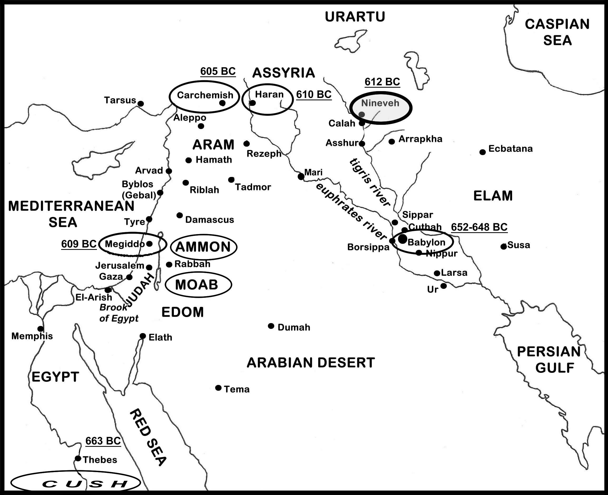
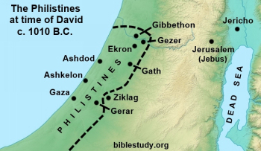
Zephaniah
2:4-15 map
630 BC
Zephaniah 2:13-14
Assyria and Nineveh
Cormorant bird
Heron bird
Zephaniah 1:10-13
Fish Gate
(Damascus Gate)
Babylon 586 BC
Zephaniah
2:4-7
Zephaniah
2:8-11
(Moab & Ammon)
Zephaniah
2:12 – Cush or Egypt/Ethiopia

Slide 4
OT True Prophets chart in respect to
Hebrews
1:1-3, 11:1-3, 11:32-40
# | Name/ Scripture | Suffer-Persecute /Scripture | King (Saul to Zedekiah) | Public/ Private | Prophecy - Near/Far or None | Nation | Bless/ Curse | Vision/ Dream | Miracle Prophet or God | Notes | Heb 11
1 | Samuel | No /1 Sam 1-28 | Saul | Private | Near/for Saul | Israel | B/C |  |  | after death | 32c
2 | Gad | No/1 Sam 22:25 | David | Public | Near/for David | Israel | B/C |  |  | Book | 32d
3 | Nathan | No/2 Sam 7. 12. | David - | Private | Near/Far-seed of David | Israel | B/C/B |  |  | Solomon | 32d
4 | Asaph | No/Psalms 50, 73-83 | David | Public | Far | Israel
5 | Ahijah | No/1 Ki 11:29-39 | Jeroboam - 1st | Private | Near/Jeroboam’s reign-son | N-Israel | B/C |  |  | 1 Ki 14:1-26 | 32d
6 | Shemaiah | No/1 Ki 12:22-24 | Rehoboam - 1st | Private | Near/for Rehoboam | S-Judah | B |  |  | Book 931 BC | 32d
7 | Iddo | No/2 Chr 9:29 | Jeroboam - 1 ^{st} | Private | Seer for Jeroboam | N-Israel | C | 1 Vision |  | Records 931 BC | 32d
8 | man of God | No/1 Kings 13 | Jeroboam – 1st | Private | Far/King Josiah, 270 yrs. | N-Israel | C |  | Hand | sick-heal | 32d
9 | old prophet | No/1 Kings 13 | Jeroboam – 1st | Private | Near/for man of God | N-Israel | C |  |  | Liar-like Lot | 32d
10 | Azariah | No/2 Chr 15:1-7 | Asa – 3rd | Public | None | S-Judah | B |  |  | war w/Ethiopia
11 | Hanani | No/2 Chr 16:7-10 | Asa – 3rd | Private | Near/ | S-Judah | C |  |  | war w/Israel-Syria
12 | Jehu | No/1 Ki 16:1-13, | Baasha-3rd | Private | Near/2 Chr 19:1-4 | N-Israel | C/B |  |  | Son of Hanani
13 | Prophet - | No/1 Ki 20:13-36 | Ahab-7th | Private | Near/Syria/man of God | N-Israel | B/B/C |  | Lion | Son of prophet
14 | Micaiah | Yes/1 Ki 22:1-28 | Ahab-death | Private | Near/400 to 1, 2 Chr 18:1-27 | N-Israel | C |  |  | Lying spirit | 33a
15 | Elijah | Yes/1 Ki 17-2 Ki 2 | Omri, Ahab – 7th | Public | Near/3 ½ years draught, 450 to 1 | N-Israel | B5/C3 |  | 8 | Gentile widow | 35
16 | Elisha | No/2 Ki 3-13 | Joram, Jehu – 8th, | Public | None/gentile general, Lu 4:27 | N-Israel | B11/C5 |  | 16 | Jezebel-death | 35
17 | Eliezer | No/2 Chronicles 20:37 | Jehosophat -4th | Private | Near/alliance with Ahaziah | S-Israel | C |  |  | Fleet destroyed
18 | Joel | No/2 Kings 11-15 | Joash ? |  | Far/ | S-Israel | C-B
19 | Jonah | No/Jonah 1-4 | Jehoash ? | Public | Near/40 days – repent | Nineveh | B |  | 9 by God | Angry-carnal
20 | Amos | No/2 Kings 14-15 | Jeroboam II | Public | Near/c 45 yrs | N-Israel | C/B | 5 visions |  | Exile Assyria 722
21 | Hosea | No/2 Kings 15-18 | Jeroboam II |  | Near/c 40 yrs, Far/2700+ yrs (7x) | N-Israel | C-B |  |  | Gomer/3 children
 | Oded | No/2 Chr 28:6-15 | Ahaz | Public | Near/ | S-Judah | B |  |  | War victory
22 | Micah | Yes/rejection | Jotham-Hezekiah | Public | Near Assyria & Babylon, Far Jesus 1st 5:2 | N-S Israel | C-B | vision(s) | 0 | that day 25%, hear
23 | Isaiah | ?/sawn by Manasseh | Uzziah-Hezekiah | Public | Near and Far/more than other prophets | S-Judah | C-B | visions | 3/time-185 | Majesty, Royalty | 34
24 | Nahum | No/Nahum 1-3 | Hezekiah | ? | Near/30 -50 years | Nineveh | C | 1 vision |  | Israel, 722 BC | 33a
25 | Habakkuk | No/ | Zedekiah | Personal | Near/ Babylon-Nebuchadnezzar | S-Judah | C-B | Vision | 0 | Trial to Triumph
26 | Zephaniah | No/ | Josiah |  | Near-Babylon/Far 2nd coming of Jesus | S-Judah | C-B | 0 | 0
27 | Huldah | No/2 Kings 22:12-20 | Josiah-16th | Private | Near/immediate in Josiah’s life, 2 Ki 23:27 | S-Judah | B/C |  | 0 | 2 Chr 34:20-28
28 | Jeremiah | Yes/ | Josiah-Zedekiah |  |  | S-Judah |  |  |  | Exile Babylon 586
29 | Daniel | Yes/ | Josiah-Babylon |  |  | S-Judah
30 | Ezekiel |  | Josiah-Babylon |  |  | S-Judah
31 | Obadiah | No/ | Zedekiah |  |  | Edom
32 | Haggai | No/ | Zerubbabel |  |  | Israel
33 | Zechariah | Yes/ | Zerubbabel |  |  | Israel
34 | Malachi |  | Zerubbabel |  |  | Israel
OT True Prophets
Before Samuel
-------------------------
Enoch
Genesis 5:24
Jude 1:14
Moses
Exodus 7:1 Deut 34:10
Acts 3:22,
7:37
Miriam – Ex 15:20
Deborah
Judges 4:9
Updated: 21 Oct 2025
W.H.

