Slide 1
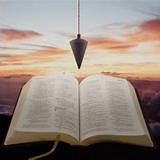
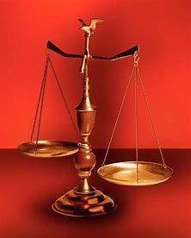
Straight and Balanced
(Luke 3:4-6)
The Faith, a noun, G3982, pis’-tis, 244x, Hebrews 11-11x (11:1-3, 6, 38-40, 12:1-4; Romans 15:23, Jude 1:3)
Fellowship Church, Apr 8, 2026 B. Heath
Psalm 23 Piano
Bing Videos
Old Testament: True Prophets of the Faith
#13 – Samuel: Lifelong Shining Faith (Heb 11:32f, 1 Sam)
#14 – Nathan & Gad: The Comforter’s Faith (Heb 11:32g)
#15 – Man of God & the Old Prophet: Weak Prophets of the Faith
#16 – Azariah & Hanani: Two Prophets and Two Effects of Truth
#17 – Jehu, a Prophet, & Micaiah: Little-Known Prophets
#18 – Elijah: The Past, Present, and Future Prophet of the Faith (Heb 11:35)
#19 – Elisha: Prophet of Power and Water (Heb 11:35)
#20 – Jonah & Nahum: God’s Mercy & Judgment on Nineveh
#21 – Hosea, Joel, & Amos: Future Judgments and Blessings
#22 – Obadiah, Jonah, & Micah: Fight with Hate, Anger, & Darkness
#23 – Isaiah: Prophet of Majesty and Royalty (Heb 11:37)
#24 – Nahum, Habakkuk, & Zephaniah: God the Loving-Holy Judge
#25 – Huldah: Prophetess of Anomaly & Conformity of the Faith
#26 – Jeremiah & Lamentations: Speak, Weep, and Turn unto the LORD
#27 – Ezekiel: Watchman on a Short Leash
#28 – Daniel: Prophet of Self-control and Godliness
#29 – Haggai, Zechariah, & Malachi: Revival, Prophecy, & Transition
#30 – Hebrews 11 Finale (The Way of the Faith)
OT: Ps 5:8, Pr 4:25-27
Amos 7:7-8, Is 28:13, 17
NT: Mt 3:3, Acts 9:11
Hebrews 12:13, Jude 3
1 Cor 15:1-4, 2 Tim 3:10
John 7:16
OT: Deut 25:13-16
Pr 20:10, Dan 5:25-28
NT: Hebrews 12:1
1 Cor 3:11-15
Philippians 4:5
James 3:17

Slide 2
Old Testament True Prophets chart Hebrews 1:1-2, 11:32-40, 12:1-2
# | Name/ Scripture | Suffer-Persecute /Scripture | King (Saul to Zedekiah) | Public/ Private | Prophecy - Near/Far or None | Nation | Bless/ Curse | Vision/ Dream | Miracle Prophet or God | Notes | Heb 11
1 | Samuel | No /1 Sam 1-28 | Saul | Private | Near/for Saul | Israel | B/C | 0 | 0 | after death | 32d
2 | Gad | No/1 Sam 22:25 | David | Public | Near/for David | Israel | B/C | 0 | 0 | Book
3 | Nathan | No/2 Sam 7. 12. | David - Solomon? | Private | Near/Far-seed of David | Israel | B/C/B | 0 | 0 | Solomon
4 | Asaph | No/Psalms 50, 73-83 | David | Public | Far/Tribulation and 1000-year reign | Israel | C/B | 0 | 0 | Revelation 6-20
5 | Ahijah | No/1 Ki 11:29-39 | Jeroboam - 1st | Private | Near/Jeroboam’s reign-son | N-Israel | B/C | 0 | 0 | 1 Ki 14:1-26
6 | Shemaiah | No/1 Ki 12:22-24 | Rehoboam - 1st | Private | Near/for Rehoboam | S-Judah | B | 0 | 0 | Book 931 BC
7 | Iddo | No/2 Chr 9:29 | Jeroboam - 1 ^{st} | Private | Seer for Jeroboam | N-Israel | C | 1 Vision | 0 | Records 931 BC
8 | man of God (sin) | No/1 Kings 13 | Jeroboam – 1st | Private | Far/King Josiah by name, c. 300 yrs., 13:2 | N-Israel | C | 0 | Heal hand | Judah, 2 Ki 23:15
9 | old prophet (sin) | No/1 Kings 13 | Jeroboam – 1st | Private | Near/for man of God, lion and donkey | N-Israel | C | 0 | 0 | Liar-like Lot
10 | Azariah | No/2 Chr 15:1-7 | Asa – 3rd | Public | None | S-Judah | B | 0 | 0 | war w/Ethiopia
11 | Hanani | No/2 Chr 16:7-10 | Asa – 3rd | Private | Near/ | S-Judah | C | 0 | 0 | war w/Israel-Syria
12 | Jehu | No/1 Ki 16:1-13, | Baasha-3rd | Private | Near/2 Chr 19:1-4 | N-Israel | C/B | 0 | 0 | Son of Hanani
13 | Prophet - | No/1 Ki 20:13-36 | Ahab-7th | Private | Near/Syria/man of God | N-Israel | B/B/C | 0 | Lion | Son of prophet
14 | Micaiah | Yes/1 Ki 22:1-28 | Ahab-death | Private | Near/400 to 1, 2 Chr 18:1-27 | N-Israel | C | 0 | 0 | Lying spirit
15 | Elijah | Yes/1 Ki 17-2 Ki 2 | Omri, Ahab – 7th | Public | Near/3 ½ years draught, 450 to 1 | N-Israel | B5/C3 | 0 | 8 | Gentile widow | 35
16 | Elisha | No/2 Ki 3-13 | Joram, Jehu – 8th, | Public | None/gentile general, Lu 4:27 | N-Israel | B11/C5 | 0 | 16 | Jezebel-death | 35
17 | Eliezer | No/2 Chronicles 20:37 | Jehosophat -4th | Private | Near/alliance with Ahaziah | S-Israel | C | 0 | 0 | Fleet destroyed
18 | Joel | No/2 Kings 11-15 | Joash -11th | Public | Far/Acts 2:16-21 | S-Israel | C-B | 0 | 0 | Locusts
19 | Jonah (weight) | No/Jonah 1-4 | Jehoash - 11th | Public | Near/40 days – repent | Nineveh | B | 0 | 9 by God | Angry-carnal
20 | Amos | No/2 Kings 14-15 | Jeroboam II – 13th | Public | Near/c 45 yrs | N-Israel | C/B | 5 Visions | 0 | Exile Assyria 722
21 | Hosea | No/2 Kings 15-18 | Jeroboam II – 13th | Public | Near/c 40 yrs, Far/2700+ yrs (7x) | N-Israel | C-B | 0 | 0 | Gomer/3 children
22 | Oded | No/2 Chr 28:6-15 | Ahaz-12th | Public | Near/ | S-Judah | B | 0 | 0 | War victory
23 | Micah | Yes/rejection | Jotham-Hezekiah | Public | Near Assyria & Babylon, Far Jesus 1st 5:2 | N-S Israel | C-B | Visions | 0 | that day 25%, hear
24 | Isaiah | Yes/sawn in half? | Uzziah-Hezekiah | Public | Near and Far/more than other prophets | S-Judah | C-B | Visions | 3/time-185 | Majesty, Royalty | 34
25 | Nahum (life) | No/Nahum 1-3 | Hezekiah-13th | Personal | Near/30 -50 years | Nineveh | C | 1 vision | 0 | Israel, 722 BC
26 | Habakkuk | No/ | Zedekiah-20th | Personal | Near/ Babylon-Nebuchadnezzar | S-Judah | C-B | Vision | 0 | Trial to Triumph
27 | Zephaniah | No/ | Josiah-16th | Personal | Near-Babylon/Far 2nd coming of Jesus | S-Judah | C-B | 0 | 0 | Trib & 1000
28 | Huldah (female) | No/2 Kings 22:11-20 | Josiah-16th | Private | Near/13 years, Josiah’s grave 2 Ki 23:27 | S-Judah | C-B | 0 | 0 | 2 Chr 34:18-28
29 | Jeremiah | Yes/no wife, pit, etc | Josiah-Zedekiah | Public | Near-Babylon, 586 BC/70-year captivity | S-Judah | C-B | Visions | 0 | Exile Babylon 586 | 36
30 | Ezekiel | No/not from people | Nebu – Babylon | Public | Near, 586 BC/Far , 37-39 ,40-48 1000 yr | S-Judah | C-B | 13 vision | 0 | 18 signs, 8 parables
31 | Daniel | Yes/furnace & lions | Nebu to Cyrus | Public | Near/Far, 1st and 2nd coming, Times of Gentiles | S-Judah | Prophecy | 2 D, 3 V | 4 | Control & Godliness | 33
32 | Obadiah (death) | No/ | Zedekiah-20th | Public | Far/Malachi 4:1-4, and Romans 9:13 | Edom | C | 0 | 0 | Haman and Herodian | 34
33 | Haggai | No/ | Zerubbabel-Gov | Public | Near/Far-2nd coming & 1000 , 2:6-9, 20-23 | Israel | C2-B3 | 0 | 0 | 5 prophecy-113 days
34 | Zechariah | Yes/btwn temple-altar | Zerubbabel | Public | Near Greece/Far 1st & 2nd coming, 9-14 | Israel | B | 8 visions | 0 | Mt 23:35 death | 37
35 | Malachi | No/ | Zerubbabel? | Public | 1-2, Near-priests/3-4, Far 1st & 2nd coming | Israel | C-B | 0 | 0 | John the Baptist
Before Samuel
Enoch
Genesis 5:24
Jude 1:14
Moses
Exodus 7:1 Deut 34:10
Acts 3:22,
7:37
Miriam
Exodus 15:20
Deborah
Judges 4:9
During & after Samuel
1 Samuel
19:18-24
2 Ki 4:38-41
Sons of the prophets-9x
Updated: 6 Apr 2026
W.H.

Slide 3
Old Testament False Prophets
New Testament True Prophets
--------------------
The office of prophet closed with Jesus
The gift of prophets was temorary and limited
# | Scripture |  | Comments on New Testament True Prophets
 | John the Baptist / Mt 11:7-15, Lu 7:26, 7:28. John is more than a prophet Luke 2:36-38 / Anna at the temple – fastings and prayers - widow |  | John is more than a prophet | Luke 2:25-35 / Simeon. 26, revealed by the Holy Ghost. 34,
1 | Jesus / Mt 13:57, 14:5, 16:4, 21:11, Lu 1:76, 7:16, 13:33, 24:19, Jn 1:21, 4:19, 4:44, 6:14, 7:40, 7:52, 9:17, Acts 3:22, 3:23, 7:37, 7:40, 7:52, 8:32, |  |  | Jesus died as the last prophet of God. Myrrh gift.
1 | Acts 11:27 , 13:1 , 15:32 / prophets from Jerusalem
 | Acts 21:9 / 4 daughters of Philip the evangelist | They did prophesy, as today all men and women can prophesy or speak the gospel (1 Corinthians 14:1)
2 | Acts 21:10-11 / Agabus | Told the Apostle Paul what he already knew. Acts 21:15 to the end of Acts 28, no more prophets in any of the New Testament, except Ephesus ( existed,,,,,,,,,,
 | 1 Cor 12:28, 12:29, 14:29. 14:32, 14:37
 | 1 Cor 13:8-9 / prophecies (noun) shall cease | 1 Cor 14:1 but rather ye may prophesy (verb)
 | Ephesians 2:20, 3:5, 4:11 | The gift in the foundation of the early church (add/revise)
 | Hebrews 1:1 -2 | ¹ God, who at sundry times and in divers manners spake in time past unto the fathers by the prophets, ² Hath in these last days spoken unto us by [his] Son, whom he hath appointed heir of all things, by whom also he made the worlds;
 | Note: on New Testament prophets | no dreams, no visions, no miracles, no persecution, no new prophecies. Simeon, Paul, Jude, and John prophesied, although never prophets.
 | Revelation 11:1-10 / The 2 witnesses – not prophet | No more prophets. Revelation 19:10 / Jesus is the spirit of prophecy
New Testament False Prophets
# | Scripture | Comments on New Testament False Prophets
 | Matthew 24:4-5, Mark 13:5-6, Luke 21:8 | Take heed that ye be not deceived, for many shall come in my name, saying, I am Christ,and shall deceive many.
1 | Matthew 7:15-20 / false prophets | Beware of false prophets, which come to you in sheep’s clothing, but inwardly they are ravening wolves. By their fruits ye shall know them.
2 | Acts 13:6-13 / Bar-jesus, a false prophet | Also a sorcerer
 | Titus 1:12 / Cretians / a false prophet | Liars, evil beasts, slow bellies. Context: Titus 1:9b-16
 | 2 Cor 11:3-4, 12-15 | False Jesus, false spirit, false gospel, false apostles, deceitful workers, angel of light, ministers of righteousness
 | 2 Peter 2 :1 / false teachers | 22 attributes. No more false prophets as in the Old Testament, only false teachers. In the New Testament.
 | 1 John 4:1 / many false prophets | ¹ Beloved, believe not every spirit, but try the spirits whether they are of God: because many false prophets are gone out into the world.
 | Rev 16:13, 19:20, 20:10 / the false prophet | No true prophets in Revelation, not even the Apostle John
# | Scripture | Comments on Old Testament False Prophets
1 | Numbers 22-24, Nehemiah 13:2 / Balaam | Gave one true prophecy. Way of Balaam: 2 Peter 2:15, Jude 1:11, Rev 2:14
2 | Deuteronomy 13:1-5, 18:21-22 / false prophets | Opposed the LORD God and true prophets
3 | Jeremiah 26:20, 29:24-32 / Shemaiah | Opposed Jeremiah, the true prophet
4 | Jeremiah 28 / Hananiah | Opposed Jeremiah, the true prophet
5 | Ezekiel 13:1-17, 17-23 / false prophet(ess) | Opposed Ezekiel, the true prophet
6 | 1 Kings 18:17-40 / 450 prophets of Baal | Opposed Elijah, the true prophet
7 | 1 Kings 22 / Zedekiah | Opposed Micaiah, the true prophet Misled Ahab?
Updated: 1 Apr 2026
W.H.

Slide 4
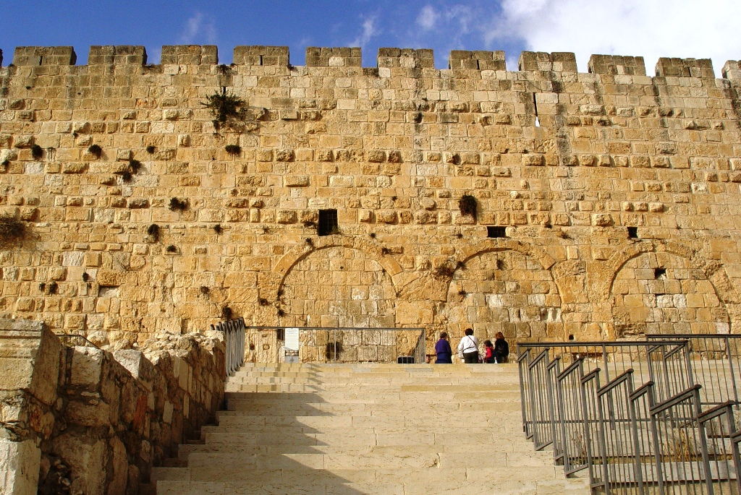
Hebrews 11 Finale (The Way of the Faith)
Hebrews 11 and Bible prophets review
Hebrews 11:40 us = New Testament saints, they = Old Testament saints
Hebrews 12:1-2 we = NT saints, witnesses = OT saints & the good angels
“let us lay aside every weight and the sin which doth so easily beset [us],
and let us run with patience the race that is set before us,
² Looking unto Jesus the author and finisher of [our] the faith; who for
the joy that was set before him endured the cross, despising the shame,
and is set down at the right hand of the throne of God.”
Decision: Tonight, let us lay aside every weight and sin

Slide 5
Hebrews 11 Finale (The Way of the Faith) “The Faith” 42x in the NT
Bible prophets review
Hebrews 11:40 us = New Testament saints, they = Old Testament saints
Hebrews 12:1-2 we = NT saints, witnesses = OT saints & the good angels
39 And these all, having obtained a good report through faith, received not the promise:
⁴⁰ God having provided some better thing for us, that they without us should not be made perfect.
1 Wherefore seeing we also are compassed about with so great a cloud of witnesses, let us lay aside every weight, and the sin
which doth so easily beset [us], and let us run with patience the race that is set before us,
² Looking unto Jesus the author and finisher of [our] faith; who for the joy that was set before him endured the cross, despising the
shame, and is set down at the right hand of the throne of God. Heb 2, 4, 6, 10, 12 the danger of apostasy
Decision: Tonight, let us lay aside every weight and sin

