Slide 1

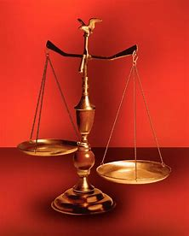
Fellowship Church, Aug 5, 2026 B. Heath
Straight and Balanced
(Luke 3:4-6)
Bio: Saints in the Way, and the Truth, and the Life
1st Great Awakening
George Whitefield: Salvation/Life (John 3:7)
Jonathan Edwards: Glorification/Truth (Deu 32:35)
William Heath: Late Bloomer (John 14:6)
3. John Wesley: Sanctification/Way (1 John)
1 – 2 / 3 – 4 / 5 – 6 / 7 – 8 / 9 – 10

Slide 2
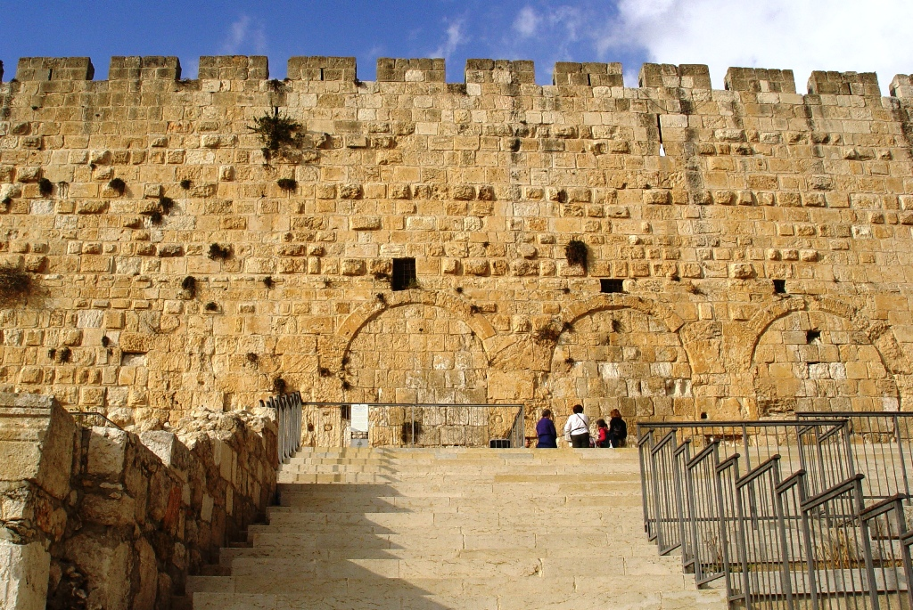
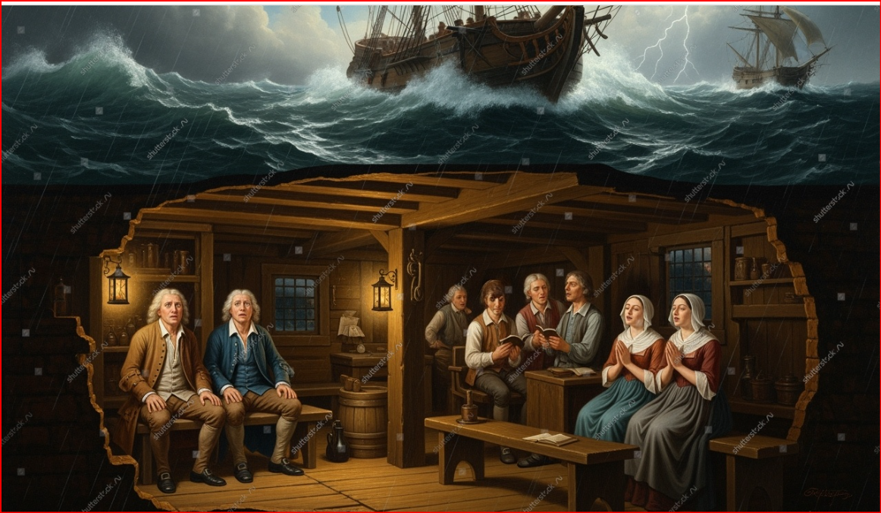
John Wesley: Sanctification/Way (1 John)
Birth to College: 1703-1737
Born in Great Britian. Grandparents Puritan, parents Anglican. Mother Susanna’s Godly influence.
Leader of Holy Club with George Whitefield.
Mission to Georgia with Moravians. Failed romance. Relieved by George Whitefield.
Salvation: 1738
At Moravian meeting in London, msg on Romans by Luther.
Never returned to the 13 colonies.
1st message “Salvation by Faith” Eph 2:7.
Sanctification: 1738 to 1791
Sermons “On Sin in Believers,” “The Almost Christian,” “Plain Account of Christian Perfection”
Unhappy marriage (1751-late 50s). His theology is framed in a 1st John framework.
Preached more than 54,000 messages. 44 sermons published for Methodism.
Glorification: 1791
Decision: Is God’s love and holiness increasing in Me?

Slide 3
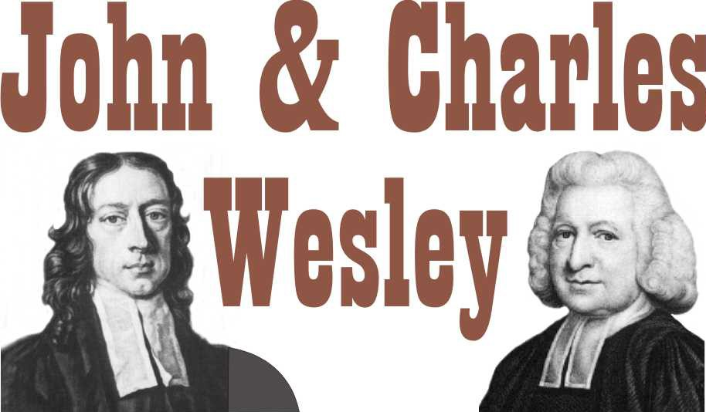

Wesley on the Christian Life, The Heart Renewed in Love
by Fred Sanders, 2013
Conclusions: Entire Sanctification: speak of scarcely, then drawing rather than driving.
Wesley led the formation of the Methodist church, later influenced Wesylan-holiness then Church of the Nazarene. Holiness and pentecostal movements refer to John Wesley’s doctrine and practice. In 2024 the United Methodist Church (UMC) endorsed homosexual pastors.
Spurgeon had a different posture toward Wesley: critical appreciation.
I am afraid that most of us are half asleep, and those that are a little awake have not begun to feel. It will be time for us to find fault with John and Charles Wesley, not when we discover their mistakes, but when we have cured our own. When we shall have more piety than they, more fire, more grace, more burning love, more intense unselfishness, then, and not till then, may we begin to find fault and criticize.
Doctrine & Practice
Sadducee 1 – 2 / 3 – 4 / Anna 5 – 6 Simeon / 7 – 8 / 9 – 10 Pharisee
Cautious Appreciation: True believer can lose salvation. Women pastors. Free-will. Errors in Baptism of the Holy Spirit as a 2nd work of grace.
Washington DC, Wesley
Theological Seminary, UMC. Gift of Great Britain, 1961

