Slide 1
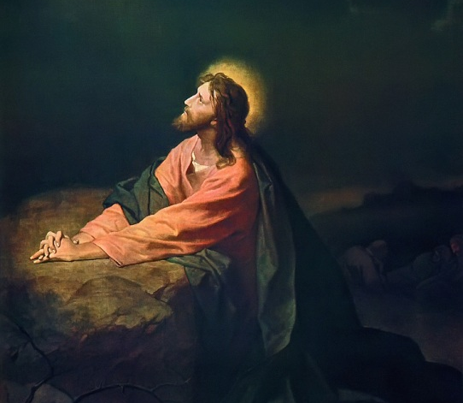
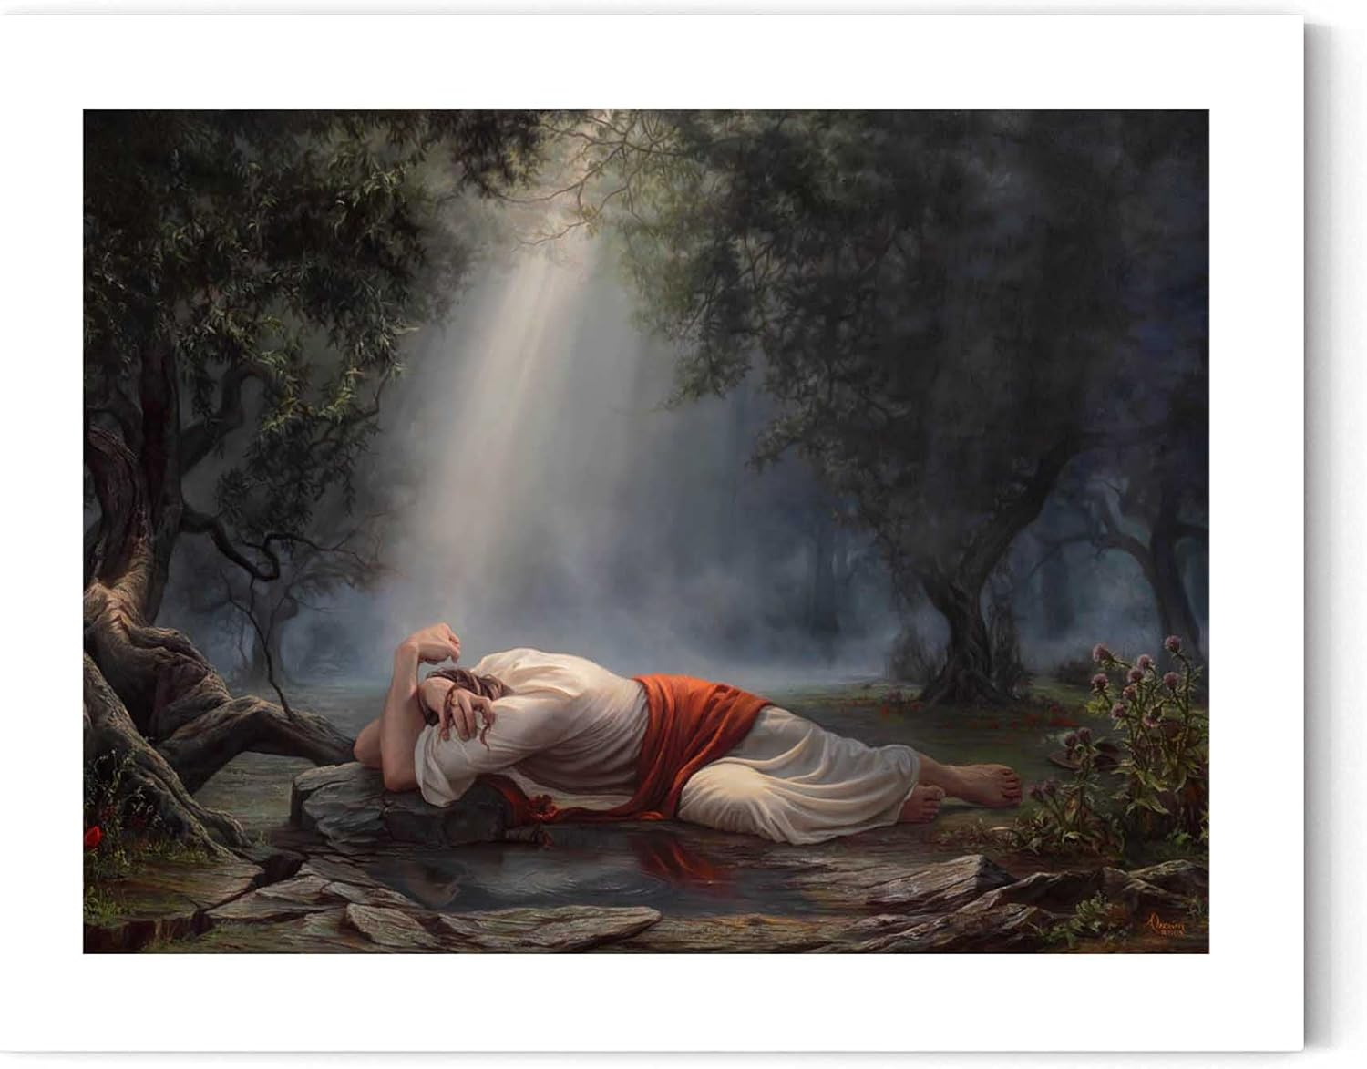
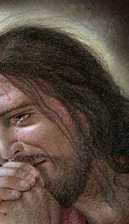
With Jesus at Gethsemane Mark 14:32-42 Sorrow, Supplication, and Strength “let this cup pass from me”
The Biblical Jesus
The traditional Jesus

