Slide 1
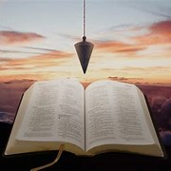
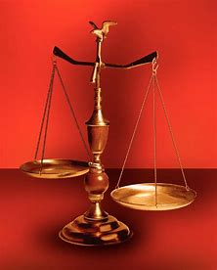
Fellowship Church, April 28, 2024 B. Heath
Straight and Balanced
(Luke 3:4-6)
Biblical characters (Hebrews 11:32)
The Death and Resurrection of Jesus
#1 – With Jesus at the Tomb (John 20:1-18)
#2 –
OT: Ps 5:8, Pr 4:25-27
Amos 7:7-8, Is 28:13, 17
NT: Mt 3:3, Acts 9:11
Hebrews 12:13
OT: Deut 25:13-16
Pr 20:10, Dan 5:25-28
NT: Hebrews12:1
1 Cor 3:11-15

Slide 2
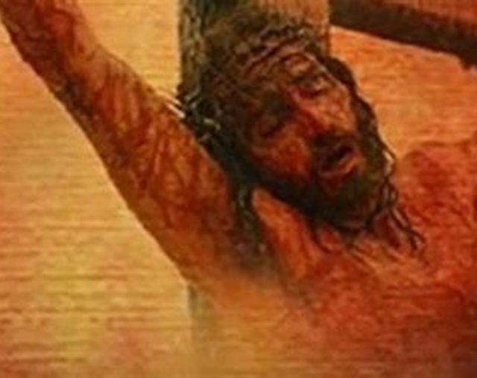
THE SEVEN SAYINGS OF JESUS ON THE CROSS (Friday from 9 am to 3 pm)
1st FATHER, FORGIVE THEM; FOR THEY KNOW NOT WHAT THEY DO. Luke 23:34
2nd TODAY SHALT THOU BE WITH ME IN PARADISE. Luke 23:43
3rd WOMAN, BEHOLD THY SON! BEHOLD THY MOTHER! John 19:26-27
4th ELI, ELI, LAMA SABACHTHANI? Mt 27:45-46, Mk 15:34-36
(MY GOD, MY GOD, WHY HAST THOU FORSAKEN ME?)
5th I THIRST. John 19:28
6th IT IS FINISHED. John 19:30
7th FATHER, INTO THY HANDS I COMMEND MY SPIRIT.
Mt 27:50, Mk 15:37, Lu 23:46

Slide 3
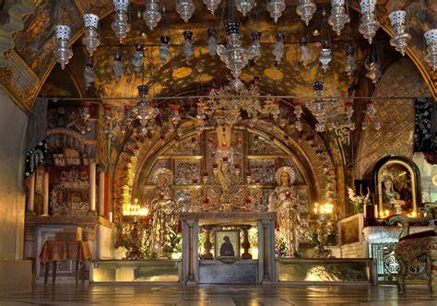
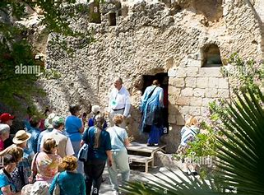
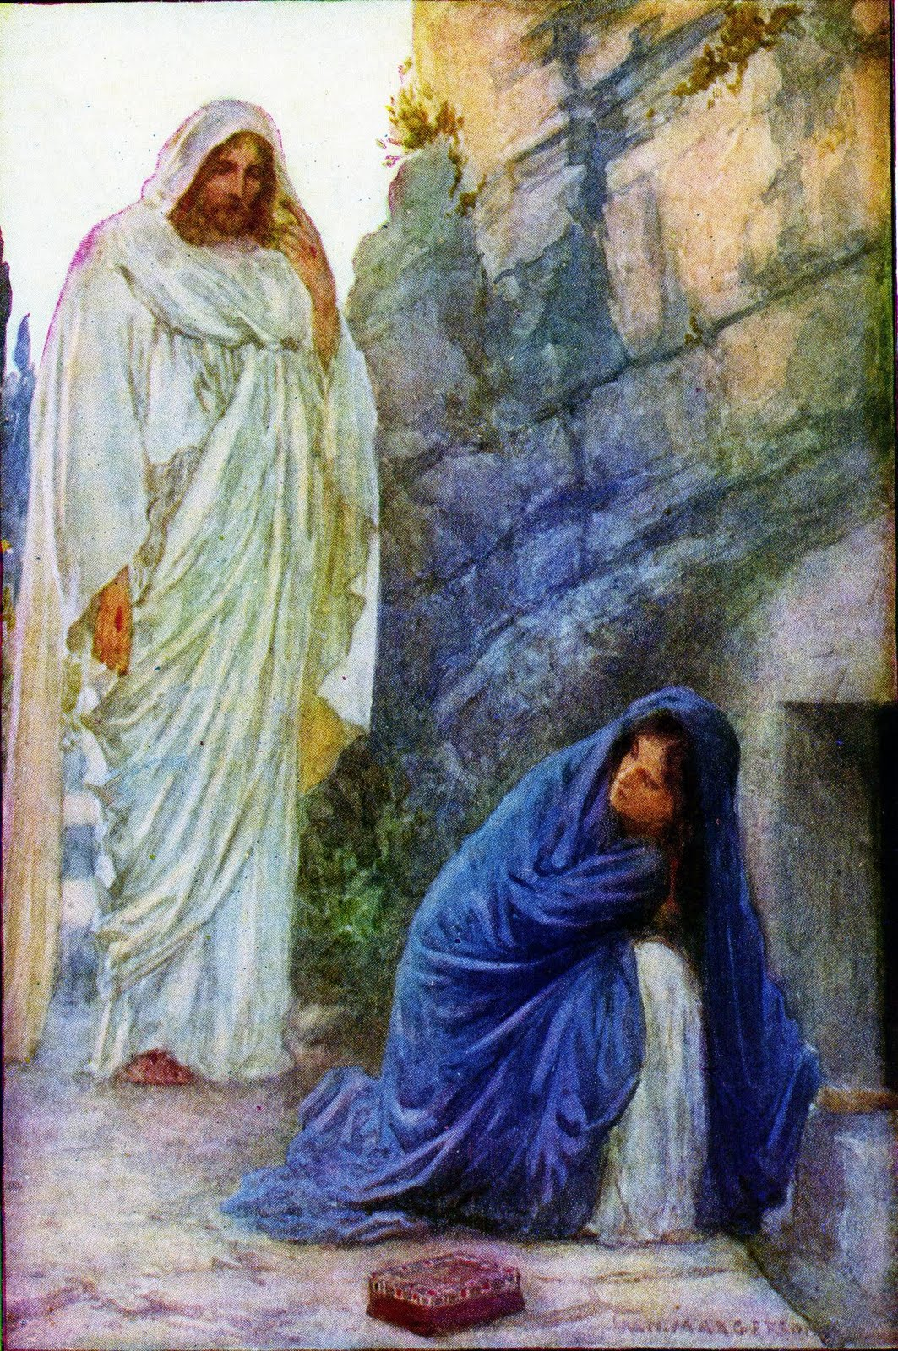
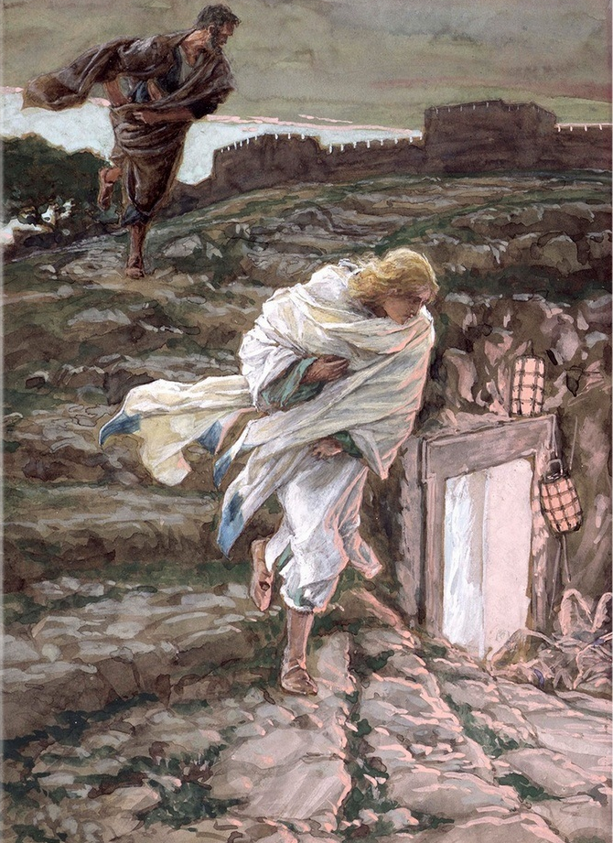
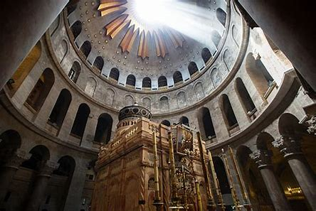
With Jesus at the Tomb John 20:1-18 Ministers & Messengers for Jesus “go to My brethren, and say unto them, I ascend unto My Father, and your Father”
The traditional Jesus
The Biblical Jesus

