Slide 1
Fashion Moments Period 1-4 Debriefing
Courtney Gardner and Lesley Diaz

Slide 2
Period 1: Decisions
No inventory was purchased
Pricing
Tops - $20
Pants - $30
Marketing
No marketing was done
Staffing
No part-time employees were hired
Special Decision
No security system was bought
Inventory:

Slide 3
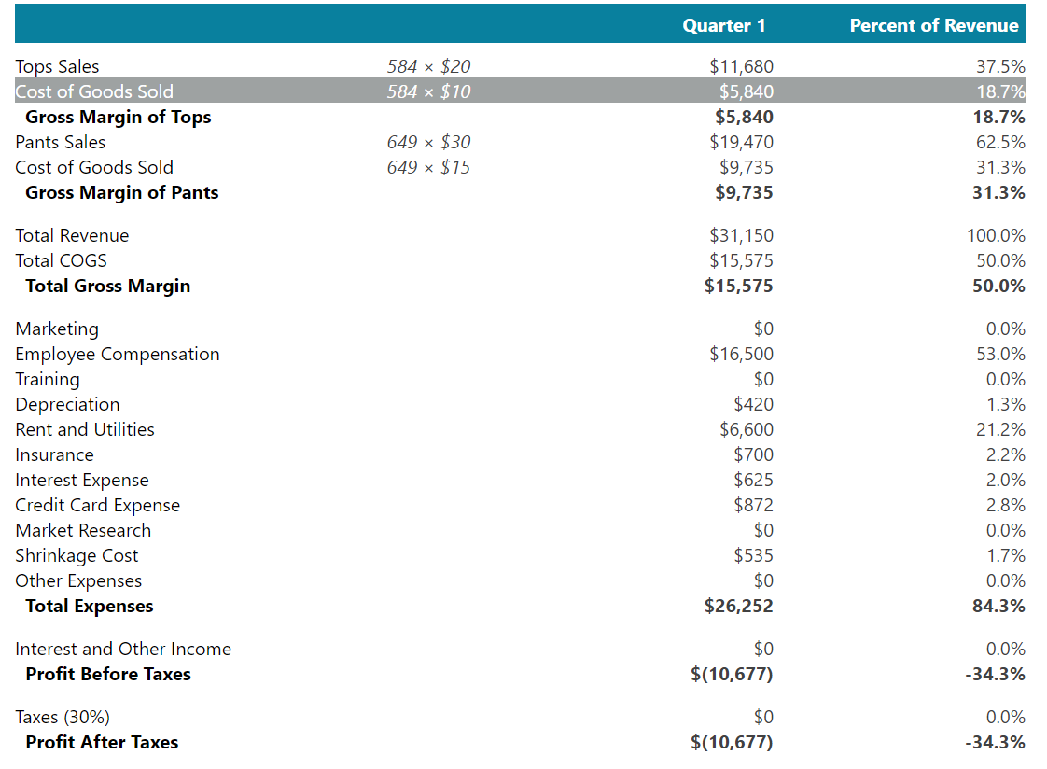
Period 1:
Income Statement

Slide 4
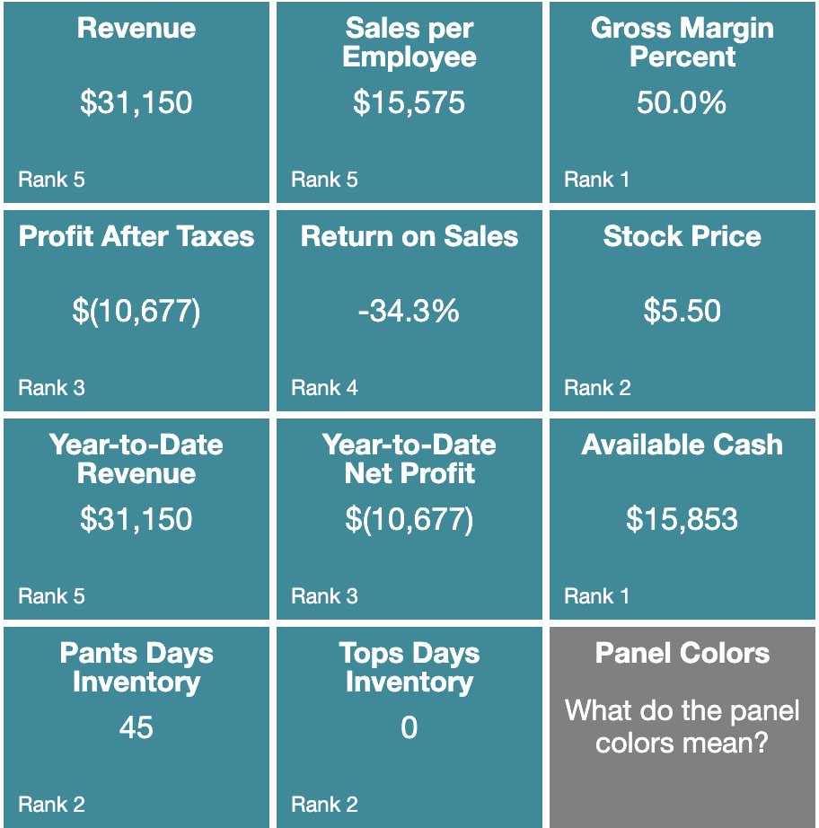
Period 1: Stats

Slide 5
Period 2:
Decisions
Inventory: Underestimated
Tops – 650
Pants – 400
Tops - $26
Pants - $32
Marketing
Social Media Advertising
Promotion: 10% Sale
Staffing
2 Part-time Employees
Some training for all new hires ($200)
Special Decision
Bought property insurance
Pricing: Increased
Wages were $8

Slide 6
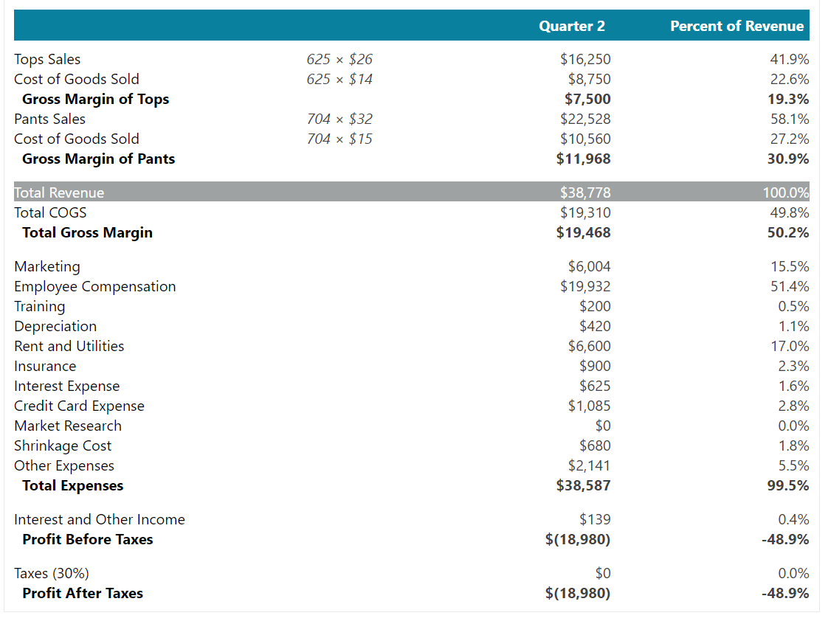
Period 2:
Income
Statement

Slide 7
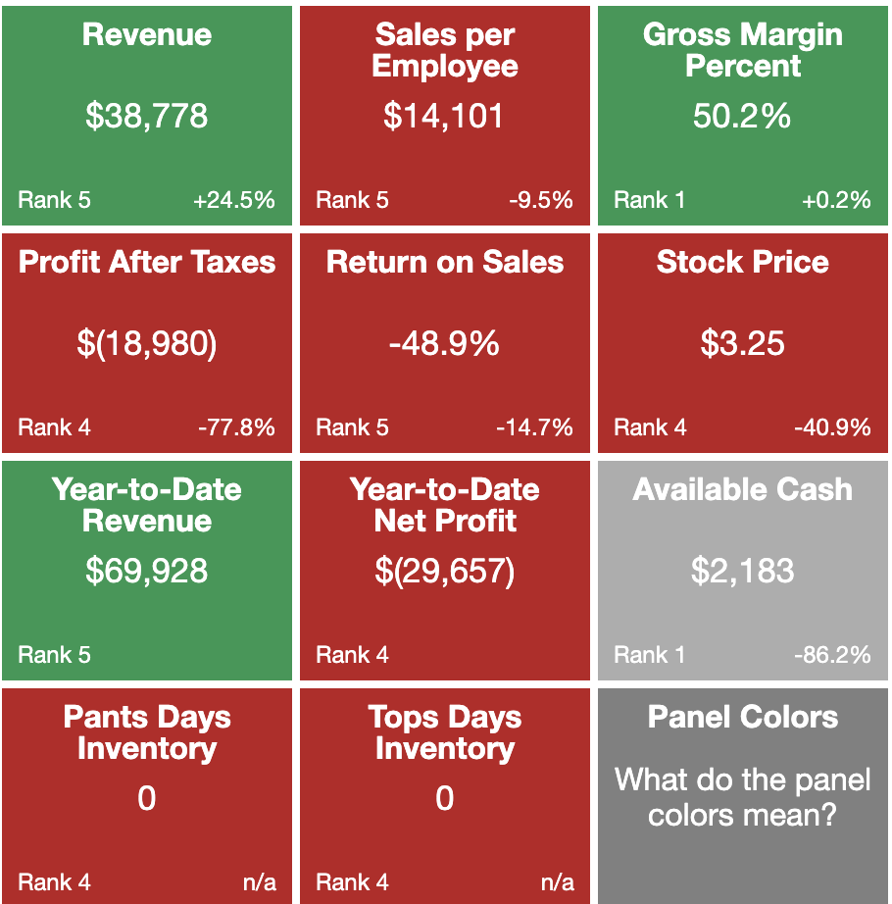
Period 2: Stats

Slide 8
Period 3:
Decisions
Inventory: Underestimated
Tops – 800
Pants – 800
Pricing: Stayed the same
Tops - $26
Pants - $32
Marketing
Social Media Advertising
Promotion: 10% Sale
Staffing
Hired 4 new part-time employees
Increased training to cover all new hires and existing employees ($800)
Special Decision
Paid for school officials country club membership
Website
Increased waged to $10

Slide 9
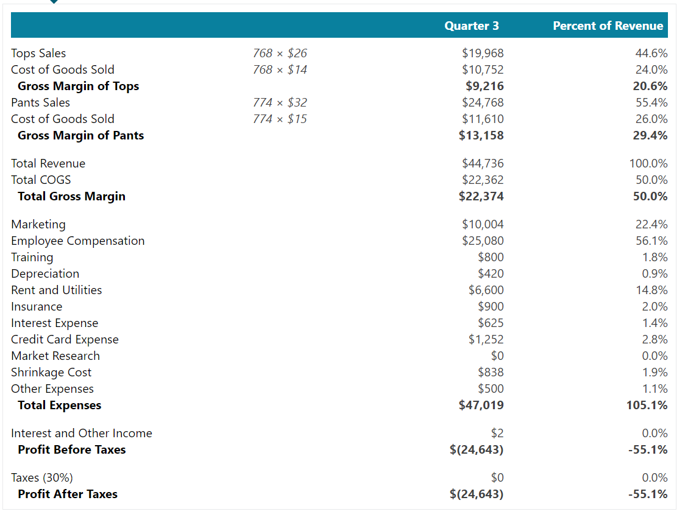
Period 3:
Income
Statement

Slide 10
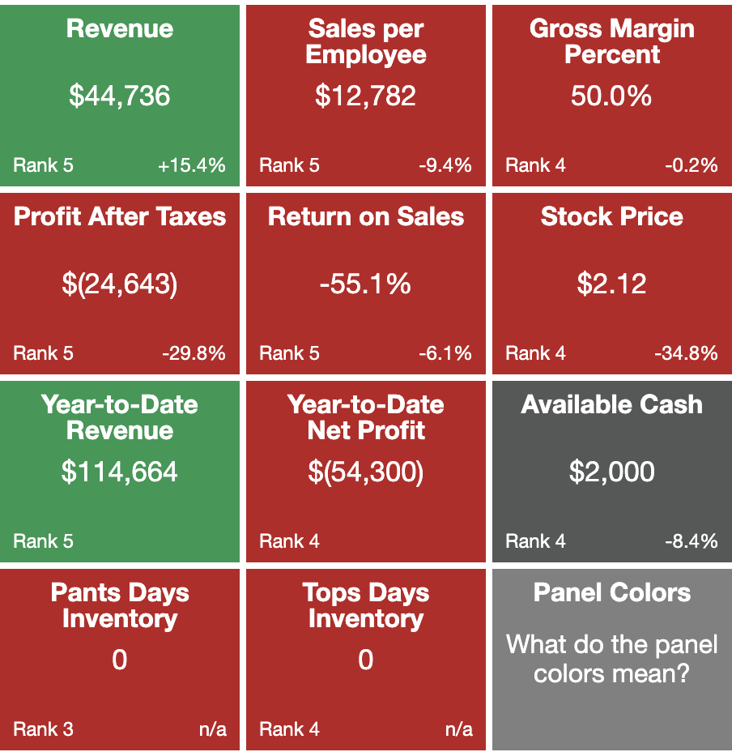
Period 3: Stats

Slide 11
Period 4:
Decisions
Inventory: Overestimated
Tops – 3,500
Pants – 4,000
Pricing: Stayed the same
Tops - $26
Pants - $32
Marketing
Social Media Advertising
Promotion: 10% Sale
Staffing
Hired 2 new part-time employees
Special Decision
Nonpartisan support in upcoming election
Website

Slide 12
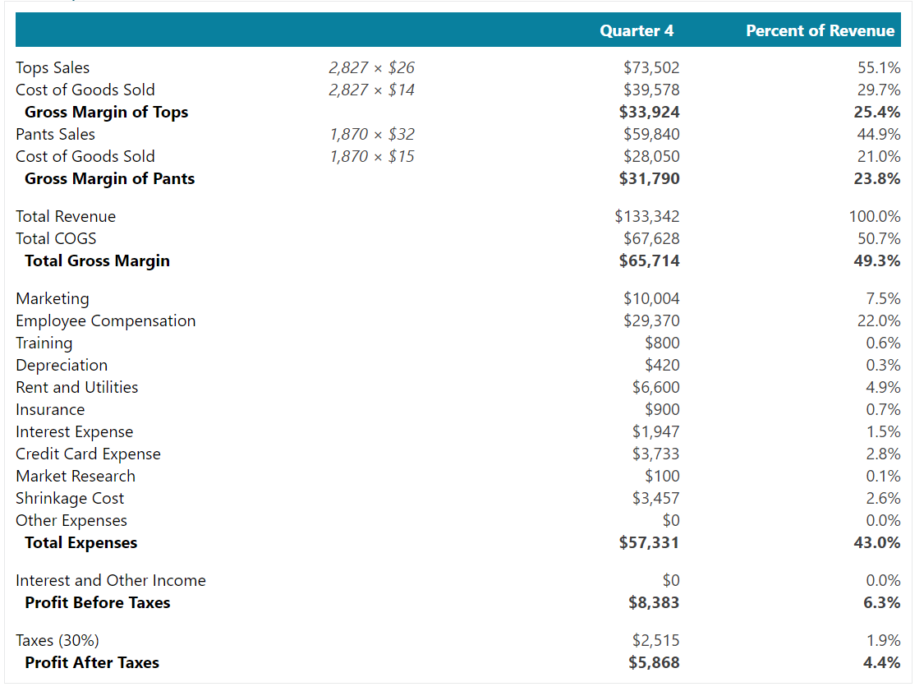
Period 4:
Income
Statement

Slide 13
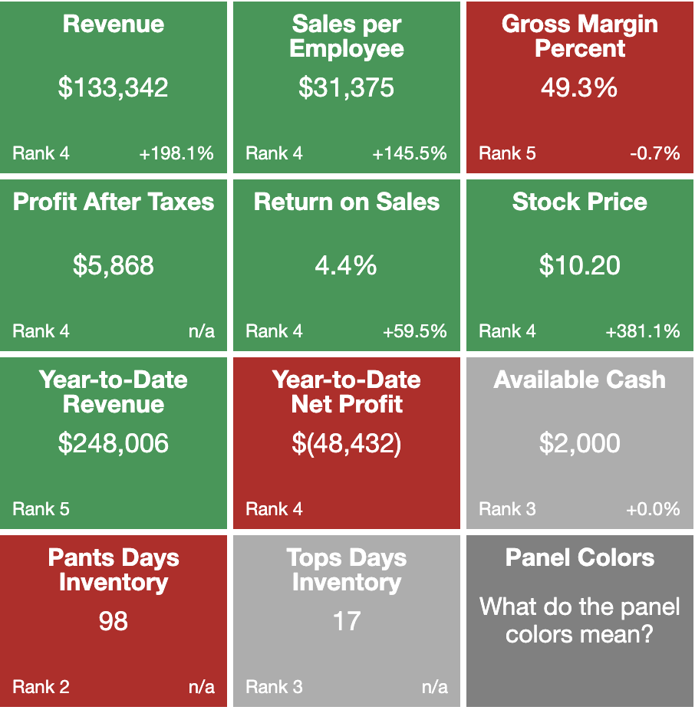
Period 4:
Stats

Slide 14
Thank You!

