Slide 1
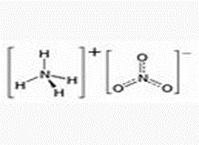
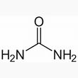
Ammonium nitrate
It is a white crystalline solid and is highly soluble in water. It is predominantly used in agriculture as a high-nitrogen fertilizer. It is being phased out of use in many countries due to concerns over its potential for use in improvised explosive devices and the synthesis of illicit substances.
Urea
It is a colorless, odorless solid, highly soluble in water and practically non-toxic. Dissolved in water, it is neither acidic nor alkaline. The body uses it in many processes, the most notable one being nitrogen excretion. Urea is widely used in fertilizers as a convenient source of nitrogen. Urea is also an important raw material for the chemical industry.

Slide 2
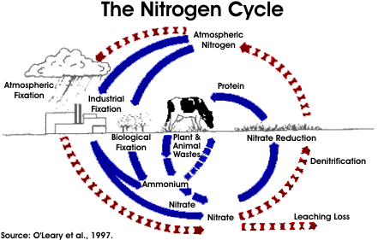
Ammonium Nitrate is a useful form of nitrogen because it is biologically available to plants and is therefore a valuable fertilizer. However, excessive levels of nitrate in drinking water can produce negative health impacts on infant humans and animals. To protect human health, EPA has set a drinking water Maximum Contaminant Level (MCL) of 10 mg/l for nitrate-nitrogen. Once a water source is contaminated, the costs of protecting consumers from nitrate exposure can be significant. Nitrate is not removed by conventional drinking water treatment processes; its removal requires additional, relatively expensive treatment units.
Nitrogen in livestock manure is almost always in the organic, ammonia or ammonium form but may become oxidized to nitrate after being diluted. It can reach surface waters via direct discharge of animal wastes. Nitrate is water soluble and moves freely through most soils. Nitrate contributions to surface water from agriculture are primarily from groundwater connections and other subsurface flows rather than overland runoff (Follett, 1995).

Slide 3
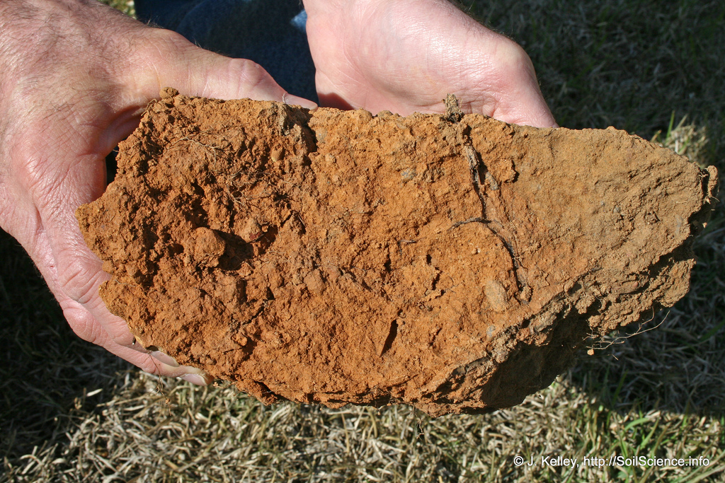
What Urea does to the soil:
There are two ways to sterilize the soil, using chemicals and using heat.
Urea is a chemical that sterilizes the soil by killing off all the good bacteria normally found living in the soil.
Urea, because of its identical molecular structure, is mistaken by bacteria and plants as a food source. Because Urea is a much more concentrated source of nitrogen, the bacteria are not fed but are actually destroyed leaving behind a mutated form of bacteria which the plants cannot use.
Slowly plants find themselves weakening, starving from lack of proper nutritionist and stressed out.
Their root systems no longer function as they should.
They depend more & more on their chemical ‘hit’ to provide nutrition for them.
The soils natural bacterial system is converted into one that cannot be used by plants root systems for food
absorption but instead the bad bacteria
themselves begin to feed off the plants!

Slide 4
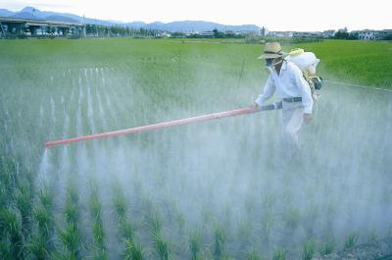
What Urea does to the Plants:
The plants get an immediate ‘relief’ when you apply or spray fertilizers based on urea or some other chemical form of high nitrogen, but as it wears off the plants return to their weakened state and become even more stressed.
This process is repeated over and over again.
Less soil bacterium, less root hair which equal less food being absorbed by the plants which means less energy, less minerals, more stress.
Many chemical fertilizers are now using timed release fertilizers that release their ‘hits’ over a time, thus reducing down time.
However this is not the case at all, instead the timed release fertilizers merely are increasing stress. Now Plants are stressed out all of the time!
Fertilizer companies are also adding more nutrients to their Urea based fertilizers to help plants
last longer. Plants thus stressed out are
more inclined to disease and pest
attacks then organically grown plants.

Slide 5
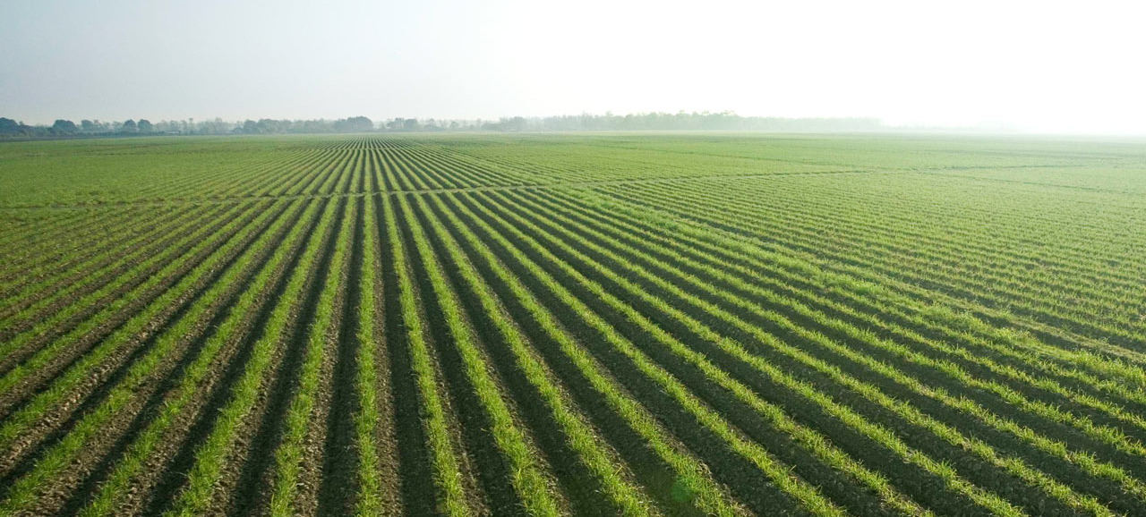
Ammonia Nitrate and Urea provide plant fertility that is used up almost immediately. Whatever is left behind, (which can be a significant amount at times), leaches out and becomes a water contaminant and can even damage ponds & lakes by causing excessive algae bloom which, in turn, lowers oxygen levels in the water; creates toxins that leach into the water.
SOIL: Ammonia Nitrate and Urea do nothing to build or improve soil conditions. Often times, losing 90% of organic material in the soil over time. After awhile, crops become dependent on synthetic fertilizers, leaves no reason for plants to grow deep roots, making them more susceptible to drought and loss of overall biomass.
Remember: High Nitrogen=High Stress=Disease/Pests=Low Minerals=Low Nutrient levels=Low Energy, High Energy=High Nutrient Levels=No Stress=No Pests/ Diseases!

Slide 6
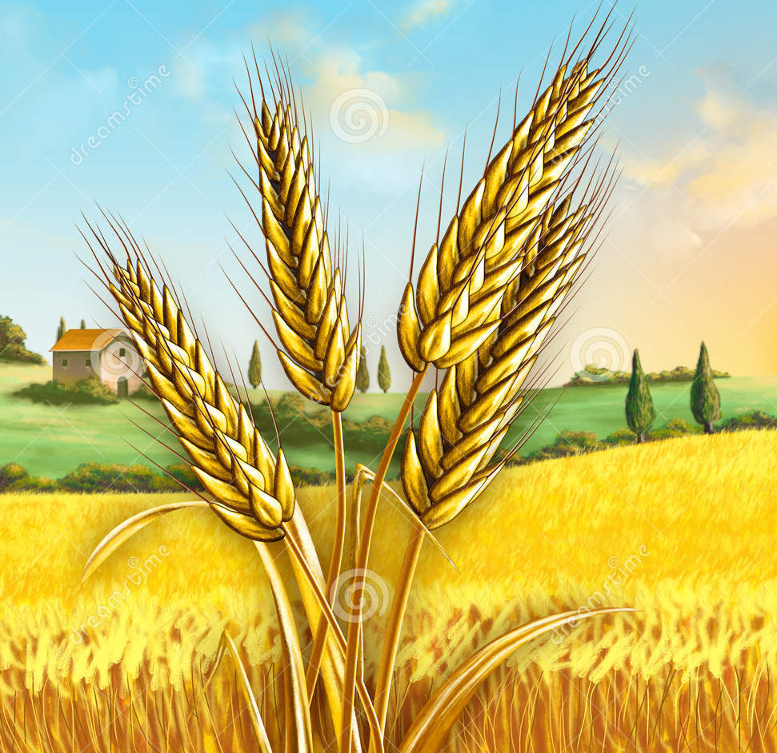
How you feed your plants is as important as what you feed them?
Some Factors that cause stress in plants & crops:
- dead soil
- low nutrition levels
- low mineral levels
- planted in wrong environment
- wrong variety planted
- other chemical use such as herbicides, pesticides, etc.

Slide 7
You may be told that:
“Compost tea needs food, O2, refrigeration, unstable, microbial population drops once applied”.
Of course it does because it is NOT a true Earthworm Castings
product! More than likely cow manure is being used in the
product which in turn causes nutrient deficiencies! Keep in mind,
cows have 4 stomachs instead of one which means cows
extracts maximum nutrients out of the food. By the time it gets
to the worms, the nutrient density is almost depleted! Since our
proprietary process does not involve the use of cow manure,
poultry or any other animal manure, that never happens!

Slide 8
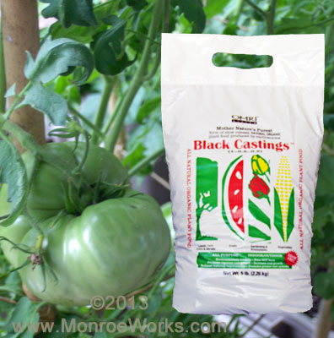

Pure Black Castings™
All purpose indoor/Outdoor Environmentally Friendly Does Not Burn Promotes Vigorous Root Growth Reduces Watering Requirements
The organic matter (humate) content in Pure Black Castings™ retains water, and the humic acid enhances soil nutrient availability.
Application is worry free because Pure Black Castings™ never burns plants.
There’s no need to post warning signs. These organic fertilizers are completely safe. Children, pets and people can play and work on the area as soon as they are applied
New Process Takes Earthworm Castings to Highest Level of Potency
Earthworm castings have always been a viable alternative to chemical fertilizer. But, with the rising cost of oil, their place in agriculture and horticulture is becoming more important than ever.
You get a more powerful and beneficial fertilizer at a lower cost.

Slide 9

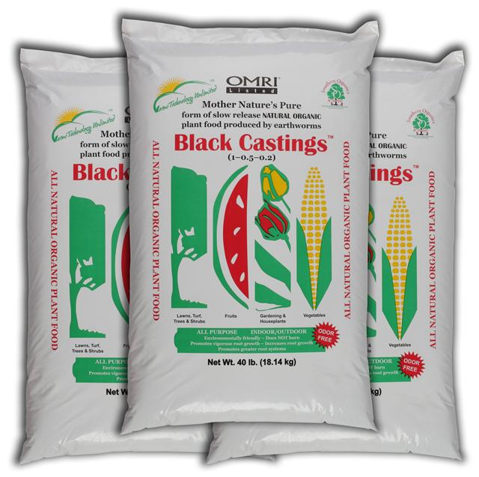
Super-Charged Worm Poop
Vermitechnology has discovered a way to supercharge the castings created naturally by earthworms, producing a more potent plant fertilizer.
This patented process boosts to maximum potency the broad spectrum plant nutrients found in “worm poop” creating Pure Black Castings™. From these enhanced castings, Southern Organics & Supply developed VermaPlex®, a powerful, safe liquid specialty fertilizer.
Improved Soil, Superior Yields, Reduced Cost
VermaPlex® and Pure Black Castings™ provide
the essential nutrients plants need to thrive and grow in a form that is readily available. They are not derived from petroleum products, but from organic matter first processed by earthworms.
When you use VermaPlex® and Pure Black Castings™, yields increase while costs decrease.
Why not offer your customers this highly effective alternative to expensive chemical fertilizer? It gets stunning results and improves the soil.

Slide 10


Derived 100% from Earthworm Castings
VermaPlex®
VermaPlex® is an all-natural fertilizer – The ONLY waste is from Earthworms. NO yard clippings, cow manure, or food wastes are used to produce VermaPlex®.
Helps the soil regulate itself. In nature, soil chemistry is self-regulating: microbes in the soil consume organic matter, inorganic matter, water, and other nutrients, and regulate their levels as needed.
Feed plants without burning them. VermaPlex® may also reduce dependence on traditional fertilizers, which can burn plants and pollute the environment

Slide 11
Urea & Ammonia Nitrates:
Rapid Growth pushes plants to grow too fast
Plants grow fast but are very weak
Promotes stress
Destroys soil organisms
Increases pest activities
Increases disease activities
Urea breaks down into various compounds some of which can inhibit plant growth.
The carbon in Urea based fertilizers is chemically converted to CO2 and lost to the atmosphere. Carbon is energy to plants and soil micro-organisms.
Black Castings™ & VermaPlex®:
Greatly Reduces Water & Fertilizer Costs - Stabilizes Soil pH
Builds Excellent Root Zone, Drought Resistance & Won't Burn Plants!
Promotes Vigorous Plant Growth, Flowering, Brix & Abundant Yields
Will not leach or contaminate the water table.
Has 2 Year Shelf Life!!
A Little Goes a Long Way
Are the culmination of over 30 years of Slow Transition from Composting to Vermicomposting
Used together, is a Sustainable Method of Plant Care
Non-Toxic Environmentally Safe for Indoor & Outdoor Use
Children & Pets Can Play After Applications
.
Enhances root development, plant growth, flowering and fruit production. VermaPlex® helps your soil reach a healthy balance.

Slide 12

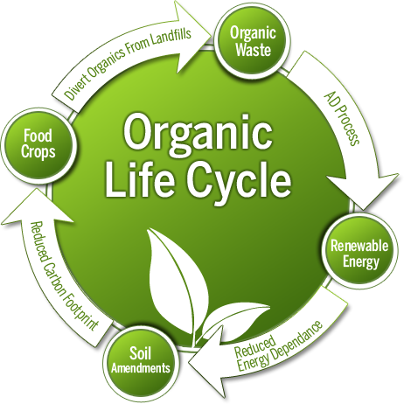

Slide 13
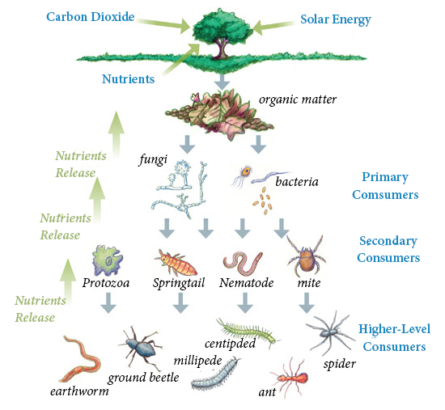
This compost food web depicts an accurate representation of
how nature manages
nutrients and uses all
available material.
There
is no waste. Everything is completely cycled in and everything shares the
bounty.
The end result is
great soil conditions
that continue to improve
every year!

Slide 14
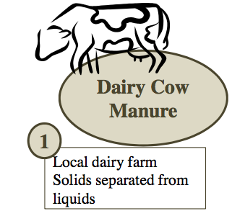
What our Vermacompost is NOT…….
It is NOT usually derived from any form of manure like other companies advertise. VermaPlex®
is derived 100% from Earth Worm Castings. If what you are buying isn’t, then you more than likely are buying plain ol’ compost folks!

Slide 15
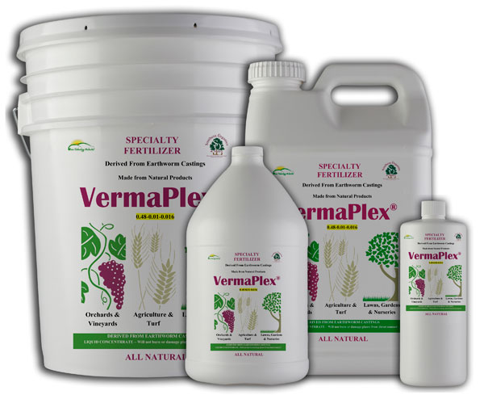

VermaPlex® & Pure Black Castings™
Helps the soil regulate itself. In nature, soil chemistry is self-regulating: microbes in the soil consume organic matter, inorganic matter, water, and other nutrients, and regulate their levels as needed.
Feed plants without burning them. VermaPlex® & Pure Black Castings™
may also reduce dependence on traditional fertilizers, which can burn plants and pollute the environment

Slide 16
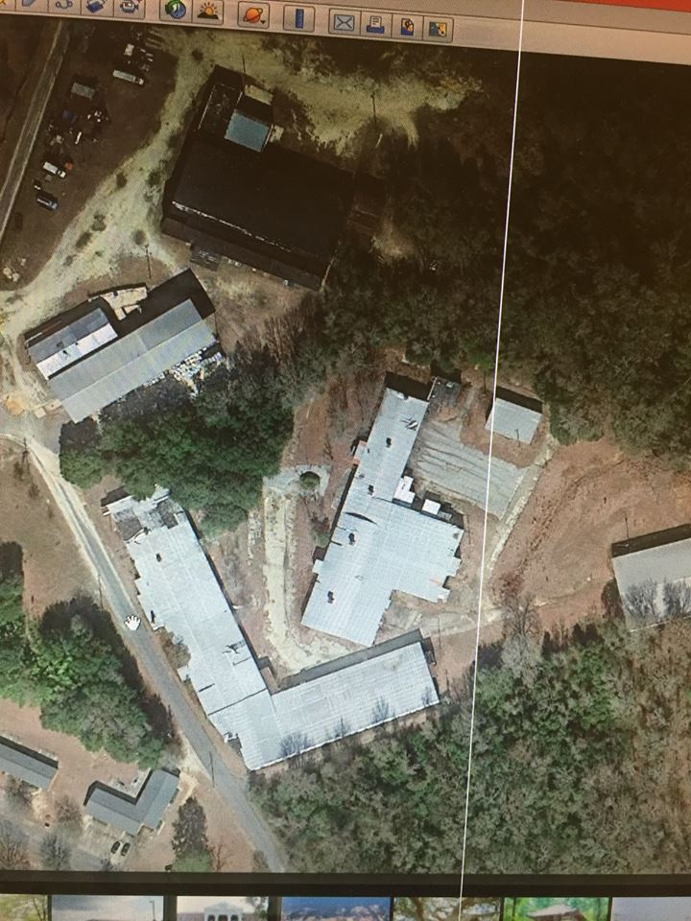
Our Facility in South Carolina
Ironwood Farms
Always made with100% pure Earthworm Castings! Consistent, Uniform, Verifiable, OMRI Listed!

Slide 17
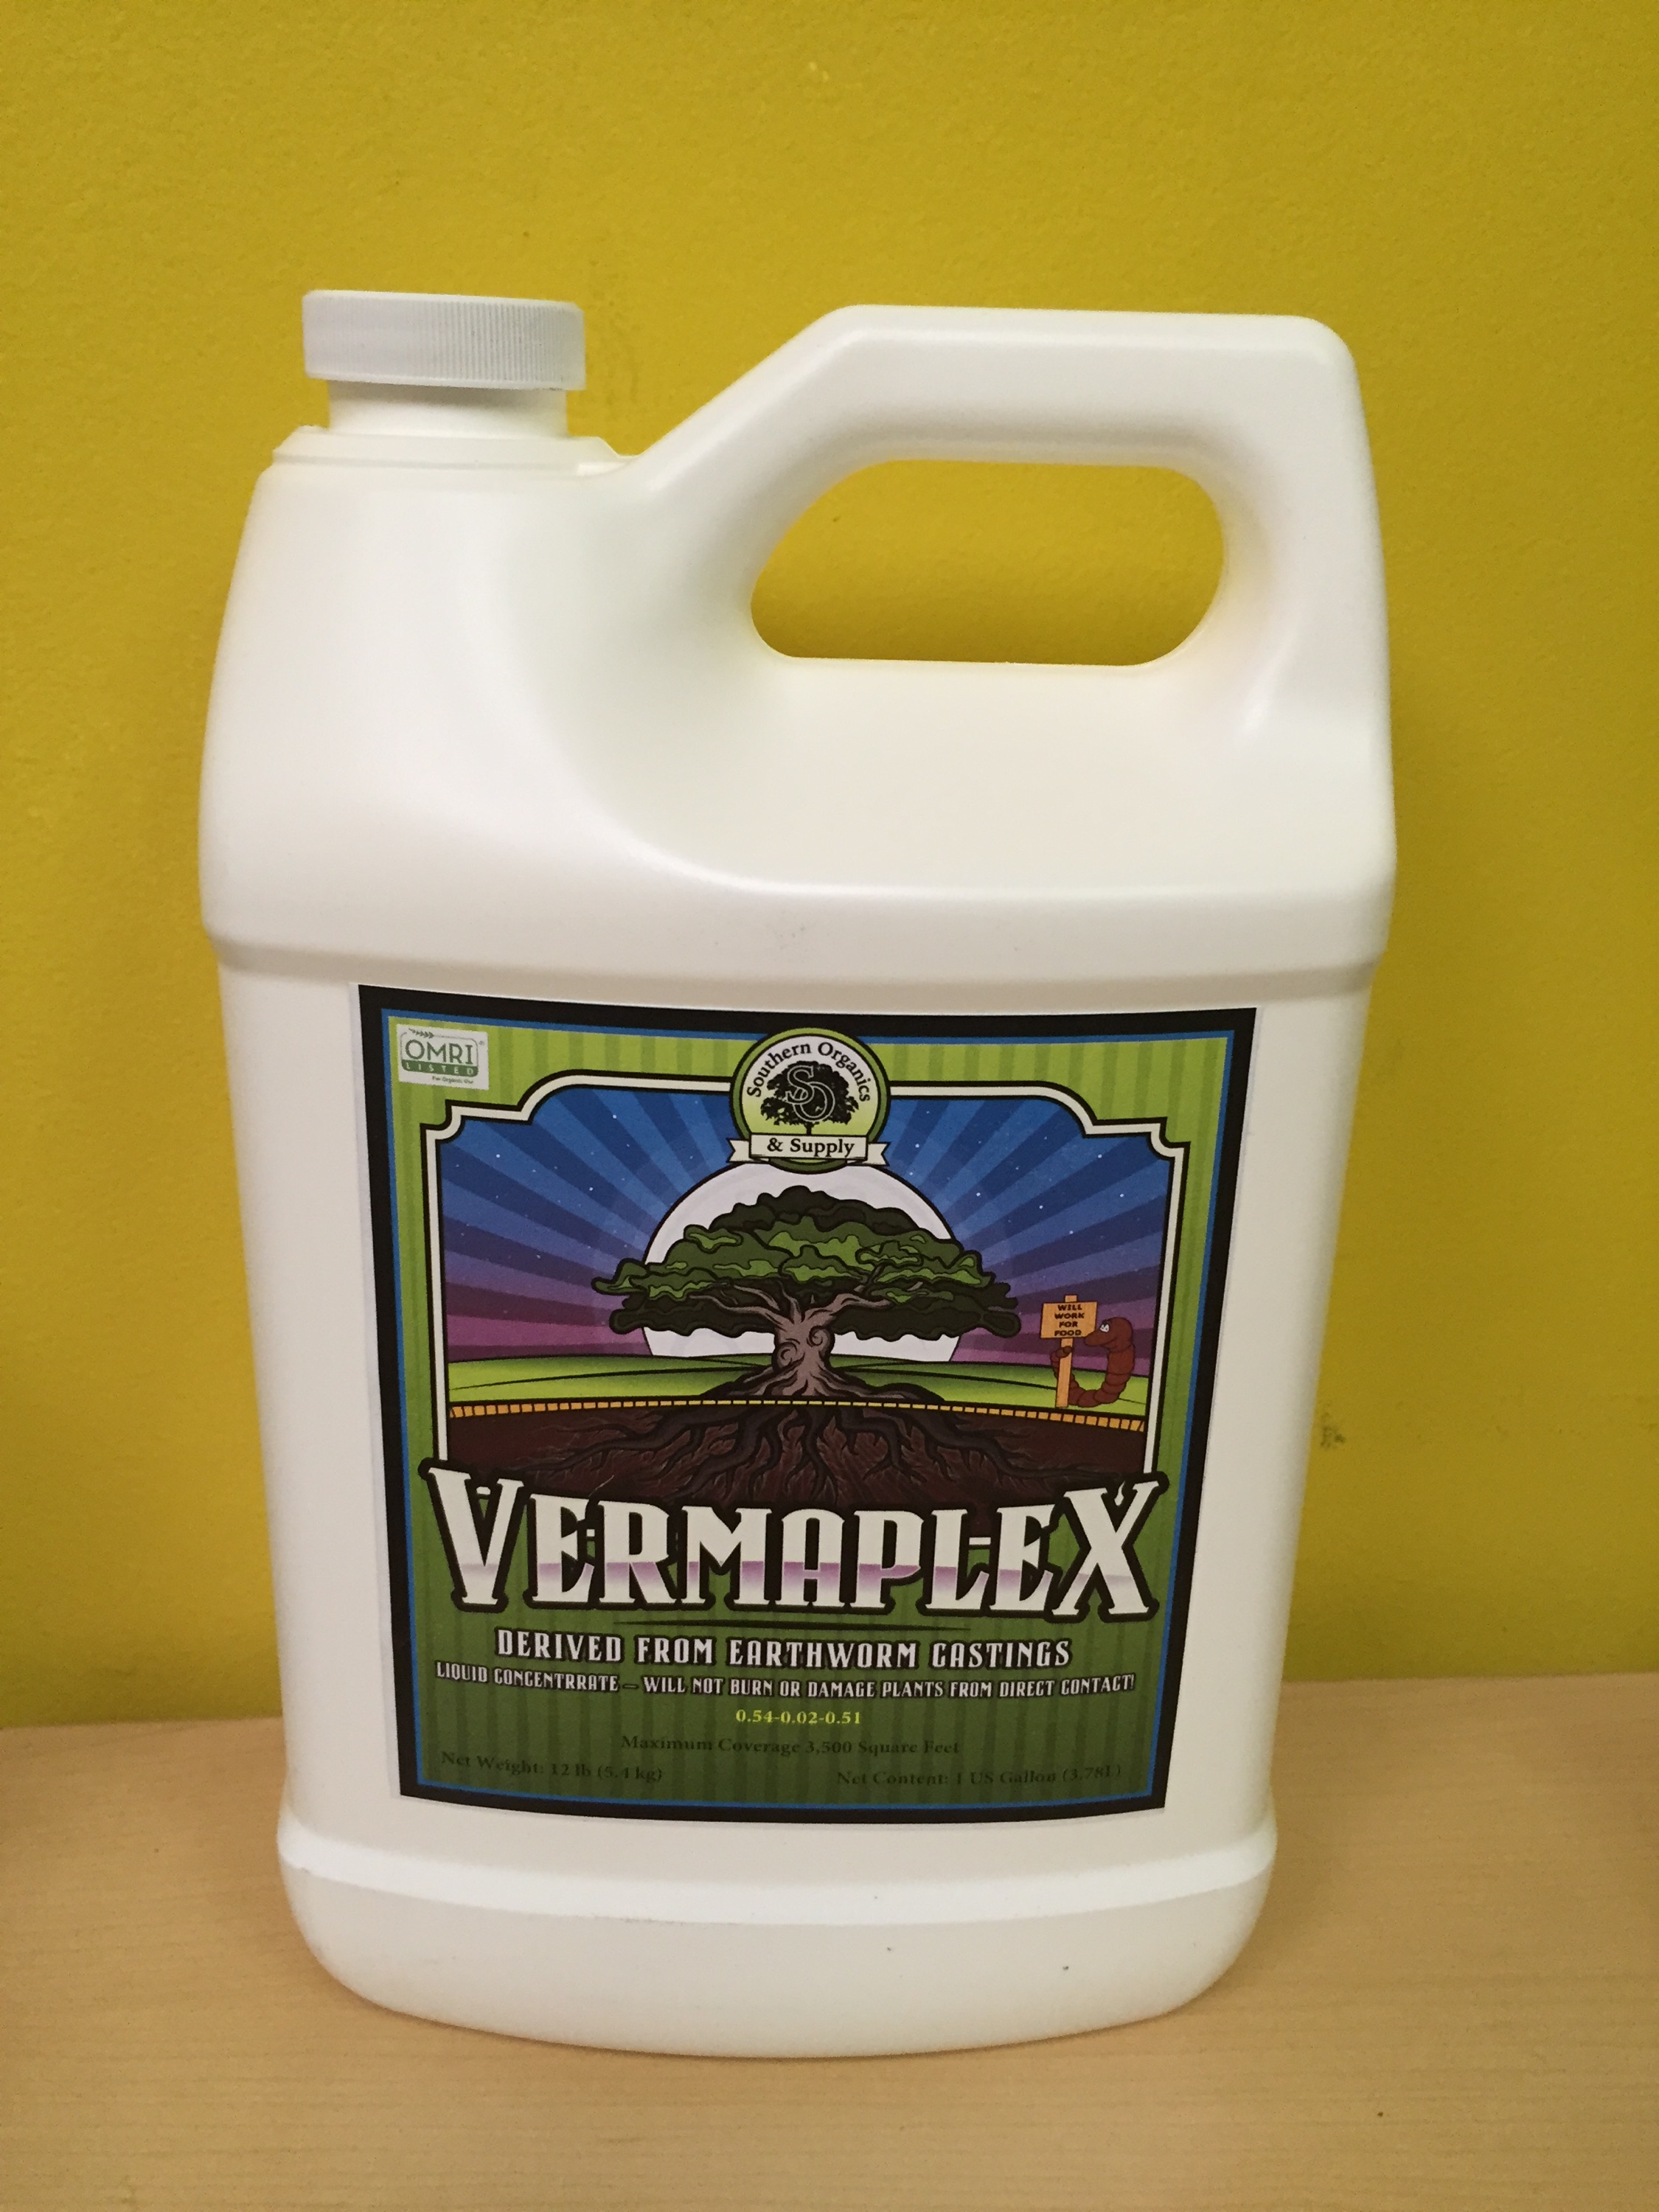
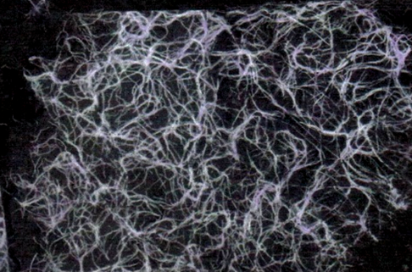
A root mass after treatment with VermaPlex® and Black Castings™. Hairy roots are a sign of healthy plants and, just as important, healthy soil
New label design!

