Slide 1
what is data?
“A datum is a single measurement of something on a scale that is understandable to both the recorder and the reader. Data is multiple such measurements.”
Provocative claim: everything is (can be) data!
5

Slide 2
identify the objective of the analysis
The objective of data analysis is to extract meaningful insights from the data that can inform decision-making and support problem-solving. The specific objective will depend on the problem or question that is being addressed, as well as the type of data that is being analyzed.
Some examples of objectives of data analysis include:
Exploratory data analysis: The objective is to get a general understanding of the data by summarizing key features and identifying patterns, outliers, and relationships among variables.
Predictive modeling: The objective is to build a model that can make predictions about future events or outcomes based on the historical data.

Slide 3
Cont…
Classification: The objective is to develop a model that can classify or group data into different categories based on specific characteristics.
Clustering: The objective is to identify and group similar data points based on their characteristics.
Anomaly detection: The objective is to identify unusual or abnormal data points that deviate from the expected pattern.
Sentiment analysis: The objective is to determine the overall emotion or opinion expressed in a piece of text, such as customer reviews or social media posts.

Slide 4
Cont…
Market research: The objective is to understand customer preferences, trends, and behavior, to inform product development, marketing strategies and customer support.
Fraud detection: The objective is to identify fraudulent activities by analyzing patterns and anomalies in financial transactions.
It is important that the objectives of the analysis are clearly defined before starting, in order to ensure that the correct methods and techniques are used, and that the results are meaningful and actionable.

Slide 5
Data Source and where does it come from?
Internal sources: already collected by or is part of the overall data collection of you organization.
For example: business-centric data that is available in the organization data base to record day to day operations; scientiﬁc or experimental data
Existing External Sources: available in ready to read format from an outside source for free or for a fee.
For example: public government databases, stock market data, Yelp reviews
External Sources Requiring Collection Efforts: available from external source but acquisition requires special processing.
For example: data appearing only in print form, or data on websites
6

Slide 6
Source of Data where does it come from?
How to get data generated, published or hosted online:
API (Application Programming Interface): using a prebuilt set of functions developed by a company to access their services. Often pay to use.
For example: Google Map API, Facebook API, Twitter API
RSS (Rich Site Summary): summarizes frequently updated online content in standard format. Free to read if the site has one.
For example: news-related sites, blogs
Web scraping: using software, scripts or by-hand extracting data from what is displayed on a page or what is contained in the HTML ﬁle.
6

Slide 7
web scraping
Why do it? Older government or smaller news sites might not have APIs for accessing data, or publish RSS feeds or have databases for download. You don’t want to pay to use the API or the database.
How do you it? See HW0
Should you do it?
⇒ You just want to explore: Are you violating their terms of service?
Privacy concerns for website and their clients?
⇒ You want to publish your analysis or product: Do they have an API or fee that you’re bypassing? Are they willing to share this data? Are you violating their terms of service? Are there privacy concerns?
7

Slide 8
what does it Look Like?
What kind of values are in your data (data types)?
Simple or atomic:
Numeric: integers, ﬂoats
Boolean: binary or true false values
Strings: sequence of symbols
8

Slide 9
what does it Look Like?
What kind of values are in your data (data types)?
Compound, composed of a bunch of atomic types:
Date and time: compound value with a speciﬁc structure
Lists: a list is a sequence of values
Dictionaries: A dictionary is a collection of key-value pairs, a pair of values x : y where x is usually a string called key representing the “name” of the value, and y is a value of any type.
Example: Student record
First: Weiwei
Last: Pan
Classes: [CS109A, STAT121A, AC209A]
8

Slide 10
what does it Look Like?
How is your data represented and stored (data format)?
Tabular Data: a dataset that is a two-dimensional table, where each row typically represents a single data record, and each column represents one type of measurement (csv, tsp, xlsx etc.).
Structured Data: each data record is presented in a form of a, possibly complex and multi-tiered, dictionary ( json, xml etc.)
Semistructured Data: not all records are represented by the same set of keys or some data records are not represented using the key-value pair structure.
8

Slide 11
Type of Data - what does it Look Like?
How is your data represented and stored (data format)?
Textual Data
Temporal Data
Geolocation Data
8

Slide 12
define the volume of data to be imported
The volume of data to be imported for analysis will depend on the specific problem that is being addressed and the resources available to process and store the data. Some factors that can influence the volume of data to be imported include:
The complexity of the problem: More complex problems may require more data to generate meaningful insights.
The availability of data: Some problems may have more or less data available depending on the domain or industry.
The storage and processing capacity: The amount of data that can be imported is limited by the storage and processing capacity of the system being used.
The time frame of the analysis: A longer time frame may require more data to be imported to ensure that the analysis is representative.

Slide 13
Cont.. define the volume of data to be imported
The specific data analysis techniques to be used: Some techniques require more data than others to produce accurate results.
The quantity of data that is sufficient to achieve the objective of the analysis.
A general rule of thumb is that more data is better, but it is also important to consider the cost and feasibility of collecting and processing large amounts of data. In many cases, a representative sample of the data can be used instead of the entire dataset.
Big Data refers to a large volume of data that exceeds the storage and processing capacity of traditional systems, and it requires specialized tools and techniques to handle and analyze.

Slide 14
define the key variables to be imported
The key variables to be imported for analysis will depend on the specific problem and type of data being analyzed. Identifying the key variables is an important step in data analysis as it helps to focus the analysis on the most important aspects of the data, and ensure that the results are meaningful and actionable.
The key variables can be determined by:
Understanding the problem and the research question.
Reviewing the data dictionary and existing documentation.
Exploring the data to identify patterns and relationships among variables.
Identifying the variables that are most likely to be associated with the outcome or target variable of interest.

Slide 15
examples of key variables for different types of data analysis
Here are some examples of key variables for different types of data analysis:
Exploratory data analysis: The key variables will depend on the problem, but they may include demographic information such as age, gender, income, and purchase history.
Predictive modeling: The key variables will depend on the problem, but they may include historical weather data such as temperature, precipitation, and wind speed, as well as other meteorological data.
Classification: The key variables will depend on the problem, but they may include image data, such as pixels and color channels, as well as other metadata, such as image labels.
Clustering: The key variables will depend on the problem, but they may include demographic information such as age, gender, income, and purchase history.

Slide 16
identify suitable sources for the data
Identifying suitable sources for data is an important step in data analysis as it helps to ensure that the data is reliable, accurate, and relevant to the problem at hand. The sources of data will depend on the specific problem and type of data being analyzed. Here are some examples of sources for different types of data:
Exploratory data analysis: Data can be obtained from various internal sources, such as company databases, CRM systems, and web analytics tools. External sources may include public data, such as Census data, or data from industry associations or research firms.
Predictive modeling: Data can be obtained from various internal sources, such as company databases, weather stations, and sensor data, as well as external sources such as government weather agencies, and private weather companies.

Slide 17
Cont ..identify suitable sources for the data
Classification: Data can be obtained from various internal sources, such as company databases, and external sources such as open-source datasets, such as the COCO dataset, or the ImageNet dataset.
Clustering: Data can be obtained from various internal sources, such as company databases, and external sources such as open-source datasets, such as the UCI Machine Learning Repository.
Anomaly detection: Data can be obtained from various internal sources, such as company databases, or external sources such as government financial transaction databases.
Sentiment analysis: Data can be obtained from various internal sources, such as company databases, and external sources such as social media platforms, such as Twitter, or customer review

Slide 18
Cont…
Anomaly detection: The key variables will depend on the problem, but they may include financial transaction data such as transaction amounts, merchants, and dates.
Sentiment analysis: The key variables will depend on the problem, but they may include text data, such as reviews or posts, and sentiment labels.
Market research: The key variables will depend on the problem, but they may include demographic information such as age, gender, income, and product preferences.
Fraud detection: The key variables will depend on the problem, but they may include financial transaction data such as transaction amounts, merchants, and dates, as well as other data such as IP addresses and device fingerprints.
It's important to note that the key variables will be different for each problem, but they should be the one that will

Slide 19
perform operations to acquire the data and store it in datasets or data frames
There are various ways to acquire data and store it in datasets or data frames depending on the source and format of the data. Here are some general steps and techniques that can be used to acquire data and store it in datasets or data frames:
Identify the source of the data: Determine where the data is located, whether it's in a database, spreadsheet, text file, or on a website.
Connect to the data source: Use a library or tool that is appropriate for the data source, such as SQL for databases, pandas for spreadsheets, or BeautifulSoup for web scraping.
Extract the data: Use the appropriate command or method to extract the data from the source, such as SQL queries for databases, pandas read_csv() for spreadsheets, or requests.get() for web scraping.
Clean and preprocess the data: Perform operations to clean and preprocess the data, such as removing duplicates, missing values, and outliers, and converting data types and formats.

Slide 20
Cont..
Store the data: Store the data in a dataset or data frame, such as a pandas DataFrame, which can be used for further analysis and modeling.
Save the data: Save the data in a format that is appropriate for the analysis and modeling tools, such as CSV, JSON, or SQLite, so that it can be easily loaded and used in the future.
Here are some examples of how to acquire data and store it in datasets or data frames:

Slide 21
Cont..
t's important to note that the specific commands and libraries will depend on the source and format of the data. And also, it's important to keep in mind that the data should be sanitized before usage to ensure that it's reliable

Slide 22
populate metadata for the imported data
Metadata is data that describes other data. To populate metadata for imported data, you would need to gather information about the data, such as its source, format, date of creation, and any other relevant information. This information can be added to the imported data as metadata fields. The method for populating metadata will depend on the specific data and the system or software being used to manage it. For example, if the data is in a database, you may need to add the metadata fields to the database schema, and then add the data to those fields as you import it. If the data is in a file format, such as a CSV or Excel file, you may need to add the metadata to a separate file or as an additional sheet within the same file.

Slide 23
example how to populate metadata for the imported data
Here is an example of how to populate metadata for imported data using Python:
First, import the necessary libraries, such as pandas for reading and manipulating the data, and os for working with the file system:
Next, read the data into a pandas DataFrame using the pd.read_csv() function:
Then create a dictionary containing the metadata fields and their values:

Slide 24
Cont.. example how to populate metadata for the imported data
Add the metadata dictionary as a new attribute of the DataFrame:
Finally, save the DataFrame with the metadata to a new file:
Note : This is just an example, you can use different libraries or different way of storing the metadata, you can also use different methods to import the data, and the metadata fields can be different depending on your data and what information you need to keep track of.

Slide 25
validate imported data using appropriate tools & processes
To validate imported data, you can use a variety of tools and processes depending on the format and structure of the data. Some common methods include:
Data profiling: This involves analyzing the data to identify patterns, outliers, missing values, and other characteristics that may indicate errors or inconsistencies.
Data validation rules: These are pre-defined rules that can be used to check the data for correctness, such as checking if a value falls within a certain range or if it is of a certain data type.
Data visualization: This can be used to quickly identify any errors or outliers in the data, such as using a scatter plot to identify duplicate data points.

Slide 26
Cont..
Data reconciliation: This involves comparing the imported data to a known source of truth, such as a previous version of the data or a different dataset, to ensure consistency.
Data quality assessment: This is a more comprehensive approach that involves measuring the overall quality of the data and can include a combination of the above methods.
Data Cleansing: This process is used to remove or correct any errors or inconsistencies in the data, such as removing duplicate data points or filling in missing values.
It's important to keep in mind that data validation is an iterative process that may require multiple rounds of testing and correction.

Slide 27
example how to validate imported data using appropriate tools & processes
One example of how to validate imported data using appropriate tools and processes is as follows:
Data profiling: Use a tool such as Trifacta or Talend to analyze the data and identify any patterns, outliers, missing values, and other characteristics that may indicate errors or inconsistencies.
Data validation rules: Use a tool such as Microsoft Excel or Google Sheets to create a set of validation rules that can be used to check the data for correctness. For example, you may want to check if a date falls within a certain range or if a numerical value is within a certain range.
Data visualization: Use a tool such as Tableau or Power BI to create visualizations of the data, such as a scatter plot or histogram, to quickly identify any errors or outliers in the data.

Slide 28
example how to validate imported data using appropriate tools & processes
Data reconciliation: Compare the imported data to a known source of truth, such as a previous version of the data or a different dataset, to ensure consistency. This can be done using a tool such as Alteryx or Informatica.
Data quality assessment: Use a tool such as Trillium or Data Quality Center to measure the overall quality of the data and identify any areas that need improvement.
Data Cleansing: Use a tool such as Talend or DataStage to remove or correct any errors or inconsistencies in the data, such as removing duplicate data points or filling in missing values.
It is important to note that the choice of tools will depend on the format and structure of the data, as well as the specific needs of the organization. It's also important to keep in mind that data validation is an iterative process that may require multiple rounds of testing and correction.

Slide 29
example of how to validate imported data using Python and the Pandas library:
This is a very simple example and in real-world scenario, you would have to handle missing values, data type, data format and also add more validation rules.
Please keep in mind that this is just an example and should be adapted to your specific use case.
Continued next page

Slide 30
Cont..

Slide 31
more on tabuLar data
In tabular data, we expect each record or observation to represent a set of measurements of a single object or event.
Hight | Radius | Do I Like It?
Cylinder # 1 10 | 5 | Yes
Cylinder # 2 3 | 7.5 | No
Each type of measurement is called a variable or an attribute of the data (e.g. Height, Radius and “Do I Like It?” are variables or attributes). The number of attributes is called the dimension of the data.
We expect each table to contain a set of records or observations of the same kind of object or event (e.g. our table above contains observations of cylinders).
9

Slide 32
more on tabuLar data
You’ll see later that it’s important to distinguish between classes of variables or attributes based on the type of values they can take on.
Quantitative variable: is numerical and can be
⇒ discrete - a ﬁnite number of values are possible in any bounded interval
For example: “Number of siblings” is a discrete variable
⇒ continuous - an inﬁnite number of values are possible in any bounded interval
For example: “Height” is a continuous variable
Categorical variable: no inherent order among the values
For example: “What kind of pet you have” is a categorical variable
9

Slide 33
is the data any good?
Common issues with data:
Missing values: how do we ﬁll in?
Wrong values: how can we detect and correct?
Messy format
Not usable: the data cannot answer the question posed

Slide 34
handLing messy data
The following is a table accounting for produce deliveries over a weekend.
What are the variables in this dataset? What object or event are we measuring?
Friday Saturday | Sunday
Morning 15 158 | 10
Afternoon 2 90 | 20
Evening 55 12 | 45
11

Slide 35
handLing messy data
We’re measuring individual deliveries; the variables are Time, Day, Number of Produce.
 | Friday | Saturday | Sunday
Morning | 15 | 158 | 10
Afternoon | 2 | 90 | 20
Evening | 55 | 12 | 45
Problem: each column header represents a single value rather than a variable. Row headers are “hiding” the Day variable. The values of the variable, “Number of Produce”, is not recorded in a single column.
11

Slide 36
handLing messy data
Delivery | Time | Day | No. of Produce
1 | Morning | Friday | 15
2 | Morning | Saturday | 158
3 | Morning | Sunday | 10
4 | Afternoon | Friday | 2
5 | Afternoon | Saturday | 90
6 | Afternoon | Sunday | 20
7 | Evening | Friday | 55
8 | Evening | Saturday | 12
9 | Evening | Sunday | 45
We need to reorganize the information to make explicit the event we’re observing and the variables associated to this event.
11

Slide 37
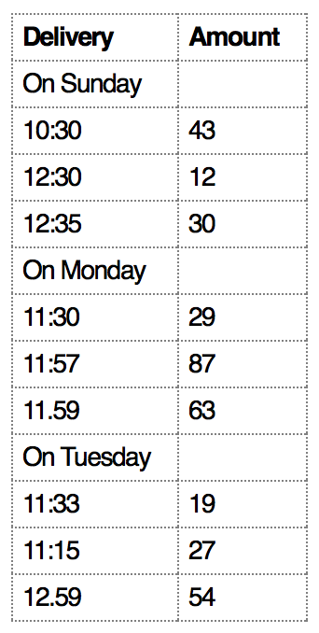
handLing messy data
What object or event are we measuring?
What are the variables in this dataset?
11

Slide 38
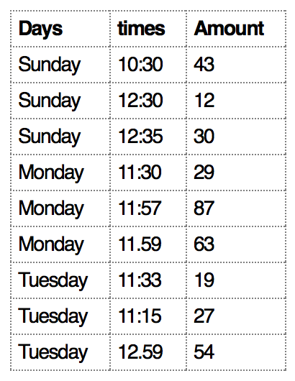
handLing messy data
We’re measuring individual deliveries; the variables are Time, Day, Number of Produce:
11

Slide 39
handLing messy data
Common causes of messiness are:
Column headers are values, not variable names
Variables are stored in both rows and columns
Multiple variables are stored in one column
Multiple types of experimental units stored in same table
In general, we want each ﬁle to correspond to a dataset, each column to represent a single variable and each row to represent a single observation.
11

Slide 40
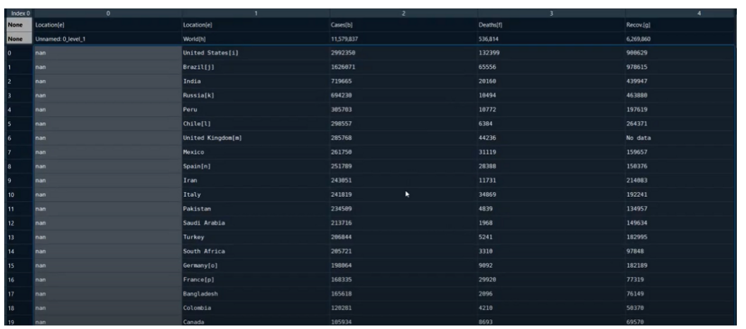
Data Importing and Acquiring lab hands-on
Python Libraries: pandas, requests
Editor: jupyter notebook
Extracting the data

Slide 41
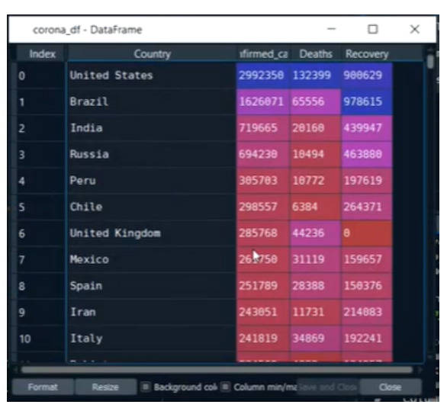
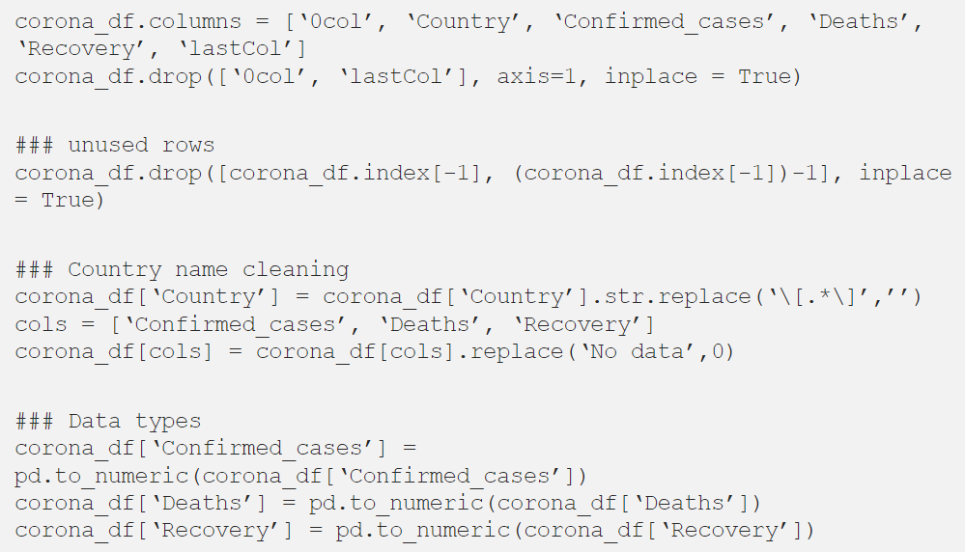
Data Importing and Acquiring lab hands-on
Cleaning the data

Slide 42
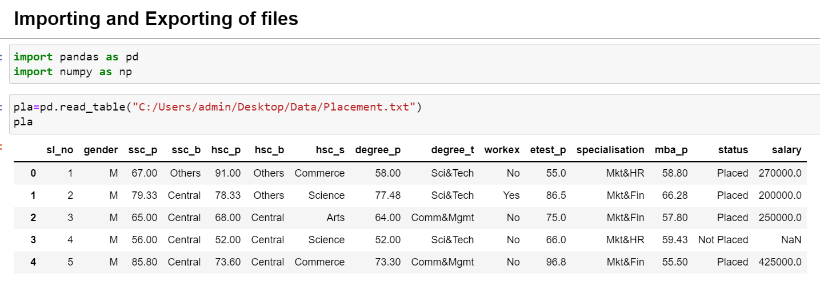
Data Importing and Acquiring lab hands-on
Importing the already present data

Slide 43
Data Importing and Acquiring lab hands-on
Importing the already present data

Slide 44
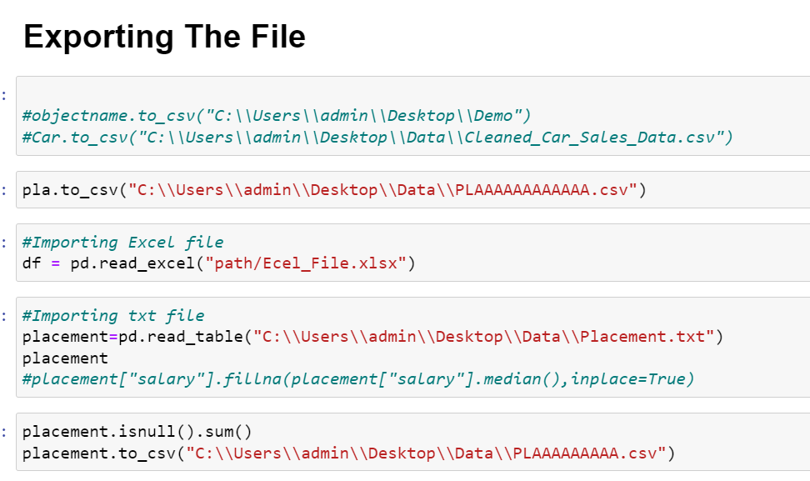
Data Importing and Acquiring lab hands-on

Slide 45
Lab Assignment
Acquire the Tuberculosis and world population date from the links given below.
Clean it and present in a readable format.
Tuberculosis: http://api.worldbank.org/v2/en/indicator/SH.TBS.INCD?downloadformat=excel%27
World population: http://api.worldbank.org/v2/en/indicator/SP.POP.TOTL?downloadformat=excel%27

Slide 46
Exploratory data analysis (EDA)
Exploratory data analysis (EDA) is the process of examining and summarizing the main characteristics of a data set in order to understand its structure, patterns, and relationships.
EDA is an important step in data analysis as it helps to identify any issues or outliers in the data, and to gain insights into the underlying distribution and relationships of the variables.
When analyzing demographic information such as age, gender, income, and purchase history, the following steps can be taken:
Load the data: Import the data into a pandas DataFrame and take a look at the first few rows to understand the structure and format of the data.
Check for missing values: Use the isnull() function or the sum() function to check for any missing values in the data.
Check for outliers: Use box plots and histograms to check for any outliers in the data.
Summarize the data: Use the describe() function to get a summary of the main characteristics of the data, such as mean, median, standard deviation, and quartiles.

Slide 47
Cont…
Visualize the data: Use plots such as bar charts, histograms, and scatter plots to visualize the distribution and relationships of the variables.
Identify patterns: Look for patterns and trends in the data by grouping and aggregating the data.

Slide 48
Example to perform EDA
Here's an example of how to perform EDA on a sample dataset containing demographic information such as age, gender, income, and purchase history:
It's important to note that the specific commands and functions will depend on the structure and format of the data, and the specific questions and insights that you are trying to gain. Also, it's important to keep in mind that the data should be sanitized before usage to ensure that it's reliable and accurate.

Slide 49
Importing and Acquiring data

