Slide 1
Model evaluation
M6 covers Module 6
Quantum Learnings Microsoft Global Training Partner mentorrbuddy.com

Slide 2
Model evaluation
Model evaluation is the process of assessing the performance of a machine learning model on a given dataset. This can be done using metrics such as accuracy, precision, recall, and F1 score.
Feature engineering is the process of transforming raw data into features that can be used to train a machine learning model. This includes techniques such as feature scaling, one-hot encoding, and feature selection. Feature engineering is an important step in the machine learning pipeline as it can greatly impact the performance of the model.

Slide 3
example model evaluation Feature Engineering
An example of model evaluation and feature engineering would be in building a machine learning model to predict housing prices. The dataset used would contain information such as the number of bedrooms, square footage, and the neighborhood the house is located in.
In the feature engineering step, you would first analyze the dataset and determine which features are relevant to the problem at hand. For example, you might decide to create new features by calculating the ratio of bedrooms to square footage or by one-hot encoding the neighborhood feature.

Slide 4
Cont.. example model evaluation Feature Engineering
Next, you would use these engineered features to train a machine learning model, such as a linear regression model. Once the model is trained, you would evaluate its performance on a separate test dataset using metrics such as mean absolute error and R-squared. This would give you an idea of how well the model is able to predict housing prices based on the engineered features.
You might also try different feature engineering techniques and compare the performance of the model with different set of features to determine which set of features work best for the model.

Slide 6
Cont..

Slide 7
Cont..
In this code example, we first load a housing dataset into a Pandas DataFrame, then perform some feature engineering by creating a new feature called 'bed_bath_ratio' which is calculated by dividing the number of bedrooms by the number of bathrooms, and one-hot encoding the 'neighborhood' feature.
We then split the data into training and test sets using scikit-learn's train_test_split function. Next, we train a linear regression model on the training data and make predictions on the test set.
Finally, we evaluate the performance of the model using the mean absolute error and R-squared metrics, which are calculated using scikit-learn's mean_absolute_error and r2_score functions.
It is important to note that this is just a sample code and it can be improved with more data and more complex feature engineering and model optimization techniques.

Slide 8
model selection
Model selection is the process of choosing the best machine learning model for a given problem based on its performance on a specific dataset. This is an important step in the machine learning pipeline as different models have different strengths and weaknesses, and choosing the right model can greatly impact the performance of the final solution.
There are several ways to select a model:
Trial and error: This involves trying out several different models and comparing their performance on the dataset. This is a simple and intuitive approach, but it can be time-consuming and may not always lead to the best model.
Model selection with cross-validation: This method involves splitting the dataset into training and validation sets, training multiple models on the training set, and selecting the model with the best performance on the validation set.

Slide 9
Cont..
Model selection with hyperparameter tuning: This method involves training multiple models with different combinations of hyperparameters, and selecting the model with the best performance on the validation set.
Ensemble methods : This methods involve training multiple models and combining their predictions to make the final prediction. This can improve the performance of the model.
It's important to keep in mind that the process of model selection should always be done with a specific dataset and problem in mind, and the chosen model should be validated on a separate test set to ensure it generalizes well to unseen data.

Slide 10
Model selection Example
Model selection refers to the process of choosing the best model from a set of candidate models for a given task or dataset. The selection is typically based on a performance metric, such as accuracy or mean squared error.
For example, imagine you have a dataset of customer data, including their age, income, and whether they purchased a product. You want to build a model that predicts whether a customer will purchase a product based on their age and income.
You could train several different models, such as a decision tree, a random forest, and a support vector machine, and compare their performance using a performance metric, such as accuracy. The model with the highest accuracy would be selected as the best model for the task.

Slide 11
example of model selection in Python using the scikit-learn library:

Slide 12
Cont..

Slide 13
Cont…
This code defines three models: a decision tree, a random forest, and a support vector machine. It trains each model on the training data and evaluates them on the test data using the accuracy metric. The results are stored in a dictionary, where the key is the name of the model and the value is the accuracy. The code then finds the best model by looking for the highest accuracy in the dictionary and prints the name of the model and its accuracy.
Please note that it's important to split your data into train and test sets, because if you evaluate your model on the same data that you used to train it, you'll likely have an over-optimistic estimate of the model's performance, and it will not generalize well to new unseen data.

Slide 14
Model Evaluation Metrics
There are several commonly used metrics for evaluating the performance of machine learning models, such as:
Accuracy: The proportion of correct predictions made by the model
Precision: The proportion of true positive predictions among all positive predictions made by the model
Recall: The proportion of true positive predictions among all actual positive cases
F1 Score: The harmonic mean of precision and recall
ROC AUC: The area under the receiver operating characteristic curve
Log Loss: The logarithm of the likelihood of the true labels given the predicted probabilities
Mean Absolute Error (MAE): The average absolute difference between the true values and the predicted values

Slide 15
Cont..
Root Mean Squared Error (RMSE): The square root of the average of the squared differences between the true values and the predicted values.
Which metric to use depends on the problem and the type of model you are using

Slide 16
example of Model Evaluation Metrics
For example, let's say you have built a binary classification model to predict whether a customer will churn (leave) or not. You have a dataset of 1000 customers, where 100 of them have churned. You use this dataset to train your model and then use it to make predictions on a test set of another 500 customers.
Accuracy: The model correctly predicted that 80 out of the 100 churning customers will churn and 420 out of the 400 non-churning customers will not churn, so the accuracy of the model is (80 + 420) / 500 = 0.8.
Precision: The model predicted that 90 customers will churn, out of which 80 actually churned, so the precision is 80 / 90 = 0.89.
2*(0.89*0.8)/(0.89+0.8) = 0.84

Slide 17
Cont..
Recall: The model predicted that 90 customers will churn, out of the 100 that actually churned, so the recall is 80 / 100 = 0.8.
F1 Score: The harmonic mean of precision and recall is
ROC AUC: The area under the ROC curve is a metric that compares the true positive rate to the false positive rate at different classification thresholds. This can be useful when there is a class imbalance in the data.
Log Loss: Log loss is used to evaluate the performance of a model where the predicted output is a probability value between 0 and 1.

Slide 18
Cont..
Mean Absolute Error (MAE): The mean absolute error of the model is the average of the absolute differences between the true values and the predicted values.
Root Mean Squared Error (RMSE): The root mean squared error of the model is the square root of the average of the squared differences between the true values and the predicted values.
Note: The values are hypothetical and just given as an example, the actual performance of model will depend on many factors including the dataset, feature engineering, model architecture, etc.

Slide 19
Sample code

Slide 20
Sample code cont..

Slide 21
Sample code cont..
It's important to keep in mind that the choice of evaluation metrics depends on the problem and the type of model you are using. It's always a good idea to use multiple evaluation metrics to get a comprehensive understanding of the performance of your model.

Slide 22
TODAY’S TOPICS
• Model Evaluation Metrics
• Bias Variance Trade-off
• Model Selection
• Model Evaluation
Quantum Learnings Microsoft Global Training Partner mentorrbuddy.com

Slide 23
MODEL EVALUATION METRICS
Classification Accuracy
RMSE
ROC
AUC
Confusion Matrix
Precision
Recall
F1 Score
Quantum Learnings Microsoft Global Training Partner mentorrbuddy.com

Slide 24
CLASSIFICATION ACCURACY
• Classification accuracy is the number of correct predictions made as a ratio of all
predictions made.
• This is the most common evaluation metric for classification problems.
• It is really only suitable when there are an equal number of observations in each class (which is rarely the case) and that all predictions and prediction errors are equally important, which is often not the case.
Quantum Learnings Microsoft Global Training Partner mentorrbuddy.com

Slide 25
MSE & RMSE
• The Mean Squared Error (or MSE) is much like the mean absolute error in that it
provides a gross idea of the magnitude of error.
• Taking the square root of the mean squared error converts the units back to the original units of the output variable and can be meaningful for description and presentation.This is called the Root Mean Squared Error (or RMSE).
• Formulae for RMSE: sqrt((xi - x)2)
Quantum Learnings Microsoft Global Training Partner mentorrbuddy.com

Slide 26
CONFUSION MATRIX
• The confusion matrix is a handy presentation of the accuracy of a model with two or
more classes.
• The table presents predictions on the x-axis and accuracy outcomes on the y-axis.The
cells of the table are the number of predictions made by a machine learning algorithm.
• For example, a machine learning algorithm can predict 0 or 1 and each prediction may actually have been a 0 or 1. Predictions for 0 that were actually 0 appear in the cell for prediction=0 and actual=0, whereas predictions for 0 that were actually 1 appear in the cell for prediction = 0 and actual=1.And so on.
Quantum Learnings Microsoft Global Training Partner mentorrbuddy.com

Slide 27
CONFUSION MATRIX EXAMPLE
Quantum Learnings Microsoft Global Training Partner mentorrbuddy.com

Slide 28
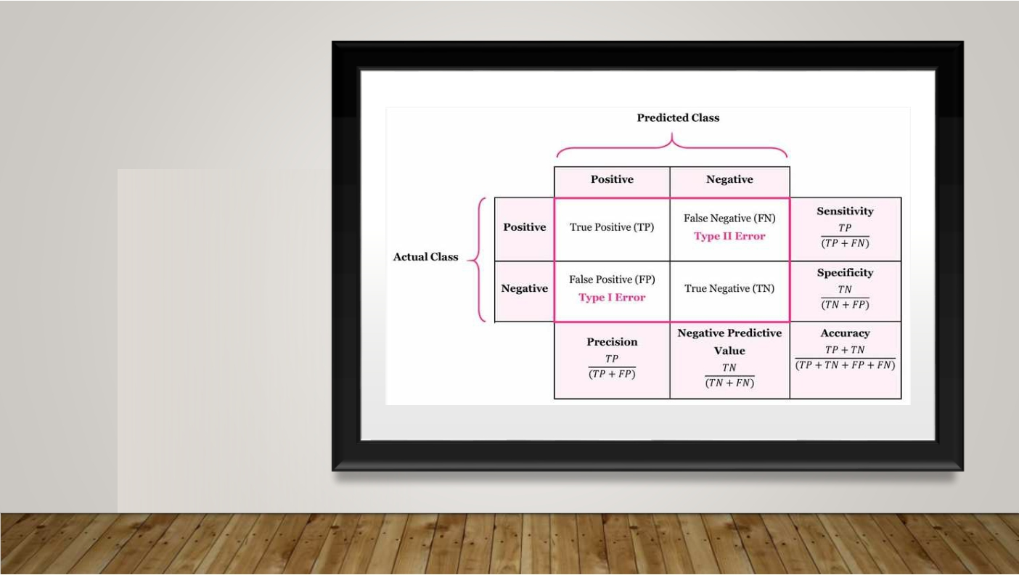
MATRIX
 | CONFUSION TERMINOLOGIES
Quantum Learnings Microsoft Global Training Partner mentorrbuddy.com

Slide 29
WHAT DO EACH TERM MEAN IN CONFUSION MATRIX ?
• True Positive (TP) is the number of correct predictions that an example is positive which
means positive class correctly identified as positive.
• False Negative (FN) is the number of incorrect predictions that an example is negative which
means positive class incorrectly identified as negative.
• False positive (FP) is the number of incorrect predictions that an example is positive which
means negative class incorrectly identified as positive.
• True Negative (TN) is the number of correct predictions that an example is negative which
means negative class correctly identified as negative.
Quantum Learnings Microsoft Global Training Partner mentorrbuddy.com

Slide 30
PRECISION
• Precision is ratio of total number of correctly classified positive examples and the total number of predicted positive examples. It shows correctness achieved in positive prediction.
• Precision = 0.843 means, when our model predicts that a patient has heart disease, it is
correct around 84% of the time.
Quantum Learnings Microsoft Global Training Partner mentorrbuddy.com

Slide 31
RECALL
• The recall is the measure of our model correctly identifying True Positives.
• Thus, for all the patients who actually have heart disease, recall tells us how many we
correctly identified as having a heart disease.
• Recall = 0.86 tells us that out of the total patients who have heart disease 86% have
been correctly identified.
• Formulae : (True Positives / (True Positives + False Negatives))
Quantum Learnings Microsoft Global Training Partner mentorrbuddy.com

Slide 32
F1 SCORE
• F1-Score provides a way to combine both precision and recall into a single measure that
captures both properties.
• Alone, neither precision or recall tells the whole story.We can have excellent precision with terrible recall, or alternately, terrible precision with excellent recall. F1-Score provides a way to express both concerns with a single score.
• Once precision and recall have been calculated for a binary or multiclass classification
problem, the two scores can be combined into the calculation of the F-Measure.
• F1-Score = (2 * Precision * Recall) / (Precision + Recall)
• This is the harmonic mean of the two fractions.This is sometimes called the F-Score or the F-
Measure and might be the most common metric used on imbalanced classification problems.
Quantum Learnings Microsoft Global Training Partner mentorrbuddy.com

Slide 33
ROC & AUC
• AUC - ROC curve is a performance measurement for the classification problems at
various threshold settings.
• ROC is a probability curve and AUC represents the degree or measure of separability.
• It tells how much the model is capable of distinguishing between classes.
• Higher the AUC, the better the model is at predicting 0s as 0s and 1s as 1s. By analogy, the Higher the AUC, the better the model is at distinguishing between patients with the disease and no disease.
Quantum Learnings Microsoft Global Training Partner mentorrbuddy.com

Slide 34
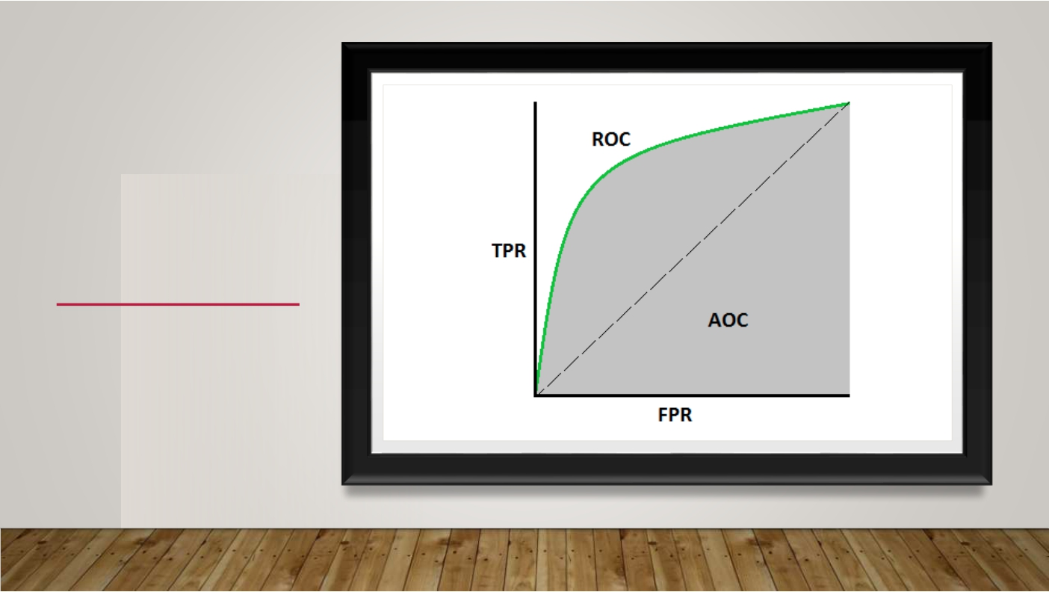
ROC & AUC
Quantum Learnings Microsoft Global Training Partner mentorrbuddy.com

Slide 35
TRUE POSITIVE RATE
Quantum Learnings Microsoft Global Training Partner mentorrbuddy.com

Slide 36
SPECIFICITY
Quantum Learnings Microsoft Global Training Partner mentorrbuddy.com

Slide 37
FALSE POSITIVE RATE
Quantum Learnings Microsoft Global Training Partner mentorrbuddy.com

Slide 38
HOW TO SPECULATE ABOUT THE PERFORMANCE OF THE MODEL?
• An excellent model has AUC near to the 1 which means it has a good measure of
separability.
• A poor model has AUC near to the 0 which means it has the worst measure of separability. In fact, it means it is reciprocating the result. It is predicting 0s as 1s and 1s as 0s.
• When AUC is 0.5, it means the model has no class separation capacity whatsoever.
Quantum Learnings Microsoft Global Training Partner mentorrbuddy.com

Slide 39
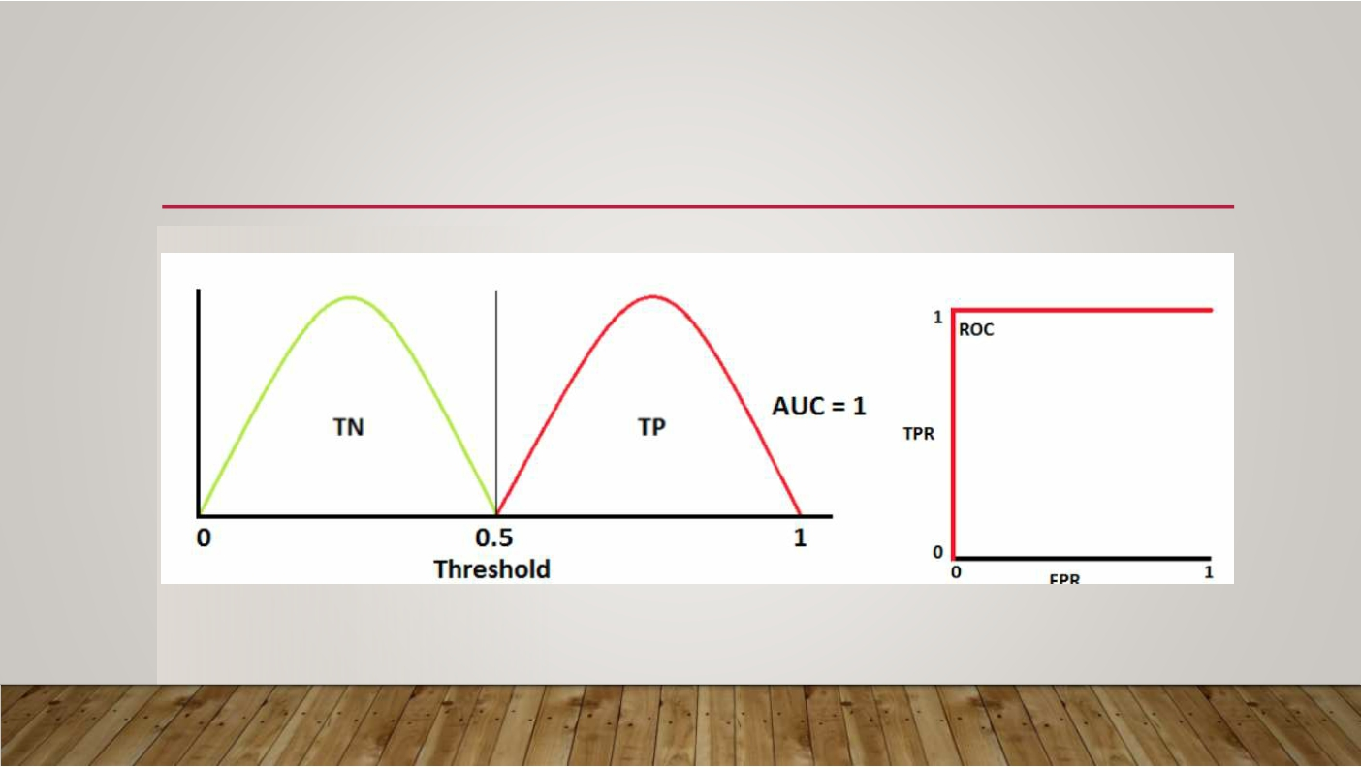
IDEAL CASE EXAMPLE:
Quantum Learnings Microsoft Global Training Partner mentorrbuddy.com

Slide 40
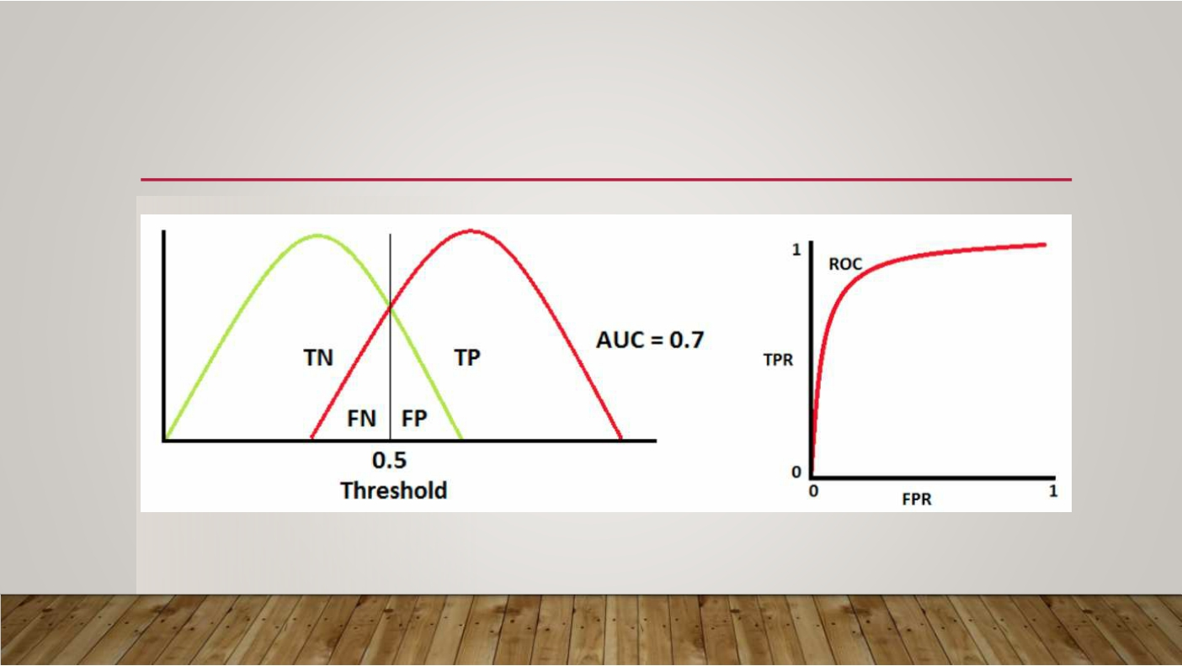
REAL WORLD EXAMPLE:
Quantum Learnings Microsoft Global Training Partner mentorrbuddy.com

Slide 41
WORST EXAMPLE:
Quantum Learnings Microsoft Global Training Partner mentorrbuddy.com

Slide 42
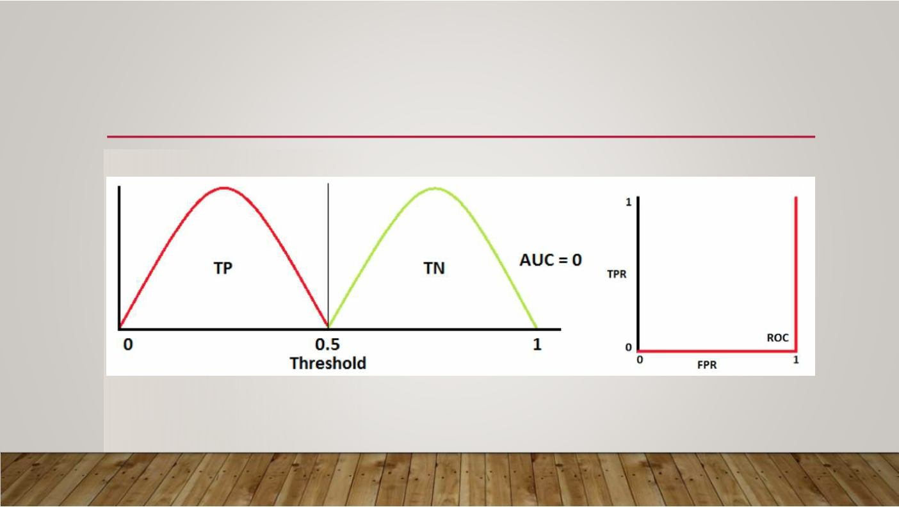
RECIPROCATING EXAMPLE:
Quantum Learnings Microsoft Global Training Partner mentorrbuddy.com

Slide 43
INTERPRETING EXAMPLES
• Red distribution curve is of the positive class (patients with disease) and the green distribution curve is
of the negative class(patients with no disease).
• This is an ideal situation.When two curves don’t overlap at all means model has an ideal measure of
separability. It is perfectly able to distinguish between positive class and negative class.
• When two distributions overlap, we introduce type 1 and type 2 errors. Depending upon the threshold, we can minimize or maximize them.When AUC is 0.7, it means there is a 70% chance that the model will be able to distinguish between positive class and negative class.
• This is the worst situation.When AUC is approximately 0.5, the model has no discrimination capacity to
distinguish between positive class and negative class.
• When AUC is approximately 0, the model is actually reciprocating the classes. It means the model is
predicting a negative class as a positive class and vice versa.
Quantum Learnings Microsoft Global Training Partner mentorrbuddy.com

Slide 44
OVERFITTING (1/2)
• Overfitting refers to a model that models the training data too well.
• Overfitting happens when a model learns the detail and noise in the training data to the
extent that it negatively impacts the performance of the model on new data.
• This means that the noise or random fluctuations in the training data is picked up and
learned as concepts by the model.
• The problem is that these concepts do not apply to new data and negatively impact the
models ability to generalize.
Quantum Learnings Microsoft Global Training Partner mentorrbuddy.com

Slide 45
OVERFITTING (2/2)
• Overfitting is more likely with nonparametric and nonlinear models that have more
flexibility when learning a target function.
• As such, many nonparametric machine learning algorithms also include parameters or
techniques to limit and constrain how much detail the model learns.
• For example, decision trees are a nonparametric machine learning algorithm that is very flexible and is subject to overfitting training data.This problem can be addressed by pruning a tree after it has learned in order to remove some of the detail it has picked up.
Quantum Learnings Microsoft Global Training Partner mentorrbuddy.com

Slide 46
BIAS
• Bias is used for making the learning of the target function of any model easier.
• This is done by making simplifying assumptions.
• These simplifying assumptions are termed bias. It is basically the difference between the model’s average prediction and the actual correct value which is being attempted to be predicted by us.
Quantum Learnings Microsoft Global Training Partner mentorrbuddy.com

Slide 47
VARIANCE
• Variance is the amount which indicates the variability of any model prediction in such a
case.
• The estimated target function here is got by the machine learning algorithm’s training data.The machine learning algorithm will have a high value of variance in its model which changes as per the training data obtained.
• The specifics of this training data influence the parameters which are used for the
characterization of target or mapping function.
• When the changes in the training dataset suggest a small change in the estimate of the target function, there is a low variance.When the changes in the training dataset suggest a large change in the estimate of the target function, there is high variance.
Quantum Learnings Microsoft Global Training Partner mentorrbuddy.com

Slide 48
BIAS TRADE GRAPH | -
 | VARIANCE OFF
Quantum Learnings Microsoft Global Training Partner mentorrbuddy.com

Slide 49
BIAS VARIANCE TRADE OFF CONCEPT
• Bias-variance tradeoff forms an essential entity of machine and statistical learning.All the
learning algorithms involve a significant measure of error.
• These errors can be reducible and non-reducible.We cannot do anything about non- reducible errors.The reducible errors which are the bias and variance can be made use off.
• These reducible errors can be effectively minimized and the efficiency of a working
system can be maximized.
• The main goal of a learning algorithm is to reduce these bias and variance errors to the
minimum and make the most feasible model.
Quantum Learnings Microsoft Global Training Partner mentorrbuddy.com

Slide 50
MODEL EVALUATION
• Model evaluation aims to estimate the generalization accuracy of a model on future
(unseen/out-of-sample) data.
• Methods for evaluating a model’s performance are divided into 2 categories:
namely, holdout and Cross-validation. Both methods use a test set (i.e data not seen by the model) to evaluate model performance.
• The purpose of holdout evaluation is to test a model on different data than it was trained on.
This provides an unbiased estimate of learning performance.
• Dataset is randomly divided into 3 subsets: training dataset, validation dataset and testing
dataset.
Quantum Learnings Microsoft Global Training Partner mentorrbuddy.com

Slide 51
Model evaluation LAB handson(1/4)
Python libraries – numpy, pandas, scikit-learn, matplotlib
Editor – Jupyter notebook
Dataset – breast_disease_data

Slide 52
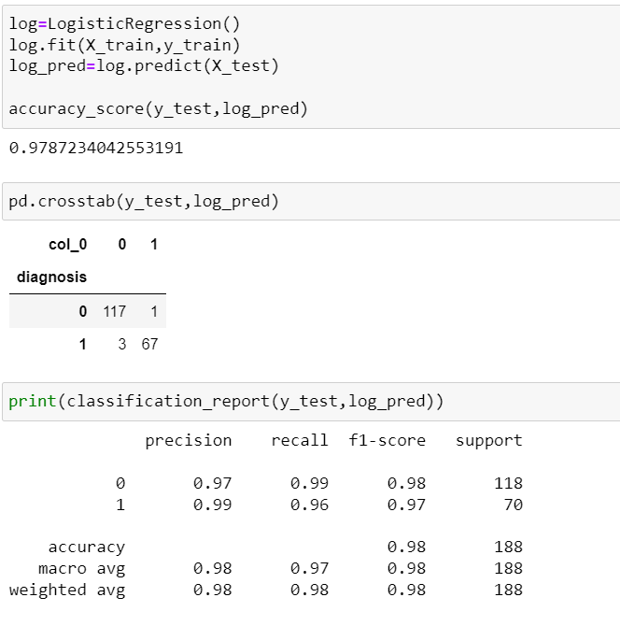
Model evaluation LAB handson(2/4)
Checking accuracy and classification report

Slide 53
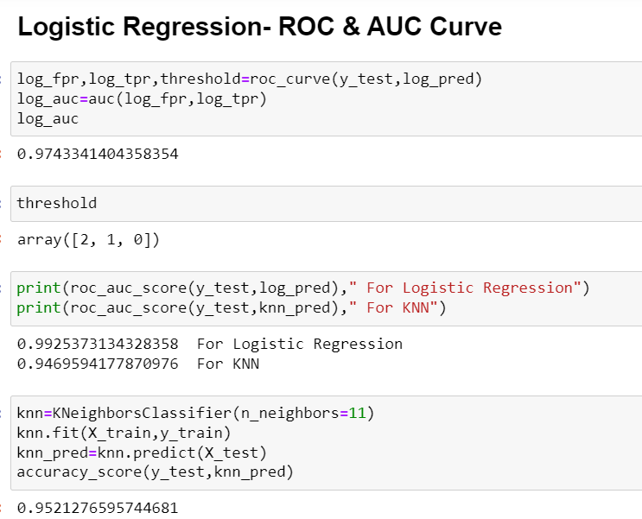
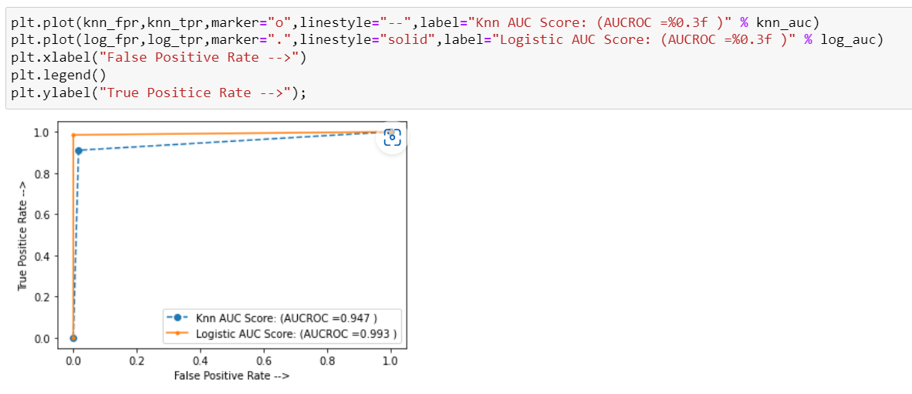
Model evaluation LAB handson(3/4)
Performing ROC and AUC curve

Slide 54
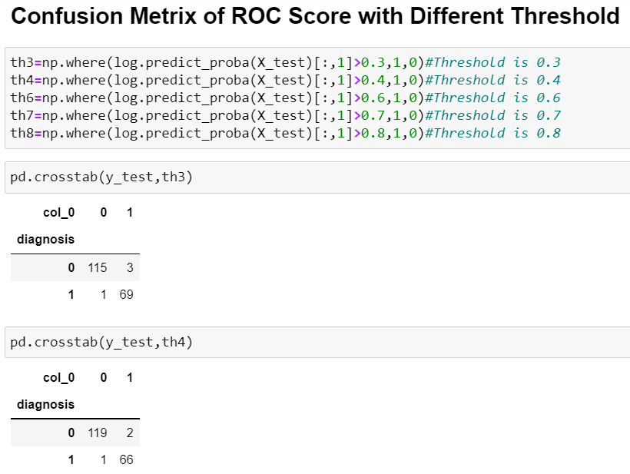
Model evaluation LAB handson(4/4)
Working with confusion matrix

Slide 55
CROSS-VALIDATION
• Cross-validation is a technique that involves partitioning the original observation dataset into a training set, used to train the model, and an independent set used to evaluate the analysis.
• The most common cross-validation technique is k-fold cross-validation, where the original dataset is partitioned into k equal size subsamples, called folds.The k is a user-specified number, usually with 5 or 10 as its preferred value.This is repeated k times, such that each time, one of the k subsets is used as the test set/validation set and the other k-1 subsets are put together to form a training set.The error estimation is averaged over all k trials to get the total effectiveness of our model.
• As can be seen, every data point gets to be in a test set exactly once and gets to be in a training set k-1 times.This significantly reduces bias, as we’re using most of the data for fitting, and it also significantly reduces variance, as most of the data is also being used in the test set. Interchanging the training and test sets also adds to the effectiveness of this method.
Quantum Learnings Microsoft Global Training Partner mentorrbuddy.com

Slide 56
Model Validation LAB handson(1/3)
Python libraries – numpy, pandas, scikit-learn, matplotlib, warnings
Editor – Jupyter notebook
Dataset – Social_Network_Ads.csv
Importing the libraries and dataset

Slide 57
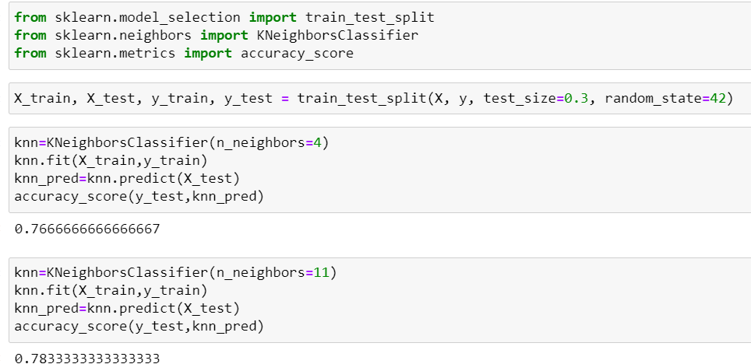
Model Validation LAB handson(2/3)
Training and testing the data

Slide 58
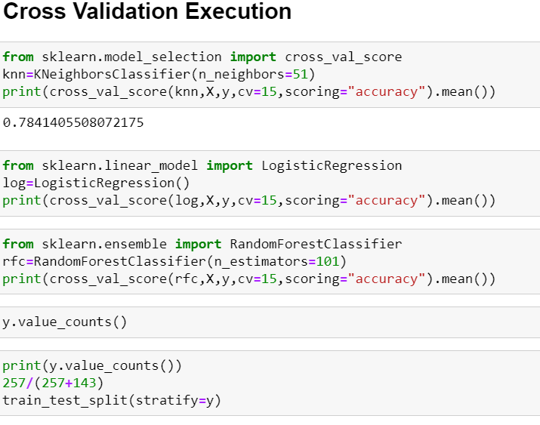
Model Validation LAB handson(3/3)
Performing cross validation

Slide 59
Model evaluation LAB assignment
Calculate the errors, goodness of fit, accuracy, ROC & AUC for the given datasets with different regression and classification techniques.
Datasets: 50_startups.csv, classified.csv

Slide 60
THANK YOU
Quantum Learnings Microsoft Global Training Partner mentorrbuddy.com

