Slide 1
Non Linear Hypothesis & Model Representation
Learning resource

Slide 2
NON Linear Hypothesis

Slide 3
Origins
Algorithms that try to mimic the brain
Was very widely used in the 80s and early 90’s
Popularity diminished in the late 90’s
Recent resurgence
State-of-the-art techniques for many applications
The “one learning algorithm” hypothesis
Auditory cortex handles hearing
Re-wire to learn to see
Somatosensory cortex handles feeling
Re-wire to learn to see
Plug in data and the brain will learn accordingly
Examples of learning

Slide 4
Model Representation -1
Neuron in the brainMany neurons in our brain
Dendrite: receive input
Axon: produce output
When it sends a message through the Axon to another neuron
It sends to another neuron’s Dendrite

Slide 5
Neuron model: logistic unit
Yellow circle: body of neuron
Input wires: dendrites
Output wire: axon

Slide 7
Neural Network3 Layers
1 Layer: input layer
2 Layer: hidden layer
Unable to observe values
Anything other than input or output layer
3 Layer: output layer

Slide 8
We calculate each of the layer-2 activations based on the input values with the bias term (which is equal to 1)
i.e. x0 to x3
We then calculate the final hypothesis (i.e. the single node in layer 3) using exactly the same logic, except in input is not x values, but the activation values from the preceding layer

Slide 9
The activation value on each hidden unit (e.g. a12 ) is equal to the sigmoid function applied to the linear combination of inputs
Three input units
Ɵ(1) is the matrix of parameters governing the mapping of the input units to hidden units
Ɵ(1) here is a [3 x 4] dimensional matrix
Three hidden units
Then Ɵ(2) is the matrix of parameters governing the mapping of the hidden layer to the output layer
Ɵ(2) here is a [1 x 4] dimensional matrix (i.e. a row vector)
Every input/activation goes to every node in following layer
Which means each “layer transition” uses a matrix of parameters with the following significance

Slide 10
j (first of two subscript numbers)= ranges from 1 to the number of units in layer l+1
i (second of two subscript numbers) = ranges from 0 to the number of units in layer l
l is the layer you’re moving FROM

Slide 12
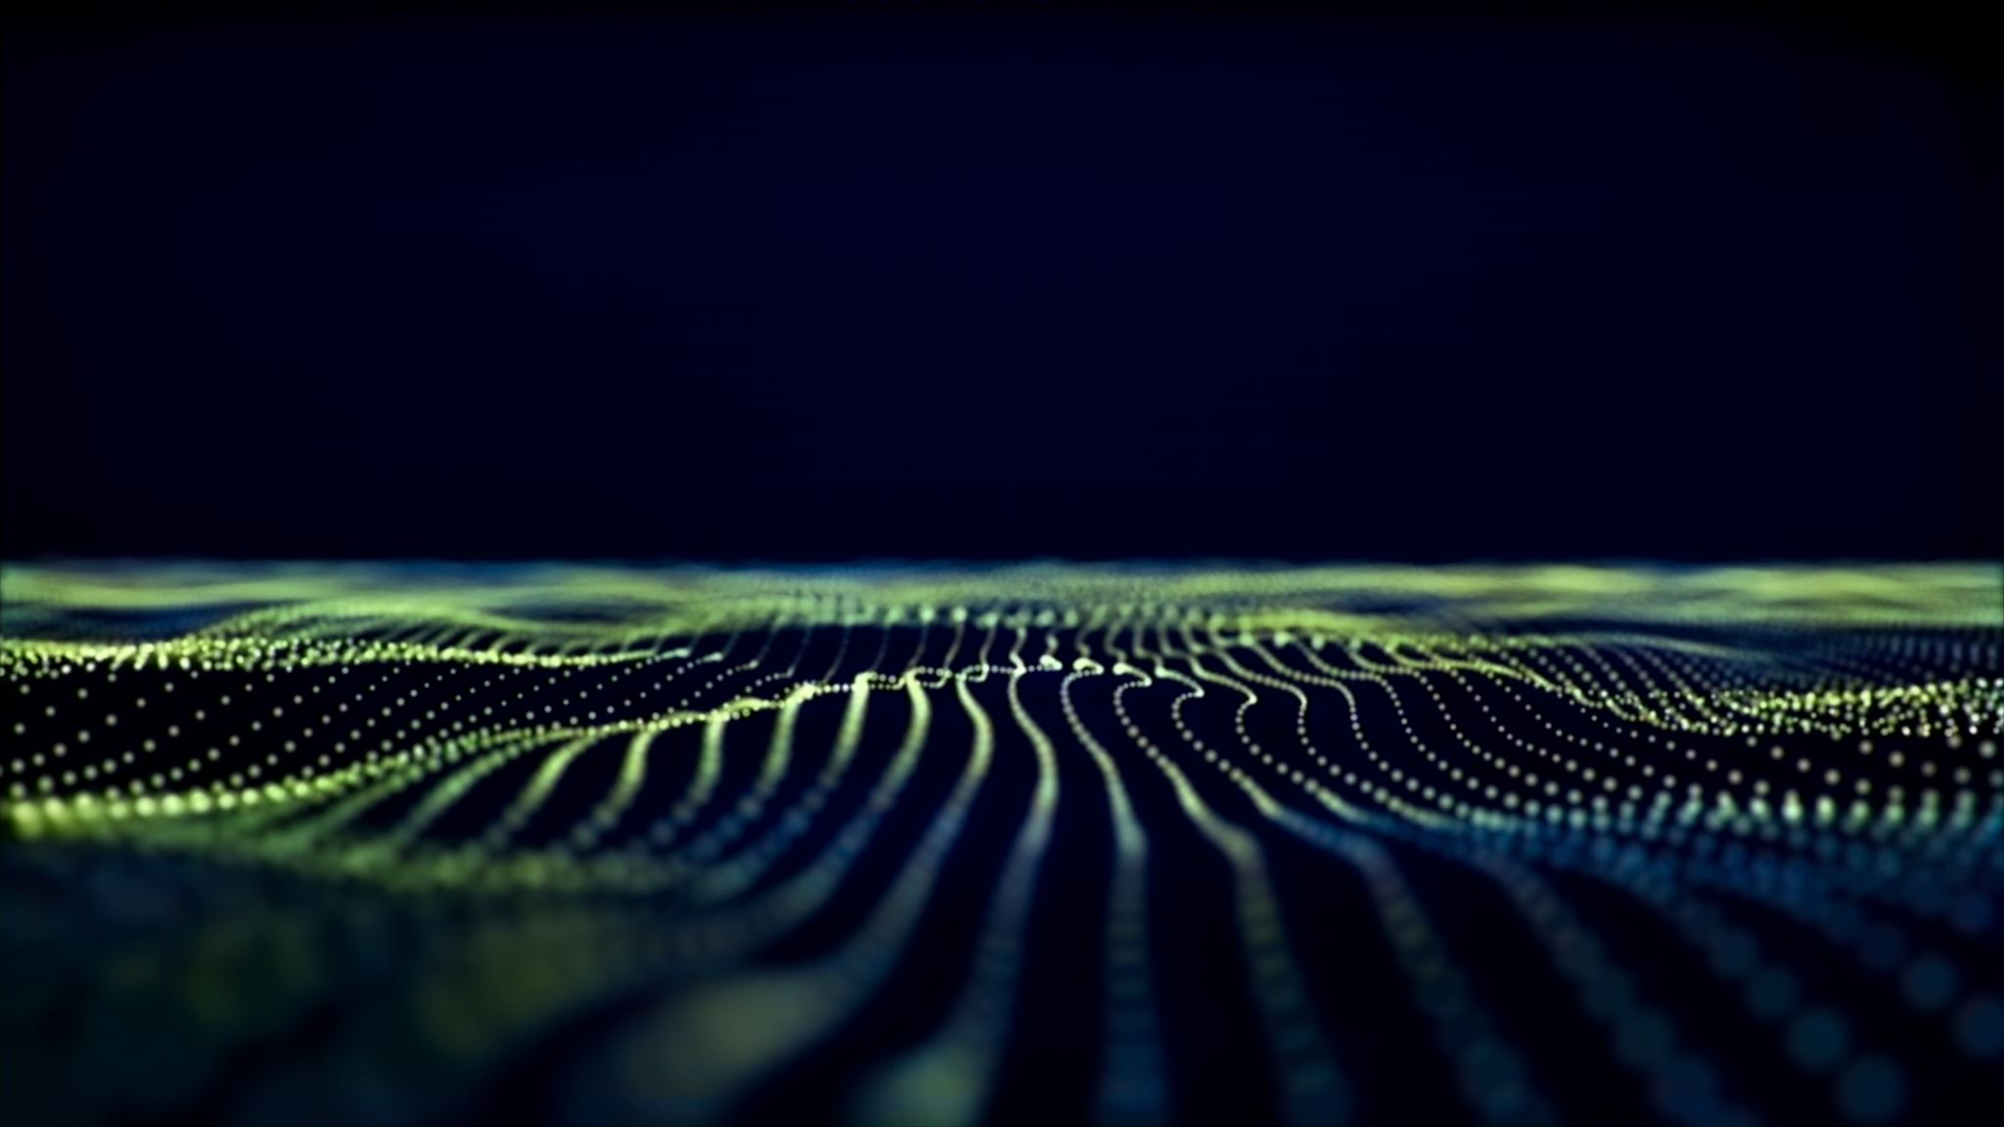
Model Representation II
Here we’ll look at how to carry out the computation efficiently through a vectorized implementation. We’ll also consider why neural networks are good and how we can use them to learn complex non-linear things
Forward propagation: vectorized implementation
g applies sigmoid-function element-wise to z
This process of calculating H(x) is called forward propagation
Worked out from the first layer
Starts off with activations of input unit
Propagate forward and calculate the activation of each layer sequentially

Slide 14
Similar to logistic regression if you leave out the first layer Only second and third layer
Third layer resembles a logistic regression node
The features in layer 2 are calculated/learned, not original features

Slide 15
Neural network, learns its own featuresThe features a’s are learned from x’s
It learns its own features to feed into logistic regression
Better hypothesis than if we were constrained with just x1, x2, x3
We can have whatever features we want to feed to the final logistic regression function
Implementation in Octave for a2
a2 = sigmoid (Theta1 * x);

Slide 17
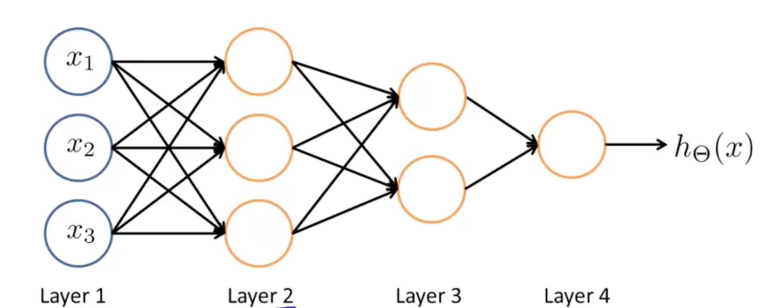
Other network architectures
Layer 2 and 3 are hidden layers

Slide 18
Cost Functions
A cost function in neural networks is a mathematical function that measures the difference between the model's predictions and the actual output (target) for a given input. The cost function is used to guide the training process by providing a measure of how well the model is performing. The goal of training is to minimize the value of the cost function. Common examples of cost functions used in neural networks include mean squared error and cross-entropy.

Slide 19
Example cost function
A common example of a cost function used in neural networks is mean squared error (MSE). MSE is defined as the average of the squared differences between the model's predicted output and the actual target output. Mathematically, it can be represented as:
MSE = (1/N) * Σ(y_pred - y_true)^2
Where y_pred is the model's predicted output, y_true is the actual target output, and N is the number of examples in the dataset.
Another example of a cost function used in neural networks is cross-entropy loss, which is commonly used in classification problems. Cross-entropy loss measures the dissimilarity between the predicted probability distribution and the true distribution. It is defined as:
Cross-entropy loss = - (1/N) * Σ(y_true * log(y_pred) + (1 - y_true) * log(1 - y_pred))
Where y_pred is the model's predicted probability of the target class, y_true is the actual target class and N is the number of examples in the dataset.
There are many other cost function that can be used depend on the problem you are working on.

Slide 20
Back propagation
Backpropagation, also known as backprop, is an algorithm used to train artificial neural networks. It is a method used to calculate the gradients of the loss function with respect to the weights of the network. These gradients are then used to update the weights in the opposite direction of the gradient, so as to minimize the loss function and improve the accuracy of the model.
The Backpropagation algorithm works by propagating the error from the output layer to the input layer, through the hidden layers. The error is propagated backwards through the network, starting from the output layer, and moving towards the input layer. The backpropagation algorithm uses the chain rule of calculus to calculate the gradients of the loss function with respect to the weights of the network.

Slide 21
Back propagation
The backpropagation algorithm consists of two phases: the forward pass and the backward pass. During the forward pass, the inputs are passed through the network, and the predictions are made. During the backward pass, the error is propagated backwards through the network, and the gradients are calculated. The weights are then updated using the gradients, and this process is repeated until the loss function converges.
In summary, Backpropagation is an algorithm used to train artificial neural networks by minimizing the loss function. It works by propagating the error backwards through the network and updating the weights based on the gradients calculated using the chain rule of calculus.

Slide 22
Here's an example of how the backpropagation algorithm might be used to train a simple neural network with one input layer, one hidden layer, and one output layer:
Initialize the weights of the network randomly
Feed the input data through the network and make a prediction
Calculate the error between the predicted output and the target output
Propagate the error backwards through the network, starting from the output layer
In the output layer, calculate the gradients of the error with respect to the weights connecting the output layer to the hidden layer
In the hidden layer, calculate the gradients of the error with respect to the weights connecting the hidden layer to the input layer
Update the weights of the network, using the gradients calculated in step 5 and step 6, and a small learning rate
Repeat steps 2-7 for a number of iterations or until the error is below a certain threshold

Slide 23
Cont…
Note that was example is a simple example of backpropagation. There are other methodologies such as mini-batch gradient descent, stochastic gradient descent, momentum, Adam, etc. that can be used to optimize the weights of the network.
Also, it's important to mention that the above example is a simple one, and in real-world scenarios, the neural network will have more layers and neurons, which will make the process of backpropagation more complex. But the main idea is the same, which is propagating the error backwards through the network and updating the weights based on the gradients calculated.

Slide 24
A common use case for developing a neural network model is image classification. Here's an example of how the process might work:
Collect and preprocess a large dataset of images, each labeled with its corresponding class.
Split the data into training, validation, and test sets.
Design and implement a neural network model that takes an image as input and outputs a probability distribution over the classes. Common architectures used for image classification include convolutional neural networks (CNNs) and residual neural networks (ResNets)
Train the model using the training set and monitor the performance on the validation set to check for overfitting.
Fine-tune the model using techniques like data augmentation, dropout, and regularization.
Evaluate the final model on the test set to measure its performance in terms of metrics such as accuracy and F1 score.
Deploy the model to a production environment, where it can be used to classify new images.

Slide 25
Cont..
This example is a general flow of developing a model for image classification, but it's important to mention that the process can vary based on the problem and the data you are working on. Additionally, there are many hyperparameters that can be tuned such as learning rate, batch size, number of layers, number of neurons, etc. which can affect the performance of the model.

Slide 26
Cost function
A cost function, also known as a loss function, is a mathematical function that is used to evaluate the performance of a neural network. The cost function compares the output of the network to the desired output, and calculates the difference. The goal of training a neural network is to minimize the value of the cost function. Common cost functions used in neural networks include mean squared error and cross-entropy.

Slide 27
Example of cost function
One example of a cost function commonly used in neural networks is mean squared error (MSE). The MSE cost function is defined as the average of the squared differences between the network's predictions and the true values.
Formula: MSE = (1/N) Σ (y_pred - y_true)^2
Where: - N is the number of samples in the dataset. - y_pred is the predicted output of the network. - y_true is the true output.
Another example is cross-entropy loss, often used in supervised multi-class classification problems. The cross-entropy loss is defined as the negative log likelihood of the true class.
Formula: H(y) = -Σ y_true * log(y_pred)
Where: - y_pred is the predicted output of the network, which is a probability distribution over the classes - y_true is the true class - H(y) is the cross-entropy loss.
These are just examples of cost functions that can be used. There are many other cost functions that can be used depending on the specific problem and the type of neural network being used.

Slide 28
Backward propogation
Backpropagation, also known as "backprop," is an algorithm used to train neural networks. It is used to calculate the gradients of the cost function with respect to the weights and biases of the network. These gradients are used to update the weights and biases in the opposite direction of the gradient, with the goal of minimizing the cost function. The process is called "backpropagation" because the gradients are propagated backward through the network, from the output layer to the input layer.
The backpropagation algorithm consists of two main steps:
Forward propagation: In this step, the input is passed through the network and the output is calculated. The error is then calculated by comparing the output to the desired output.

Slide 29
Backward propagation. Cont..
Backward propagation: In this step, the error is propagated backwards through the network, starting from the output layer. At each layer, the gradients of the weights and biases are calculated, with respect to the error. These gradients are then used to update the weights and biases of the network in order to minimize the error.
Backpropagation is widely used for training neural networks because it allows for efficient and accurate calculation of gradients, which is essential for the optimization process.

Slide 30
Example backpropagation algorithm
Here is an example of how the backpropagation algorithm works for a simple neural network with one hidden layer:
Input data is passed through the network, and the output is calculated. Let's say the input data is [1, 2] and the desired output is [0, 1].
The error is calculated by comparing the output to the desired output. Using mean squared error as the cost function, the error would be (0-0)^2 + (0.8-1)^2 = 0.04
Backpropagation starts by calculating the gradient of the cost function with respect to the output of the final layer. In this case, the gradient would be 2*(0.8-1) = -0.4

Slide 31
backpropagation algorithm Cont…
The gradient is then propagated backwards through the network, starting with the final layer. The gradient is multiplied by the derivative of the activation function to obtain the gradient with respect to the weights and biases of the final layer.
Next, the gradient is calculated for the hidden layer. This is done by multiplying the gradient of the final layer with the transpose of the weights between the hidden and final layers. The gradient is then multiplied by the derivative of the activation function to obtain the gradient with respect to the weights and biases of the hidden layer.
Finally, the weights and biases are updated using the gradients. Using a common optimization technique like gradient descent, the weights and biases are updated in the opposite direction of the gradients, with a step size determined by the learning rate.
This is an example of how backpropagation works, it's important to note that in practice the neural networks are more complex and backpropagation can be done with many layers and different types of activation functions, also the optimization algorithm used can be different from gradient descent.

Slide 32
Use case for neural networks in model development
A use case for neural networks in model development could involve image classification. The goal would be to train a neural network to recognize and classify different objects within an image.
Collect and prepare the training data: This would involve gathering a large dataset of images, along with labels indicating what objects are present in each image. The images would need to be resized and pre-processed to ensure they are in a format that can be used by the neural network.
Define the architecture of the network: A convolutional neural network (CNN) would be a suitable architecture for this task as it is well-suited for image classification. The architecture would include several layers of convolutional and pooling layers, followed by fully connected layers.

Slide 33
Cont…
Initialize the weights and biases: The weights and biases of the network would be randomly initialized.
Train the network: The training process would involve passing the images through the network, calculating the output, and then using the backpropagation algorithm to update the weights and biases in order to minimize the cost function. The training process would be repeated multiple times with different subsets of the data (batch or epochs) until the cost function converges to an acceptable level.
Test the network: After the network has been trained, it would be tested using a separate dataset that was not used in the training process. The performance of the network would be evaluated based on the accuracy of the object classifications.
Fine-tune the network: If the network does not perform well on the test data, various techniques such as regularization, early stopping, and different architectures can be tried to improve the performance of the network.
Deployment: Once the network has been fine-tuned, and it reaches the desired level of accuracy, it would be deployed in a production environment to automatically classify objects within images.
This example illustrates how neural networks can be used to develop models that can perform complex tasks such as image classification, neural networks are widely used in other areas like natural language processing, speech recognition and generation, among others.

Slide 34
Use Case –Project- train a neural network to recognize and classify different objects within an image
Here is an example of how you could train a neural network to recognize and classify different objects within an image:
Collect and prepare the training data:
Gather a large dataset of images of different objects, such as cars, dogs, and bicycles.
Label each image with the corresponding object class (e.g. car, dog, bicycle).
Pre-process the images by resizing them to a consistent size and normalizing their pixel values.

Slide 35
Cont…. Define the architecture of the network:
Define the architecture of the network:
Use a convolutional neural network (CNN) as the architecture, which is well-suited for image classification tasks.
The architecture could include several layers of convolutional and pooling layers, followed by fully connected layers.
Initialize the weights and biases:
Initialize the weights and biases of the network with small random values.

Slide 36
Cont ..Train the network:
Train the network:
Split the data into training and validation sets.
Pass the training images through the network, calculate the output, and use the backpropagation algorithm to update the weights and biases in order to minimize the cost function (e.g. cross-entropy).
Repeat this process for several epochs, each time using a different subset of the training data (batch).
Monitor the performance of the network on the validation set during the training, to ensure that the network is not overfitting.

Slide 37
Test the network:
Test the network:
After the network has been trained, test it using a separate test dataset that was not used in the training process.
Evaluate the performance of the network based on its accuracy in classifying the objects within the test images.

Slide 38
Data Set for training a neural network to recognize and classify different objects within an image
A sample dataset to train a neural network to recognize and classify different objects within an image could include the following:
A collection of images of cars, with labels indicating that they are cars.
A collection of images of dogs, with labels indicating that they are dogs.
A collection of images of bicycles, with labels indicating that they are bicycles.
Each category should have a considerable amount of images, ideally thousands, to ensure that the network can learn to generalize well on new unseen data.
The images could be taken from different angles and lighting conditions to increase the diversity of the dataset.
Ideally, the dataset should also be balanced, meaning that it should have roughly the same number of images for each class, to avoid the network to be biased towards certain classes
There are public datasets available for image classification, such as CIFAR-10, CIFAR-100, ImageNet, etc. These datasets have thousands of images already labeled and pre-processed, making them a good option to start experimenting with neural networks.

