Slide 1


BA FOOTBALL 2022
JAN 2022 PLAYER MEETING

Slide 2
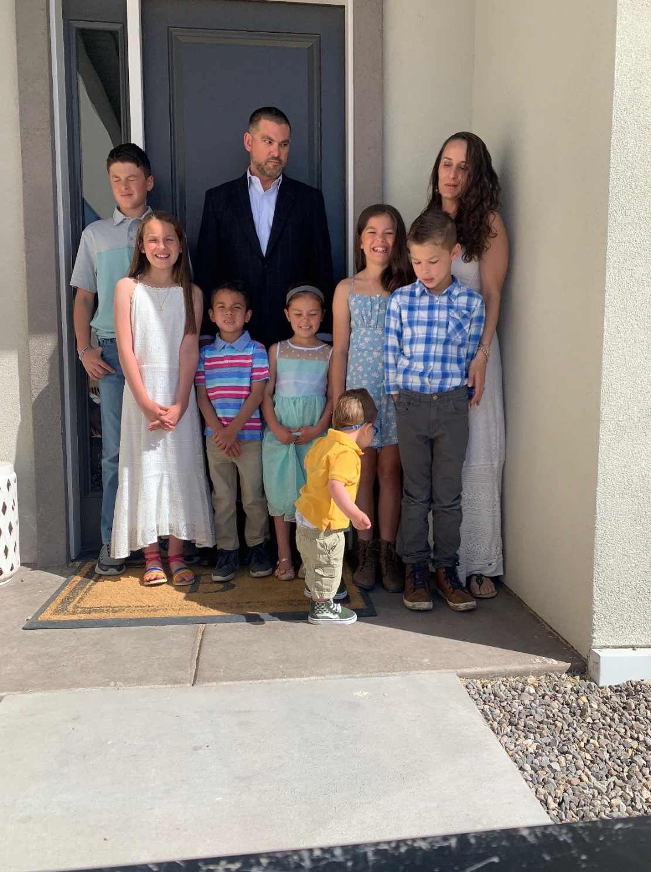

Slide 3
Who I am?
My Faith
My Family
My Purpose

Slide 4
Philosophy and Plan?
Every Day – Every Way
  Develop/Mentor Men
  Staff with shared values
  Relational Approach
  Create Culture
  Model/Demand Excellence
Winning and Championships will be a byproduct

Slide 5
Schedule/Calendar
Weeks until Spring Break
  Minimal time
Weekly Routine
  4 day lift program, 1 day competition—5 day week… Wednesdays earliest finished
  All players finish between 4:00-4:15
    Voluntary work after
    Multi-sport
Post-Spring Break
  More “Football” emphasis
  Spring Prep
  Spring Ball
  Summer
Ideal Vacation dates

Slide 6
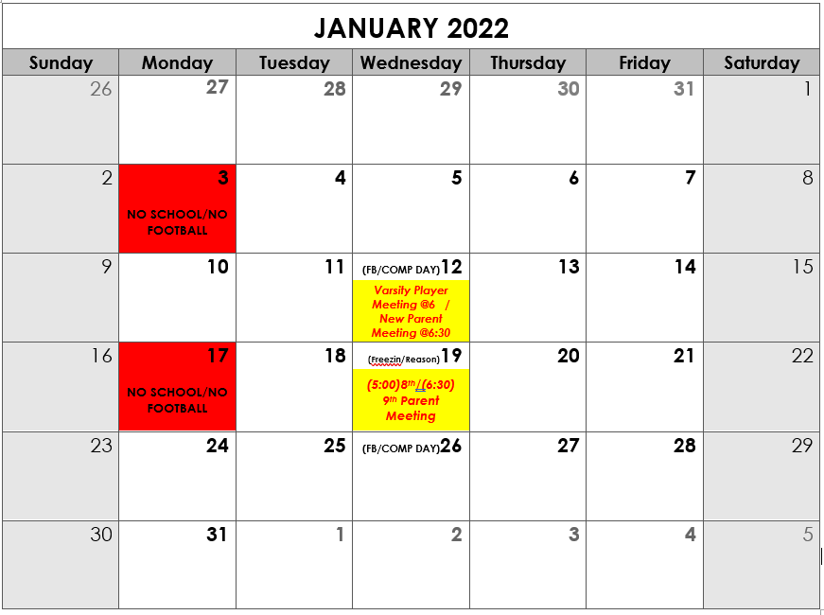

Slide 7
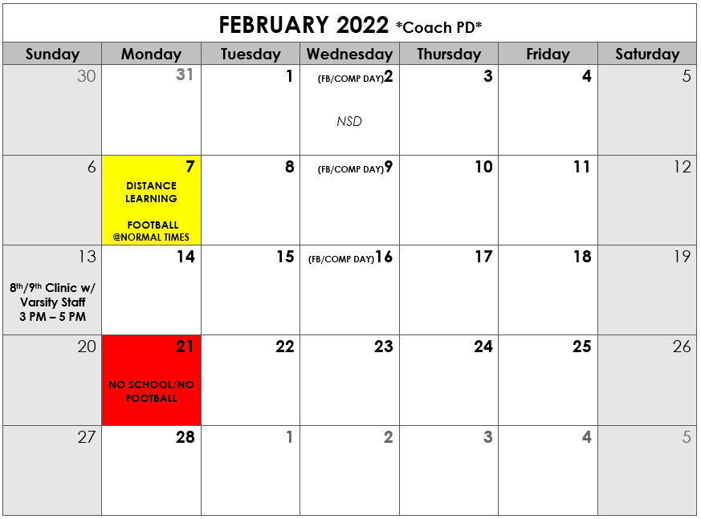

Slide 8
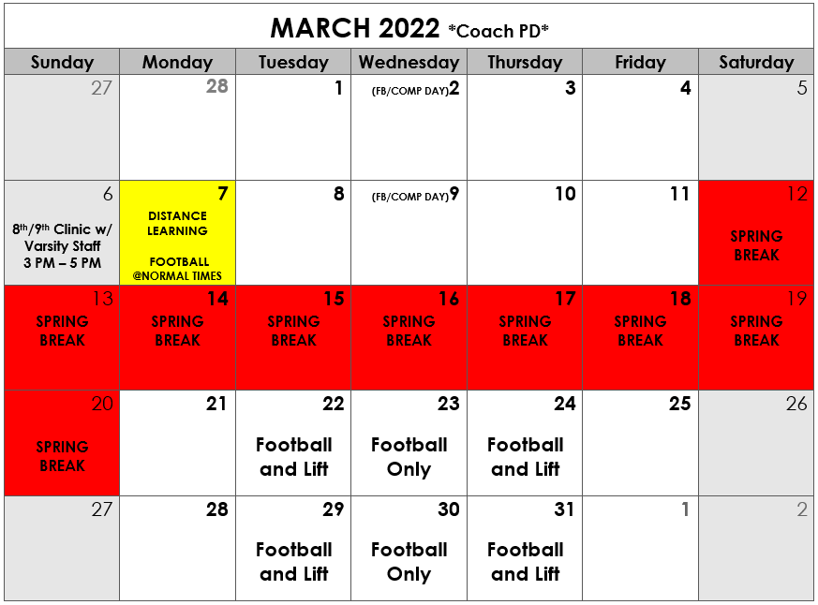

Slide 9
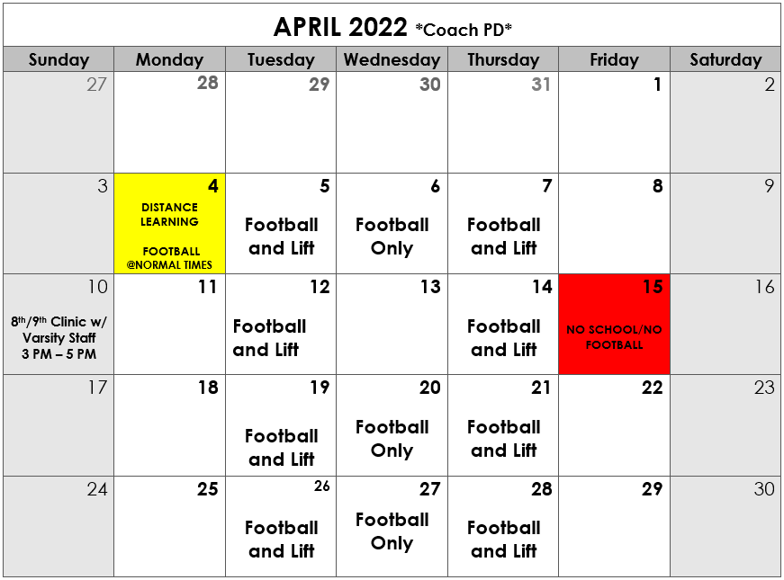

Slide 10
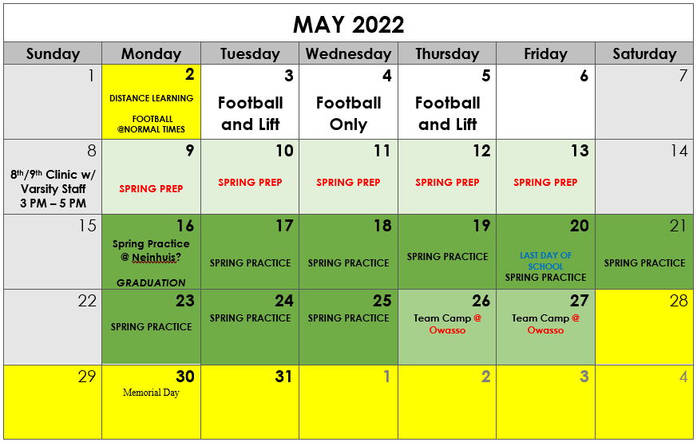

Slide 11
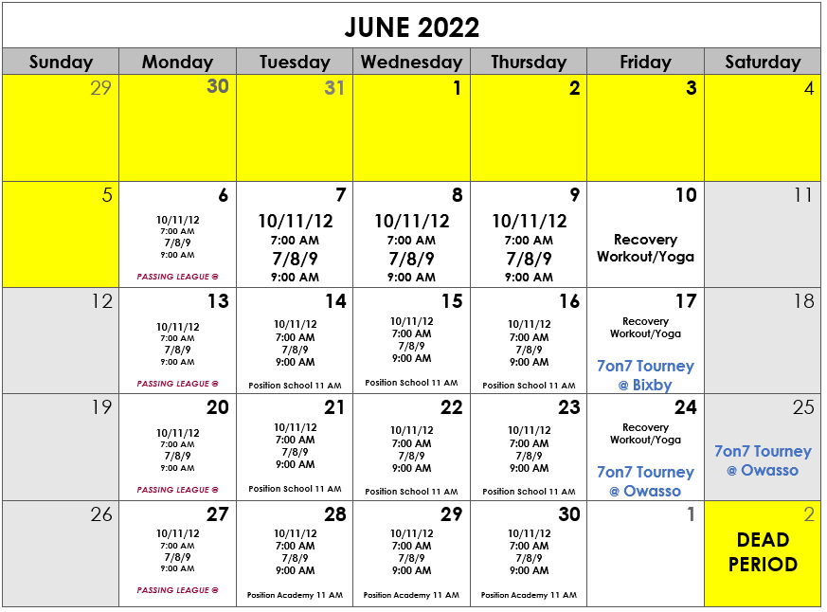

Slide 12
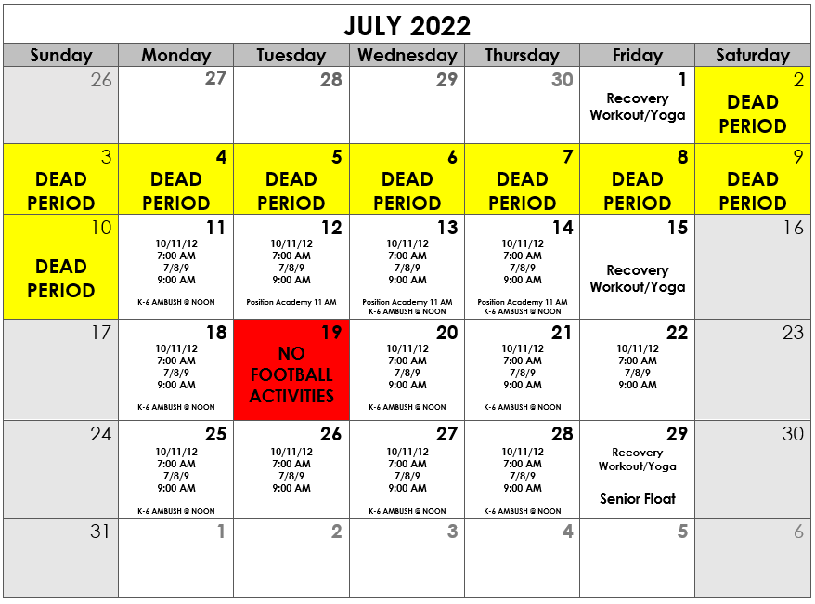

Slide 13
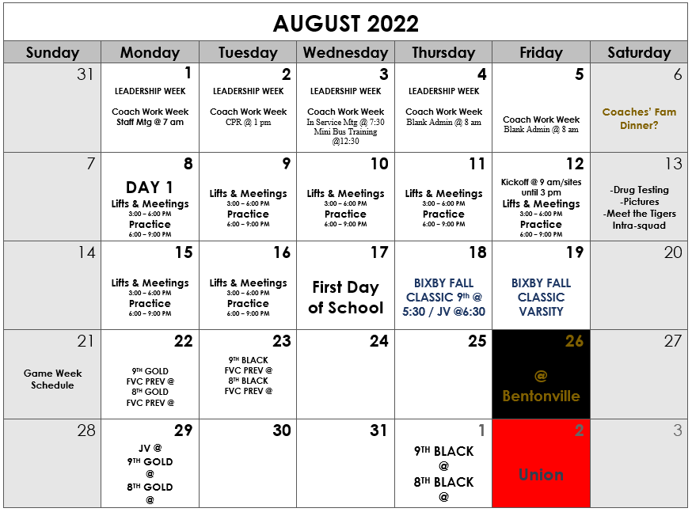

Slide 14
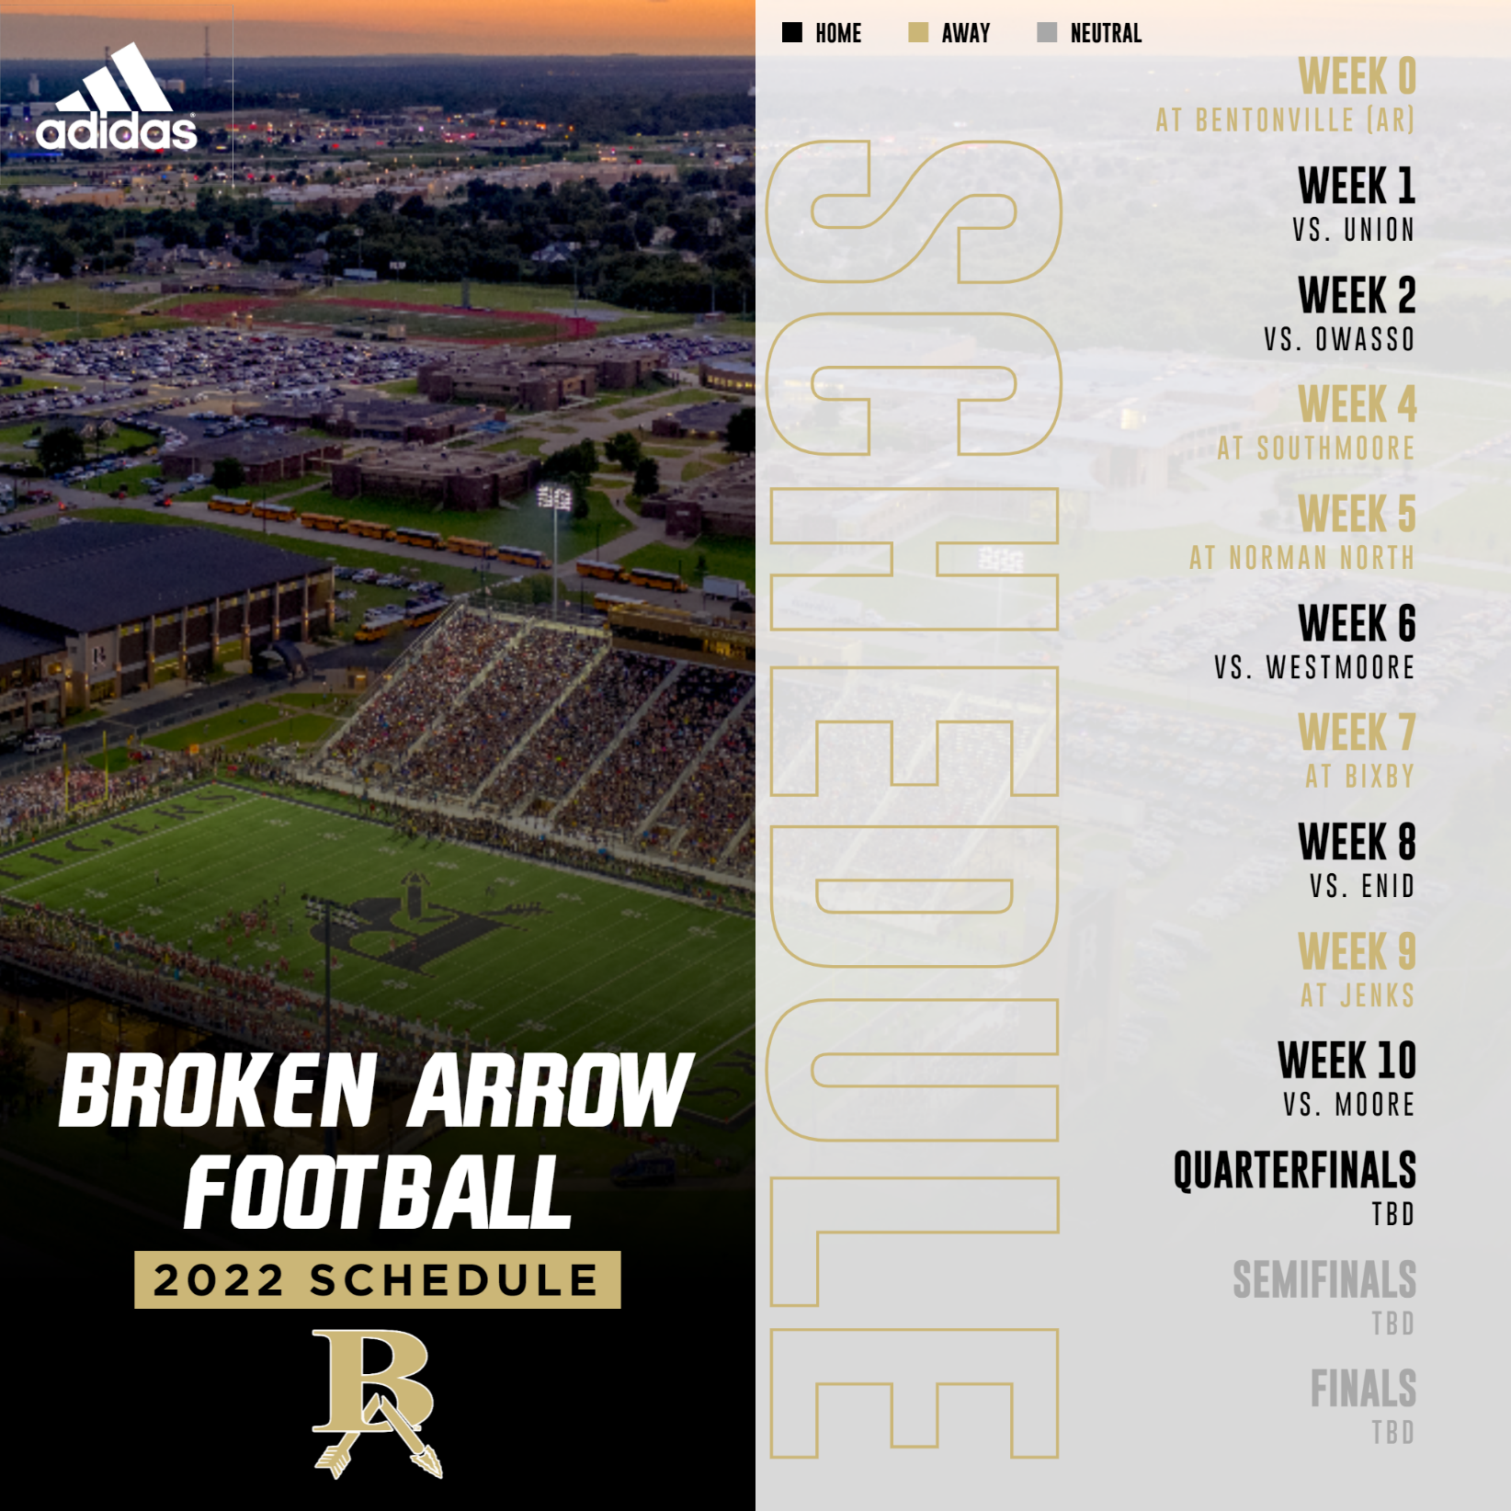

Slide 15
Expectations
Full commitment
  Voluntary to join, Demanding once part of it
  Be present (no absences)
  Communicate—YOU, not your parents
  Be fully engaged and energetic
  Be coachable
  Give your all - our way
Other Expectations to plan for
  Spring Ball, camps, summer schedule, passing league, 7on7 tourneys
  $ Summer Fees; Black Adidas game cleats
  $ Fundraising expectations*
  Community Service expectations
  Academic expectations
  Locker Room, Training Room, Buses, Facilities
  Snow Days vs Distance Days and schedule
  Parent communication
    Your son, Remind App, Dori/Booster Club, Chain of Command, Email/Canvas

Slide 16

REMIND APP (New 2022 Group)

Slide 17


Slide 19
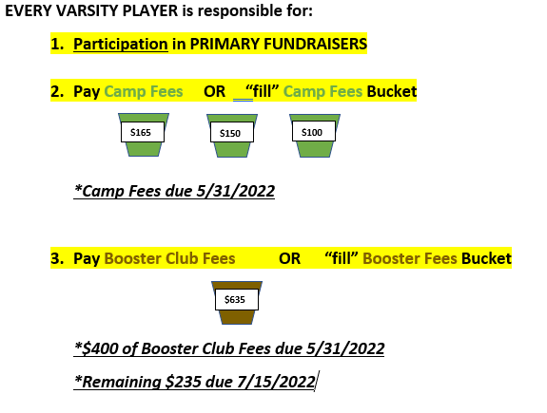
FUNDRAISING EXPECTATIONS

Slide 20
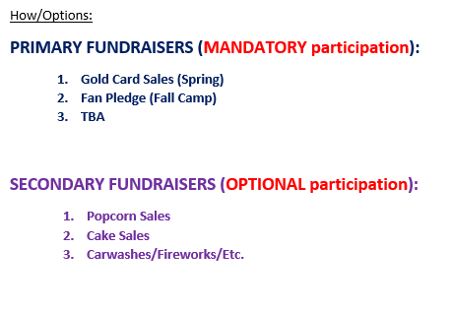
FUNDRAISING EXPECTATIONS

Slide 21
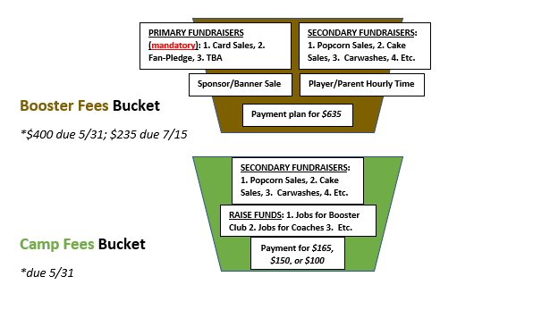
FUNDRAISING EXPECTATIONS

Slide 22
FUNDRAISING EXPECTATIONS
Info and Numbers:
AMBUSH - $100 School - $50 Academy - $50
  TOTAL: $165, $150, or $100
Total booster club expenses per player in one year (average for all players): $635
Total expenses plus total AMBUSH package: $800

Slide 23
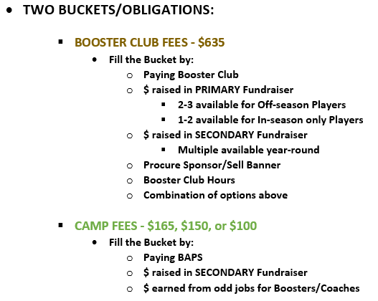
FUNDRAISING EXPECTATIONS

Slide 24


Slide 25
BA FOOTBALL 2022
JAN 2022 PARENT MEETING

Slide 27
Who I am?
My Faith
My Family
My Purpose

Slide 28
Broken Arrow Tiger Football
Program Foundation, Pillars, Pinnacle, and Prize
Our Foundation: What our CULTURE is built upon.
Every Day – Every Way
This is the foundational principal upon which our program is built. Living like a Champion is not a “sometimes” kind of thing. A Champion does not turn it off and on; a Champion is always a Champion. Excellence and greatness is an everyday endeavor, and it is pursued in every facet of life. Champions strive for and seek out excellence in all areas of their lives—athletically, academically, socially, spiritually, etc. Champions do not take days off from striving for excellence in every area of their lives. Excellence can be a mysterious and distant thing to many, because excellence is uncommon in a world satisfied with mediocrity. The path to excellence is often long and tortuous. One thing is certain—Excellence is contagious! The more someone tastes greatness, the hungrier he becomes for more of it. Anyone can achieve greatness, but most will not because the cost is too great.
Champions/Men/Tigers are what they are, because the seek excellence EVERY DAY and in EVERY WAY.

Slide 29
Broken Arrow Tiger Football
Program Foundation, Pillars, Pinnacle, and Prize
Our Pillars: What frames who we are, provides our structure, and guides our CULTURE.
Selfless – Kill the Boy
The common man buys into what the world says he should be and what the world says success is. The message from the world is a cop-out, it is an excuse, and it is the path of least resistance. The world speaks of financial achievement, sexual conquest, fitting in, doing what “feels good,” acquiring possessions, acquiring power, and athletic prowess. Our contention is that manhood, masculinity, and success are something far different than what the world says. Success is UNCOMMON, therefore not to be enjoyed by the common man. We coaches are looking to build UNCOMMON MEN, SELFLESS MEN. There must be a transformation in the young men we are developing. They must put away the selfish, childish ways of their youth (Kill the Boy!). They must put others ahead of themselves.
Manhood – Love and Legacy
If you listened to the greatest speeches of all time (Martin Luther King Jr., John F. Kennedy, Winston Churchill, Abraham Lincoln), you would find a similar message in all of them: relationships and a cause. If you have ever visited with someone on their deathbed, you have probably found two central things that person is concerned with: his relationships and what he is leaving for those people he cares about. If relationships and a cause are important at the moment we realize our life is at an end, why are we not driven by that focus all our lives? The UNCOMMON MAN is! A SELFLESS MAN is! Relationships and a cause…. or as we word it in BA Football, LOVE and a LEGACY.

Slide 30
Broken Arrow Tiger Football
Program Foundation, Pillars, Pinnacle, and Prize
Family
  One is too small of a number to achieve greatness. When we act and carry on as a FAMILY, we allow ourselves to reach greater heights—as a group and individually. We believe that the essence of MANHOOD is Relationship and Cause… A team is a set of relationships put together for a common cause. Thus, MANHOOD can be achieved when one commits to the FAMILY. We LOVE one another, and we demonstrate this love in our words and in our actions. The greater the challenge, the greater the need for FAMILY. Our CULUTRE is sustained and passed on through ACCOUNTABILITY, OWNERSHIP, and MENTORSHIP within our FAMILY.
Focused Work Ethic – To the Tree
  All of our opponents have talent. All of our opponents work hard. All of our opponents invest time and “sweat-equity.” If the assumption is that everyone (us and our competitors) “works hard,” what will separate and distinguish the BA Football Program from the others?
  The answer is two-fold:
    HOW we work… We will work as a cohesive unit. We will move in unison. We will be highly focused and disciplined within the grind. We will simulate game time experiences. We will emphasize a start and a finish to everything. We will operate under a system of “Coach-Command + Player-Response.” Players, while giving everything they have physically, will be training their minds for adversity and in-game focus. Players will ignore “how they physically feel,” and instead will focus on THEIR JOB: LAAER.
    HOW FAR we will go… While our opponents will measure success by crossing the goal line, BA Tigers will always go farther. We will not be content with just crossing the goal line or entering the end zone; we will carry our work all the way to the Touchdown Tree… beyond the end zone and behind the goal posts. "It is not the violence that sets a man apart. It's the distance he's prepared to go," -Forrest Bondurant

Slide 31
Broken Arrow Tiger Football
Program Foundation, Pillars, Pinnacle, and Prize
1-0
  Singular focus. One play at a time. One game at a time. Control what we can control. We cannot control the refs, weather, schedule, sickness, injury, etc. E + R = O! EVENT + RESPONSE = OUTCOME. We can only control our RESPONSE.
  We will train our minds to operate one play at a time – LAAER
    Listen
    Align
    Assign
    Explode
    Reset
Obsession with Growth
  Our profession is a results-based profession, but the key to achieving the desired results is an unwavering focus on the PROCESS to get there. We cannot allow success/wins/achievements/accolades distract us from constant growth and improvement. We will certainly celebrate those things, but they will not slow us in our journey. Conversely, we will not allow growth to be hindered by disappointment/losses/setbacks/failures. Our passion for constant improvement must be part of our program culture, and it must be guided and modeled by our coaches.

Slide 32
Broken Arrow Tiger Football
Program Foundation, Pillars, Pinnacle, and Prize
Embrace Adversity - Persist
  Adversity is an absolute guarantee—in every game and in every season. We must PERSIST regardless of the obstacles. Nothing else matters, our FOUNDATION nor our PILLARS, if we do not PERSIST. Tigers PERSIST under any circumstances that we might encounter—under the toughest of conditions, even when it seems to most that we are beaten. If our opponent has hit us in the mouth a thousand times, they will grow tired, because we will not go away. We will be standing. Whatever we can contribute, the team will have it all. Nothing will distract us, our focus, or our energy. Our effort is always there. We do not flinch when it gets tough—when it gets difficult to see hope—when others seek to separate us in tough times and criticism is all around us. We remain strong in mind and spirit. We never quit believing in the BA TIGERS. We are here to the end!
  In Old England, in far less civilized times, groups of people would organize dog fights for determining the characteristics of dogs for breeding purposes. A dog that would quit in a fight was no longer kept for breeding. One type of dog that commonly was used in these fights was a Bull Terrier. The fight was held in a pit, usually a 16 by 16 square. These were matches common to a boxing match; there was a referee, a handler for each dog and a timekeeper. In the pit there was a scratch line drawn diagonally from one neutral corner of the pit to the other. For a new round to start a dog must cross that line to ANSWER THE SCRATCH. A dog that would continue to ANSWER THE SCRATCH in spite of broken bones, torn muscles, dehydration and exhaustion was considered to have gameness or heart.
  Gameness is a canine virtue that is most akin to the human virtue of tenacious courage. It is determination to master any situation and never back down out of fear. That indeterminable will, the ability to continue to be relentless in adverse conditions was something that was recognized as a trait that could not be taught and was valued highly by the breeders.
  ANSWER THE SCRATCH means RELENTLESS DETERMINATION IN THE PASSIONATE PURSUIT OF EXCELLENCE.
Covenant
  The essence of COVENANT is PROMISE. BA Football Players enter into a COVENANT with their brothers on the team. A COVENANT is something much larger and deeper than “being on a team,” and it involves much more than signing a contract or a commitment. A COVENANT is a solemn and sacred agreement, an agreement to engage in and/or to refrain from particular actions, thoughts, and attitudes. A contract is an exchange—“That is mine, and this is yours.” A COVENANT calls for an exchange of persons that creates a shared bond—“I am yours, and you are mine.” A contract is an agreement made in suspicion; the parties do not trust each other, and they set limits to their own responsibility. A COVENANT is an agreement made in trust; the parties love each other, and they put no limits on their own responsibility. The difference is in the attitude. A COVENANT is not conditional on the other person keeping their promise. Because of this distinction, there is a much larger gravity to the violation of a COVENANT than to a contract.
  A contract is sealed in my own name—a signature on the line at the bottom of the contract. A COVENANT is sealed by the making of a vow or an oath—this vow or oath is made in the presence of witnesses and often made in God’s name. Entering into every season, Tigers will stand before the team and make an oath and/or a vow.

Slide 33
Broken Arrow Tiger Football
Program Foundation, Pillars, Pinnacle, and Prize
Legacy
  Our LEGACY is our CAUSE, our REASON and PURPOSE for what we do. LEGACY is leaving something better than it was before we got there—places, programs, and people. When we visit a stadium and locker room, it will be cleaner when we leave than it was when we arrived. Our teammates will be better men because of the impact we have had on one another. In all of our relationships, friends, teachers, coaches, girlfriends… these people will be better people because of how we treat them. Broken Arrow High School, the community of BA, and The BA Football Program will better than it was before we arrived. Leaving a LEGACY is an obsession of ours, and we pass down the importance of LEGACY to the group of players that follow us. When we consistently pass down the importance of Leaving a LEGACY from one group to the next, we raise our program to immeasurable heights.
Believe
  There is something magical in sports, especially our game. We can never allow ourselves, coaches and players, to stop believing that the magic is always possible. The magic is EARNED; it does not just happen by chance. BELIEF is critical for the magic to be earned. When we stop believing, when we doubt, when we are negative… we defeat ourselves.
-There must be belief IN the COACHING STAFF and WITHIN the COACHING STAFF
-There must be belief in the SYSTEM
-The players must believe in EACH OTHER
-We all must believe we WILL WIN

Slide 34
Broken Arrow Tiger Football
Program Foundation, Pillars, Pinnacle, and Prize
Our Pinnacle: Our ultimate goal
A Man – A Champion – A Tiger
  If we lay our foundation, EVERY DAY – EVERY WAY, then we have something to build upon. If we remain focused on our structure and what frames and guides our CULTURE (the Pillars), then we have a chance to arrive at the Pinnacle. Our Pinnacle, our ultimate goal, is to develop Men—Uncommon Men, by the standards of the world. We believe that “A Man” is synonymous with “A Champion.” We also believe that the true definition of “A Tiger” is also synonymous with “A Man” and “A Champion.” A Champion is not decided at the Championship Game; The Champion arrives at the game already a Champion. All that remains is to collect the Prize.
A MAN is patient. A MAN is kind. A MAN is not jealous. A MAN does not brag. A MAN it is not full of himself. A MAN does not dishonor others. A MAN is not self-seeking. A MAN it is not easily angered. A MAN doesn’t hold a grudge. A MAN does not delight in evil. A MAN rejoices with the truth. A MAN always protects. A MAN always trusts. A MAN always hopes. A MAN always perseveres. A MAN never gives up. A MAN cares more for others than for self. A MAN doesn't want what it doesn't have. A MAN doesn't strut. A MAN doesn't have a swelled head. A MAN doesn't force itself on others. A MAN isn't always "me first!" A MAN doesn't fly off the handle. A MAN doesn't keep score of the wrongs of others. A MAN despises wrongdoing and evil. A MAN takes pleasure in truth and virtue. A MAN puts up with anything. A MAN trusts God always. A MAN always looks for the best. A MAN never looks back. A MAN keeps going to the end.
Our Prize: Our reward comes as result of our arrival as Men
Oklahoma State Championship!

Slide 35
Philosophy and Plan?
Every Day – Every Way
  Develop/Mentor Men
  Staff with shared values
  Relational Approach
  Create Culture
  Model/Demand Excellence
Winning and Championships will be a byproduct

Slide 36
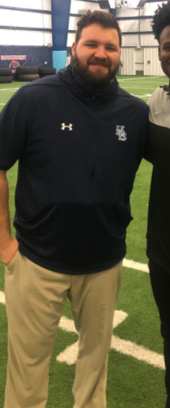
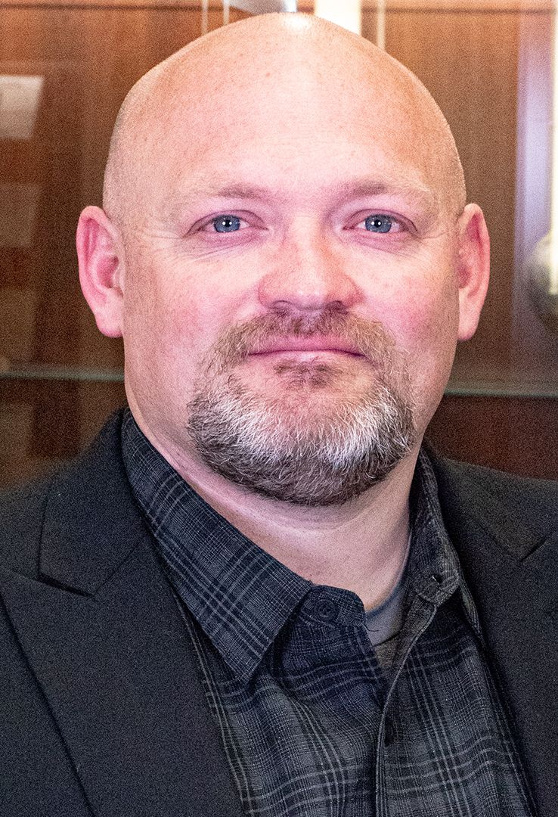
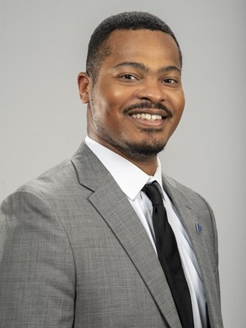
Coaching Staff
Justin Pruitt – OC/OL
Jacques Washington – Secondary Coordinator/ST Coordinator
Britt Maughan – Asst. Head Coach/DC

Slide 37
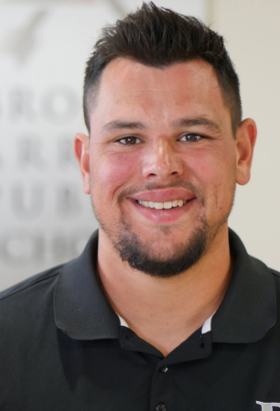
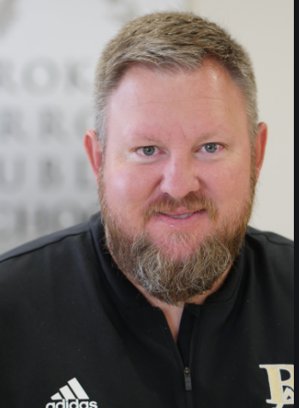
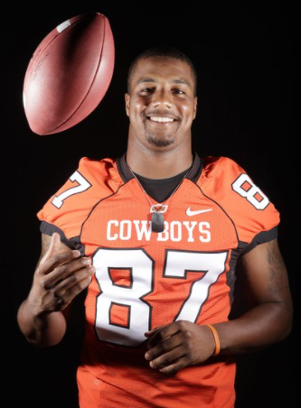
Coaching Staff
Nick Gorman - TE
Mark Broyles – Asst. OL
Tracy Moore - WR

Slide 38
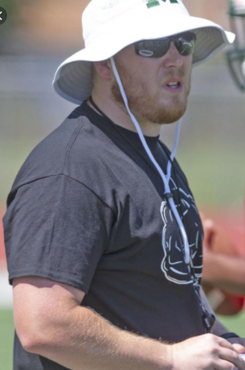
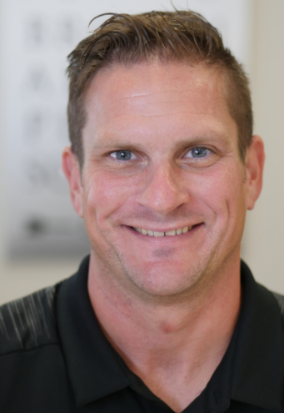
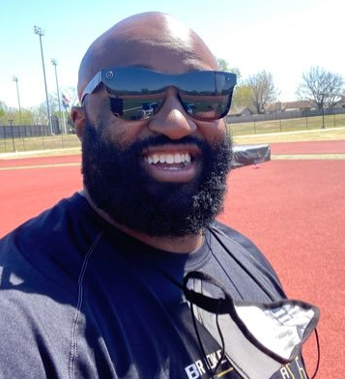
Coaching Staff
Vince Davis – RB
John Graham – QB
Daniel Hendrickson – Equipment/Asst. LB

Slide 39
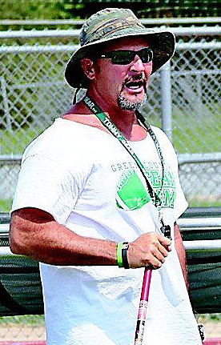
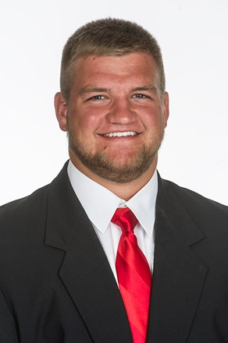
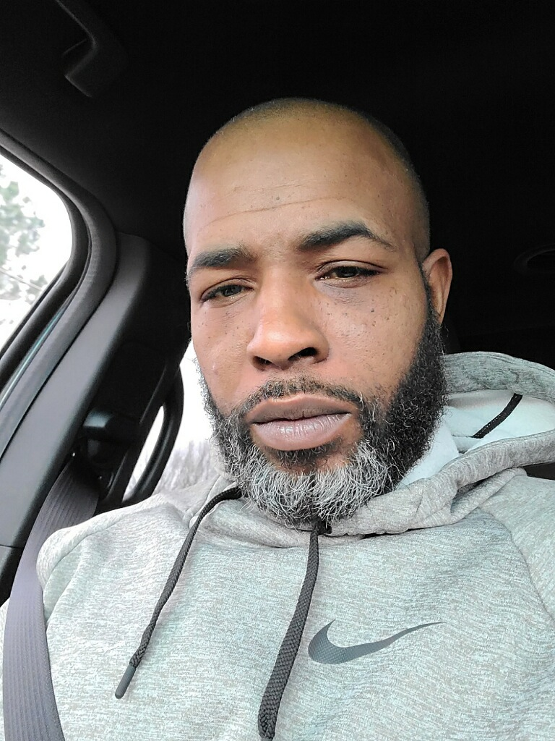
Coaching Staff
Julius Allen – Nickels/Returners
Dave Heath - DL
Bo Farrow – Asst. DL

Slide 40
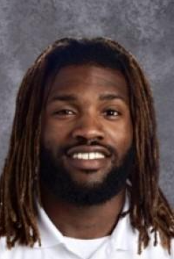
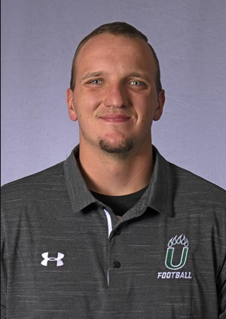
Coaching Staff
Ivan King - DB
Mitch Allen - LB

Slide 41
What we are doing now?
Program Development
  Inventory complete
  8th graders at the Indoor
  6th and 7th grade Off-Season Club
Varsity Team Development
  Strength Training + Discipline = FOCUSED EFFORT
  Character/Service Training
  Competition
  Simulate Adversity – DEVELOP 6 SECOND PLAYERS
  High Expectations and Accountability
  Love
Football IQ/Position development
Sense of Urgency
Pushing to raise the standard
  Wall of contentment
Fundraising

Slide 42
Schedule/Calendar
Weeks until Spring Break
  Minimal time
Weekly Routine
  4 day lift program, 1 day competition—5 day week… Wednesdays earliest finished
  All players finish between 4:00-4:15
    Voluntary work after
    Multi-sport
Post-Spring Break
  More “Football” emphasis
  Spring Prep
  Spring Ball
  Summer
Ideal Vacation dates

Slide 52
Expectations
Full commitment
  Voluntary to join, Demanding once part of it
  Be present (no absences)
  Communicate—YOU, not your parents
  Be fully engaged and energetic
  Be coachable
  Give your all - our way
Other Expectations to plan for
  Spring Ball, camps, summer schedule, passing league, 7on7 tourneys
  Black Adidas game cleats
  Fundraising expectations*
  Community Service expectations
  Academic expectations
  Locker Room, Training Room, Buses, Facilities
  Snow Days vs Distance Days and schedule
  Parent communication
    Your son, Remind App, Dori/Booster Club, Chain of Command, Email/Canvas

Slide 53
REMIND APP (New 2022 Group)

Slide 56
FUNDRAISING EXPECTATIONS

Slide 57
FUNDRAISING EXPECTATIONS

Slide 58
FUNDRAISING EXPECTATIONS

Slide 59
FUNDRAISING EXPECTATIONS
Info and Numbers:
AMBUSH - $100 School - $50 Academy - $50
  TOTAL: $165, $150, or $100
Total booster club expenses per player in one year (average for all players): $635
Total expenses plus total AMBUSH package: $800

Slide 60
FUNDRAISING EXPECTATIONS

