Slide 1
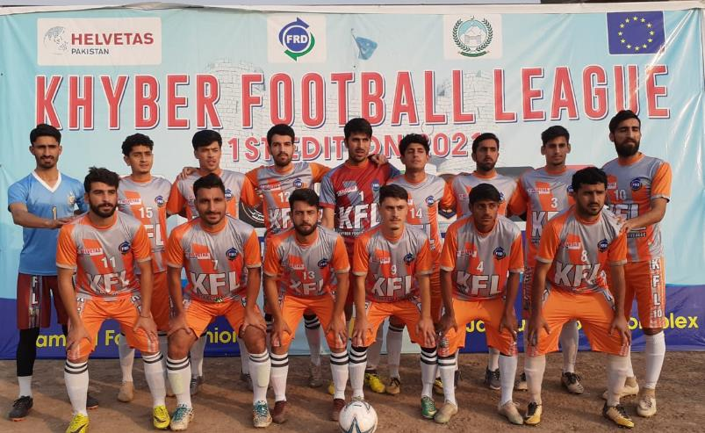
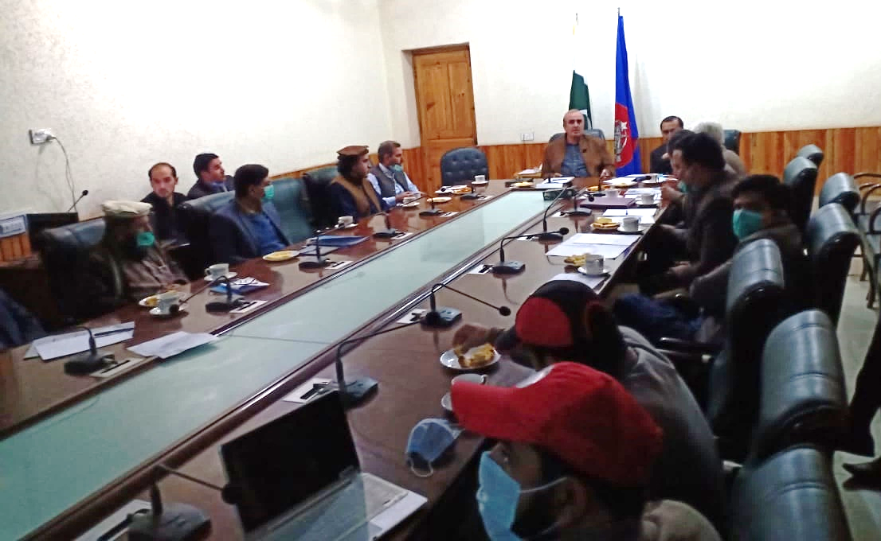
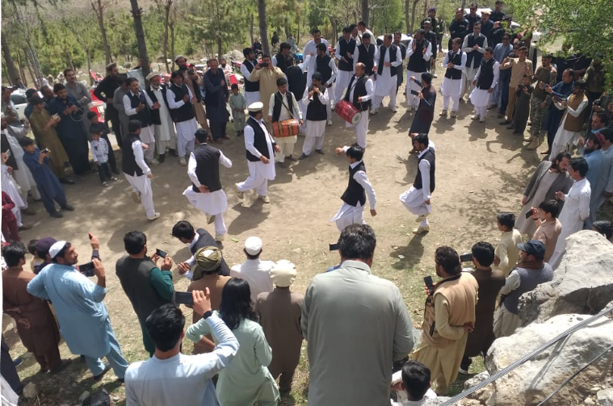
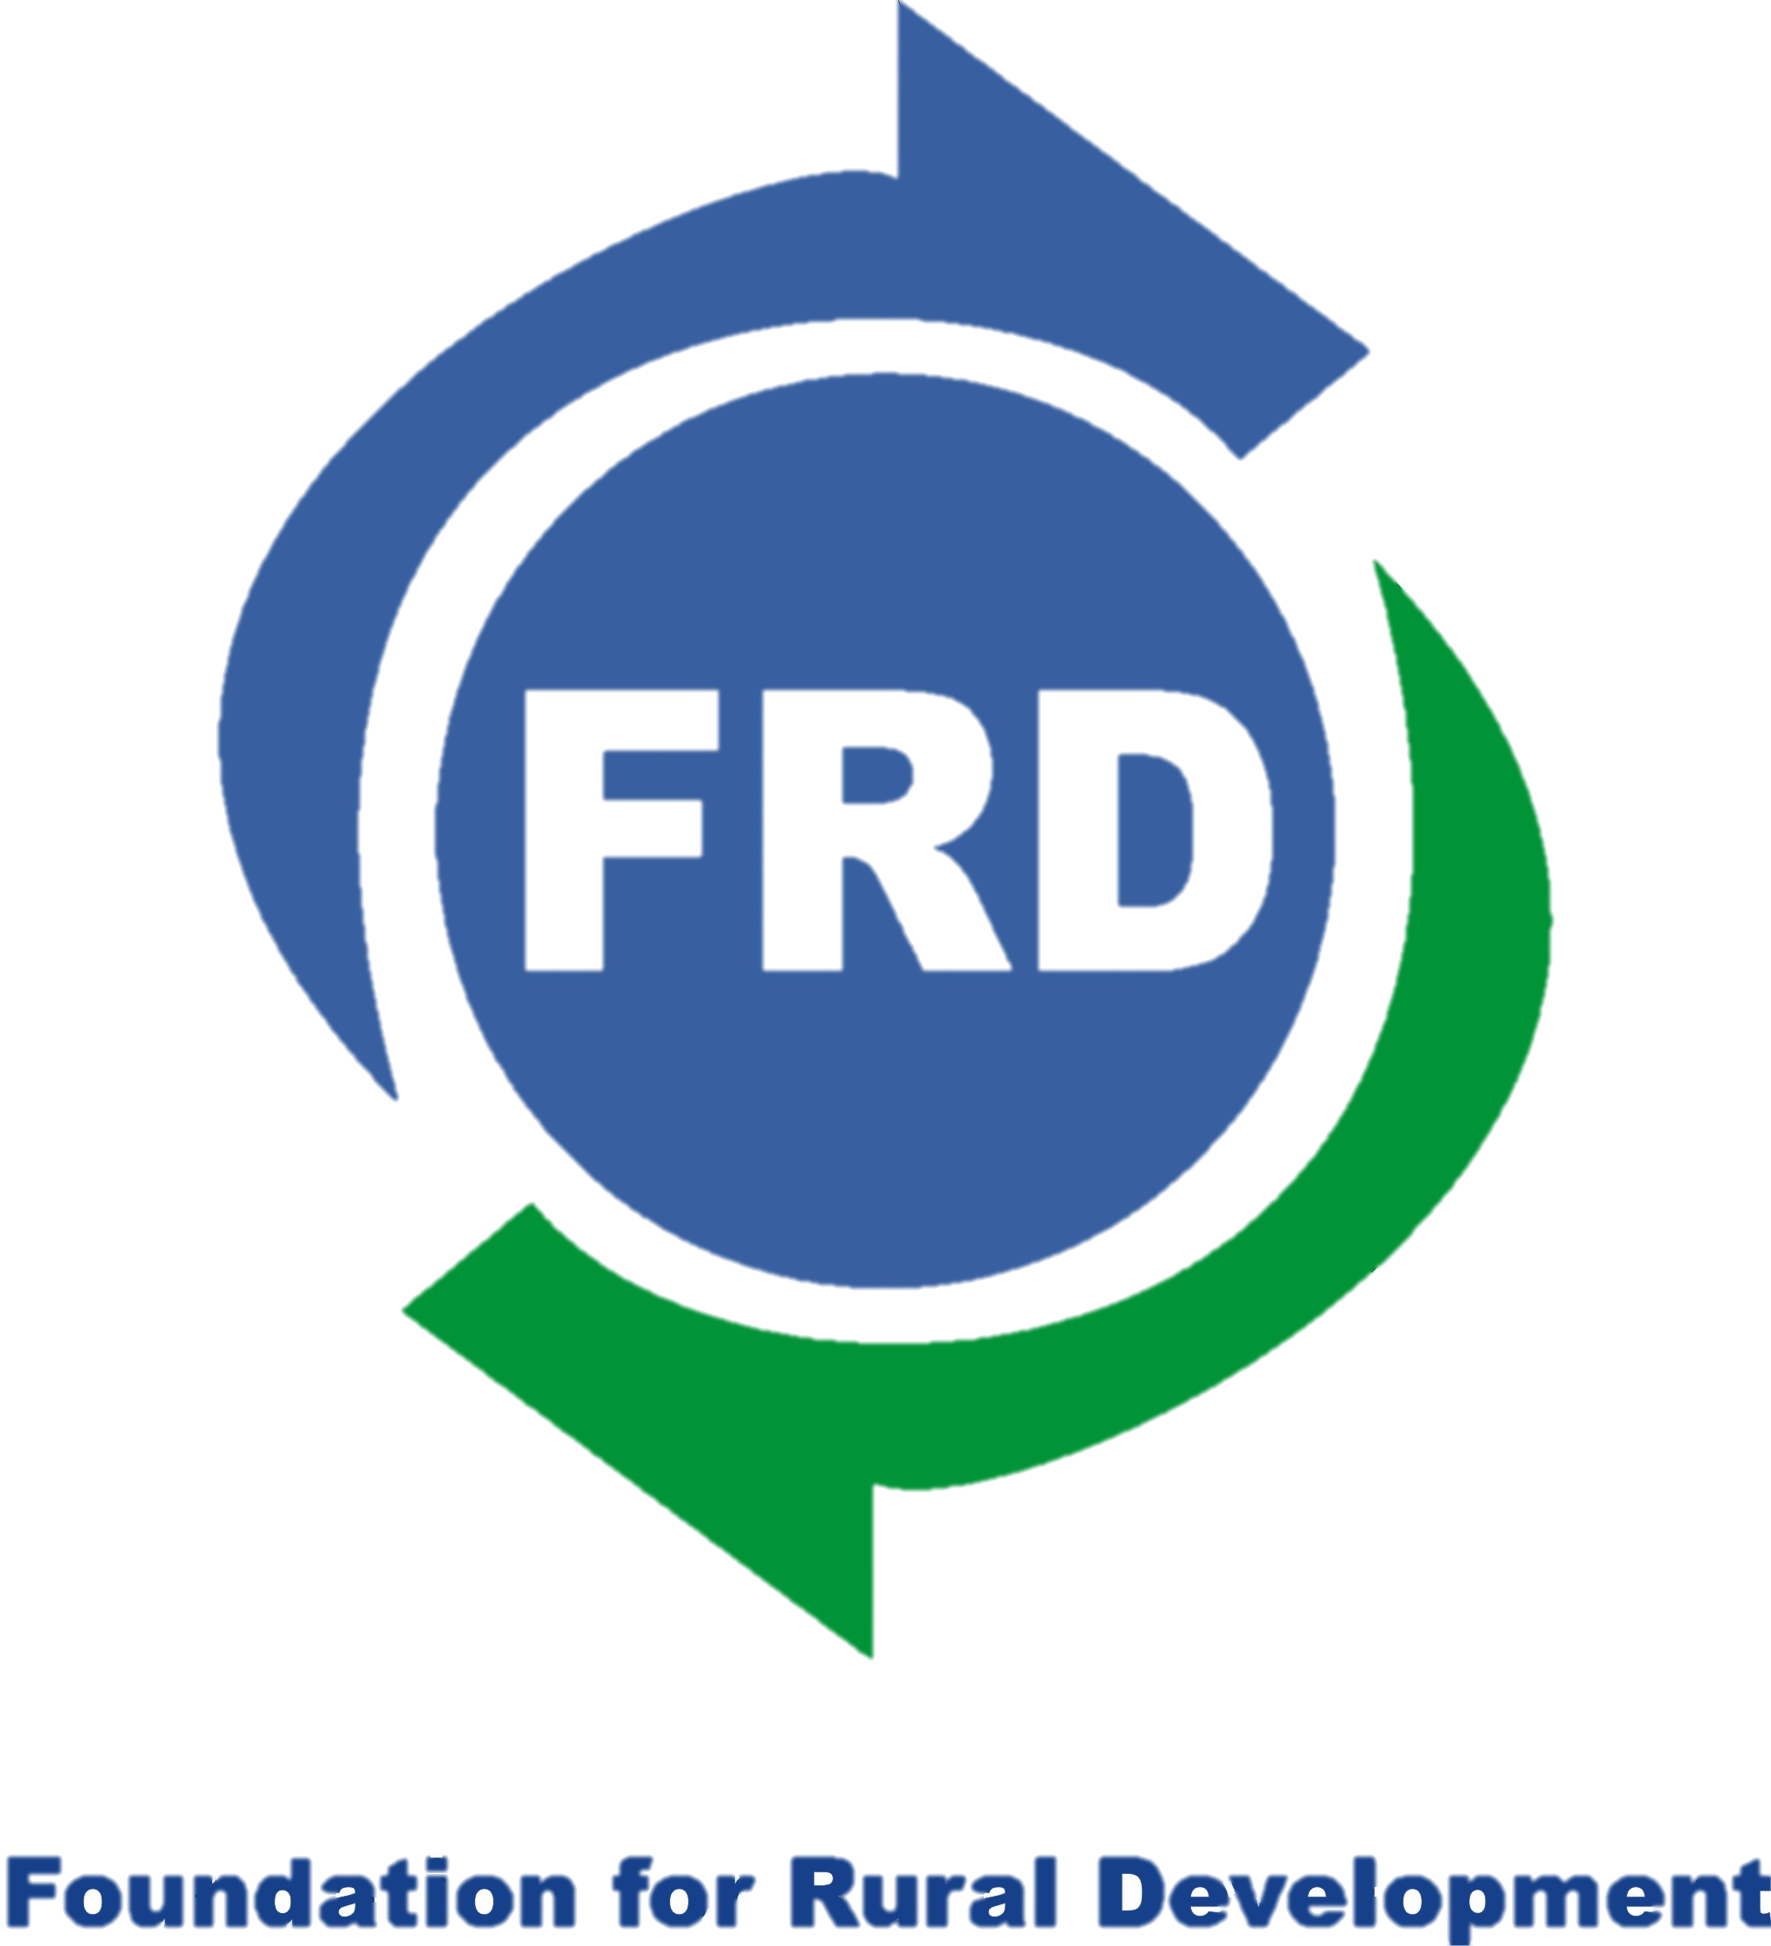
Integrating Resilience, Humanitarian Response, and Sustainable Development in Fragile States

Slide 2
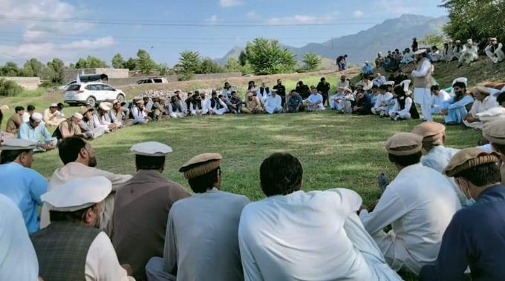
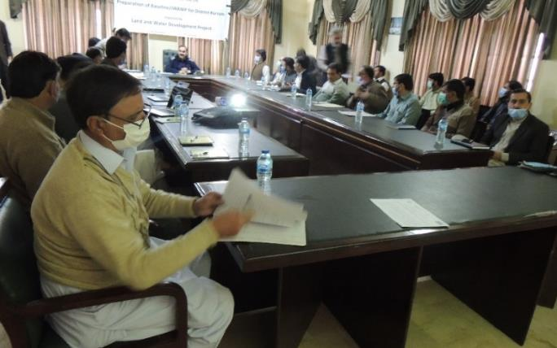
Introduction
FRD implemented a project from (2019-2023) in the conflict and climate-affected districts of Khyber Pakhtunkhwa (Khyber, Mohmand, Bajaur, and Kurram) with the financial support of the European Union. This project has addressed critical land and water resource challenges through integrated management, fostering long-term peace, development, and sustainability.
The project aimed at social cohesion for peace and stability in tribal communities of FATA strengthened through the engagement of local authorities and CSOs in confidence-building measures and dialogue around land and water.

Slide 3
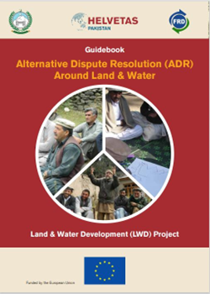
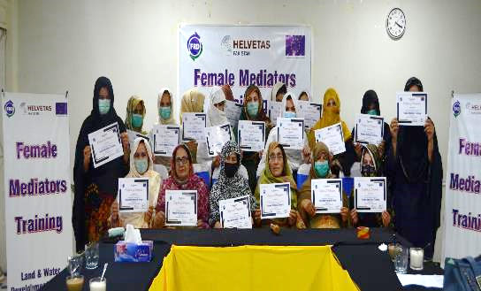
Project Summary
The Project has trained 6 women, and 12 men project/IPs staff in ADR and CSPM.
121 men and 40 women of the target communities were involved in the baseline survey and IWRM was used as a baseline tool.
64 Govt. officials and 8 representatives (women and men) from other projects/NGOs participated in the trust-building/interface events and baseline.
80 (men) community mediators were trained in mediation and negotiation skills (ADR).
20 (women) mediators/social activists were trained in mediation and negotiation skills (ADR).
8 IP staff (4 women and 4 men) were trained as master trainers in leadership management skills.

Slide 4
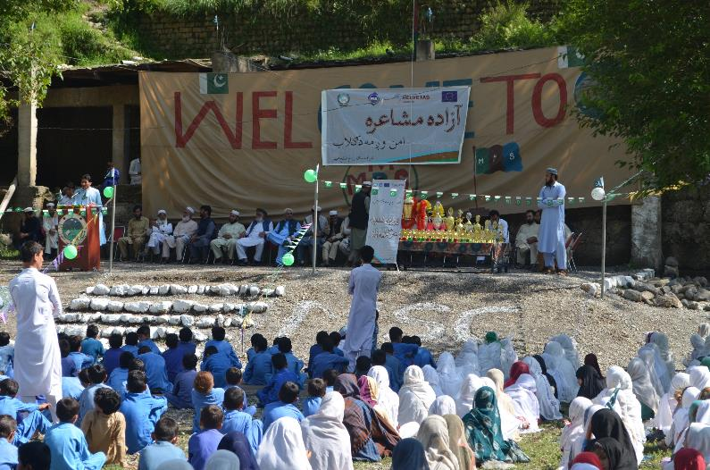
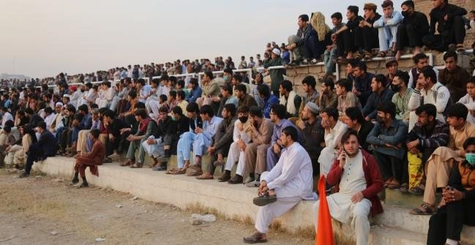
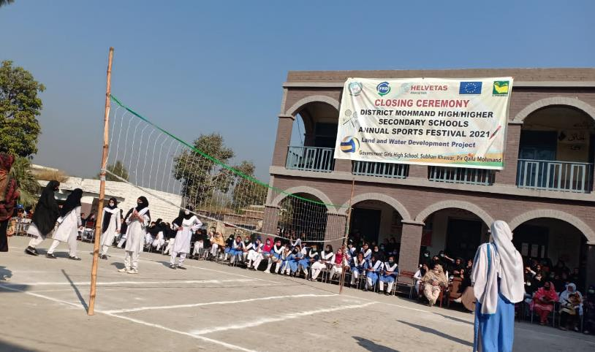
500 men and 503 women were trained in leadership management skills through 15 two-day training events in the four districts.
2,533 boy players and 360 girl players participated in 11 (9 men and 2 women) sports events.
40,000 plus spectators attended the sports events.
162 poets (154 men and 8 women) participated in 6 poetic symposiums for peace.
2,080 plus (2,000 men and 80 women) audiences attended the poetic symposia/cultural events.

Slide 5
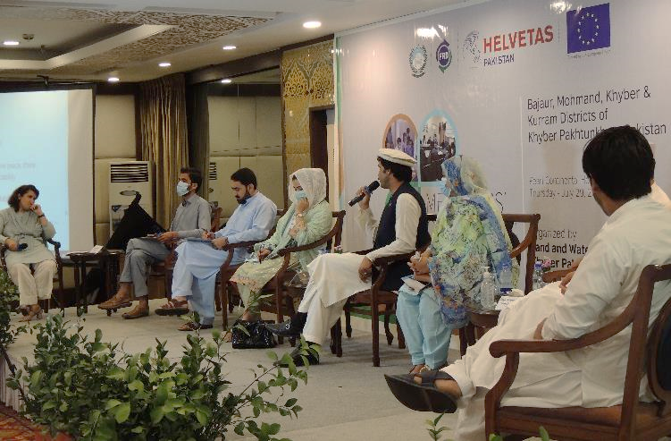
80 men and 20 women mediators, 60 representatives of different stakeholders also participated in the mediators’ convention.
40 engineering students/young graduates from the partner districts were sponsored to participate in 2 online ‘International Conferences on Recent Advances in Civil and Earthquake Engineering, organized by the University of Engineering & Technology, Peshawar in collaboration with LWD.
The project has conducted two exposure visits, in the first case, 7 boys, 7 girls’ students, 2 women, and 4 men teachers visited different education institutions organizations, and cultural heritage in Gilgit Baltistan.
In the second case, the 20 young students and 4 teachers (men and women) visited different academic, cultural, and historical places in Sindh i.e., skills development centers, career counseling, and business incubation centers.

Slide 6
Case Study 1: Synergies Radiates More Energies for Conflict Transformation
The project conducted various activities in collaboration with other civil society actors to support long-term development through an integrated approach.
In one of our case studies, trained project mediators successfully settled a land dispute with the consensus of the village development committee, which was also affected by climate change (specifically water scarcity).
The mediators and community implemented their idea of constructing a water tank so that both reconciled parties could access drinking water, thereby strengthening social cohesion. The project coordinated its activities with another project working in the same area to achieve sustainable solutions.
As a result, a total of 200 households now benefit from improved access to clean drinking water. Both parties use the shared water tank during the summer when water scarcity is high, thereby promoting social cohesion and peace.

Slide 7
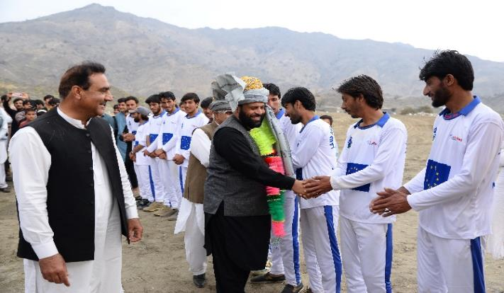
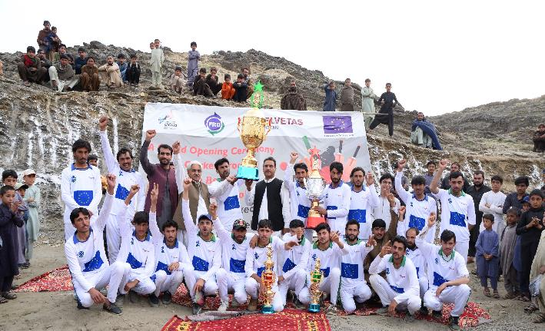
Case Study 2: Peace and Development Through Sports
In another case study, trained mediators successfully resolved a communal dispute between two tribes. Following the settlement, community members requested the construction of a cricket ground with the primary objective of engaging youth in peaceful and positive activities.
A large tape-ball tournament titled “Peace” was organized at the renovated ground with support from the district administration and the sports department.
The project has also constructed some check dams with the integration of another project to protect the sports ground and promote long-term peace.

