Slide 1
Reviving Water Resources & Livelihood through Nature-Based Solutions for Sustainable Aquifer Recharge

Slide 2
Background
Overall underground water table is continuously dropping
(KP-IWRM Strategy 2022, FRD, 2019, Dallion 2005)
Districts Mohmand, Khyber, Kurram and Orakzai being Part of the Hindukush Region with steep slopes is prone to destructive flash floods
(Hussain et.al 2023, Shaw et. al 2014)
Climate Change phenomenon combined with the Topography of the area increases the risk of flash floods and reduces the recharge to underground water due to a limited contact time of run-off with the ground.

Slide 3
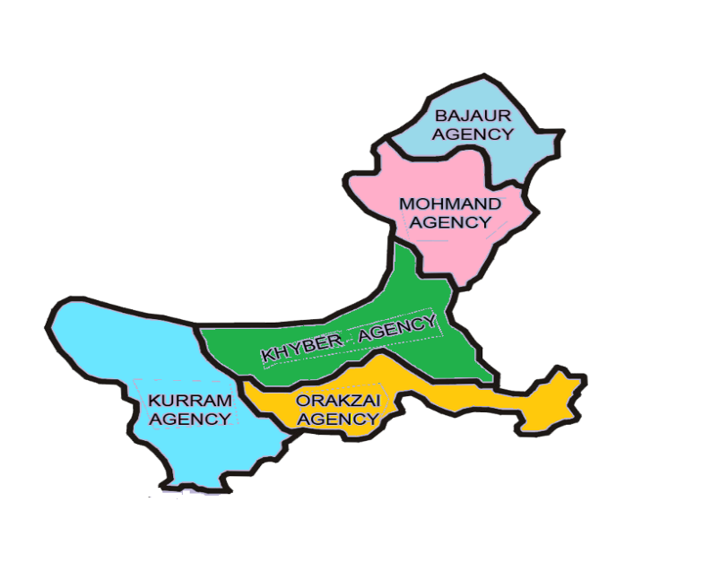
FRD,s Presence in the Area
FRD exists in Mohmand Since 2008, in Kurram since 2012, Bajaur 2013, Orakzai 2014 and Khyber 2016.

Slide 4
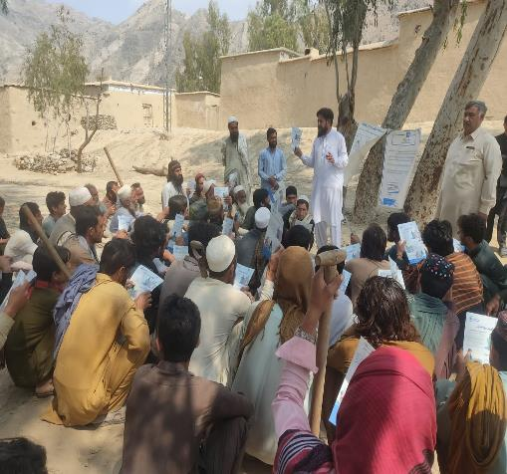
Implementation Approach
Communities identify nullahs/torrents/
gullies that cause the most damage in
terms of flash floods. Technical team of
FRD jointly inspects the area for check
dams and gully plugs.
Communities implement
and FRD supervises

Slide 5
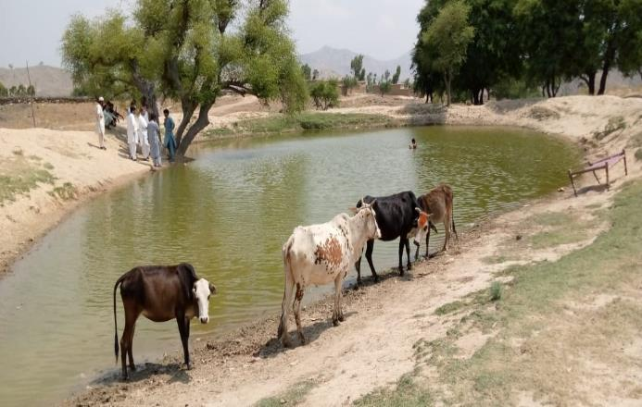
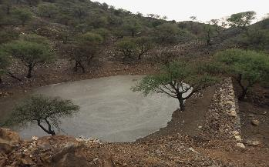
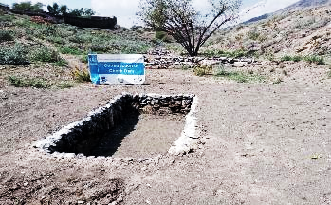
Implementation Approach
To reduce the over-exploitation of aquifers for construction, Livestock, and washing purposes, Rainwater earthen ponds are built with the communities.

Slide 6
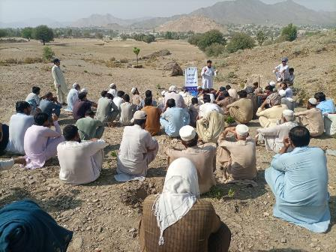
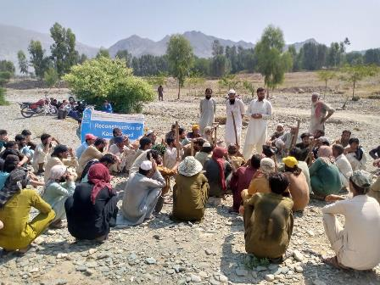
Implementation approach
Put more pictures of community meeting

Slide 7
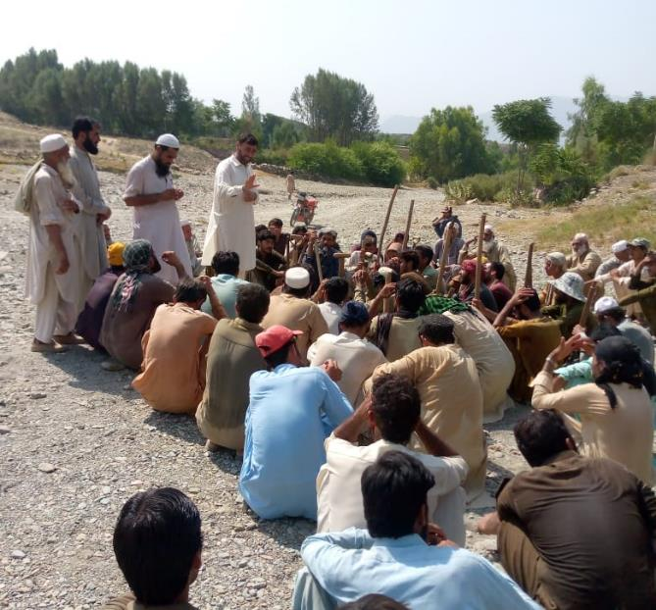
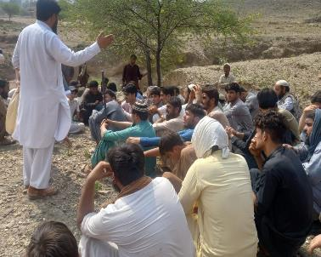
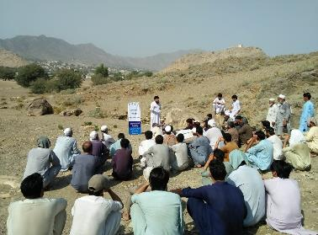

Slide 8
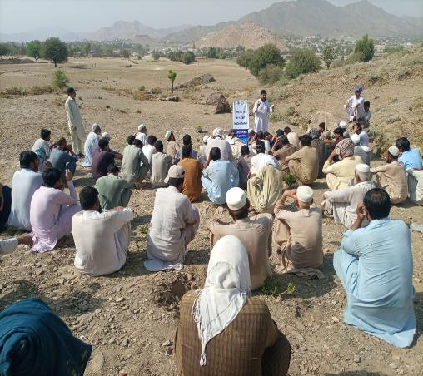
Implementation Approach

Slide 9
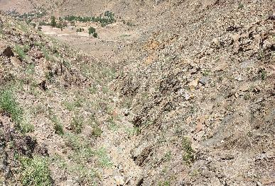
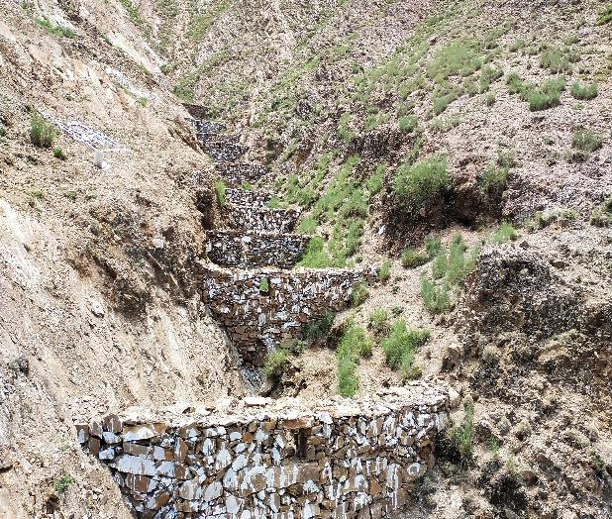
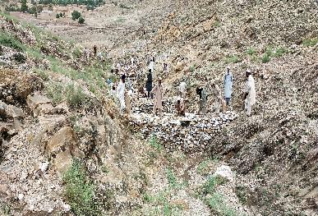
Implementation approach

Slide 10
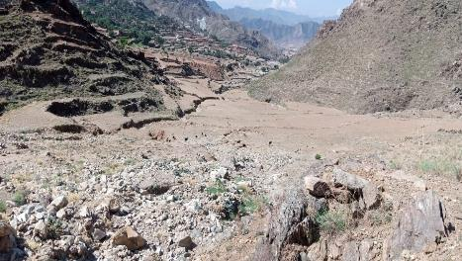
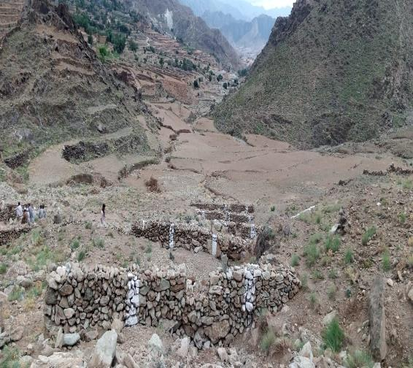
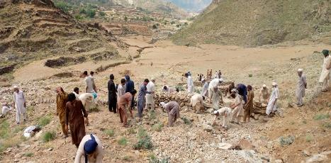
Implementation approach

Slide 11
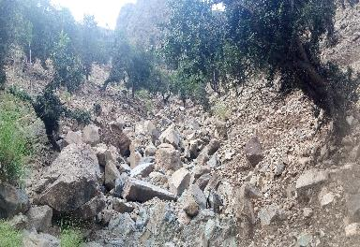
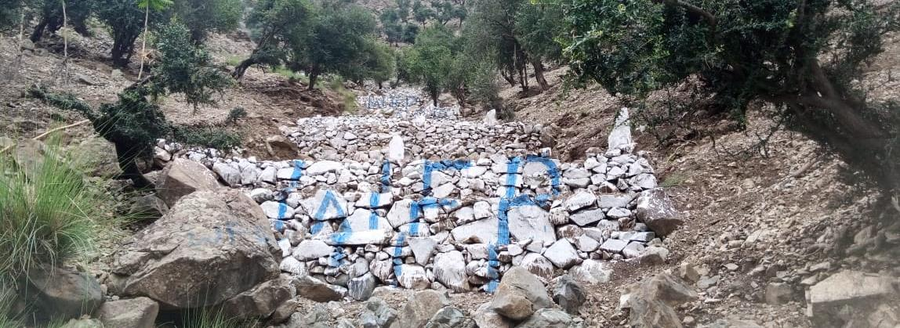
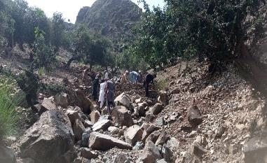
Implementation approach

Slide 12
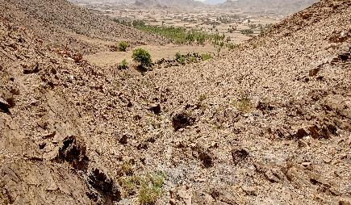
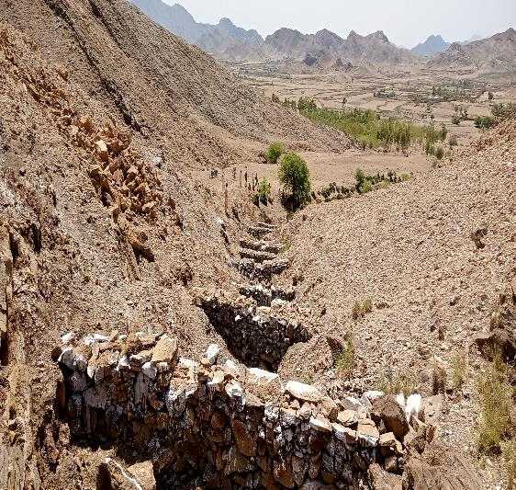
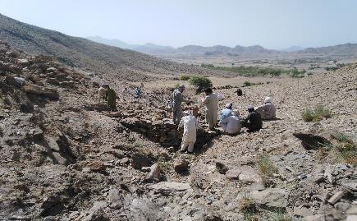
Implementation approach

Slide 13
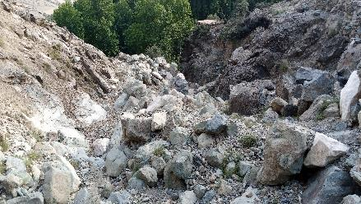
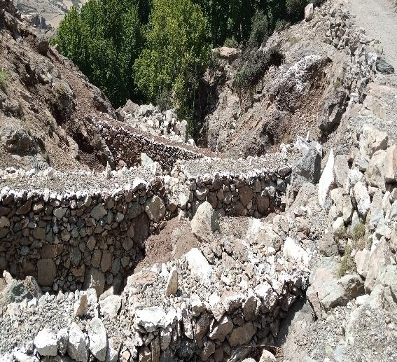
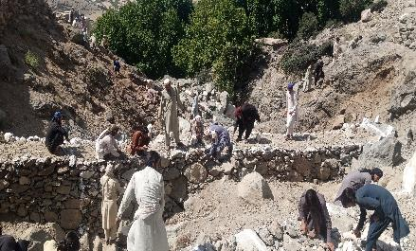
Implementation approach

Slide 14
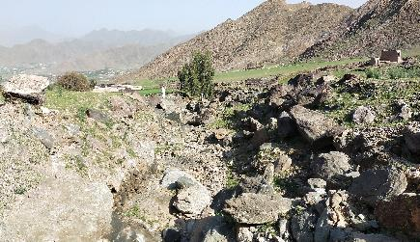
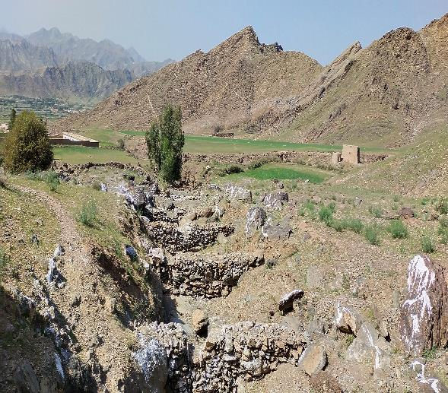
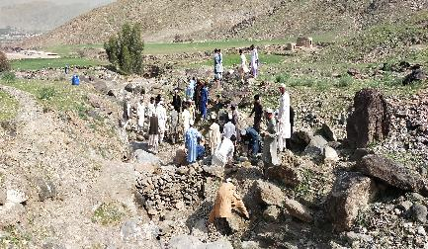
Implementation approach

Slide 15
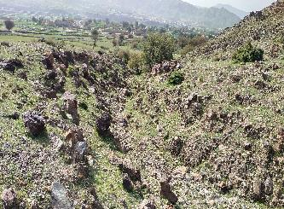
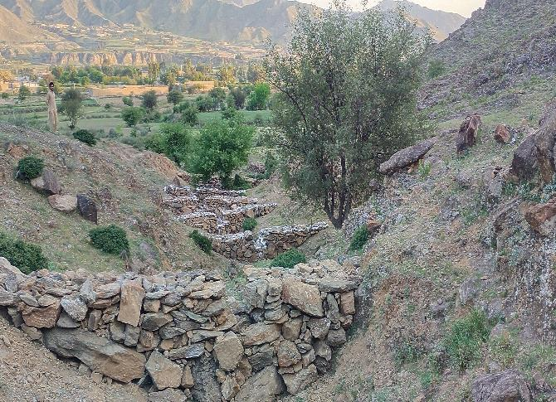
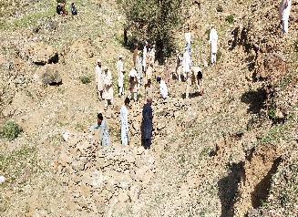
Implementation approach

Slide 16
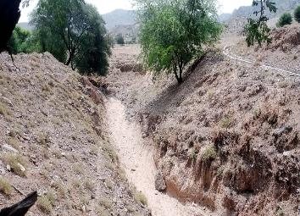
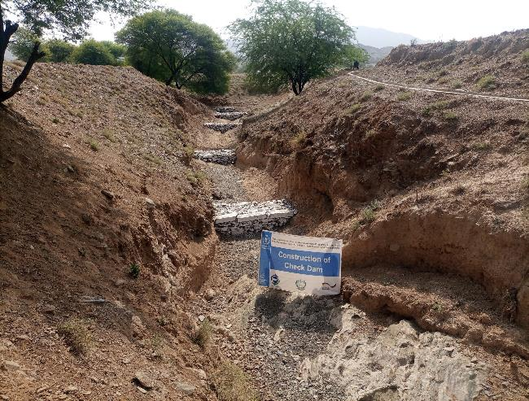
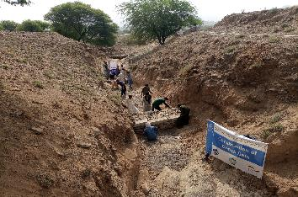
Implementation approach

Slide 17
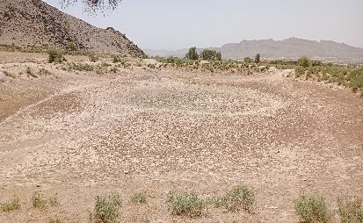
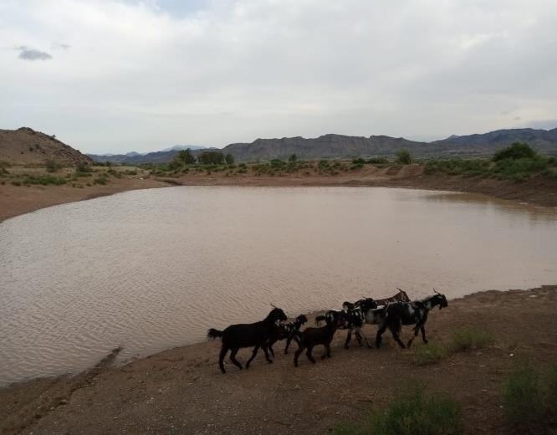
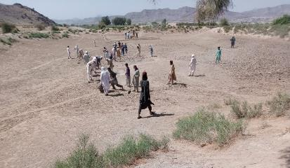
Implementation approach

Slide 18
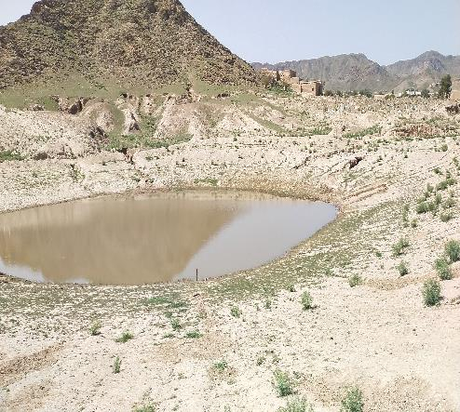
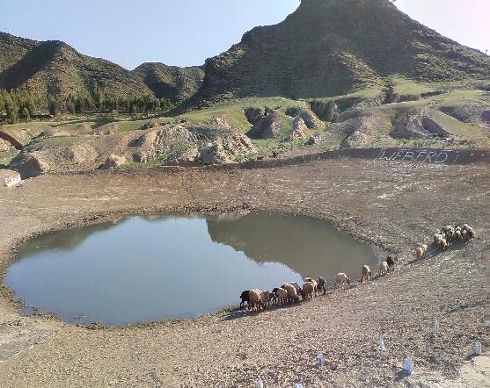
Implementation approach

Slide 19
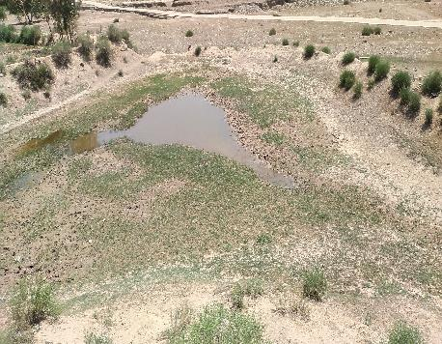
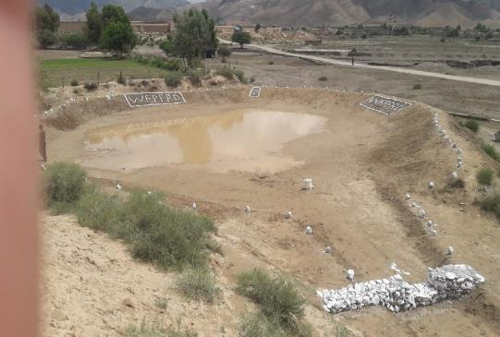
Implementation approach

Slide 20
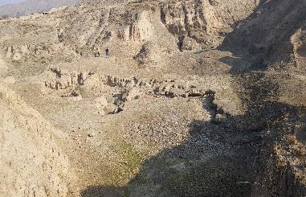
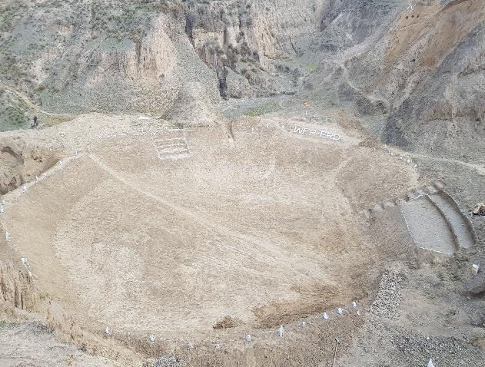
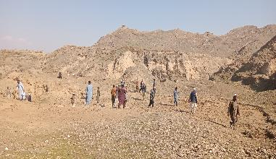
Implementation approach

Slide 21
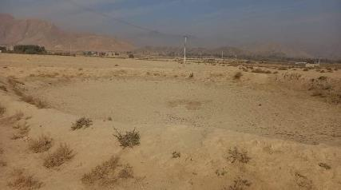
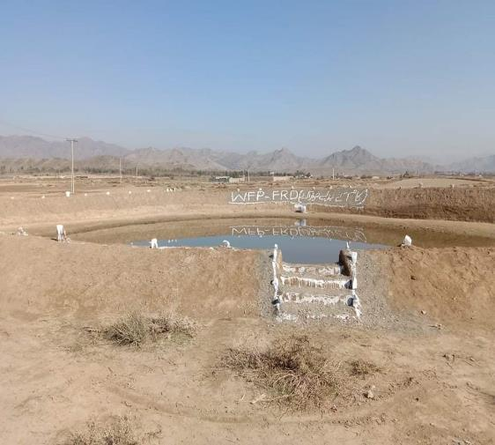
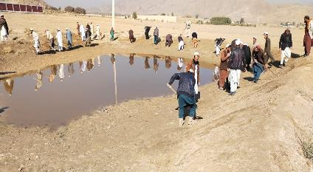
Implementation approach

Slide 22
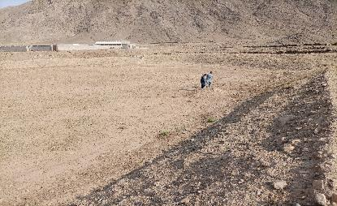
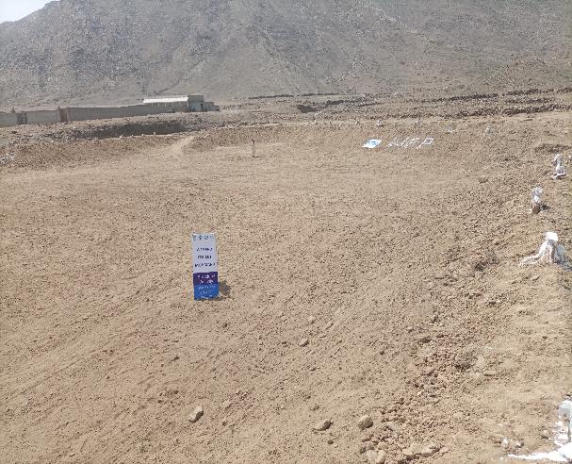
Implementation approach

Slide 23
Implementation approach

Slide 24
Implementation approach

Slide 25
Implementation approach

Slide 26
Implementation approach

Slide 27
Alignment with Country Development Strategy 2023-2028
In Line with DO 1: Broad-based, climate-resilient economic growth advanced
Under this Development Objective, the activity directly contributes to IR 1.2 Climate change adaptation accelerated, and making a conducive environment for IR1.3 “Climate changed mitigation actions advanced” by contributing to the regeneration of eco-systems health

Slide 28
Alignment with Government of Pakistan
The objective 2.10 of the Pakistan National Water Policy (2018) focuses on the improvement and management of watersheds through soil conservation, and treatment of catchment areas for sustainable development;
The objective 2.7 of the water policy emphasis the food security and expanding water availability to help adapt to climate change, population, and other large-scale stresses;
The objective 2.12 highlights flood management to mitigate floods and minimize their damages and the objective 2.13 covers drought management with emphasis on long-term vulnerability reduction;
The objective 2.16 focuses on Regulating groundwater withdrawals for curbing over-abstraction and promoting aquifer recharge;
The objective 2.19 encourages beneficiary participation and public-private partnerships.

Slide 29
Alignment with SDGs
The Activity is in line with the Sustainable Development Goals, which have been adopted by the government of Pakistan as National Agenda.
Target 2.3 Increasing access to productive resources for agriculture productivity and we increase access to both surface and Underground water.
Target 6.1, safe and affordable drinking water, Target 6.4, water efficiency and reduce water scarcity, Target 6.5 Integrated water Management and 6.b involvement of local communities.
Target 6.5 Integrated water Management and 6.b involvement
of local communities.

Slide 30
Alignment with SDGs
11.5 reduce sufferings and losses including economic losses from disasters including water related disasters.
Target 13.1, increasing resilience for climate related hazards and DRR.
Target 15.3 restoration of degraded land, drought and floods affects and overcome land degradation

Slide 31
Process of construction of check dams

Slide 32
Process of pond construction

Slide 33
Action of check dams

Slide 34
Action of check dams

Slide 35
Expectations from USAID
Support the upscaling of the intervention to enhance the impact on bigger level with visible changes to the aquifer
Provide resources for value addition in the form of Recharge wells

