Slide 1
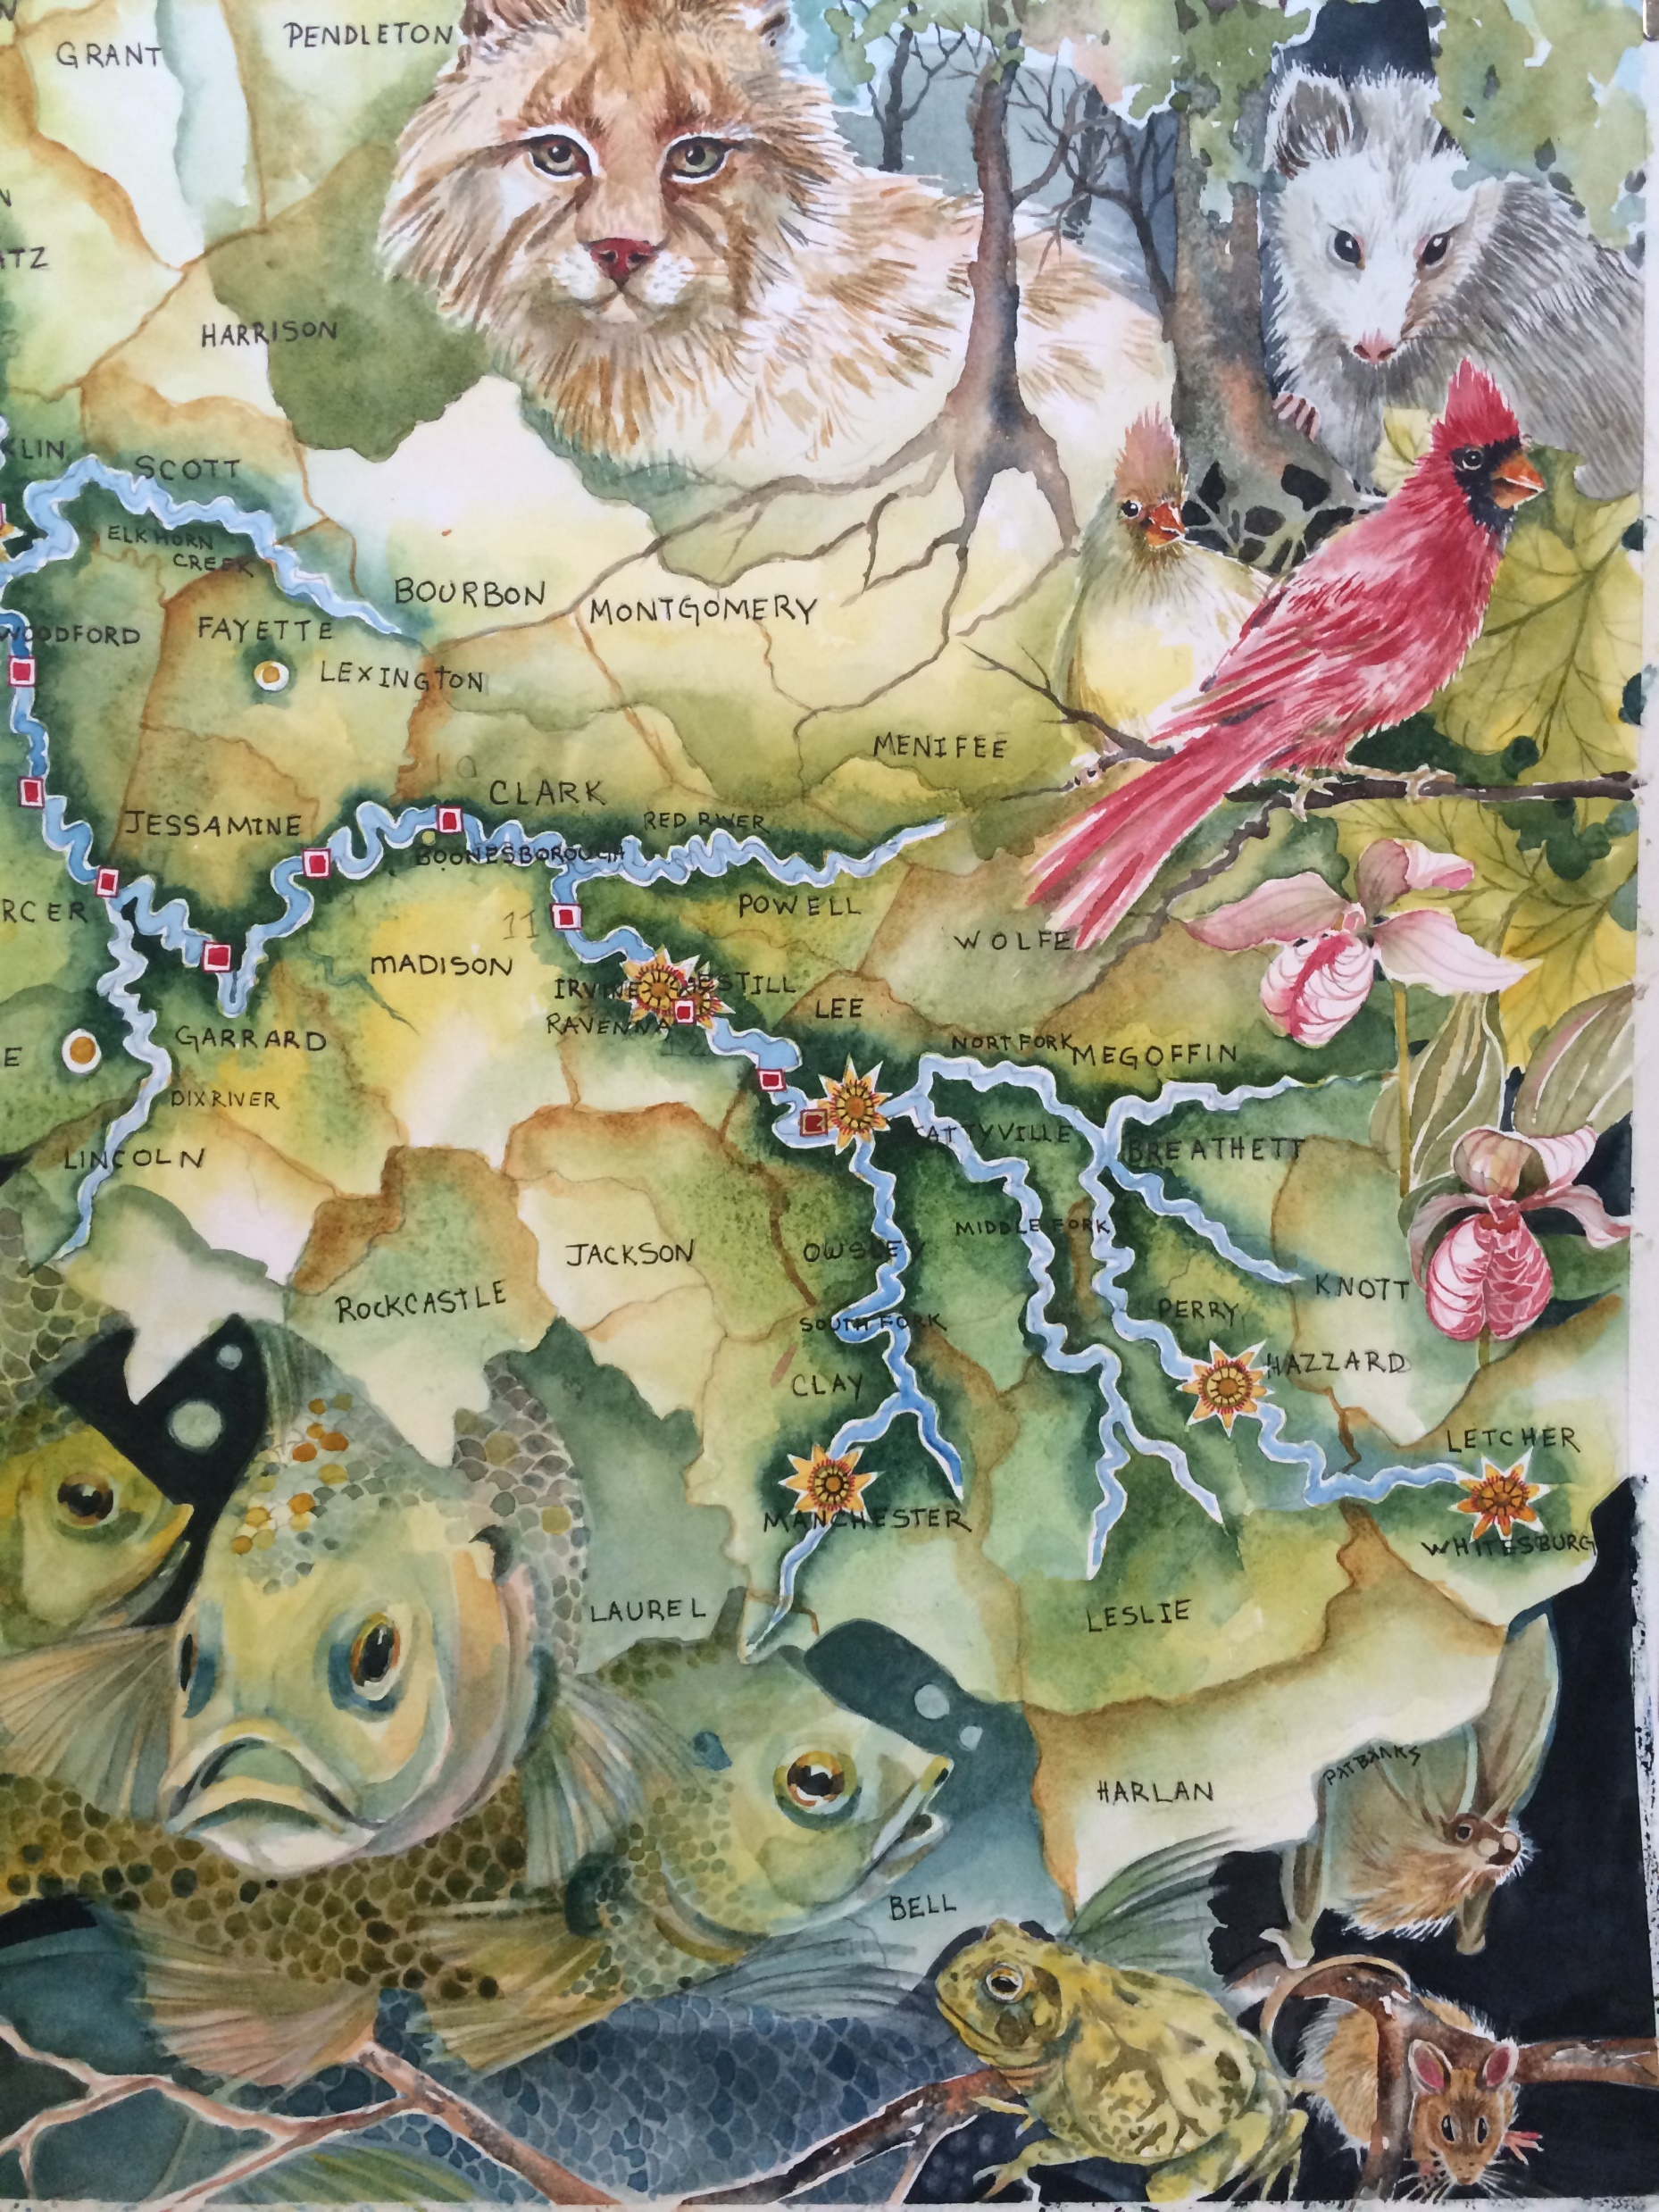
Discover the Kentucky River
Watershed
Through History, Science, Art, Culture, Conservation,
Recreation and Education
Funded in part by:
The Kentucky RIVERKEEPER
The Kentucky River Authority
The Kentucky Arts Council
The Kentucky Water Resources Research Institute

Slide 2
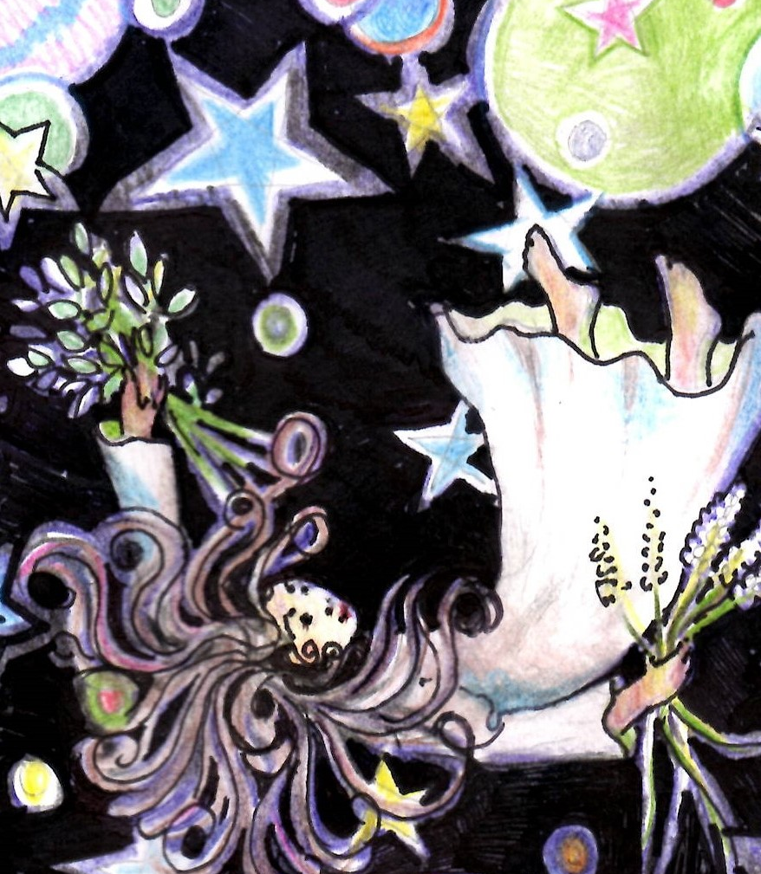
Introduction to the Project
For us to understand why it is of utmost importance to develop and practice stewardship of the Kentucky River Watershed, and of course the world because we are part of the larger system, we must understand that what happens on the land and in the air affects what is in our water, and in our bodies.
We have had different philosophies, languages, cultures, and experiences in our approach to using the land, water, and resources. We have had differences in our practices of stewardship, sustainability, and responsibility..

Slide 3
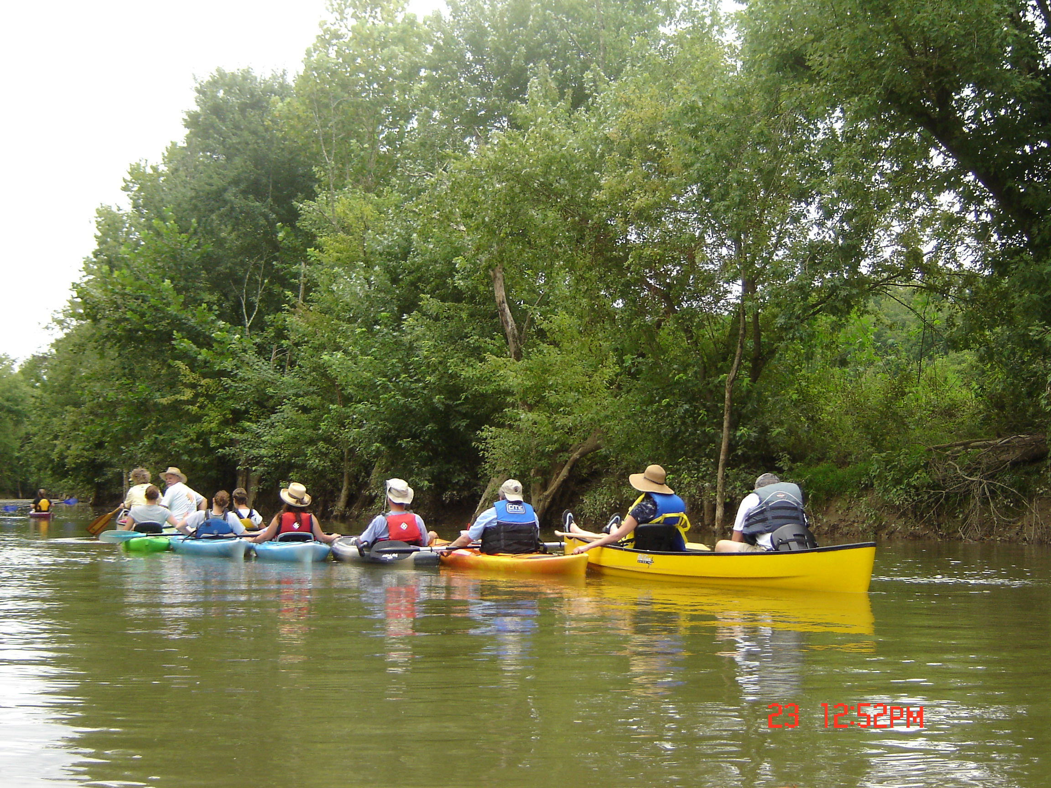
In this collection of chapters, we are exploring the Kentucky River Watershed through the lens of science, history, arts, culture, conservation, recreation, and education. To support the lesson plans we have collected and created handouts, projects, and experiences to enhance, illustrate, illuminate, inform, and engage the students’ senses and spark creativity and curiosity

Slide 4
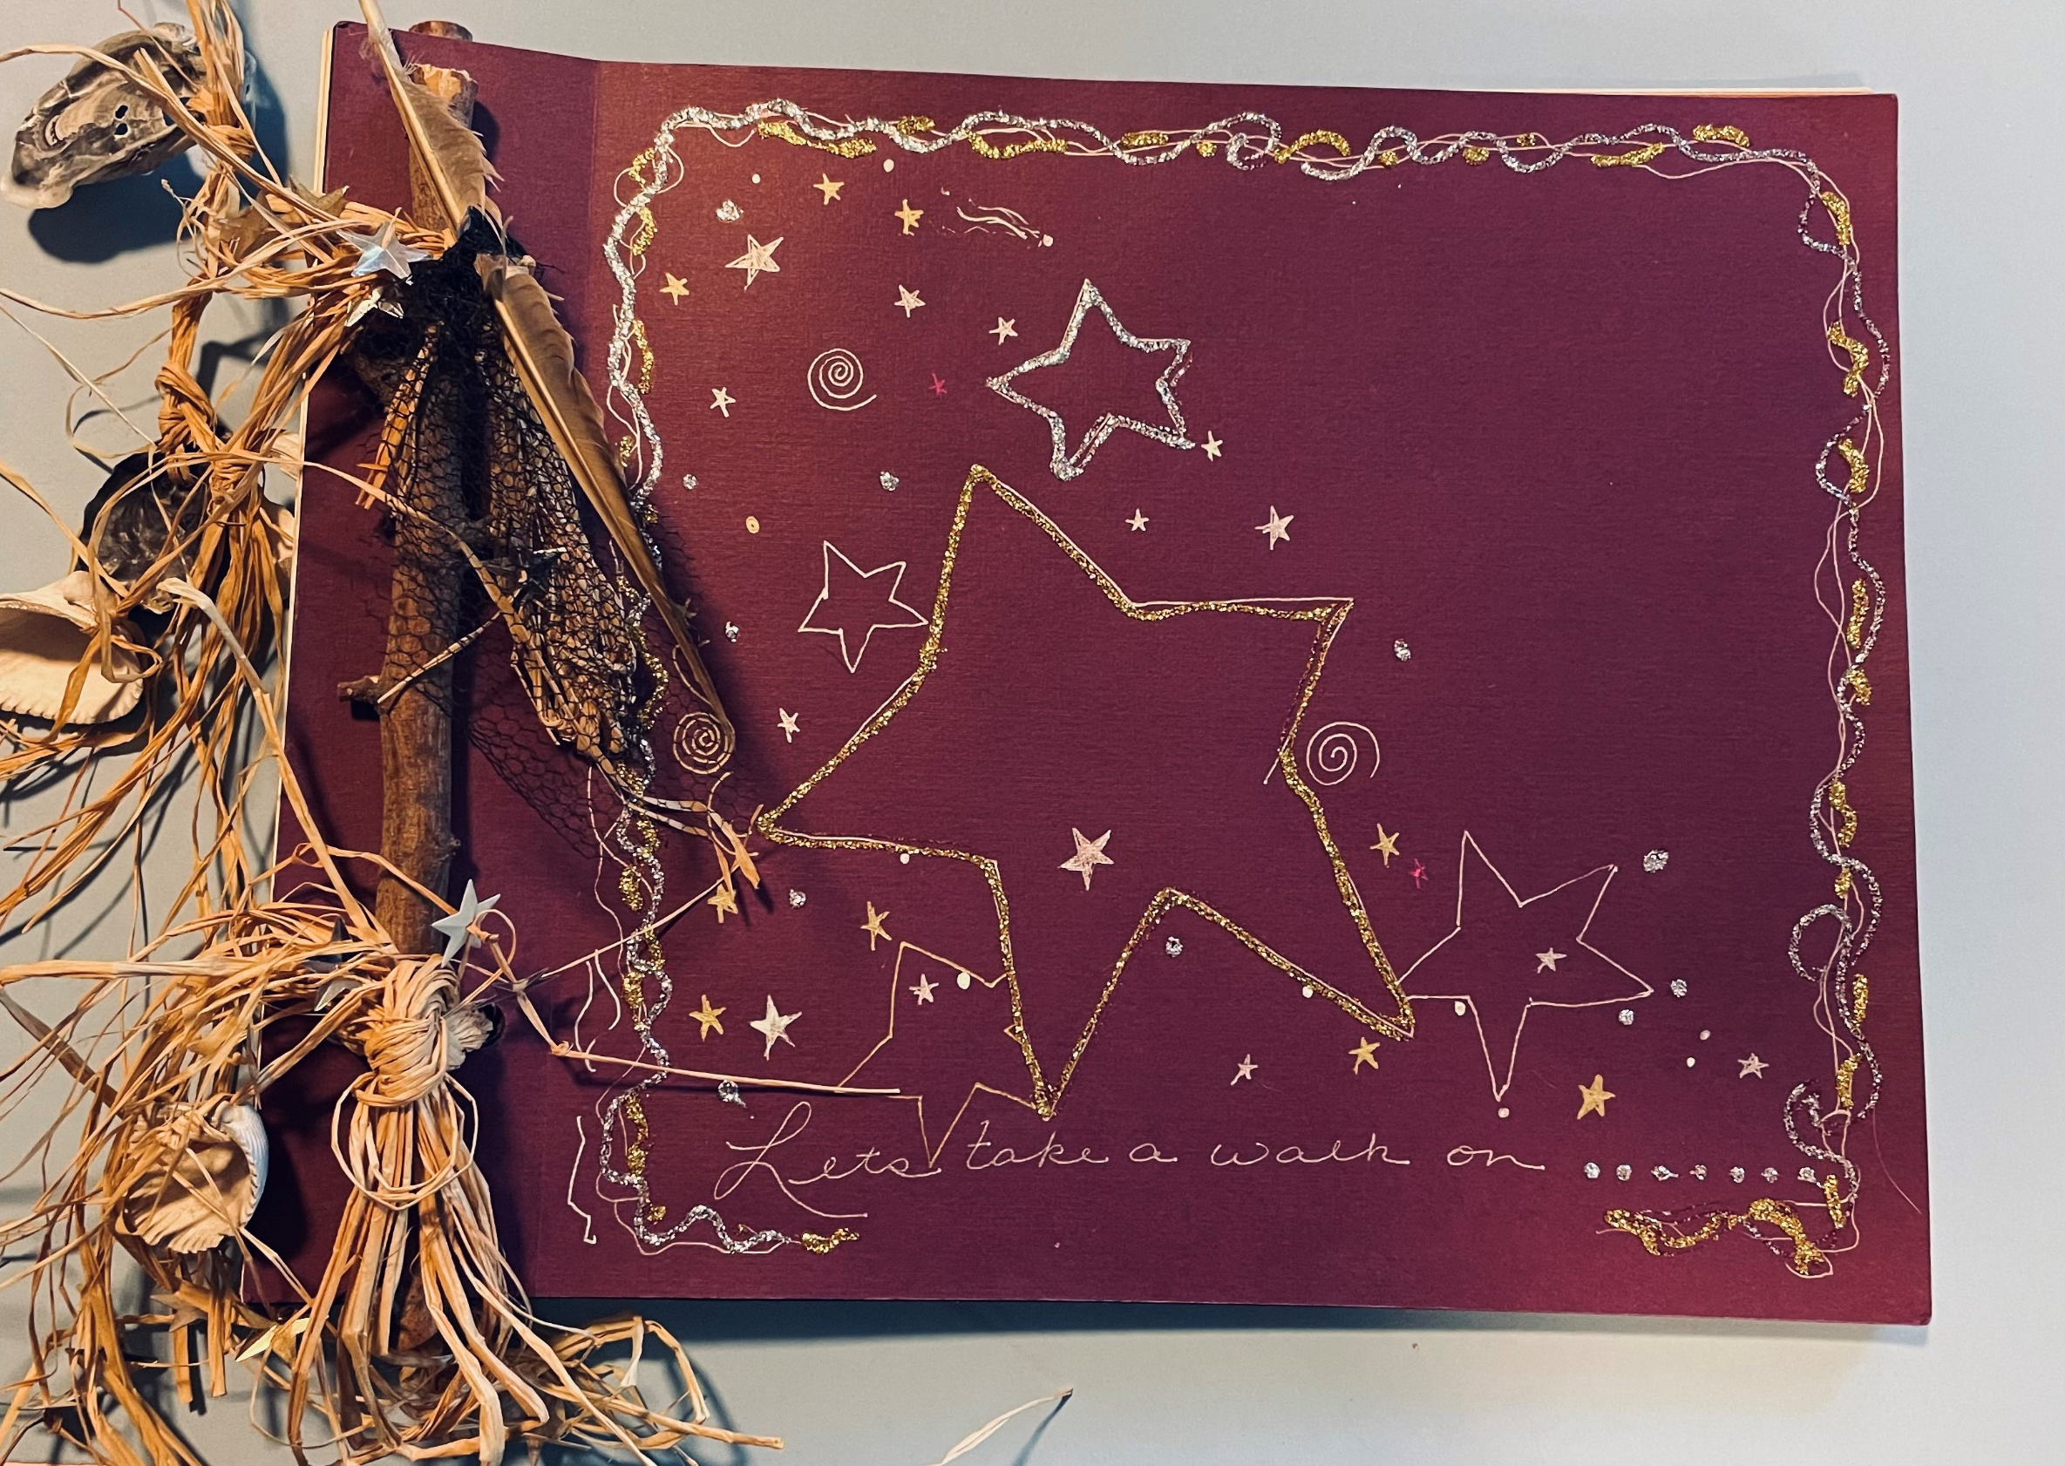
One of the first things to note is the idea of students (and teachers) keeping a “Journal.” As the students work through the chapters, activities, maps, and handouts they will accumulate materials that need to be organized and presented

Slide 5
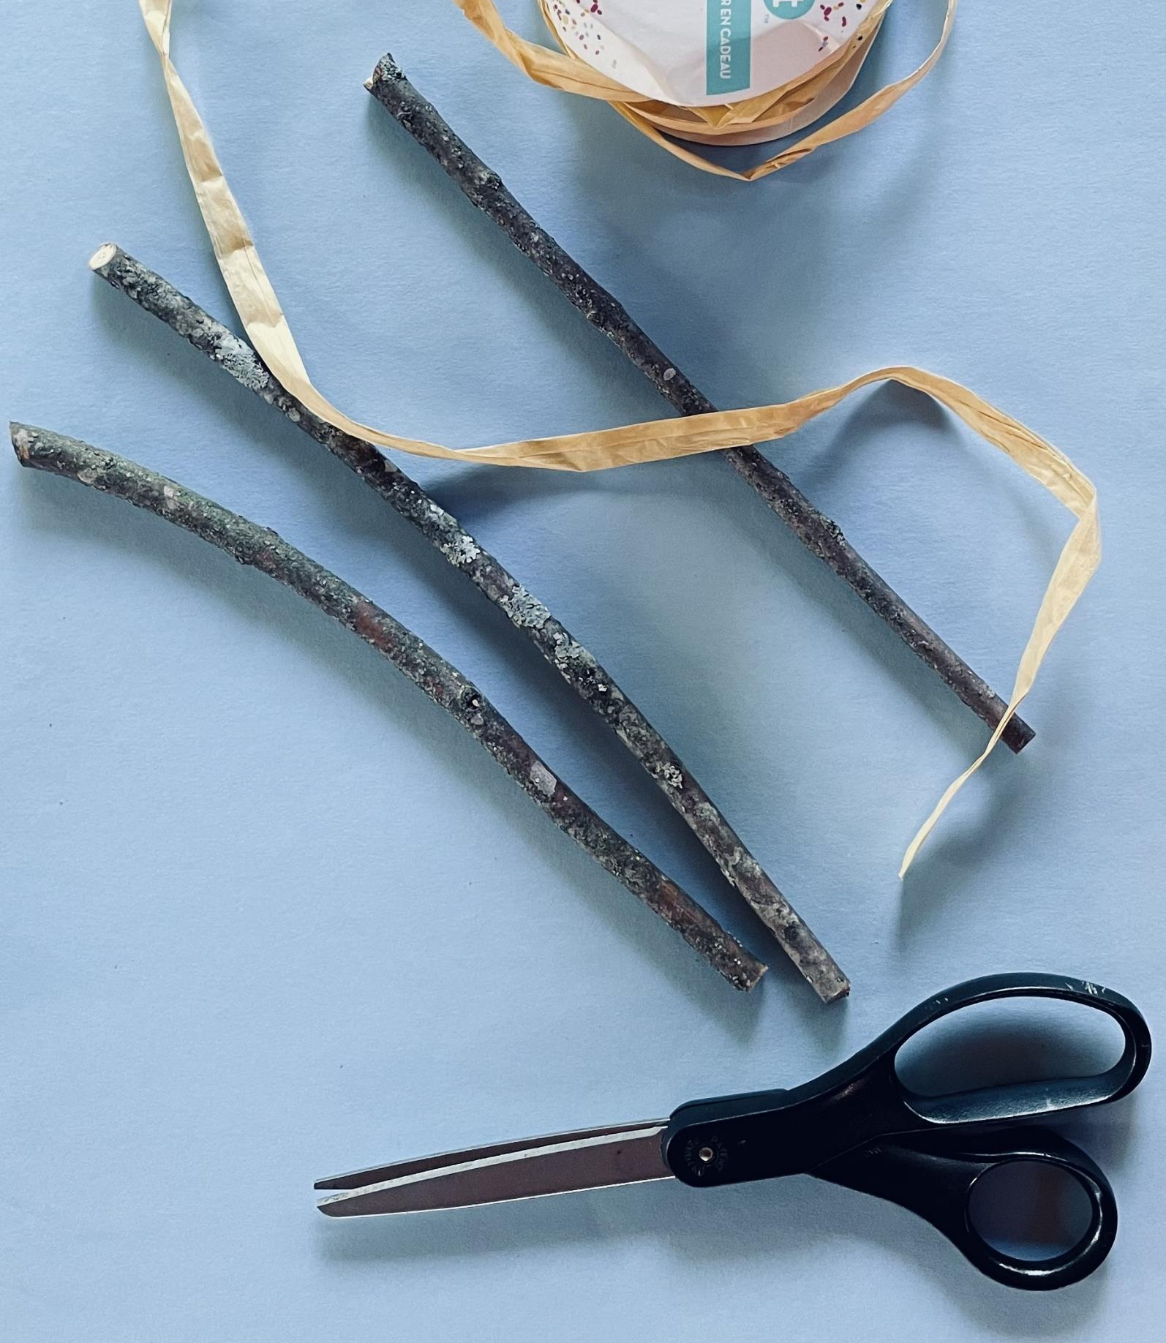
Students will learn some practical, basic skills such as using a ruler, glue and scissors while having an in-depth experience of what the Kentucky River Watershed means to all of us! (See suggestions on making the journal) This hopefully will be a meaningful resource and keepsake for the students.

Slide 6
We have supplied some of the academic standards for your convenience, however we know there are more connections you (the teacher) can make through connecting disciplines, grade and achievement levels and experiences. We have some teaching tips, ideas and supports included in the materials as well!
Levels K-High School
Note: The strands continue through High school, not by grades but by levels of accomplishment: HS Proficient (I), HS Accomplished (II), HS Advanced (III)
Anchor Standards 1: Media Arts: Generate and Conceptualize artistic ideas and work
MA:Cr1.1.K MA:Cr1.1.1
MA:Cr1.1.2 MA:Cr1.1.3
MA:Cr1.1.4 MA:Cr1.1.5
MA:Cr1.1.6 MA:Cr1.1.7
MA:Cr1.1.8

Slide 7
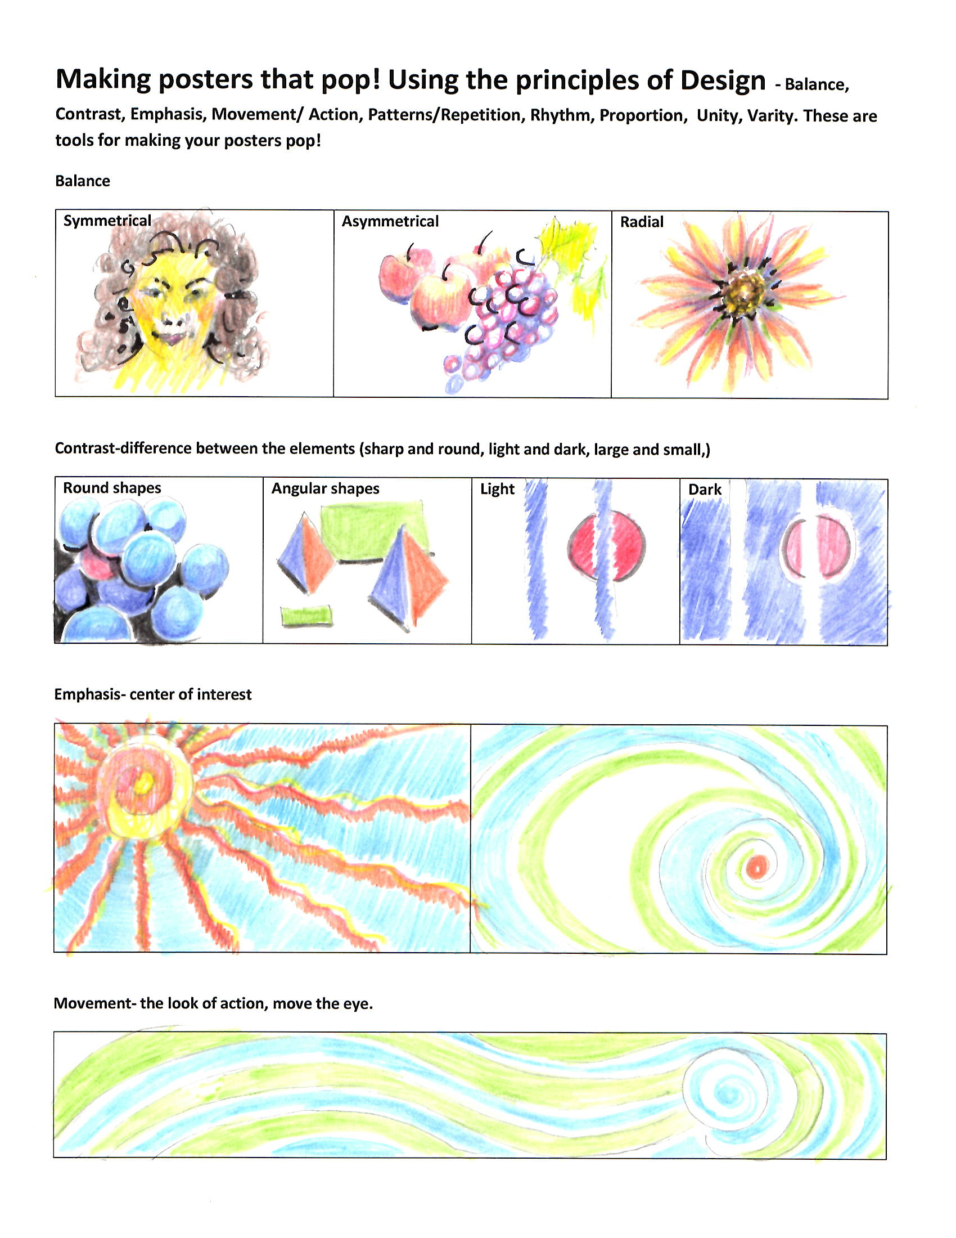
We have an extended RESOURCE section. Some of the resources are for a specific chapter but some of them can be used throughout the chapters.
How to make posters POP!,
Creating a Journal
Portfolio,
Poetry
Maps etc.…
So, feel free to use these where they fit your schedule and class plans.

Slide 8
How to use and think about this collection of lessons.
These lessons can be used throughout the 1-12 curriculum as supplements to other content areas and disciplines.
These lessons can be used as content connections to traditional disciplines but can also be used to make connections up and down the curriculum. Such as a science teacher working on environmental pollution can use “the making Posters that Pop!” and languages arts for content, factual writing and informational communications. These are connected and inform each other.
Some of content is traditionally presented at lower grade levels and other content at higher grade levels such as: teaching the water cycle in lower elementary grades can be relevant to the upper grades as it is integral in the understanding of the impacts of pollution and its affect locally, regionally and worldwide in our environment. Pascals law that might be taught in the upper grades can be related to the lower grades through the lock and dam systems and the flow and management of their Kentucky river.
We are trying to make connections to inform and connect this knowledge and create a body of work that is connected conceptually , emotionally, historically, socially, responsibly and creatively.
This is important because we are in a world and time that makes it necessary to find solutions that we might not know we need. We believe that we need to change our relationship to nature, instead of being at war with nature, we need to live with nature. Thinking and connecting across disciplines, philosophies and cultures and language will help us become better stewards.

