Slide 2
Hold Your Dollars! The right, and wrong ways to engage North Korea
Georgetown Security Studies Luncheon
October 30, 2018
William Brown, NAEIA.Com

Slide 3
Washington Post Blog

Slide 4
2017 Tensions Lead to …
April 7 -- Trump-Xi Summit, after year of nuclear and missile tests, China imposes near embargo on imports from NK.
Summer -- NK domestic oil prices soar, exports fall steeply
Sep 2 -- NK 6th nuclear test, ten times larger than previous 5.
Fall -- Trump “Maximum pressure” campaign intensifies.
Nov 28 -- ICBM ‘’straight up” launch.
2017 -- NK GDP said to drop 3.5 percent, by ROK estimates.

Slide 5
… His big 2018 Initiatives
In New Years address Kim suggests participation in SK Winter Olympics.
Requests summit with Trump/Trump immediately accepts.
Travels to Beijing, three times—talks up agriculture, maybe reform.
Travels to DMZ, two times—talks up N-S trade, investment.
Meets Trump in Sinagpore—talks up end of hostile relations.
Jan and April tells public top priority on economy, nukes are complete.
He continues to allow markets to grow, money to trump rations.
But state media still proclaims socialist economy, holding nukes.
While creating dangerous domestic expectations for positive change.

Slide 6
Two Theories
1. Kim Acting on Strength of nuclear and missile successes.
2. Kim Acting on Weakness -- immediate crisis of Chinese sanctions combined with long term erosion of command economy, rise of markets, and of US (“bloody nose”) pressures.
Policy advice differs based on theory.
If 1, tough, ”strategic patience “ needed to deter and change North Korea or, simply accept nuclear North Korea.
If 2, engagement is warranted to press the advantage and force change.
No one knows
I line up with 2. If Kim is in a box, engage to change.

Slide 7
Kim in a Box
Command Economy System
Only remaining M-L command economy
Broken
Stuck in dual traps
Bottom -up, Not top-down, reforms
Markets
Money
Limited foreign trade, no foreign investment
Debt Default/Foreign aid dependent
Col B , non WTO tariff treatment
Very tough Chinese Sanctions
Kim’s New Promises
Since Singapore—high expectations for growth
Very tough environment—exchange rate, drought, no aid, oil power shortages
Sanctions remain as long as no progress on de nuclearization
Reforms are dangerous but only way out. So Engagement should try to lessen danger of reform.

Slide 8
Broken Command Economy
Marx—no trust of markets, especially labor and capital markets
Lenin—created non-money system, rule by ration, central plan
All socialist countries failed, weak incentives, overly complex,
NK planned system also failed, famine, but propped up by outside fears.
Markets now prevalent but plan, rations still exist—half/half
Market economy “ law of one price” arbitrage
Planned economy “law of ration” fixed, policy price
North Korea “land of many prices “
Examples -- textile workers, electricity, rice

Slide 10
Trade Troubles
Not really ‘hermit” kingdom
Always needed trade
Not focused on comparative advantage but absoltute advantage—exports only what it needs to buy commodities it doesn’t have, can’t make.
Exports—ferrous and non-ferrous metals, coal, textiles, fish
Imports—oil, machinery, coking coal, industrial inputs
UN and unilateral sanctions gradually pushed all trade to China.
Since mid-2017, China also has closed the door to imports from NK. Its exports to NK also have fallen sharply.
No aid except Chinese crude oil, no investment.

Slide 12
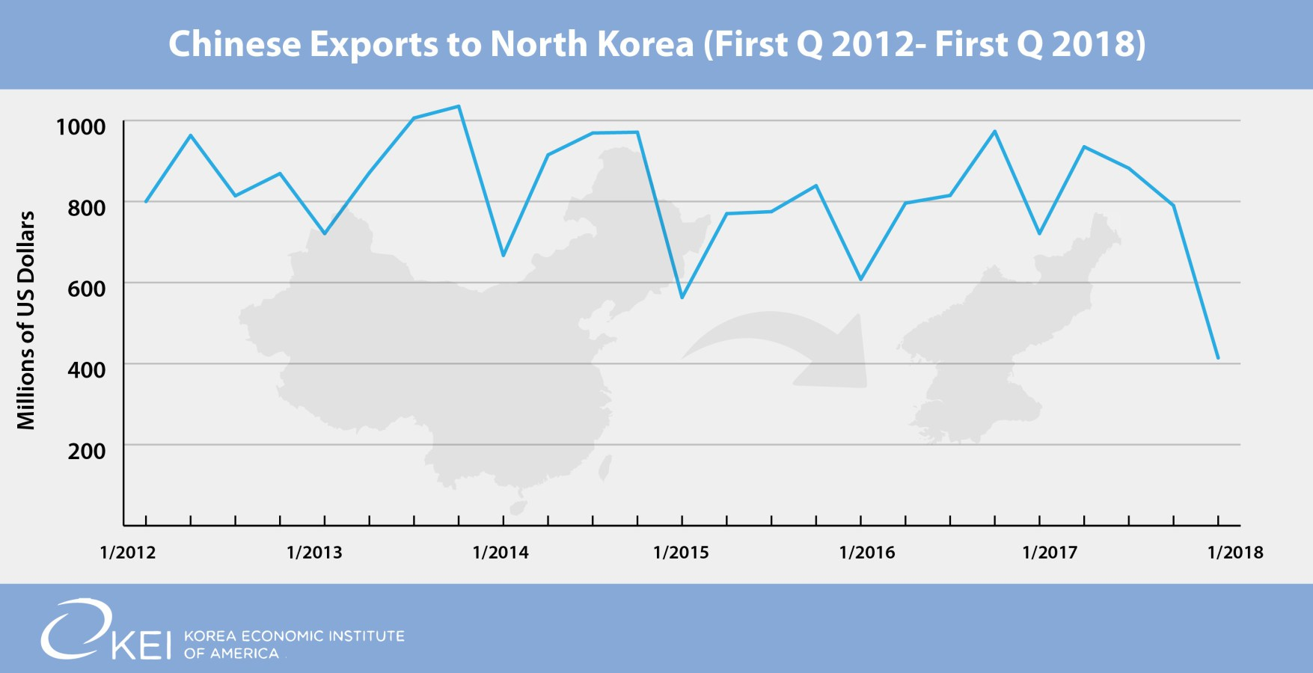

Slide 13
China-NK Goods Trade Balance

Slide 14
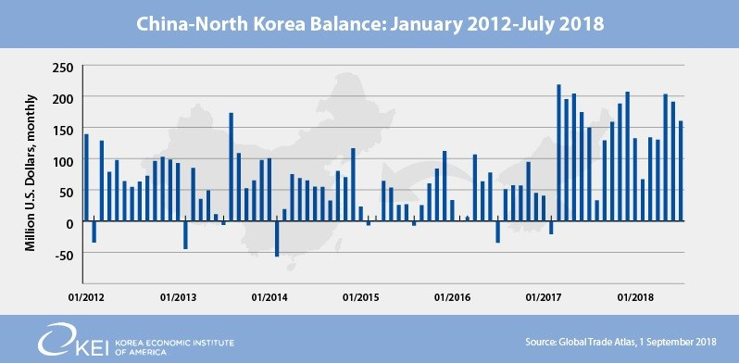

Slide 15
Money Troubles Rations to dollarization in 3 generations.
Grandfather Kim’s (Il Sung) command economy didn’t use money. Rations gave the regime totalitarian control over citizens.
Father Kim (Jong Il), after famine, couldn’t provide rations and allowed won to be used as money, which succumbed to hyper-inflation .
Kim Jong Un is allowing full influx of dollars and yuan into economy, stabilizing prices and the exchange rate
Mixed use of NK won, Chinese yuan, US dollars.
Implies total loss of fiscal/monetary control (like currency board)
Likely extremely tight money creation, no credit, no investment
Vulnerable to financial panic—sudden shift to dollars
UN sanctions hit ability to earn dollars.

Slide 16
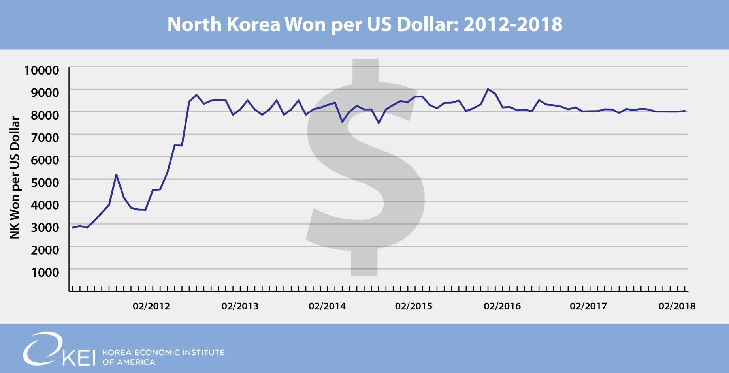
Controlling the won
http://blog.keia.org/2018/03/pyongyang-controlling-won/

Slide 17
Kim’s Mindset
Dangerous to speculate, no one knows. But new economic initiative in midst of tight sanctions must put him under great pressure to perform.
This summer/fall embarked on camping to isit industry and give “on the spot guidance”. Much of it negative “need to do better”. Cabinet members also. But Kim must know this won’t solve the problem.
Market activity driving economic productivity but state control is weakening, amid a divergence in incomes/wealth. Poorly paid military/buraeaucracy, especially dangerous.
Typical solution—create foreign emergency , nuclear test, would create disastrous relationship with China, cutting oil, so very unlikely.
Hoping for sanctionsrelief, money flow from South Korea to NK government. But so far, not happening.
But there is a positive way out—privatize i.e. liquidate state assets, firm up NK won, reduce government employment, raise state sector prices and wages, export to earn credit, sell/trade off some nuclear materials.
Can he do all this without de-nuclearization?

Slide 18
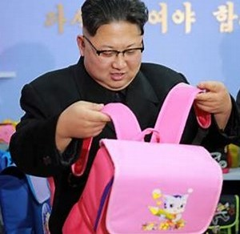
Nice, but the zipper doesn’t work.

Slide 19
Rules of Engagement
1. Engage on economic development/reform, not just denuclearization.
2. An early”give” might be to remove them from Terroist List and TWE act sanctions.
3. An early “ask” might be for the to return to “family farms”, allowing private property in agriculture.
4. Key rule should be any of our activities should pay workers directly, and start insisting NK do same for its own workers,.
5. Only use market, not official exchange rate.
6. Consider sanctions relief to open Kaesong, provided direct pay to workers, use of market exchange rate.

Slide 20
Rules of Engagement
1. No commodity or finanancial aid until above reforms are implemented.
2. No investment until private property is officially legalized and liberalizing money and banking reforms are set. We should offer to assist them in doing this, including advancing their membership in IMF, WB, and especially WTO memberships.
3. With such reforms, large amounts of Japanese repatration money combined with competitive FDI, should enable economic take-off.

