Slide 1
Is North Korea Losing its Socialism?
October 22, 2026
For GWIKS
William B. Brown
NAEIA.Com

Slide 2
A Paradox
State Fights to Centralize, Reclaim Socialist Controls
  Bankrupt state has no funds for investment led growth
  Sheds/Liquidates state owned capital to private use for growth
  Officially acknowledges private money, capital
  Tries to control foreign trade and finance
Just As Markets Force Decentralization
  Unstable won leads to strong dollarization
  Private use of capital spurs great productivity improvement and growth
  Increased flows of goods and capital from China.
  Huge inflation, collapse of won, as state loses control of finance.
Who Wins?
  My View, 60/40, is that Money will, is winning.
  What is Your View?

Slide 3
Pro or Re Action
Evading the socialist lifestyle crackdown | North Korea News
Jung Gu-jin, a visiting researcher at Seoul National University’s Law Research Institute, said the legal push reveals more than the regime intends. “The fact that North Korea enacted laws controlling the socialist lifestyle and even reflected this in its constitution paradoxically shows that what it considers an ‘anti-socialist lifestyle’ has likely spread widely enough for the state to feel it must control it at the national level,” Jung said.

Slide 4
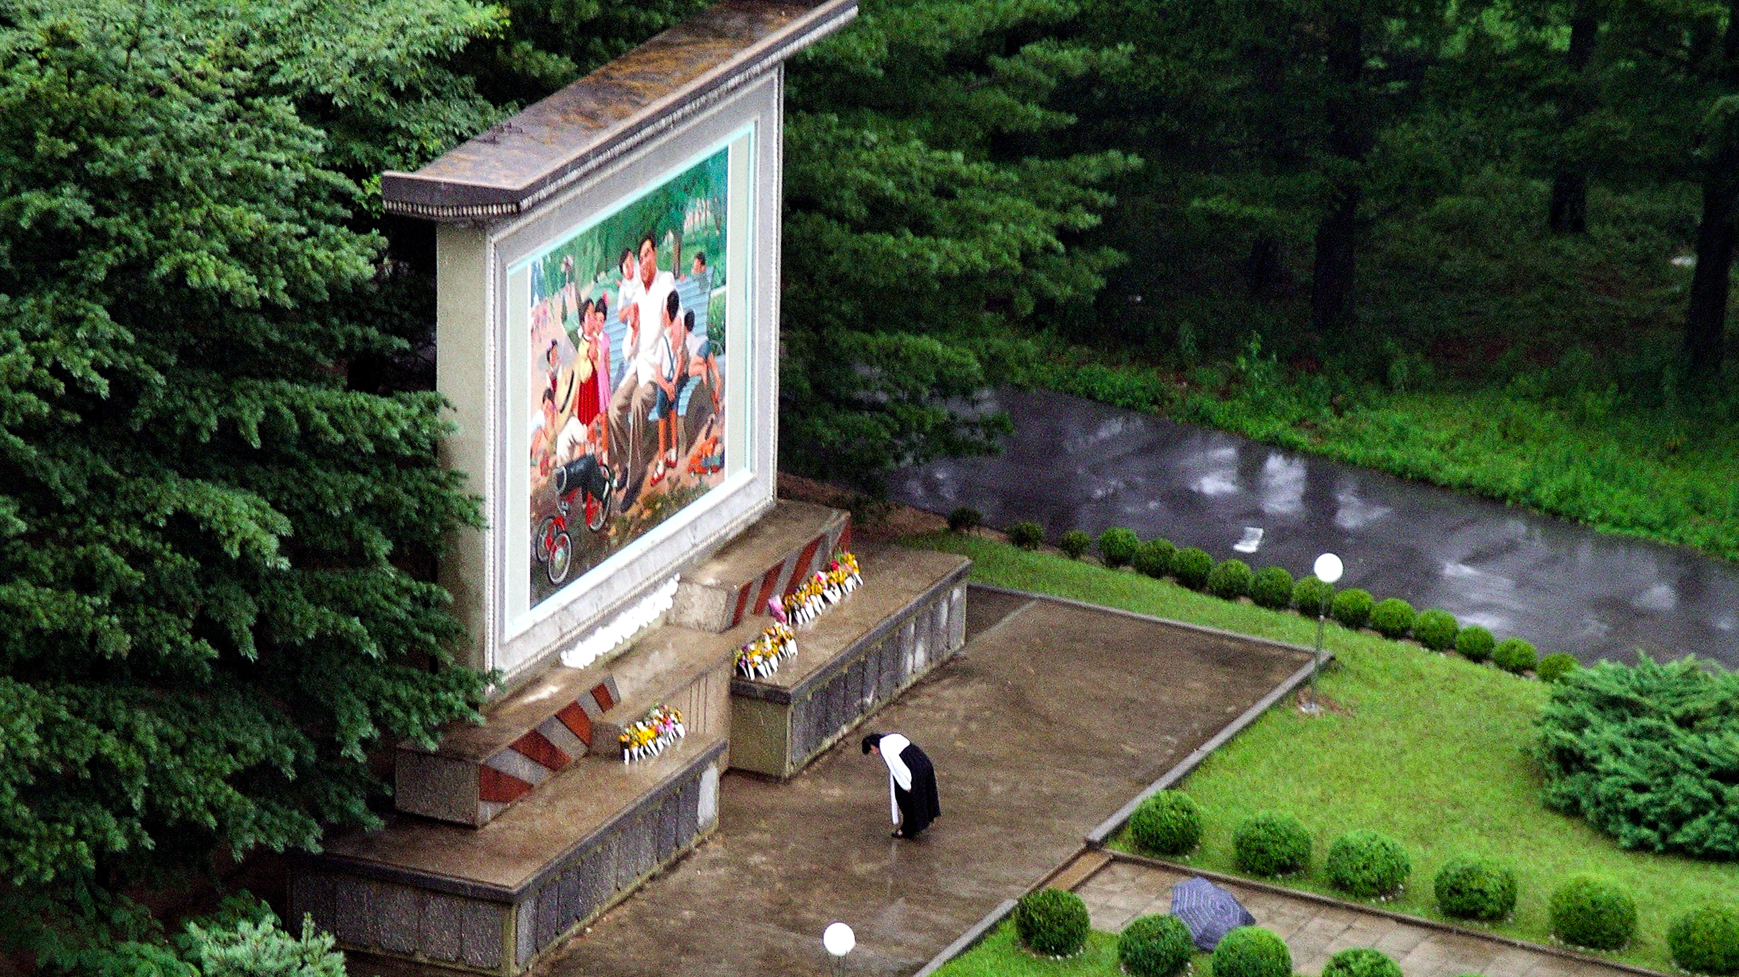

Slide 5
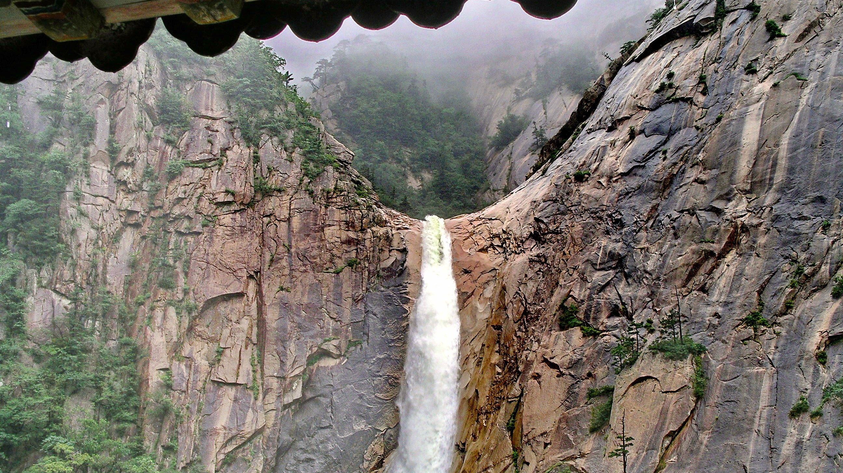

Slide 6
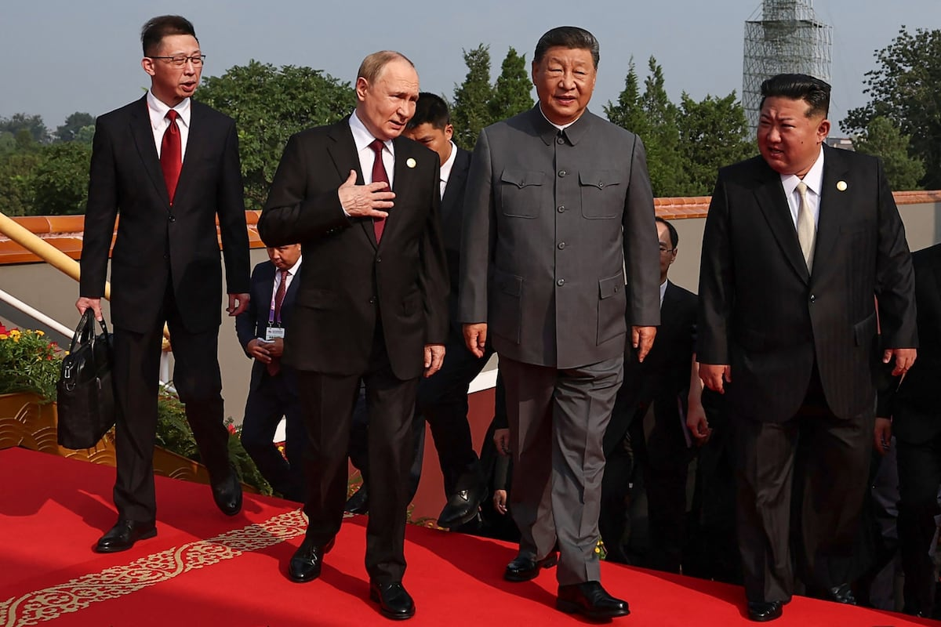

Slide 7
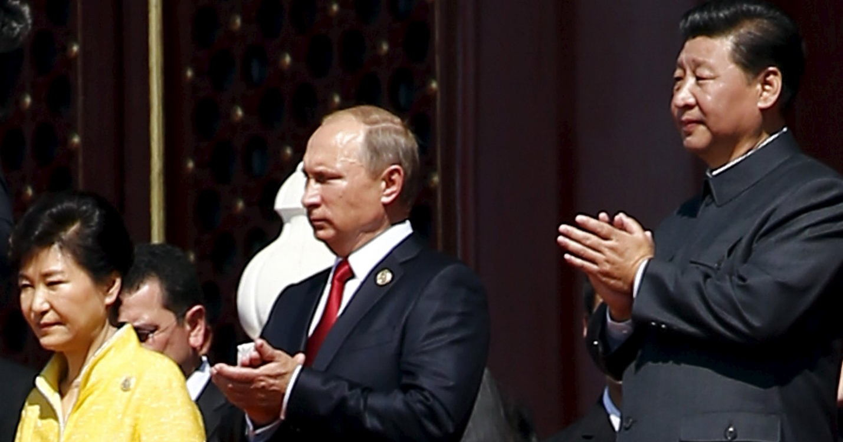

Slide 8
Current Economics Conditions:
What And How Do We Think We Know What We Know

Slide 9
What We Think We Know
A Very Poor Country
GDP in 2021 about $27 bn. BOK estimate
Population 26 million
Per-capita GDP $1,000 - $2,000
180 in the world
NY Times reports $1,184.79 in 2020 !
Negative growth 2020-22 (BOK)
Slight positive in 2023-24
Pick- up in 2025
Malnutrition, extreme poverty is prevalent, but no observed famine.

Slide 10
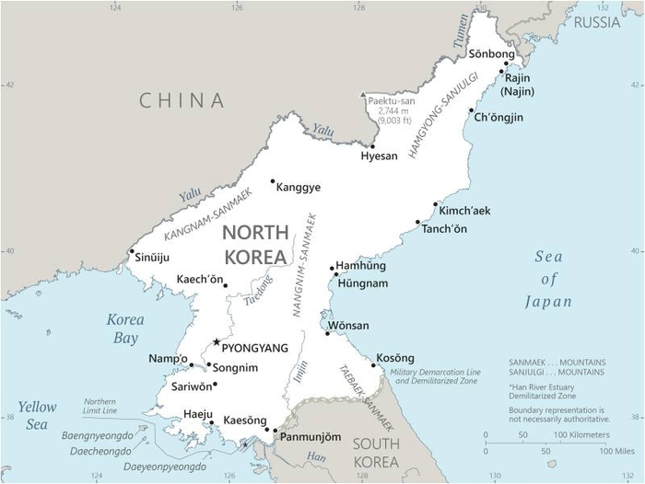

Slide 11
Sources:
NK Propaganda—Nodong Shinmun, KCNA etc.
They don’t outright lie. It is what they don’t say that is telling.
Data Sources
Defector units Daily NK and Aisa Press
Exchange rate and price data very helpful
Stories lean to the negative.
Chinese trade data, Timely and deep but obvious holes. Home - GACC
Governement sources:
US is opaque.
ROK tends to political
Bank of Korea, nice try but not good enough
Media
Stories are observational. Beware of what they don’t see. Overly confident.
Academia/Ad-hoc
Weak on macro-economics
Strong on anecdotes/particular cases

Slide 12
What Do Sources Say
NK Gov. Sources
  Very sparse data despite UN requirements. So, no international Credit
  New 5-yr plan underway. Goals not much different. A lot of talk about “socialist lifestyle”.
  Legal changes
    Allowing private autos
    Changing rules on agriculture—confusing but seem to allow more farm team discretion in selling to state (quota) and to market. Must sells to state food stores which sell to public. After quotas reached, market prices. (like food stamps for all)
    Allow private labor market at market wages.
    State still employes huge labor force, paid by old pulsed up ration system.
  Money used via state bank cards. Won/US dollars/RMB
    My interpretation is won used for state purchases, intra industry. Yuan for foreign imports. USD for savings, big capital purchases. (housing)

Slide 13
Best Data Sources
NK Won Market Exchange Rate
Two sources, Daily NK, Asia Press
Official rate appears to have gone away.
Biweekly phone surveys
    After collapse last year, won/dollar/yuan stable recently.
    Exchanged freely.
    Won used for strict govt. functions, small change.
    Yuan used for foreign imports, China
    Dollar used for savings, large capital expenditure.

Slide 14
NK Won Exchange Rate

Slide 15
NK Won per USD

Slide 17
Other government Sources
US intel says nothing.
  Agriculture and USGS provide annual reports
UN agencies, UNDP, UNFAO, WFP say little new.
  Agriculture this year and last seems good, weather is fine.
  No sign of corn – soy shift, proclaimed by Kim in 2024
ROK
  Politics dictate. Lee government doesn’t want to embarrass Kim.
  Bank of Korea says 3 percent GDP growth last year.
    Useless macro figure, interesting micro/industry data.
    No mention of inflation, balance of payments, exchange rates, etc.
    Industry data shows very little energy growth.

Slide 18
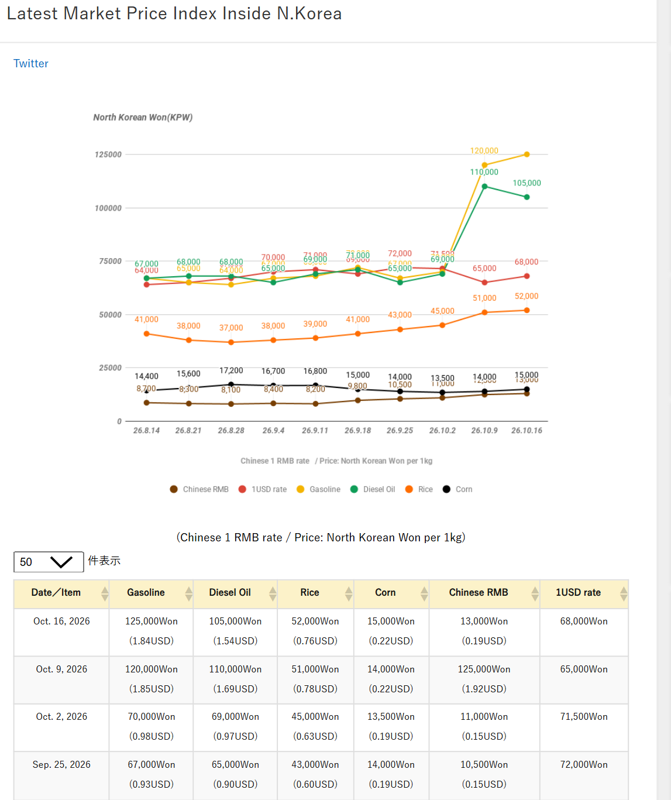
Asia Press Price Data

Slide 19
Six-Week Asia Press Prices Latest Market Price Index Inside N.Korea
Gasoline shoots up.
Diesel holds
Rice/Corn ratio is good
Dollar/Yuan is jumpy.
 | Gasoline | Diesel | Rice | Corn | R/C | $ | Y | $/y | Int. Y/$
4-Sep | 67 | 65 | 52 | 15 | 3.5 | 70 | 8.4 | 8.3 | 6.68
11-Sep | 68 | 69 | 51 | 14 | 3.6 | 71 | 8.2 | 8.7
18-Sep | 72 | 71 | 45 | 13.5 | 3.3 | 69 | 9.8 | 7.0
25-Sep | 67 | 65 | 43 | 14 | 3.1 | 72 | 10.5 | 6.9
2-Oct | 70 | 69 | 41 | 15 | 2.7 | 71.5 | 11 | 6.5
9-Oct | 120 | 110 | 39 | 16.8 | 2.3 | 65 | 12.5 | 5.2
16-Oct | 125 | 105 | 38 | 16.7 | 2.3 | 68 | 13 | 5.2

Slide 22
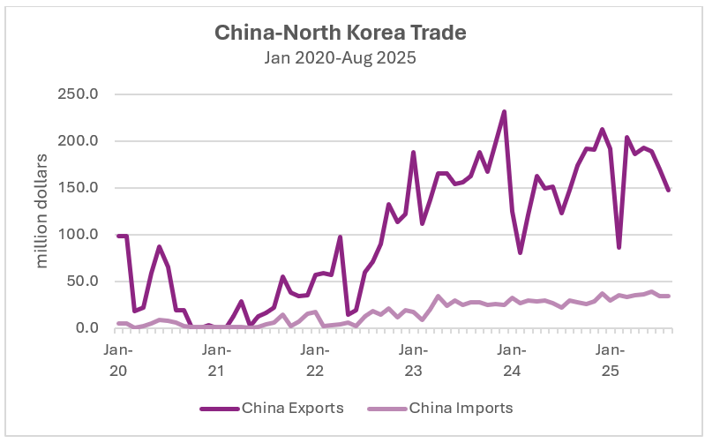
Plenty of Imports, Not much exports.

Slide 23
Beginning of Kim’s 3rd Five-Year Plan
KJU Resurrected 5-year plans
2016-21 Plan—first after 20-year hiatus
  Byongjin
  Tourism projects
2021-5 Plan
  Focus on 12 key industries
  Urban housing
  Provincial development
  Decentralized development? 10x20
New Plan, Not much different
  Health Establishments
  Military
  State Control + Economic Establishments
  Productivity Improvement
What Kind of Plans Are These?
Soviet style-Ration Directed or
French Style – Indicative Plans, Money Directed
Are they slowly moving to decentralized decision making or are they trying to retain central control over everything. Role of money will give us the answer.

Slide 24
Economic Growth
Growth in Economy ( Gross Domestic Product ) is a function of:
  More Inputs of Capital, Labor, Land, Natural Resources
  Efficiency in use of these inputs. Total Factor Productivity
Capital inputs --Capital Stock built by Savings employed as Investment. Includes physical and human capital. It depreciates. (NDP)
Savings is production less consumption. Labor is working hours delivered by working age population.
Socialist or “command” systems grow by forced saving and investments as determined by state planners. Capital or “means of production” owned by the state. Markets, money interfere with the plan. Fixed--non adjusting--wages and prices, weak incentives and slow adjustment, are problems. Rations are key.
Capitalist systems,s where capital is owned privately, grow by profit driven efficiency, determined by competition. Prices force adjustments. Monopoly interferes with competition, and “externalities,” require regulation. Money is key.

Slide 25
Poverty Trap
Subsistence Economy, no savings possible.
Growth can come only via external sources of savings/investment, foreign aid, or efficiency change (technology).

Slide 26
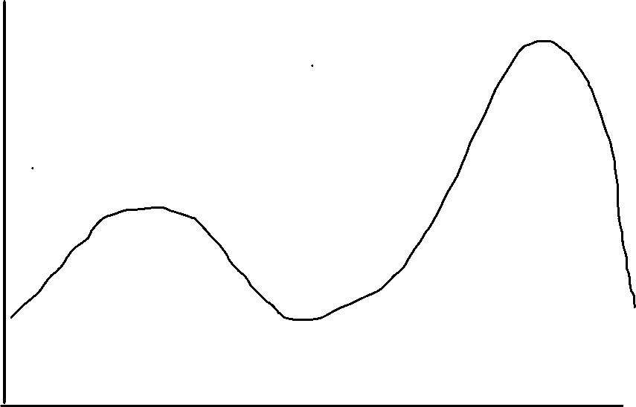
Production
efficiency
Stylized Economic Systems
Rule by ration
Rule by money
Command (state) Mixed Market (private)

Slide 27
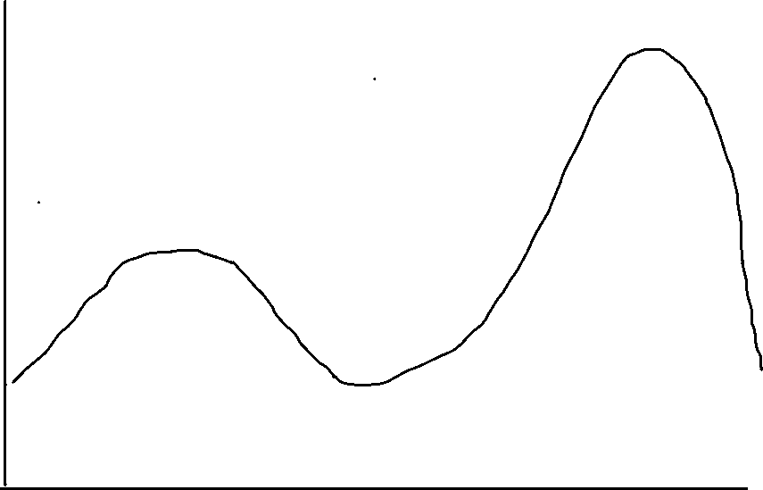
Production
efficiency
Stylized Economic Systems
US 2008
<< US 2023
China 2023 < >
USSR 1957 >
China 1978 >>
Two prices
Law of one price
Many Prices
Command (state) Mixed Market (private)

Slide 28
Production
Efficiency
North Korea: Caught in the Middle
1960
2025?
2017
2023
1995
Command (state) Mixed Market (private)

Slide 29

Production
Efficiency
North Korea’s Double Trap
1960
2017
2023
Poverty Trap
1995
famine
Command (state) Mixed Market (private)

Slide 30
Why is North Korea So Poor?
Hint: It is not for lack of capital and resources, or culture
Excellent natural resources per capita
  Nonferrous , rare earths, and iron metals
  Hydro power
  Coal
  Relatively low pop density for East Asia
Excellent geography
Good human capital relative to income
Much industrial capital
Well organized ancient civilization

Slide 31
Answer—Weak productivity
North Korea’s system makes poor use of its ample physical and human capital resources—probably the worst in the world.
Why? Two issues, one micro, one macro
  Mixed command and market system delivers poor economic decisions. Two prices for everything.
  Partial dollarization stopped inflation but impeded monetary policy, starved state economy.
  State now trying to recover, raised wages 10 times!, creating new bout of hyperinflation.
Trapped between both systems. Poverty trap plus transition trap.

Slide 32
Not Always This Way: 1945 in Good Shape
Probably in better shape then rest of Asia. No WWII in Korea.
1910-'45 Japan built up infrastructure, rail and electric, and industry in northern part of its Korean colony.
  taking advantage of mineral resources and hydro.
  avoiding US bombing
  launchpad for invasion of China
Russians counted 1,400 factories taken over by socialist state in 1945
Korean War devastating but Soviet, EE, Chinese aid built back quickly.

Slide 33
1956-1976 Golden Age of NK Socialism
By 1949 all industry socialized.
By 1956 all farms collectivized.
Central plan economy replaced ancient money/market economy
Trade was strong with bloc countries, Japan and Europe. US laws prevented trade.
Russians and Chinese criticized Kim Il Sung for too much investment, not enough attention to living standards, and weak exports but industry grew rapidly.
1976, prior to devastating default on western credits, probably peak year.
Downward spiral ever since.

Slide 34
Zhou Enlai and Kim Il Sung, circa 1960
Kim is visiting China trying to obtain more industrial aid
Zhou: ‘’We notice, looking across the river (Yalu) that you never have to turn off your lights. You have developed socialism far faster than we have.’’
KIS: ‘’Yes, but it is with your help.’’
Zhou: ‘’That is because you are holding down so many American forces, thus protecting the entire socialist world.’’ (Wilson Center Archives)

Slide 35
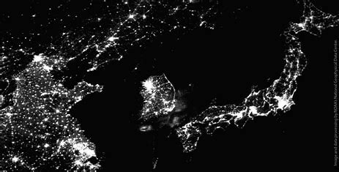
1997 Lights out

Slide 36
Command Economy
Marxism
Results
Strong central state
Ownership of capital (means of production) is by state or collective, no private ownership.
Plan emphasizes material growth via high investment, low consumption
State sets prices high for consumption goods, low for investment goods.
Allocation by decree via central plan.
High share of investment rel. to consumption.
No personal financial savings.
Individual incentives weak, poor productivity
Limited gains from trade—COCOM
All Marxist economies experience massive famine, dissolution.
Except North Korea
Labor is paid rations, not money.
No money economy creates dependent public.
Rejects market prices for capital and labor.
Divergent price systems prevents normal trade, investment with capitalist world.
Supply Chain Nightmare!

Slide 37
Capitalist, Market Economy
What is a Market?
Marketization: Much more than “marketplaces”
Goods Markets
Services Markets
Labor Markets
Real Estate/Land Markets
Capital/Finance Markets
Foreign Exchange Markets
Private ownership of means of production
Many sellers, Many buyers
Rules, Structure
Time, currency, behavior
Compete for best price
Market clears with flex price
Usually most efficient outcome
Decentralized, Unplanned
Law of One Price
Requires competition, the force.

Slide 38
Kim Jong Un’s Half-Step Financial Reforms
Allowed foreign currency to circulate at will.
As in other dollarized economies, this dampened inflation.
Creates new “good” for citizens to use their won to purchase.
First time NK people had a financial savings vehicle—US dollars. Private savings must have soared, stopping inflation.
Encouraged factory autonomy, gave them pricing and production authority. How much is open to question.
Market pricing would increase productivity, dampen inflation by creating new products. Especially in tech sector.
New Central Bank law in 2015 gave CB authority for exchange rate and loan activity, not Finance Ministry.

Slide 39

But reform not extended to farmers and state employees—most of the population
Pilot program aimed to decentralize farms stalled out.
Many state enterprises excluded, required to support Plan.
State set prices for key goods, like electricity, remained far to low.
Most importantly, without property rights, private savings flowed to US dollars and yuan cash and not to productive investments. Exception was small scale entrepreneurs, donju, and housing.
Macro-economy thus shifted from (state) investment-led to (private) consumption-led. No increase in aggregate demand so no inflation.

Slide 40
And dual wages system exploded, leading to massive state corruption.
Most critically, state wages remained at fixed low rates while market, productivity related wages, soared.
State wages set at 3-5,000 won per month, with declining value of ration perquisites.
Private wages soared to 300,000 won per month with no ration privaledge. Investors could make much more.

Slide 41
Potential Origins of Instability
Financial panic—plunge in won exchange rate, jump in won prices. Forces reforms.
Elite complaints, loss of dollars, crackdowns
Firm’s failure, can’t meet ration or pay requirements
Labor unrest, unequal treatments (but no labor unions)
Military unrest, bad living conditions, no future
Peasant revolt, withholding grain supplies.
Regional uprising, far from center.
Population probably won’t blame Kim regime but second , third order hierarchy. Local Workers Party cells possibly take hit.
Offsets. No alternative leadership. Weak organizations. Worry of foreign intervention.

Slide 42
Dangerous Lack of Progress: Financial Issues Can Spark Unrest, Reform or Collapse
Wage and income differential between state sector and private sector seems to be widening. Trouble brewing for state industrial workers . (Poland example, not yet).
Reaction appears to target private incomes. Corruption increasing rampant.
Use of money creating private financial markets. Lack of regulation, laws, creates domestic hostility.
Dollarization helped stop inflation but inevitable speculation between currencies. Borrow in one, lend in the other. No bankruptcy laws. Fights.
Factory managers have more authority to adjust prices, procurement, and distribution but irrational prices leads to irrational results.
State faces balance budget requirement due to dollarization, tight money. No investment is the result. Deteriorating infrastructure.

Slide 43
Conclusion: Kim’s singular achievement is in danger.
Kim’s singular economic achievement, exchange rate and price stability, is in big danger with potential to disrupt the political and economic system. Inflation and money theft does that.
Tight monetary policy has pushed economy into severe recession.
Public has much more power than in previous regimes given their private holdings of foreign exchange, yuan and dollars. State has less control.
State budgets and wages are severely constrained due to need to protect won against circulating dollars and yuan.
Textbook solution is to sell state assets to private sector thus easing budget constraint, while raising state salaries, increasing prices of state supplied goods, and allowing property rights to encourage private sector productivity.
This could be done even in UN Sanctions environment.

Slide 44
Reform then Open
Chinese Construct, the order is important.
Reform in NK context means:
Unify price and wage system
Establish some private property rights
Decollectivize agriculture
Create new money and banking system, using interest rate to encourage private savings and direct investment to best uses. (SK model)
Raise pay but shrink size of huge bureaucracy and military
Privatize significant state assets including major factories.
Establish tax system and transparent budget.
This could put economy on moderate growth track, without foreign opening.
Reform then leads to Opening, and massive engagement with rest of world. Breakout economic growth would ensue.

Slide 45
Discussion
Are NKs new relationships with China and Russia ideological, geostrategic or transactional in nature?
  Relationships no longer about global communism/socialism but defensive vs. West
  How solid? Transactional?
  Does that offer opportunities. We can play the same game.
Should US Engage?
  Trump/Kim meet?
  What Level of engagement? Open to tourism, liaison office?
Sanctions
  Lower them to nuclear related and, delivery systems, only?
  Hold line, press Russia/China
  Secondary sanctions?
Induce Reform?
  Aid to build capitalist system (modern banking and capital markets, solid XR) like Pak Chung he 1962
  No Aid, maintain tough pressure, look for cracks.
  Dealing with South Korea?

