Slide 1
Is North Korea Losing its Socialism?
October 22, 2026
For GWIKS
William B. Brown
NAEIA.Com

Slide 2
A Paradox
State Fights to Centralize, Reclaim Socialist Controls
  Bankrupt state has no funds for investment led growth
  Sheds/Liquidates state owned capital to private use for growth
  Officially acknowledges private money, capital
  Tries to control foreign trade and finance
Just As Markets Force Decentralization
  Unstable won leads to strong dollarization
  Private use of capital spurs great productivity improvement and growth
  Increased flows of goods and capital from China.
  Huge inflation, collapse of won, as state loses control of finance.
Who Wins?
  My View, 60/40, is that Money will, is winning.
  What is Your View?

Slide 3
We See Reaction
Evading the socialist lifestyle crackdown | North Korea News
Jung Gu-jin, a visiting researcher at Seoul National University’s Law Research Institute, said the legal push reveals more than the regime intends. “The fact that North Korea enacted laws controlling the socialist lifestyle and even reflected this in its constitution paradoxically shows that what it considers an ‘anti-socialist lifestyle’ has likely spread widely enough for the state to feel it must control it at the national level,” Jung said.

Slide 4
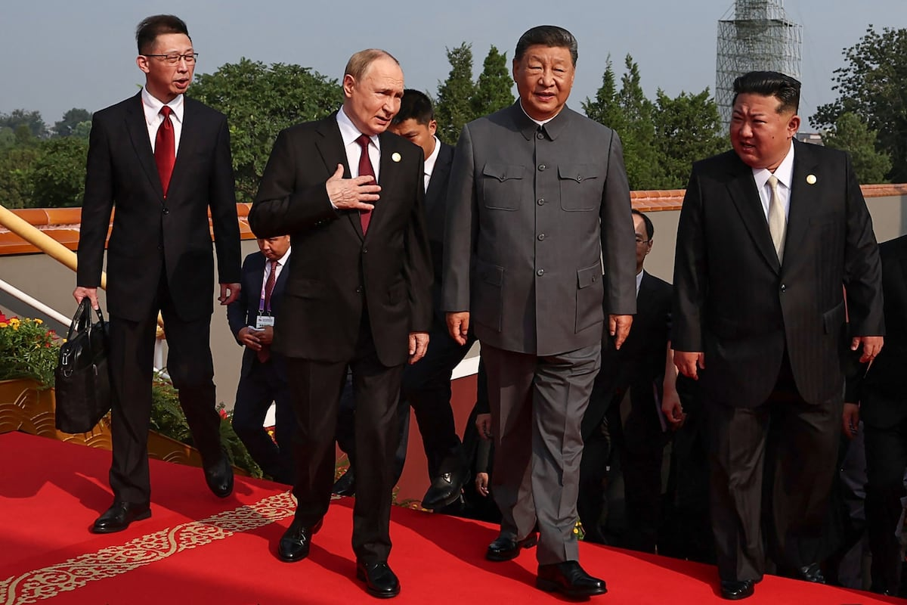

Slide 5
Current Economics Conditions:
What And How Do We Think We Know What We Know

Slide 6
NK Won Exchange Rate

Slide 8
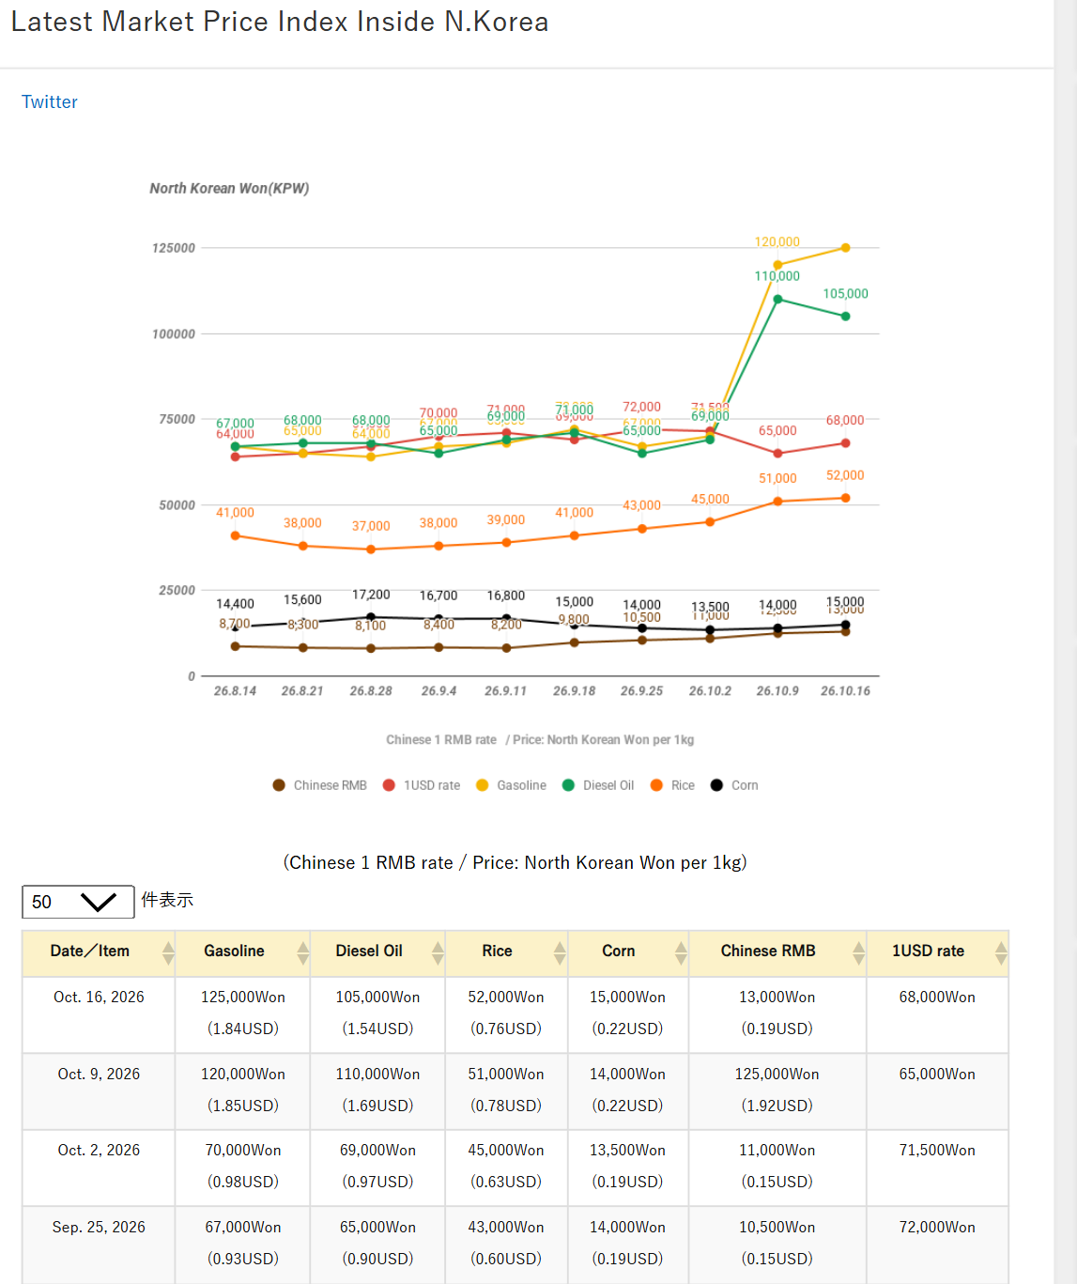
Asia Press Price Data

Slide 9
Six-Week Asia Press Prices Latest Market Price Index Inside N.Korea
Gasoline shoots up.
Diesel holds
Rice/Corn ratio is good
Dollar/Yuan is jumpy.
 | Gasoline | Diesel | Rice | Corn | R/C | $ | Y | $/y | Int. Y/$
4-Sep | 67 | 65 | 52 | 15 | 3.5 | 70 | 8.4 | 8.3 | 6.68
11-Sep | 68 | 69 | 51 | 14 | 3.6 | 71 | 8.2 | 8.7
18-Sep | 72 | 71 | 45 | 13.5 | 3.3 | 69 | 9.8 | 7.0
25-Sep | 67 | 65 | 43 | 14 | 3.1 | 72 | 10.5 | 6.9
2-Oct | 70 | 69 | 41 | 15 | 2.7 | 71.5 | 11 | 6.5
9-Oct | 120 | 110 | 39 | 16.8 | 2.3 | 65 | 12.5 | 5.2
16-Oct | 125 | 105 | 38 | 16.7 | 2.3 | 68 | 13 | 5.2

