Slide 1
Pandemic or Not, North Korean Economy Under Great Strain
2018 Kim raised expectations. In 2020 he talks plan failure. Apologizes. Self reliance.
Weak productivity, not lack of resources, makes North Korea very poor.
UN sanctions and pandemic closing sare having a large impact, external trade near zero.
Money stabilized but monetary, fiscal policy tight. Government is starving itself, privatizing a few assets. Little investment.
Pandemic controls likely stifling emergent markets. Some in Pyongyang no doubt approve.
Is there hope for reform under Kim Jong Un?
“Bottom Up” Marketization Underway
“Top Down” Macro / Micro Support Needed
Party Congress, New Plan, may give hints.
Notes:
I think North Korea’s economy is under quite some strain but maybe not in the way most people think. Are the sanctions working? Well yes, but again, maybe not in the way people expect. Amid the fire and fury, is there room to hope of a normalized North Korea? Absolutely. And a good part of the answer is the stealth marketization currently under way in North Korea.
First, a few definitions. We often limit our thoughts of marketization to marketplaces. In the Korean context, market towns and huge urban markets, like East Gate in Seoul. Many buyers and many sellers congregating to get their best possible deals; the buyer the cheapest price, the seller the highest price with arbiters forcing the action. It’s that competition that drives a market economy to efficient outcomes. Markets are organized, with rules on how to efficiently conduct transactions; for example, the day and time they will be open. But for an economist, markets mean much more than these places. We think of markets for goods, services, labor, capital, real estate, and foreign exchange. North Korea always had some marketplaces. Its challenge is opening these other kinds of markets disdained by Marx and prohibited by the Stalinist system.
Also, closely connected with markets is money, prices, and ownership. You can’t, or shouldn’t, trade what you don’t own. The socialist system prohibited private ownership of capital, and thus disallowed trade in “the means of production”, otherwise known as capitalism. And markets inevitably mean use of money and credit, also prohibited in North Korea’s formal socialism. Flexible prices and wages, equilibrating supply and demand, are the key dynamic of any market, not the fixed, policy induced prices of socialism. And, of course, the interest rate or return on capital is the price of capital, usually forced to zero in the socialism system lest “money make money” and the “rich get richer.”

Slide 2
Impact of Pandemic
Border Closing and Internal Restrictions must be impacting markets.
Fewer Chinese consumer products
Traders losing money
Private employment endangered
No investment
Decline in living standards
Government Benefits
Less outflow of foreign exchange
Less competition for state
Stronger controls, especially movement.
But Economy now Depends on Markets
Plan Needs imports
Imports need exports
Financial instability
Notes:
I think North Korea’s economy is under quite some strain but maybe not in the way most people think. Are the sanctions working? Well yes, but again, maybe not in the way people expect. Amid the fire and fury, is there room to hope of a normalized North Korea? Absolutely. And a good part of the answer is the stealth marketization currently under way in North Korea.
First, a few definitions. We often limit our thoughts of marketization to marketplaces. In the Korean context, market towns and huge urban markets, like East Gate in Seoul. Many buyers and many sellers congregating to get their best possible deals; the buyer the cheapest price, the seller the highest price with arbiters forcing the action. It’s that competition that drives a market economy to efficient outcomes. Markets are organized, with rules on how to efficiently conduct transactions; for example, the day and time they will be open. But for an economist, markets mean much more than these places. We think of markets for goods, services, labor, capital, real estate, and foreign exchange. North Korea always had some marketplaces. Its challenge is opening these other kinds of markets disdained by Marx and prohibited by the Stalinist system.
Also, closely connected with markets is money, prices, and ownership. You can’t, or shouldn’t, trade what you don’t own. The socialist system prohibited private ownership of capital, and thus disallowed trade in “the means of production”, otherwise known as capitalism. And markets inevitably mean use of money and credit, also prohibited in North Korea’s formal socialism. Flexible prices and wages, equilibrating supply and demand, are the key dynamic of any market, not the fixed, policy induced prices of socialism. And, of course, the interest rate or return on capital is the price of capital, usually forced to zero in the socialism system lest “money make money” and the “rich get richer.”

Slide 3
Marketization Underway, Not Finished
What is a Market?
Marketization: Much more than “marketplaces”
Goods Markets
Services Markets
Labor Markets
Real Estate/Land Markets
Capital/Finance Markets
Foreign Exchange Markets
Many buyers
Many sellers
Rules, Structure
Time, currency, behavior
Compete for best price
Market clears with flex price
Usually most efficient outcome
Decentralized, Unplanned
Law of One Price

Slide 4
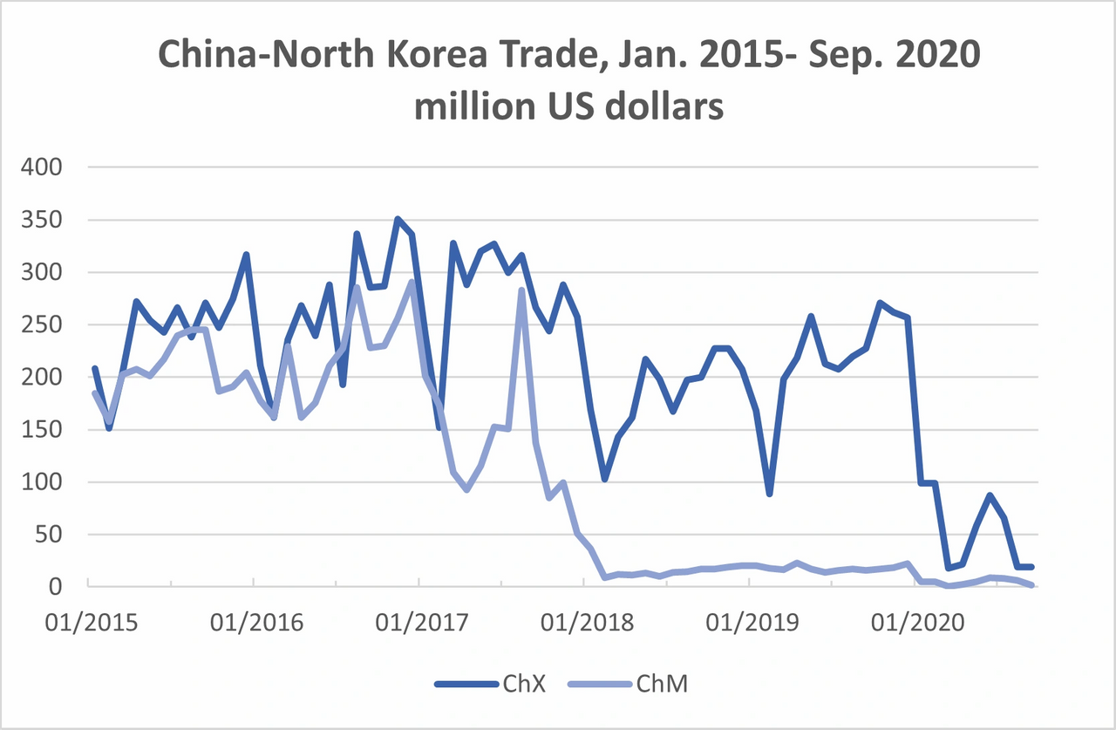

Slide 5
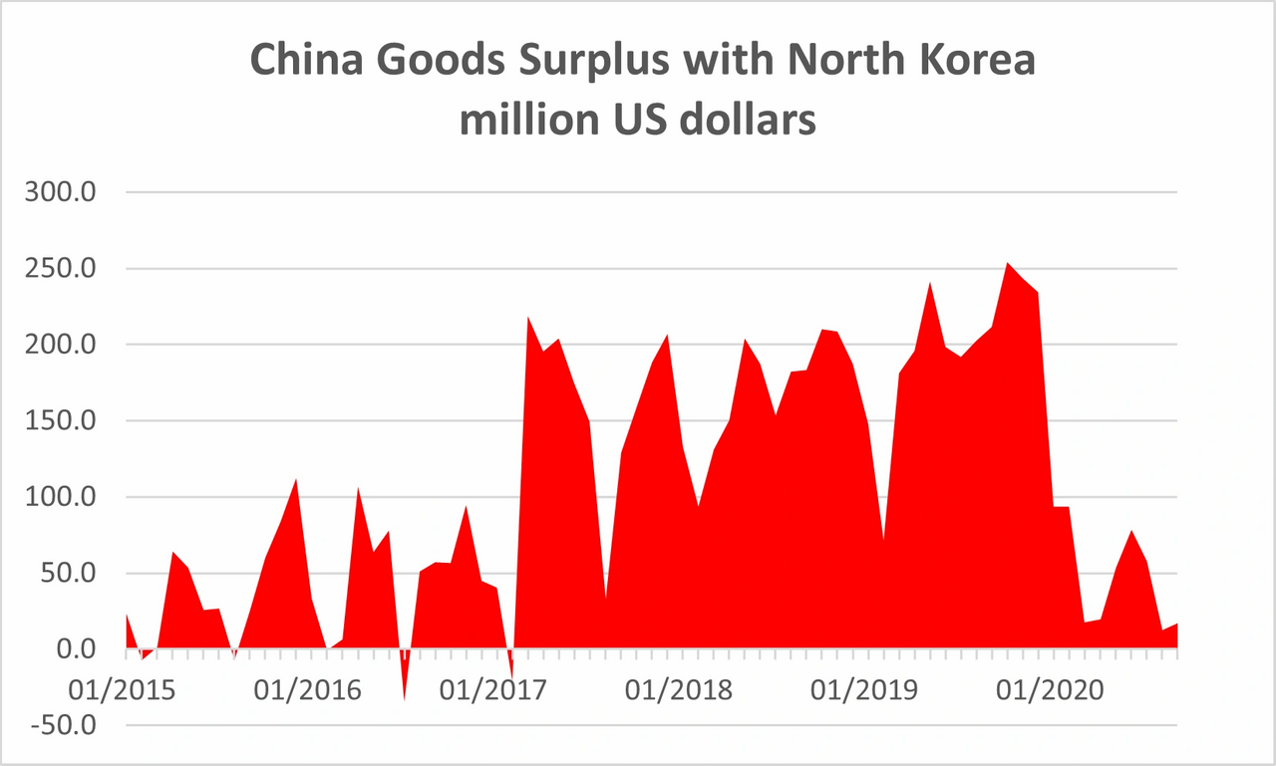

Slide 6
 | 2017 | 2018 | % ch | Jan-18 | Jan-19
China Exports | 3,328 | 2,218 | -33 | 169 | 167
of which
Soybean oil | 111.4 | 135.6 | 22 | 11.9 | 9.7
Cereals | 32.6 | 25.7 | -21 | 0.1 | 0.5
Milled | 35.5 | 65.9 | 86
Seafood | 102.1 | 70.6 | -31 | 6.9 | 7.2
Agriculture plus | 349.7 | 478.9 | 37 | 42.3 | 34.4
Plastics | 231.4 | 221.8 | -4
Clocks & watches (parts) | 2 | 36.9 |  | 1.7 | 9.1
Woven syn fiber | 205.4 | 126 | -39
Fertilizer | 36.4 | 84.8 | 126
Vehicles | 202 | 1.9 | -99
Trucks # | 6170 | 20
Autos # | 3269 | 46 | -99
Electric Machinery | 338 | 7.7 | -98
Non-Electric Machinery | 268 | 7 | -97
China Imports | 1,651 | 194.6 | -88 | 36.4 | 20.1
Clock & Watches | 1.8 | 31.1 |  | 1.2 | 6.8
Coal | 401.7 | 0 | -100 | 0 | 0

Slide 7
Won stabilized despite export collapse

Slide 8
Theory: Very Tight Monetary, Fiscal Policy
Central bank reduces won supply in parallel with loss of dollars.
Little printing of new cash.
Few new net loans to state enterprises and state agencies
State firms allowed to privatize assets to make ends meet.
State agencies raise all kinds of fees to raise funds. (no normal tax system). Allow workers to engage in private income earning work.
Impact is good for inflation but devastating to state investment, employment.
Cost of stable won is shrinking , privatization of, state sector. State has very large assets so this can last a long time. Like China.
Also, by allowing US dollars and RMB to circulate, real savings vehicles are available for the first time, allowing citizens to save. Reduces current demand.

Slide 9
Asia Press, source data.

Slide 10
Asia Press, source data.

Slide 11
Asia Press, source data.

Slide 12
Reform and Opening
Chinese construct. Order is important. Reform then Open.
What is meant by Reform?
Unify price system
Establish at least some private property rights
Decollectivize agriculture
Create new money and banking system
Shrink huge bureaucracy and military
Privatize state assets
Establish tax system and transparent budget
This could put economy on moderate growth track, without foreign opening.
Reform then leads to Opening, and massive engagement with rest of world. (like SK, China)

Slide 13
Readings:
KEIA.org Peninsula Blog, Many Items
NAEIA.org Many items
http://blog.keia.org/2019/01/north-koreas-pegged-won-wiggles-doesnt-break-yet/
https://www.ncnk.org/sites/default/files/NCNK_William_Brown_NK_Shackled_Economy_Report.pdf
http://www.theasanforum.org/sanctions-and-nuclear-weapons-are-changing-north-korea/

