Slide 1

North Korea’s Economy and Marketization
Amid Severe Global Sanctions
GWIKS Korea Seminar, Nov. 7, 2019
William Brown
wmbbrown@Hotmail.com NAEIA.com
Notes:
I think North Korea’s economy is under quite some strain but maybe not in the way most people think. Are the sanctions working? Well yes, but again, maybe not in the way people expect. Amid the fire and fury, is there room to hope of a normalized North Korea? Absolutely. And a good part of the answer is the stealth marketization currently under way in North Korea.
First, a few definitions. We often limit our thoughts of marketization to marketplaces. In the Korean context, market towns and huge urban markets, like East Gate in Seoul. Many buyers and many sellers congregating to get their best possible deals; the buyer the cheapest price, the seller the highest price with arbiters forcing the action. It’s that competition that drives a market economy to efficient outcomes. Markets are organized, with rules on how to efficiently conduct transactions; for example, the day and time they will be open. But for an economist, markets mean much more than these places. We think of markets for goods, services, labor, capital, real estate, and foreign exchange. North Korea always had some marketplaces. Its challenge is opening these other kinds of markets disdained by Marx and prohibited by the Stalinist system.
Also, closely connected with markets is money, prices, and ownership. You can’t, or shouldn’t, trade what you don’t own. The socialist system prohibited private ownership of capital, and thus disallowed trade in “the means of production”, otherwise known as capitalism. And markets inevitably mean use of money and credit, also prohibited in North Korea’s formal socialism. Flexible prices and wages, equilibrating supply and demand, are the key dynamic of any market, not the fixed, policy induced prices of socialism. And, of course, the interest rate or return on capital is the price of capital, usually forced to zero in the socialism system lest “money make money” and the “rich get richer.”

Slide 2
Overview
Economy Under Severe Strain
  2017 Kim announced prosperity drive, raising expectations for externally enabled growth. But in 2019 he talks belt tightening, self reliance.
  Weak productivity, inefficiency, not lack of resources, makes North Korea one of poorest, that is least productive, countries in the world.
  UN nuclear sanctions are having a large impact, but not quite as expected.
  Monetary system has stabilized but monetary, fiscal policy very tight. Government is starving itself, privatizing assets. Little investment.
  Is there hope for reform under Kim Jong Un?
    “Bottom Up” Marketization Underway
    “Top Down” Macro / Micro Support Needed
  How Can We Press for Reform?
Notes:
I think North Korea’s economy is under quite some strain but maybe not in the way most people think. Are the sanctions working? Well yes, but again, maybe not in the way people expect. Amid the fire and fury, is there room to hope of a normalized North Korea? Absolutely. And a good part of the answer is the stealth marketization currently under way in North Korea.
First, a few definitions. We often limit our thoughts of marketization to marketplaces. In the Korean context, market towns and huge urban markets, like East Gate in Seoul. Many buyers and many sellers congregating to get their best possible deals; the buyer the cheapest price, the seller the highest price with arbiters forcing the action. It’s that competition that drives a market economy to efficient outcomes. Markets are organized, with rules on how to efficiently conduct transactions; for example, the day and time they will be open. But for an economist, markets mean much more than these places. We think of markets for goods, services, labor, capital, real estate, and foreign exchange. North Korea always had some marketplaces. Its challenge is opening these other kinds of markets disdained by Marx and prohibited by the Stalinist system.
Also, closely connected with markets is money, prices, and ownership. You can’t, or shouldn’t, trade what you don’t own. The socialist system prohibited private ownership of capital, and thus disallowed trade in “the means of production”, otherwise known as capitalism. And markets inevitably mean use of money and credit, also prohibited in North Korea’s formal socialism. Flexible prices and wages, equilibrating supply and demand, are the key dynamic of any market, not the fixed, policy induced prices of socialism. And, of course, the interest rate or return on capital is the price of capital, usually forced to zero in the socialism system lest “money make money” and the “rich get richer.”

Slide 3
Definitions
What is a Market ?
Marketization: More than “marketplace”

Slide 4
Definitions
What is a Market?
Marketization: Much more than “marketplace”
Many buyers
Many sellers
Rules, Structure
Usually most efficient outcome
Law of One Price
Compete for best price
-- Time, currency, behavior
Market clears with flex price
Decentralized, unplanned

Slide 5
Definitions
What is a Market?
Marketization: Much more than “marketplaces”
Goods Markets
Services Markets
Labor Markets
Real Estate/Land Markets
Capital/Finance Markets
Foreign Exchange Markets
Many buyers
Many sellers
Rules, Structure
Time, currency, behavior
Compete for best price
Market clears with flex price
Usually most efficient outcome
Decentralized, Unplanned
Law of One Price

Slide 6
Outline
10 -15 minutes each
Korea’s Economic Geography, Resources, History
NK’s broken, but not finished, command economy—half centralized, half decentralized creates dual prices for everything, and huge inefficiencies
Potential US Role
Break
Discussion
Chinese sanctions creating financial headaches for Kim
The Marxist (Socialist/Command/Centrally Planned) System

Slide 7
Economic Geography, Resources, and History
Not really a “Hermit Kingdom, until maybe 2017
  Ancient Korea traded with China, Japan
  Extensive industrialization and trade during Japanese occupation, through WWII. Networked railroads.
  Soviet bloc made extensive investments and trade linked to central plans of all of them.
  Opened to western and Japanese investment in 1970s—promptly defaulted on debts.
  Even in 2016, large trade volume with China.
And North Korea never really “self reliant”. Perpetual goods trade deficit financed by remittances and foreign aid.
Notes:
Geography, resources, and history of the North Korean economy.
(use map board)
Not really a “hermit” and rarely “self-reliant”. Well, at least until 2017 when its nuclear program and consequential, very broad UN nuclear sanctions, pushed it into a shell.
Korea often considered a hermit kingdom since it was the last significant civilization to open to the West in late 19th century. But, while never a major trading nation it was hardly shut off from China and Japan, except as the latter shut itself off. And it has traded with many countries of Europe and Asia.
Both immediate neighbors shielded it for centuries from the opportunistic European traders and Siberia/Manchuria effectively closed it from the north, until the opening of the Tran-Siberian railroad in 1903, which soon thereafter connected all the way through to Mokpo and Pusan, opening to a great deal of trade.
Importantly, the US was the first Western power to really enter commerce with the Korean Kingdom and has thus played an oversized role in Korean affairs, ever since, at least as viewed by Koreans.
Japan, with some US private sector participation, industrialized the North as it fought its way into China and WWI . In WWII sheltered from US attack. Metals, chemicals, electric power—coal and hydro; and railroads and ports. Supported Japan’s aim to control Manchuria and helped feed Japan with southern rice.
A significant international competition took place around 1900 for rights to build out the Korean railroad system, won by Japan but with stiff competition from Russian, French, German and even American companies.
The Soviet takeover of the North in 1945 brought NK into the Soviet bloc trading system; not formally in COCOM but quite a lot of centrally planned barter trade with EE and Soviets, and later China.
Rich in non-ferrous metals, some rare earths, anthracite coal, iron ore, hydro power, many chemicals and these were traded for capital goods, machinery of all sorts, and petroleum. NK has no petroleum or natural gas and must trade for them and related petrochemicals. Also it has no metallurgical or coking coal. It is usually self-sufficient in food but only because its central plan puts a third or more of its workforce into inefficient farming of rice and corn.
Opened in mid 1970s to European and Japanese investment but immediately defaulted on billions in debts—fault of lenders as much as Pyongyang. Never has it regained solvency and never has it repaid debts. So it begin to become a kind of hermit.
For its entire existence NK regime has been dependent on foreign aid--never a trade surplus, tens of billions of trade deficits. Even West has in a way victimized NK by dumping policy, not development driven aid. This had had a big impact in destroying incentives to export making NK one of the weakest exporters in the world, even before sanctions.
Where would its comparative advantages lie? Metals and minerals to be sure but also probably in industries that can take advantage of high school level education at cheap wages—textiles, assembly of all sorts. Literacy is a big plus. And I’d say tourism. Kim and Trump are right about that.
So, is it a hermit? Yes, but not naturally so. Its been made into a hermit. It is fairly self-reliant but at an extremely wasteful level, making little use of comparative advantage. [question]. I’d say North Korea makes the most inefficient use of its ample capital and natural resources, and ideal territory, as any country in the world. It tries to make everything and thus does everything very badly and at great expense. Kim visiting big iron wheel factory.
William Elliot Griffis, “The Hermit Kingdom”, 1882.

Slide 8
Natural Comparative Advantages
Comparative Advantages (natural)
Anthracite Coal
Iron Ore
Cement
Non-ferrous metals
Sea industries, fisheries
Hydropower
Comparative Disadvantages
Petroleum
Coking coal
Arable Land- Food

Slide 9
Constructed, modern day, comparative advantages.
Comparative Advantages (constructed)
Textiles/shoes L
Tourism L,G
Anthracite Coal
Non-ferrous metals
Sea industries, fisheries
Assembly –i.e. watches L
Computer applications L
Conventional military
Comparative Disadvantages
Petroleum, natural gas
Coking coal
Arable Land- Food
Aluminum
Machinery, electronics

Slide 10
Kim Il Song’s “Command Economy” System
Also known as Marxist, Socialist, Centrally Planned, Communist.
Imposed on North Korea by Soviet Union in 1945; held together longer there than anywhere. No other country comes close.
Some similarities to traditional anti – capitalist Confucian and religious systems.
What are key attributes of a Command Economy? How does it differ from a decentralized capitalist market system?
Notes:
II. In Theory, a Socialist, Centrally Planned, Marxist, or “Command” Economy
What are basic features of this type of system, transplanted to NK by the Soviet Union in 1945? Or rather, how does this system differ from its opposite—a market, decentralized, capitalist system? [question—capitalist definition?]
Public ownership of most “means of production”, that is capital, and no private trade in capital. (capitalism, by definition, is a system that allows, encourages, trade in capital. But one can’ trade something one can’t own.
W/O private capital, state takes on role of investor. Creates a massive complex plan—input output matrix—to produce and distribute what rulers want the people to have and to invest in the future.
No market prices. Socialists, Marx, don’t trust the prices, wages and interest earnings that decentralized markets come up with. So, they fix prices and allocate resources needed to make what they want utilizing a highly complex in-put/out-put plan, usually five or seven years. Computers very helpful in this.
Distribution to the public is by ration ticket, not money. [question—definition of money?]
Absence of money creates powerful state control device, like with slavery. People have no savings, no ability to consume beyond what daily or weekly ration gives them.
State uses forced surplus of production over consumption to invest, often 50 percent, of GDP. Investment intensive growth but with poor efficiency. Huge bureaucracies and large militaries paid by ration not money.
All fail due to over complexity of production requirements in modern society and absence of incentives to use capital productively.
Fixed prices mean trade with outside market economies is inherently difficult for both sides. Only way to trade is through barter like trade agreements.
Market economies thrive on law of one price but that price is different than socialist price, hence arbitrage takes place amid corruption and huge inefficiency. [example—electricity price].

Slide 11
Kim Il Song’s Idealized Command Economy
  Public (state or collective) ownership of “means of production” including land.
  No private trade in capital.
  Absence of real money—ration ticket economy a powerful control device.
  Distribution of goods to public by ration ticket; to industry by five-year or seven-year input-output plans.
  State invests forced savings (surplus of production less consumption). Investment usually a high share of GDP, together with forced labor creates input driven growth.
Foreign trade by state-to-state barter agreement with Soviet bloc and China. Trade with non-socialist countries based on credit. Not repaid.
Tight border, immigration controls.
Markets: small farmer’s markets allowed. No legal labor, or capital markets.
Real estate—some legacy homes retained private ownership, small private farmer’s gardens.
Result—with much Soviet bloc aid, economy industrialized and grew through 1960s.Per capita higher than South Korea .
Notes:
What are basic features of this type of system, transplanted to NK by the Soviet Union in 1945? Or rather, how does this system differ from its opposite—a market, decentralized, capitalist system? [question—capitalist definition?]
Public ownership of most “means of production”, that is capital, and no private trade in capital. (capitalism, by definition, is a system that allows, encourages, trade in capital. But one can’ trade something one can’t own.
W/O private capital, state takes on role of investor. Creates a massive complex plan—input output matrix—to produce and distribute what rulers want the people to have and to invest in the future.
No market prices. Socialists, Marx, don’t trust the prices, wages and interest earnings that decentralized markets come up with. So, they fix prices and allocate resources needed to make what they want utilizing a highly complex in-put/out-put plan, usually five or seven years. Computers very helpful in this.
Distribution to the public is by ration ticket, not money. [question—definition of money?]
Absence of money creates powerful state control device, like with slavery. People have no savings, no ability to consume beyond what daily or weekly ration gives them.
State uses forced surplus of production over consumption to invest, often 50 percent, of GDP. Investment intensive growth but with poor efficiency. Huge bureaucracies and large militaries paid by ration not money.
All fail due to over complexity of production requirements in modern society and absence of incentives to use capital productively.
Fixed prices mean trade with outside market economies is inherently difficult for both sides. Only way to trade is through barter like trade agreements.
Market economies thrive on law of one price but that price is different than socialist price, hence arbitrage takes place amid corruption and huge inefficiency. [example—electricity price].

Slide 12
Long Economic Transition—But to what end?
Planned economy slowed in 1970s, 80’s and failed after mid-1990s Great Famine as the government couldn’t provide rations. But it didn’t go away. Now an odd, dysfunctional, hybrid. Partly comand and partly unregulated, market system.
Absence of rations has induced market activity. Planned system requires tight control over prices. When it can’t deliver essential goods, even food, people start to trade and natural prices, dictated by supply and demand, take over.
Economy has thus trasnsitioned from a ration system under KIS to a bad, inflation prone money system under KCI, to a dollarized system under KJU.
Notes:
III. Economic Transition—but to where?
North Korea’s planned economy failed before, during, and after mid-1990s Great Famine. But it didn’t go away. It is now an odd, dysfunctional, hybrid, partly a severe command system and partly an unregulated, even unruly, market system. Even a feudal/serf system in some respects.
Failure of plan over the years, and absence of rations, has induced market activity. Planned system requires tight control over prices—similar to US pharmaceutical industry. When it can’t deliver essential goods, even food, people start to trade and natural prices, dictated by supply and demand, take over, further disrupting and corrupting the plan.
NK thus goes from a relatively pure ration system under KIS to a bad, inflation prone money system under KCI, to a dollarized, relatively good money system under KJU.
Won/yuan/dollars all circulate legally in NK, in markets, in factory transactions, even inside the government. They typically use won for small items, yuan for imported Chinese items, and US dollars for big items, housing, and most importantly, for private savings. [what to won, yuan, dollar have in common?] And there seems to be a reasonably well working market system for exchanging currency. More liberal than most.
But command economy still exists—collective farms and millions of state workers and the huge military. Maybe half market, half command.
Amazing discrepancy in prices and wages. Examples. Textile workers, teachers, nurses.
How did Kim stabilize money, his most important success?
Before 2017 big increase in exports, coal, to China, plus expanded service earnings, including illicit.
After 2017, export earnings fell 80 percent, but won maintained about an 8,000 won rate. How?
Many theories, puzzle not a mystery. My suspicion is an extremely tight won monetary policy and, by allowing public to save, savings must be growing very rapidly. Robs the market side of the economy of demand, pushing prices down and kills private employment.
Implies a huge fiscal problem on Kim’s hands—can’t pay workers or supply them with rations. Market sector is much more productive and hands out much more wealth. So, it is not just the old problem of hungry people. It’s a new problem of millions of hungry people—often loyal party people—side by side with millions of relatively well to do merchants and outcasts who live off of money, not rations. Recipe for high tension and even revolt.
And it means no funds for investment, no growth without reform.
III. “Reform and Opening”
I argue order is important. Opening without reform will be another disaster. It happened before in the 1970s and 80s.
North Korea’s planned economy failed before, during, and after mid-1990s Great Famine. But it didn’t go away. It is now an odd, dysfunctional, hybrid, partly a severe command system and partly an unregulated, even unruly, market system. Even a feudal/serf system in some respects.
Failure of plan over the years, and absence of rations, has induced market activity. Planned system requires tight control over prices—similar to US pharmaceutical industry. When it can’t deliver essential goods, even food, people start to trade and natural prices, dictated by supply and demand, take over, further disrupting and corrupting the plan.
NK thus goes from a relatively pure ration system under KIS to a bad, inflation prone money system under KCI, to a dollarized, relatively good money system under KJU.
Won/yuan/dollars all circulate legally in NK, in markets, in factory transactions, even inside the government. They typically use won for small items, yuan for imported Chinese items, and US dollars for big items, housing, and most importantly, for private savings. [what to won, yuan, dollar have in common?] And there seems to be a reasonably well working market system for exchanging currency. More liberal than most.
But command economy still exists—collective farms and millions of state workers and the huge military. Maybe half market, half command.
Amazing discrepancy in prices and wages. Examples. Textile workers, teachers, nurses.
How did Kim stabilize money, his most important success?
Before 2017 big increase in exports, coal, to China, plus expanded service earnings, including illicit.
After 2017, export earnings fell 80 percent, but won maintained about an 8,000 won rate. How?
Many theories, puzzle not a mystery. My suspicion is an extremely tight won monetary policy and, by allowing public to save, savings must be growing very rapidly. Robs the market side of the economy of demand, pushing prices down and kills private employment.
Implies a huge fiscal problem on Kim’s hands—can’t pay workers or supply them with rations. Market sector is much more productive and hands out much more wealth. So, it is not just the old problem of hungry people. It’s a new problem of millions of hungry people—often loyal party people—side by side with millions of relatively well to do merchants and outcasts who live off of money, not rations. Recipe for high tension and even revolt.
And it means no funds for investment, no growth without reform.

Slide 13
Dollarization solves inflation problem, for the moment.
NK Won/yuan/dollars all circulate legally in NK, in markets, in factory transactions, even inside the government. Won used for small items, yuan for imported Chinese items, and US dollars for big items--housing, and most importantly, for private savings. And there seems to be a reasonably well -working market for exchanging currency. Prices stable.
But command economy using a very different ration price structure still exists—collective farms and millions of state workers and the huge military. Maybe half market, half command.
Notes:
III. Economic Transition—but to where?
North Korea’s planned economy failed before, during, and after mid-1990s Great Famine. But it didn’t go away. It is now an odd, dysfunctional, hybrid, partly a severe command system and partly an unregulated, even unruly, market system. Even a feudal/serf system in some respects.
Failure of plan over the years, and absence of rations, has induced market activity. Planned system requires tight control over prices—similar to US pharmaceutical industry. When it can’t deliver essential goods, even food, people start to trade and natural prices, dictated by supply and demand, take over, further disrupting and corrupting the plan.
NK thus goes from a relatively pure ration system under KIS to a bad, inflation prone money system under KCI, to a dollarized, relatively good money system under KJU.
Won/yuan/dollars all circulate legally in NK, in markets, in factory transactions, even inside the government. They typically use won for small items, yuan for imported Chinese items, and US dollars for big items, housing, and most importantly, for private savings. [what to won, yuan, dollar have in common?] And there seems to be a reasonably well working market system for exchanging currency. More liberal than most.
But command economy still exists—collective farms and millions of state workers and the huge military. Maybe half market, half command.
Amazing discrepancy in prices and wages. Examples. Textile workers, teachers, nurses.
How did Kim stabilize money, his most important success?
Before 2017 big increase in exports, coal, to China, plus expanded service earnings, including illicit.
After 2017, export earnings fell 80 percent, but won maintained about an 8,000 won rate. How?
Many theories, puzzle not a mystery. My suspicion is an extremely tight won monetary policy and, by allowing public to save, savings must be growing very rapidly. Robs the market side of the economy of demand, pushing prices down and kills private employment.
Implies a huge fiscal problem on Kim’s hands—can’t pay workers or supply them with rations. Market sector is much more productive and hands out much more wealth. So, it is not just the old problem of hungry people. It’s a new problem of millions of hungry people—often loyal party people—side by side with millions of relatively well to do merchants and outcasts who live off of money, not rations. Recipe for high tension and even revolt.
And it means no funds for investment, no growth without reform.
III. “Reform and Opening”
I argue order is important. Opening without reform will be another disaster. It happened before in the 1970s and 80s.
North Korea’s planned economy failed before, during, and after mid-1990s Great Famine. But it didn’t go away. It is now an odd, dysfunctional, hybrid, partly a severe command system and partly an unregulated, even unruly, market system. Even a feudal/serf system in some respects.
Failure of plan over the years, and absence of rations, has induced market activity. Planned system requires tight control over prices—similar to US pharmaceutical industry. When it can’t deliver essential goods, even food, people start to trade and natural prices, dictated by supply and demand, take over, further disrupting and corrupting the plan.
NK thus goes from a relatively pure ration system under KIS to a bad, inflation prone money system under KCI, to a dollarized, relatively good money system under KJU.
Won/yuan/dollars all circulate legally in NK, in markets, in factory transactions, even inside the government. They typically use won for small items, yuan for imported Chinese items, and US dollars for big items, housing, and most importantly, for private savings. [what to won, yuan, dollar have in common?] And there seems to be a reasonably well working market system for exchanging currency. More liberal than most.
But command economy still exists—collective farms and millions of state workers and the huge military. Maybe half market, half command.
Amazing discrepancy in prices and wages. Examples. Textile workers, teachers, nurses.
How did Kim stabilize money, his most important success?
Before 2017 big increase in exports, coal, to China, plus expanded service earnings, including illicit.
After 2017, export earnings fell 80 percent, but won maintained about an 8,000 won rate. How?
Many theories, puzzle not a mystery. My suspicion is an extremely tight won monetary policy and, by allowing public to save, savings must be growing very rapidly. Robs the market side of the economy of demand, pushing prices down and kills private employment.
Implies a huge fiscal problem on Kim’s hands—can’t pay workers or supply them with rations. Market sector is much more productive and hands out much more wealth. So, it is not just the old problem of hungry people. It’s a new problem of millions of hungry people—often loyal party people—side by side with millions of relatively well to do merchants and outcasts who live off of money, not rations. Recipe for high tension and even revolt.
And it means no funds for investment, no growth without reform.

Slide 14
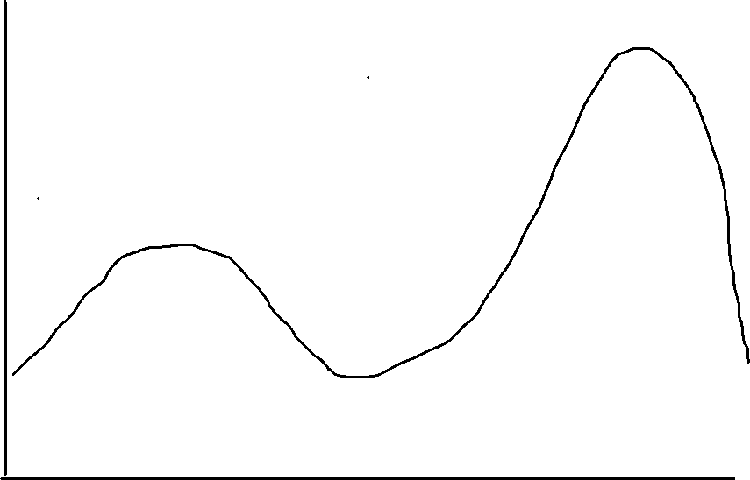
Production
efficiency
Stylized Economic Systems
Rule by ration
Rule by money
Command (state) Mixed Market (private)

Slide 15
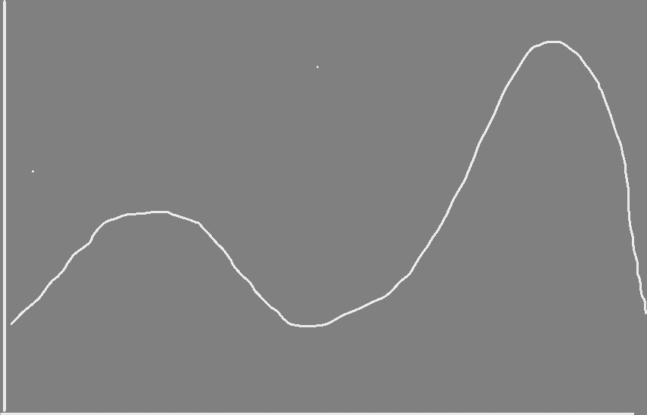
Production
efficiency
Poverty Trap
Poverty Trap
Command (state) Mixed Market (private)

Slide 16

Production
Efficiency
North Korea’s Double Trap
1960
2019
Poverty Trap
1995
famine
Command (state) Mixed Market (private)

Slide 17
China dominates North Korea Trade
Currently more than 90 percent of North Korea’s trade is with China.
After Korean War through the 1980s, Soviet Union and Eastern Europe were largest partners.
Japan and Western Europe raised trade in 1970s and 1980s to high levels.
Debt default, collapse of Soviet Union, Japanese sanctions and huge expansion of China’s trade economy, shifted almost all trade to China in 2000s.
Not unusual that big contiguous partner dominates trade.

Slide 19
China-UN 2016-7 Nuclear sanctions create trade, financial crisis.

Slide 20
 | 2017 | 2018 | % ch | Jan-18 | Jan-19
China Exports | 3,328 | 2,218 | -33 | 169 | 167
of which
Soybean oil | 111.4 | 135.6 | 22 | 11.9 | 9.7
Cereals | 32.6 | 25.7 | -21 | 0.1 | 0.5
Milled | 35.5 | 65.9 | 86
Seafood | 102.1 | 70.6 | -31 | 6.9 | 7.2
Agriculture plus | 349.7 | 478.9 | 37 | 42.3 | 34.4
Plastics | 231.4 | 221.8 | -4
Clocks & watches (parts) | 2 | 36.9 |  | 1.7 | 9.1
Woven syn fiber | 205.4 | 126 | -39
Fertilizer | 36.4 | 84.8 | 126
Vehicles | 202 | 1.9 | -99
Trucks # | 6170 | 20
Autos # | 3269 | 46 | -99
Electric Machinery | 338 | 7.7 | -98
Non-Electric Machinery | 268 | 7 | -97
China Imports | 1,651 | 194.6 | -88 | 36.4 | 20.1
Clock & Watches | 1.8 | 31.1 |  | 1.2 | 6.8
Coal | 401.7 | 0 | -100 | 0 | 0

Slide 21
North Korea-China Trade
Year-to-date , Jan-July
Million US Dollars
Source: China Customs,
North Korea Imports
 | 2016 | 2017 | 2018 | 2019
Total | 1,596 | 1,956 | 1,158 | 1,352
Plastics | 98 | 130 | 15 | 16
Soybeans | 92 | 144 | 72 | 104
Fibres | 36 | 33 | 63 | 41
Fertilizer | 36 | 34 | 63 | 42
Apparel | 89 | 131 | 65 | 76
Tobacco | 23 | 19 | 36 | 43
Grain | 5 | 2 | 5 | 35
Timing devices | 2 | 1 | 16 | 51
Elec Machinery | 198 | 149 | 8 | 8
N-Elec Machinery | 169 | 136 | 7 | 7
Vehicles | 121 | 112 | 2 | 2

Slide 22
North Korea Exports Jan-July
 | 2016 | 2017 | 2018 | 2019
Total | 1,343 | 994 | 105 | 124
Clocks | - | - | 10 | 32
Ferrosilicon | 10 | 11 | 13 | 16
Tungsten | 0 | 0 | 11 | 10
Molybdeum | 2 | 3 | 3 | 5
Wigs | 1 | 3 | 10 | 15
Electricity | 1 | 5 | 5 | 7
Graphite | 3 | 7 | 10 | -
Magnesite | 14 | 11 | 5 | -
Optics | 1 | 3 | 6 | 9
Footware parts | 0 | 1 | 1 | 3
Carbide | - | - | - | 1
98 Special | - | - | - | 5
Net North Korea Goods Deficit with China, Jan-Jul
 | 253 | 961 | 1,053 | 1,228
Annual | 2016 | 2017 | 2018 | 2019*
 | 558 | 1,672 | 2,024 | 2,216
Rest of current account plus small net investment on capital account may total about $500 million per year meaning current monthly outlfow would be running about $150 million. Does not include Chinese aid deliveries of all NK crude oil consumption, about 500,000 tons per year.

Slide 23
Petroleum Issue
Almost all petroleum consumed by North Korea comes from China.
Most is delivered free via pipeline and is refined in North Korea in Chinese supplied refinery. (500,000 tons of crude per year.) Allowed by UNSC.
Several hundred thousand tons of refined products is sually imported at market prices, mostly from China, some from Russia. These are capped by UNSC.
Ship–to-ship transfers are seen in which gasoline, diesel fuels are transferred from foreign ships to smaller North Korean ships, avoiding customs and the UN sanctions.
Gasoline in sold in North Korean markets at higher than world prices.

Slide 24
Why does China allow this?
Crude oil provision may be China’s last big weapon to use on Kim should Kim engage in nuclear or ICBM test.
Ship to ship transfers profits are very high, corrupting everyone’s sanctions enforcement.
China may consider petroleum is last lifeline to regime and doesn’t want to go further.

Slide 25
Won stabilized despite export collapse

Slide 26
We need non-existent balance of payments data to accurately analyze exchange rate.
Current Account plus capital account = change in foreign exchange reserves.
Current account = net goods trade plus net services trade plus net income plus net remittances
Capital account = net direct investment inflow plus portfolio inflow plus bank borrowing. (North Korea is virtually bankrupt so assume this is 0. )
Partner reported trade deficit running about $200 million/per month, offset perhaps by $100 million net services, remittances, and unreported or illicit exports.
How can won remain stable with $100 million a month net outflow?

Slide 27
Theory: Very Tight Monetary, Fiscal Policy
Central bank reduces won supply in parallel with loss of dollars.
  Little printing of new cash.
  Few new net loans to state enterprises and state agencies
  State firms allowed to privatize assets to make ends meet.
  State agencies raise all kinds of fees to raise funds. (no normal tax system). Allow workers to engage in private income earning work.
Impact is good for inflation but devastating to state investment, employment.
Cost of stable won is shrinking state sector. State has very large assets so this can last a long time. Like China.
Also, by allowing US dollars and RMB to circulate, real savings vehicles are available for the first time, allowing citizens to save. Reduces current demand.

Slide 28
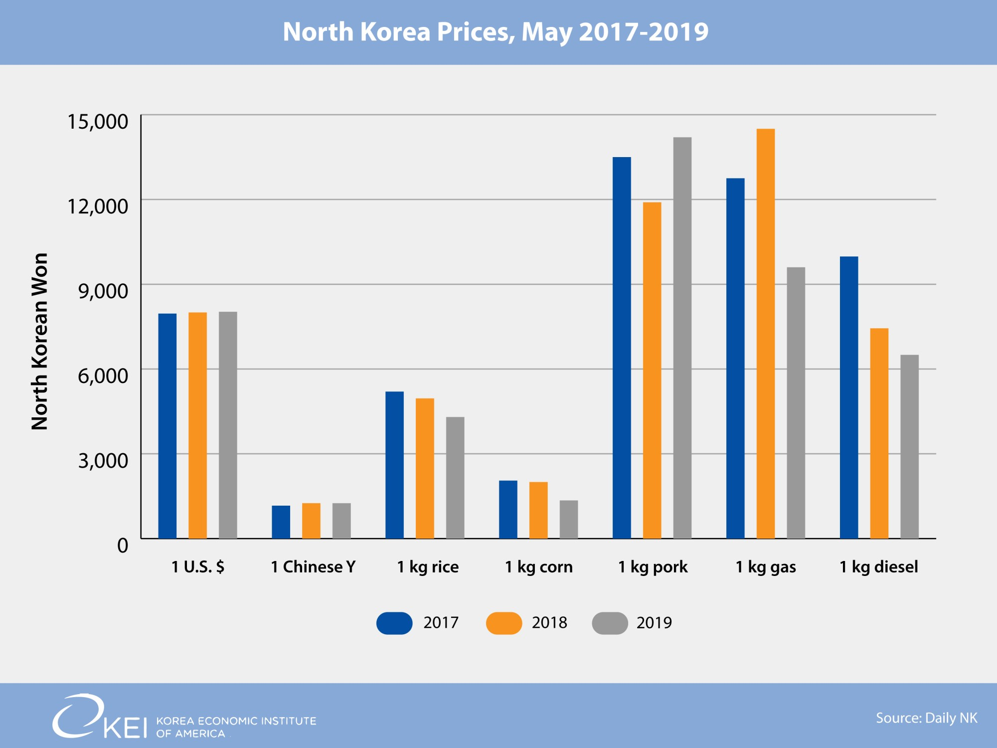

Slide 29
Reform and Opening
Chinese construct. Order is important. Reform then Open.
What is meant by Reform
  Unify price system
  Establish at least some private property rights
  Decollectivize agriculture
  Create new money and banking system
  Shrink huge bureaucracy and military,
  Establish tax system and transparent fiscal budget
This could put economy on moderate growth track, without foreign opening.

Slide 30
Then comes opening
Join WTO, IMF, World Bank
  Removes non-market tariff issues, especially with US
  Old debt workout
Normalization with Japan
  Obtain $10-20 bn in colonial era reparations.
Carefully allow inward FDI. Borrow to build domestic firms.
Comparative Advantage based exports. (ROK model)
Result would like by very rapid long-term growth taking advantage of high human capital, natural resources, and geographic resources.

Slide 31
US - North Korea Economic Issues
Non-Market Economy Issues
Trading with the Enemy Act
Terrorist List
Many Executive Order sanctions
UNSC Sanctions

Slide 32
Readings:
KEIA.org Peninsula Blog, Many Items
NAEIA.org Many items
http://blog.keia.org/2019/01/north-koreas-pegged-won-wiggles-doesnt-break-yet/
https://www.ncnk.org/sites/default/files/NCNK_William_Brown_NK_Shackled_Economy_Report.pdf
http://www.theasanforum.org/sanctions-and-nuclear-weapons-are-changing-north-korea/

