Slide 1
North Korea’s Economic Future Trapped October 23, 2023 For GWIKS William B. Brown NAEIA.Com

Slide 2
Trapped Between Plan and Market: Implications for North Korean Stability
Quick theoretical look at the North Korean Economic Problem and suggestions as to where it is going. I
In Depth Look at NK Monetary Issues
Website NAEIA.com naeia.com
Analysis Tab -- this presentation
Sept 18: North Korea Exchange Rate Pressures
Stinson 38 North
Thanks to Kim Byong Yeon: “Unveiling the North Korean Economic Collapse,” 2017
Brown, Chapter Two: “Kim Il Sung’s Juche Economy ‘’ in Chiang Min-hua, North Korea’s Political Economy, 2022
The Political Economy of North Korea: Domestic, Regional, and Global Dynamics: Chiang, Min-Hua: 9781955055451: Amazon.com: Books
Brown, Features of International Sanctions on North Korea, Korea Development InstituteKi n NEIA.com

Slide 3
Economic Growth
Growth in GDP is a function of:
More Inputs of Capital, Labor, Land, Natural Resources
Efficiency in use of these inputs. TFP.
Capital inputs supplied by Capital Stock which is built by savings over time employed as investment. It depreciates to create NDP.
Savings equal production less consumption.
Socialist or command systems grow by forced saving and investment, increasing capital stock, as determined by state planners. Markets, money interfere with the plan. Fixed wages and price, weak incentives and slow adjustment, are problems.
Capitalist systems grow by efficiency, changing use of inputs, as determined by competition and as prices force adjustments. Monopoly interferes with competition, and externalities, require regulation.

Slide 4
Poverty Trap
Subsistence Economy, no savings possible.
Growth can come only via external sources of savings/investment, foreign aid, or Efficiency Change

Slide 5
Production
efficiency
Stylized Economic Systems
Rule by ration
Rule by money
Command (state) Mixed Market (private)

Slide 6
Production
efficiency
Stylized Economic Systems
US 2008
<< US 2023
China 2023 < >
USSR 1957 >
China 1978 >>
Two prices
Law of one price
Many Prices
Command (state) Mixed Market (private)

Slide 7
Production
Efficiency
North Korea: Caught in the Middle
1960
2017
2023
1995
Command (state) Mixed Market (private)

Slide 8
Production
Efficiency
North Korea’s Double Trap
1960
2017
2023
Poverty Trap
1995
famine
Command (state) Mixed Market (private)

Slide 9
What We Think We Know
A Very Poor Country
GDP in 2021 about $27 bn. BOK estimate
Population 26 million
Per-capita GDP $1,000 - $2,000
180 in the world
NY Times reports $1,184.79 in 2020 !
Negative growth 2020-22
Malnutrition, extreme poverty is prevalent

Slide 10
Why is North Korea So Poor?
Hint: Its not for lack of capital and resources, or culture
Excellent natural resources per capita
Nonferrous and iron metals
Hydro power
Coal
Relatively low pop density for East Asia
Excellent geography
Excellent human capital relative to income
Much industrial capital
Well organized ancient civilization

Slide 11
Answer—Weak productivity
North Korea’s system makes poor use of its ample physical and human capital resources—probably the worst in the world.
Why? Two issues, one micro, one macro
Mixed command and market system delivers poor economic decisions. Two prices for everything.
Partial dollarization fixes inflation but impedes monetary policy, starves state economy.
Trapped between both systems. Poverty trap plus transition trap.

Slide 12
Not Always This Way: 1945 in Good Shape
Probably in better shape then rest of Asia. No WWII in Korea.
1910-45 Japan built up infrastructure and industry in northern part of its Korean colony.
taking advantage of mineral resources and hydro.
avoiding US bombing
launchpad for invasion of China
Russians counted 1,400 factories taken over by socialist state in 1945
Korean War devastating but Soviet, EE, and Chinese aid built back quickly.

Slide 13
1956-1976 Golden Age of NK Socialism
By 1949 all industry socialized.
By 1956 all farms collectivized.
Central plan economy replaced ancient money/market economy
Trade was strong with bloc countries, Japan and Europe. US rules prevented trade.
Russians and Chinese criticized Kim Il Sung for too much investment, not enough attention to living standards, and weak exports but industry grew rapidly.
1976, prior to devastating default on western credits, probably peak year.
Downward spiral ever since.

Slide 14
Zhou Enlai and Kim Il Sung, circa 1960
Kim is visiting China trying to obtain more industrial aid
Zhou: ‘’We notice, looking across the river (Yalu) that you never have to turn off your lights. You have developed socialism far faster than we have.’’
KIS: ‘’Yes, but it is with your help.’’
Zhou: ‘’That is because you are holding down so many American forces, thus protecting the entire socialist world.’’ (Wilson Center Archives)

Slide 15
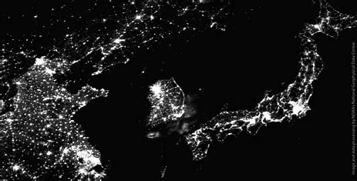
1997 Lights out

Slide 16
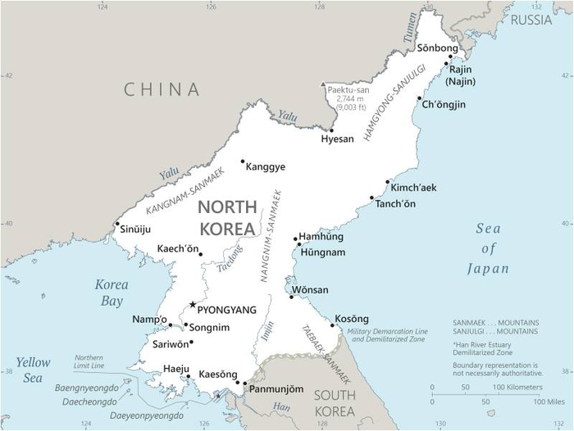

Slide 17
Command Economy
Marxism
Results
Strong central state
Ownership of capital (means of production) is by state or collective, no private ownership.
Plan emphasizes material growth via high investment, low consumption
State sets prices high for consumption goods, low for investment goods.
Allocation by decree via central plan.
High share of investment rel. to consumption.
No personal financial savings.
Individual incentives weak, poor productivity
Limited gains from trade—COCOM
All Marxist economies experience massive famine, dissolution.
Except North Korea
Labor is paid rations, not money.
No money economy creates dependent public.
Rejects market prices for capital and labor.
Divergent price systems prevents normal trade, investment with capitalist world.
Supply Chain Nightmare!

Slide 18
Capitalist, Market Economy
What is a Market?
Marketization: Much more than “marketplaces”
Goods Markets
Services Markets
Labor Markets
Real Estate/Land Markets
Capital/Finance Markets
Foreign Exchange Markets
Private ownership of means of production
Many sellers, Many buyers
Rules, Structure
Time, currency, behavior
Compete for best price
Market clears with flex price
Usually most efficient outcome
Decentralized, Unplanned
Law of One Price
Requires competition, the force.

Slide 19
Kim Jong Un’s Half-Step Financial Reforms
Allowed foreign currency to circulate at will.
As in other dollarized economies, this dampened inflation.
Creates new “good” for citizens to use their won to purchase.
First time NK people had a financial savings vehicle—US dollars. Private savings must have soared, stopping inflation.
Encouraged factory autonomy, gave them pricing and production authority. How much is open to question.
Market pricing would increase productivity, dampen inflation by creating new products. Especially in tech sector.
New Central Bank law in 2015 gave CB authority for exchange rate and loan activity, not Finance Ministry.

Slide 20
But reform not extended to farmers and state employees—most of the population
Pilot program aimed to decentralize farms stalled out.
Many state enterprises excluded, required to support Plan.
State set prices for key goods, like electricity, remained far to low.
Most importantly, without property rights, private savings flowed to US dollars and yuan cash and not to productive investments. Exception was small scale entrepreneurs, donju, and housing.
Macro-economy thus shifted from (state) investment-led to (private) consumption-led. No increase in aggregate demand so no inflation.

Slide 21
And dual wages system exploded, leading to massive state corruption.
Most critically, state wages remained at fixed low rates while market, productivity related wages, soared.
State wages set at 3-5,000 won per month, with declining value of ration perquisites.
Private wages soared to 300,000 won per month with no ration privaledge. Investors could make much more.

Slide 22
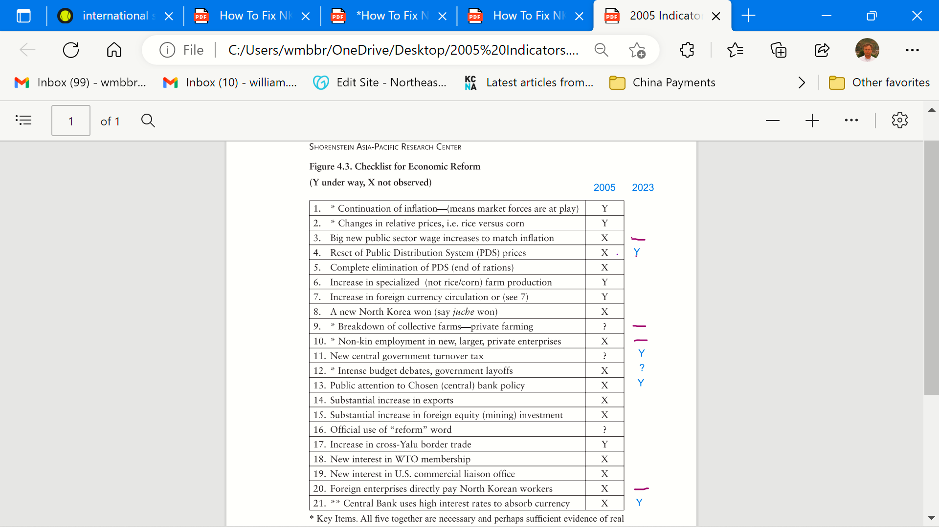

Slide 23
North Korea Foreign Exchange Rate Pressures Control by Money? For: US Department of Treasury, Korea Development Institute September 14-15,2023 William B. Brown NAEIA.Com

Slide 24
Kim’s Biggest Success

Slide 25
Last 4Years

Slide 26
Dollarization
Kim Jong Un’s Letter to Assembled Banking and Finance Functionaries in Pyongyang, 2015
‘”The sovereignty of the country is being violated as currencies of other countries are publicly circulating at home, but the financial and banking sector has not taken decisive measures. The flaws appearing in financial and banking work owe to the fact that the functionaries of this sector lack the revolutionary consciousness that they are the masters in charge of the country’s economy, have fallen into defeatism, and are unable to implement with a do-or-die spirit the party’s fiscal and financial policies.”
Lee and Carlin, 38 North

Slide 27
China-North Korea Trade Jan 2015- August 2023

Slide 28
China Trade Surplus with North Korea Jan 2015 - July 2023 China Customs (excludes crude oil)
Conjectured non-trade net income

Slide 29
China Visible Trade Surplus with North Korea Jan 2015 - July 2023 China Customs (excludes crude oil)
Conjectured non-trade net income

Slide 30
Implied North Korea Visible Trade Deficit with China Jan 2015 - July 2023 China Customs (excludes crude oil)
Conjectured non-trade net income

Slide 32
Go to KDI Sanctions Paper

Slide 33
Potential Origins of Instability
Financial panic—plunge in won exchange rate, jump in won prices. Forces reforms.
Elite complaints, loss of dollars, crackdowns
Firm’s failure, can’t meet ration or pay requirements
Labor unrest, unequal treatments (but no labor unions)
Military unrest, bad living conditions, no future
Peasant revolt, withholding grain supplies.
Regional uprising, far from center.
Population probably won’t blame Kim regime but second , third order hierarchy. Local Workers Party cells possibly take hit.
Offsets. No alternative leadership. Weak organizations. Worry of foreign intervention.

Slide 34
Dangerous Lack of Progress: Financial Issues Can Spark Unrest, Reform or Collapse
Wage and income differential between state sector and private sector seems to be widening. Trouble brewing for state industrial workers . (Poland example, not yet).
Reaction appears to target private incomes. Corruption increasing rampant.
Use of money creating private financial markets. Lack of regulation, laws, creates domestic hostility.
Dollarization helped stop inflation but inevitable speculation between currencies. Borrow in one, lend in the other. No bankruptcy laws. Fights.
Factory managers have more authority to adjust prices, procurement, and distribution but irrational prices leads to irrational results.
State faces balance budget requirement due to dollarization, tight money. No investment is the result. Deteriorating infrastructure.

Slide 35
Conclusion: Kim’s singular achievement is in danger.
Kim’s singular economic achievement, exchange rate and price stability, is in big danger with potential to disrupt the political and economic system. Inflation and money theft does that.
Tight monetary policy has pushed economy into severe recession.
Public has much more power than in previous regimes given their private holdings of foreign exchange, yuan and dollars. State has less control.
State budgets and wages are severely constrained due to need to protect won against circulating dollars and yuan.
Textbook solution is to sell state assets to private sector thus easing budget constraint, while raising state salaries, increasing prices of state supplied goods, and allowing property rights to encourage private sector productivity.
This could be done even in UN Sanctions environment.

Slide 36
Reform then Open
Chinese Construct, the order is important.
Reform in NK context means:
Unify price and wage system
Establish some private property rights
Decollectivize agriculture
Create new money and banking system, using interest rate to encourage private savings and direct investment to best uses. (SK model)
Raise pay but shrink size of huge bureaucracy and military
Privatize significant state assets including major factories.
Establish tax system and transparent budget.
This could put economy on moderate growth track, without foreign opening.
Reform then leads to Opening, and massive engagement with rest of world. Breakout economic growth would ensue.

