Slide 1
Trying to Understand North Korea’s Monetary Regime:
Opportunities for Policy Adjustments
For: US Department of Treasury, Korea Development Institute
September 8 ,2022
William B. Brown
NAEIA.Com

Slide 2
Present Situation
Deep, investment-bust recession, potential political trouble.
No credit, scarce money, little investment, shortage of consumer goods.
Tight budget and fixed low state wages leading to corruption. Dollarization under attack as state can’t print won money. Current account stable but unsustainable given need for imports. Prices and exchange rates volatile, speculation, “anti-socialist” that is capitalist, activity growing.
Opening border is a big risk of capital flight, import surge and panic.
Closed border unsustainable due to needed industrial inputs, supply chain.
Temporary border openings this year have been met with drop in won as imports exceed exports.
Great need for export development, difficult but not impossible in sanctions environment.
Big need is completion of banking reforms began in 2015 but stalled.

Slide 3
North Korea, a textbook for monetary theory.
Something for Everyone
Ration or command system—no real money, fixed prices (Kim Il Sung)
Inflated money—no domestic trust , hyper-inflation (Kim Jong IL)
Partially dollarized system—mixed success(Kim Jong Un)
Almost a currency board system without the board
Elements of everything all at once, no clear direction

Slide 4
Basics, Is North Korean Won Really Money?
Medium of Exchange.
  But state planning system and rations still exist on a large scale, especially in state employment and enterprise sector. Money usually works but often you also need a permission slip.
Measure of value, Numiere.
  This is a big problem since it seems there are at least two prices for everything, state set price or value and market value.
Store of Value
  This is what is changing, fast. Rations had no store of value, nor did inflation prone won. But dollars and yuan have store of value and are lending stability to won, making savings possible. A very big change.

Slide 5
Types of Money in circulation
North Korean Won
Largest notes 5,000 w (about 1 US$) cash denomination
Electronic debit card bank accounts
Use for government payments, wages, small purchases
North Korean Don-pyo
5,000 won only exchanged via FX.
Like FTC or military scipt
Chinese yuan
Used in markets for imported goods
1-100 Yuan notes (max about $15)
US Dollars
$100 max, Used for major purchases
Inter company payments
Some government fees
Other—phone money etc.

Slide 6
KDI Research
Excellent papers in 2021 Review
Suggestions
  Deeper look at private financial savings
  Use of electronic money
  GDP by expenditure
  Relative prices vs world prices

Slide 7
History of Money in Korea:
More sophisticated than we usually think.
Ancient Korea had sophisticated copper coin system using Chinese and Korean coins. Values often linked to rice and cloth by the King for tax purposes. Korea also probably used Chinese paper or fiat money long before West, but Kings inflated it away.
This degenerated in late Chosun Dynasty into a dollarized system much like today’s North Korea and for the same reasons. Poorly developed credit system unlike Japanese banking system. Ruling classes afraid ordinary people would use money, credit to buy their farms. Extensive curb market using pooled resources. Pawn shops created collateral.
Japanese era—Japanese, Korean banks and yen currency, well advanced.
1945-1993: Kim Il Sung socialist ration system replaced money by 1956, centrally commanded economy, multiple devaluations, huge drop in productivity, aid dependent, famine
1994-2010: KJI mixed ration-won money economy, hyperinflation, dollarization

Slide 8
Kim Jong Un’s Inheritance: A Complex of Mixed Currencies
Kim Il Sung era. By 1956, NK had fully transitioned to a command economy system with no real money. Won circulated but was secondary to rations and state plan allocations and thus not a store of value or a required medium of exchange. Prices were set by state and designed to promote investment, not consumption.
Kim Jong Il era. Without Soviet and EE aid, by mid-1990s KIS’s command system had broken down. With resulting famine, ration distributions were not met and won came to be used as medium of exchange in illegal but pervasive markets. There was too much Won in circulation and hyperinflation ensued. Dollars and Yuan started seeping in.
2009 Currency Fiasco. With market and ration prices and wages differing by 50 times, and corruption endemic, state tried to suck up foreign money and unify prices at state-set levels, by redenominating won. People panicked as their won savings disappeared and the government relented, too late--a big lesson in finance for the young leader-in-waiting.

Slide 9
Kim’s Half-Step Financial Reforms
Allowed foreign currency to circulate at will.
As in other dollarized economies, this dampened inflation.
Creates new “good” for citizens to use their won to purchase.
First time NK people had a financial savings vehicle—US dollars. Private savings must have soared, stopping inflation.
Encouraged factory autonomy, gave them pricing and production authority. How much is open to question.
Market pricing would increase productivity, dampen inflation by creating new products. Especially in tech sector.
New Central Bank law in 2015 gave CB authority for exchange rate and loan activity, not Finance Ministry.

Slide 10
But reform not extended to farmers and state employees—most of the population
Pilot program aimed to decentralize farms stalled out.
Many state enterprises excluded, required to support Plan.
State set prices for key goods, like electricity, remained far too low.
Most importantly, without property rights, private savings flowed to US dollars and yuan cash and not to productive investments. Exception was small scale entrepreneurs, donju, and housing.
Macro-economy thus shifted from (state) investment-led to (private) consumption-led. No increase in aggregate demand so no inflation.

Slide 11
And dual wages system exploded, leading to massive state corruption.
Most critically, state wages remained at fixed low rates while market, productivity related wages, soared.
State wages set at 3-5,000 won per month, with declining free ration perquisites.
Private wages soared to 300,000 won per month with no ration privaledge. Investors could make much more.

Slide 12
Whatever they did, It worked to stabilize the won.

Slide 13
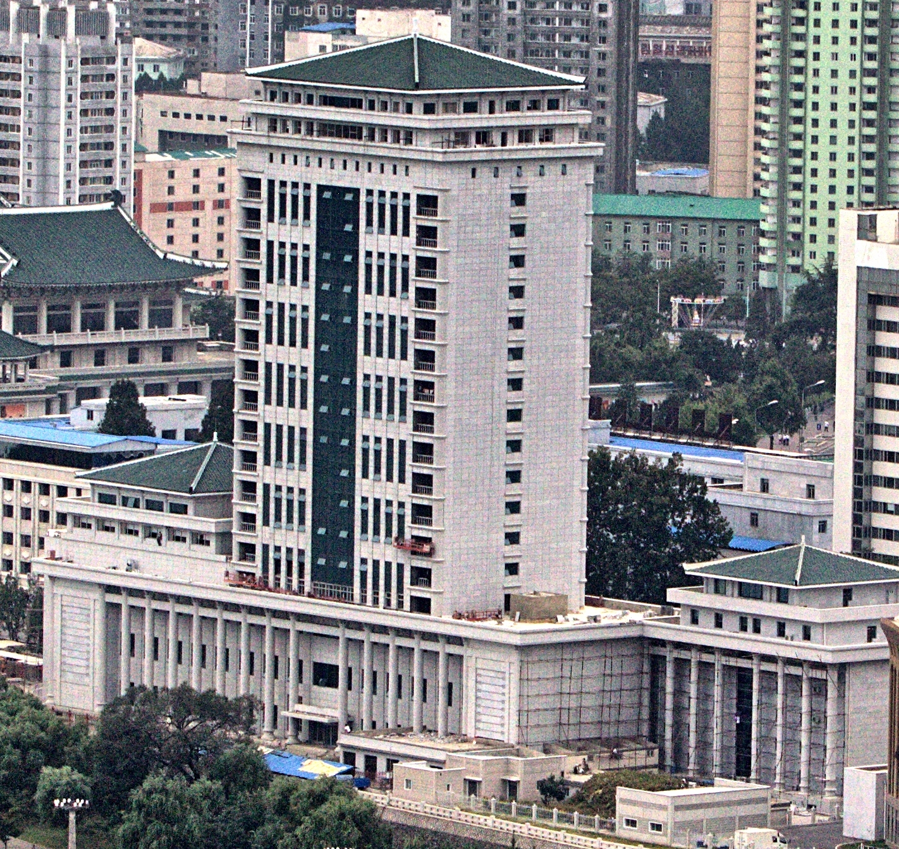
How Did Central Bank control the Won?
Dollarized economy creates huge constraints on monetary policy, much like currency board system.
In order to stabilize won, CB may have set an extremely tight monetary policy, restricting new loans to state enterprises and not printing new currency.
And the Finance Ministry thus may have required a very tight fiscal policy since CB would not finance new debt.
This would have shoved the economy into recession by 2017.
Evidence is observed shortage of won cash in markets, money “cleaning”, attempts to issue bonds, and fee increases by state organs.
State budget shows only a tiny increase in 2021-2 government budgeted expenditures, despite ambitious plan goals.

Slide 14
Then came sanctions and coronavirus
North Korea normally runs $500 million per-year in observable goods trade deficit that is probably offset by an equivalent services/transfers surplus. So current account is normally balanced.
But in 2017, collapse in exports to China led to $2 bn/ year goods deficits and thus a large current account deficit financed by an outflow of dollars and yuan Tight money policy would have required CB to reduce circulation of won to compensate, keeping won rate even.
By 2020 imports also collapsed, due to border closure and likely lack of hard currency funds or credit. So current account was again in balance. Continued tight monetary policy , however, caused won to reverse course and rise in value as economy fell into deep recession.

Slide 15
China-North Korea Trade
Jan 2015-July 2022
China Customs (excludes Chinese crude oil exports)
Tight UN Sanctions

Slide 16
China Trade Surplus with North Korea
Jan 2015 - July 2022
China Customs (excludes crude oil)
Conjectured non-trade net income

Slide 17
North Korea Won per US Dollar
September 2020-August 2022
Asia Press (border towns)

Slide 18
North Korea Won/China Yuan
Sep 2020 – Aug 2022
Asia Press (border towns)

Slide 19
Yuan/Dollar
Pyongyang Cross Rate vs international rate
Asia Press
Fed Reserve

Slide 20
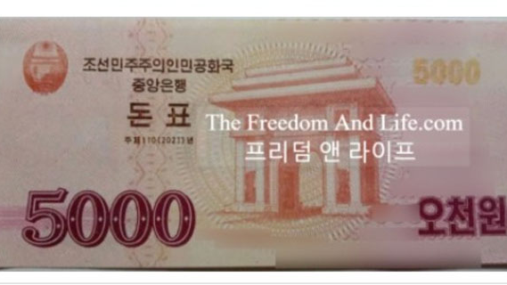

Slide 21
Conclusion: Kim’s singular achievement is in danger.
Kim’s singular economic achievement, exchange rate and price stability, is in big danger with potential to disrupt the political and economic system. Inflation and money theft does that.
Tight monetary policy has pushed economy into severe recession.
Public has much more power than in previous regimes given their private holdings of foreign exchange, yuan and dollars. State has less control.
State budgets and wages are severely constrained due to need to protect won against circulating dollars and yuan.
Textbook solution is to sell state assets to private sector thus easing budget constraint, while raising state salaries, increasing prices of state supplied goods, and allowing property rights to encourage private sector productivity.
This could be done even in UN Sanctions environment.

