Slide 1
Nov 2020: NK Economy Under Severe Strain
Kim in 2017-18 raised expectations for externally enabled growth.
But in October 2020 he talks of failure. Apologizes. Self reliance.
Economy’s weak productivity, not lack of resources, makes NK one of poorest in the world. Weak productivity due to incomplete transition from planned to market economy.
UN nuclear sanctions are having a large impact; external trade is near zero.
Monetary system stabilized but policy extremely tight. Government is starving itself to protect won. Privatizing via corruption. Little investment.
Is there hope for reform under Kim Jong Un?
“Bottom Up” Marketization Underway
“Top Down” Macro / Micro /Legal Support Needed
Upcoming Party Congress may give hints.
Sudden X Rate movements portend big changes.
Notes:
I think North Korea’s economy is under quite some strain but maybe not in the way most people think. Are the sanctions working? Well yes, but again, maybe not in the way people expect. Amid the fire and fury, is there room to hope of a normalized North Korea? Absolutely. And a good part of the answer is the stealth marketization currently under way in North Korea.
First, a few definitions. We often limit our thoughts of marketization to marketplaces. In the Korean context, market towns and huge urban markets, like East Gate in Seoul. Many buyers and many sellers congregating to get their best possible deals; the buyer the cheapest price, the seller the highest price with arbiters forcing the action. It’s that competition that drives a market economy to efficient outcomes. Markets are organized, with rules on how to efficiently conduct transactions; for example, the day and time they will be open. But for an economist, markets mean much more than these places. We think of markets for goods, services, labor, capital, real estate, and foreign exchange. North Korea always had some marketplaces. Its challenge is opening these other kinds of markets disdained by Marx and prohibited by the Stalinist system.
Also, closely connected with markets is money, prices, and ownership. You can’t, or shouldn’t, trade what you don’t own. The socialist system prohibited private ownership of capital, and thus disallowed trade in “the means of production”, otherwise known as capitalism. And markets inevitably mean use of money and credit, also prohibited in North Korea’s formal socialism. Flexible prices and wages, equilibrating supply and demand, are the key dynamic of any market, not the fixed, policy induced prices of socialism. And, of course, the interest rate or return on capital is the price of capital, usually forced to zero in the socialism system lest “money make money” and the “rich get richer.”

Slide 2
Markets
What is a Market?
Marketization: Much more than “marketplaces”
Goods Markets
Capital/Finance Markets
Foreign Exchange Markets
Many buyers, sellers
Rules, Structure, defines boundaries
Flex price clears the market
Usually most efficient outcome
Money the medium; Competition the force.
Law of One Price
Labor Markets -
Services Markets
Real Estate/Land Markets
$$√$$

Slide 3
Too Long Economic Transition—to what end?
Planned economy failed during famine – no rations. But it didn’t go away. Now dysfunctional, hybrid. Part command, part unregulated markets.
Sustained by external support through 2017. Now that support has been suspended.
Transitioned from ration, no money, economy under KIS to hyper-inflated won economy under KCI, to partially dollarized economy under KJU.
People now can have financial assets, US dollars, RMB. Emergent capitalism.
Rations, fixed wages, still exist but real money circulates. Trouble for the Plan and the state budget.
Won, RMB , US$ freely circulate. Two prices, fixed plan price and market, for everything.
Notes:
III. Economic Transition—but to where?
North Korea’s planned economy failed before, during, and after mid-1990s Great Famine. But it didn’t go away. It is now an odd, dysfunctional, hybrid, partly a severe command system and partly an unregulated, even unruly, market system. Even a feudal/serf system in some respects.
Failure of plan over the years, and absence of rations, has induced market activity. Planned system requires tight control over prices—similar to US pharmaceutical industry. When it can’t deliver essential goods, even food, people start to trade and natural prices, dictated by supply and demand, take over, further disrupting and corrupting the plan.
NK thus goes from a relatively pure ration system under KIS to a bad, inflation prone money system under KCI, to a dollarized, relatively good money system under KJU.
Won/yuan/dollars all circulate legally in NK, in markets, in factory transactions, even inside the government. They typically use won for small items, yuan for imported Chinese items, and US dollars for big items, housing, and most importantly, for private savings. [what to won, yuan, dollar have in common?] And there seems to be a reasonably well working market system for exchanging currency. More liberal than most.
But command economy still exists—collective farms and millions of state workers and the huge military. Maybe half market, half command.
Amazing discrepancy in prices and wages. Examples. Textile workers, teachers, nurses.
How did Kim stabilize money, his most important success?
Before 2017 big increase in exports, coal, to China, plus expanded service earnings, including illicit.
After 2017, export earnings fell 80 percent, but won maintained about an 8,000 won rate. How?
Many theories, puzzle not a mystery. My suspicion is an extremely tight won monetary policy and, by allowing public to save, savings must be growing very rapidly. Robs the market side of the economy of demand, pushing prices down and kills private employment.
Implies a huge fiscal problem on Kim’s hands—can’t pay workers or supply them with rations. Market sector is much more productive and hands out much more wealth. So, it is not just the old problem of hungry people. It’s a new problem of millions of hungry people—often loyal party people—side by side with millions of relatively well to do merchants and outcasts who live off of money, not rations. Recipe for high tension and even revolt.
And it means no funds for investment, no growth without reform.
III. “Reform and Opening”
I argue order is important. Opening without reform will be another disaster. It happened before in the 1970s and 80s.
North Korea’s planned economy failed before, during, and after mid-1990s Great Famine. But it didn’t go away. It is now an odd, dysfunctional, hybrid, partly a severe command system and partly an unregulated, even unruly, market system. Even a feudal/serf system in some respects.
Failure of plan over the years, and absence of rations, has induced market activity. Planned system requires tight control over prices—similar to US pharmaceutical industry. When it can’t deliver essential goods, even food, people start to trade and natural prices, dictated by supply and demand, take over, further disrupting and corrupting the plan.
NK thus goes from a relatively pure ration system under KIS to a bad, inflation prone money system under KCI, to a dollarized, relatively good money system under KJU.
Won/yuan/dollars all circulate legally in NK, in markets, in factory transactions, even inside the government. They typically use won for small items, yuan for imported Chinese items, and US dollars for big items, housing, and most importantly, for private savings. [what to won, yuan, dollar have in common?] And there seems to be a reasonably well working market system for exchanging currency. More liberal than most.
But command economy still exists—collective farms and millions of state workers and the huge military. Maybe half market, half command.
Amazing discrepancy in prices and wages. Examples. Textile workers, teachers, nurses.
How did Kim stabilize money, his most important success?
Before 2017 big increase in exports, coal, to China, plus expanded service earnings, including illicit.
After 2017, export earnings fell 80 percent, but won maintained about an 8,000 won rate. How?
Many theories, puzzle not a mystery. My suspicion is an extremely tight won monetary policy and, by allowing public to save, savings must be growing very rapidly. Robs the market side of the economy of demand, pushing prices down and kills private employment.
Implies a huge fiscal problem on Kim’s hands—can’t pay workers or supply them with rations. Market sector is much more productive and hands out much more wealth. So, it is not just the old problem of hungry people. It’s a new problem of millions of hungry people—often loyal party people—side by side with millions of relatively well to do merchants and outcasts who live off of money, not rations. Recipe for high tension and even revolt.
And it means no funds for investment, no growth without reform.

Slide 4
Global Trae Atlas source data

Slide 5
China 2016-7 Nuclear sanctions create trade, financial crisis.
China Customs data

Slide 6
Won stabilized despite export collapse
Daily NK source data

Slide 7
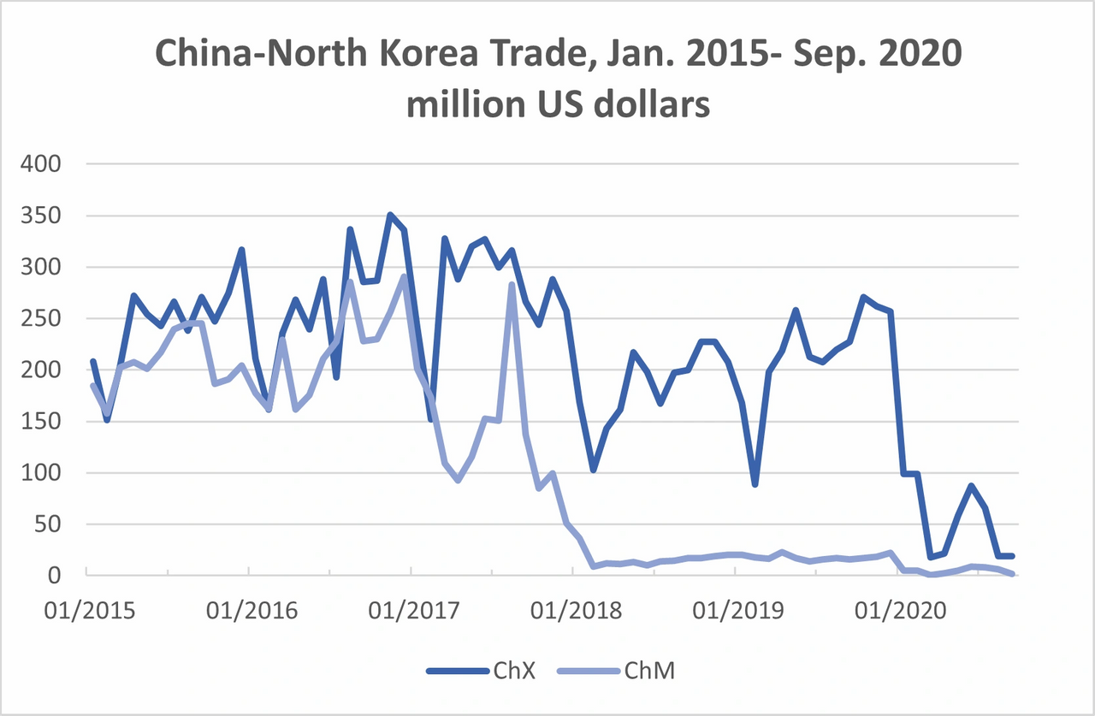
China Customs data

Slide 8
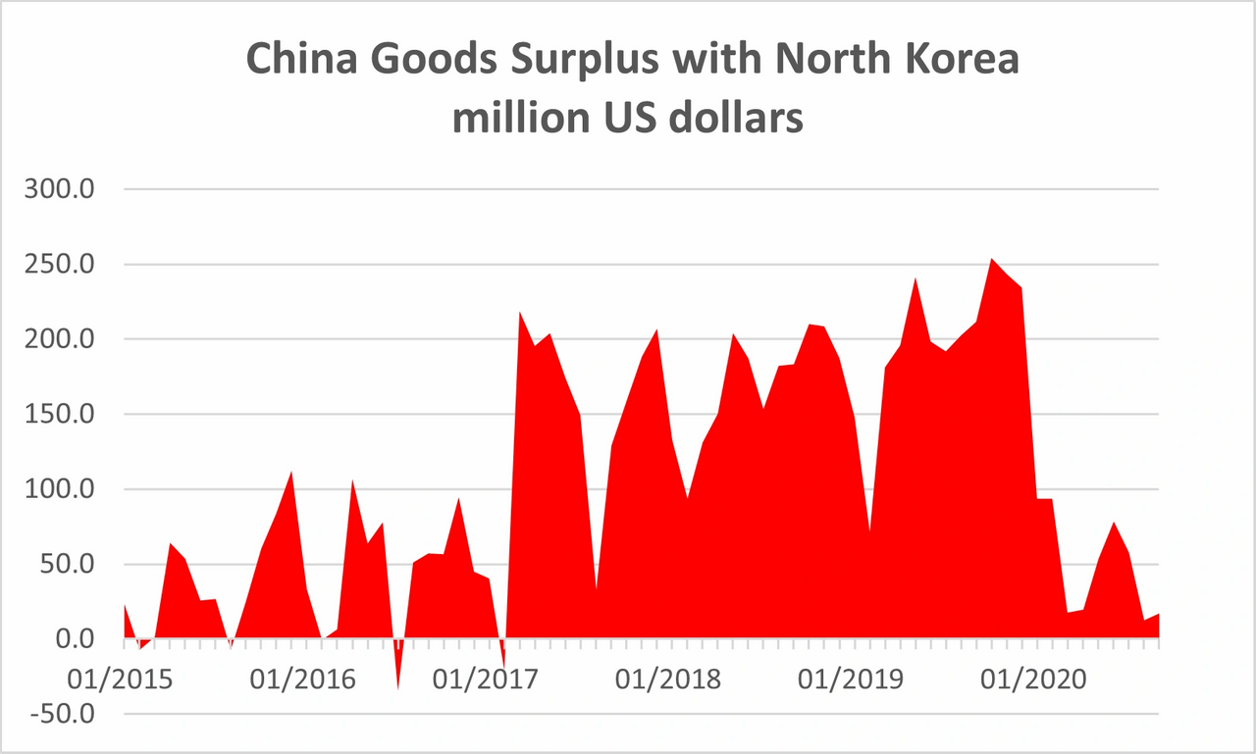

Slide 9
Hypothetical Balance of Payments
To 2017, per month
- $50 million goods
+ $50 million illicit , services, transfers, income, FDI, Portfolio, bank credit
NET 0
No Change in FX
Post 2017
- $150 million goods
+ $50 million service, transfers, income, FDI, Portfolio, bank credit
NET - $100 million
Cumulative $3 billion outflow, private and public
2020
NET $0

Slide 10
Tight Monetary, Fiscal Policy to Defend Won
Central bank reduces won supply in parallel with loss of dollars.
Little printing of new cash.
Few new net loans to state enterprises and state agencies
State firms allowed to privatize assets to make ends meet.
State agencies raise fees to raise funds. (no normal tax system).
Allow state workers to engage in private income earning work.
Impact stops inflation and devaluation, but devastates state investment, employment.
Cost of stable won is shrinking state sector. State owns the country so this can last a long time. Like China.
By allowing $US RMB to circulate, real savings vehicles are available for the first time, allowing citizens to save. Reduces current demand.

Slide 11
Asia Press, source data.

Slide 12
Asia Press, source data.

Slide 13
Asia Press, source data.

Slide 14
Why Revalue Won ? Speculation
Maybe Not real market action
Otherwise RMB would not drop versus dollar.
Daily NK sources say no one sell dollar at the new rate.
Government is trying to eliminate use of FX
Orders use of won, not dollars, yuan in state stores
Getting ready for new Plan to reset state prices, “move to market”. First attempting to shore up won.
With imports near zero, state doesn’t think it needs FX. Forcing a juche isolationist country.
Implications: Unclear if stop toward reform or step backwards. But sure sign of trouble in Pyongyang.

Slide 15
FURTHER READINGS
NAEIA.org
https://naeia.com/links/f/north-korea-hits-bottom--decision-time-for-the-young-chairman
https://www.ncnk.org/sites/default/files/NCNK_William_Brown_NK_Shackled_Economy_Report.pdf
http://www.theasanforum.org/sanctions-and-nuclear-weapons-are-changing-north-korea/
https://img1.wsimg.com/blobby/go/9a8f9774-2f47-4d62-a2f0-85fdb2cadf25/downloads/GW%20Lecture%20(2).pdf?ver=1586459563795

