Slide 1
Scott Triggers©: Perioperative Skin Assessment
Susan M. Scott MSN, RN, WOC Nurse
Mona Baharestani, PhD, APN, CWON, FACCWS
Mary Arnold Long, DNP, APRN, CRRN, CWOCN-AP, ACNS-BC, WOCNF

Slide 2
Objectives
1.Review the anatomy and physiology of the skin and etiology of pressure injury (PI) development in the perioperative setting.
2.Describe and stage a pressure injury and distinguish between types of skin injuries in surgical patients.
3.Illustrate the pressure points and common location of pressure injury in the various surgical positions.
4.Identify best practices for assessment, staging, and documenting normal vs abnormal findings to improve competency and skills of the perioperative nurse.
Notes:
1.Review the anatomy and physiology of the skin and etiology of pressure injury (PI) development in the perioperative setting.
2.Describe and stage a pressure injury and distinguish between types of skin injuries in surgical patients.
3.Illustrate the pressure points and common location of pressure injury in the various surgical positions.
4.Identify best practices for assessment, staging, and documenting normal vs abnormal findings to improve competency and skills of the perioperative nurse.
Define pressure injury.
Describe tools used to assess the patient’s skin & evaluate the risks of developing a skin injury during perioperative care.
Define patient’s risk factors associated with pressure injuries in the in the perioperative setting.
Discuss how pressure injury risk is influenced by surgery.
Identify evidence-based interventions to help prevent skin injury from occurring in the surgical patient population.

Slide 3
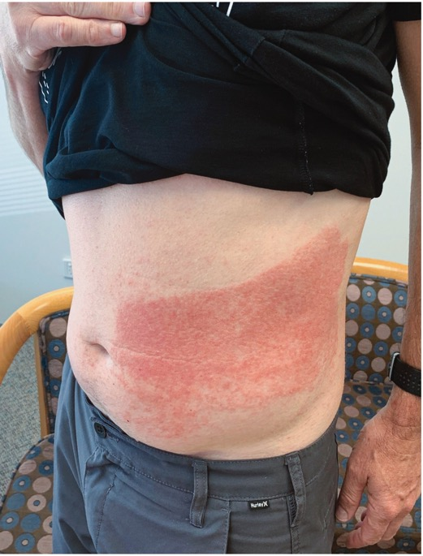
Surgical Skin Safety Statistics
550-650 surgical fires annually
Fuel source –Oxidizer - Ignition source
1.5 million skin tears (MARSI)
Acute care prevalence 3.3-22%
Surgical irritant contact dermatitis
Reaction to product
Latex, alcohol, CHG
Product not permitted to dry
Surgical pressure injuries
Most commonly reported positioning injury
Incidence 0.3% to 57.4%
Carle et al., 2021. Allergic contact dermatitis to a dye or alcohol in a chlorhexidine-based skin preparation: A case report. Anaesthesia and Intensive Care, 9(1), 70-73.
Notes:
Many types of skin injuries can be associated with surgery. There are between 550 and 650 surgical fires annually. Common fuel sources include degreasers, prepping agents, drapes, towels, sponges, dressings, tapes, gowns, hoods, masks, ointments, benzoin, aerosols, alcohol, mattress, pillows, blankets, ECG electrodes, hoses, tissue, GI gases.[2] The second component is an oxidizer. Common oxidizers are room air, oxygen, nitrous oxide.[2] Lastly, the third necessary component is an ignition source. Common ignition sources include a light source, laser, electrocautery, sparks from high-speed drills and burrs, defibrillators, glowing embers of charred tissue, flexible endoscopes, tourniquet cuffs.
Skin tears in surgery have not been reported, although acute care prevalence is reported between 3.3-33%
Chemical hazards leading to irritant dermatitis arise from sources, such as cleaning, disinfecting, and sterilizing agents, solvents, glues, metals, hazardous drugs, laboratory chemical reagents, waste anesthetic gases, surgical smoke, and other indoor air contaminants. Surgical irritant contact dermatitis occurs when the product pools or is not permitted to dry.
Pressure injuries are the most commonly reported positioning injury with a reported incidence between 1.3 and 54.8%.
A systematic review reported that the incidence of surgery-related PIs ranged from 0.3% to 57.4%

Slide 4
Components of Skin Assessment
Skin color
Skin temperature
Skin turgor
Skin moisture
Skin integrity
Mufti et al., 2022
Notes:
One intervention to assist with perioperative pressure injury prevention is a skin assessment in the preoperative area, in the operating room, and in the postanesthesia care unit. Skin assessment, although usually considered a visual observation, also includes touch and palpation. A thorough skin assessment consists of skin color, skin temperature, skin turgor, skin moisture, and skin integrity.

Slide 5
Skin Color
Normal variations in skin color may occur
Determine baseline normal in concert with patient or caregiver
Lightening or darkening of skin color can indicate pathology
Rubor
Pallor
Cyanosis
Necrosis
Mufti, A., Maliyar, K., Ayello, E.A. & Sibbald, R.G. (2022). Anatomy and physiology of the skin in WOCN Core Curriculum Wound Management 2nd. Ed., pp.12-38, L.L. McNichol, C.R. Ratliff & S.S. Yates, Eds.; Wolters Kluwer.
Notes:
All individuals have some normal variations in their skin color or tone. It is helpful to include the patient or caregiver in discussions about whether identified variations are normal or abnormal for the patient as lightening or darkening of skin color can indicate pathology and may be described as rubor, pallor, cyanosis, or necrosis.
Mufti et al., 2022

Slide 6
Skin Color
Skin assessment best performed with natural or halogen lighting
Fluorescent lighting can create blue hue
Assess head to toe with emphasis over bony prominences
Mufti, A., Maliyar, K., Ayello, E.A. & Sibbald, R.G. (2022). Anatomy and physiology of the skin in WOCN Core Curriculum Wound Management 2nd. Ed., pp.12-38, L.L. McNichol, C.R. Ratliff & S.S. Yates, Eds.; Wolters Kluwer.
Notes:
Assessment of the skin is best performed using natural sunlight or halogen lighting as florescent lighting can create a bluish hue. If your site has fluorescent lighting, invest in a halogen head lamp or flashlight for skin assessment. Assess the patient from head to toe, front, sides, and back with an emphasis over bony prominences.

Slide 7
Skin Temperature
Normal skin = warm to touch
Ischemic skin = generally cool to touch
Trauma, deep & surrounding infection & deep inflammation are generally warmer than adjacent skin
Best felt with back of hand
Can be measured with infrared thermometers
Temperature increase of 4◦F on foot indicates increased risk of DFU.
Mufti, A., Maliyar, K., Ayello, E.A. & Sibbald, R.G. (2022). Anatomy and physiology of the skin in WOCN Core Curriculum Wound Management 2nd. Ed., pp.12-38, L.L. McNichol, C.R. Ratliff & S.S. Yates, Eds.; Wolters Kluwer.
Notes:
Skin temperature is best assessed using the back of the hand or with an infrared thermometer. Normal skin is warm to touch while ischemic skin is cool to touch. Areas of trauma, deep infection and deep inflammation are warmer than adjacent skin. Research in the diabetic population has demonstrated an increase of 4 degrees Fahrenheit on the foot is indicative of diabetic foot ulceration.

Slide 8
Skin Turgor
Refers to skin resiliency
Ability to return to original state
Use two fingers to lift skin over sternum
Altered skin turgor common among older adults
May be a sign of dehydration
Difficult to determine specificity & consistency
Mufti, A., Maliyar, K., Ayello, E.A. & Sibbald, R.G. (2022). Anatomy and physiology of the skin in WOCN Core Curriculum Wound Management 2nd. Ed., pp.12-38, L.L. McNichol, C.R. Ratliff & S.S. Yates, Eds.; Wolters Kluwer.
Goehring ,M.T., Farran, J., Ingles-Laughlin, C., Benedista-Seelman, S. & Williams, B. (2022). Measures of Skin Turgor in Humans: A Systematic Review of the Literature. Wound Management and Prevention, 68(4),14-24.
Notes:
Skin turgor is skin resiliency or the ability of skin to return to its original state when lifted. The preferred location for checking turgor is over the sternum. Remember that, due to loss of elastin and collagen, the skin of the older adult has less resiliency than the skin of the younger adult. Poor skin turgor may be associated with dehydration, but a specific and consistent evidence-based measure has not been defined.

Slide 9
Skin Moisture
Stratum corneum has 10-15% water content
Xerosis
When TEWL >15% leads to skin dryness
Skin that is too dry or too wet contributes to risk of skin injury from pressure, shear, friction
Xerosis
Light skin tones = flaky & dull
Dark skin tones = ashy
Overhydrated skin
Light skin tones = may appear lighter (maceration), erythematous, or irregular edges
Dark skin tones = ashy, variable colors, erythema may be difficult to discern
1. Mufti, A., Maliyar, K., Ayello, E.A. & Sibbald, R.G. (2022). Anatomy and physiology of the skin in WOCN Core Curriculum Wound Management 2nd. Ed., pp.12-38, L.L. McNichol, C.R. Ratliff & S.S. Yates, Eds.; Wolters Kluwer.
2. LeBlanc, K., Baranoski, S., Christensen, D., Langemo, D., Edwards, K., Holloway, S…. Regan, M. (2013). International Skin Tear Advisory Panel: A Tool Kit to Aid in the Prevention, Assessment, and Treatment of Skin Tears Using a Simplified Classification System©. Advances in Skin & Wound Care, 26(10), 459-476.
Notes:
Normal stratum corneum of the epidermis has a 10 to 15 percent water content. When transepidermal water loss over 15 percent leads to skin dryness, xerosis can occur. In light skin tones, xerosis appears flaky and dull. In dark skin tones, xerosis appears ashy. In light skin tones, overhydrated skin may appear lighter, as with maceration, or erythematous or with irregular edges. In dark skin tones, overhydrated skin may appear ashy, variable colors, and erythema may be hard to discern. Both skin that is too dry or too wet is at risk of injury from pressure, shear, and friction. There is emerging evidence that elevated sub-epidermal moisture levels may be indicative of increased risk or presence of PI, especially in darker skin toned individuals.
Mufti, A., Maliyar, K., Ayello, E.A. & Sibbald, R.G. (2022). Anatomy and physiology of the skin in WOCN Core Curriculum Wound Management 2nd. Ed., pp.12-38, L.L. McNichol, C.R. Ratliff & S.S. Yates, Eds.; Wolters Kluwer.
LeBlanc, K., Baranoski, S., Christensen, D., Langemo, D., Edwards, K., Holloway, S…. Regan, M. (2013). International Skin Tear Advisory Panel: A Tool Kit to Aid in the Prevention, Assessment, and Treatment of Skin Tears Using a Simplified Classification System©. Advances in Skin & Wound Care, 26(10), 459-476.

Slide 10
Skin Integrity
Intact skin = normal finding
Intact epidermis protects against micro-organisms
Any breaks in integrity should be identified, type of damage determined & treatment of causative factors initiated
Correct tool should be used to classify injury
Pressure injury = NPIAP pressure injury staging guide
Skin tear = ISTAP skin tear classification system
Incontinence associated dermatitis (IAD)
GLOBIAD
IADs-D
Mufti et al., 2022; Beeckman, 2018; Bliss et al., 2014
Notes:
Intact skin is a normal finding. The epidermal layer of the skin, when intact, protects against exogenous micro-organisms and infection. Any breaks in skin integrity should be identified, the type of damage determined, and treatment of underlying factors initiated. The correct tools should be used to classify injury. For pressure injuries, the NPIAP pressure injury staging guidelines should be used. Only pressure injuries should be staged with this tool. Skin tear should be classified with the ISTAP skin tear classification system. Incontinence associated dermatitis should be classified using one of the tools specific to this skin injury.

Slide 11
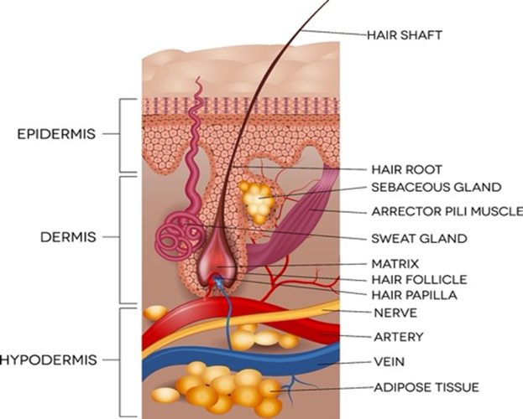
Anatomy
Epidermis
5 layers
Basement Membrane
Dermis
Collagen, Elastin (proteins)
Hypodermis
Fat
Muscle
Notes:
One Square centimeter of the skin contains:
15 Sebaceous glands,25 Pressure receptors,100 sweat glands,200 nerve endings
1 yard of blood vessels,12 heat sensors,2 cold sensors,4 yards of nerves with 3,000 sensors for communication three million cells constantly renewing them selves. That 1 square cm is about the size of a sugar cube.
If we take a look at the skin you will notice several layers. Epidermis, Dermis and the Hypodermis that include the fat and muscle layers.
The epidermis is composed of several layers
stratum corneum or horny layer which is basically dead keratinized cells.
stratum lucidum This layer is found when the epidermis is thicker such as the palm of your hand or the soles of the feet. It is absent from thinner skin such as the eyelid.
Stratum Granulosum that gets stained when you have a tattoo.
Stratum Spinosum prickly layer
Stratum Basale, or Stratum Germinativum These cells respond to growth factors, hormones, vitamin. Upward migration takes 2-3 weeks
Melanocytes responsible for skin pigmentation. Carotene or carotenoids are responsible to making the yellow hue of skin. This can happen if you eat a lot of carrots.
The Basement Membrane Zone BMZ or epidermal junction seperates the epidermis from the dermis.The major protein found in the BMZ are fibronectin, an adhesive glycoprotein this anchors the epidermis to the dermis, this is the layer that is affected in the formation of blisters.
Dermis is the thickest tissue layer of the skin. This layer contains fibroblast cells, blood vessels, and nerves. It ranges from 2-4 mm thick. Major proteins found in the dermis are collagen and elastin.
Collagen is the most abundant protein in the body. Normal human dermis is primarily composed of type I collagen , a fiber-forming collagen this Collagen is the protein that gives the skin its tensile strength.
Elastin - Elastin is a protein that give the skin it elastic recoil. Large concentrations of elastin are present in blood vessels, especially the aortic arch near the heart.
If the Epidermis is the Shirt and the Dermis are the pants, then collagen is the belt that hold the two together.
‘’ Layers of the skin
Epidermis - dry keratinocytes
• Rete pegs bind the two layers
Dermis - living layer contains nerves, vessels, lymphatics, hair follicles
• Two layers – Papillary (superficial) – Reticular (deeper)
» Contains epidermal elements that support healing

Slide 12
Pressure Injury
A pressure injury is localized damage to the skin and underlying soft tissue usually over a bony prominence or related to a medical or other device.
The injury can present as intact skin or an open ulcer and may be painful.
The injury occurs as a result of intense and/or prolonged pressure or pressure in combination with shear.
The tolerance of soft tissue for pressure and shear may also be affected by microclimate, nutrition, perfusion, co-morbidities & condition of the soft tissue.
NPIAP, 2016
Notes:
According to the NPIAP, who is the national authority on pressure injuries in the United States, a pressure injury is localized damage to the skin and underlying soft tissue usually over a bony prominence or related to a medical or other device.
The injury can present as intact skin or an open ulcer and may be painful.
The injury occurs as a result of intense and/or prolonged pressure or pressure in combination with shear.
The tolerance of soft tissue for pressure and shear may also be affected by microclimate, nutrition, perfusion, co-morbidities & condition of the soft tissue.

Slide 13
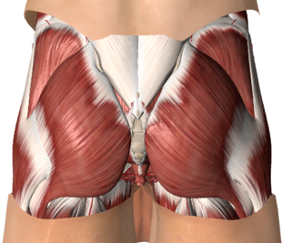
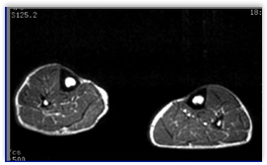
Etiology of Pressure Injury ¹⁻³
Bony Prominence
Sustained Pressure
Tissue Distortion
Cell Death
Pressure Injury
1.. Gefen A, Creehan S, Black J. Critical biomechanical and clinical insights concerning tissue protection when positioning patients in the operating room: A scoping review. Int Wound J. 2020;1-19.
2. European Pressure Ulcer Advisory Panel National Pressure Injury Advisory Panel, and Pan Pacific Pressure Injury Alliance. in Haesler E, ed. Prevention and Treatment of Pressure Ulcers/Injuries: Clinical Practice Guideline. The International Guideline. Westford, MA, USA: EPUAP-NPIAP-PPPIA; 2019.
3. Gefen A, Brienza D, Edsberg L, et al. The etiology of pressure injuries. In: Prevention and Treatment of Pressure Ulcers/Injuries: Clinical Practice Guideline European Pressure Ulcer Advisory Panel (EPUAP), National Pressure Injury Advisory Panel (NPIAP) and the Pan Pacific Pressure Injury Alliance (PPPIA). 3rd ed. Westford, MA, USA: EPUAP-NPIAP-PPPIA; 2019a.
Notes:
Slide 14 Etiology of Pressure injury. “Dr. Amit Gefen states “The primary cause of PI is sustained exposure to cell and tissue deformation”.
In the Context of surgery we start with a bony prominences with sharp edges such as the sacrum or heel. When we have sustained high pressures as in longer surgery cases, the tissue is distorted and deformed creating microscopic damage to the cells. When the cells are damaged, they leak fluid contributing to edema and triggers the immune response and inflammation. You may see erythema post op. Repetitive exposure to tissue distortion and prolonged unrelieved pressure from procedures increase the risk for PI This explains why reoperations have been identified in OR PI research.
Gefen A, Creehan S, Black J. Critical biomechanical and clinical insights concerning tissue protection when positioning patients in the operating room: A scoping review. Int Wound J. 2020;1-19.
European Pressure Ulcer Advisory Panel National Pressure Injury Advisory Panel, and Pan Pacific Pressure Injury Alliance. in Haesler E, ed. Prevention and Treatment of Pressure Ulcers/Injuries: Clinical Practice Guideline. The International Guideline. Westford, MA, USA: EPUAP-NPIAP-PPPIA; 2019.

Slide 14
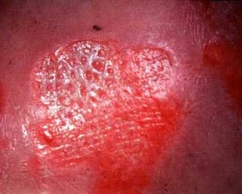
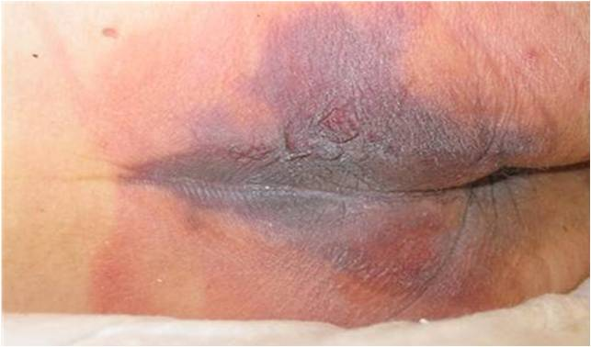
Top-Down vs Bottom-Up Tissue Damage
Bottom-Up
Stage 3, 4, Unstageable, DTI
Top-Down
Stage 1, 2
Wound Ostomy and Continence Nurses Society. (2016) Bottom-Up (Pressure Shear) Injuries. In D. Doughty, and L. McNichol (Ed). Core Curriculum Wound Management. (pp. 313-332). Philadelphia, Wolters Kluwer.
Notes:
Depending on etiology skin damage may be related to surface level injury that progresses inward or a bottom up injury that starts at the muscle level and progress outward (WOCN).
Examples of top-down damage may include stage I, II or partial thickness skin loss whereas
Bottom up damage may be suspected deep tissue injury (photo on the right) or a stage III, IV or unstageable ulcers

Slide 15
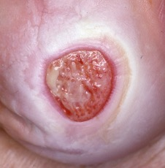
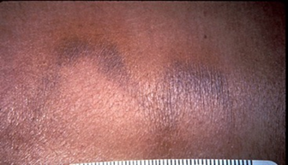
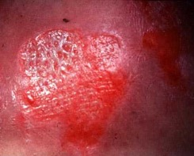
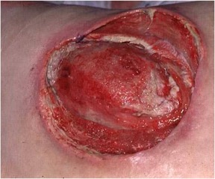
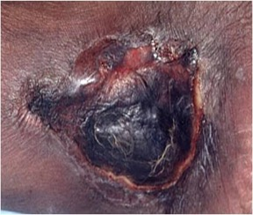
Stages of Pressure Injury
Image credits scotttriggers.com

Slide 16
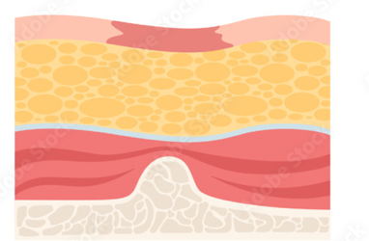
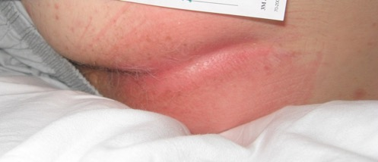
Stage 1 Pressure Injury
Intact skin with a localized area of non-blanchable erythema, which may appear differently in darkly pigmented skin. Presence of blanchable erythema or changes in sensation, temperature, or firmness may precede visual changes.
National Pressure Ulcer Advisory Panel. Pressure Injury Stages. http://www.npuap.org/resources/educational-and-clinical-resources/npuap-pressure-injury-stages/.
Image Credit(s): Adobe Stock Images, M. Arnold Long
Notes:
A Stage 1 pressure injury is Non-blanchable erythema of intact skin .
Intact skin with a localized area of non-blanchable erythema, which may appear differently in darkly pigmented skin. Presence of blanchable erythema or changes in sensation, temperature, or firmness may precede visual changes.
Color changes do not include purple or maroon discoloration; these may indicate deep tissue pressure injury.
The artist’s rendition shows erythema but not a break in the epidermis. The bottom image shows that non-blanchable erythema. However, erythema may be more difficult to discern in darkly pigmented skin. Stage 1 Pressure Injury: Non-blanchable erythema of intact skin Intact skin with a localized area of non-blanchable erythema, which may appear differently in darkly pigmented skin. Presence of blanchable erythema or changes in sensation, temperature, or firmness may precede visual changes. Color changes do not include purple or maroon discoloration; these may indicate deep tissue pressure injury.

Slide 17
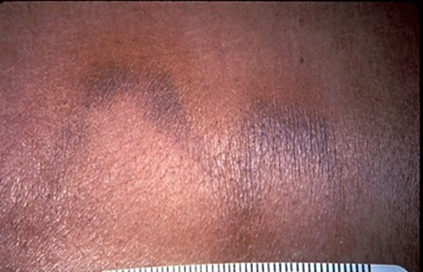
Stage 1 Pressure Injury
Color changes do not include purple or maroon discoloration; these may indicate deep tissue pressure injury.
Post-op anterior ribs, prone position on towel roll
National Pressure Ulcer Advisory Panel. Pressure Injury Stages. http://www.npuap.org/resources/educational-and-clinical-resources/npuap-pressure-injury-stages/.
Image Credit(s): Adobe Stock Images, M. Arnold Long Scott Triggers PLLC
Notes:
The bottom left image is a stage 1 heel ulcer and the bottom right image is a stage 1 costal margin ulcer from a towel roll used for positioning. This is why using touch and palpation is so important so that changes in sensation, temperature, firmness, or pain can be ascertained as visual changes may be more difficult to elucidate.

Slide 18
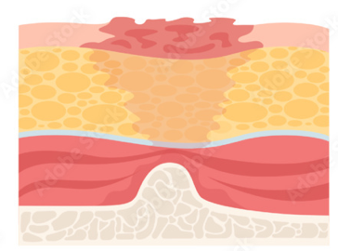
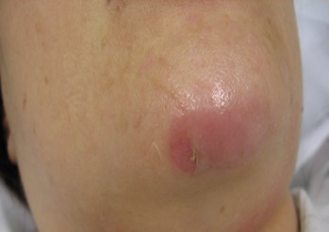
Stage 2 Pressure Injury
The wound bed is viable, pink or red, moist, and may also present as an intact or ruptured serum-filled blister. Adipose (fat) is not visible and deeper tissues are not visible. Granulation tissue, slough, and eschar are not present. These injuries commonly result from adverse microclimate and shear in the skin over the pelvis and shear in the heel.
9. National Pressure Ulcer Advisory Panel. Pressure Injury Stages. http://www.npuap.org/resources/educational-and-clinical-resources/npuap-pressure-injury-stages/.
Image Credit(s): Adobe Stock Images, M. Arnold Long
Notes:
Stage 2 Pressure Injury: Partial-thickness loss of skin with exposed dermis. The wound bed is viable, pink or red, moist, and may also present as an intact or ruptured serum-filled blister. Adipose (fat) is not visible and deeper tissues are not visible. Granulation tissue, slough and eschar are not present. These injuries commonly result from adverse microclimate and shear in the skin over the pelvis and shear in the heel.

Slide 19
Stage 2 Pressure Injury
Granulation tissue, slough, and eschar are not present.
National Pressure Injury Advisory Panel (2016). NPUAP Pressure Injury Stages. https://cdn.ymaws.com/npuap.site-ym.com/resource/resmgr/npuap_pressure_injury_stages.pdf
Images credit: Scotttriggers.com
Notes:
A stage 2 pressure injury is partial-thickness loss of skin with exposed dermis. This injury is into, but not through, the epidermis. If we think of the epidermis as the thickness of a piece of paper, that injury is not very deep.
The wound bed is viable, pink or red, moist, & may also present as an intact or ruptured serum-filled blister.
Adipose (fat) is not visible and deeper tissues are not visible. Granulation tissue, slough and eschar are not present.
These injuries commonly result from adverse microclimate & shear in the skin over the pelvis & shear in the heel.
This stage should not be used to describe moisture associated skin damage (MASD) including incontinence associated dermatitis (IAD), intertriginous dermatitis (ITD), medical adhesive related skin injury (MARSI), or traumatic wounds (skin tears, burns, abrasions).

Slide 20
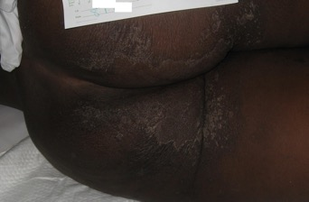
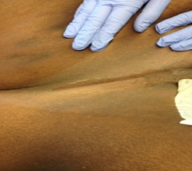
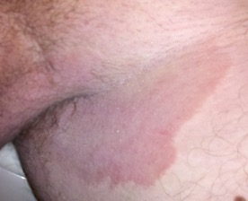
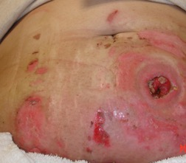
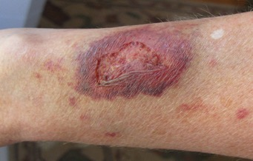
What Stage 2 Pressure Injury is NOT…
IAD
This stage should NOT be used to describe moisture associated skin damage (MASD) including incontinence associated dermatitis (IAD), intertriginous dermatitis (ITD), medical adhesive related skin injury (MARSI), or traumatic wounds (skin tears, burns, abrasions).
ITD
MARSI
Trauma
9. National Pressure Ulcer Advisory Panel. Pressure Injury Stages. http://www.npuap.org/resources/educational-and-clinical-resources/npuap-pressure-injury-stages/.
Image Credit(s): Wiki Commons & , M. Arnold Long
Notes:
This stage should NOT be used to describe moisture associated skin damage (MASD) including incontinence associated dermatitis (IAD), intertriginous dermatitis (ITD), medical adhesive related skin injury (MARSI), or traumatic wounds (skin tears, burns, abrasions).
Remember only pressure injuries should be staged. So other skin injuries such as incontinence associated dermatitis, intertriginous dermatitis or intertrigo, medical adhesive related skin injury, or traumatic wounds should not be staged. The top two images are incontinence associated dermatitis on light and dark skin tones. Note the more ashen appearance on the dark skin toned individual. The middle two images are intertriginous dermatitis on dark and light skin tones. Note the whiter appearance on the dark skin toned individual and the more erythematous appearance on the light skin toned individual.

Slide 21
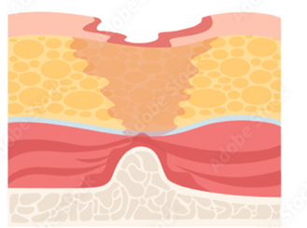
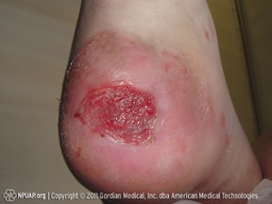
Stage 3 Pressure Injury
Full-thickness loss of skin, in which adipose (fat) is visible in the ulcer and granulation tissue and epibole (rolled wound edges) are often present.
Slough and/or eschar may be visible. The depth of tissue damage varies by anatomical location; areas of significant adiposity can develop deep wounds.
Undermining and tunneling may occur. Fascia, muscle, tendon, ligament, cartilage, and/or bone are not exposed.
If slough or eschar obscures the extent of tissue loss this is an Unstageable Pressure Injury.
National Pressure Ulcer Advisory Panel. Pressure Injury Stages. http://www.npuap.org/resources/educational-and-clinical-resources/npuap-pressure-injury-stages/.
Image Credit(s): Adobe Stock Images, M. Arnold Long
Notes:
A stage three pressure injury extends beyond the dermis into the hypodermis or fat. Healthy fat is yellow, whereas necrotic fat is brownish. A stage three pressure injury is a full thickness loss of skin, in which adipose (fat) is visible in the ulcer & granulation tissue & epibole (rolled wound edges) are often present.
Slough and/or eschar may be visible.
The depth of tissue damage varies by anatomical location; areas of significant adiposity can develop deep wounds.
Undermining and tunneling may occur. Fascia, muscle, tendon, ligament, cartilage and/or bone are not exposed.
If slough or eschar obscures the extent of tissue loss this is an Unstageable Pressure Injury.

Slide 22
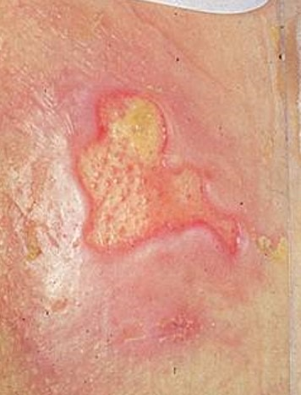
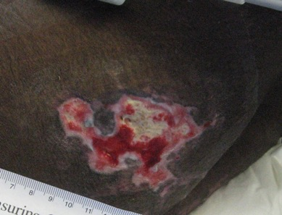
Stage 3 Pressure Injury
AVR Occipital - Reoperation
CABG Sacral
National Pressure Ulcer Advisory Panel. Pressure Injury Stages. http://www.npuap.org/resources/educational-and-clinical-resources/npuap-pressure-injury-stages/.
Image Credit(s): M. Arnold Long, ScottTriggers.com
Notes:
This first wound is a stage 3 Occipital pressure injury noted post op day 1 after a Aortic Valve Replacement which required a reoperationg. The middle wound should a stage 3 with some slough and the far right is post op week one observe in clinic on a CABG patient.

Slide 23
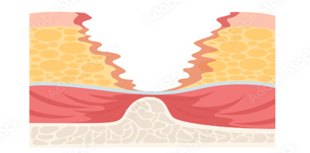
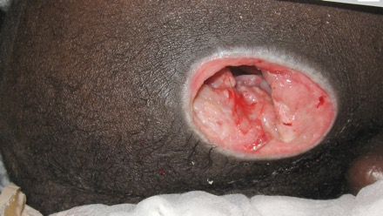
Stage 4 -Pressure Injury
Full-thickness skin and tissue loss with exposed or directly palpable fascia, muscle, tendon, ligament, cartilage or bone in the ulcer.
Slough and/or eschar may be visible.
Epibole (rolled edges), undermining and/or tunneling often occur.
Depth varies by anatomical location.
If slough or eschar obscures the extent of tissue loss this is an Unstageable Pressure Injury.
National Pressure Ulcer Advisory Panel. Pressure Injury Stages. http://www.npuap.org/resources/educational-and-clinical-resources/npuap-pressure-injury-stages/.
Image Credit(s): Adobe Stock Images, M. Arnold Long
Notes:
Stage 4 Pressure Injury: Full-thickness skin and tissue loss Full-thickness skin and tissue loss with exposed or directly palpable fascia, muscle, tendon, ligament, cartilage or bone in the ulcer. Slough and/or eschar may be visible. Epibole (rolled edges), undermining and/or tunneling often occur. Depth varies by anatomical location. If slough or eschar obscures the extent of tissue loss this is an Unstageable Pressure Injury.
Note that even though there is some slough in the middle image, the underlying muscle can be seen, so it is a stage 4 PI.

Slide 24
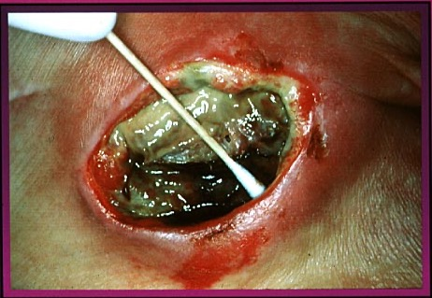
Pressure Injury Unstageable
Full-thickness skin & tissue loss in which the extent of tissue damage within the ulcer cannot be confirmed because it is obscured by slough or eschar.
Slough
National Pressure Ulcer Advisory Panel. Pressure Injury Stages. http://www.npuap.org/resources/educational-and-clinical-resources/npuap-pressure-injury-stages/.
Image Credit(s): scotttriggers.com
Notes:
An unstageable pressure injury is Full-thickness skin & tissue loss in which the extent of tissue damage within the ulcer cannot be confirmed because it is obscured by slough or eschar.
If slough or eschar is removed, a Stage 3 or Stage 4 pressure injury will be revealed.
Stable eschar (i.e. dry, adherent, intact without erythema or fluctuance) on the heel or ischemic limb should not be softened or removed.

Slide 25
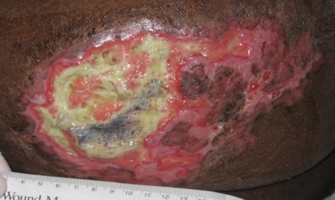
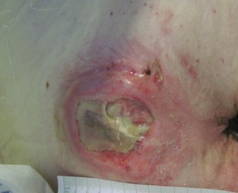
Pressure Injury Unstageable
If slough or eschar is removed, a Stage 3 or Stage 4 pressure injury will be revealed.
Stable eschar (i.e. dry, adherent, intact without erythema or fluctuance) on the heel or ischemic limb should not be softened or removed.
Slough
National Pressure Ulcer Advisory Panel. Pressure Injury Stages. http://www.npuap.org/resources/educational-and-clinical-resources/npuap-pressure-injury-stages/.
Image Credit(s): M. Arnold Long
Notes:
An unstageable pressure injury is Full-thickness skin & tissue loss in which the extent of tissue damage within the ulcer cannot be confirmed because it is obscured by slough or eschar.
If slough or eschar is removed, a Stage 3 or Stage 4 pressure injury will be revealed.
Stable eschar (i.e. dry, adherent, intact without erythema or fluctuance) on the heel or ischemic limb should not be softened or removed.

Slide 26
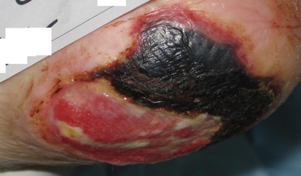
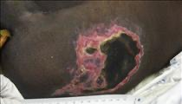
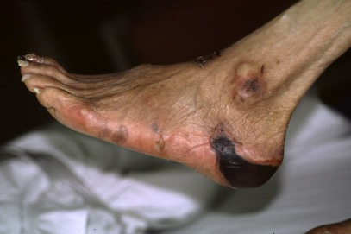
Unstageable with Eschar
CABG reoperation
Image Credit(s): M. Arnold Long, Scotttriggers.com
Notes:
Top right shows a combination deep tissue injury with eschar that is unstageable. S/P CABG with reoperation.
Bottom Right show eschar but also injury from compression stockings. Caution should be used with compression stockings on patients with inadequate circulation. Or non palpable pulses

Slide 27
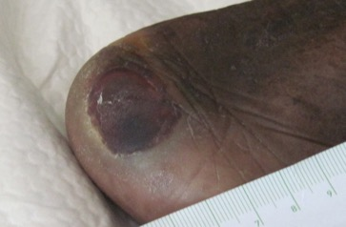
Deep Tissue Pressure Injury
Intact or non-intact skin with localized area of persistent non-blanchable deep red, maroon, purple discoloration or epidermal separation revealing a dark wound bed or blood filled blister.
Pain & temperature change often precede skin color changes. Discoloration may appear differently in darkly pigmented skin.
This injury results from intense and/or prolonged pressure & shear forces at the bone-muscle interface.
The wound may evolve rapidly to reveal the actual extent of tissue injury, or may resolve without tissue loss.
National Pressure Ulcer Advisory Panel. Pressure Injury Stages. http://www.npuap.org/resources/educational-and-clinical-resources/npuap-pressure-injury-stages/.
Image Credit(s): Adobe Stock Images, M. Arnold Long ScottTriggers.com
Notes:
A deep tissue pressure injury is Intact or non-intact skin with localized area of persistent non-blanchable deep red, maroon, purple discoloration or epidermal separation revealing a dark wound bed or blood filled blister.
Pain & temperature change often precede skin color changes. Discoloration may appear differently in darkly pigmented skin.
This injury results from intense and/or prolonged pressure & shear forces at the bone-muscle interface.
The wound may evolve rapidly to reveal the actual extent of tissue injury, or may resolve without tissue loss.
If necrotic tissue, subcutaneous tissue, granulation tissue, fascia, muscle or other underlying structures are visible, this indicates a full thickness pressure injury (Unstageable, Stage 3 or Stage 4).
Do not use DTPI to describe vascular, traumatic, neuropathic, or dermatologic conditions.
As with stage 1 pressure injuries, DTPI may be more difficult to ascertain on dark skin tones.

Slide 28
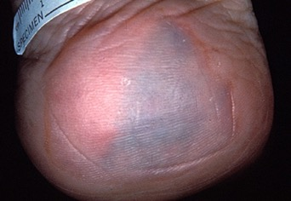
Deep Tissue Pressure Injury
If necrotic tissue, subcutaneous tissue, granulation tissue, fascia, muscle or other underlying structures are visible, this indicates a full thickness pressure injury (Unstageable, Stage 3 or Stage 4).
CABG 48 hrs post op
National Pressure Ulcer Advisory Panel. Pressure Injury Stages. http://www.npuap.org/resources/educational-and-clinical-resources/npuap-pressure-injury-stages/.
Image Credit(s): ScottTriggers.com
Notes:
If necrotic tissue, subcutaneous tissue, granulation tissue, fascia, muscle or other underlying structures are visible, this indicates a full thickness pressure injury (Unstageable, Stage 3 or Stage 4).

Slide 29
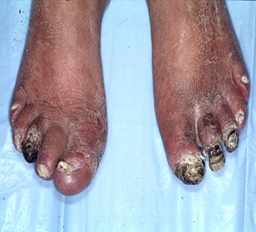
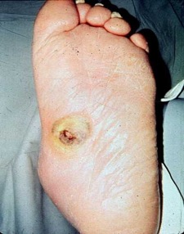
Deep Tissue Pressure Injury is NOT…
Do not use DTPI to describe vascular, traumatic, neuropathic, or dermatologic conditions.
National Pressure Ulcer Advisory Panel. Pressure Injury Stages. http://www.npuap.org/resources/educational-and-clinical-resources/npuap-pressure-injury-stages/.
Image Credit(s): ScottTriggers.com
Notes:
Do not use DTPI to describe vascular, traumatic, neuropathic, or dermatologic conditions.

Slide 30
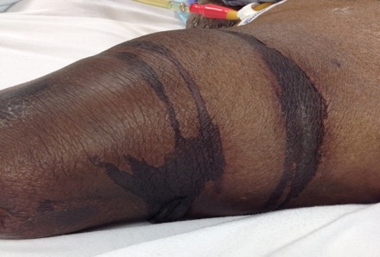
Medical Device Related Pressure Injury (MDRPI)
Oxygen Tubing
This describes an etiology.
Medical device related pressure injuries result from the use of devices designed and applied for diagnostic or therapeutic purposes. The resultant pressure injury generally conforms to the pattern or shape of the device.
The injury should be staged using the staging system.
Stump Shrinker
National Pressure Ulcer Advisory Panel. Pressure Injury Stages. http://www.npuap.org/resources/educational-and-clinical-resources/npuap-pressure-injury-stages/.
Image Credit(s): Adobe Stock Images, M. Arnold Long
Notes:
A Medical Device Related pressure injury describes an etiology or underlying cause of the pressure injury. Medical device related pressure injuries result from the use of devices designed and applied for diagnostic or therapeutic purposes. The resultant pressure injury generally conforms to the pattern or shape of the device.
The injury should be staged using the staging system.

Slide 31
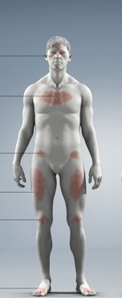
Location of MDRPI
Occiput 1.5%
Ears 35%
Nose 5%
Mouth/Lips 3%
Ribs 1.5%
Arm 1.5%
Buttocks 3%
Sacrum/Coccyx 3%
Ischium 1.5%
Thigh 5%
Knee 5%
Lower Leg 11%
Ankle 5%
Feet 5%
Heel 8%
Toes 6%
Black JM, Cuddigan JE, Walko MA, Didier LA, Lander MJ, Kelpe MR. Medical device related pressure ulcers in hospitalized patients. Int Wound J. 2010;7(5):358-365. doi:10.1111/j.1742-481X.2010.00699. Image credit: Illustration by Blaine Miller used with permission
Notes:
Location of MDRPI Majority are on the head but can occur anywhere. Surgical patients should be assessed post op for MDRPI.

Slide 32
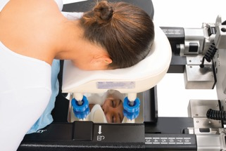
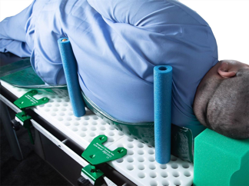
High risk medical devices
Anesthesia devices³
Face plates in prone position³
External fixators
Urinary catheters & tubing^{1,2}
Vacuum-packed positioning device¹
Peg Boards²
Mayo stands on the toes³
Safety straps³
Compression stockings
1. Guideline for prevention of perioperative pressure injury. In: Guidelines for Perioperative Practice. Denver, CO: AORN, Inc; 2023:751-776.
2. Prevention and Treatment of Pressure Ulcers/Injuries: Clinical Practice Guideline. The International Guideline. 3rd ed. European Pressure Ulcer Advisory Panel, National Pressure Injury Advisory Panel (NPIAP), and Pan Pacific Pressure Injury Alliance; 2019.
3. Guideline for positioning the patient. In: Guidelines for Perioperative Practice. Denver, CO: AORN, Inc; 2023:701-750.
Notes:
In general 70% MDRPI occur on the Head, but in the OR we have multiple devices that can contribute to skin and soft tissue damage. Besides the increased pressure on the tissue there can be microclimate changes, heat, sweat and friction such as the face plates in prone position. Micromovements and sweat may contribute to facial injury. Many of the devices are rigid so Careful positioning, extra padding, and prophylactic dressings may be helpful in prevention.
Anesthesia devices
Face plates in prone position
External fixators
Urinary catheters & tubing
Vacuum-Packed Positioning Device
Peg Boards
r
Mayo stands on the toes p 710
Safety straps
Compression stockings

Slide 33
MDRPI in the OR
Bean Bag
Notes:
These are 2 examples of PI on the lateral side after placement on a BEAN BAG device

Slide 34
Medical-device related PI Prevention Bundles^{15,16}
Assessment
Anchoring and Securement
Pressure Redistribution
Partnering with Team
Skin Protection
15.Pittman J, Gillespie C. Medical Device-Related Pressure Injuries. Crit Care Nurs Clin North Am. 2020;32(4):533-542. doi:10.1016/j.cnc.2020.08.004
16. Stellar JJ, Hasbani NR, Kulik LA, et al. Medical Device-Related Pressure Injuries in Infants and Children. J Wound Ostomy Continence Nurs. 2020;47(5):459-469. doi:10.1097/WON.0000000000000683
Notes:
Medical device prevention bundle Pittman and Stellar published
Assessment
Includes frequent assessment of skin beneath the device as well as proper fit of the device, changes in fluid shifts
Anchoring/securement
Includes proper securement of the device and use of specifically designed devices for safe securement
Pressure redistribution
Includes lifting, removal, and/or rotation of devices
Collaborate with pertinent disciplines for MDRPI prevention
• Partnering with other disciplines for joint assessment and care (eg, respiratory therapy, trauma, orthopedics, ECMO, vascular team, PT, and OT) . Periodic rounding for compliance
Skin protection
Includes management of microclimate of skin beneath
Mucosal Membrane Pressure Injury: Mucosal membrane pressure injury is found on mucous membranes with a history of a medical device in use at the location of the injury. Due to the anatomy of the tissue these ulcers cannot be staged.
Assessment
Includes frequent assessment of skin beneath the device as well as proper fit of the device
• Skin, mucous membrane assessment beneath and around device
• Device inspection for proper fit
• Frequent assessments during periods of fluid shifts, weight gain/loss, distention
• Device inspection for soilage and trapping of body fluids
Anchoring/securement
Includes proper securement of the device and use of specifically designed devices for safe securement
• When possible, utilize securing devices or taping techniques designed for safe securement/anchoring of the device without undue amount of pressure
• For adjustable securement straps—ensure these are not overly tight
• Consider rotating site of anchoring/securing (eg, alternate thigh for Foley drainage tubing securement)
• For devices that are temporarily sutured in place—discuss with the team standardized suture removal time frame (eg, new tracheostomy tube)
• Adjusting securement during periods of fluid shifts
Pressure redistribution
Includes lifting, removal, and/or rotation of devices
• Periodic lifting of device, preferably every 4 h
• For devices that can be—rotate to different location
• Daily or every 12-h multidisciplinary discussion of patient need for the device
• Proper (neutral) positioning of patient
Partnering
Collaborate with pertinent disciplines for MDRPI prevention
• Partnering with other disciplines for joint assessment and care (eg, respiratory therapy, trauma, orthopedics, ECMO, vascular team, PT, and OT)
• Periodic rounding for compliance
• Multidisciplinary review of all reportable MDRPIs to address practice, product, or systems concerns
Skin protection
Includes management of microclimate of skin beneath
Mucosal Membrane Pressure Injury: Mucosal membrane pressure injury is found on mucous membranes with a history of a medical device in use at the location of the injury. Due to the anatomy of the tissue these ulcers cannot be staged.

Slide 35
Pressure Injury Mucosal Membrane
Mucosal membrane pressure injury is found on mucous membranes with a history of a medical device in use at the location of the injury.
Due to the anatomy of the tissue these ulcers cannot be staged.
Bite Block
Lip
Indwelling Catheter
Urethral Meatus
National Pressure Ulcer Advisory Panel. Pressure Injury Stages. http://www.npuap.org/resources/educational-and-clinical-resources/npuap-pressure-injury-stages/.
Image Credit(s): Adobe Stock Images, M. Arnold Long
Notes:
A mucosal membrane pressure injury is an etiology and location. It involves use of a medical device creating pressure on a mucous membrane. Because mucous membranes do not have the same anatomical layers as skin, these pressure injuries cannot be staged.

Slide 36
Medical Adhesive-Related Skin Injury (MARSI)
Types of MARSI
Erythema
Tension injury or blister
Skin stripping
Irritant contact dermatitis
Skin tear
Maceration
Bulla S/P CABG
Notes:
MARSI is the occurrence of erythema and or skin abnormalities such as a vesicle, bulla, (blister), erosion, or tear that persists for 30 minutes or more after adhesive removal. (McNichol) This is an example of top-down skin damage. In a study of 1,189 observations with the number of adhesive product exposures evaluated being 6,131 Medical adhesive is defined as ay product used to approximate wound edges or to affix an external device ( i.e., tape, dressing catheter, electrode, pouch, or patch) to the skin. (Farris, Petty, Hamilton (2015).
Types of medical Adhesive related skin injuries may include:
Erythema i.e. redness
Tension injury or blister, Bulla is a large blister.
Skin stripping
Irritant contact dermatitis
Skin tear
Maceration
In another 8 week study of 155 older individuals the observance Incidence was 15.5% related to Medical adhesive tape.
McNichol L, Lund C, Rosen T, Gray M. Medical adhesives and patient safety: state of the science: consensus statements for the assessment, prevention, and treatment of adhesive-related skin injuries. J Wound Ostomy Continence Nurs. 2013;40(4):365-380.
Farris, M, Petty M, Hamilton, J, Walters S, Flynn M. Medical adhesive-related skin injury prevalence among adult acute care patients: A single-center observational Study. J Wound Ostomy Continence Nurs. 2015;42(6):589-598.

Slide 37
MARSI
Types of Medical Adhesive Product Categories
Surgical dressing (transparent dressing, tape)
Surgical closure (strips)
IV dressings (transparent, bordered dressings)
Wound dressing
Tube securement (NG, feeding, chest, foley)
Electrodes
Tension injury blister
Notes:
Transparent dressing was used to secure an electrode resulting in MARSI skin damage.
Types of medical Adhesive Product Categories may include:
Surgical dressing (transparent dressing, tape)
Surgical closure (strips)
IV dressings (transparent, bordered dressings)
Wound dressing
Tube securement (NG, feeding, chest, foley)
Electrodes

Slide 38
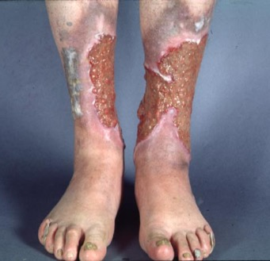
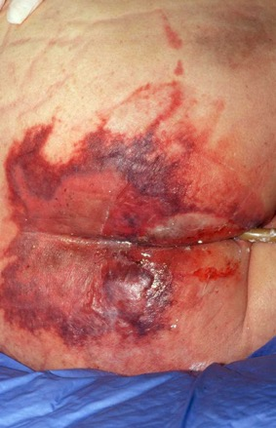
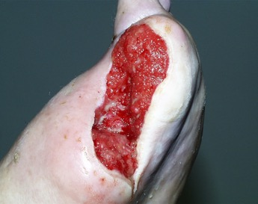
Etiology
6
1
2
3
5
4
Notes:
Guidelines for diagnosis wound etiology
• Clinical assessment
• Perfusion studies/ venous studies
• Monofilament testing
• Serum studies and wound biopsy to diagnose
vasculitis/ other atypical wounds
• Biopsy to R/O malignancy
• Critical question: all etiologic factors
effectively addressed?

Slide 39
Skin Assessment
Timing
Skill
Accuracy
Documentation
European Pressure Ulcer Advisory Panel, National Pressure Injury Advisory Panel, and Pan Pacific Pressure Injury Alliance. Prevention and Treatment of Pressure Ulcers/Injuries: Clinical Practice. The International Guideline 2019. EPUAP/NPIAP/PPPIA; 2019.
Notes:
Accurate, timely, documented skin assessments establish a baseline, and drive prevention protocols. Early recognition may prevent new injuries from progressing to more severe stages through aggressive care planning.
All blanchable and non-blanchable erythema should be observed, documented, and reported until resolved.
Incorporate the systematic skin assessment while performing your routine tasks, placing the patient in a gown, or moving patient onto the table.
Darkly pigmented skin should be assessed by checking skin temp, and for the presence of edema, induration or pain.2 Don’t make it hard. One best practice from John Muir includes a full body skin assessments for all cases over 2 hours with a 4-eyes Visual Skin Assessment between the OR and PeriAnesthesia staff at handoff.
.

Slide 40
Perioperative Skin Assessment
Pre-operatively
Complete assessment
Visual and tactile
Don’t just ask!
Consider positioning in OR
Report to OR nurse
Document
Notes:
It is essential for a complete skin assessment to be done pre-operatively, whether that is on the patient care unit or in same day surgery. The assessment should be visual and tactile. Do not just ask the patient if they have any skin issues. They may not know, or they may not reveal them. Think about how the patient will be positioned in the OR and pay special attention to the bony prominences at risk in that position.

Slide 41
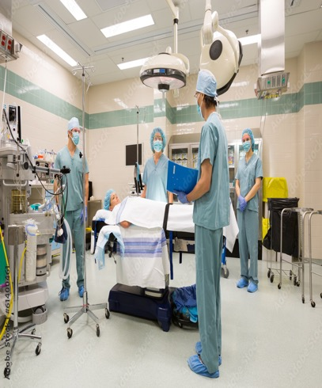
Perioperative Skin Assessment
Intraoperative
Get hand-off report from previous nurse
Double check skin areas of concern
Implement prevention
Consider prophylactic dressings for high risk bony prominences
Support surface
Appropriate positioning devices
Off loading heels
Any surgical breaks for repositioning, micro-shift?
Document
Notes:
The surgical nurse should receive a person-to-person report from the pre-op or unit nurse. If there are any reported skin areas of concern, those should be double-checked prior to surgical positioning. Preventive measures, including prophylactic dressing, a pressure reducing support surface, appropriate positioning devices, and heel off loading should be considered for implementation. If there are any anticipated breaks in surgery, utilize them for repositioning, even if it is small shifts. Document findings and interventions.

Slide 42
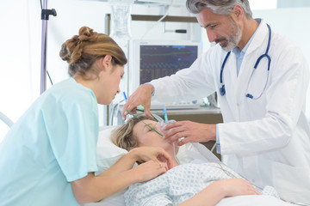
Perioperative Skin Assessment
PACU
Hand-off report from OR nurse
Position patient in different position than OR
Complete skin assessment when stable
Hand-off report to receiving nurse if inpatient
Document
Notes:
Use standardized handoff communication to Conducts a postoperative patient assessment to identify pressure injuries acquired in the intraoperative period.
The surgical nurse should report any skin-related concerns to the PACU nurse. In PACU, the patient should be positioned differently than they were on the operating table to offload areas of potential compromise. When the patient is stabilized, a complete skin assessment should be completed and a hand-off report to the receiving nurse if the patient is staying in-house. Document any findings, concerns, and interventions.

Slide 43
Hints for Assessing Darkly Toned Skin
Establish baseline skin tone
In area not exposed to UV
Use adequate lighting
Avoid fluorescent lighting
Use halogen light or flashlight/headlamp
Thoroughly cleanse area before assessment
Compare area being assessed to unaffected areas
Moisten areas to rehydrate epidermis
Compare moist areas being assessed to dry skin
Implement a skin tone classification system intended for skin pigmentation
Use more than visual assessment
Include palpation to assess temperature, erythema, blanching, or pain
Include technology, when possible
SEM, ultrasound, thermography
Notes:
In skin of darker tones, it is helpful to establish a baseline normal skin tone and appearance in an area not exposed to ultraviolet light. Ambient or natural sources of lighting can be used (open the blinds) as can a halogen light or headlamp. Fluorescent lighting can cast a bluish tint on darkly pigmented skin
Remove body fluids and skin care products prior to assessment and compare areas being assessed to unaffected areas. Use contralateral comparison when possible. Moistening areas of skin to rehydrate the epidermis can make assessment easier and moist areas should be compared to dry. It is helpful to add a skin tone classification system intended for skin pigmentation, such as the Monk scale, to your skin assessment tools. Use more than visual assessment, incorporating palpation to elicit temperature, erythema, blanching, or pain. If available, use technology such as sub-epidermal moisture measurement, ultrasound or thermography to identify potential lesions not yet visible to the human eye.

Slide 44
Skin Tone Classification
The Monk Skin Tone Scale
Open-source, 10-shade scale describing human skin color, developed by Ellis Monk in partnership with Google.
To replace the Fitzpatrick scale in fields such as computer vision research, after an IEEE study found the Fitzpatrick scale to be "poorly predictive of skin tone" and advised it "not be used as such in evaluations of computer vision applications.“
The Fitzpatrick scale was found to under-represent darker shades of skin relative to the global human population.
Wikipedia, 2024; Monk, n.d.
Notes:
There are many skin tone classification scales available including the Fitzpatrick Scale, the Massey-Martin NIS Scale, the Ho and Robinson Color Bar Tool, the Thompson Hyperpigmentation Chart, and the Munsell Scale. However, the Monk Skin Tone Scale is being recommended by several researchers as not all scales were developed specifically to represent pigmentation.

Slide 45
Assessing Skin of Color Recommendations
Condition | Findings
Cyanosis | Lips & tongue will be gray or white; palms, soles, conjunctiva, & nail beds will have bluish tinge. Utilize other assessment (O2 saturation, ABGs) to determine level of hypoxia.
Stage 1 PI | No visible blanching response; erythema might not be visible or detectable. Inspect & palpate for additional skin tissue changes.
DTPI | Might not be easily visible. Assess for preceding changes (pain & temperature change) in the affected area.
Inflammation | Can be subtle or unnoticeable to naked eye. Areas with recently resolved inflammation appear darker than the patient's normal skin tone. The following techniques can be used: compare & contrast an affected & nonaffected area for increased warmth, skin color changes, & texture; examine the affected area for shine, tautness, & pitting edema with pressure; palpate for differences in texture.
Pusey-Reid, E., Quinn, L., Samost, M. E. & Reidy, P. A. (2023). Skin assessment in patients with dark skin tone. American Journal of Nursing, 123(3), 36-43 Pusey-Reid et al., 2023
Notes:
Specific recommendations for assessment of various skin conditions in individuals with dark toned skin include: With cyanosis the lips & tongue will be gray or white; palms, soles, conjunctiva, & nail beds will have bluish tinge. Other assessment tools such as O2 saturation and/or ABGs should be utilized to determine level of hypoxia. With a stage 1 pressure injury there is likely no visible blanching response; erythema might not be visible or detectable. Inspect & palpate for additional skin tissue changes such as change in temperature, texture or patient complaint of pain. With a deep tissue pressure injury, again it might not be easily visible. Palpation should again be utilized for additional skin changes. With inflammation, it can be subtle or unnoticeable to visual assessment. Areas with recently resolved inflammation appear darker than the patient's normal skin tone. The following techniques can be used: compare & contrast an affected & nonaffected area for increased warmth, skin color changes, & texture; examine the affected area for shine, tautness, & pitting edema with pressure; palpate for differences in texture.

Slide 46
Assessing Skin of Color Recommendations
Condition | Findings
Petechiae | On darkly pigmented skin rarely visible. May be visible in oral mucosa or conjunctiva.
Skin irritation & erythema | May present as inflammatory or post-inflammatory hyperpigmentation (affected area darker than surrounding skin tone).
Ecchymoses | Areas appear darker than person's usual skin tone; may be tender & easily palpable, depending on whether a hematoma is present.
Pallor | Inspect mucous membranes for an ash gray color, using ambient lighting or a halogen lamp. Because of decreased blood flow to the skin, brown skin appears yellow-brown, & very dark brown or black skin appears ash gray.
Pusey-Reid, E., Quinn, L., Samost, M. E. & Reidy, P. A. (2023). Skin assessment in patients with dark skin tone. American Journal of Nursing, 123(3), 36-43 Pusey-Reid et al., 2023
Notes:
Additional recommendations for assessing skin conditions in individuals with dark toned skin include: With petechiae, it is rarely visible on darkly pigmented skin. However, it may be visible in oral mucosa or conjunctiva. With skin irritation and erythema, they may present as inflammatory or post-inflammatory hyperpigmentation (affected area darker than surrounding skin tone). With ecchymoses, the areas appear darker than person's usual skin tone; may be tender & easily palpable, depending on whether a hematoma is present. With pallor, the mucous membranes should be inspected for an ash gray color, using ambient lighting or a halogen lamp. Because of decreased blood flow to the skin, brown skin appears yellow-brown, & very dark brown or black skin appears ash gray.

Slide 47
Assessing Skin of Color Recommendations
Condition | Findings
Jaundice | Inspect oral mucosa, especially the hard palate, for yellow discoloration. For a more accurate determination of jaundice, examine the sclera closest to the cornea. If the palms and soles have callouses, they may appear yellow even when jaundice is not present.
Nails | Melanonychia, dyschromia, or chromonychia (discoloration or hyperpigmentation of the distal matrix of the nail bed) present in 75% of people with dark skin tone. When assessing for abnormalities, ask the patient if they have had rapid hyperpigmented changes or new onset hyperpigmentation, widening hyperpigmented stripe, triangular pigmented shape, & dystrophy of nails.
Pusey-Reid, E., Quinn, L., Samost, M. E. & Reidy, P. A. (2023). Skin assessment in patients with dark skin tone. American Journal of Nursing, 123(3), 36-43 Pusey-Reid et al., 2023
Notes:
Finally, with jaundice, Inspect oral mucosa, especially the hard palate, for yellow discoloration. For a more accurate determination of jaundice, examine the sclera closest to the cornea. If the palms and soles have callouses, they may appear yellow even when jaundice is not present. Nail variations such as Melanonychia, dyschromia, or chromonychia (discoloration or hyperpigmentation of the distal matrix of the nail bed) present in 75% of people with dark skin tone. When assessing for abnormalities, ask the patient if they have had rapid hyperpigmented changes or new onset hyperpigmentation, widening hyperpigmented stripe, triangular pigmented shape, & dystrophy of nails.
Pusey-Reid, E., Quinn, L., Samost, M. E. & Reidy, P. A. (2023). Skin assessment in patients with dark skin tone. American Journal of Nursing, 123(3), 36-43

Slide 48
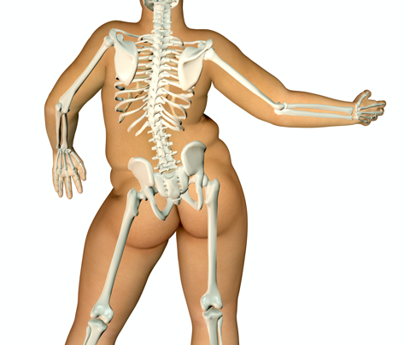
Bariatric Skin Considerations
Skin on skin environment
Lack of airflow to tissue
Increased effect of moisture
Poor tissue perfusion
Weight of pannus
PI may not be over bony prominence
Use mobility equipment
Use of tape
Image Credit: https://www.shutterstock.com/catalog/collections/2773448902110611311
Skin Integrity, Immobility, and Pressure Ulcers in Class III Obese Patients. Pa Patient Saf Advisory 2013 Jun;10(2):50-4.
http://patientsafety.pa.gov/ADVISORIES/Pages/201306_50.aspx#
Notes:
Slide 37 Bariatric 74.1% of the US population is overweight or obese with an average 2.6 co-morbid conditions.
Class III obese patients are identified as having a body mass index greater than or equal to 40 kg/m2 ¹ or weighing 100 pounds or greater than their ideal body weight. They are at risk for respiratory, circulatory compromise and skin integrity issues.
The Pennsylvania Patient Safety Authority report:
33.1% of reports of patient harm for obese patients were related to skin integrity issues
82.8% of these listed immobility as the main factor
85% pressure-related
In severely obese patients, excess adipose tissue creates increased pressure due to the weight of the tissue these injuries may not be over a bony prominence as seen in ‘normal’ weight patients

Slide 49
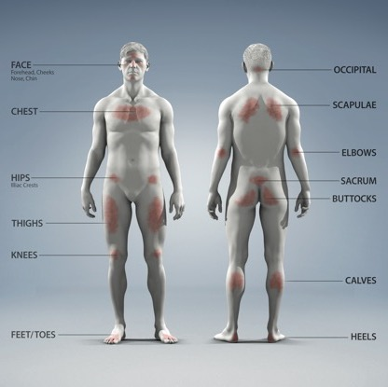
Surgical Procedural Positioning and High-Risk Pressure Points
Image Credit: Blaine Miller used with permission
Notes:
To perform a full body skin assessment you must thoroughly inspect the skin with special attention to pressure points and bony prominences, look at lower extremities, skin folds, crevasses and skin under medical devices.
Along with visual visual skin assessment (VSA) palpation Is used to identify area of altered skin texture, induration, skin temperature or tenderness.
You need to be aware of the pressure points in the various surgical position and communicate this in handover.

Slide 50
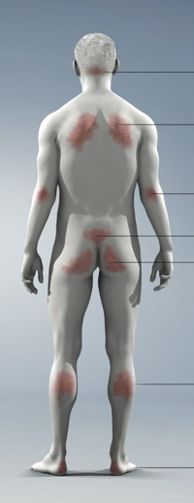
PI Location in Studies
Occiput 4%
Elbow 5%
Sacral 22% - 41%
Buttocks 11% - 47%
Heels 14% - 52%
Chen H, Chen X, Wu J. The incidence of pressure ulcers in surgical patients of the last 5 years: a systematic review. Wounds. 2012;24(9):234–241.
Image Credit: Blaine Miller used with permission
Notes:
Studies tells us the most common areas for PI are consistent with supine position, in one study 85.1% of subjects were in supine. High pressures and sharp bones can compress and distort the tissues resulting in cell death which leads to the high incidence in the sacral and heel areas.
.

Slide 51
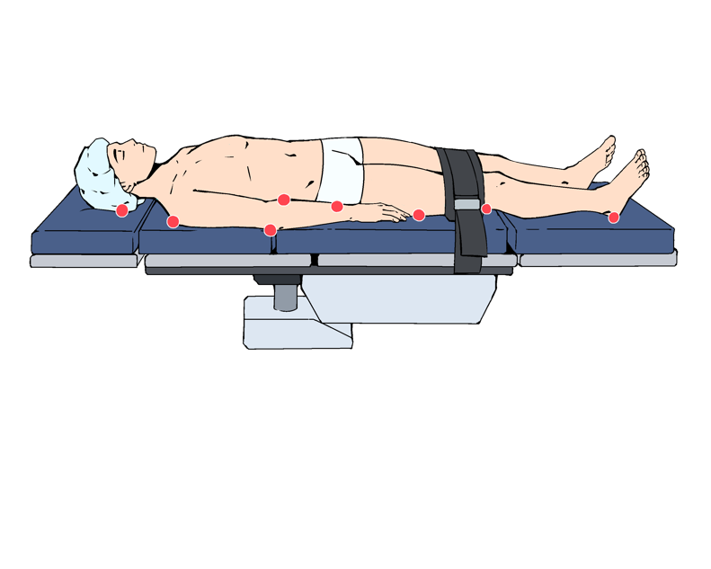
Supine position
Supine Position ^{4,2 10, 15, 37}
Occiput
Scapulae (shoulder blades)
Arms
Elbows
Thoracic vertebrae
Lumbar area and spine
Sacrum/coccyx
Buttocks
Heels
Illustration by Rex Neal, Scott Triggers©
Guideline for prevention of perioperative pressure injury. In: Guidelines for Perioperative Practice. Denver, CO: AORN, Inc; 2023:751-776.
Notes:
Slide 42 Supine is the most frequently used position for surgery, estimates 80-85% of cases. High risk pressure points are listed, particularly the sacrum, buttocks and heels. Pressure to the Brachial plexus and ulnar nerves can result in nerve injury.
The SUPINE Positioning Bundle includes:
• Pressure-reducing OR table pad
Extra padding to sacral area, may be foam, gel, or air cushions.
Prophylactic dressings may be applied to bony prominences (e.g., Heels, sacrum) or under other areas subjected to pressure, friction and shear
• ARM Placement, and arms are securement with arm guards, arm boards, or tucking.
- Arm boards level with the OR bed mattress
- abduct the arms less than 90 degrees
- position the arms with the palms facing up, Ankles uncrossed.
• Flex the patient’s knees approximately 5 to 10 degrees.
• Place the safety strap approximately 2 inches above the patient’s knees.
• Elevate the patient’s heels off the underlying surface.
• Redistribute pressure on the heels by using a heel suspension device or by elevating the patient’s calves with a pressure-redistributing surface.
• Protect the patient’s feet from hyperflexion and hyperextension.

Slide 52
Prone position
Forehead, eyes, ears, and chin
Chest/breasts, ports, implants
Lower costal margins
Iliac crest
Genitalia
Knees
Shins
Dorsum of the feet
Toes
Illustration by Rex Neal, Scott Triggers©
Guideline for prevention of perioperative pressure injury. In: Guidelines for Perioperative Practice. Denver, CO: AORN, Inc; 2023:751-776.
Notes:
Slide 43 44 Prone and Prone Risks
Prone position is face down and is used for access to the posterior body. Spinal surgery, kidney surgery or access to posterior structures for plastic surgery.
Pressure Points: If there is one thing, we have learned from the pandemic is that prone position can significantly increase of the risk of pressure injuries. Pressure points at highest risk are listed here. include forehead, cheeks, nose, chin, clavicle or shoulder, elbow, chest or breasts, genitalia, anterior pelvic bones (iliac crests, ischium, symphysis pubis), knees or patella, dorsal feet, and toes.
Some of the considerations in the Skin Bundle are
Positioning the Head is critical.
Neutral post Position the patient’s head in a neutral position, without excessive flexion, extension, or rotation. Use a face positioner when the patient’s head is positioned in the midline. Unfortunately, the research on these devices is minimal
Monitor the position of the patient’s face.
Prevent direct pressure on the patient’s eyes.
When using Spinal tables inspect the pads regularly and replace with Bariatric pads if appropriate.
Apply additional padding e.g., foam backpack kits, and prophylactic dressings to high-risk areas,
Special attention to the placement of the breasts, (report of ruptured implants, pressure mostly on chest, watch for ports.
Avoid towel rolls for positioning.
The Knees – apply padding
One study reported the incidence of tissue injury of the genitalia at 7.7%
The lower extremities e.g., knees, shins, dorsum of the feet and toes should be floated and protected
Arms should be placed on the padded arm boards by slowly rotating the arm downward and brought to the arm board for placement with care not to over stretch the shoulder. The arm board should be lower than the patient's chest with palms facing down.

Slide 53
Prone position risks
Pressure injury
Increased intraocular pressure - Blindness
Increased intra-abdominal pressure
Cardiovascular changes
Venous air embolism
Respiratory changes
Injury to the caregiver
Do not use Wilson Frame
Face, chin and forehead highest risk
Illustration by Rex Neal, Scott Triggers©
Guideline for positioning the patient. In: Guidelines for Perioperative Practice. Denver, CO: AORN, Inc; 2023:701-750.
Notes:
IN addition to pressure injury there are many risks associated with the prone position that are listed.
Other Risks
Increased intraocular pressure may resulting in blindness
Increased Intra-abdominal Pressure can compromise the cardiovascular and respiratory systems.
Caregivers’ safety Safe Patient handling devices. Use four or more caregivers to transfer the patient to the prone position. To reduce injury to the patient and the caregiver distributing the weight between all caregivers.
Key take always:
The goal is to place the patient in the prone position for the shortest time possible.
If possible, place the patient in 5 to 10 degrees of reverse Trendelenburg to decrease ocular pressure and reduce the risk of blindness. You want the head above the heart to reduce pressure.
AORN states to avoid the Wilson Frame.

Slide 54
Trendelenburg and Reverse Trendelenburg position
Occiput
Scapulae
Elbows
Arms
Thoracic vertebrae
Lumbar spine
Buttocks
Sacrum/coccyx
Heels
Illustration by Rex Neal, Scott Triggers©
Guideline for prevention of perioperative pressure injury. In: Guidelines for Perioperative Practice. Denver, CO: AORN, Inc; 2023:751-776.
Notes:
SLIDE 45, 46, 47, 48, 49 Trendelenburg and Reverse Trendelenburg position is when the body supine, or flat on the back with a 15–30-degree tilt, it is used in laparoscopic and robotic- assisted procedures primarily for gynecology, urology, and colorectal surgery. The position may also combine lithotomy for lower abdominal, GYN, and Urology cases.
Pressure Points: are consistent with supine position however additional pressure can occur from positioning devices used to prevent sliding.
We know the amount of pressure needed to result in a skin injury is reduced by 50% with sufficient shear force so this position has an increased risk of tissue distortion.

Slide 55
Trendelenburg position – risks
Pressure Injury
Brachial Plexus Nerve Injury
Cephalad sliding “toward the head”
Hemodynamic changes
Altered pulmonary function
Retinal detachment – Blindness
Patient Falls
Patient harm, brain damage, paralysis and death
Malpractice claims
CMS lost reimbursement
Reasonably preventable!
Illustration by Rex Neal, Scott Triggers©
Guideline for positioning the patient. In: Guidelines for Perioperative Practice. Denver, CO: AORN, Inc; 2023:701-750.
Notes:
Slide 46 Risks of Trendelenburg Position
In addition to pressure injury other significant injuries have been reported particularly in the Steep Trendelenburg position, which is defined as 30–40-degree tilt in the head down position,
Brachial Plexus Nerve Injury has been associated with the use of shoulder braces. AORN no longer recommends the use of these devices. However, in a 2018 survey of anesthesia providers regarding Steep TRENDELENBURG COMPLICATIONS 90% reported using shoulder braces. And 17% reported incidence of Brachial Plexus Nerve Injury, 9% had a patient slide off the table, interesting only 2.1% had a policy for Trendelenburg.
Mechanical sliding can result in tears from the robotic trocars,
Safety issues such as hemodynamic changes, altered pulmonary function, airway edema, from result from changes in abdominal pressure. Retinal detachment and even blindness has occurred from increased intraocular pressure.
In a QI project using data from Root Cause Analysis of Operating Room (OR) patient falls the Veterans Health Administration they identified extreme tilting of the OR bed such as Trend, reverse trend, or lateral tilting as a primary factor. In 60% of the RCAs, equipment issues were identified as a root cause of the fall.
In a study of American Society of Anesthesiologist Closed Claims Project of patient falls from the OR and procedure tables they identified vulnerabilities that resulted in brain damage paralysis and death and the resulting liability and legal costs to the facility and practitioners.
CMS will no longer reimburse hospitals for care provided to patients with injuries occurring as the result of a fall that could reasonably have been prevented (Soncrant)

Slide 56
Lithotomy position
Occiput
Shoulders
Scapulae
Elbows
Arms
Thoracic vertebrae
Lumbar spine
Buttocks
Sacrum/coccyx
Lateral aspect of thighs
Heels
Illustration by Rex Neal, Scott Triggers©
Guideline for prevention of perioperative pressure injury. In: Guidelines for Perioperative Practice. Denver, CO: AORN, Inc; 2023:751-776.
Notes:
Slide 47 and 48 Lithotomy Position
What is it the lithotomy position is commonly used in Obstetrics, GYN, Rectal, and Genitourinary procedures, may be used in combination with the steep Trendelenburg position?
Pressure Points Pressure points are consistent with the supine position plus careful attention to the buttocks. The area where the bed breaks and there is a perineal cut out in the OR table pad. Do not allow the buttocks to extend over break of bed.
The patients body should be prevented from contact with metal portions of the OR bed or other hard surfaces particularly the lateral aspect of the leg.
Consider micro shifts
Skin Bundle Same as Supine

Slide 57
Lateral position
Side of face and ear
Shoulder
Arms
Dependent axilla
Dependent hip
Dependent knee
Ankles
Feet
Illustration by Rex Neal, Scott Triggers©
Guideline for prevention of perioperative pressure injury. In: Guidelines for Perioperative Practice. Denver, CO: AORN, Inc; 2023:751-776.
Notes:
Slide 49 Lateral position What is it
What is it used for the lateral position is used for orthopedic procedures involving the hip, or shoulder and for kidney and thoracic procedures?
Pressure Points Pressure points include the dependent side of the body Side of face and ear
Shoulder
Arms
Dependent axilla
Dependent hip
Dependent knee
Ankles
Feet
Skin Bundle
Bean Bag devices are known to contribute to high pressures so you should use extra padding like a foam or gel layer and/or Prophylactic dressing between the patient and the device.
Place a head positioner or pillow under the patient’s head.
Make sure the ear is not folded
Support and secure the patient’s arms on two level and parallel arm boards, with one arm on each arm board, and both arms abducted less than 90 degrees.
Place an axillary roll under the patient’s dependent thorax, distal to the axillary fold, at the level of the seventh to ninth rib. DO not use IV BAGS or rolled towels or sheets as an axillary roll.
Verify the patient’s bilateral radial pulses after placement of the axillary roll.
Maintain the patient’s physiologic spinal alignment.
Place a safety restraint across the patient’s hips.
Flex the patient’s dependent leg at the hip and knee.
Position the patient’s upper leg straight and support it with
pillows between the legs.
LATERAL POSITION
• Place a head positioner or pillow under the patient’s head.
• Assess and monitor the patient’s dependent ear after
positioning.
• Support and secure the patient’s arms on two level and
parallel arm boards, with one arm on each arm board, and
both arms abducted less than 90 degrees.
• Place an axillary roll under the patient’s dependent thorax, distal
to the axillary fold, at the level of the seventh to ninth rib.
• Verify the patient’s bilateral radial pulses after placement of
the axillary roll.
• Maintain the patient’s physiologic spinal alignment.
• Place a safety restraint across the patient’s hips.
• Flex the patient’s dependent leg at the hip and knee.
• Position the patient’s upper leg straight and support it with
pillows between the legs.
• Minimize the degree of bed flexion and the duration of
kidney rest elevation as much as possible.
• When using kidney braces, place the longer brace anterior
against the iliac crest and the shorter brace posterior
against the lumbar back.
• Keep the patient in the lateral position for the shortest
time possible.
• Reposition the patient at established intervals, if possible.

Slide 58
Sitting position
Back of head
Positioner specific
Scapula
Ischial Tuberosities
Back of knees
Heels
Illustration by Rex Neal, Scott Triggers©
Guideline for prevention of perioperative pressure injury. In: Guidelines for Perioperative Practice. Denver, CO: AORN, Inc; 2023:751-776.
Notes:
Slide 50 Sitting Position SITTING OR SEMI-SITTING POSITION
What is it Sitting position also known as high fowlers, or beach chair?
What is it used for: The sitting and semi-sitting positions are used for access to the shoulder, posterior cervical spine, or posterior or lateral head? Orthopedics, Neurosurgery.
Pressure Points Same as supine but higher distortion on ischial tuberosity or (Sit bones)
Occiput
Scapulae
Ischial tuberosities
Back of knees
Heels
Skin Bundle Extra padding under the buttocks, behind the knees and the heels need to be floated.
Other Risks Complications that may arise from these positions include venous air embolism, hemodynamic instability, pneumocephalus, quadriplegia, and compressive peripheral neuropathy.
AORN Key Take Away
When positioning the patient in the sitting or semi-sitting position, follow the policy and procedure for All Positions and the procedures described below.
Minimize the degree of head elevation as much as possible.
Maintain the patient’s head in a neutral position without excessive flexion, extension, or rotation.
Assess and monitor the patient’s head position after positioning activities and during the procedure and implement corrective actions as indicated.
Do not use a horseshoe-shaped head positioner, if possible.
Flex and secure the patient’s arms or nonoperative arm across the body.
Support the patient’s operative arm by having the surgeon or surgical assistant hold it or using an arm-positioning device designed for this purpose.
Minimize extension and external rotation of the patient’s operative arm as much as possible.
Pad the patient’s buttocks.
Flex the patient’s knees 30 degrees.
After the patient is moved into a sitting or semi-sitting position,
prevent the patient’s abdominal pannus from resting on the thighs, if possible, and
verify placement and security of the safety restraint across the patient’s thighs.
Use sequential compression devices with physician’s order.
Do not use the sitting position for patients with ventriculoperitoneal shunts, if possible.

Slide 59
Perioperative Skin Assessment
Pre-op Intra-op Post-op
1. Guideline for prevention of perioperative pressure injury. In: Guidelines for Perioperative Practice. Denver, CO: AORN, Inc; 2023:751-776.
2. Guideline for positioning the patient. In: Guidelines for Perioperative Practice. Denver, CO: AORN, Inc; 2023:701-750.
8
Notes:
Perioperative RNs should collaborate with the perianesthesia RN to identify PI in the immediate postoperative period.
The RN circulator should conduct a postoperative patient assessment to identify PI acquired in the intraoperative period.
The RN circulator has knowledge of pressure points associated with the intraoperative position and of the locations where safety restraints, adhesives, monitoring devices, positioning equipment or devices, and other items that may present a risk for patient injury were placed during the procedure.
And they also have the knowledge of intraoperative factors that may increase the likelihood of a positioning injury (eg, intraoperative blood administration).
The time between development of a PI and the point when a PI becomes visible at the skin varies between several hours and 3 to 5 days. Even if a thorough skin assessment is conducted, the perioperative RN cannot detect early damage or identify microscopic signs of tissue damage. When the signs of a PI are visible, they are often at a stage where substantial deep tissue necrosis has already occurred and the damage to the skin is irreversible.
Guideline for prevention of perioperative pressure injury. In: Guidelines for Perioperative Practice. Denver, CO: AORN, Inc; 2023.

Slide 60
OR/Procedure to PeriAnesthesia
Communication¹
Postoperative Assessment^{1,2}
Does the RN circulator complete a postoperative assessment to identify positioning and pressure injuries?
4-eyes Skin Assessment³
Quality Improvement⁴
Does the health care organization’s QM program evaluate the Perioperative PI Protocols and outcomes?
Real-time RCA and Action^{3,5}
1. Guideline for prevention of perioperative pressure injury. In: Guidelines for Perioperative Practice. Denver, CO: AORN, Inc; 2023:751-776.
2. Guideline for positioning the patient. In: Guidelines for Perioperative Practice. Denver, CO: AORN, Inc; 2023:701-750.
3. Minnich L, Bennett J, Mercer J. Partnering for perioperative skin assessment: a time to change a practice culture. J Perianesth Nurs. 2014;29(5):361-366.
4. AORN Position Statement on Prevention of Perioperative Pressure Injury. AORN J, 2022;115(5):458-461.
5. Scott SM, Bennett J. Avoiding pressure injuries with root cause analysis and action. AORN J. 2018:108(5):15-16.
Notes:
Slide 50 OR to PeriAnesthesia Gap Assessment Where are my Pacu nurses?
AORN states The OR nurse should collaborate with the PeriAnesthesia RN to identify pressure injury or patient injury caused by intraoperative positioning in the immediate post-operative period.
This includes active Communication¹
And detailed Postoperative Assessment^{1,2}
QUESTION Does the RN circulator complete a postoperative assessment to identify positioning and pressure injuries?
----One best practice I have seen is from John Muir in California is the 4 eyes skin assessment during the handoff between the OR and PACU nursing staff. This practice was a key driver for integrating Real-time RCA and Action³⁻⁴ This was the focus of a QI project on documented skin assessments. REX’s tool
During phase I of the postoperative period, the perianesthesia RN should
place the patient in a position other than the surgical position, if possible, and
monitor areas that are at high risk for positioning injuries.
WE needs to extend into the surgical floors, discharge education and follow up into the surgical clinics. I have seen several of these PI in the surgery clinic one week after surgery. We have not closed the loop on this issue

Slide 61
Thank you very much!
1992
2022
Susan M. Scott MSN, RN, WOC Nurse
Email: scotttriggers@gmail.com
Webpage: www.scotttriggers.com
GOV Webpage: www.scotttriggersgov.com

Slide 62
Post-Test
.
Notes:
Skin inspection and assessment is a critical competency of all nursing staff
Your knowledge, skill, and diligence will make a huge impact on patient safety and reducing harm from PPIOccurs after a system reacts to a stressor, and involves acknowledging problems and interventions that address issues before stressors become the target of the lines of resistance.

Slide 63
References and Resources
AORN Position Statement on Prevention of Perioperative Pressure Injury. AORN J, 2022;115(5):458-461.
Bates-Jensen, B.M., McCreath, H.E. & Pongquan, V. (2009). Subepidermal moisture is associated with early pressure ulcer damage in nursing home residents with dark skin tones: pilot findings. Journal of Wound, Ostomy Continence Nursing, 36(3), 277-284.
Beeckman, D., Van den Bussche. K., Alves, P., Arnold Long, M.C., Beele, H., Ciprandi, G… Kottner J. (92018) Towards an international language for incontinence-associated dermatitis (IAD): design and evaluation of psychometric properties of the Ghent Global IAD Categorization Tool (GLOBIAD) in 30 countries. British Journal of Dermatology,178(6):1331-1340.
Black, J. & Simende, A. (2020). Top ten tips: assessing darkly pigmented skin. Wounds International 2020, 11(3), 8-11. www.woundsinternational.com
Black, J., Cox, J., Capasso, V., Bliss, D.Z., Delmore, B., Iyer, V...Ayello, E.A. (2023). Current Perspectives on Pressure Injuries in Persons with Dark Skin Tones from the National Pressure Injury Advisory Panel. Advances in Skin and Wound Care36(9), 470-480.
Bliss, D.Z., Hurlow, J., Cefalu, J., Mahlum, L., Borchert, K. &Savik, K. (2014). Refinement of an instrument for assessing incontinent-associated dermatitis and its severity for use with darker-toned skin. Journal of Wound Ostomy Continence Nursing, 41(4):365-70. Francis, K. F. (2023). Assessment and Identification of Skin Disorders in Skin of Color: An Integrative Review. Journal of Wound, Ostomy Continence Nursing, 50(2), 107-114.
Carle et al., 2021. Allergic contact dermatitis to a dye or alcohol in a chlorhexidine-based skin preparation: A case report. Anaesthesia and Intensive Care, 9(1), 70-73.
Notes:
Carle et al., 2021. Allergic contact dermatitis to a dye or alcohol in a chlorhexidine-based skin preparation: A case report. Anaesthesia and Intensive Care, 9(1), 70-73.

Slide 64
References and Resources
Chen H, Chen X, Wu J. The incidence of pressure ulcers in surgical patients of the last 5 years: a systematic review. Wounds. 2012;24(9):234–241.
European Pressure Ulcer Advisory Panel, National Pressure Injury Advisory Panel, and Pan Pacific Pressure Injury Alliance. Prevention and Treatment of Pressure Ulcers/Injuries: Clinical Practice. The International Guideline 2019. EPUAP/NPIAP/PPPIA; 2019.
Goehring ,M.T., Farran, J., Ingles-Laughlin, C., Benedista-Seelman, S. & Williams, B. (2022). Measures of Skin Turgor in Humans: A Systematic Review of the Literature. Wound Management and Prevention, 68(4),14-24.
Guideline for positioning the patient. In: Guidelines for Perioperative Practice. Denver, CO: AORN, Inc; 2023:701-750.
Guideline for prevention of perioperative pressure injury. In: Guidelines for Perioperative Practice. Denver, CO: AORN, Inc; 2023:751-776.
Ho, B.K. & Robinson, J.K.(2015). Color bar tool for skin type self-identification: A cross-sectional study. Journal of the American Academy of Dermatology, 73(2), 312-313.e1.
LeBlanc, K., Baranoski, S., Christensen, D., Langemo, D., Edwards, K., Holloway, S…. Regan, M. (2013). International Skin Tear Advisory Panel: A Tool Kit to Aid in the Prevention, Assessment, and Treatment of Skin Tears Using a Simplified Classification System©. Advances in Skin & Wound Care, 26(10), 459-476.
Massey-Martin NIS scale (2003). https://nis.princeton.edu/downloads/NIS-Skin-Color-Scale.pdf
Minnich L, Bennett J, Mercer J. Partnering for perioperative skin assessment: a time to change a practice culture. J Perianesth Nurs. 2014;29(5):361-366.
Monk, E. (n.d.). Skin tone and medical devices: Why measurement matters. https://www.fda.gov/media/176292/download
Notes:
Carle et al., 2021. Allergic contact dermatitis to a dye or alcohol in a chlorhexidine-based skin preparation: A case report. Anaesthesia and Intensive Care, 9(1), 70-73.

Slide 65
References and Resources
Mufti, A., Maliyar, K., Ayello, E.A. & Sibbald, R.G. (2022). Anatomy and physiology of the skin in WOCN Core Curriculum Wound Management 2nd. Ed., pp.12-38, L.L. McNichol, C.R. Ratliff & S.S. Yates, Eds.; Wolters Kluwer.
National Pressure Injury Advisory Panel (2016). NPUAP Pressure Injury Stages. https://cdn.ymaws.com/npuap.site-ym.com/resource/resmgr/npuap_pressure_injury_stages.pdf
Pan Pacific Pressure Injury Alliance (2020). Resources https://pppia.org/pppia-resources
Pittman J, Gillespie C. Medical Device-Related Pressure Injuries. Crit Care Nurs Clin North Am. 2020;32(4):533-542. doi:10.1016/j.cnc.2020.08.004
Pusey-Reid, E., Quinn, L., Samost, M. E. & Reidy, P. A. (2023). Skin assessment in patients with dark skin tone. American Journal of Nursing, 123(3), 36-43.
Pusey-Reid, E., Quinn, L.W., Wong, J. & Wucherpfennig, A. (2023). Representation of dark skin tones in foundational nursing textbooks: An image analysis. Nurse Educ Today. 130:105927. doi: 10.1016/j.nedt.2023.105927. Epub 2023 Aug 3. PMID: 37556863.
Scott SM, Bennett J. Avoiding pressure injuries with root cause analysis and action. AORN J. 2018:108(5):15-16.
Shen, L.Y., Kenner-Bell, B.M. Ricketts, J. & Kundu, R.V. (2016). Ethnic skin: Kids are not just little people. Clinics in Dermatology, 24(6), 690-697.

Slide 66
References and Resources
Skin Integrity, Immobility, and Pressure Ulcers in Class III Obese Patients. Pa Patient Saf Advisory 2013 Jun;10(2):50-4. http://patientsafety.pa.gov/ADVISORIES/Pages/201306_50.aspx#
Stellar JJ, Hasbani NR, Kulik LA, et al. Medical Device-Related Pressure Injuries in Infants and Children. J Wound Ostomy Continence Nurs. 2020;47(5):459-469. doi:10.1097/WON.0000000000000683
Taylor, S.C., Arsonnaud, S. & Czernielewski, J. for the Hyperpigmentation Scale Study Group. (2005).The Taylor Hyperpigmentation Scale: A new visual assessment tool for the evaluation of skin color and pigmentation. Cutis, 76, 270-274.
Wikipedia (2024). Monk Skin Tone Scale.
Wound Ostomy and Continence Nurses Society. (2016) Bottom-Up (Pressure Shear) Injuries. In D. Doughty, and L. McNichol (Ed). Core Curriculum Wound Management. (pp. 313-332). Philadelphia, Wolters Kluwer.

Slide 67
Preoperative Phase
Intraoperative Phase
Postoperative Phase
Perform Full body Skin Assessment data and record in EHR
Review results of Scott Triggers©
Collaborates with Perianesthesia RN to identify Patient Injury and record in EHR
Perform Scott Triggers© Risk Assessment and record in EHR
Intra-Op RN will visibly assess Full Body skin, document additional findings in EHR
PACU
Record Final assessment & interventions in EHR
Patient is transferred or provided Discharge Instructions
Pre-Op RN reviews Full Body Skin Assessment and Scott Triggers
Utilize SPHM guidelines to transfer patient to OR table
OR
Collaborative Hand Off communication occurs
RN Collaborative Hand Off communication occurs
Perform Full body Skin Assessment and record in EHR
Initiate applicable positioning bundle, add gel pads/approved positioning devices as appropriate
>2 ST yes’s = High Risk Surgical Patient
Implement OR Skin Bundle.
Critical Care Unit or Surgical Unit
If No
Implement Prevention of Pressure Injury Plan of Care
Confirm the correct patient position and position equipment during Surgical Time Out
If Yes
OR
Patient is provided Discharge Instructions
Collaboratively initiate the Prevention of Pressure Injury plan of care
Complete Procedure & Document in EHR
Home with Follow UP Ambulatory Care
Transfer patient to Operative Area
Transfer patient to Post-Op Area
Assess for post-op pressure injury
(absent, present, worsened, resolved)
If No
Actual or Potential Pressure injury identified
If Yes
Provider requests WOC Consult or Other Service as indicated and includes SECM in plan of care
SCOTT TRIGGERS© CRITERIA
-Age (Age 62 or Older)
-Serum Albumin <3.5 g/l)
-BMI <19 or >40
-ASA score 3 or >
-Estimated Surgical Time >3 hours/180 minutes
OR SKIN BUNDLE SELECTIONS
-Supine
-Prone
-Lateral/Park Bench
-Lithotomy
-Sitting
-Trendelenburg
-Reverse Trendelenburg
SCOTT TRIGGERS© HIGH RISK TARGET PATIENTS
>2 ST yes’s = High Risk Surgical Patient
Implement OR Skin Bundle.
Document Final assessment/interventions in EHR
Notes:
DeBeer Guidelimes = Look at these for postop
AORN Standard about OR & Perianesthia identify any injury = look for addition in PostOp phase
SKIN INSPECTION
ASSESSMENT = determining abnormal skin areas
Screening should be preformed on 1st Post Op Visit in clinic
(1) Screening should be performed for all post-op veterans upon first follow-up visit after surgery.
13 Surgical Services
Procedures for pressure injury prevention process in the perioperative setting are as follows:
a. All perioperative patients should be assessed preoperatively for risk factors that are known to increase pressure injury development in the surgical patient/
b. The standardized risk assessment tool selected for VHA is the “Scott Triggers” This tool has validity studies and has demonstrated reliability (see reference nn-qq)
c. All at risk individuals should have targeted evidence-based interventions to reduce the patient’s risk of developing a pressure injury (mm).
d. Skin inspections should be performed pre-operatively, intraoperative, postoperatively and on follow up outpatient clinic visit.
e. Hand-over communication and documentation should include the results of the risk assessment, skin inspection, surgical position, any pressure injury noted, intervention used to reduce risk, and further assessments needed.
f. Perioperative pressure injuries (PPI) may not be present on initial visual skin assessments immediately post-op. Perioperative pressure injury may present up to 5-7 days after surgery. This may require addition screening on the first post op visit.
g. Consultation with the interdisciplinary pressure injury team, and root cause analysis is recommended to investigate reported and confirmed perioperative pressure injury.
h. Formal tracking of PPI incidence may be used in quality improvement initiatives.

