Slide 1
Riverside Crane 2/12/26
149 Ft Tall
Contact MedComm as early as possible to notify construction team
Crane will weathervane when not in use
Overflight of Noise abatement is authorized if required.

Slide 2
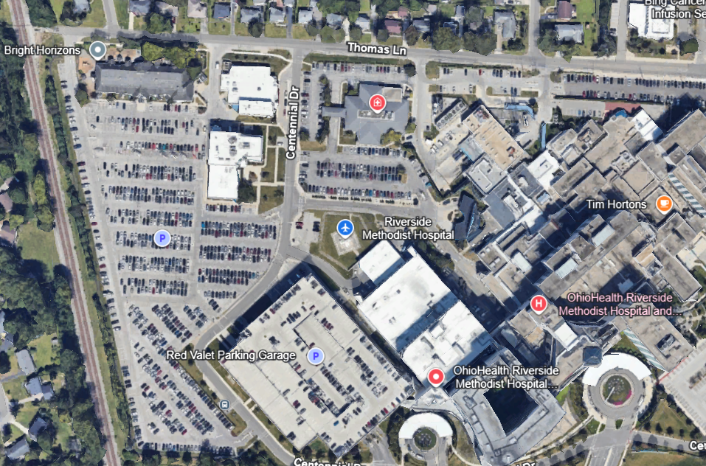
If northbound departure, climb above buildings to the north, rotate then left turn at Thomas Ln followed by a right turn at railroad tracks. Make your way to 315.
Current
Proposed
Tower Crane - 149’ Tall
If overflight of Red Garage, vertical takeoff to 50’ above highest point on garage then rotate aircraft

Slide 3
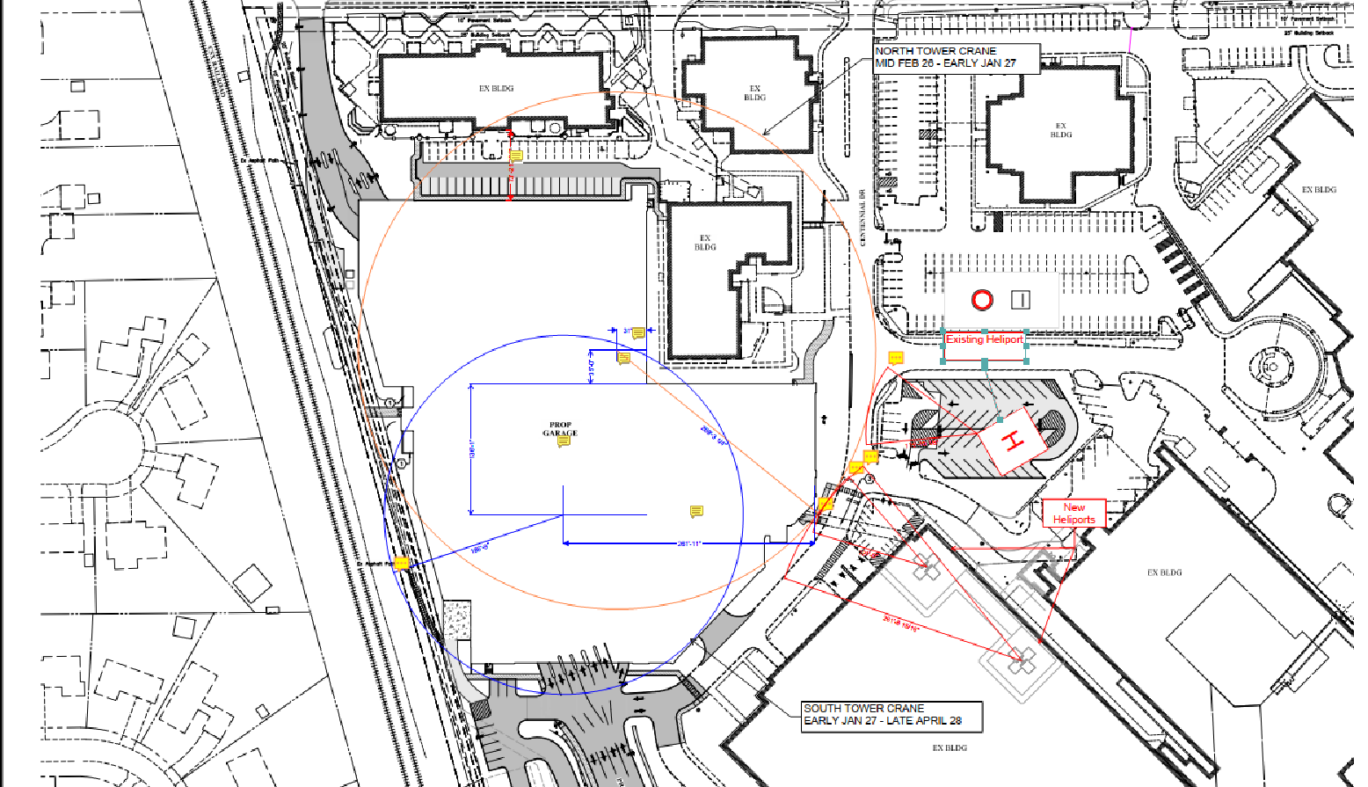

Slide 5
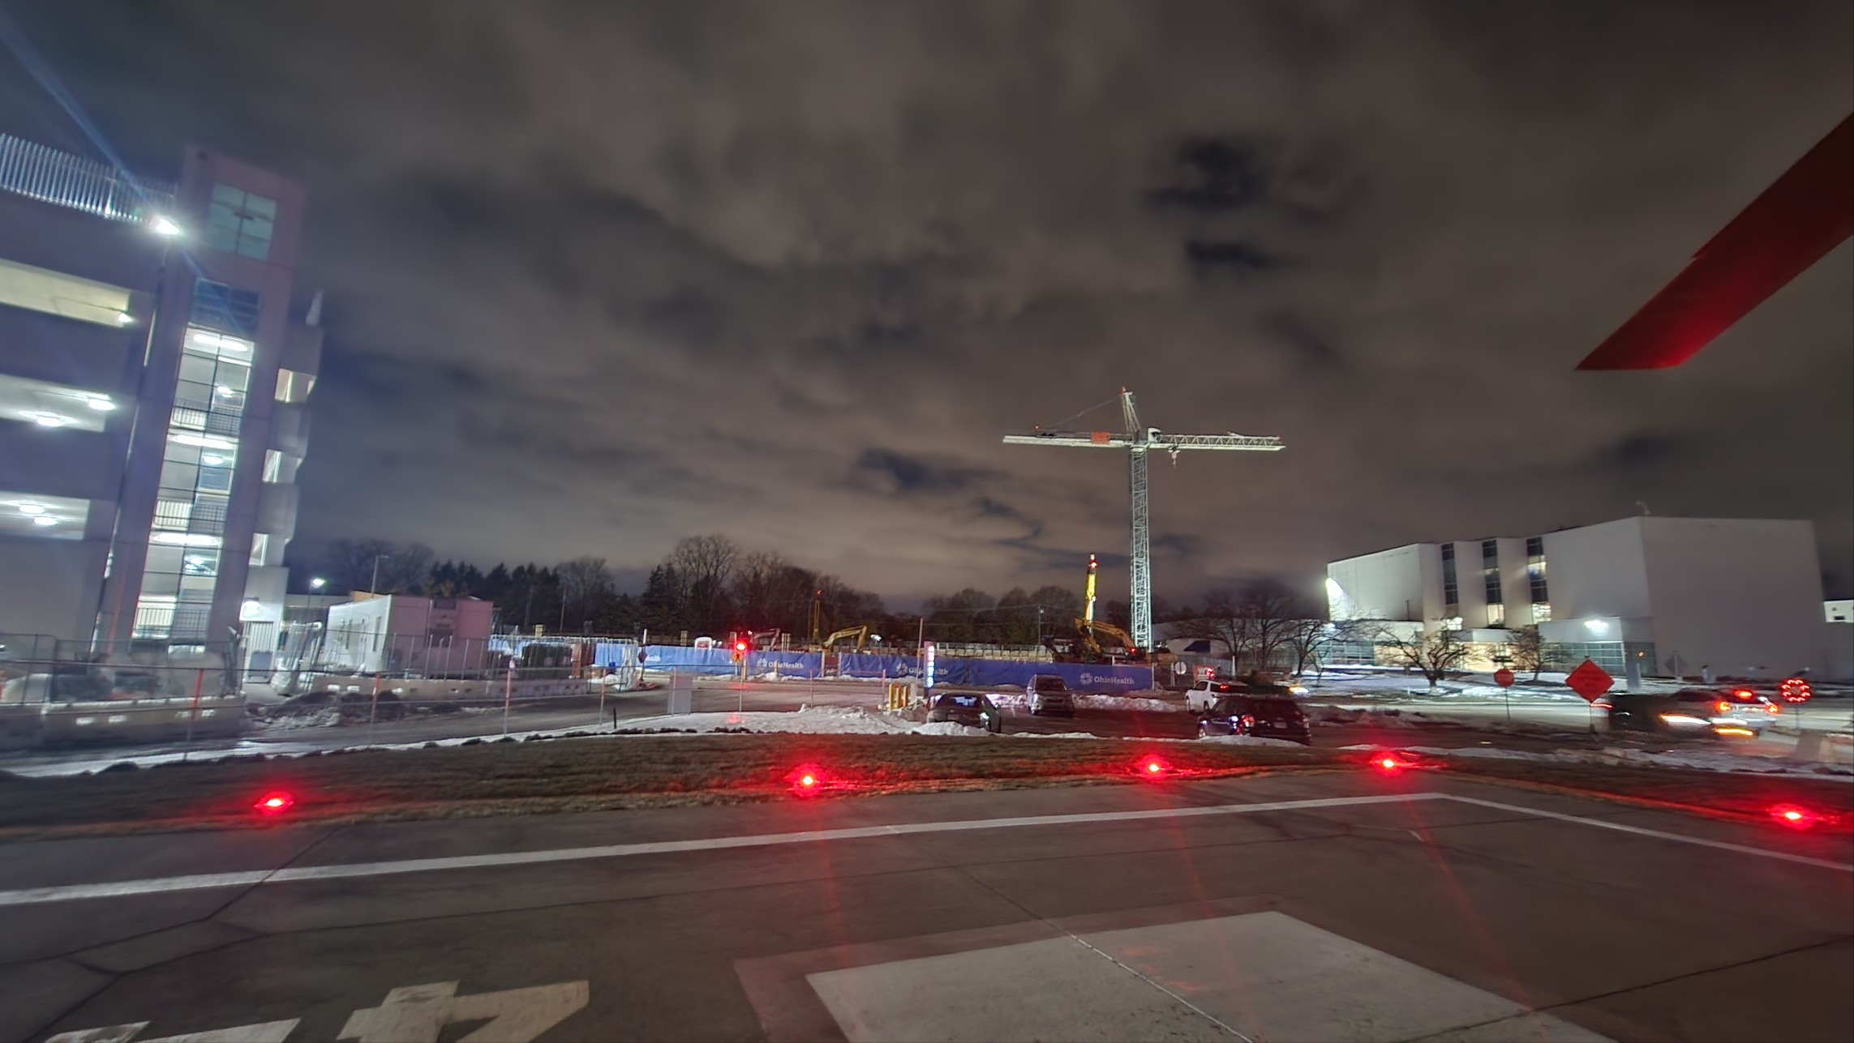
Boom is not finished in this picture

Slide 6
OSU Medical Center New Tower Opening
Preferred approach and departure is East to West
Open for patients around 23 Feb
Contact MedComm for helipad assignment
Pilot controlled lighting on 123.025
5 clicks for helipad
7 clicks whole area lights

Slide 7
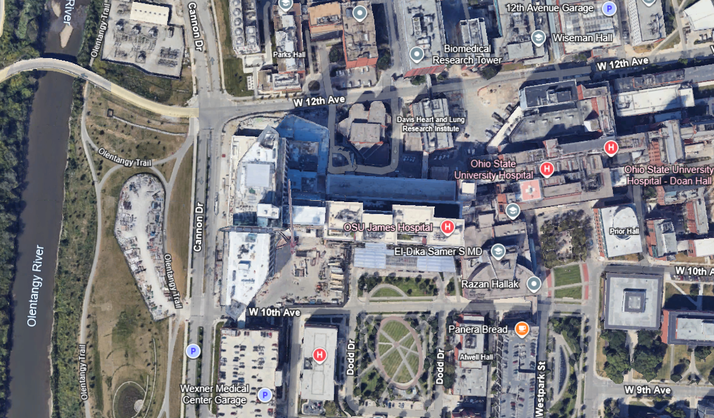

Slide 8
