Slide 1

Tiny Home Eco-Village Study
Verdantronix
01/19/2026
This presentation is for the first phase of the Tiny Home Eco Village Project, the study for the project.
It outlines how the study would be conducted and exists to solicit partners with Verdantronix for the study.
Those partners are being made aware of the study proposal with this presentation.
They have not committed nor are limited to those prospects in this presentation.

Slide 2
Contents
1.
The Team & Motivations
2.
The Study
3.
The Challenges
4.
Overcoming the Challenges
5.
Measuring Success
6.
Deliverables

Slide 3










The Team to Assemble
Verdantronix
Organizer
Oregon Legislature
Funding
Multnomah County
Oversight
City of Portland
Benefactor
City of Gresham
Benefactor
Our Just Future
Chief of Operations
Oregon Food Bank
Partner
PCEF
Advisor
OSU
Advisor
PSU
Advisor

Slide 4



Collaborators
Government
Education
Non-Profit
Government has a duty to solve the crisis of the unhoused and develop renewable energy for Oregon.
Educators in Oregon have an opportunity to solve the crisis of the unhoused and develop renewable energy.
Oregon non-profit organizations have incentive to solve the crisis of the unhoused and develop renewable energy.

Slide 5
I have worked with the unhoused and seen many are able to work and want a Tiny Home Eco Village program.
–Mode Ben Avraham, Verdantronix
Street Roots
Multnomah County Public Health Department COVID Outreach Team
JOIN C3P0 safe rest village pilot project
Lift Up Portland food pantry
Snowcap Gresham clothing center

Slide 6
There are barriers to employment for the unhoused and renewable energy has barriers.
REMOVE THE BARRIERS!
An employment program specifically for the unhoused is needed.
A biogas program, specifically for the Oregon Food Bank and local supermarkets is needed.

Slide 7
Oregon Needs This Study!
Distribute Findings
Organize Members
Research Focus Areas
Meetings & Discussions
White Paper
Tiny Home Eco Village Study
Research partners commit to a joint study on Tiny Home Eco Villages
Research partners commit to study a focus area and peer review each other.
Research results are peer reviewed.
A white paper is published on the compiled study of all research focus areas.
The white paper is made public information and distributed for consideration.

Slide 8
Research Focus Areas
Tiny home eco village model
In a white paper, describe in full detail all aspects of the Tiny Home Eco Village Project.
Regulations
Gather data on all regulations pertaining to the Tiny Home Eco Village Project.
Costs
Gather data on costs for tiny homes, utilities, biomass collection, biogas digesters, training, etc.
Biogas and the power grid
Gather data on biogas equipment and how much electricity it can contribute to the grid.
Biomass for biogas
Gather data on biomass waste from the Oregon Food Bank and supermarkets.
Able bodied Houseless
Gather data on the able bodied houseless population.

Slide 9
The data exists, but much of it is confidential or proprietary.
Confidentiality
I know the Oregon Food Bank paid for a feasibility study on turning their waste food into biogas; but they would not share it.
I know the data exists on able bodied houseless, but confidentiality is a barrier shelters have to getting that data.
Proprietary
I know WinCo Foods has tons of waste food and much of it goes to a landfill; but exact details were not shared with me because it was proprietary information.
Companies have proprietary data on on their own equipment and operations.

Slide 10
Facing the challenges ahead
Potential challenges
How we’ll respond
Study data is held in confidentiality with agencies, institutions and companies.
Signed petitions and formal endorsements to persuade those with the data to share it for the purpose of the study.
1
Study data is proprietary information requiring purchases or payment.
Make any purchases or payments so data would be shared with money from crowdfunding for the study.
2
Legal fees, for nondisclosure agreements or agreements to share data.
Solicit pro bono attorneys who believe the study has a moral and fiduciary imperative for the welfare of Oregonians.
3

Slide 11
Research partners encounter barriers to data collection
Addressing barriers
Step 1
Verdantronix is notified of barrier as project manager for the study group.
Step 2
Verdantronix taps supporters, interested parties, influential people and crowd funding.
Step 3
Overcoming the barrier and how it was overcome is documented and made transparent to the entire study group.

Slide 12
The Tiny Home Eco Village Study
The study group is prepared to overcome the challenges that may explain why no study like it has been done before.
It has the completion of the feasibility study as it’s goal without ulterior motives such as profit, political gain, etc.
Unlike government, social services, businesses and nonprofit organizations the study group has no other agenda.
The study is a feasibility study and focus group.
Concentrate all your thoughts upon the work at hand. The sun’s rays do not burn until brought to a focus.
–Alexander Graham Bell

Slide 13
Research & Negotiation
The study group is compartmentalized into research focus areas, for each partner.
The group has regular meetings to address findings and barriers.
Verdantronix is on call to assist research partners as needed.

Slide 14

The People Need The Study
Meet Ava
Ava
Ava lives in downtown Portland where she also works for a law firm.
She was born in Portland and has seen the city change in a bad way despite almost everyone she knows being good people who also volunteer and participate in social justice causes.
Age: 35
Profession: Paralegal
Needs and motivations
Ava doesn’t want to see people suffering on the streets-at least that shouldn’t be a normal thing to see; but it is.
She wants to see an end to the crisis of the unhoused and believes something that has not been tried before should be done.
Pain points
Ava is a Democrat and feels Republicans aren’t helping solve the crisis of the unhoused.
How we can help
The study will give Ava new data and non political perspective on the crisis.

Slide 15
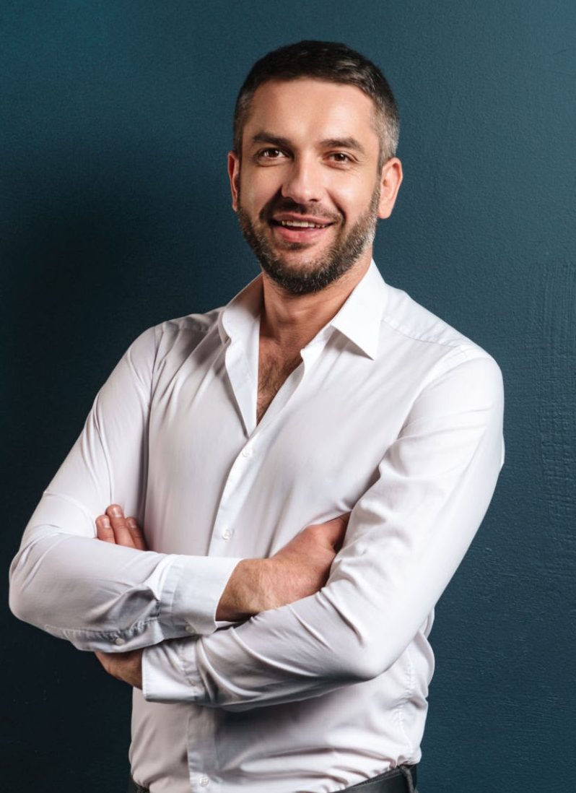
The People Want The Study
Meet John
John
John lives in Gresham where he also works after moving there from California in 2010.
He no longer goes to Portland like he used to when he first moved to the area because of crime, open drug use by the homelessness and political agitators.
Age: 40
Profession: Auto Sales Manager
Needs and motivations
John doesn’t want to see people turn to slow suicide by addiction on the streets.
He doesn’t want to be a victim of crime, targeted by people lost to addiction and mental illness.
He is motivated to leave Oregon.
Pain points
John is a Republican and feels Democrats put taxes before economic growth–causing the crisis of the unhoused.
How we can help
The study will give John new data and non political perspective on the crisis.

Slide 16
Company Name
How we’ll measure the success of this study
Communication objectives
Marketing objectives
Business objectives
Outreach by email and telephone.
Number of study group members.
Zoom meetings attendance.
Social media: favorable support for the project.
Marketing data for supermarkets and companies that would partner.
Political support data.
Cost/benefit analysis of the project.
Comparative cost/benefit analysis of project compared to other models.
Crowdfunding for costs of the study.

Slide 17
Communication
1
2
3
4
Outreach
Group Members
Zoom Meetings
Summary
Outreach by email and telephone documented and shared with the study group.
Possible study group partners and interested parties.
The larger the group the more research hours and peer review.
Success is measured by group size.
Scheduled, regular, Zoom meetings.
Zoom meetings with Verdantronix as needed.
Zoom meetings attendance, outreach effort and study group size determines the success of the communication plan.

Slide 18
Marketing
Social Media
Marketing Data
1
2
Social media for the study will be created and it’s popularity will indicate interest in the project.
“Biomass for biogas” and “biogas for the power grid” research focus areas will produce marketing data for supermarkets and companies.
Political Data
Summary
3
4
Social media data and outreach-communication data will produce political data for elected officials.
The study will produce marketing and political data to indicate popularity of the Tiny Home Eco Village model.

Slide 19
Business
Cost/Benefit Analysis
Comparative Analysis
Crowdfunding
Summary
1
2
3
4
The study is a feasibility study centered on a cost/benefit analysis of a joint housing-employment program.
The study has comparative analysis: housing-employment programs juxtaposed housing-shelter programs.
The cost of the study itself will be low, volunteer centered, and hopes to secure needed funding by crowdfunding and possibly grant writing.
The business goal of this study is to provide unbiased data on the feasibility of a Tiny Home Eco Village project.

Slide 20
This concludes the breakdown of the proposed study on the Tiny Home Eco Village project.
This proposal intents to garner support for and partnership with Verdantronix to complete the study.
It is to be a feasibility study co-authored by volunteers.
Mode Ben Avraham, Verdantronix, has already begun the research and organizing to publish the white paper.
For further information and answers to questions, please visit https://verdantronix.com/

Slide 21
Thank you

