Slide 1
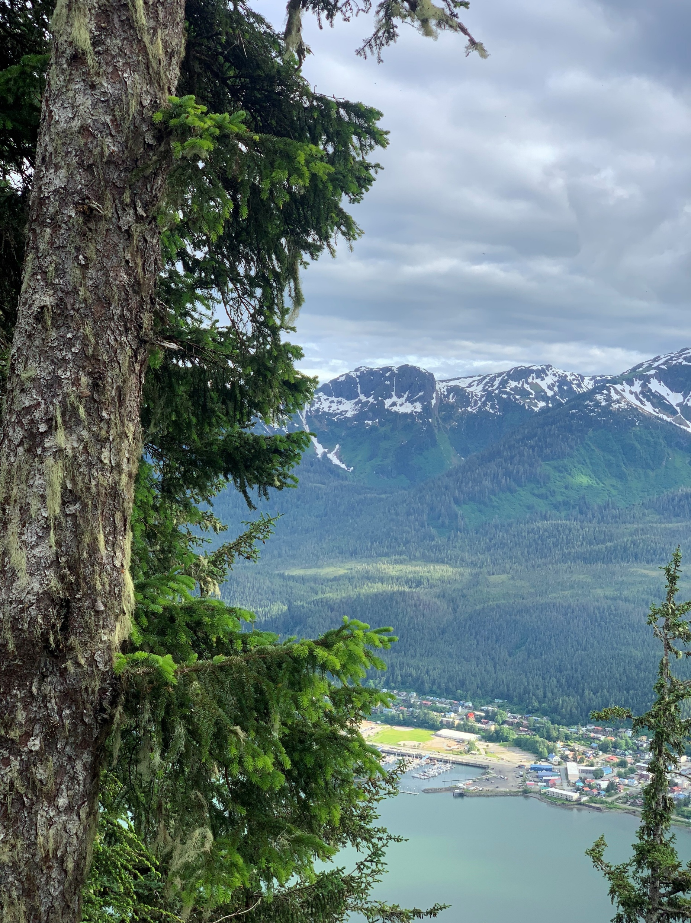
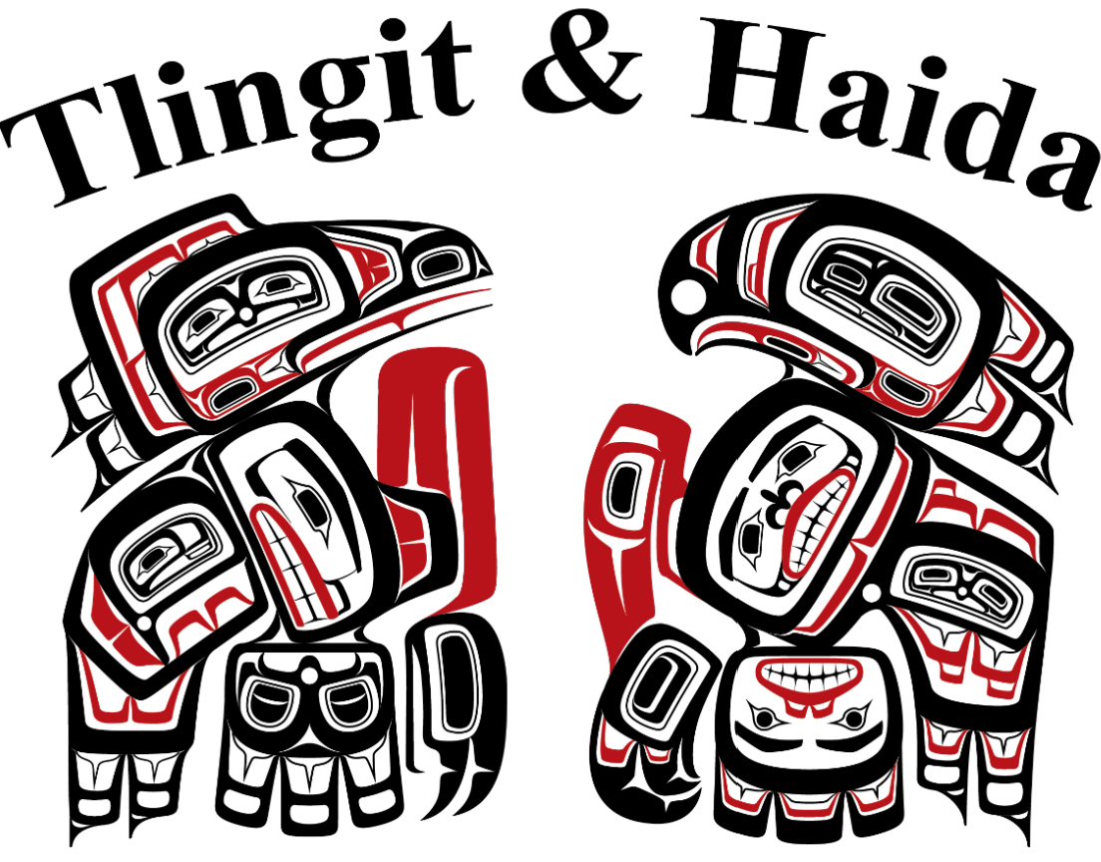

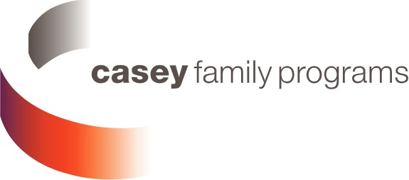
August 12, 2025
Strengthening Sovereignty: Washington State's Historic Contract Agreement with
Tlingit & Haida
Notes:
Chelsey – intro to the session

Slide 2
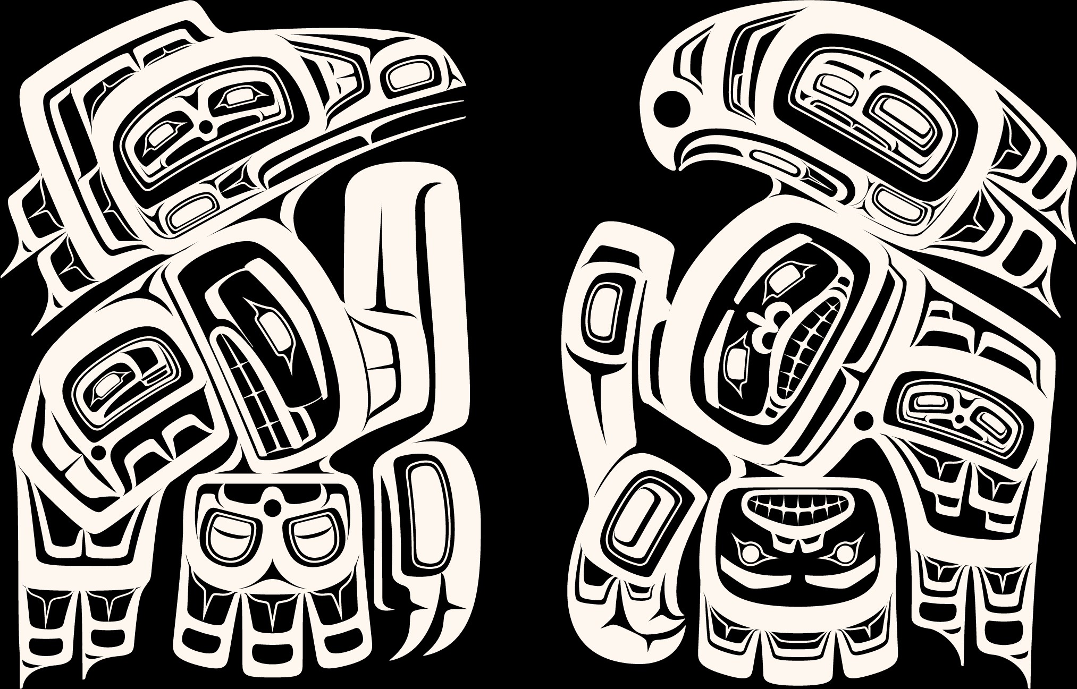
Presenters
  Central Council of the Tlingit & Haida Indian Tribes of Alaska
  Mary Johnson
  Senior Director
  Tribal Family Services
  Chelsey Welch
  Manager
  Tribal Family & Youth Services
  Tleena Ives
  Managing Director
  Casey Family Programs
  Former
  Director, Office of Tribal Relations Washington State DCYF
Notes:
Casey

Slide 3
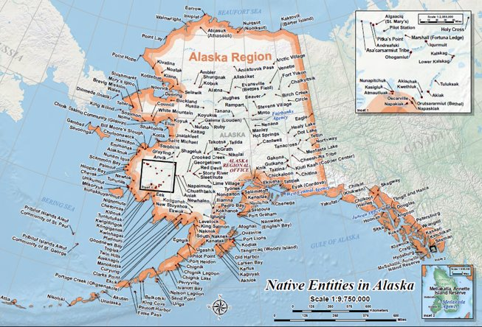
TRIBES IN ALASKA:
229 federally recognized Tribes in Alaska out of the 574 federally recognized Tribes in the USA
Many different ways to self-identify which might be by Tribe, cultural group, or by ancestral lands.
In Alaska, there are 11 distinct cultural groups that are defined geographically
Size of Tribes in Alaska vary from less than 100 to thousands.
Notes:
Mary

Slide 4
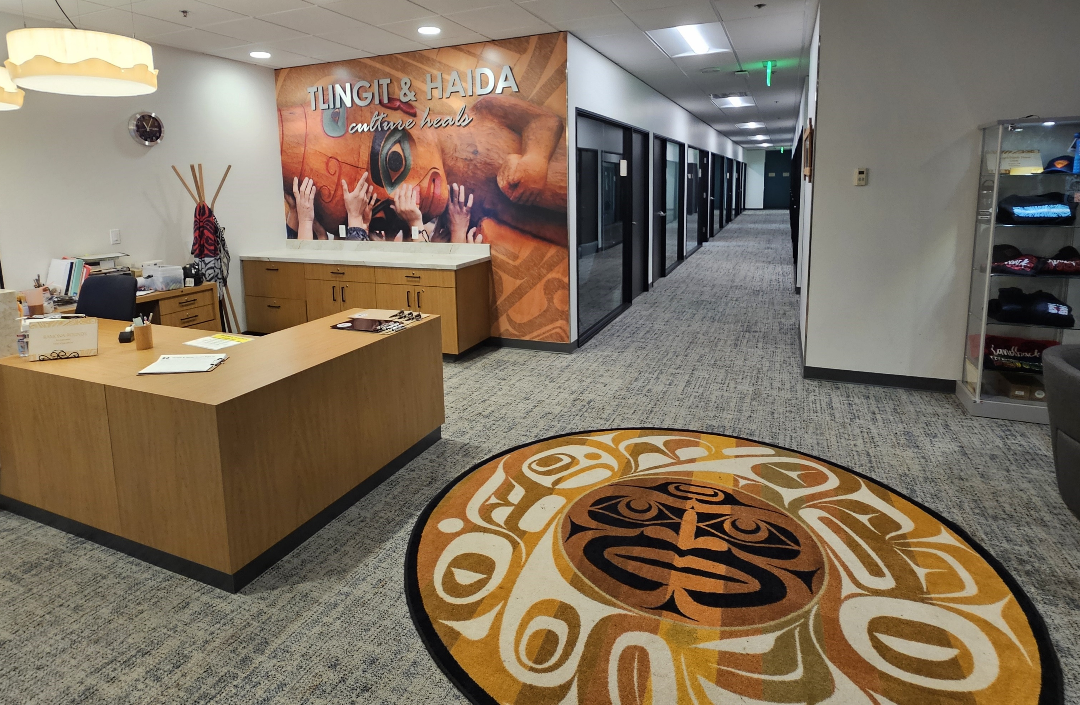
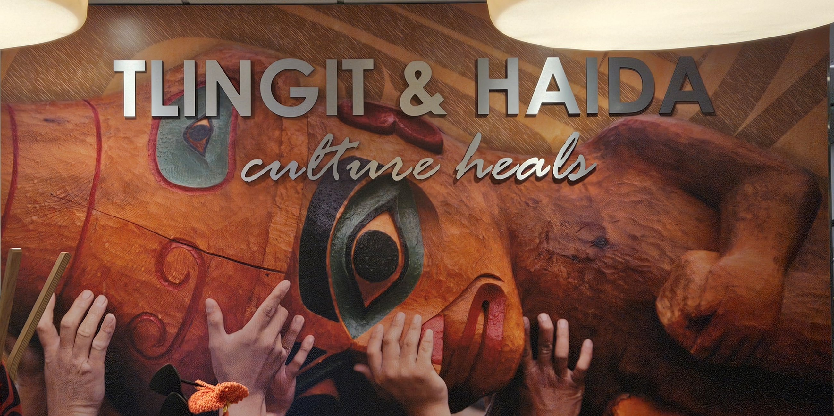
TLINGIT & HAIDA
Tlingit & Haida is a Tribal government and sovereign entity with a government-to-government relationship with the United States.
38,000+
Tribal Citizens
Over 9,000 are in Seattle Community
Through a written Constitution, Tlingit & Haida organized as a single regional Tribal entity and gained federal recognition in 1935.
Notes:
Chelsey

Slide 5
OUR WAY OF LIFE
  Respect for Self, Elders & Others
  Respect for Nature & Property
  Patience
  Be Strong in Mind, Body & Spirit
  Humor
  Hold Each Other Up
  Listen Well & with Respect
  Pride in Family, Clan & Traditions is Found in Love, Loyalty & Generosity
  Discipline & Obedience to the Traditions of our Ancestors
  Speak with Care
  We are Stewards of the Air, Land & Sea
  Reverence for Our Creator
  Live in Peace & Harmony
  Be Strong & Have Courage
OUR
TRIBAL VALUES
GUIDE US
“Haa Kusti” (Tlingit)
“Tlagw íitl’ xíinangaa Gíidang” (Haida)
Notes:
Chelsey

Slide 6
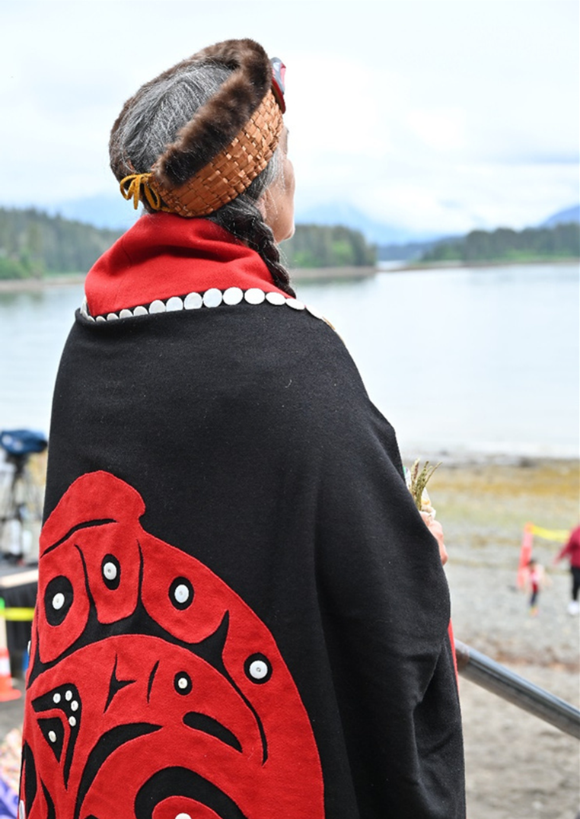
Tribal Family & Youth Services: Supporting Families Across Communities
  Tribal Family & Youth Services provides case management to Tribal citizens and families involved with or at risk of entering the child welfare system.
  Family Caseworkers support safety, connection to culture and community, and overall wellbeing through services grounded in tribal values and strengths-based practices
  We have 12 ICWA Family Caseworkers across 10 offices, located in:
Notes:
Chelsey

Slide 7
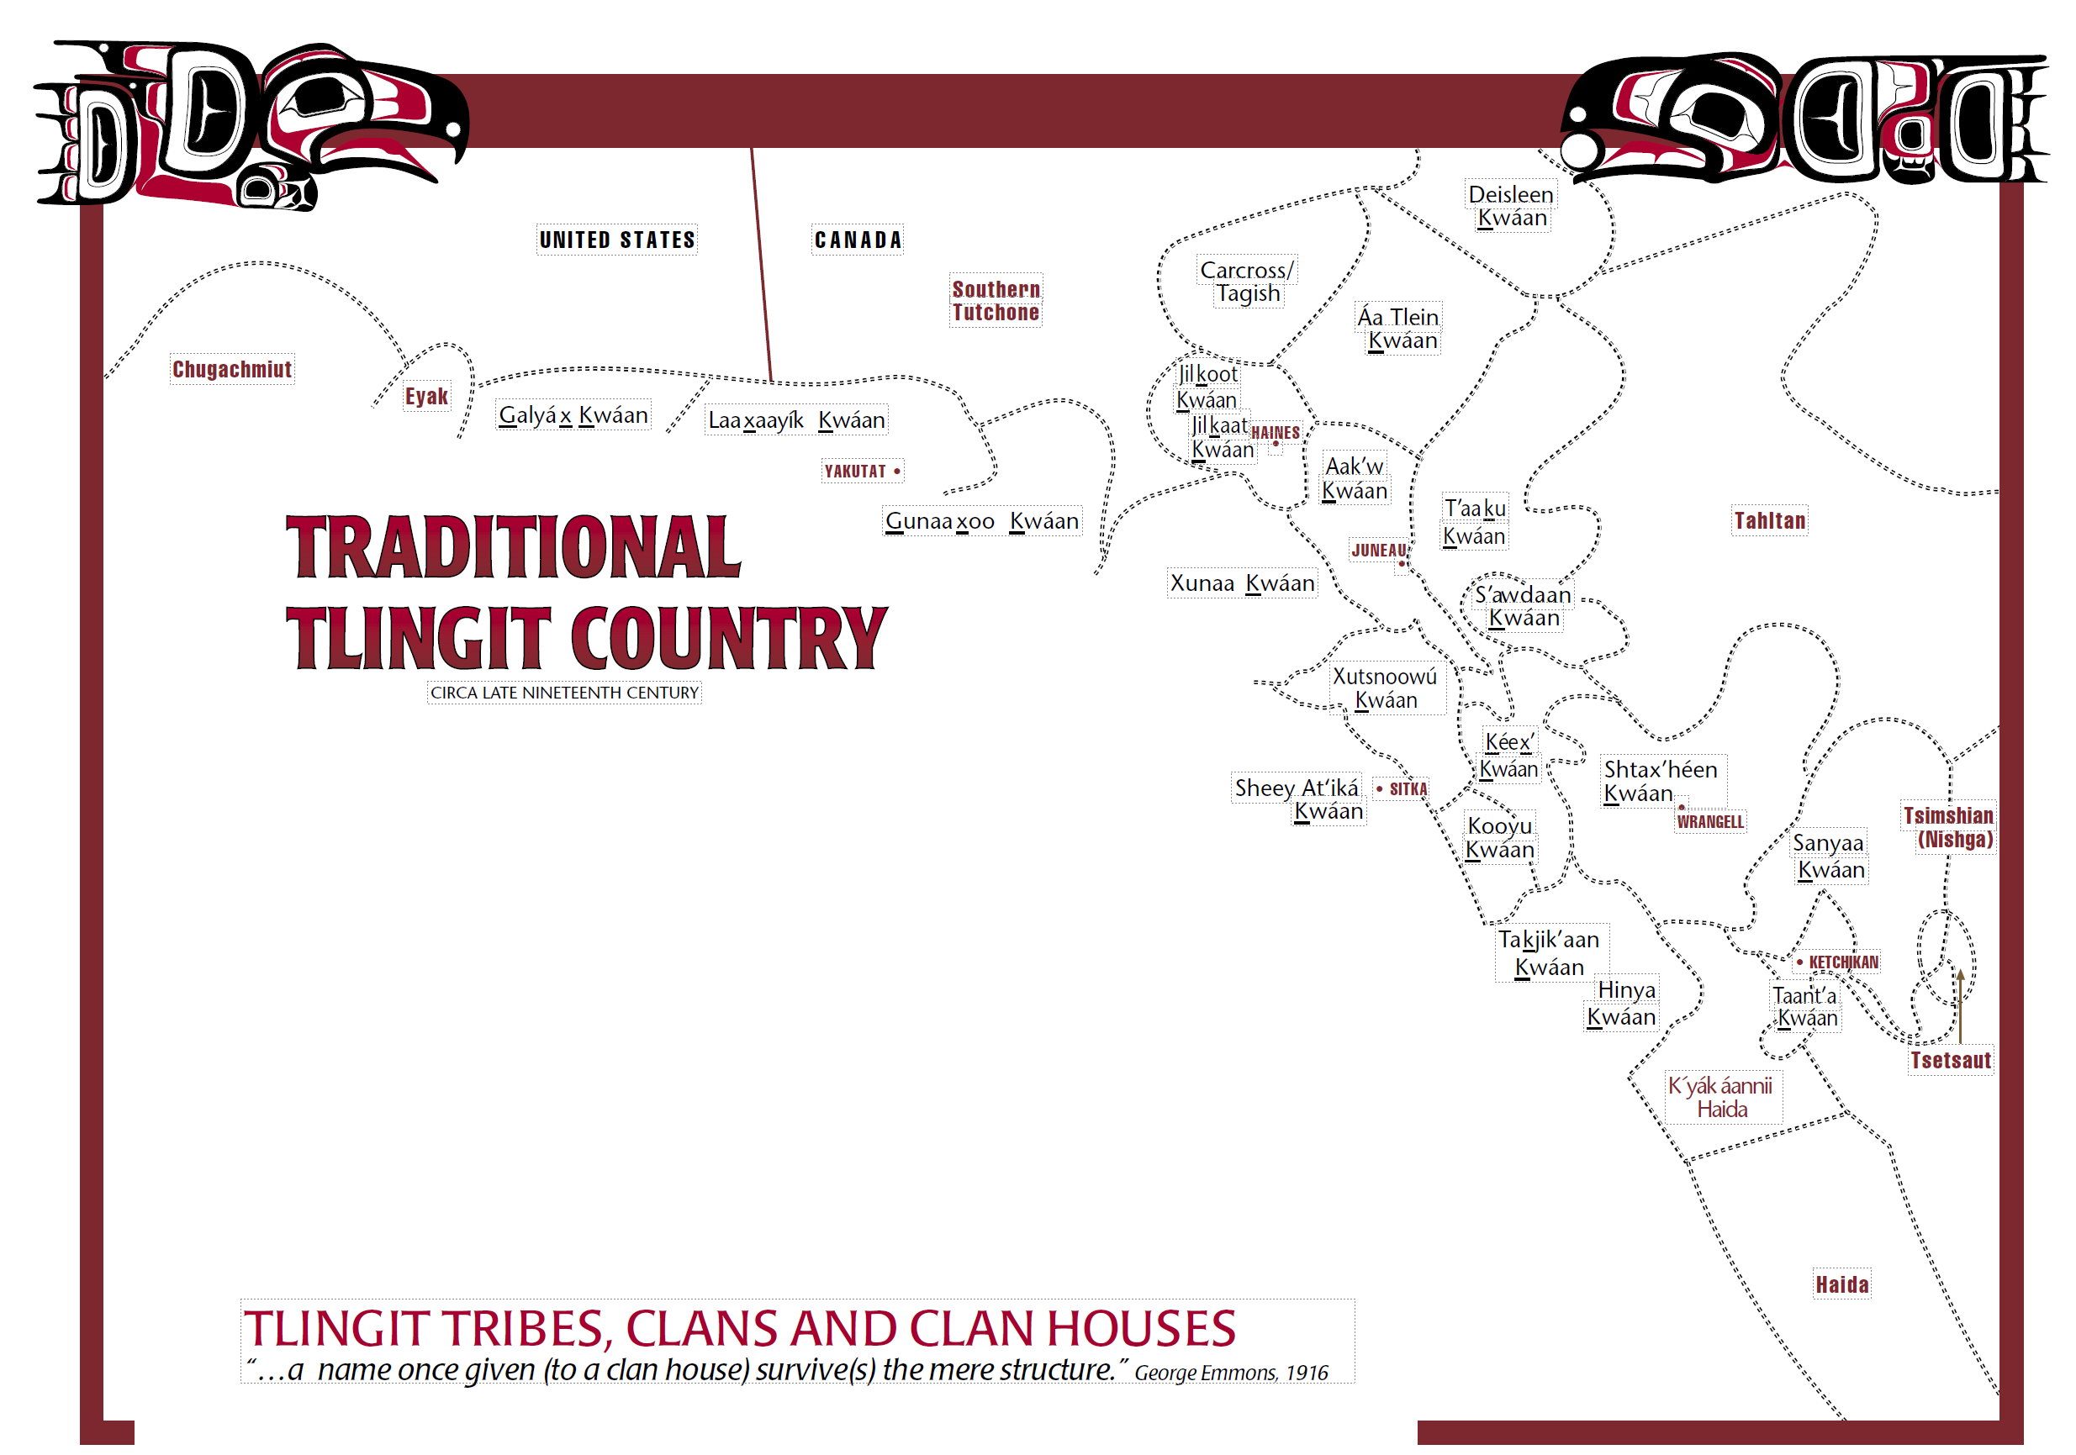
Lynnwood, WA (2) | Juneau (2) | Anchorage
Wrangell | Angoon | Haines
Klawock | Kasaan | Hydaburg
Craig |  | Saxman
Notes:
Chelsey

Slide 8
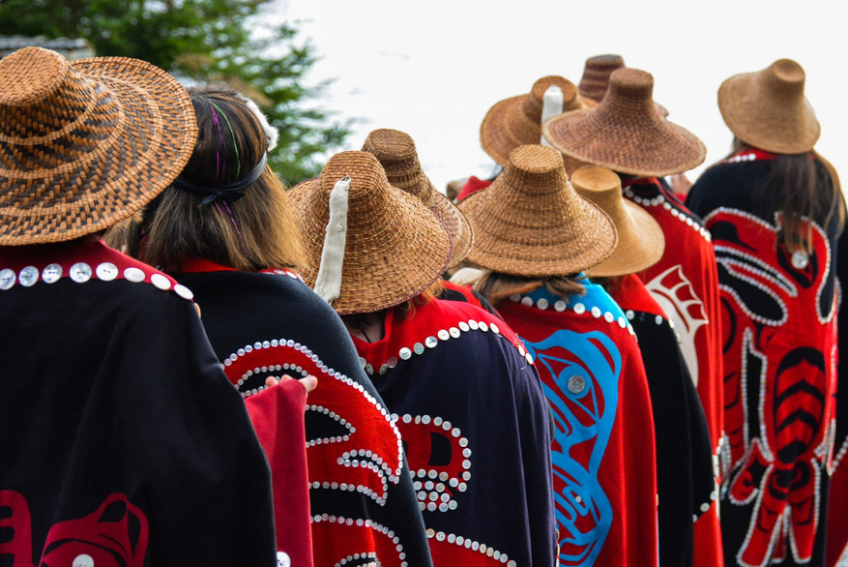
History of Alaska Tribal State Relationships
  1994 Tribal State Collaboration Group under IV-B
  1998 ICWA Statewide Specialist
  2000 Tlingit & Haida entered into Title IV-E Agreement with the State
  2016-2020 Strategic Plan – Transforming CW Outcomes for Alaska Native Children
  2017 Tribal Child Welfare Compact signed by 18 Tribes/Tribal Organizations – 163 Compacted Tribes
  July 2022 HB 123 State to formally recognize 229 Tribes
  August 2022 HB 184 Codify Compact
Notes:
Mary

Slide 9
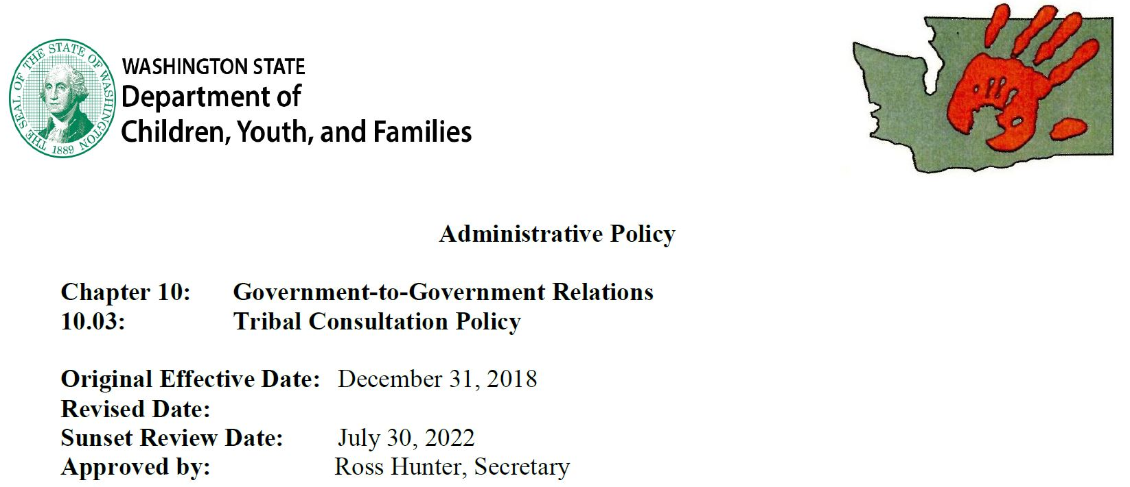
History of Washington Tribal State Relations
1977 Office of Indian Policies
Centennial Accord
ICWA State Law
2018 Office of Tribal Relations
Notes:
Tleena
Hiring preferences – tribal representation in hiring process
Elders engaged in development of Office of Indian Policies
Governors office of Indian Affairs
Elevate voices of those working with Tribes/Tribal Citizens

Slide 10
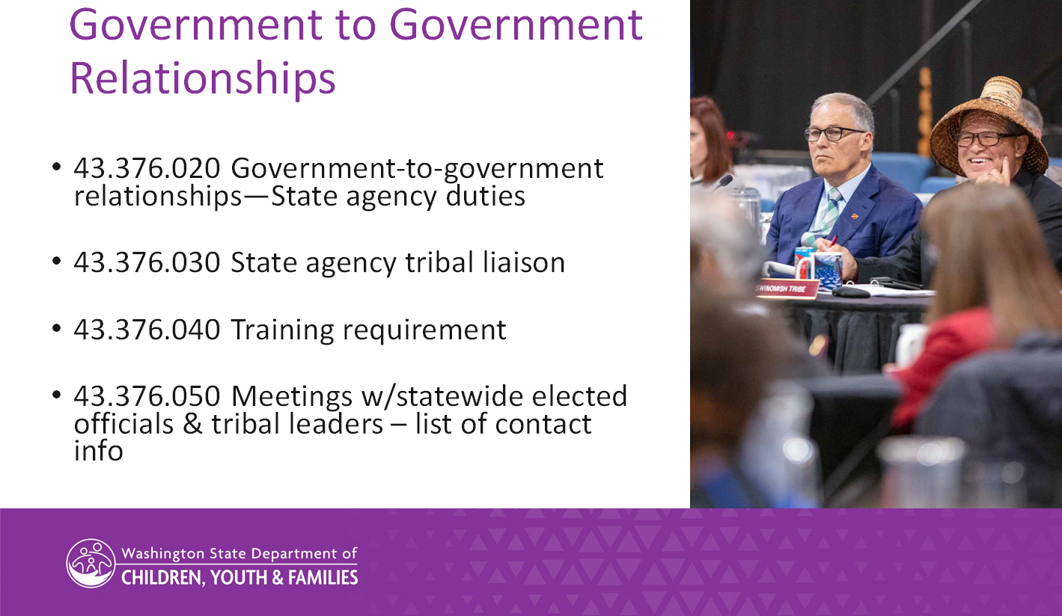
History of Washington Tribal State Relations, continued
Notes:
Tleena
Hiring preferences – tribal representation in hiring process
Elders engaged in development of Office of Indian Policies
Governors office of Indian Affairs
Elevate voices of those working with Tribes/Tribal Citizens

Slide 11
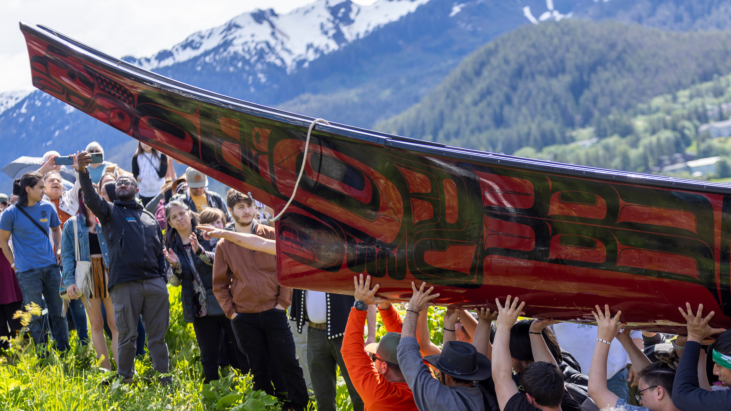
Successful Engagement
Tribes as experts about their needs
Prepared to listen
Open minded to explore options
Respect and experts on both teams - State and Tribe
Willing to engage in difficult conversations
Notes:
Group – Mary to kick off
Examples of state and Tribes sitting on different sides of the room

Slide 12
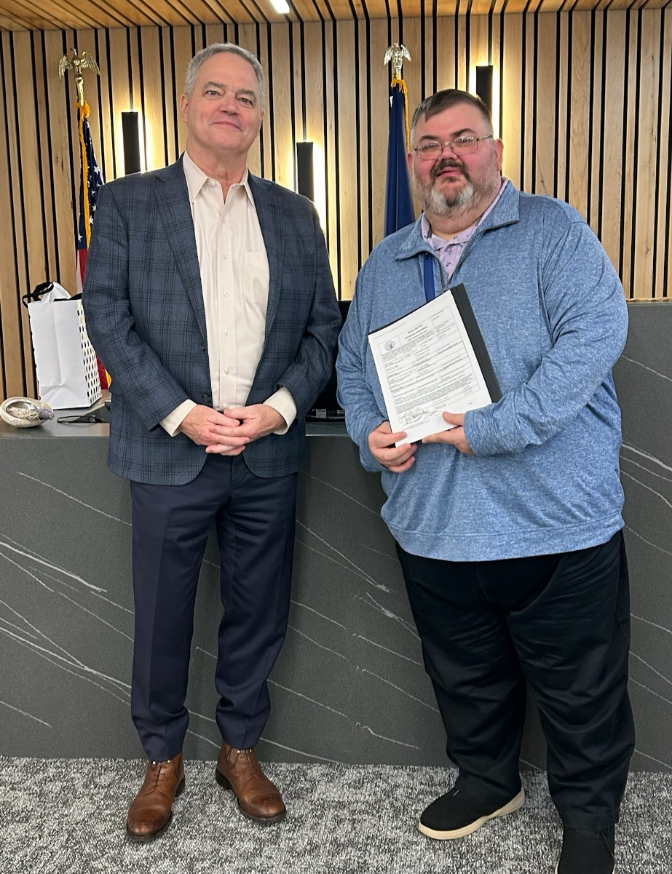
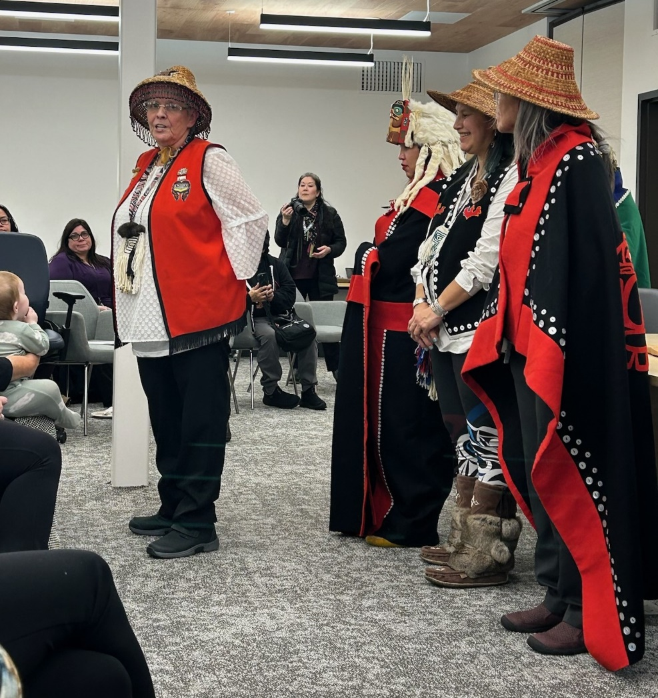
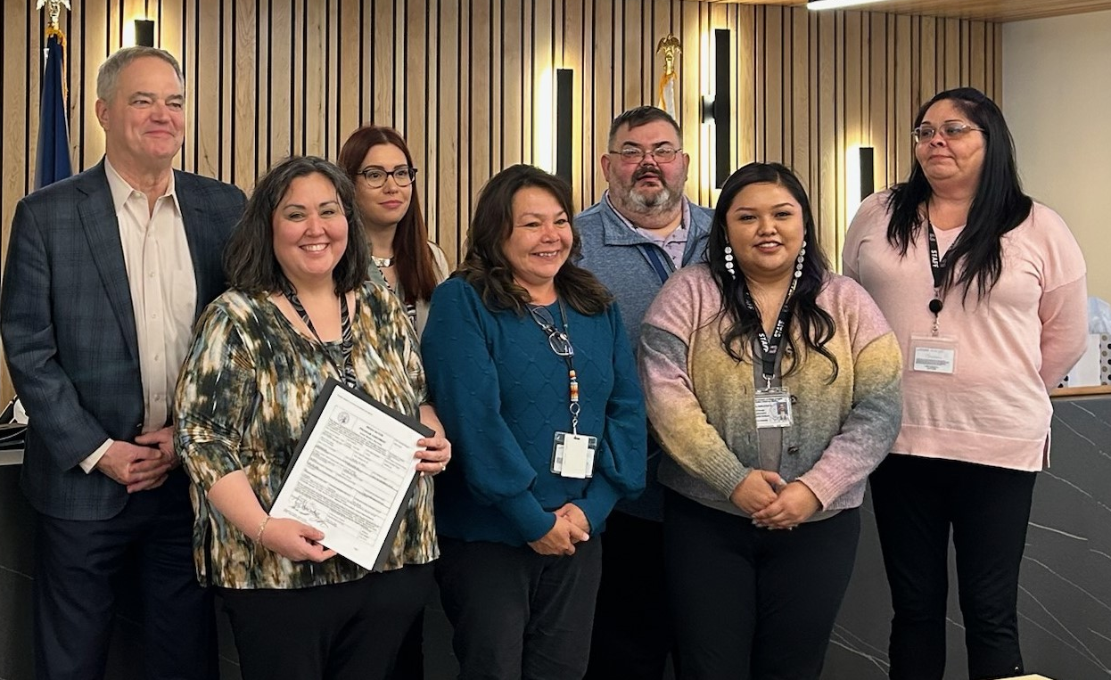
Tlingit & Haida and State of Washington Agreement
  Tribal Self-Determination in Child Welfare
  Tribe is a true partner and is a help to meet state and federal requirements
Notes:
Tleena changes to policies, broader application of MOAs
Coordinate and cooperate with Tribes that have citizens/member live in WA state @8,000 T&H
Mary – relationship Tone of RESPECT Signing Ceremony in Juneau Tribal Courtroom
Highlevel information about the agreement

Slide 13
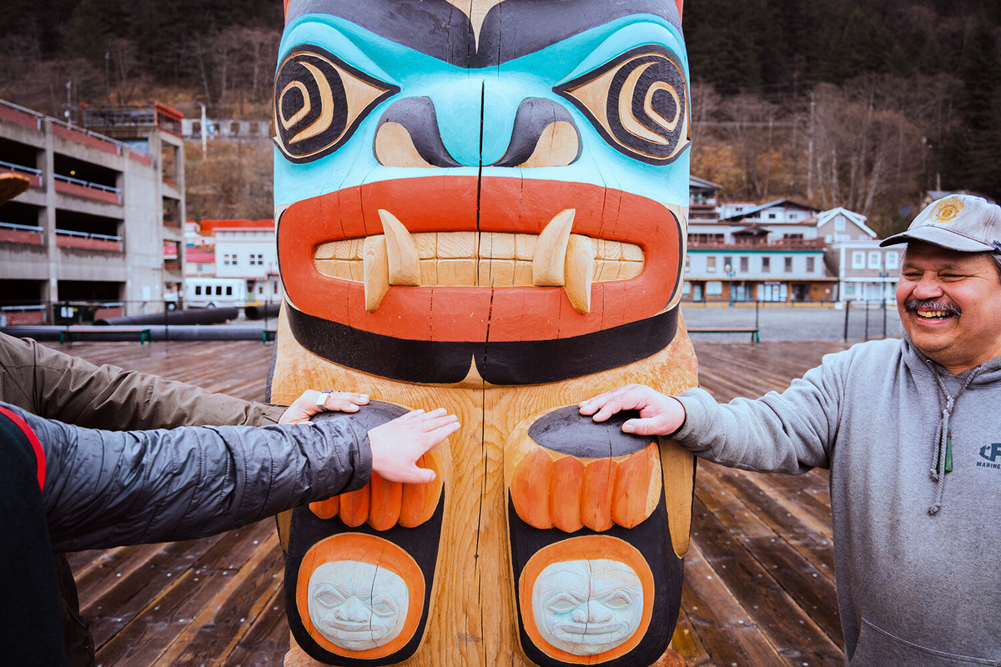
Additional Information
  Contract Activities
    Relative Searches
    Family Time
    Safety Evaluations
    Licensing Assist & Support
    Prevention
  Sustainability
    Title IV-E
    Title IV-B
    Service Contracts
Notes:
Mary

Slide 14
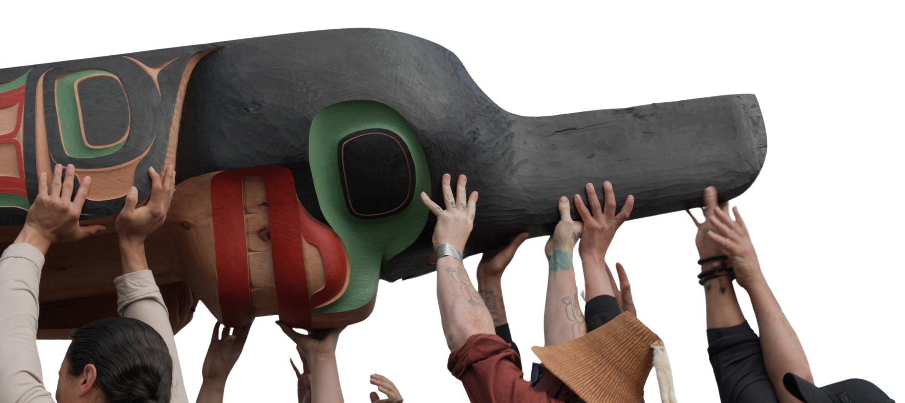
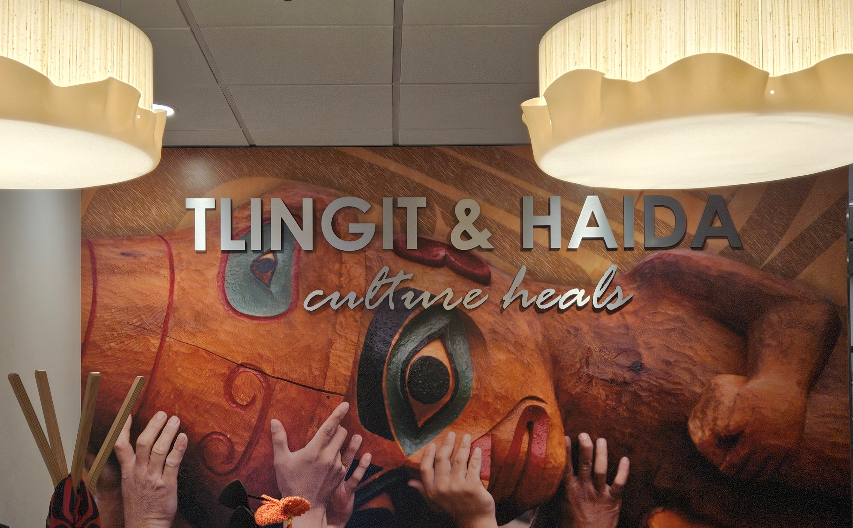
Questions?
Notes:
Mary – questions and closure

