Slide 1
Indian Child Welfare Act Litigation: Haaland v. Brackeen
Erin Dougherty Lynch
Native American Rights Fund
Anchorage, Alaska
Pascua Yaqui Tribe of Arizona
5th Annual Utteaka Naawak
ICWA & Child Welfare Conference
October 12, 2022

Slide 2
Native American Rights Fund Indian Child Welfare Docket
A Practical Guide to the Indian Child Welfare Act, an ICWA bench guide
Representation for Tribes in tribal child welfare impact litigation
Technical assistance, research, and trainings for Tribes, including assistance with tribal-state child welfare agreements
Monitors anti-ICWA litigation and works to defend ICWA as part of the ICWA Defense Project
Authored all Tribal Amicus Briefs in federal challenges to ICWA, in addition to running the Tribal Supreme Court Project process.

Slide 3
Background: ICWA in the Federal Courts
“The federal courts have interpreted ICWA on rare occasions . . . ” Doe v. Mann, 415 F. 3d 1038, 1051 (9th Cir. 2005)
Just two Supreme Court decisions addressing ICWA
Mississippi Band of Choctaw Indians v. Holyfield, 490 U.S. 30 (1989) (appeal from Mississippi Supreme Court)
Adoptive Couple v. Baby Girl, 133 S. Ct. 2552 (2013) (appeal from South Carolina Supreme Court). Decided in the first sentence.

Slide 4
Background: After Adoptive Couple
Department of the Interior:
2015: Updates ICWA Guidelines; significant overhaul is first since 1979 Guidelines, with focus on tribal participation and tribal family placements; rejects “existing Indian family” exception; like earlier Guidelines, remains non-binding.
2016: Publishes ICWA Regulations (a.k.a. the “Final Rule”): Drawing from thousands of comments from Tribes, States, and child welfare agencies, these legally binding regulations incorporate many of the protections recommended in the Guidelines.

Slide 5
Background: After Adoptive Couple & ICWA Regulations
Federal Court Challenges to ICWA:
Coordinated litigation: Federal cases in Virginia, then Arizona, and now Texas.
Same organizations, same attorneys, common themes: Argue that ICWA / Guidelines / Regulations: (1) discriminate on the basis of race, (2) “commandeer” the States, (3) exceed Congress’s authority. Arguments rooted in anti-Tribal bias, not child welfare.

Slide 6
Background: Texas v. Zinke
The Court:
Northern District of Texas
October 25, 2017
The Plaintiffs:
Individual prospective adoptive parents
Texas, Indiana, Louisiana
The Defendants/Intervenors:
United States
Intervening Tribes
Amici
Plaintiffs:
Goldwater Institute
State of Ohio
Defendants/Intervenors
124 Tribes & 14 Tribal Organizations
7 States
Federal Indian Law Scholars

Slide 8
Background: Texas v. Zinke
Issues in the Second Amended Complaint:
Administrative Procedure Act (Final Rule)
Equal Protection, Tenth Amendment, Article I
Violation of Article I/Commerce Clause
Violation of the Tenth Amendment
Violation of the Fifth Amendment/Equal Protection
Violation of APA/Substantive Due Process
Violation of the Fifth Amendment/Due Process
Violation of Article I/Non-Delegation

Slide 9
Background: Texas v. Zinke
Order Released on Oct. 10, 2018 granting the Plaintiffs Motions for Summary Judgment in part and denying in part. Includes broad holdings finding ICWA unconstitutional on a number of grounds.
Granted:
Equal Protection
Non-Delegation
Anti-Commandeering
APA
Unconstitutional under the Indian Commerce Clause (in one paragraph)
Denied
Substantive Due Process

Slide 10
Brackeen: Fifth Circuit Appeal

Slide 11
Brackeen: Fifth Circuit Appeal ― Panel
Procedure:
Stay granted on December 3, 2018
Oral arguments March 13, 2019
Amici for Defendants/Intervenors:
21 States
325 Tribes & 57 Tribal Organizations
Members of Congress
Casey Family Programs et al
Constitutional Law Scholars
Federal Indian Law Scholars
. . . and others
Amici for Plaintiffs:
State of Ohio
Goldwater Institute
Christian Alliance
Project on Fair Representation

Slide 12
Brackeen: Fifth Circuit Appeal ― Panel
Panel Decision Issued on August 9, 2019
Tribes and Federal Government won on all issues except standing, including:
Equal Protection
Commandeering
Non-Delegation
Administrative Procedures Act
Partial dissent found for Texas on commandeering

Slide 13
Brackeen: Fifth Circuit Appeal ― En Banc
Procedure:
En Banc granted
Oral argument held on January 22, 2020
Briefing here
Amici for Defendants/Intervenors:
26 States & District of Columbia
76 Members of Congress
486 Tribes & 59 Tribal Organizations
Casey Family Programs et al
Administrative & Constitutional Law Scholars
Federal Indian Law Scholars
. . . and others
Amici for Plaintiffs:
State of Ohio
New Civil Liberties Alliance
Goldwater Institute
Christian Alliance
Project on Fair Representation

Slide 14
Brackeen: En Banc Key Holdings
Congress has the authority to enact ICWA
ICWA does not discriminate on the basis of race
Many provisions of ICWA upheld as constitutional (or were not challenged in the appeal)
Court equally divided as to a number of other provisions
Narrow majority held three provisions unconstitutionally “commandeered” state agencies
ICWA regulations mostly upheld
Judge Costa: Since no state court has to listen to us it’s a 300 page advisory opinion.
315 page opinion with various concurring opinions.
Take away:
It’s a mess!

Slide 15
Brackeen: En Banc Decision Details
Upheld | Equally Divided | Unconstitutional
Right to intervention (§ 1911(c)) Right to court-appointed counsel (§ 1912(b)) Right to examine reports and documents (§ 1912(c)) Right to informed written consent to foster care or adoptive placements, or to TPR, and to withdraw that consent (§ 1913(a), (b), and (c)) Right to collaterally attack state court adoption decree or petition for its invalidation (§§ 1913(d) and 1914)) Right to petition for return of custody (§ 1916(a)) Right of adult adoptees to obtain tribal affiliation information (§ 1917) Placement preferences (§ 1915(a) and (b)) (to the extent applicable to state courts) Heightened evidentiary standards in foster care and termination of parental rights proceedings (§1912(e) and (f)) (to the extent applicable to state courts) | Right to notice of state child welfare proceedings involving Indian children (§ 1912(a)) Placement preferences (to the extent applicable to state agencies) (§ 1915(a)–(b)) Adoptive placement preference for “other Indian families” (§ 1915(a)(3)) Foster care placement preferences for a licensed “Indian foster home” (§ 1915(b)(iii)) Requirement that states must provide certain adoption records to the Department of the Interior (§ 1951(a)) | Active efforts requirement (§ 1912(d)) Qualified expert witness requirement (§1912(e) and (f)) Requirement that states maintain records of placements of Indian children pursuant to the placement preferences (§ 1915(e))

Slide 16
Brackeen: Impact of En Banc Decision
Limited applicability:
Controlling only in federal courts in three states
Louisiana
Mississippi
Texas
Not binding on any State or Tribal court

Slide 17
Brackeen: Cert Petitions to U.S. Supreme Court
February 28, 2022: Supreme Court grants all petitions and consolidates case under Haaland v. Brackeen.
The Court does not limit or focus the arguments.
Fall 2021: Petitions filed by:
United States
Intervenor Tribes
Texas
Foster parents

Slide 18
Questions Presented to the Court
Does ICWA in general, or do certain provisions governing minimum standards, placement preferences, and recordkeeping, impermissibly commandeer states?
Has Congress exceeded its Article I authority by enacting laws governing child custody proceedings?
Does ICWA violate the nondelegation doctrine by allowing tribes to alter the statute’s placement preferences?
Do the individual families have standing to challenge ICWA’s placement preferences?
Does ICWA in general, or do the statute’s placement preferences for “other Indian families” and “Indian foster homes,” violate equal protection?

Slide 19
Tribal Supreme Court Project
Communication
Staffed by NARF and NCAI with a Working Group of over 300 Indian law attorneys and academics from around the nation.
Calls and emails keep participants up to date and facilitate discussion among participants
Coordination
Streamline our Supreme Court argument by reducing duplication end emphasizing narrow, targeted arguments
Collaboration
Exchange of briefs to ensure that everyone is rowing in the same direction and on the same count

Slide 20
Brackeen: SCOTUS Merits Briefs
Texas and foster parents briefs filed Thursday, May 26
Amicus briefs in support filed Thursday, June 2
DOJ and Party Tribes briefs filed Friday, August 12
Amicus briefs in support filed Friday, August 19
Texas and foster parent reply briefs filed Monday, October 3
All briefs are available on the Tribal Supreme Court Project website at https://sct.narf.org/caseindexes/haaland_v_brackeen.html

Slide 21
Brackeen: Anti-ICWA Amici
Amici for Plaintiffs:
States of Ohio, Oklahoma
Pacific Legal Foundation
New Civil Liberties Alliance
Academy of Adoption & Assisted Reproduction Attorneys
Goldwater Institute
Christian Alliance
Project on Fair Representation
Citizens Equal Rights Foundation

Slide 22
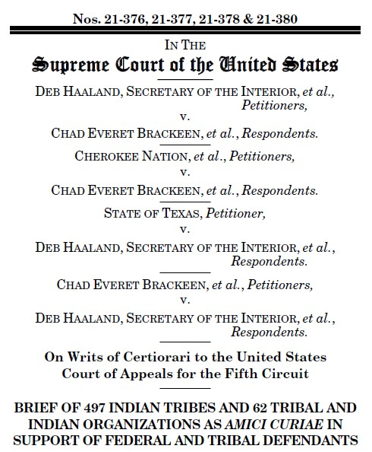
Brackeen: ICWA Amicus Coalition ― Briefs from Governments
Tribal Nations and Tribal and Native Organizations Brief: 497 Tribes and 62 tribal and Native organizations (likely the most ever on a brief together). The brief focuses on the history of federal and state involvement in the lives of tribal children, the importance of children in tribal cultures, the political relationship between Tribes and the federal government, and the potential harms that could flow from this case for potentially millions of tribal members.

Slide 23
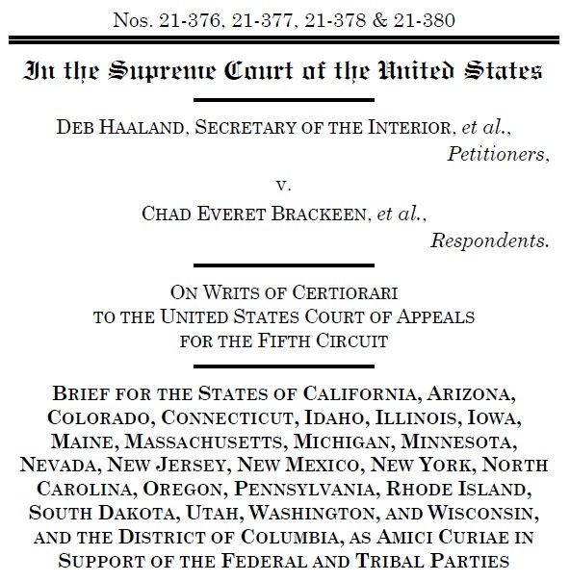
Brackeen: ICWA Amicus Coalition ― Briefs from Governments, cont.
Bipartisan States Brief: 23 states and the District of Columbia signed on to this brief, which highlights how ICWA is a critical tool for protecting Indian children, allows and encourages tribal-state collaboration in the area of child welfare, and does not commandeer state governments.

Slide 24
Brackeen: ICWA Amicus Coalition ― Briefs from Governments, cont.
Bipartisan Members of Congress Brief: Bipartisan coalition of 87 Members of Congress signed this brief focusing on all four of the primary arguments in the case and explaining that passing ICWA was well within Congress’s constitutional authority.
Los Angeles County Brief: Brief from counsel for the county with the largest child welfare system in the country, which is also the county that is home to the largest American Indian and Alaska Native population in the United States. Brief focuses on the history of Indian relocation and ICWA’s importance to all Tribes, not just those with reservation land.

Slide 25
Brackeen: ICWA Amicus Coalition ― Briefs from experts on Child Welfare, Children’s Rights, and the Rights of Families
Casey Family Programs
Adopt America Network
American Adoption Congress
Ampersand Families
Annie E. Casey Foundation
Black Administrators in Child Welfare, Inc.
Center for Native American Youth
Center for the Study of Social Policy
Child Welfare League of America
Children’s Defense Fund
Dave Thomas Foundation for Adoption
FosterAdopt Connect
FosterClub
Generations United
National Alliance of Child Abuse Prevention Funds
National Association of Social Workers
National Center on Adoption and Permanency
North American Council on Adoptable Children
Spaulding for Children
Voice for Adoption
W. Haywood Burns Institute
Child Welfare and Adoption Organizations Brief: Casey Family Programs and 26 of the nation’s other most well-respected child welfare, adoption, foster care, and social work organizations. This brief cites specific research and discusses how ICWA is a model for child welfare best practices. Some of the signatories include:

Slide 26
Brackeen: ICWA Amicus Coalition ― Briefs from experts on Child Welfare, Children’s Rights, and the Rights of Families, cont.
Children’s Rights Organizations Brief: The National Association of Counsel for Children and 30 other children’s rights organizations who provide legal representation or policy advocacy on behalf of children in foster care. This brief explores the constitutional rights of families, addresses how ICWA supports the best interests of children in state proceedings, and provides critical information to state courts.
Family Defense Providers Brief: Organizations that represent parents in dependency cases in nine states and discusses the constitutional rights afforded to parents and children, how those rights intersect with the child welfare system, and the importance of ICWA in establishing procedures that ensure child safety and protect family integrity.
American Bar Association Brief: Brief directly challenges the contention that child welfare is the sole province of the states, describes how child welfare has long been governed by a combination of state and federal law, and explains how federal law routinely imposes substantive and procedural requirements on state child welfare agencies and state courts.

Slide 27
Brackeen: ICWA Amicus Coalition ― Briefs from Medical Experts
Pediatricians and Doctors Brief: Brief from the American Academy of Pediatrics and the American Medical Association describes the federal and state policies designed to destroy tribal families and extended tribal networks, how those policies and have resulted in historical trauma that affects the health of Native children today, and the manner in which ICWA provides for the preservation of family and community connections.
Psychologists Brief: Brief from the American Psychological Association, the Society of Indian Psychologists, and the Texas, Indiana, Louisiana Psychological Associations detailing the research-supported benefits for Native children when they are parented by Native families.

Slide 28
ICWA Amicus Coalition ― Briefs From Individuals Who Have Lived Experiences that Confirm ICWA’s Importance
Former Foster Children Brief: Brief from tribal members who were involved with the child welfare system as youth. The brief shares with the Court their lived experiences in foster care to dispel misconceptions about Indian children’s experiences with ICWA.
Bradshaw Brief: Brief provides important case background from the grandmother who adopted her granddaughter, P.S., the child who was the subject of the claims of the Cliffords (one of the foster family plaintiffs). The brief shows that the narratives advanced by the Cliffords and accepted by the federal appellate court were not truthful, and explains why the Cliffords and other two foster family plaintiffs in this case lack standing.
Non-Native Adoptive Parents Brief: Though this case is not about voluntary adoptions, this brief addresses how ICWA works in voluntary adoptions and provides important context about how ICWA fosters positive outcomes in adoption.

Slide 29
Brackeen: ICWA Amicus Coalition ― Legal and Historical Scholar Briefs
Indian Law Professors Brief: Brief from 30 leading Indian law scholars focuses on the foundations of the federal-tribal relationship and the exclusive power of Congress to legislate on behalf of Indians as a political class.
Administrative and Constitutional Law Professors Brief: Brief from some of the nation’s most prominent administrative and constitutional law scholars addresses Congress’s power to enact statutes that implement treaties with Native Nations, regulate state actors, and incorporate the law of other sovereigns into its legislation.
Historians Brief: Brief from the American Historical Association and the Organization of American Historians describes the federal government’s history of exercising authority over Native children and families and the role of state child welfare agencies in accelerating the removal of Native children from their communities.

Slide 30
Brackeen: ICWA Amicus Coalition ― Legal and Historical Scholar Briefs, cont.
Professor Ablavsky Brief: Brief from a professor who teaches both law and history at Stanford discusses the original constitutional understandings of the federal power over Indian affairs, including issues related to Indian children.
Constitutional Accountability Center Brief: Brief that takes an originalist perspective in explaining that there are no anti-commandeering concerns when Congress requires state officials to engage in recordkeeping and share information with the federal government, and likens provisions of ICWA to the Servicemembers Civil Relief Act.

Slide 31
Brackeen: ICWA Amicus Coalition ― Other Groups and Individuals With Unique Legal and Professional Perspectives
National Indigenous Women’s Resource Center Brief: Brief from NIWRC, two individuals, and 88 victim advocacy, legal services, and religious organizations details the manner in which any holding that finds Indian to be a racial, and not a political, classification would impede the ability of Tribes to protect their member women and children from violence.
ACLU Brief: Brief argues that ICWA’s provisions involve political, not racial, classifications and that even if the Court were to apply a heighted level of scrutiny, ICWA would still be constitutional.
Senator Abourezk Brief: Brief from the former Senator from South Dakota and primary sponsor of ICWA details relevant legislative history.

Slide 32
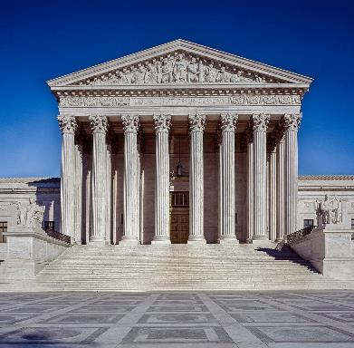
Brackeen: What’s Next
Oral argument will be November 9, 2022
Decision expected June 2023

Slide 33
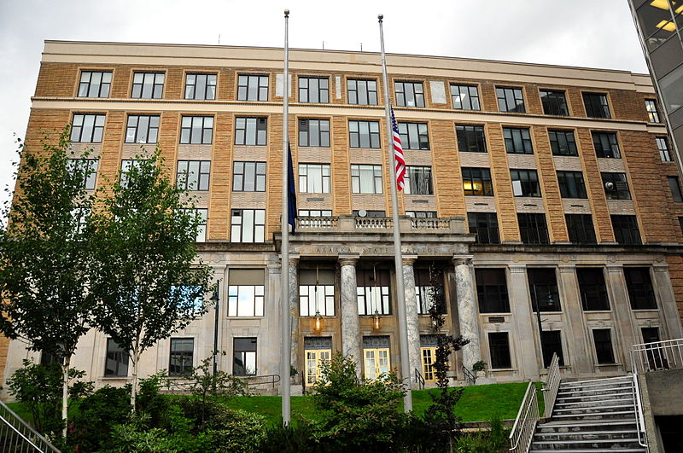
What Can I Do?
Consider a State ICWA:
Michigan
Minnesota
Nebraska
New Mexico
Oklahoma
Oregon
Washington
Wisconsin
Help build the public’s knowledge of ICWA:
Follow and support the Protect ICWA Campaign.

Slide 34
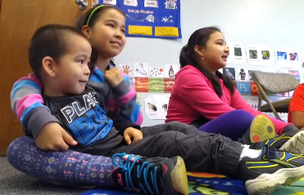
What Can I Do?
Consider a Tribal-State agreement
Keep building tribal systems!

Slide 35
Erin Dougherty Lynch
Managing Attorney ― NARF Alaska
dougherty@narf.org

