Slide 1

Mapping the Way Forward:
Adapting, Advancing, Achieving
Domingo DeGrazia – ICWA Supervising Attorney

Slide 2
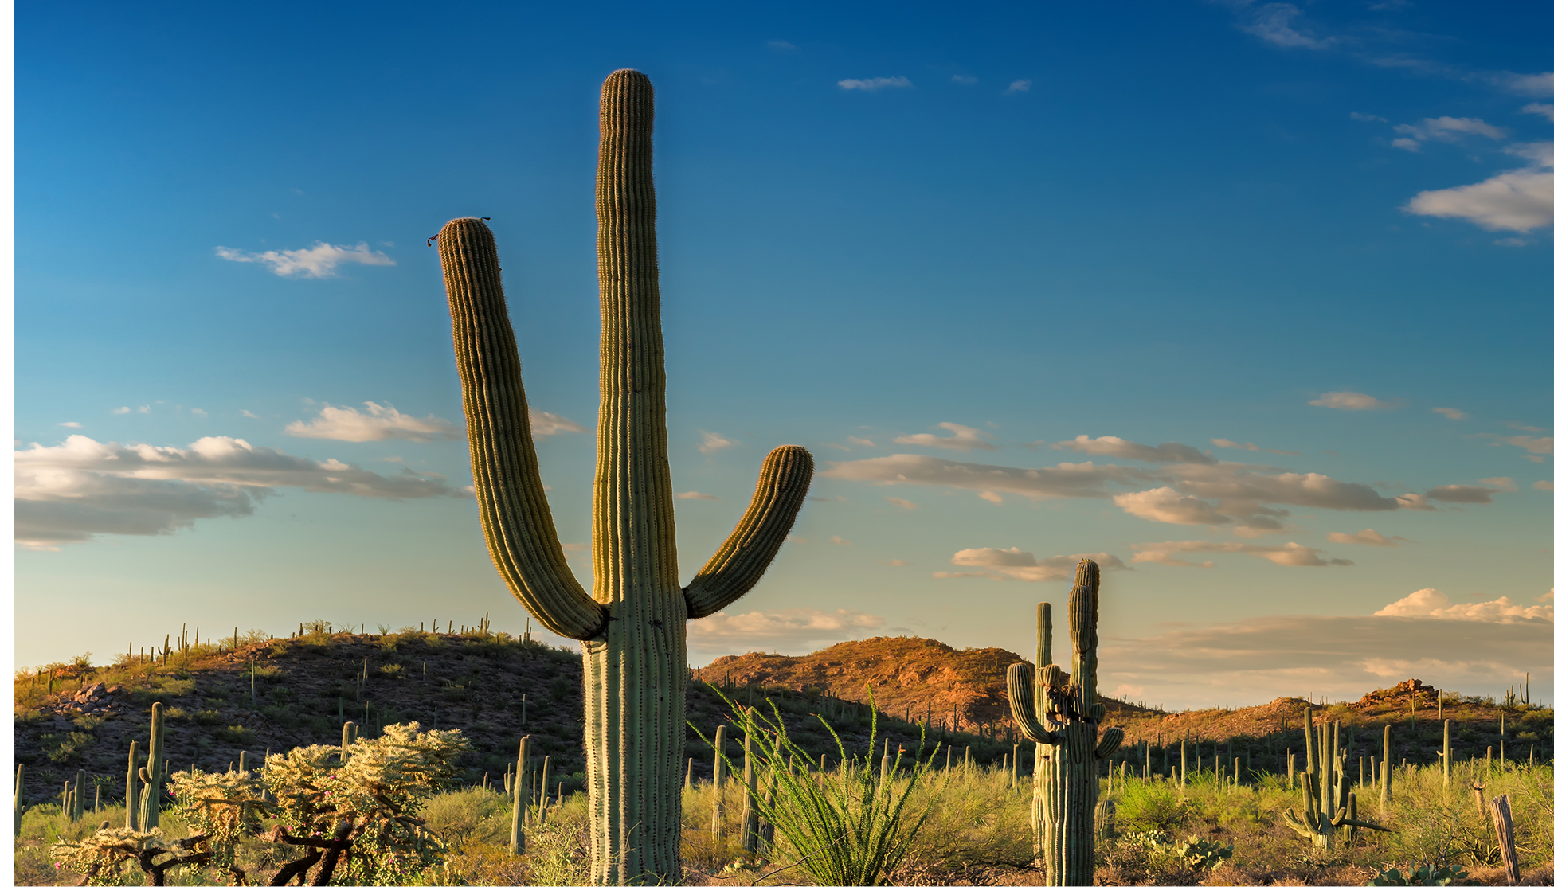

Slide 3
Overview
Pascua Yaqui ICWA History
The Role of Tribal Leadership
Key Tribal Departments
Record Keeping and File Management
Data Aggregation & AI
Next Steps In Protecting ICWA

Slide 4
History of the Yaqui People
21,000 BC Footprints in what is now New Mexico
4,000 BC Settlements in what is now Tucson, Arizona
1533-1929
Yaqui Wars with Spanish
1978 Pascua Yaqui become federally recognized.

Slide 5
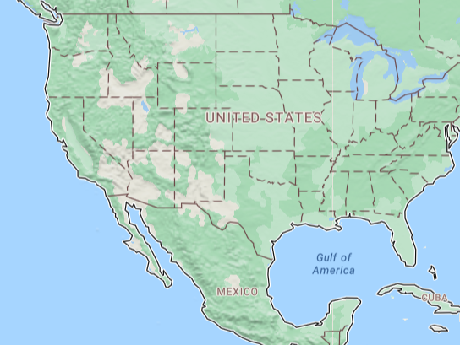

History of the Yaqui People

Slide 6

Pascua Yaqui ICWA History
2002 – Tribal Council resolves to support ICWA
2006 – Begins sending monthly ICWA reports to Tribal Council
2016 – Federal Tiwahe funding
2025 – Pascua Yaqui Tribal Committee on ICWA formed

Slide 7
The Role of Tribal Leadership
Goal Setting
Resource Commitment
Facilitating Inter-departmental Coordination
Building State and Federal Coalitions
Program Oversight and Adjustment

Slide 8
Advancing ICWA Practices
What Questions are you Asking?
What is the current level of foster care children?
How do you measure change when an ICWA is implemented?
How many ICWA social workers were present in the Tribe?
How many Tribal ICWA attorneys were in place?
During the reporting time:
What happened in the economy/world?
Did state law change?
Did state policy change?
What happened with non-Indian child welfare cases in US?

Slide 9
Tribal Organizational Collaboration
The Tribal ICWA ecosystem
Tribal Council
Tribal Department of Social Services
Tribal Enrollment
Tribal Attorney General

Slide 10
ICWA Coalitions in Arizona
MOU
ICWA Courts
State Attorneys
Tribal Attorney General
State Child Welfare
Arizona ICWA Court Committee
ICWA Training
ICWA Guide
https://www.azcourts.gov/stfcf/icwa-committee

Slide 11
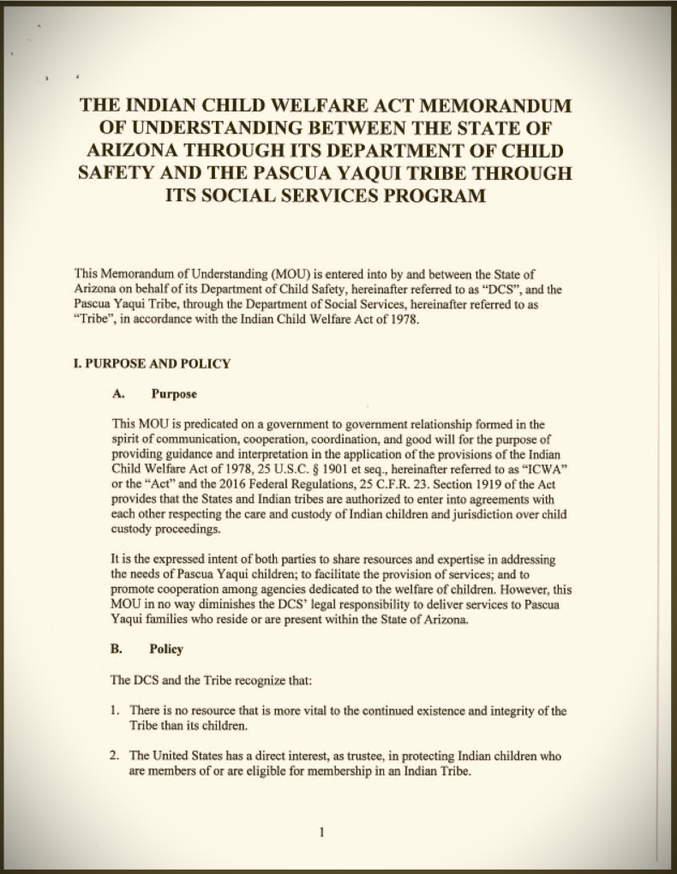
Memorandum
Of
Understanding
Pascua Yaqui & AZ
(View MOU)

Slide 12
In-Court
Collaboration:
ICWA Court Involvement
Early notice of potential cases
Rapid enrollment verification
Attendance in all meetings
Engagement in all court Hearings
Advocacy for placement preferences

Slide 13
Child-Custody Proceedings that Invoke ICWA:
Any action that may culminate in one of these outcomes:
Foster-care placement
Termination of Parental Rights
Pre-adoptive Placement
Adoptive Placement
Notes:
25 CFR 23.2 Child-custody proceeding.

Slide 14
Child Custody Proceeding Defined
A child custody proceedings is any action where a child is removed from the parent:
  for temporary placement;
  in a home or institution;
  and where the parent cannot have the child returned upon demand but where parental rights have not been terminated.
Notes:
25 U.S.C. § 1903(1)(i)
Definitions
For the purposes of this chapter, except as may be specifically provided otherwise, the term-
(1) "child custody proceeding" shall mean and include-
(i) "foster care placement" which shall mean any action removing an Indian child from its parent or Indian custodian for temporary placement in a foster home or institution or the home of a guardian or conservator where the parent or Indian custodian cannot have the child returned upon demand, but where parental rights have not been terminated;

Slide 15
Qualified Expert Witness
§ 23.122 Qualified expert witness
The QEW, Continued Custody, Cultural Standards
  A qualified expert witness must be qualified to testify regarding whether the child's continued custody by the parent or Indian custodian is likely to result in serious emotional or physical damage to the child and should be qualified to testify as to the prevailing social and cultural standards of the Indian child's Tribe. A person may be designated by the Indian child's Tribe as being qualified to testify to the prevailing social and cultural standards of the Indian child's Tribe.
BIA Assistance
  The court or any party may request the assistance of the Indian child's Tribe or the BIA office serving the Indian child's Tribe in locating persons qualified to serve as expert witnesses.
No Dual Roles
  The social worker regularly assigned to the Indian child may not serve as a qualified expert witness in child-custody proceedings concerning the child.
Notes:
§ 23.81 Assistance in identifying witnesses. Upon the request of a party in an involuntary Indian child custody proceeding or of a court, the Secretary or his/her designee shall assist in identifying qualified expert witnesses. Such requests for assistance shall be sent to the Regional Director designated in § 23.11(c). The BIA is not obligated to pay for the services of such expert witnesses.

Slide 16
Qualified Expert Witness
§ 23.121 Standards of evidence
Clear and Convincing, QEW, Serious Harm
  The court must not order a foster-care placement of an Indian child unless clear and convincing evidence is presented, including the testimony of one or more qualified expert witnesses, demonstrating that the child's continued custody by the child's parent or Indian custodian is likely to result in serious emotional or physical damage to the child.
Beyond Reasonable Doubt, QEW, Serious Harm
  The court must not order a termination of parental rights for an Indian child unless evidence beyond a reasonable doubt is presented, including the testimony of one or more qualified expert witnesses, demonstrating that the child's continued custody by the child's parent or Indian custodian is likely to result in serious emotional or physical damage to the child.
Notes:
§ 23.81 Assistance in identifying witnesses. Upon the request of a party in an involuntary Indian child custody proceeding or of a court, the Secretary or his/her designee shall assist in identifying qualified expert witnesses. Such requests for assistance shall be sent to the Regional Director designated in § 23.11(c). The BIA is not obligated to pay for the services of such expert witnesses.

Slide 17
Preliminary Hearing
Key Decisions
Whether each participant knows or has reason to know that the child is an Indian child.
  Inquiry made at the commencement of the proceeding and on the record. 25 C.F.R. § 23.107(a)
  Proper notice. 25 U.S.C. § 1912(a); 25 C.F.R. § 23.111(b)(2)
Whether proper notice was received at least 10 days prior to a hearing.
  25 U.S.C. § 1912(a); 25 C.F.R. § 23.111(b)
If the tribe was unknown, was notice sent to the regional BIA office?
25 C.F.R. § 23.111(e)
Whether copies of the notices were sent to the appropriate BIA Regional Director? 25 C.F.R. § 23.11(a) & (b)

Slide 18
Preliminary Hearing
Notice to Tribes
Petitioner Obligations:
  The party seeking the foster care placement of, or termination of parental rights to an Indian child shall notify the parent or Indian custodian and the Indian child's tribe, by registered mail with return receipt requested, of the pending proceedings and of their right of intervention.
Adequate Notice
  Service be completed at least 10 days prior to an initial hearing.
  Compare Arizona
Extension of Time
  If a notified parent, Indian custodian, or Tribe subsequently requests additional time to prepare for a hearing, the court must adjourn the case for up to 20 additional days.
See also ICWA Regulations § 23.112(a) for time limit extensions.
Notes:
§1912. Pending court proceedings
§ 23.112 What time limits and extensions apply?

Slide 19
Preliminary Hearing
Findings
Domicile - Whether at the time of removal, the child lives or is domiciled on a reservation or is already a ward of a tribal court thereby depriving the state court of jurisdiction. 25 U.S.C. § 1911(a)
Indian Custodian - Whether at the time of removal, the child was in the custody of an Indian custodian. 25 U.S.C. § 1903(6)
Harm - Whether the removal or placement is necessary to prevent imminent physical damage or harm to the child. 25 U.S.C. § 1922; 25 C.F.R. § 23.113(b)(1)
Notice - If all notice was properly done prior to the hearing.

Slide 20
Preliminary Hearing
Findings
20 Day Request – Did the parent or tribe request an additional 20 days? 25 U.S.C. § 1912(a)
Active Efforts – Efforts made to prevent the breakup of the family, and whether the efforts were successful. 25 U.S.C. § 1912(d)
Custody and Serious Emotional Harm - Whether there was clear and convincing evidence, supported by the testimony of a qualified expert witness, that continued custody of the child by the parent or Indian custodian is likely to result in serious emotional or physical damage to the child. 25 U.S.C. § 1912(e)

Slide 21
Preliminary Hearing
Best-Practice Determinations
Does the parent understand the case plan?
Is the long-term permanent plan still the best plan for the child?
Do case plan services match parenting deficiencies?
Whether the child is in a preferred placement. 25 U.S.C. § 1915(b)14
Do the visitation terms need to be modified to match customs?
What is the time frame for the permanency plan?

Slide 22
Placement Preferences
Tribal Placement Preferences Control
Different rules for foster-care placements vs adoptive placements
Preferences apply in any placement that is:
pre-adoptive,
adoptive,
or foster-care placement
Apply Tribal or statutory preferences unless there is good cause not to follow
Notes:
§ 23.129 When do the placement preferences apply?(a) In any preadoptive, adoptive, or foster-care placement of an Indian child, the placement preferences specified in § 23.130 and § 23.131 apply.(b) Where a consenting parent requests anonymity in a voluntary proceeding, the court must give weight to the request in applying the preferences.(c) The placement preferences must be applied in any foster-care, preadoptive, or adoptive placement unless there is a determination on the record that good cause under § 23.132 exists to not apply those placement preferences.

Slide 23
Adjudication Hearing
Key Decisions
Reason to Know
Jurisdiction
Allegations
Legal Basis
Active Efforts
Transfer Request?
Notes:
Reason to Know - Whether the child is, or the court has reason to know the child is an Indian child as defined by ICWA. 25 U.S.C. § 1903(4); 25 C.F.R. § 23.107(a)
Jurisdiction - Whether the state court lacks jurisdiction because the child is already a ward of a tribal court or is either domiciled on or resides within the reservation. 25 U.S.C. § 1911(a)
Allegations - Which allegations of the petition have been proved or admitted.
Legal Basis - Whether there is a legal basis for continued court and agency intervention.
Active Efforts - Whether the agency made active efforts to provide remedial services and rehabilitative programs designed to prevent the breakup of the family. If so, were these efforts successful? 25 U.S.C. § 1912(d); 25 C.F.R. § 23.120(b)
Transfer Request - If a request is made to transfer the case to tribal court, whether or not the case will be transferred. 25 U.S.C. § 1911(b)

Slide 24
Key ICWA Departments
Tribal Council
Attorney General
Social Services Department
Enrollment
Health Department*

Slide 25

Tribal Partners
Tribal Council
Community
Tribal Culture
Tribal Court
Tribal Health

Slide 26
Record Keeping in an ICWA Program
Organizing data and documents
File Management
Policy: Retention, Access & Destruction
Physical vs Digital
Organize data
Eliminate redundancy
Reduce data storage costs
Data security
Manage growing volumes of data
HighQ
  What it is not
  Built for multi-user online access
  Stores case documents
  Enables tracking of data points
  Customizable views
  Report generation
Notes:
ER 1.6. Confidentiality of Information
ER 1.10. Imputation of Conflicts of Interest: General Rule
Firewall within ICWA team from conflicted attorneys
ER 1.7 Conflict of Interest: Current Clients

Slide 27

Data Aggregation & AI for Better Insights
AI Ingest documents
Creates/updates database
Natural language search
Information retrieval
Map data vs other programs

Slide 28

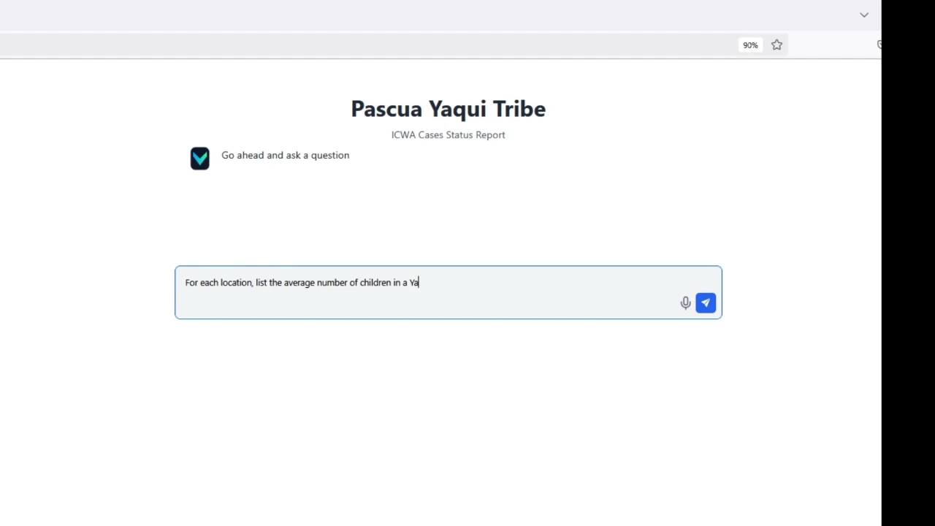

AI ICWA DATA

Slide 29
Meaningful ICWA Data
Report
Easily generate internal and external reports: Tribal Council & BIA
Measure
Visualize the performance of your program over time and compare vs state/federal data
Explore
Determine which issues are most prevalent
Find
Find which communities are most in need
Plan
Plan resources for:
Increases in case numbers
Worker absence
Drug epidemic
Economic recession
Pandemic
Other

Slide 30
The Path Forward – Coalition building
Build Consensus Among Tribes in Support of ICWA
Find Allies in Cities and Towns
Find Advocates with State Government
Find ICWA Success Stories in Your Community
Do the Hard work to Justify Dollars spent on ICWA
Advocate for State Protection of ICWA

Slide 31
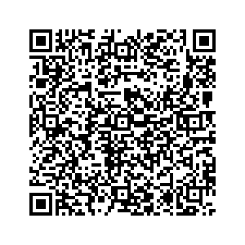
Domingo DeGrazia
ICWA Supervising Attorney
Office of the Attorney General
Pascua Yaqui Tribe ddegrazia@pascuayaqui-nsn.gov
Cell: (520) 404-2624

Slide 32
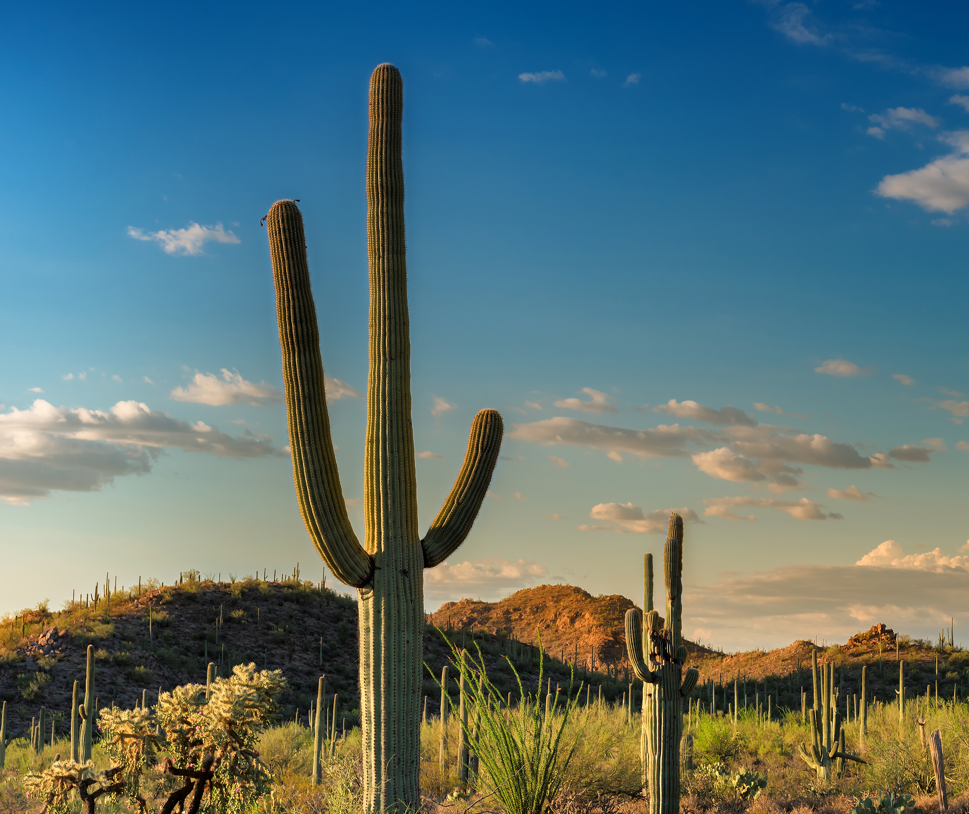

Thank You
Thank you

