Slide 1
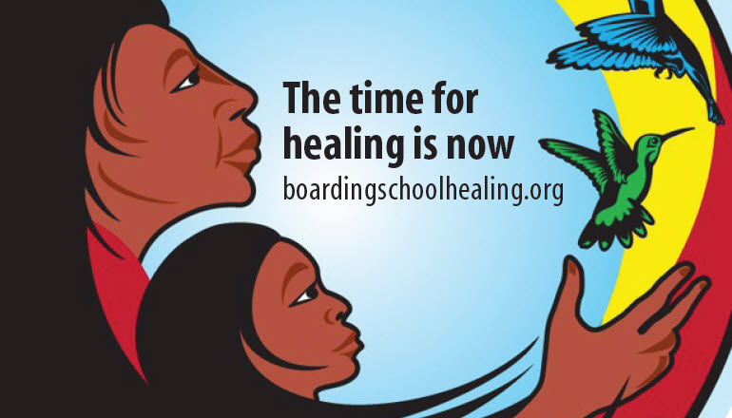
TRUTH, JUSTICE, AND HEALING: INDIAN BOARDING SCHOOLS AND ICWA
5th Annual Indian Child Welfare Conference - Pascua Yaqui Tribe | October 13, 2022
Deborah Parker (Tulalip Tribes) Chief Executive Officer

Slide 2
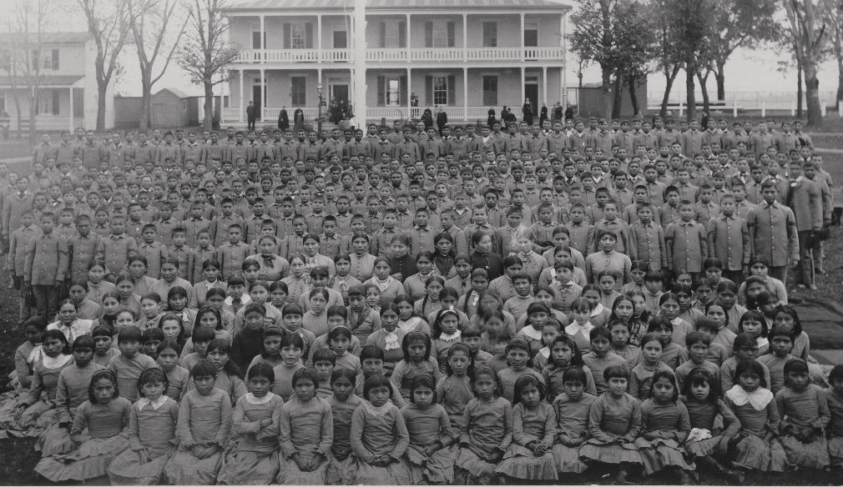
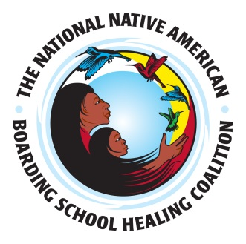
NABS VISION:
Indigenous cultural sovereignty.
NABS MISSION:
To lead in the pursuit of understanding and addressing the ongoing trauma created by the US Indian Boarding School policy.
Notes:
Started at symposium 2011 in response to public outcry about the lasting effects of the boarding school era. This was shortly after Canada launched its TRC in 2010 using settlement funds from a class action lawsuit.
NARF Fiscal Agent
Today:
501c3 non-profit
Over 120 members and
Over 20 resolutions from tribes and tribal orgs

Slide 3
DEBORAH PARKER CHIEF EXECUTIVE OFFICER TULALIP TRIBES
DEIDRE WHITEMAN DIRECTOR OF RESEARCH AND EDUCATION MESKWAKI/DAKOTA/ OJIBWE/HIDATSA
SAMUEL B. TORRES, ED.D. DEPUTY CHIEF EXECUTIVE OFFICER MEXICA/NAHUA
JENNIFER BLEVINS, PH.D. DIRECTOR OF OPERATIONS
STEPHEN CURLEY, MALIS DIRECTOR OF DIGITAL ARCHIVES DINÉ/NAVAJO NATION
IKO'TSIMISKIMAKI "EKOO" BECK COMMUNITY ENGAGEMENT COORDINATOR BLACKFEET/RED RIVER MÉTIS
THERESA SHELDON DIRECTOR OF POLICY AND ADVOCACY TULALIP TRIBES
LACEY KINNART PROGRAM AND OPERATIONS COORDINATOR SAULT STE. MARIE TRIBE OF OJIBWE
KENRICK ESCALANTI CREATIVE DIRECTOR FORT YUMA QUECHAN INDIAN TRIBE

Slide 4
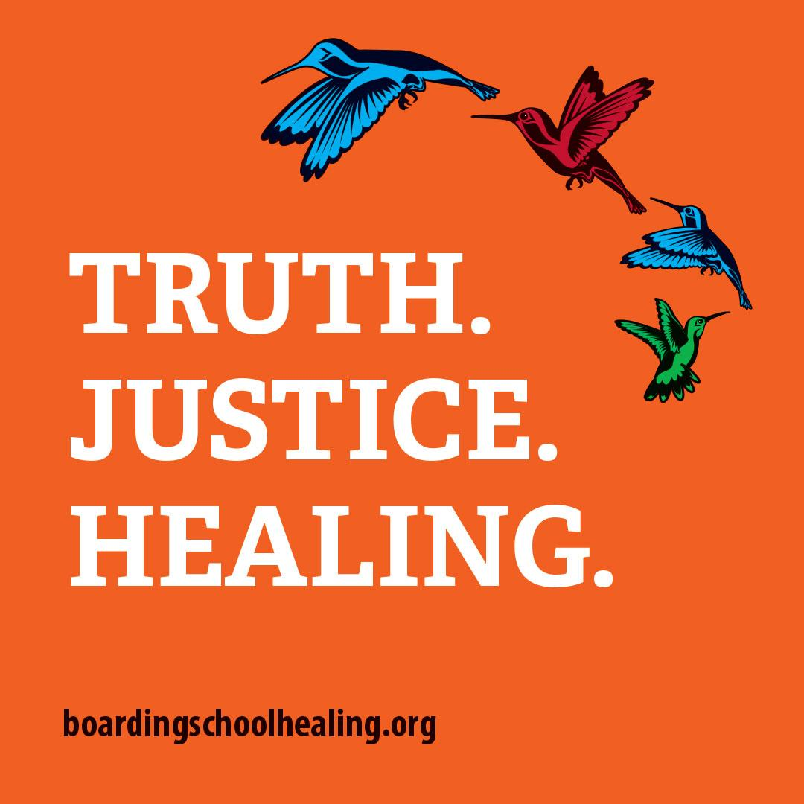
Formed after a national symposium in 2011. Leaders from the U.S. and Canada came together to discuss the Canadian Truth and Reconciliation Commission and the need for such a process in the U.S.
Created to increase public awareness and cultivate healing for the trauma experienced by individuals, families, communities, of American Indian and Alaska Native Nations resulting from the U.S. Indian Boarding School Policy of 1869.
NABS was fiscally sponsored by the Native American Rights Fund (NARF) until it became financially independent in 2015.

Slide 5
Membership Coalition
Purpose and Vision for Membership
We are a coalition of people who support the healing of boarding school survivors and descendants.
We use our coalition voice to educate others about the truth of the Boarding School Policies, experiences, and legacy.
We call for action towards justice and healing.
We use our network to share research, healing resources, and advocacy.
We learn from one another, and we grow and heal together.

Slide 7
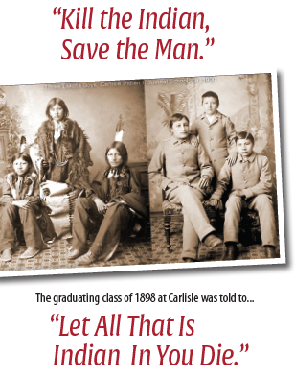
Setting the Context: Indian Boarding Schools in the US
1879-1970s
367+ U.S. Indian Boarding schools
Government-funded
Government- and Church-run
Assimilation and genocide
Indian children were:
Forcibly abducted
Sent hundreds of miles away
Stripped of clothes, hair cut, often given a number rather than name
Neglected, malnourished, beaten, starved, or abused
Notes:
Between 1879 and the 1970s, the U.S. federal government removed thousands of American Indian and Alaska Native children from their homes and families, placing them in assimilative boarding schools that were meant to strip away their languages, identities, and cultures.
Structured through the idea “Kill the Indian Save the Man”
Schools sought to destroy Indian languages and cultures and ultimately dismantle Indian nations to enable to U.S. government to obtain more Indian land.

Slide 8
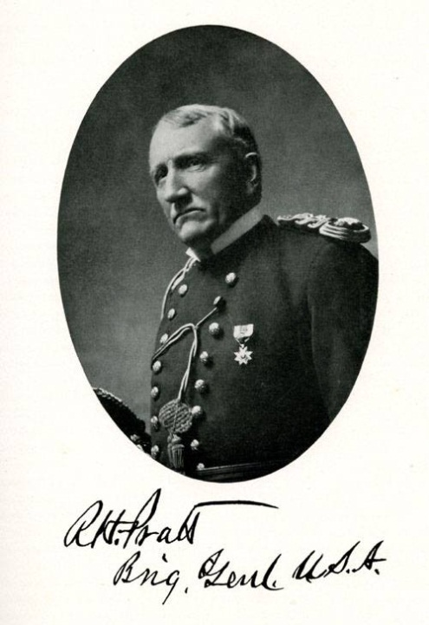
“Kill The Indian... Save the Man”
Gen. Richard H. Pratt
Carlisle Indian School Student Body
"A great general has said that the only good Indian is a dead one, and that high sanction of his destruction has been an enormous factor in promoting Indian massacres. In a sense, I agree with the sentiment, but only in this: that all the Indian there is in the race should be dead. Kill the Indian in him, and save the man.” --Capt. Richard H. Pratt
Notes:
The stated purpose of the U.S. Indian Boarding School policy was to destroy Indian culture by using education as weapon. General Richard Henry Pratt said:
"A great general has said that the only good Indian is a dead one, and that high sanction of his destruction has been an enormous factor in promoting Indian massacres. In a sense, I agree with the sentiment, but only in this: that all the Indian there is in the race should be dead. Kill the Indian in him, and save the man.“

Slide 9
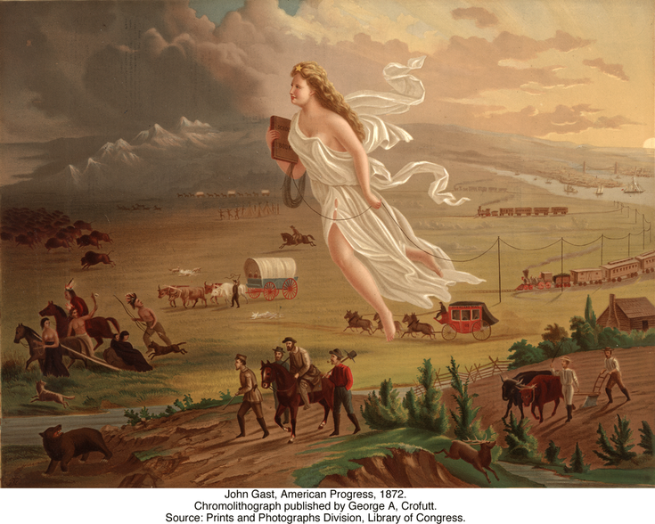
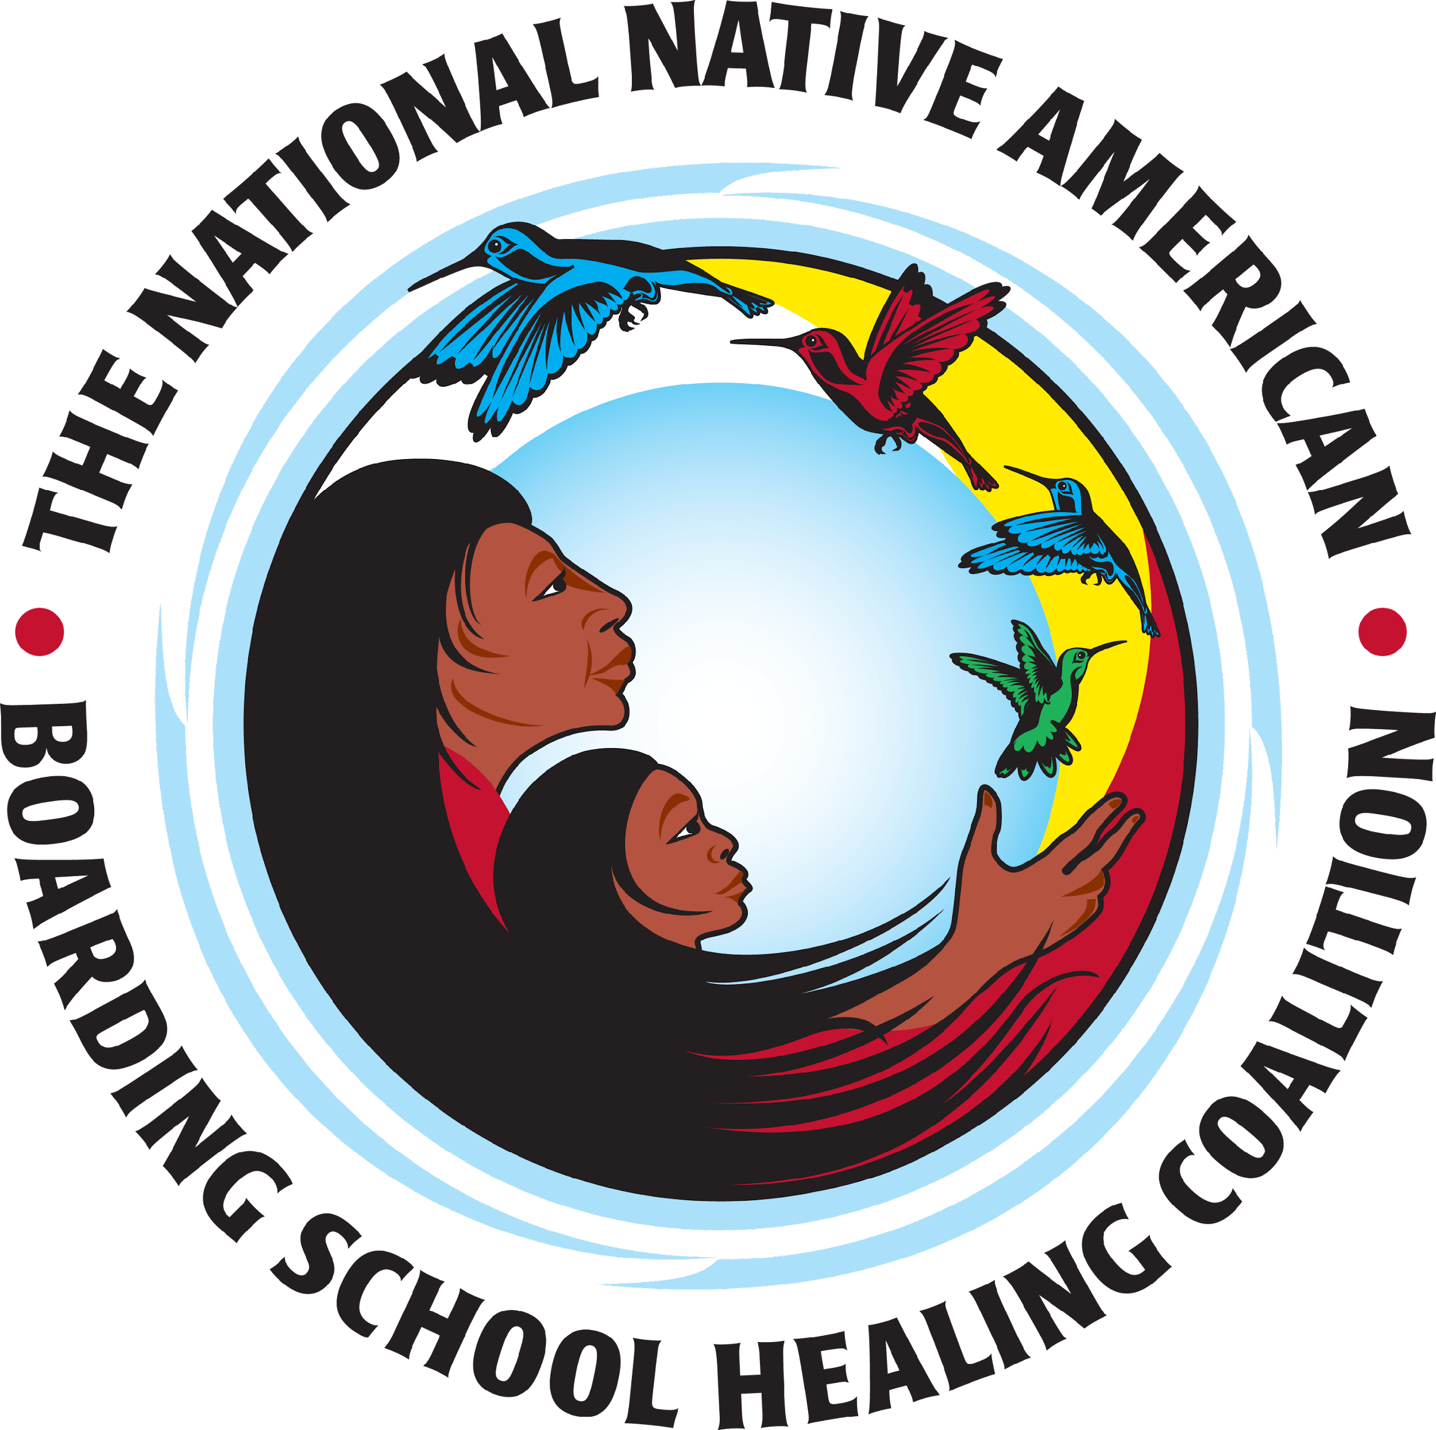
Doctrine of Discovery & Manifest Destiny
Notes:
The Doctrine of Discovery laid the groundwork for racism in America, which for Native American and Alaska Native peoples manifested in genocide, literal and cultural, and loss of land through forced removal and coercion.
The Doctrine was made up of three documents that provided sanction and justification for the invasion and colonization of land inhabited by non-Christians. One of the lasting legacies of this doctrine is the legal and cultural belief that indigenous people do not have the right to our own cultures, lands, practices, and even how we raise our own children. (Francis Gardiner Davenport, European Treaties bearing on the History of the United States and its Dependencies to 1648)

Slide 10
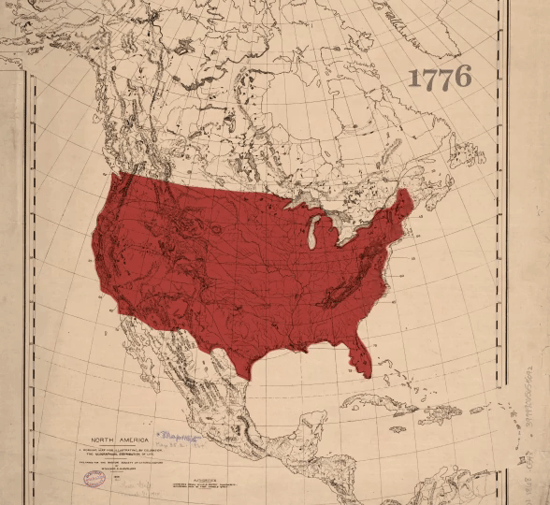
Federal Policy: Stripping of Rights and Assets
Contact (1492)
Invasion/Removal (1637-1851)
Reservations/Indian Wars (1851-1887)
Assimilation (1868-1934)
Reorganization/Termination/Relocation/ Changes in Boarding Schools (1934-1975)
Self Determination (1975-Present)
Graphic from: Vox – “How the US stole thousands of Native American children”
Notes:
Six Phases of Historical Unresolved Grief
Contact
1492—Columbus
1493—Doctrine of Discovery
Invasion/War (1637-1851)
1637—Pequot War, first major armed conflict between settler and Natives in New England
1646—John Eliot preaches first sermon, beginning of comprehensive missionary program in New England
1774-1871—Tribes sign over 370 treaties
1819—Indian Civilization Act Fund ($$ to support religious groups teaching among Indians)
1824—Creation of BIA (administers funds to churches)
1830—Indian Removal Act
1838—Trail of Tears
Reservations/Indian Wars (1851-1887)
1851—Indian Appropriations Act, creation of reservations
1868—Grant’s Peace Policy
1871—End of Treaty-Making between U.S. federal government and Indian tribes
1887—General Allotment Act
Assimilation (1869-1934)
1879—Carlisle Indian Industrial School opens, the first federal Indian boarding school
1924—Native Americans become U.S. citizens
1928—Merriam Report (cites malnourishment, poor living conditions, corporal punishment in boarding schools)
Reorganization, Termination, Relocation, Changes in Boarding Schools (1934-1975)
1934—Indian Reorganization Act
1940s-1960s—Termination
1956—Indian Relocation Act
1960s-1980s—BIA starts to close boarding schools and turn them over to BIE and Tribes
1969—U.S. Indian Education Senate report
1972—Survival Schools and American Indian Movement
1972—Indian Education Act
Self-Determination (1975-Present)
1975—Indian Self-Determination and Education Assistance Act
1978—American Indian Religious Freedom Act
1988—Indian Gaming Regulatory Act
1990—Language Revitalization Act
1990—Native American Graves Protection and Repatriation Act and Indian Arts and Craft Act
2001—No Child Left Behind Act
2006—Esther Martinez Native American Language Preservation Act

Slide 11
U.S. Policy—Education for Assimilation
Indian Civilization Fund Act of March 3, 1819
"civilization” was stripping of traditions and customs to transform Indians into Christian farmers or laborers
The Bureau of Indian Affairs (BIA)
Created within the Department of War primarily to administer the moneys from the Civilization Fund
Grant’s Peace Policy 1868-1881
To replace corrupt Indian Agents “Indian Ring” and replace them with Christian missionaries
3 Mar. 1819
1824
1868–1881
Notes:
Beginning with the Indian Civilization Act Fund of March 3, 1819⁽¹⁾ the U.S., in concert with and at the urging of several Christian denominations, adopted a boarding school policy expressly intended to implement cultural genocide through the removal and reprogramming of American Indian and Alaska Native children.
This policy was further enacted through the creation of the Bureau of Indian Affairs (BIA) in 1824 (created within the Department of War primarily to administer the funds to the churches from the Civilization Fund)⁽²⁾
And through Grant’s Peace Policy 1868-1881—which replaced corrupt Indian Agents “Indian Ring” and replace them with Christian missionaries.

Slide 12
Timeline of U.S. Indian Policy—Layers of Historical Trauma
Notes:
The stated purpose of the U.S. Indian Boarding School policy was to destroy Indian culture by using education as weapon. General Richard Henry Pratt said:
"A great general has said that the only good Indian is a dead one, and that high sanction of his destruction has been an enormous factor in promoting Indian massacres. In a sense, I agree with the sentiment, but only in this: that all the Indian there is in the race should be dead. Kill the Indian in him, and save the man.“

Slide 13
Structural Colonialism and Epistemological Colonialism
“Invasion is a structure, not an event” (Patrick Wolfe, 2006)
Impacts of Structural Colonialism
Stolen Land
Stolen Lives
Sovereignty Denied
Impacts of Epistemological Colonialism
Language, Culture, and Knowledge Denied and Punished
Delegitimization of Indigenous ways of living, knowing, and being
Indigenous Erasure
US Exceptionalism
Manifest Destiny
Doctrine of Discovery
Notes:
IT is not that something unjust happened and that atonement must be made, it is that an entire system has been assembled, maintained, and protected—which some folks benefit from and others continue to be cast to the margins with. This includes tokenized surface level justice frameworks
The lack of societal understanding of Indian Boarding Schools in American society/Western societies:
Systemic, widespread, intentional
Disrupts the origin narratives/origin myths of US exceptionalism, stemming from Manifest Destiny, stemming from the Doctrine of Discovery
Doctrine of Discovery: The Papal Bull that authorized the theft of land from non-Christian people that has, as recently as 2005 in the decision City of Sherrill v. Oneida Indian Nation of New York.

Slide 14
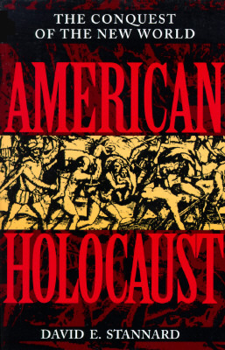
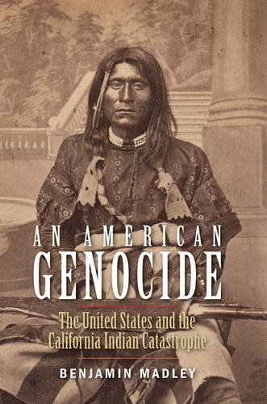
A Human Rights Issue: Cultural Genocide = Genocide
Article 8, UN Declaration on the Rights of Indigenous Peoples (UNDRIP)
“Indigenous peoples and individuals have the right not to be subjected to forced assimilation or destruction of their culture”
American Holocaust: The Conquest of the New World
An American Genocide: The United States and the California Indian Catastrophe
Notes:
Adopted by the General Assembly on Thursday, 13 September 2007, by a majority of 144 states in favour, 4 votes against (Australia, Canada, New Zealand and the United States (Wikipedia)
On 16 December 2010, President Obama declared that the United States was endorsing the Declaration.
Article 14 UNDRIP: Indigenous peoples have the right to establish and control their educational systems and institutions providing education in their own languages, in a manner appropriate to their cultural methods of teaching and learning
In the view of the United States government, the Declaration advances "a new and distinct international concept of self-determination specific to indigenous peoples," which is not the same as the existing concept in international law.^{[44]} The statement also interprets free, prior, and informed consent, "which the United States understands to call for a process of meaningful consultation with tribal leaders, but not necessarily the agreement of those leaders, before the actions addressed in those consultations are taken."^{[44]}

Slide 15
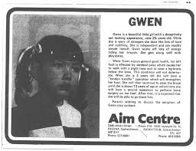
Indian Boarding Schools: The First U.S. Indian Child Welfare Policy
The problem is systemic
1958, as the Indian Boarding Schools were starting to wane, the Bureau of Indian Affairs (BIA) created the Indian Adoption Project.
Both the U.S. Indian Boarding School and the Indian Adoption Policies were intentionally designed to force assimilation and eradicate Native cultures and family systems.
By the 1960s about one in four Native children were living apart from their families. During this era, social workers found more dubious ways of taking children from their mothers.
Indian Child Welfare Act (ICWA) 1978
Native children are still placed at higher rates per capita than any other ethnic group and these placements often still lead to adoption with non-Native families despite ICWA.
Notes:
Indian Adoption Project: Created by BIA for the purpose of forcibly assimilating Native cultures and family systems.
The Project enlisted social workers to visit reservations and convince parents to sign away their parental rights
Connection to boarding schools: these policies fit within a long legacy of attempting to assimilate Native children by removing them from their homes.
It was based in the same assumption “that Indian families did not have a religion and a spiritual belief system or a family system.” –Sandy White Hawk
The idea that white, Christian families and people were superior to non-white Christian families and peoples led to abusive environments in these adoptive homes.
In spite of ICWA, the struggle continues. Native children are placed in foster care at higher rates per capita than any other group, effectively removing them form our communities.
Nationwide AI/AN children are overrepresented in state foster care at a rate 2.6 times greater than their proportion in the general population.

Slide 16
This first of its kind study, Child Removal in Native Communities: An Anonymous Survey, aims to learn more about:
The correlation between Indian boarding schools, adoption, and foster care in later generations,
The intergenerational impacts of child removal on behavioral, mental, and physical health, as well as parenting and child welfare, and
How American Indian and Alaskan Native people are healing from historical and intergenerational trauma related to child removal.
If you are a boarding school survivor, have boarding school history in your family, or have you ever been adopted or placed in foster care, we need your help! You can take the survey now at: z.umn.edu/child-removal-study
Notes:
The National Native American Boarding School Healing Coalition, First Nations Repatriation Institute, and the University of Minnesota are conducting an anonymous survey to learn more about American Indian and Alaskan Native experiences and impacts of child removal related to the United States’ federal Indian boarding school policy.
The trauma of family and community separation as well as the violently assimilative strategies of boarding schools and adoption affected hundreds of thousands of children, their families, and their communities so deeply that the effects of trauma can be seen intergenerationally.

Slide 17
Grounded in ceremony
In honor of those who are answering this survey the research team had a pipe ceremony to ask for guidance and healing. Our intent is to honor these experiences in a way that will benefit boarding school survivors, their families and those yet to come.
Notes:
We recognize the impact of hearing experiences of our elders will be sadness. We asked for protection and guidance.

Slide 18
769 Respondents to Date

Slide 19
How often have you felt or experienced any of the following regarding the history of boarding schools, child removal, or adoption/foster care within Native communities?

Slide 20
Mental Health Impacts
Nearly half of respondents reported being diagnosed with a mental health condition
77% reported struggling with depression
Approx. 1/3 of respondents reported symptoms of PTSD
75% of respondents reported having attempted suicide

Slide 21
Parenting
12% reported their children placed in foster care or adopted out
87% believed their experience affected their parenting

Slide 22
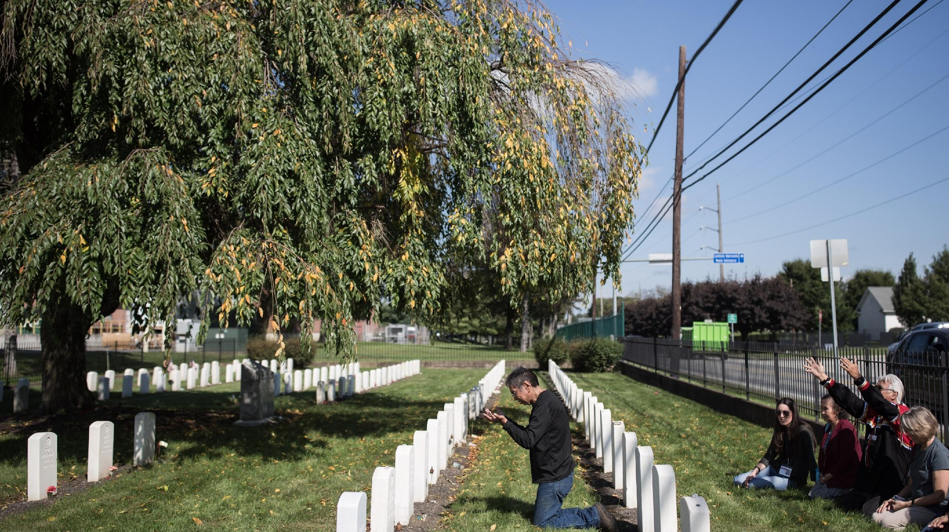
Healing
81% of respondents believe they need to heal from their experiences
73% have sought therapy or counseling

Slide 23
2014 White House Report on Native Youth
Finds major disparities in health, education, as well as a state of emergency regarding Native youth suicide and PTSD rates three times the general public—the same rate as Iraqi war veterans.
More than one in three American Indian and Alaska Native children live in poverty
The American Indian/Alaskan Native high school graduation rate is 67 percent, the lowest of any racial/ethnic demographic group across all schools. And the most recent Department of Education data indicate that the Bureau of Indian Education (BIE) schools fare even worse, with a graduation rate of 53 percent, compared to a national average of 80 percent.
Suicide is the second leading cause of death—2.5 times the national rate—for Native youth in the 15 to 24 year old age group.

Slide 24
Intergenerational Trauma

Slide 25
Historical Trauma
Dr. Maria Yellow Horse Brave Heart, describes historical trauma as:
“…the cumulative emotional and psychological wounding over one’s lifetime and from generation to generation following loss of lives, land and vital aspects of culture.”
–Brave Heart, M.Y.H., & DeBruyn, L.M. (1998). The American Indian holocaust: Healing historical unresolved grief. American Indian and Alaska Native Mental Health Research, 8(2), 60-82.

Slide 26
The Legacy of Boarding Schools: Intergenerational Trauma
EPIGENETICS
Study finds trauma effects may linger in body chemistry of next generation:
“children of Holocaust survivors…could be more likely to develop stress or anxiety disorders.”
Study by RACHEL YEHUDA,
ICAHN SCHOOL OF MEDICINE AT MT. SINAI
Notes:
Epigenists are beginning to uncover evidence that intergenerational trauma is real and historical trauma contributes to the development of illnesses such at PTSD, depression and type 2 diabetes, high rates of addiction, suicide, mental illness, sexual violence may in part be influenced by historical trauma.
Trauma leaves mark on DNA of some victims: Gene-environment interaction causes lifelong dysregulation of stress hormones. --Max-Planck-Gesellschaft
Dr. Yehuda director of Mont Sinai’s traumatic stress studies division noticed an ‘epigenetic change, a chemical changed in a marker attached to the gene itself. In the Holocaust survivor, it suggests that here has been an adaptation or response to a horrendous environmental event, in the second generation it suggests that here has also been a response of the offspring to this parental trauma. Which means children of Holocaust survivors could be more likely to develop stress or anxiety disorders.
DNA is passed from parent to children, her research suggests parental life experiences can modify their body chemistry and those modifications can be transmitted to children as well.

Slide 27
Healing Historical Trauma Today
Notes:
Switch over to Elicia’s Presentation

Slide 28
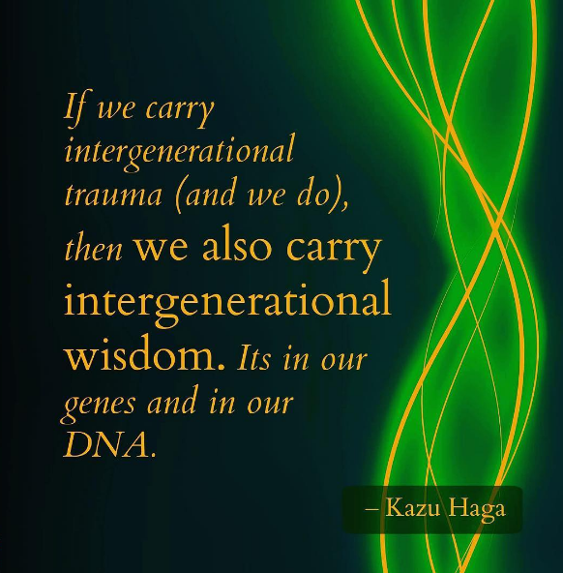
Transcending Historical Trauma
Dr. Brave Heart talks about the process of moving forward from historical grief:
Confront the historical trauma
Understand the trauma
Release the pain
Transcend the trauma
http://discoveringourstory.wisdomoftheelders.org/resources/transcending-historical-trauma

Slide 29
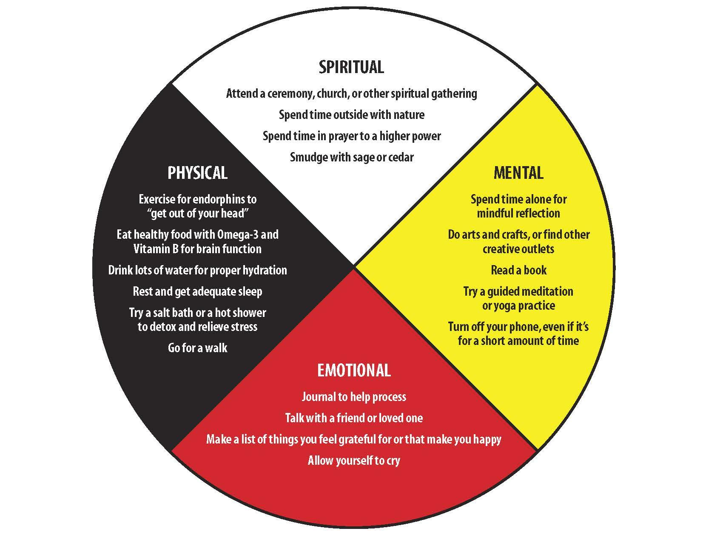
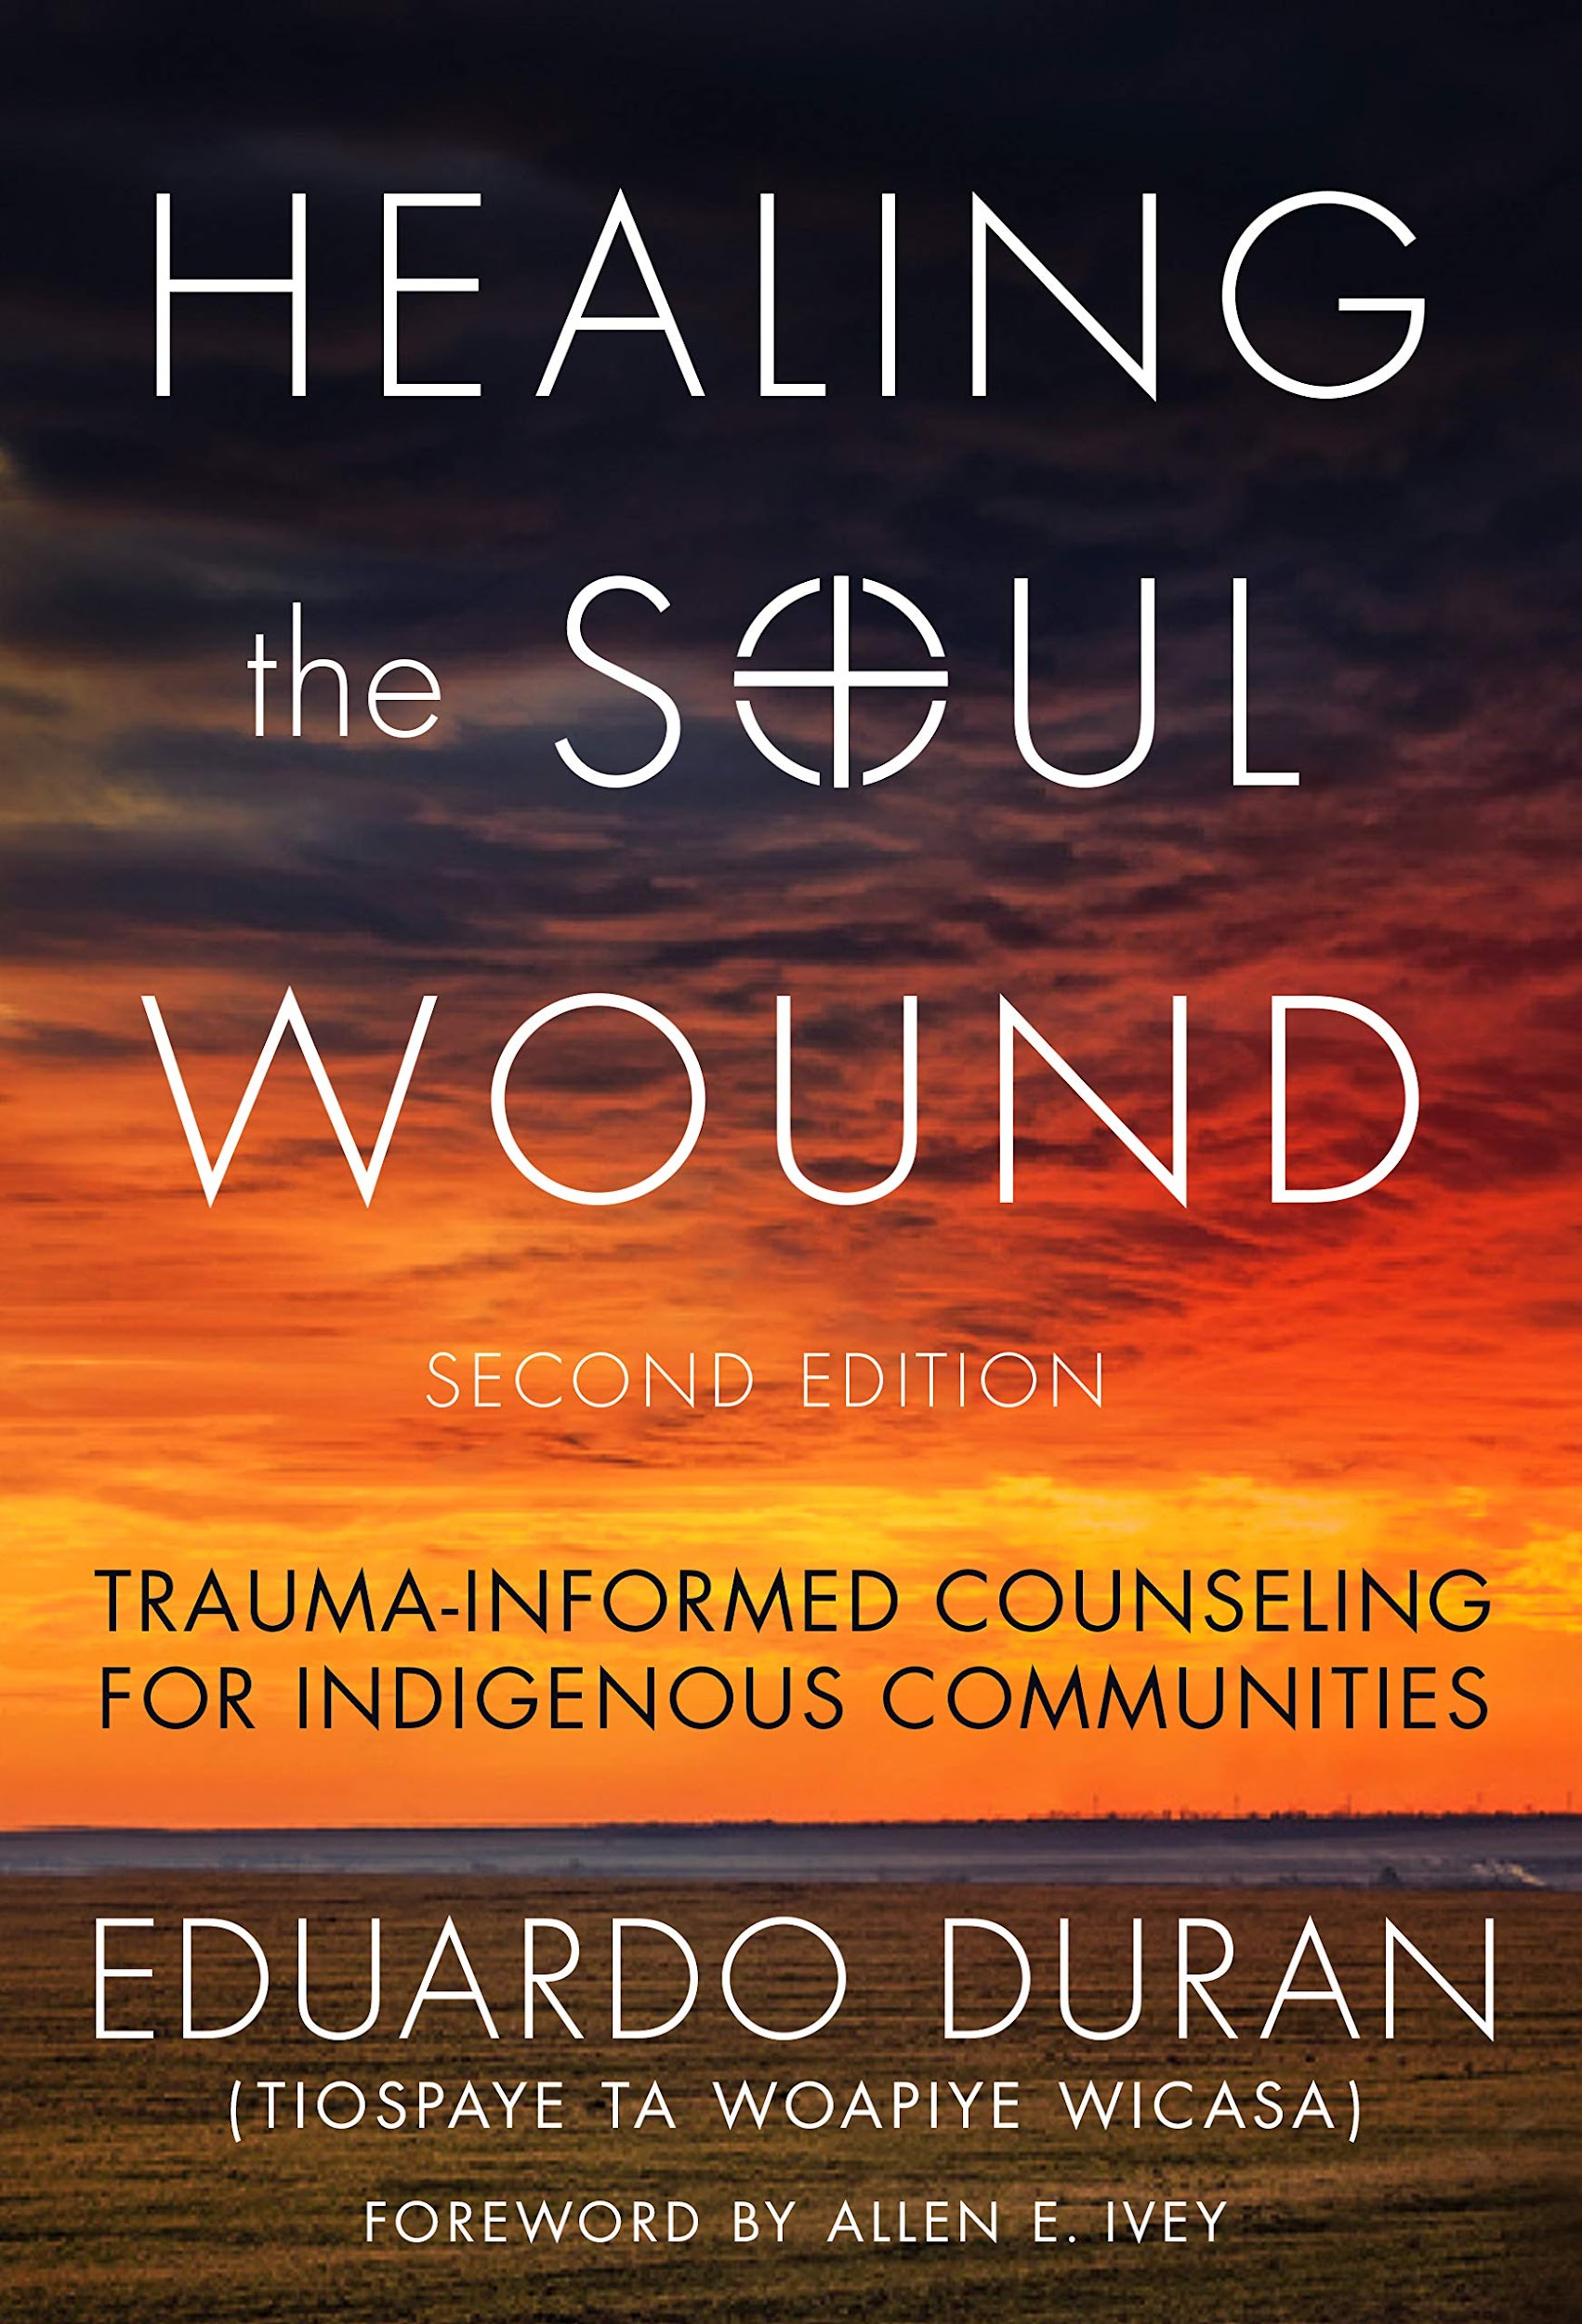
Balanced Self-Care
boardingschoolhealing.org/self-care-resources/
Four Steps for Working Through Trauma
Learn Self-Regulation
Take Steps Toward Self-Empowerment
Learn to Express Your Experience
Integrate the Senses Through Rhythm & Movement
Adapted from Bessel van der Kolk, MD and Ruth Buczynski, PhD
Source: boardingschoolhealing.org

Slide 30
Healing Modalities
Ceremony, plant medicines, sweat lodge
Songs, prayers, dances
Tapping, EMDR
Holotropic breathwork
Yoga and mind-body connection
Wellbriety/12-steps
Image Source: Healing The Complex Trauma Of Holocaust And Genocide | The Oxford Development Centre

Slide 31
Hope, Healing, Resiliency

Slide 32
DOI Investigation
The primary goals of the investigation:
identify boarding school facilities and sites;
locations of known and possible student burial sites located at or near school facilities; and
identities and Tribal affiliations of children interred at such locations.
Identification and collection of records and information related to the Department’s oversight and implementation of the Indian boarding school program (Program) from 1819 to 1969;
Formal consultations with Tribal Nations, Alaska Native corporations, and Native Hawaiian organizations to clarify the processes and procedures for protecting identified burial sites and associated information; and
Final written report due to the Secretary by April 1, 2022
Notes:
Press Release: https://www.doi.gov/pressreleases/secretary-haaland-announces-federal-indian-boarding-school-initiative
Secretarial Memo: https://www.doi.gov/sites/doi.gov/files/secint-memo-esb46-01914-federal-indian-boarding-school-truth-initiative-2021-06-22-final508-1.pdf

Slide 34
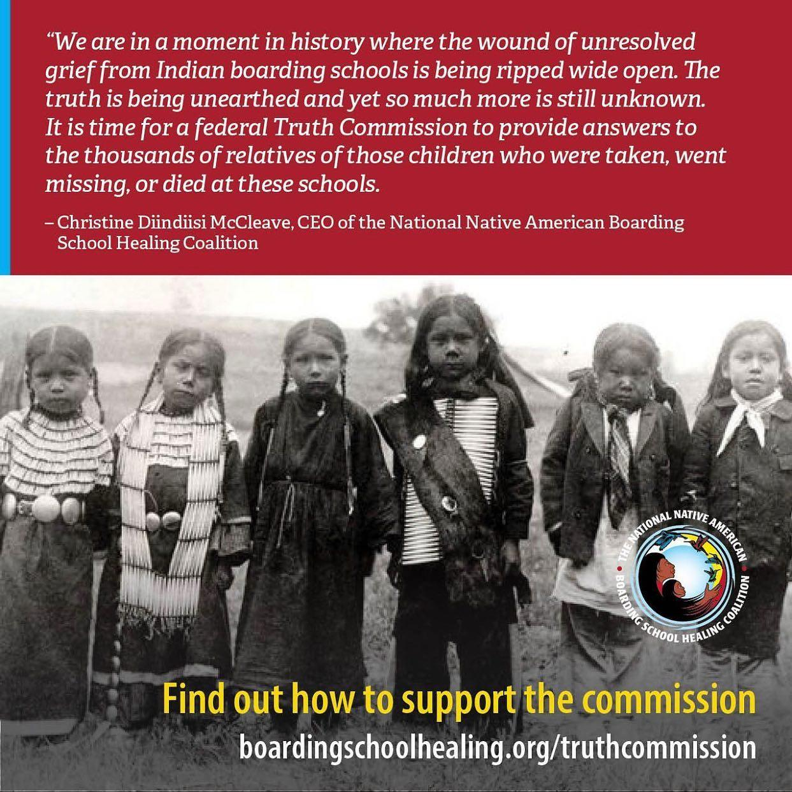
Truth Commission
“It’s taken a long time to be able to share our stories and we’ve reached a point where the dam of awareness is bursting. The time for healing is now.”
- James LaBelle Sr. (Inupiaq), Boarding School Survivor
5-year commission
Examines the location of children
Documents ongoing impacts from boarding schools
Locates church and government records
Holds culturally-appropriate public hearings to collect testimony from survivors and descendants.
Institutional knowledge gathering from subject matter experts
Shares findings publicly
Provides a final report with a list of recommendations for justice and healing

Slide 35
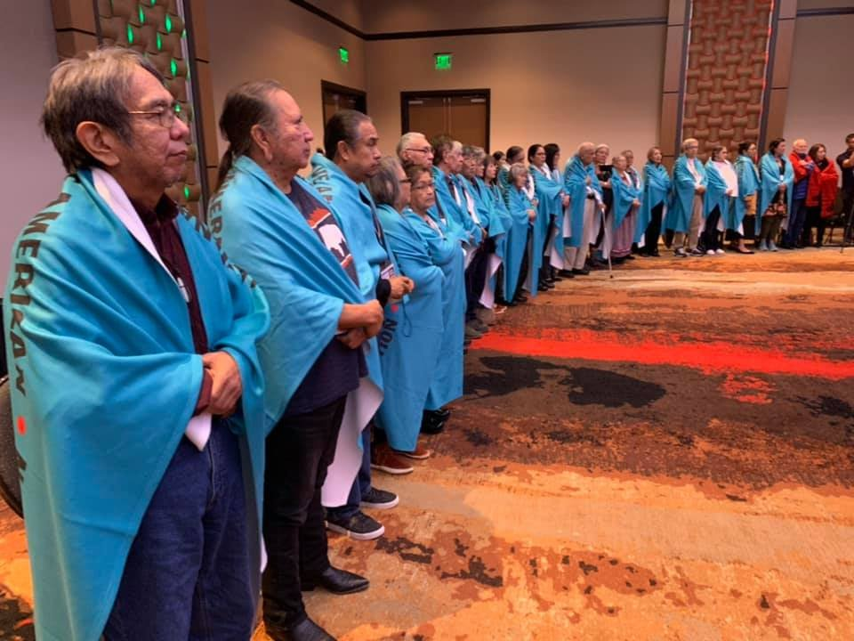
Call to Action! Here’s how you can help:
Resolutions: Work on having your Tribal Nation, organization, city, or other legislative bodies pass a resolution in support of a Truth and Healing Commission on Indian Boarding Schools. If you are interested in templates for a resolution, please email us at info@nabshc.org.
Political engagement: We encourage you to reach out to your Tribal Council, Senators, Representatives, national, state, and local politicians and speak with them about the history of Indian Boarding Schools, how they have impacted your family, and what you would like to see done on the topic. You can set a meeting with legislators, send emails, or start a letter or phone campaign.
Spread the word: Share posts from @nabshc on Instagram and Twitter. Help build the grassroots movement for #TruthJusticeHealing from Indian boarding schools.
Boarding School Survivors at NABS 2nd Annual Conference

Slide 36
Call to Action: Support Truth, Healing, and Justice in the U.S.
Here’s how you can help:
Join the Coalition (free for individuals)
Sign our Petitions
Make a donation
Sign up for e-news
Follow us on Facebook, Twitter & Instagram
Take Specific Action
For Churches: Help us find the church records
Boarding School Survivors at NABS 2nd Annual Conference

Slide 37
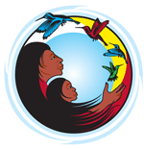
Healing from Boarding Schools
Ultimately, our vision aims to restore the cultural sovereignty that was taken away through boarding schools and that sovereignty includes the right to set the terms of healing and reconciliation.
Tribal Sovereignty: the inherent authority of indigenous tribes to govern themselves
UN Declaration on the Rights of Indigenous Peoples: the right not to be subjected to forced assimilation or destruction of their culture
Data Sovereignty: the right of indigenous peoples and nations to govern the collection, ownership, and application of their own data

Slide 39
Join us in the Truth and Healing Movement!
Follow us and Share!
boardingschoolhealing.org

