Slide 1
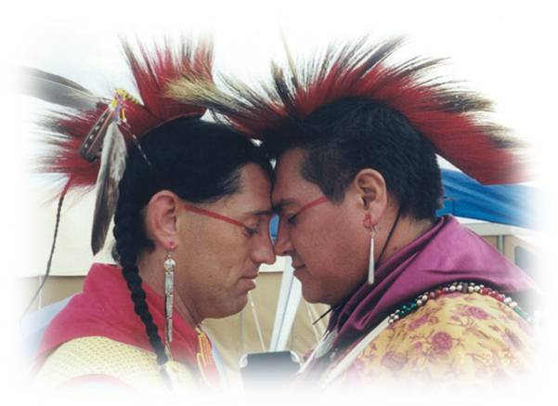
Native LGBTQ+ and Two Spirit Panel
Pascua Yaqui ICWA Training ~ October 13, 2022

Slide 2
Understanding Challenges of our Native LGBT2S Community
Historical Trauma
Bullying
Depression
Violence
Lack of Support Networks – Family/Relatives, Friends, Community, Tribe.

Slide 3
Supportive Recommendations
Acknowledge the history and trauma of Native and Two Spirit LGBTQ people.
Cultural understanding and accountability establishes trust and strengthens relationships.
Recognize the strengths and positive capabilities of Two Spirit LGBTQ populations experiencing disparities – health, cultural, & social.
Educate and promote greater Two Spirit LGBTQ sensitivity of among other providers, advocates and leadership.

Slide 4
Supportive Recommendations
Adapt and tailor curriculums and trainings to be inclusive of Native LGBT2S populations – ex. THRIVE.
Ensure that Native LGBT2S community is included in any policy and action planning.
Identify local tribal and/or regional LGBT or 2S agencies or organizations (ie. Two Spirit Societies)
Provide and collect more comprehensive data and information in reporting and reassess forms to include LGBT2S catagories.

Slide 5
Supportive Strategies
Recognize that Two Spirit people are often especially vulnerable to being targets of violence.
Be honest to the feelings, concerns and wishes with Two Spirit individuals and about the risks that they may place themselves in.
Encourage and support Two Spirit people to share their stories and experiences when they are comfortable in doing so.
Support and/or attend Two Spirit gatherings, picnics, talking circles, etc.

Slide 6
Supportive Strategies
Include Two Spirit people in all aspects of community life and cultural activities.
Assist in finding the local traditional roles that two spirits played or held in your community, prior to European contact.
Speak out against homophobia, transphobia, hate crimes, including jokes against Two Spirit people.
Produce social marketing information relevant to Two Spirit LGBTQ people – language, images, etc.

Slide 7
Building Protective Laws for Our 2S & Native LGBTQ Communities
Many tribal nations have rich histories of acknowledging and including 2S & Native LGBTQ+ in community
Examine your traditional teachings, language, and gender roles
Include 2S and Native LGBTQ+ voices
Seek out resources and organizations focused on 2S work to learn more
Image Credit: Indigenizing Love Toolkit

Slide 8
Address Gaps in Data & Laws
Include 2S and Native LGBTQ+ prompts in data collection
Use anonymous data collection methods
Conduct survey of needs in communities
Review tribal laws and codes for discrimination
Adopt a non-discrimination ordinance and other protective tribal laws, e.g., Tribal Equity Toolkit 2.0
Image Credit: Tribal Equity Toolkit 3.0

Slide 9
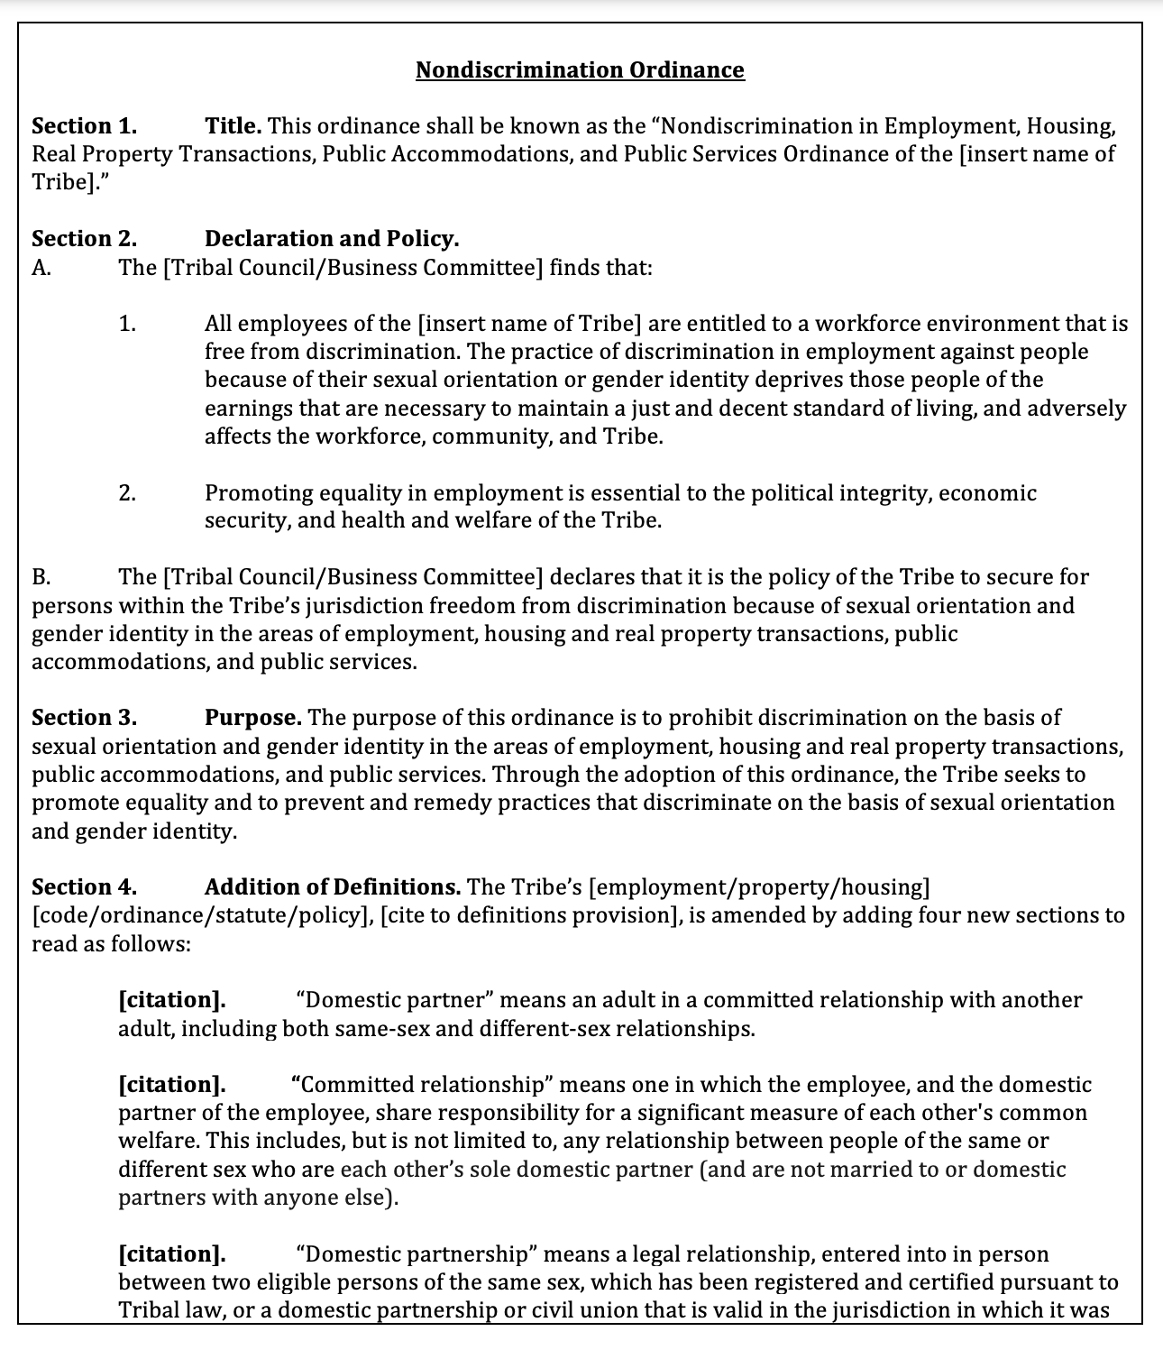
Sample Non-Discrimination Ordinance
Tribal Equity Toolkit 3.0
Sample Non-Discrimination Ordinance for tribal governments to add sexual orientation and gender identity as a protected class to prohibit discrimination in the areas of employment, housing, real property transactions, public accommodations, and public services.
Other sample ordinances:
  Education Equality Ordinance
  End-of-Life Equality Ordinance
  Marriage Equality Ordinance

Slide 10
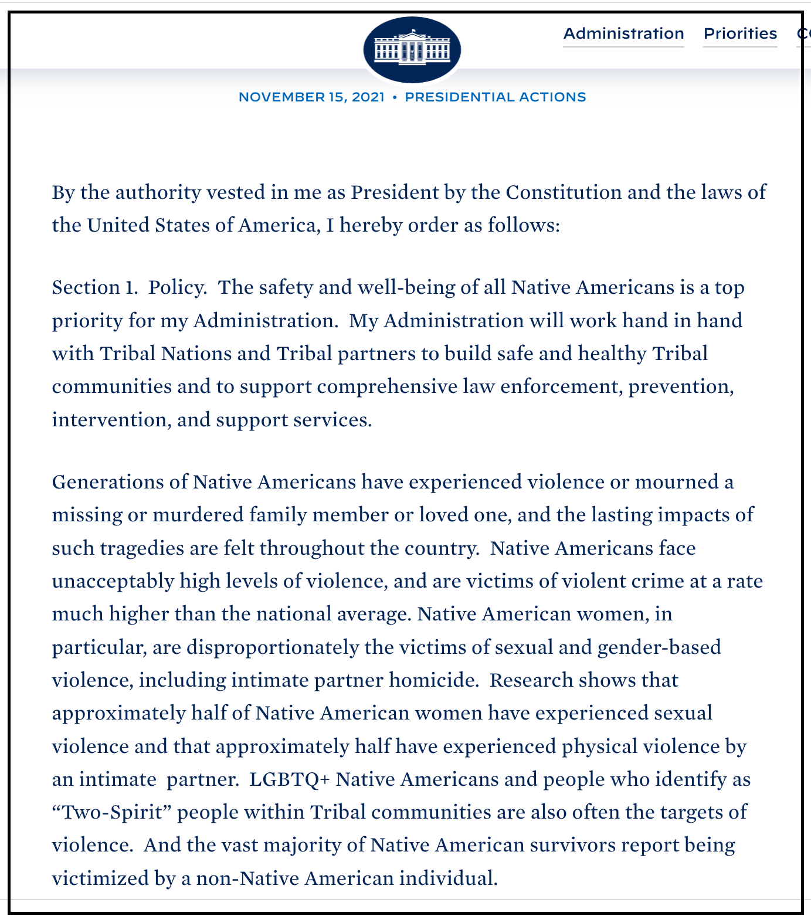
Implement Protective Laws
VAWA Reauthorization Act of 2022
Savannah’s Act of 2019 (Oct. 2020)
Not Invisible Act of 2019 (Oct. 2020)
Biden’s Executive Order on Improving Public Safety and Criminal Justice for Native Americans and Addressing the Crisis of MMIP (Nov. 15, 2021)
Image Credit: Indian Country Today

Slide 11
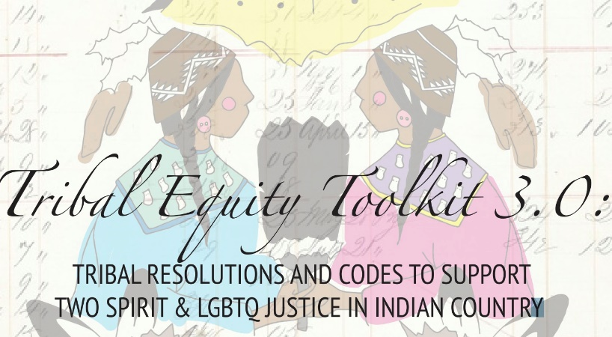
Tribal Equity Toolkit
Tribal Equity Toolkit: Tribal Resolutions and Codes to Support Two Spirit/LGBT Justice in Indian Country
  Bias-Motivated (Hate) Crimes
  Criminal Offenses with Bias Motive
  Prohibiting Specific Actions
  Enhanced Penalties
  Bias-Motivated Crime Reporting and Training
https://www.thetaskforce.org/wp-content/uploads/2014/09/TET3.0.pdf

Slide 12
Physical Space Recommendations
Images and décor that are inclusive (e.g. Safe Zone stickers, Two Spirit or LGBTQ resources or pamphlets, etc.)
Create a gender neutral restroom
Produce marketing information relevant to Two Spirit and LGBTQ people – language, images, etc.
Hire a workforce that is congruent with the population you serve

Slide 13

SAFE Zone Trainings
Safe Zone trainings are opportunities to learn about Two Spirit and LGBTQ identities, gender and sexuality, and examine prejudice, assumptions, and privilege.
People attend Safe Zone trainings for many reasons. One reason is that most Two Spirit and LGBTQ question whether they will feel safe, welcomed, or supported in a new environment. People also attend to explore, for themselves, the concepts of sexuality and gender.
Displaying “Safe Zone” sticker can help an agency communicate to others a commitment to creating an Two Spirit LGBTQ- inclusive space.
Image by Safe Zone Project, retrieved from: https://thesafezoneproject.com on July 25, 2019.

Slide 14
Resources
Center for Native American Youth (CNAY)
  A Report from GLSEN and CNAY, Erasure and Resilience: The Experience of LGBTQ Students of Color (2020), available at: https://www.glsen.org/sites/default/files/2020-03/Erasure-and-Resilience-Native-2020.pdf
  We Are the Future: A Native Youth Narrative (2020), available at: https://live-cnay.pantheonsite.io/wp-content/uploads/2021/06/IFS-Youth-Report.pdf
Western States Center
  Tribal Equity Toolkit 3.0 (2017), available at: https://www.thetaskforce.org/wp-content/uploads/2014/09/TET3.0.pdf
  Indigenizing Love Toolkit (2019), available at https://www.healthynativeyouth.org/wp-content/uploads/2019/09/IndigenizingLoveToolkitYouth.pdf

Slide 15
Resources
National Congress of American Indians Policy Research Center, Research Policy Update: State of Violence Against American Indian and Alaska Native Women and Girls (October 2021).
https://www.ncai.org/policy-research-center/research-data/prc-publications/NCAI_VAWA_Data_Update_2021_FINAL.pdf
Sovereign Bodies Institute and Yurok Tribal Court, Year 2 Progress Report: Missing & Murdered Indigenous Women, Girls & Two-Spirit People of Northern California (July 2021). https://www.sovereignbodies.org/_files/ugd/6b33f7_d7e4c0de2a434f6e9d4b1608a0648495.pdf
Urban Indian Health Institute, Missing and Murdered Indigenous Women & Girls: A snapshot of data from 71 urban cities in the United States (2018). https://www.uihi.org/wp-content/uploads/2018/11/Missing-and-Murdered-Indigenous-Women-and-Girls-Report.pdf

Slide 16
Resources
Transgender Resource Center of New Mexico, “Transgender Cultural Fluency for Lawyers,” available here: https://us06web.zoom.us/rec/play/Su-8-ogk2CiHuxvAhme3vaNDXRPNOtLYGo8n8cRQbHNd-_Ob59jrELqf1hcUkRKmznAnRUaKIpB5TMLc.JQqnMTNO0w9SBn-f.
Delaney Savoie, “LGBTQ+ Awareness: Using Culturally Sensitive Terminology,” Clarity Clinic, September 2021, available here: https://www.claritychi.com/lgbtq-awareness-using-culturally-sensitive-terminology/.
Steven Petrow and Jacki Lyden, “A Modern Guide To LGBT Manners,” NPR, September 2011, available here: https://www.npr.org/2011/09/07/140250573/a-modern-guide-to-lgbt-manners.

Slide 17
Resources - Organizations
National Coalition of Anti-Violence Programs
24-Hour Hotline 212-714-1141 www.avp.org
Suicide Prevention Resource Center, NW Portland Area Indian Health Board www.nwpaihb.org www.sprc.org
National Child Welfare Resource Center for Tribes www.nrc4tribes.org

Slide 18
Resources - Organizations
  Southwest Indigenous Women’s Coalition LGBT Advisory Council www.swiwc.org
  National Indigenous Women’s Resource Center www.niwrc.org
  National Gay and Lesbian Task Force www.thetaskforce.org
  Center for Excellence for Transgender Health, University of California, San Francisco www.transhealth.ucsf.edu

Slide 19
Resources - Reports
Injustice at Every Turn, Executive Summary
www.thetaskforce.org/static_html/downloads/reports/reports/ntds_summary.pdf
US Trans Survey 2015, Executive Summary
www.transequality.org/sites/default/files/docs/usts/USTS-Executive-Summary-Dec17.pdf
AIDS United Consensus Statement
www.aidsunited.org/resources/stepping-up-a-consensus-statement-by-trans-leaders
Office of Victims and Crime
www.ovc.gov/pubs/forge/sexual_numbers.html
www.ovc.gov/pubs/forge/tips_five_keys.html
www.ovc.gov/pubs/forge/printerFriendlyPDF/tips.pdf

Slide 20
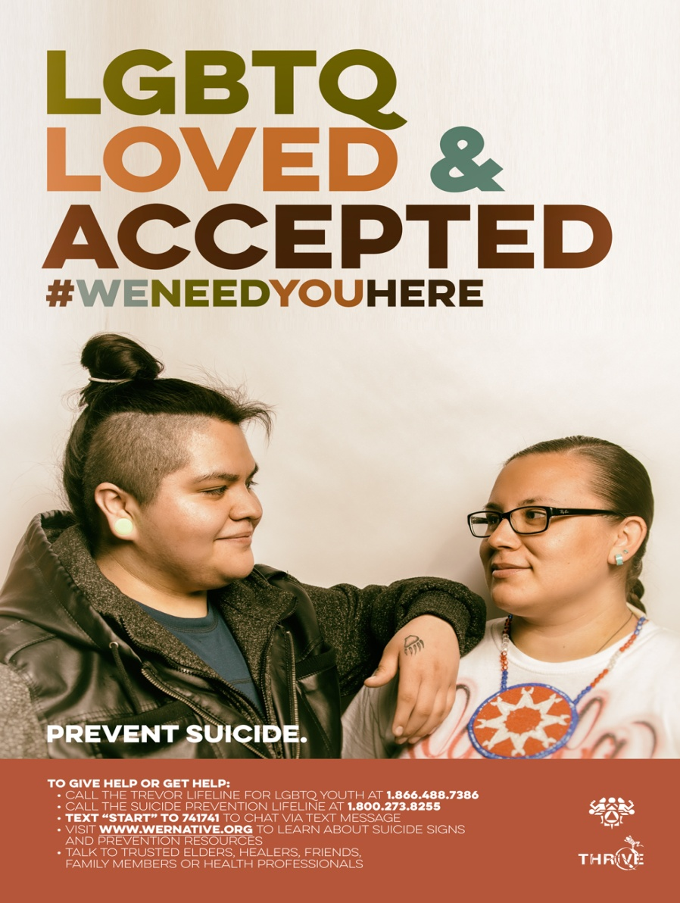
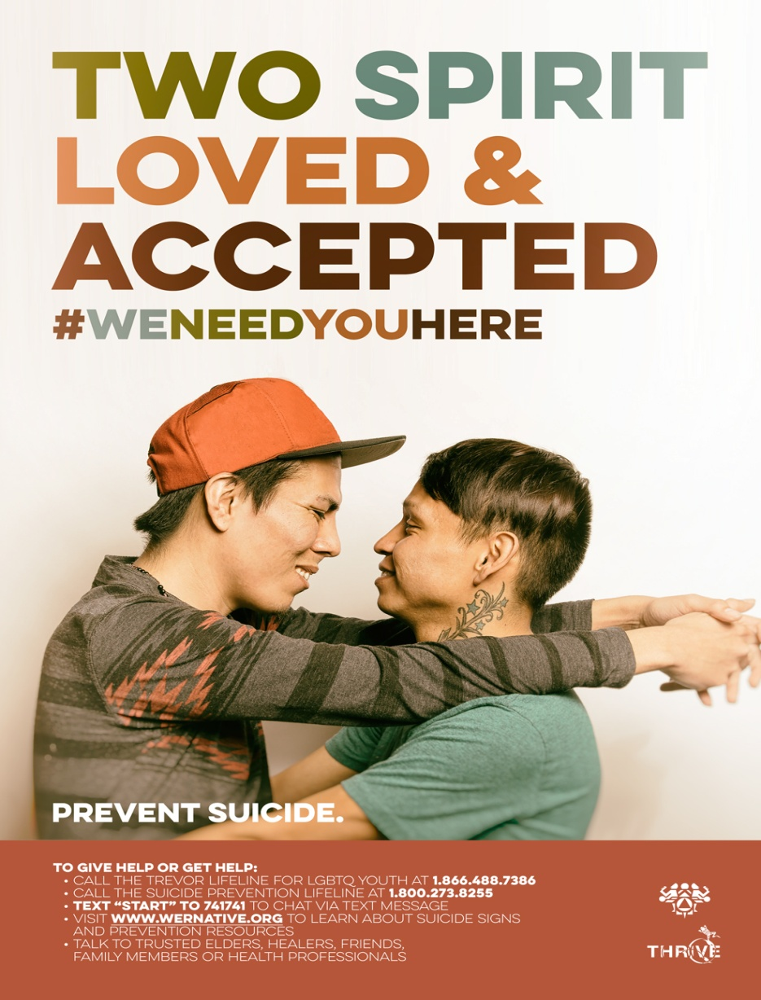
Resources – Social Marketing

Slide 21
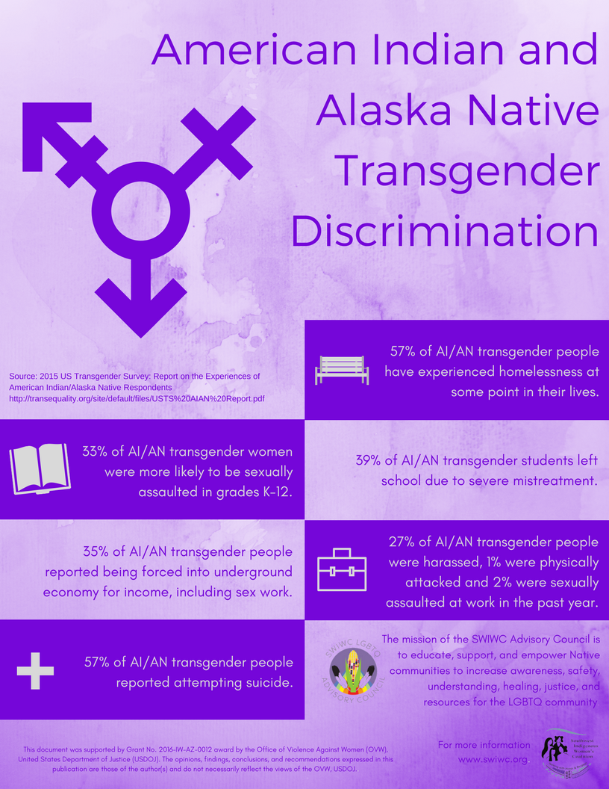
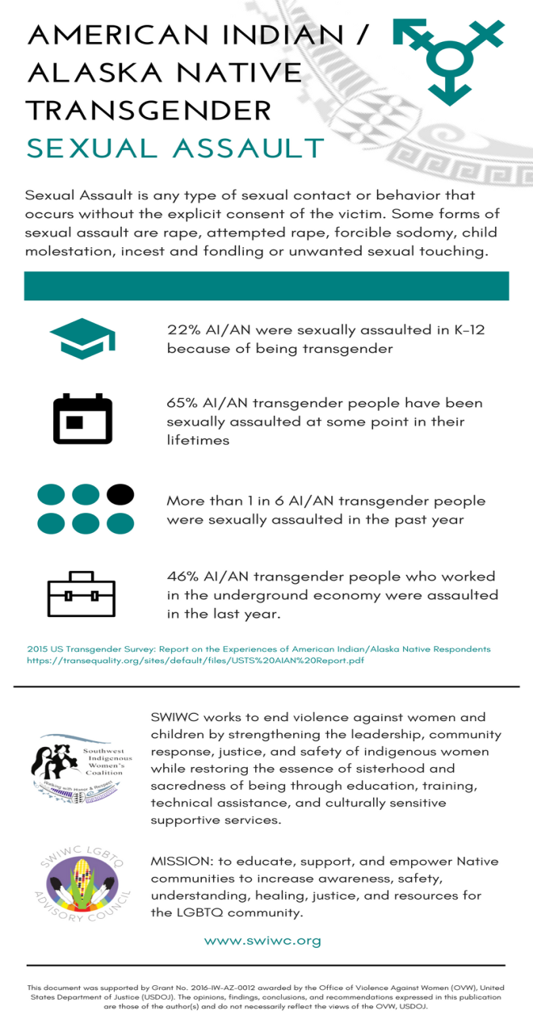
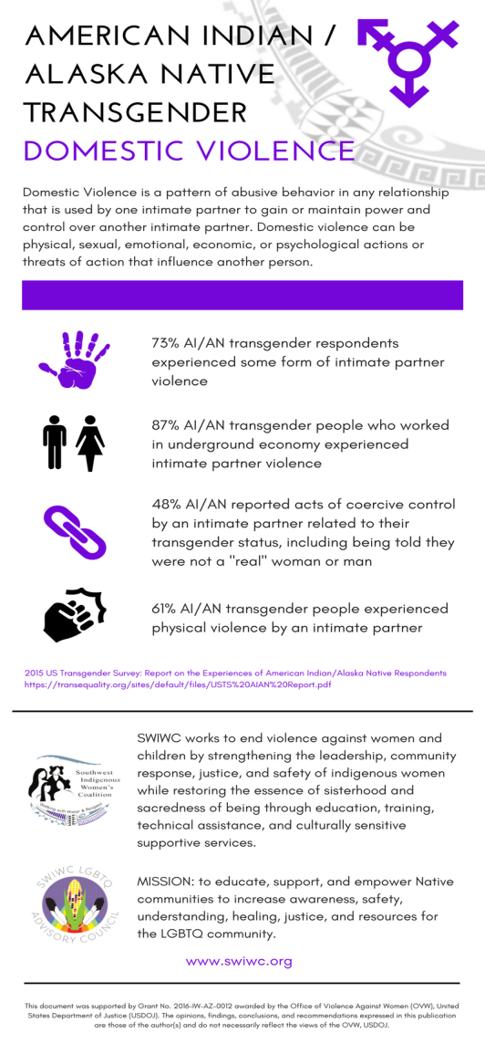
Resources – Native Transgender
www.swiwc.org/fact-sheets

Slide 22
Resources – Two Spirit Organizations
Central Oklahoma Two Spirit Society
Sapulpa Two-Spirit Society
Wichita Two-Spirit Society
Portland's Indigenous Two Spirits
Minnesota Two Spirit Society
Sacramento Valley Two Spirit Society
North Valley Two Spirit Society
Sioux Falls Two-Spirit and Allies
Two Spirit Society of Chicago
Sisseton Wahpeton Oyate Two-Spirited Society & Allies
Northwest Two-Spirit Society
Montana Two-Spirit Society
Bay Area American Indian Two Spirits
Two-Spirit Society of Indian Canyon
East Coast Two Spirit Society
Texas Two Spirit Society
Idaho Two-Spirit Society
City of Angels Two Spirit Society
Indiana Two-Spirit Society

Slide 23
Resources – Two Spirit Organizations
Southeast Two-Spirit Collective
Saginaw Chippewa Indian Tribe Two Spirit/Straight Ally Group
Two Spirit People of the Great Lakes
Salt River L.O.V.E. (Lifting Our Voices for Equality)
HOPE Gila River (Helping O'odham Pursue Equality)
Phoenix Native PFLAG
Okmulgee Two Spirit Society
Dakota/Nakota/Lakota Winte Oyate
Gay Straight Alliance of Dine' College
Indigenous Queer and Two-Spirit Society of New Mexico
Two Spirit Group of Detroit
Cherokee Two-Spirit/Asegi/Nudale (Gay Lesbian Bisexual Trans) Community
We Belong LGBTQ group at Analenisgi
Black Hills Two Spirit Society "Nagi Nupa He Sapa Okolakiciye"
Two Spirit Nation
Southwest Two Spirit Society

Slide 24
QUESTIONS ?

Slide 25

THANK YOU!
Elton Naswood
E: elton.naswood@gmail.com

Slide 26
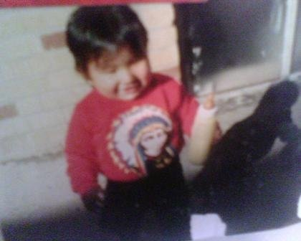
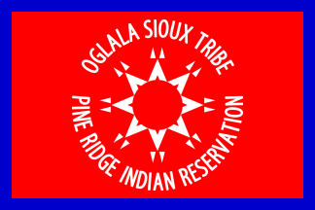
Daryle Conquering Bear Crow
Conquering Bear-Mother
Crow- Father
Oglala, South Dakota,
Pine Ridge Indian Reservation
Lakota Sioux
Nothing About US
WITHOUT US!!

Slide 27
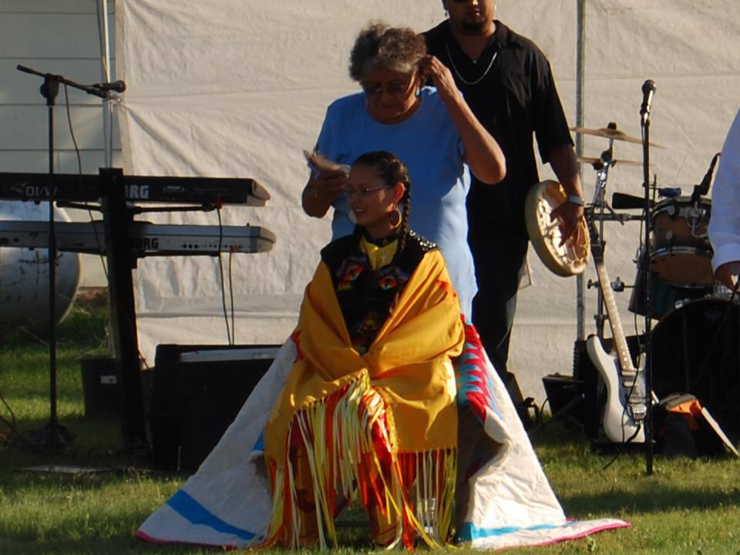
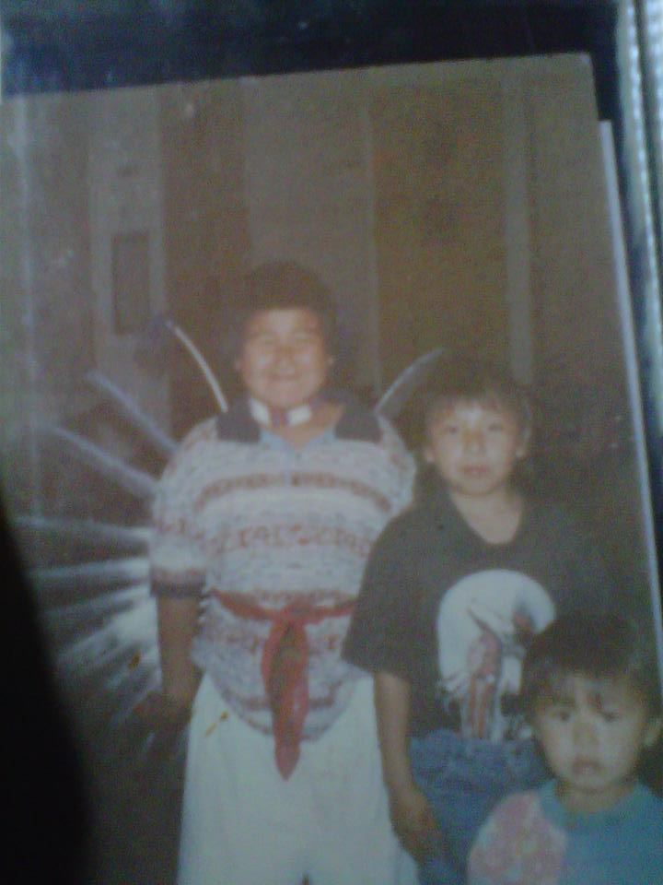
Traditions and Growing up

Slide 28
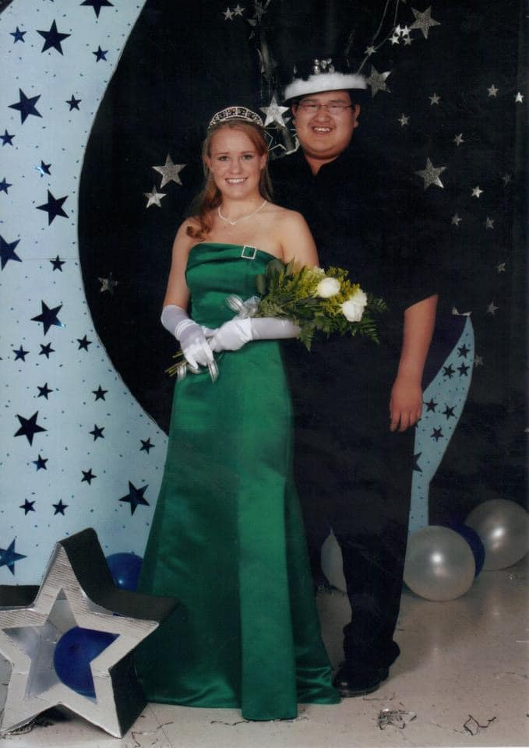
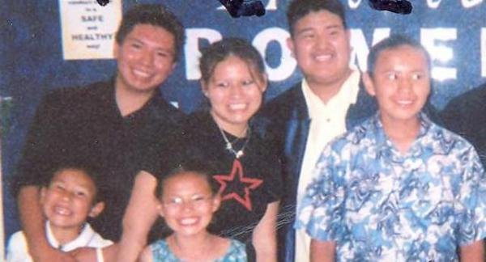
Milestone- High School Graduation

Slide 29
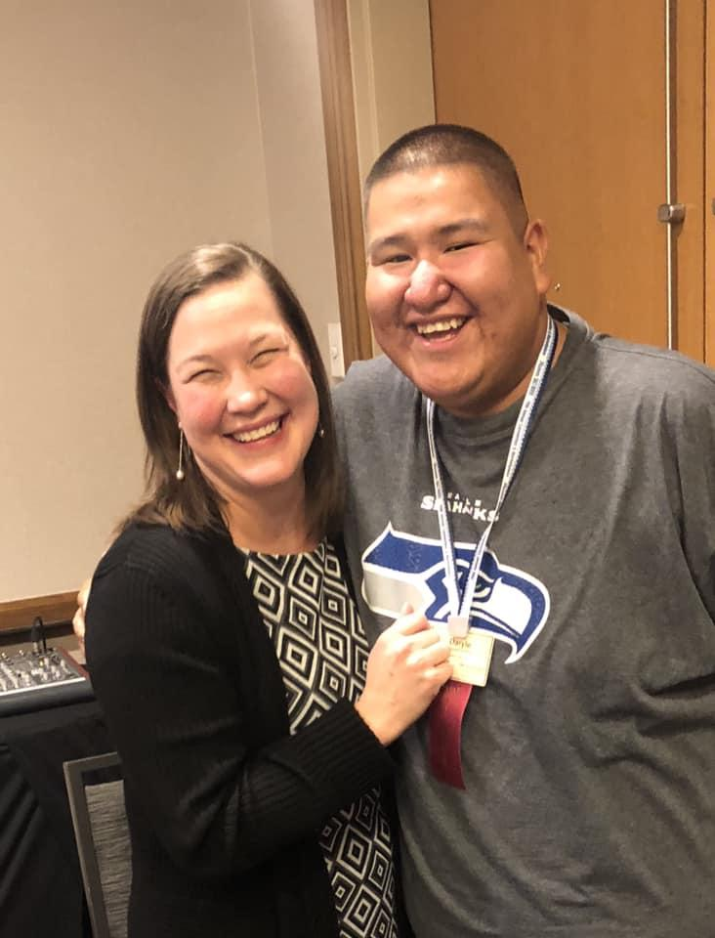
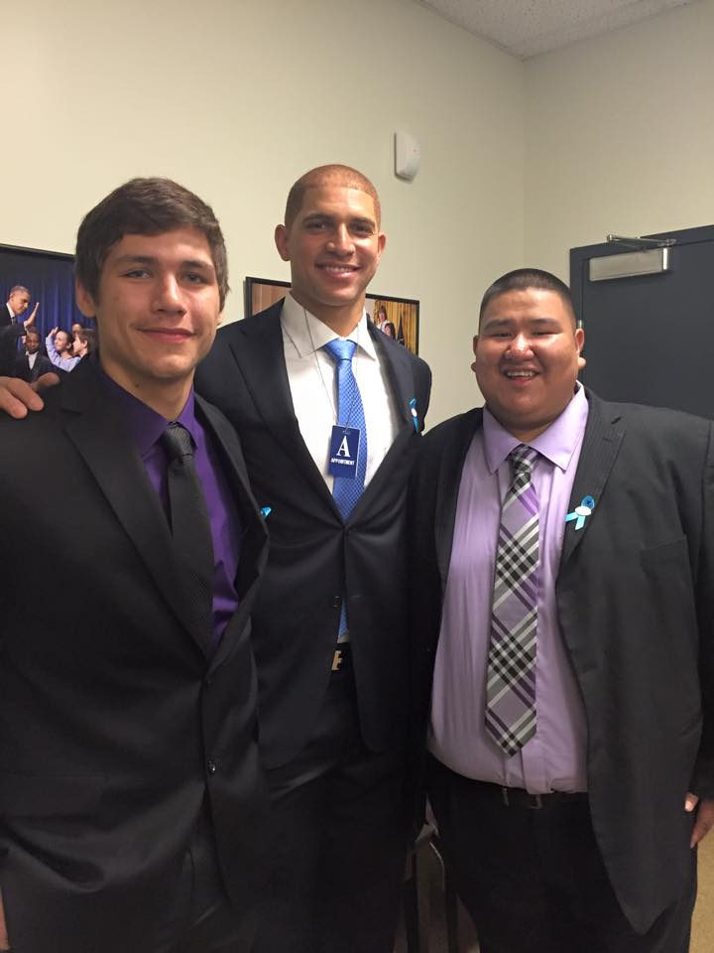
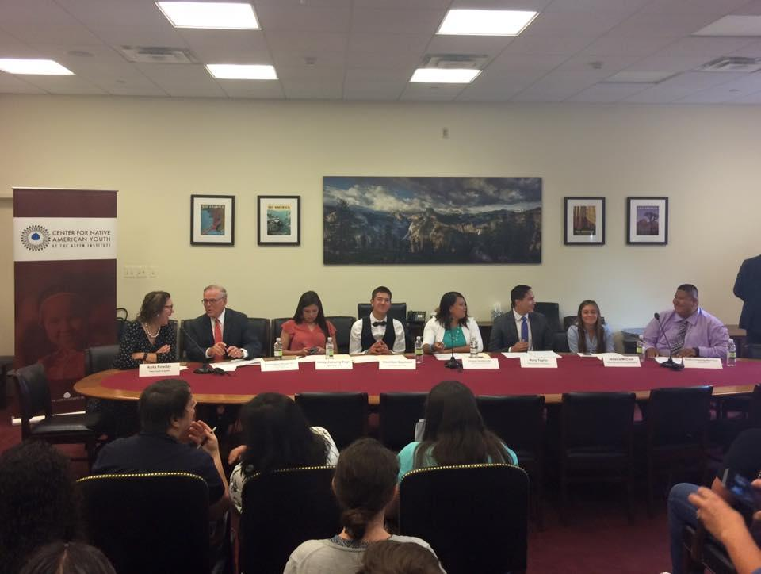
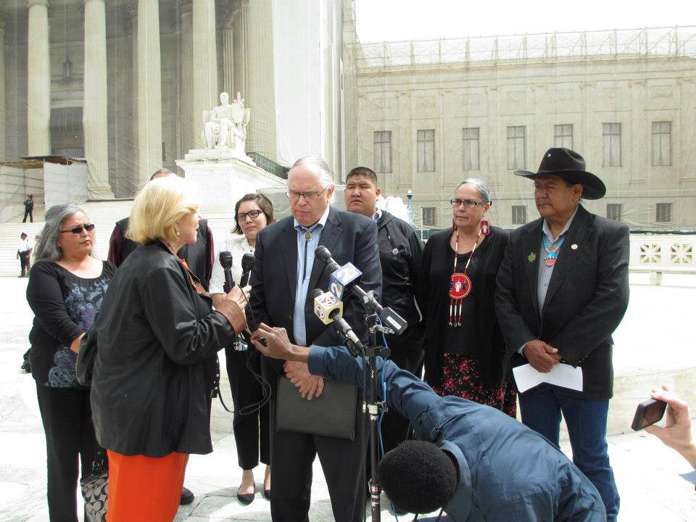
Advocacy

Slide 30
Two Spirit Identity

Slide 31
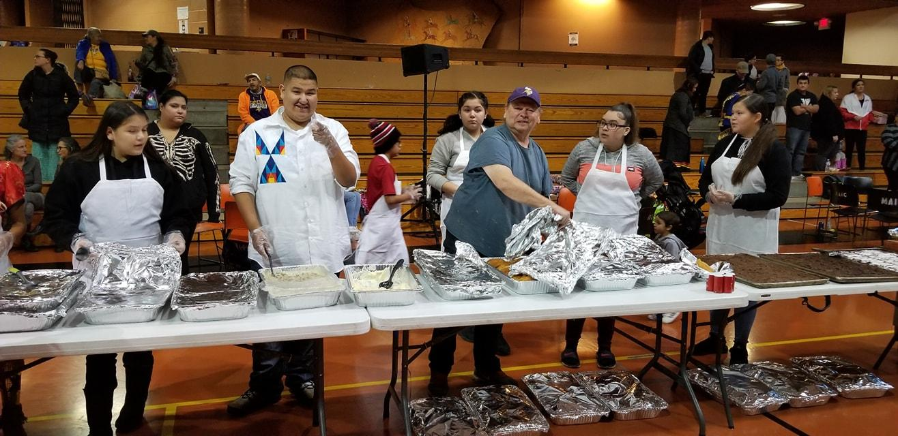
Nothing About US
WITHOUT US!!
Daryle Conquering Bear Crow
daryleconqueringbear@gmail.com

