Slide 1
ICWA as the Gold Standard
Presented as part of the 2022 5th Annual Utteaka Naau Naawak ICWA and Child Welfare Conference Casino del Sol, Tucson, AZ October 12, 2022
Presented by Jack F. Trope, Sr. Director, Indian Child Welfare Program

Slide 2
History of Family Separation and Cultural Suppression

Slide 3
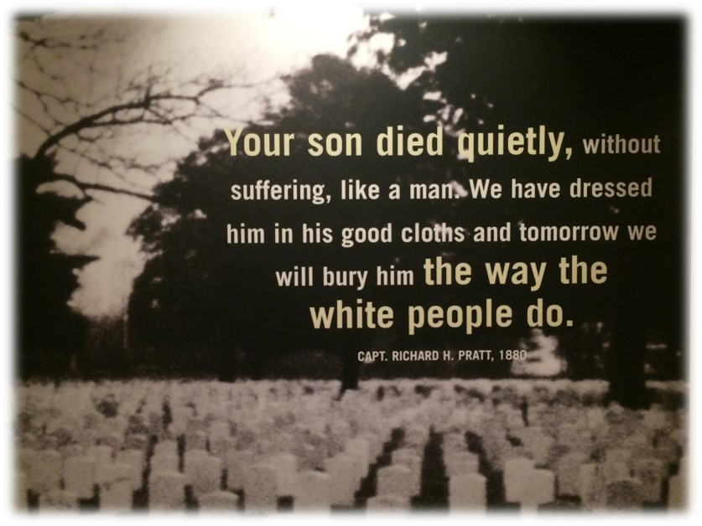
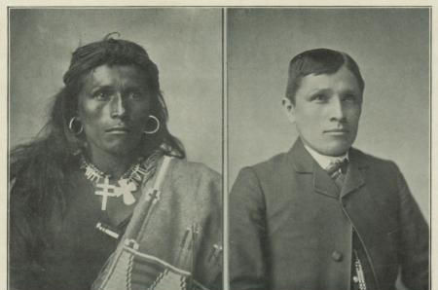
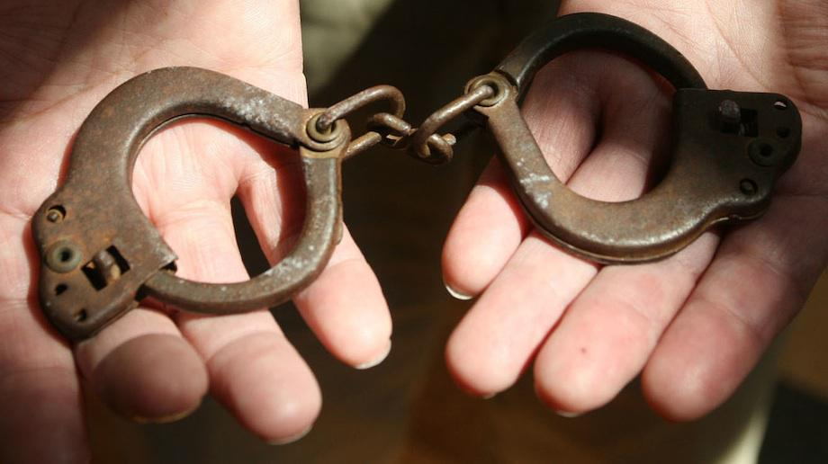
Boarding Schools
Began in the 1880s, continued into the mid-20th Century
-357 known Indian boarding schools
“Kill the Indian, save the man.”

Slide 4
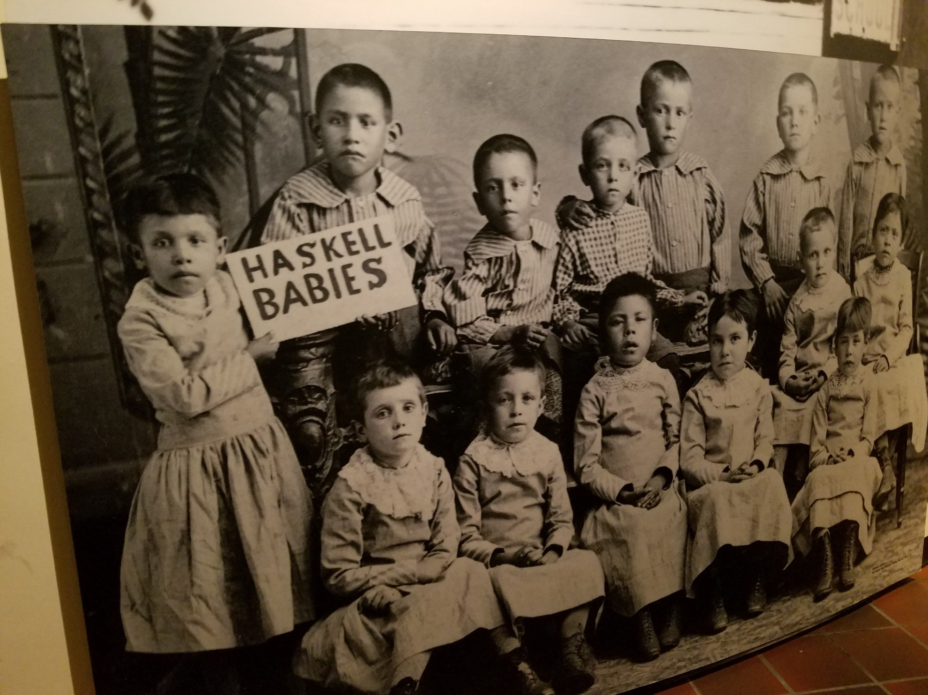
Children were taken away when very young

Slide 5
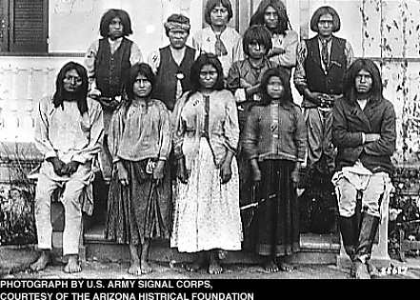
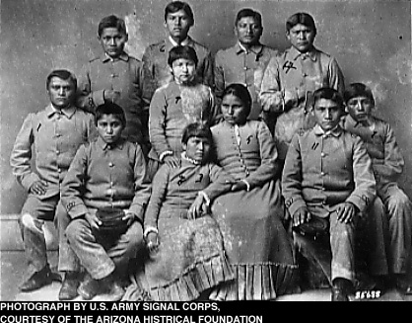
The intent of boarding schools was to strip away Indian identity. Children were punished for speaking their native language, banned from acting in any way representative of traditional or cultural practices, stripped of traditional clothing, hair and all things and behaviors reflective of their culture.

Slide 6
Indian Adoption Project, 1950s-1960s
"No matter how well intentioned and how squarely in the mainstream this was at the time, it was wrong; it was hurtful; and it reflected a kind of bias that surfaces feelings of shame, as we look back with the 20/20 vision of hindsight.“
Shay Bilchik, Executive Director of Child Welfare League of America
"No matter how well intentioned and how squarely in the mainstream this was at the time, it was wrong; it was hurtful; and it reflected a kind of bias that surfaces feelings of shame, as we look back with the 20/20 vision of hindsight.“
Shay Bilchik, Executive Director of Child Welfare League of America, NICWA Conference 2001

Slide 7
Association on American Indian Affairs 1960-70s found:

Slide 8
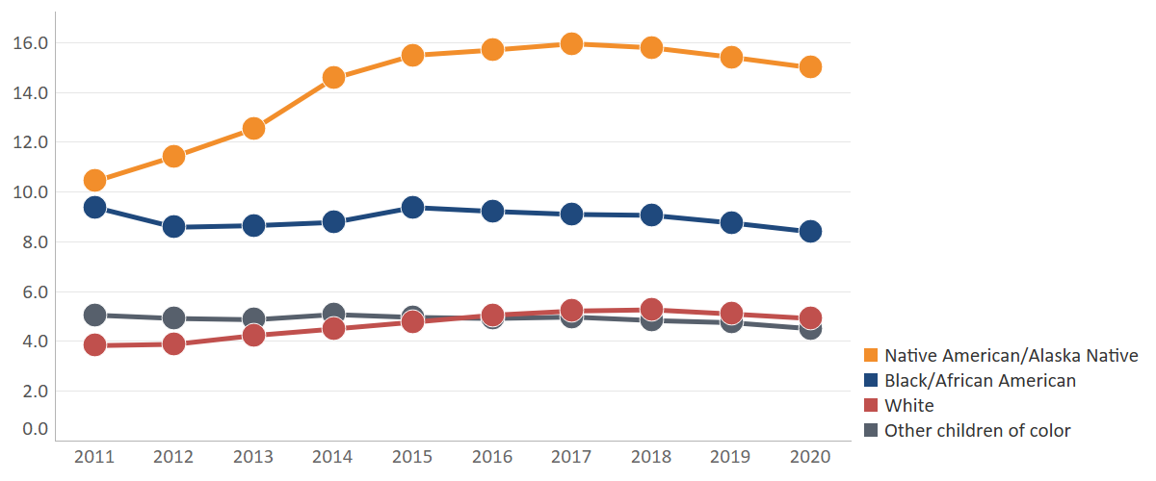
Disparity continues for American Indian/
Alaska Native children in care (per 1,000 children)
In 2020, 57% of American Indian/Alaska Native children in care were placed with non-Native families
Notes:
PUBLIC DATA—Share as you wish
2011-2020
Black/African American children split out
Children < age 18
Race calculation based off primary race (Counts are children identified as Native American/Alaska Native alone)
Source: National AFCARS files obtained from National Data Archive on Child Abuse and Neglect (NDANCA) at Cornell University
Calculation of % placed with non-native families includes children in all placement settings except: trial return home, run-a-way, or supervised independent living situations.

Slide 9
ICWA: Basic Concepts and Philosophy

Slide 10
Indian Child Welfare Act of 1978 (ICWA)
Response to problems identified in state child welfare systems
Act pertains to children in state systems; it does not apply to children under tribal jurisdiction; families who currently live or have a permanent home on the reservation are subject to the Tribal Code, not ICWA
Purpose of Act: to curtail state authority
Adds federal standards to state child welfare law, but does not replace state law except where state law is inconsistent with ICWA

Slide 11
Indian Child Welfare Act of 1978
Key principles of the Act:
Emphasis on protecting the rights of biological parents and extended family as Congress believed that this would advance the best interests of Indian children
Recognizes the importance of maintaining the child’s connections with community and culture
Incorporates and acknowledges pre-existing tribal sovereignty and the important role of tribes in protecting the well-being of tribal children

Slide 12
Indian Child Welfare Act of 1978 –
Rights of parents and extended family (kin)
Some of the most important parental rights are:
Active efforts
Higher legal standard must be met before removal of child or termination of parental rights
Parents can seek transfer to tribal court or veto transfer
Parents can have input into the placement of their children
Extended family
Must be contacted as part of active efforts to keep families together or to reunify families
Are preferred placements if children must be removed for their safety

Slide 13
Indian Child Welfare Act of 1978
Connection with tribal culture and community
Placement preferences (after extended family) – tribal foster homes, tribal families, other Indian families (unless tribe sets its own standards)
Social and cultural standards of the Indian community to be applied
Tribal involvement helps maintain connection with tribal culture and community

Slide 14
Indian Child Welfare Act of 1978
Tribal rights
Right to Notice
Right to Intervene
Right to have case transferred to tribal court (subject to certain exceptions)
Exclusive jurisdiction over children resident and domiciled on the reservation or wards of the tribal court (except for limited circumstances)

Slide 15
ICWA as the Gold Standard

Slide 16

Why the Gold Standard of child welfare?
Community/Culture
Relatives
Families
Active efforts to keep children safely with their families or to reunify them with their families.
Placement Preferences to keep them connected to relatives, identity and culture.
All within a community context (Transfer).
Notes:
Frame work of the gold standard philosophy believes that children are best raised within their family, relatives and communities.

Slide 17

Adjudication: Active Efforts
[25 C.F.R. §§ 23.2 and 120; Guideline B.5]
Affirmative, active, thorough and timely efforts to maintain or reunite a child with his or her family
Involve assisting the parents/Indian custodian through the steps of a case plan and with accessing or developing necessary resources
Should be conducted in partnership with tribe, child, parents, extended family and consistent with tribe’s social/cultural standards
Agency must document that active efforts were provided prior to removal and before TPR and that they were unsuccessful
Active efforts should be provided “at the earliest possible point”

Slide 18
Keeping Families Together
Research and experience confirm that, whenever possible, children’s best interests are served by staying with their families
Removing children is traumatic to both the child and the family
Families who have suffered trauma, often across generations, need to receive services and supports to address their needs (“help the child by helping the family heal, not by separating the child from the family”)

Slide 19
Disposition: Placement Preferences
[25 U.S.C. § 1915]
Placement preferences apply to all foster care, pre-adoptive and adoptive placements.
Foster care placement preferences, absent good cause:
Relative
Tribally-licensed or approved foster home
Indian home licensed by non-Indian entity,
Tribally approved or operated institution
Adoption placement preference, absent good cause:
Relative
Other members of the child’s tribe
Other Indian families
U.S. Supreme Court (in Holyfield) – placement preferences most important substantive requirement placed upon states

Slide 20
Continued Connection to Family and Culture
Pre – ICWA
Mel Tonasket – President, Colville Tribe - There is no such thing on my reservation as an abandoned child because even if you are a one-eighth cousin, if that child is left alone, that’s like your brother or sister, or your son or daughter. It’s been that way since our old people can remember.
Today
The Native Village of Barrow (AK) lñupiat Traditional Government Children’s Code - A child has the right to learn about and preserve his identity throughout his life, including the right to maintain ties to his birth parents, his extended family and his village. A child has the right to learn about and benefit from tribal history, culture, language, spiritual traditions, and philosophy.
Shana King – MHA Nation/Three Affiliated Tribes - Parent Mentor – ICWA Law Center – Native Americans do not have a colonized understanding of family. In my family, my cousins were considered siblings, and my ‘aunties’ are my children’s grandmothers.

Slide 21
Keeping Children Connected with Kin
A kinship placement is almost always preferrable to placement with a non-relative
Placements with extended family are more stable and less disruptive to the child
Children placed with kin have fewer behavioral problems and mental health disorders

Slide 22
Keeping Children Connected with Culture and Community
Emphasizing community ties keeps the child connected to a network of relationships with caring adults (“no one has ever complained that a child has too many caring adults in their life”)
Fosters relationship permanency
Connection with culture provides the child with a sense of identity and positive self worth, reinforces intergenerational teachings and connection, and provides resilience

Slide 23
Involvement of the Tribe
Studies indicate that early tribal involvement in state court proceedings increases reunification of children with their parents and shortens the time required for reunification
Tribes can help to identify extended family members and connect children and families with culturally-appropriate, trauma-informed services and supports
Transfers to tribal court (when parents agree) ensure that appropriate tribal standards are applied to the Indian child and his/her family, standards which emphasize continued connection with family, culture and community

Slide 24
Does ICWA work?
The evidence is that when ICWA is applied properly, it leads to:
Increased reunification rates
Higher rates of kinship placement
Lower rates of congregate care
Lower rates of “aging out” of care
Unfortunately, compliance with ICWA is uneven and as a result:
Although rates are lower than pre-ICWA
Out-of-home placements are still far too high
A majority of children are still placed in non-Native homes
ICWA is vitally important to Native children and families
Continuing efforts to strengthen ICWA and enhance ICWA compliance are needed

Slide 25
For Further Information
Jack F. Trope
jtrope@casey.org

