Slide 1
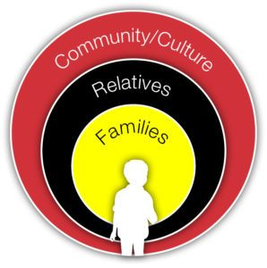
Ethics and Professionalism
Icwa conference
October 12, 2022

Slide 2
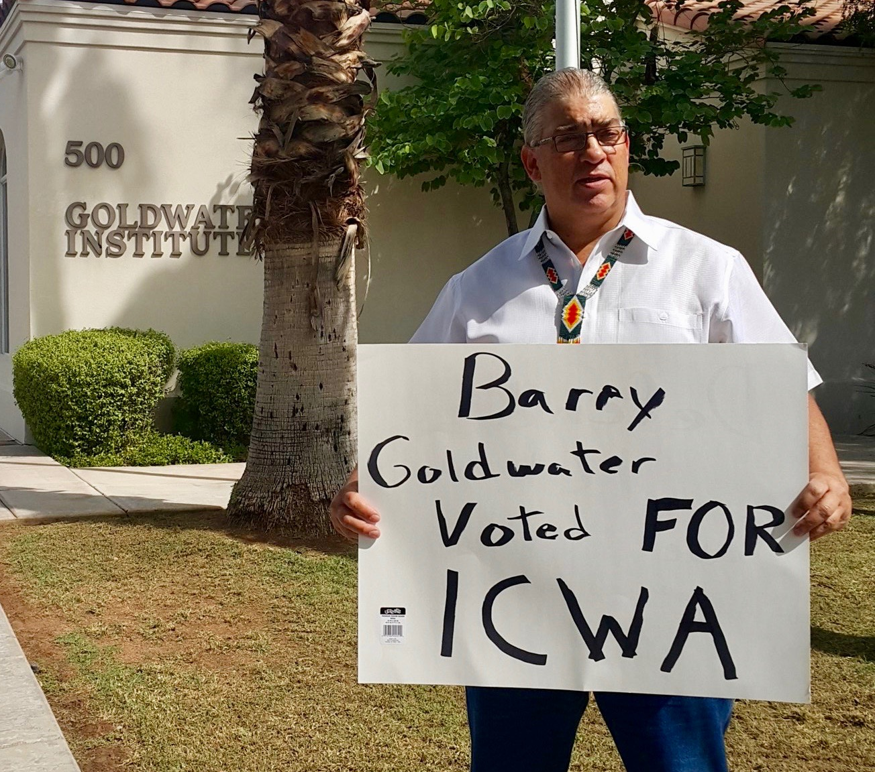
Ethics and Professionalism

Slide 3
Three topics:
1. What is your role?
2. Biases, Common Sense, and Reasonable Efforts
3. A Different Slant on Competency

Slide 4
Ethics and Professionalism
What are your roles?

Slide 5
Ethics and Professionalism
What is your role?

Slide 6
Ethics and Professionalism
Role Rules

Slide 7
Ethics and Professionalism
Role rule #1
Understand your role

Slide 8
Ethics and Professionalism
Role rule #2
Your role dictates what you say, what you do, what you don’t do, what you don’t say.

Slide 9
Ethics and Professionalism
Role rule #3
Know the rules of your role

Slide 10
Ethics and Professionalism
Role rule #4
Know the rules of every other role

Slide 11
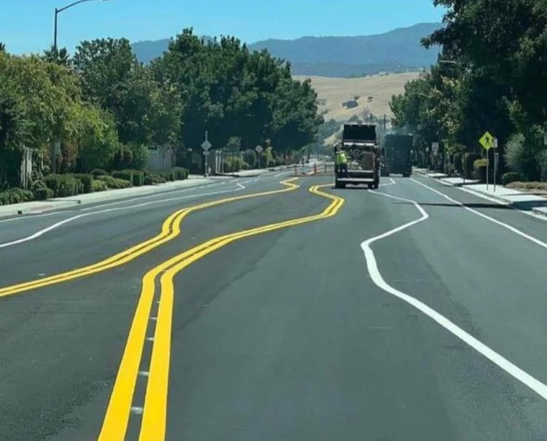
Ethics and Professionalism
Role rule #5
Stay in your lane

Slide 12
Ethics and Professionalism
Child’s Attorney
a. State Court
b. Tribal Court
Guardian ad Litem
Parent’s Attorney
Agency Attorney
Judge

Slide 13
Ethics and Professionalism
Child’s Attorney
> Normal Lawyer-client relationship
> Client directed
> Keep client’s secrets

Slide 14
Ethics and Professionalism
Child’s attorney in State Court – New rules!
> Substituted judgement
> Placement observer

Slide 15
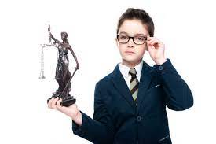
Ethics and Professionalism
New rule 306(a)(1)(b)
If a child’s attorney cannot maintain a normal lawyer-client relationship the attorney . . .

Slide 16
Ethics and Professionalism
> Normal Lawyer-client relationship
> Client directed
> Keep client’s secrets

Slide 17
Ethics and professionalism
. . .must make a substituted judgment.
What does that look like?

Slide 18
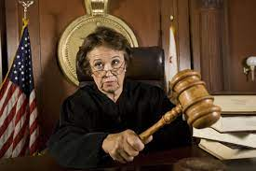
Ethics and professionalism
The attorney must advise the court of the determination of capacity that requires substituted judgment and any subsequent change in that determination.

Slide 19
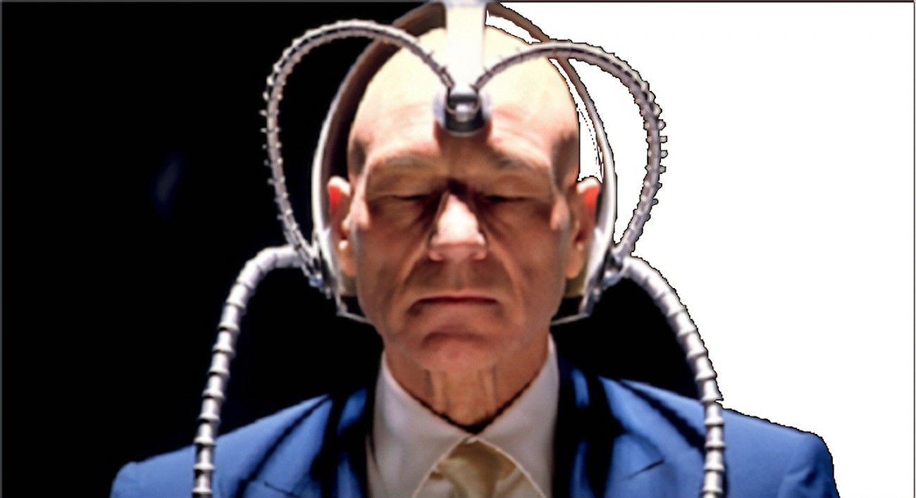
A substituted judgment includes determining what the child would decide if the child was capable of making an adequately considered decision

Slide 20
Ethics and Professionalism
Don’t ask for a GAL, substitute your judgment.
But tell the judge that is what you are doing and why.

Slide 21
Ethics and Professionalism
(e) . . . In all cases, if practicable and appropriate, an attorney and GAL should observe the child's residential environment and the child's interaction with the caregiver.

Slide 22
Ethics and Professionalism
Pop quiz:
Can children’s attorneys report to the court what they observe at the placement?

Slide 23
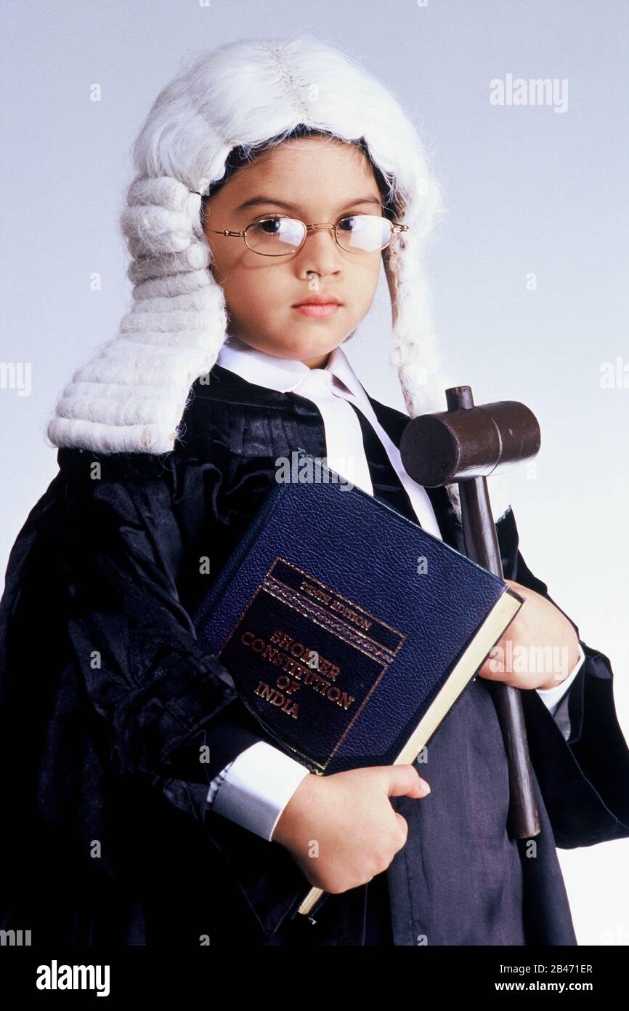
Ethics and Professionalism
GALs can!
A child is not the GAL’s client . . .
No confidentiality
Not client directed
Substituted judgment is expected

Slide 24
Ethics and Professionalism
Child’s attorney Gal
Confidentiality yes no
Follow child’s Wishes yes, if child can NO
communicate
Primary loyalty child Court
Advice to child court

Slide 25
Ethics and Professionalism
Pop quiz part 2:
Kids are placed with Grandma. Kids tell you that GM allows parents to visit in violation to court order . . .

Slide 26
Ethics and Professionalism
Pop quiz part 2:
Kids want to stay with Grandma no matter what.

Slide 27
Ethics and Professionalism
What do you do if:
> You are child’s attorney in state court?
> You are child’s attorney in Tribal Court?
> You are GAL?

Slide 28
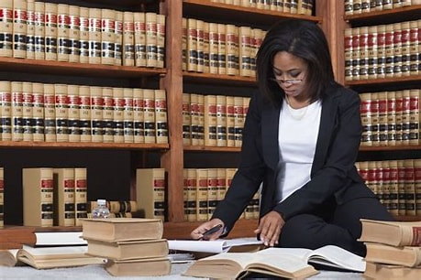
Ethics and Professionalism
Parents’ attorney’s role:
1. Understand your client
2. Advise them
3. Only then, advocate
their position

Slide 29
Ethics and Professionalism
Rule 2.1:
. . . in rendering advice, a lawyer may refer not only to law but to other considerations such as moral, economic, social and political factors, that may be relevant to the client's situation.

Slide 30
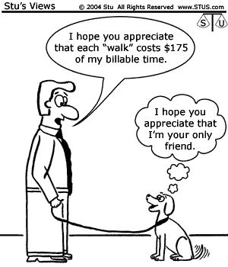
Ethics and Professionalism
Explain what’s going on – especially “reasonable efforts” and

Slide 31
Ethics and Professionalism
Child And Family Team Meetings

Slide 32
Ethics and Professionalism
Respect their Confidentiality

Slide 33
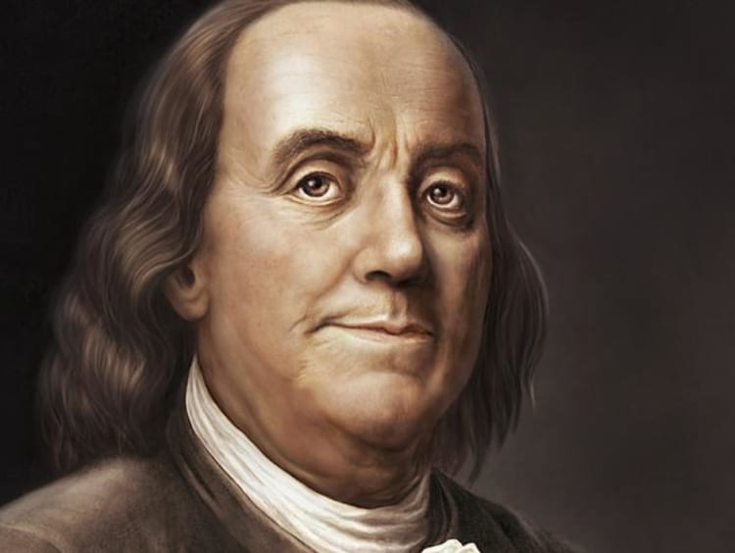
Ethics and Professionalism
“Three may keep a secret, if two of them are dead.”
― Benjamin Franklin

Slide 34
Ethics and Professionalism
Pop quiz:
What is confidential?

Slide 35
Ethics and Professionalism
Everything!!!

Slide 36
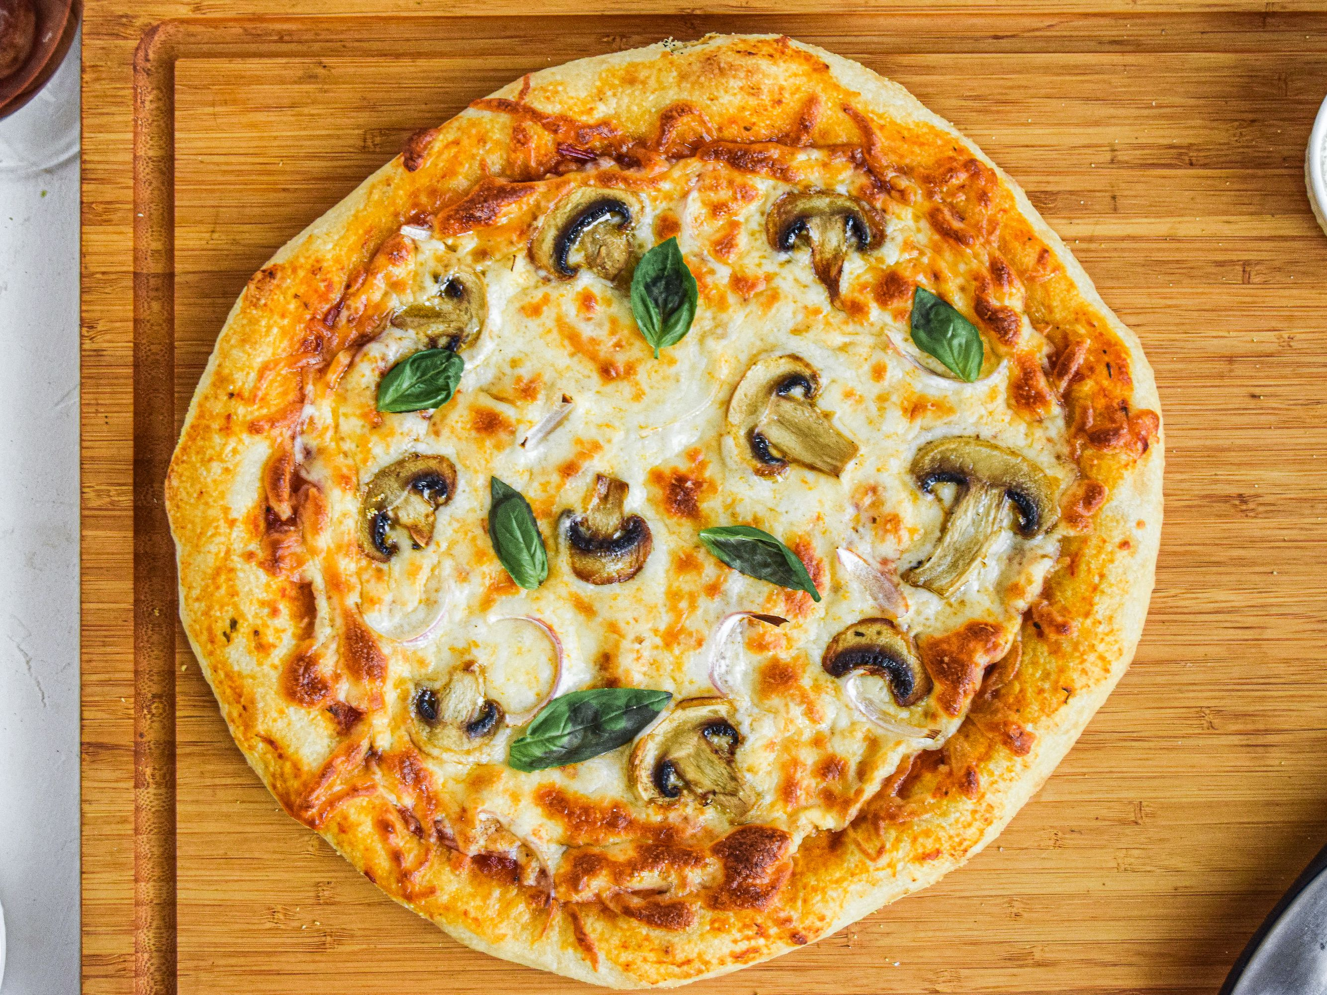
Ethics and Professionalism
> Address
> Marital status
> Names of children
> Their financial status
> Color of their socks
> What they like on pizza

Slide 37
No matter what the source!

Slide 38
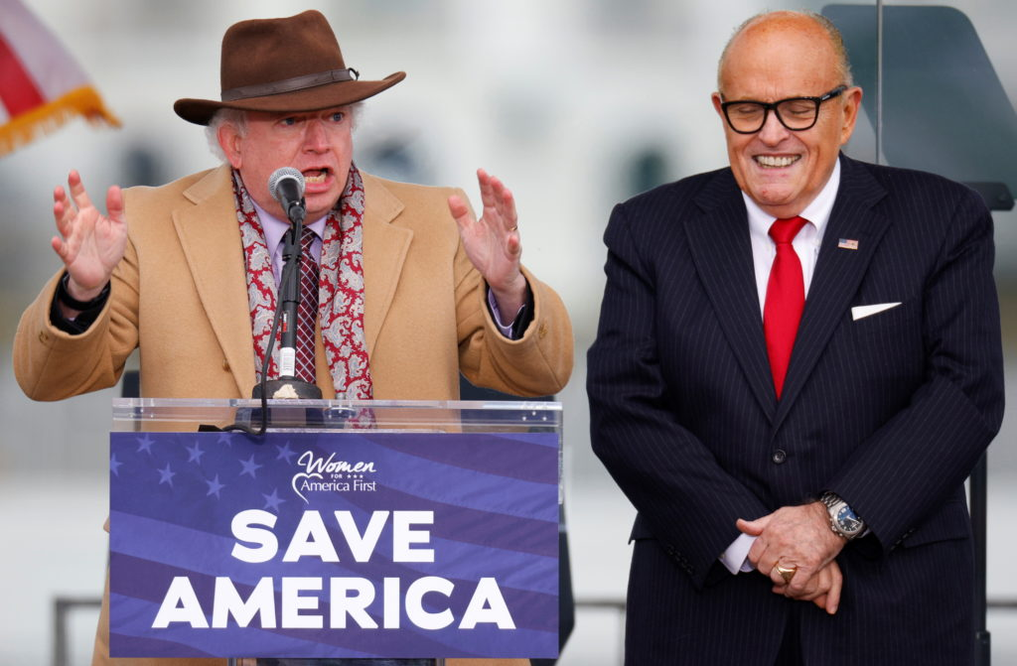
Ethics and Professionalism
Agency Attorney’s role
1. Who is your client?
2. Who speaks for your client?
3. Whom do you advise?

Slide 39
Ethics and Professionalism
Advising an Agency Client

Slide 40
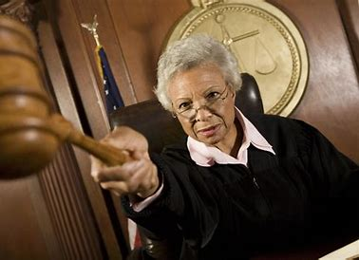
Ethics and Professionalism
Judges
Be Fair
Look Fair
Listen

Slide 41
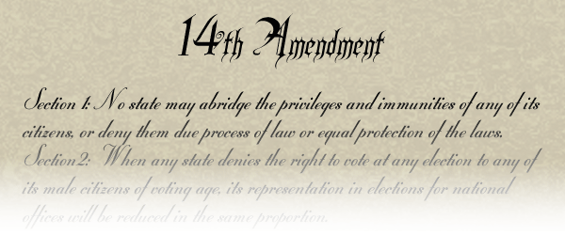
Ethics and Professionalism
Due process is
Notice and the opportunity to be heard

Slide 42
Ethics and Professionalism
Challenge
One thing you can do to better perform your role

Slide 43
Ethics and Professionalism
Biases, Common Sense, and Reasonable Efforts

Slide 44
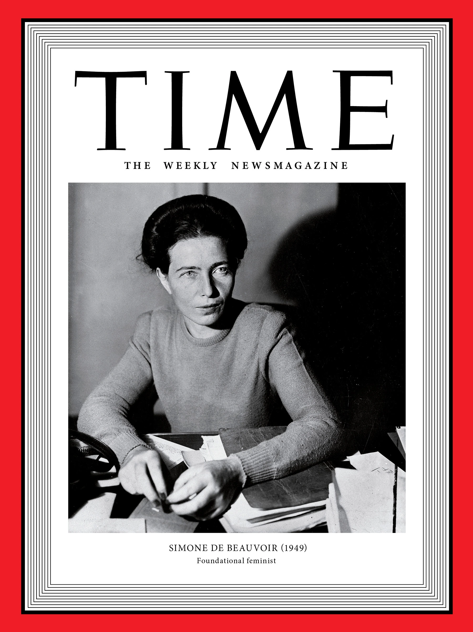
Biases, Common Sense, and Reasonable Efforts
It is doubtless impossible to approach any human problems with a mind free from bias.
Simone De Beauvoir

Slide 45
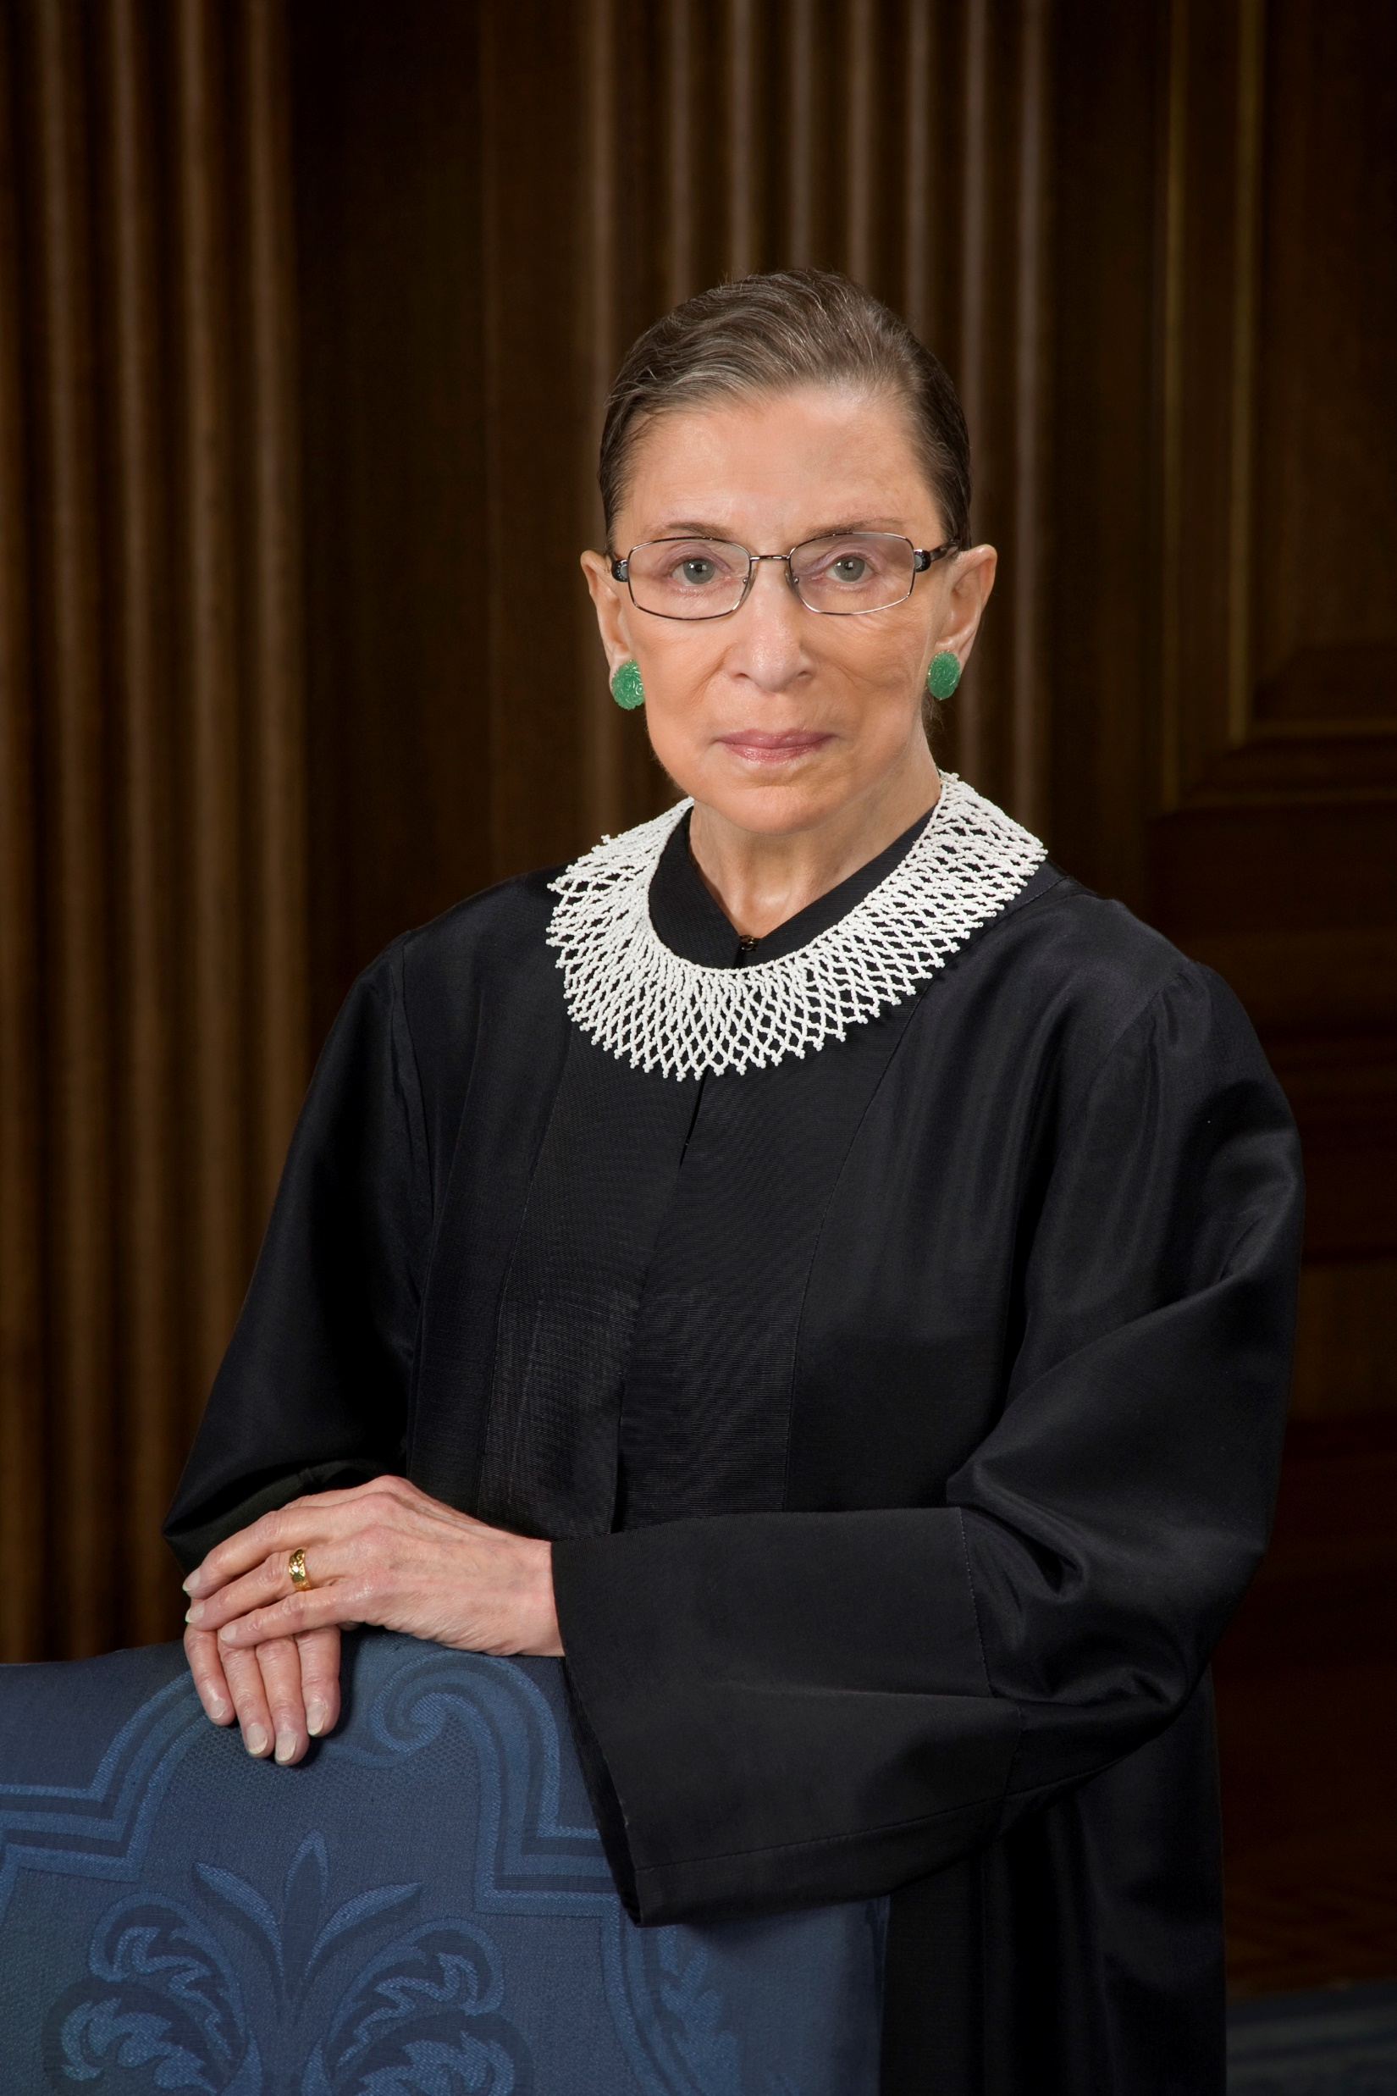
Biases, Common Sense, and Reasonable Efforts
I think unconscious bias is one of the hardest things to get at
Ruth Bader Ginsburg

Slide 46
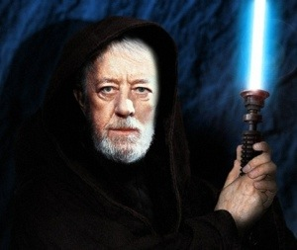
Biases, Common Sense, and Reasonable Efforts
Many of the truths that we cling to depend on our point of view
Obi Wan Kenobi

Slide 47
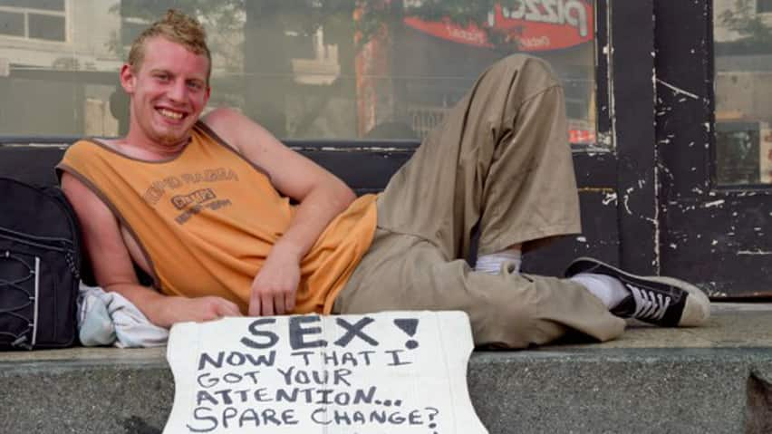
Biases, Common Sense, and Reasonable Efforts
Our biases about people who are poor

Slide 48
Biases, Common Sense, and Reasonable Efforts
The predominant feature of child welfare law’s landscape is poverty.

Slide 49
Biases, Common Sense, and Reasonable Efforts
Poverty was the condition for entry into the first child welfare system in Elizabethan England, it was the condition for entry into the refuge and reform systems of 19th century America,

Slide 50
Biases, Common Sense, and Reasonable Efforts
and it remains, coupled with race, an undeniable factor in the current system.

Slide 51
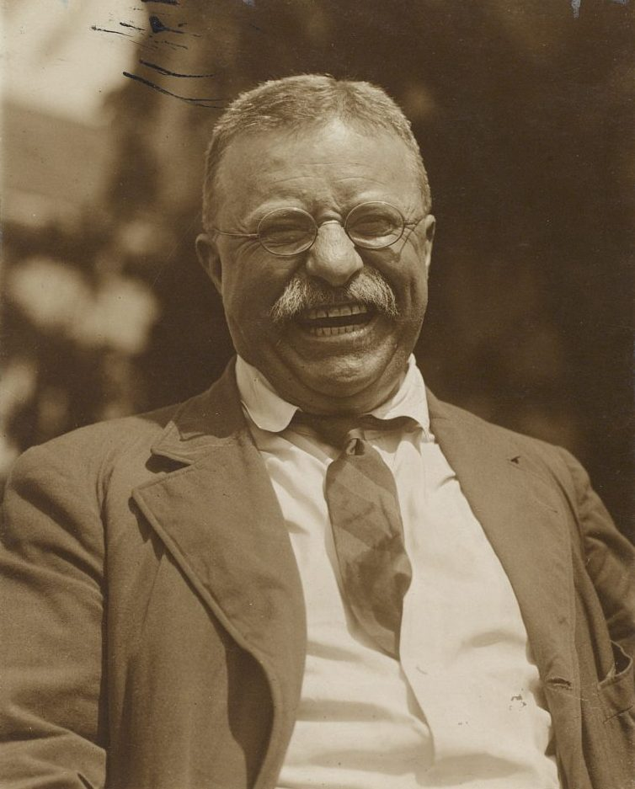
Biases, Common Sense, and Reasonable Efforts
Homes should not be broken up for reasons of poverty
Theodore Roosevelt 1909
Ditto Lyndon Johnson 1965
Ditto Adoption Assistance and Child
Welfare Act 1980
Ditto ASFA 1997
Ditto Barack Obama 2014
Ditto American Rescue Plan Act of 2021

Slide 52
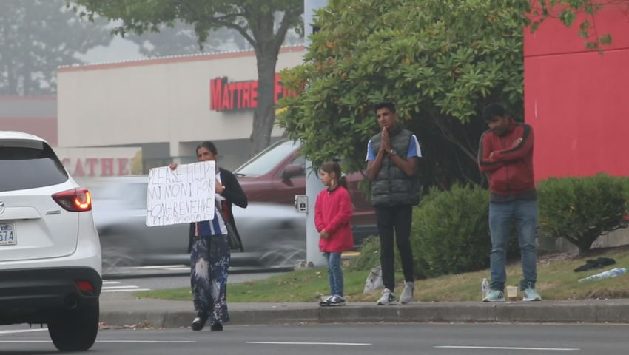
Biases, Common Sense, and Reasonable Efforts
Family of four is seen panhandling outside of a supermarket. The police are called. The family is polite, clean and staying at a local motel. They leave when asked. . .

Slide 53
Biases, Common Sense, and Reasonable Efforts
DCS is called. DCS decides to remove two children – age 1 and 2 -- because panhandling is unsafe and inappropriate -- and the family appears homeless.

Slide 54
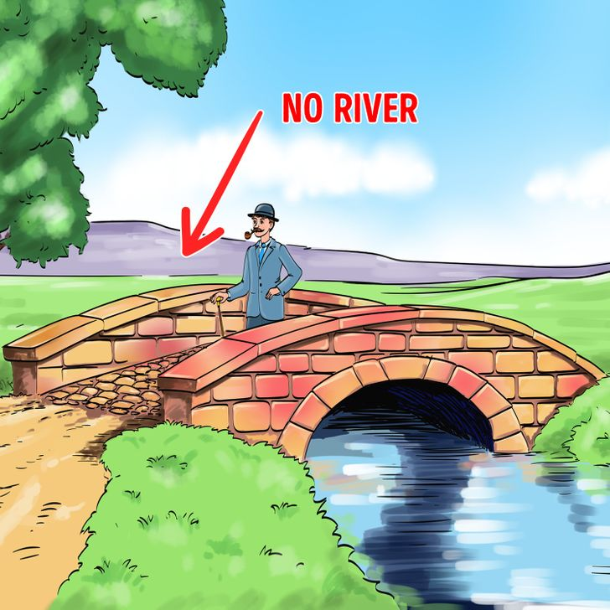
Biases, Common Sense, and Reasonable Efforts
The children are put in foster care. The foster family receives a cash stipend of about $1400/ month.
What’s wrong with this picture?

Slide 55
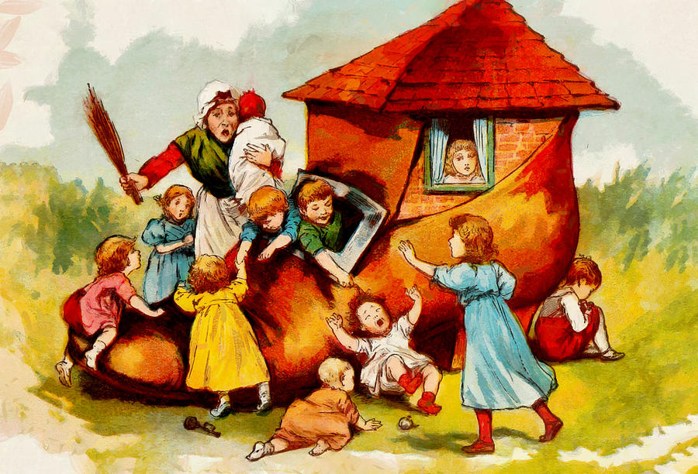
Biases, Common Sense, and Reasonable Efforts
ARS 8-462
> Enacted in 1996
> Unchanged in 26 years
> $300/mo for six months maximum for housing for our families

Slide 56
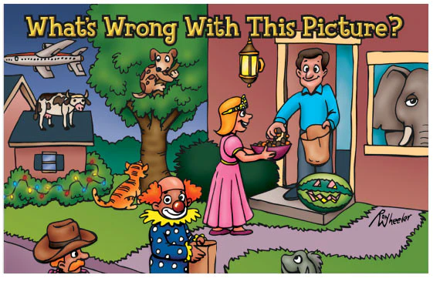
Biases, Common Sense, and Reasonable Efforts
C. The case record shall reflect barriers that the family faces in obtaining adequate housing, a specific, time oriented plan for phasing out the need of the family for continued housing assistance, the actions that are being taken by the family for economic self-sufficiency

Slide 57
Biases, Common Sense, and Reasonable Efforts
We need to make sure they are “deserving” of our help

Slide 58
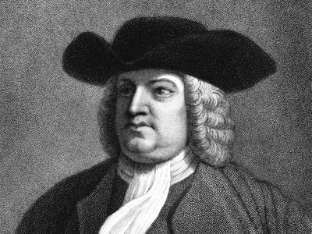
Biases, Common Sense, and Reasonable Efforts
In 1718, the Colony of Pennsylvania made its first attempt at welfare reform

Slide 59
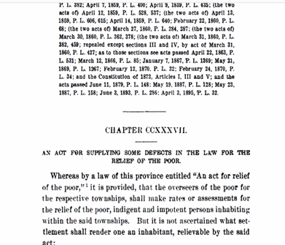
Biases, Common Sense, and Reasonable Efforts

Slide 60
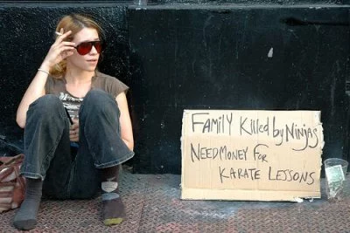
Biases, Common Sense, and Reasonable Efforts
Pennsylvania began to provide cash relief (outdoor relief) for “deserving poor” – not to be used by “the idle, sturdy and disorderly beggars”

Slide 61
Biases, Common Sense, and Reasonable Efforts
Every parent and child had to wear:
upon the shoulder of the right sleeve of the upper garment of every such person, in an open and visible manner, wear such badge . . . a large Roman P, cut either in red or blue cloth

Slide 62
Biases, Common Sense, and Reasonable Efforts

Slide 63
Biases, Common Sense, and Reasonable Efforts
We badge differently today. But we still help the “deserving poor” and we disparage the undeserving poor.

Slide 64
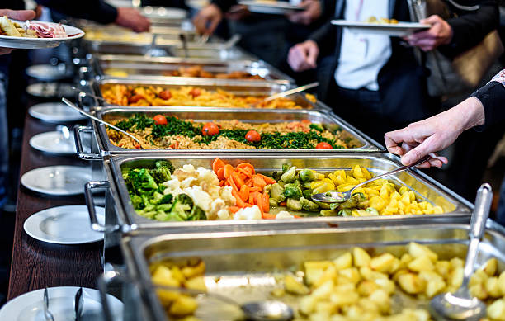
Biases, Common Sense, and Reasonable Efforts
Poor people may not use food stamps or SNAP to purchase ready to eat food.

Slide 65
Biases, Common Sense, and Reasonable Efforts
In six states, including Arizona, if you are homeless or disabled, you can use SNAP benefits at designated restaurants.

Slide 66
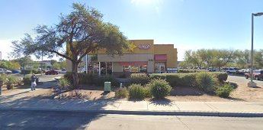
Biases, Common Sense, and Reasonable Efforts
If you live in Sells, the nearest such restaurant is Carl’s Jr on Valencia and Mission 56 miles away.

Slide 67
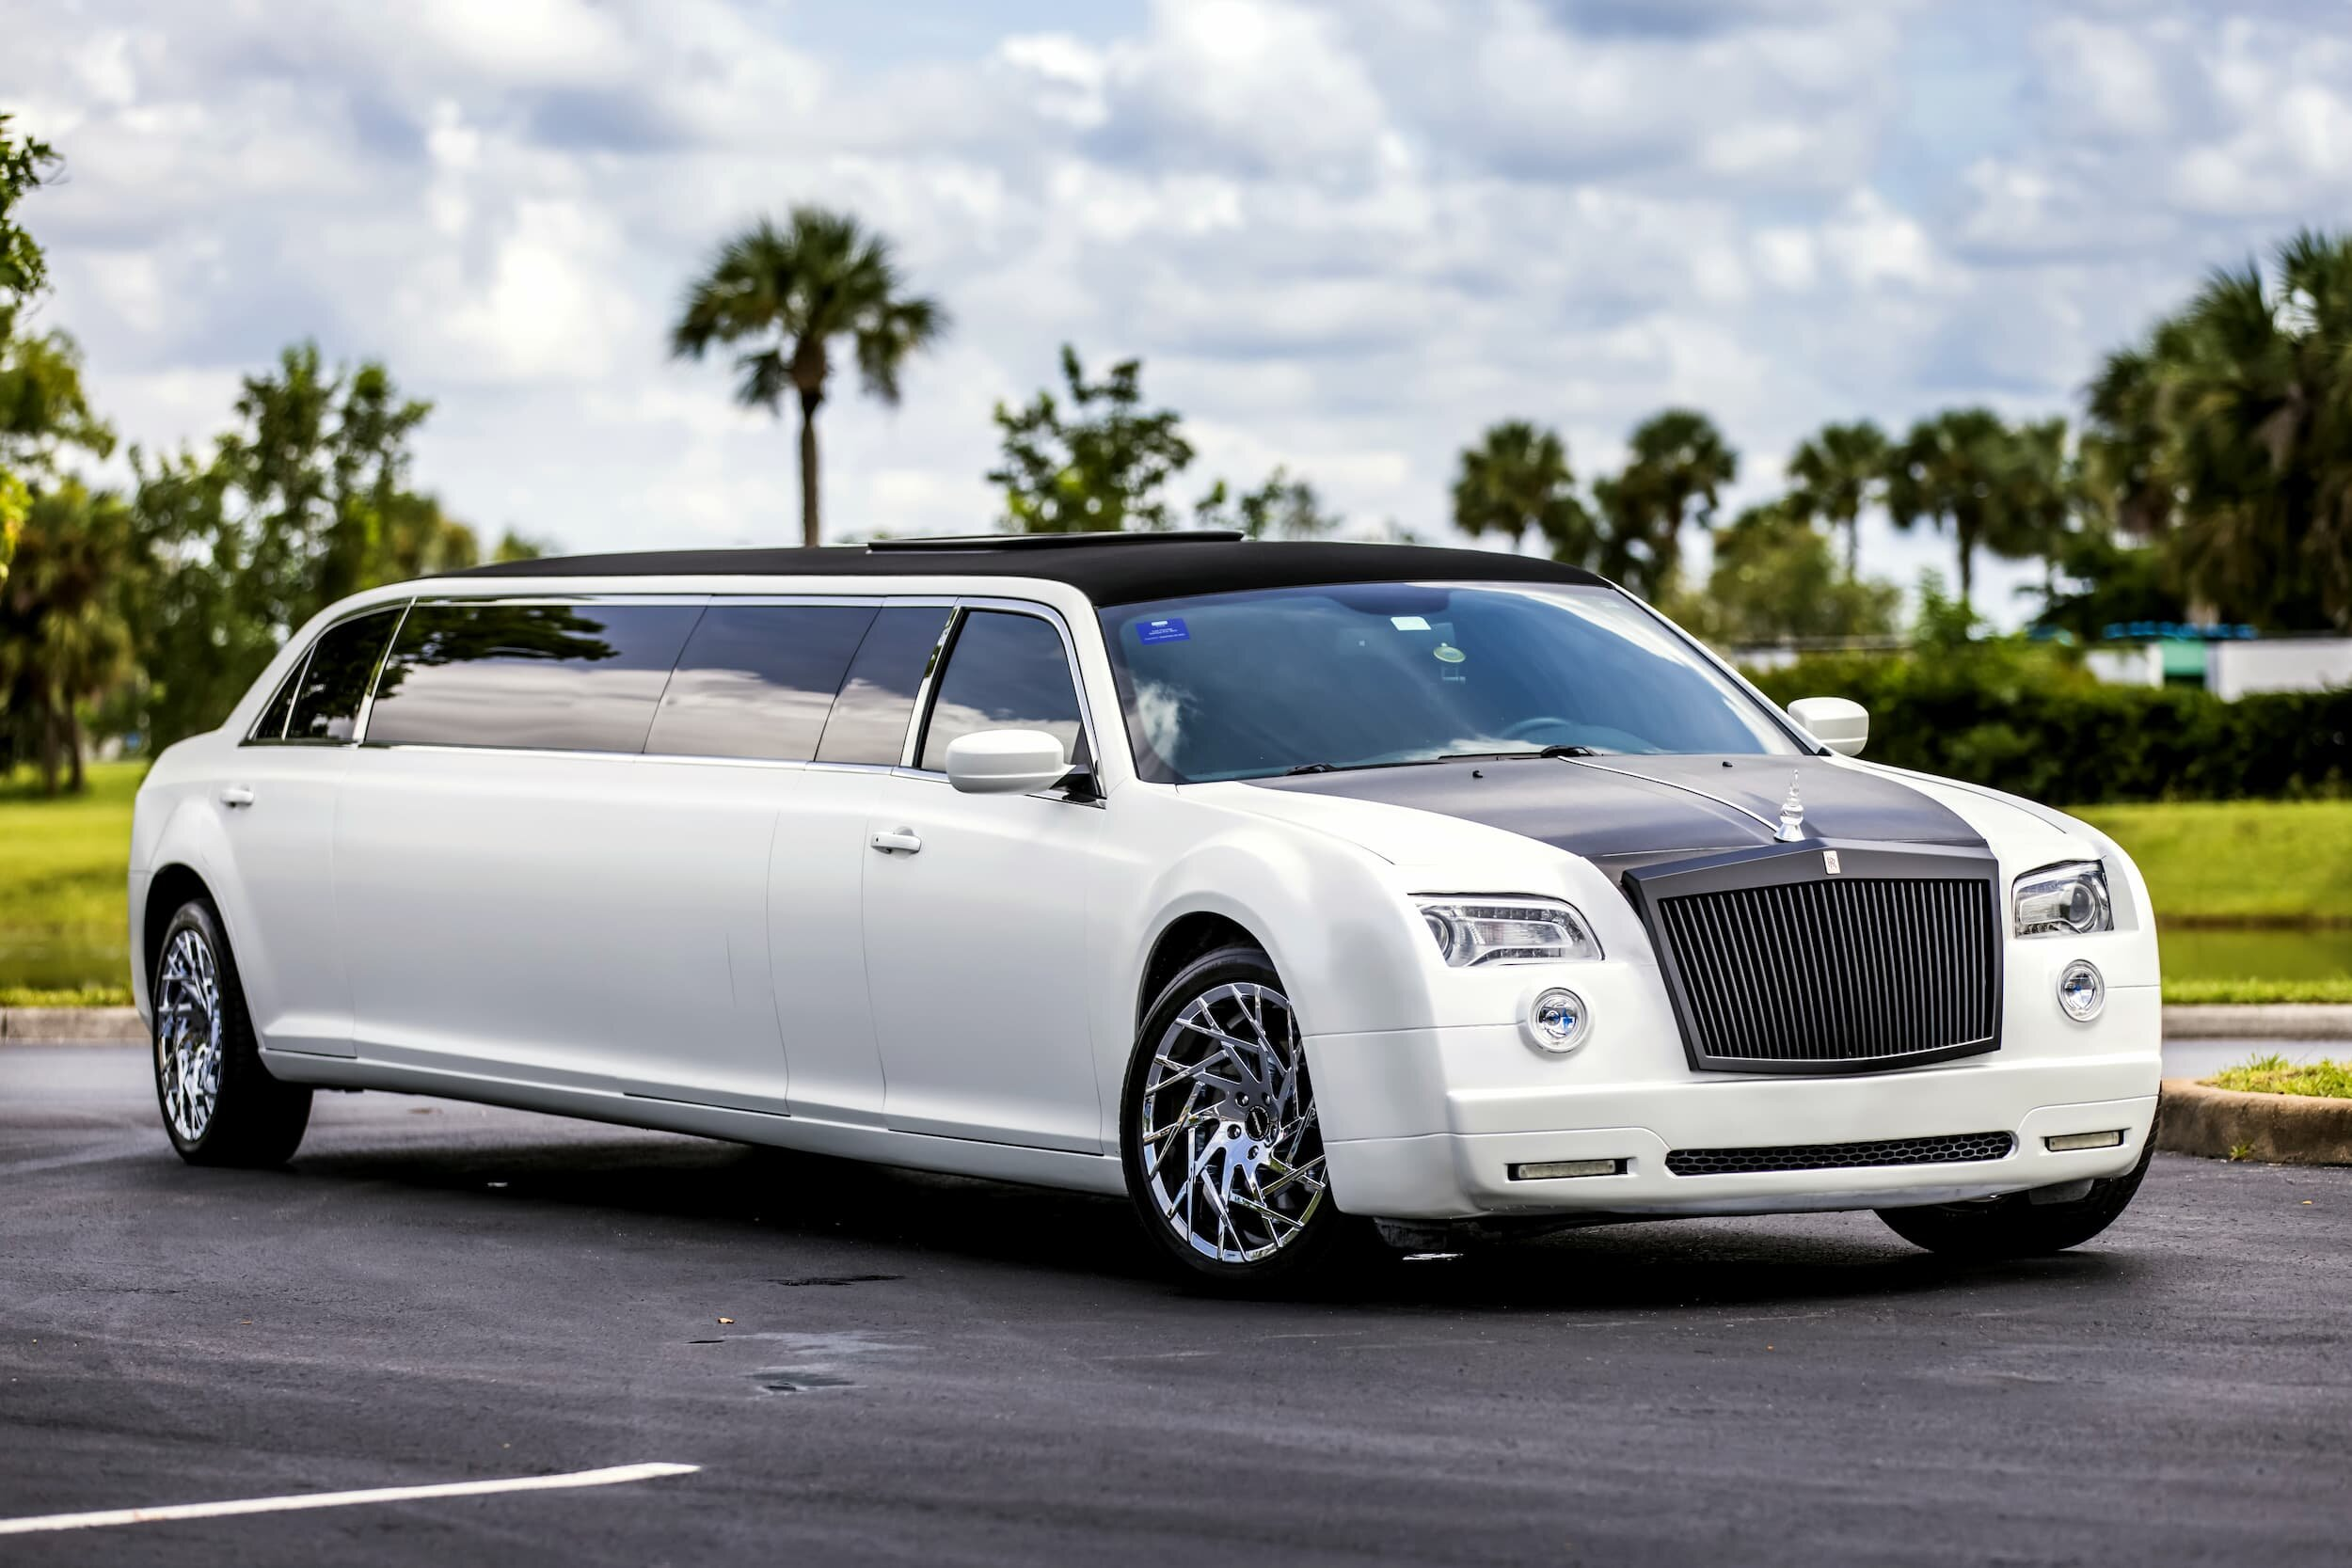
Biases, Common Sense, and Reasonable Efforts
But we don’t help adults with transportation issues in the child welfare system.

Slide 68
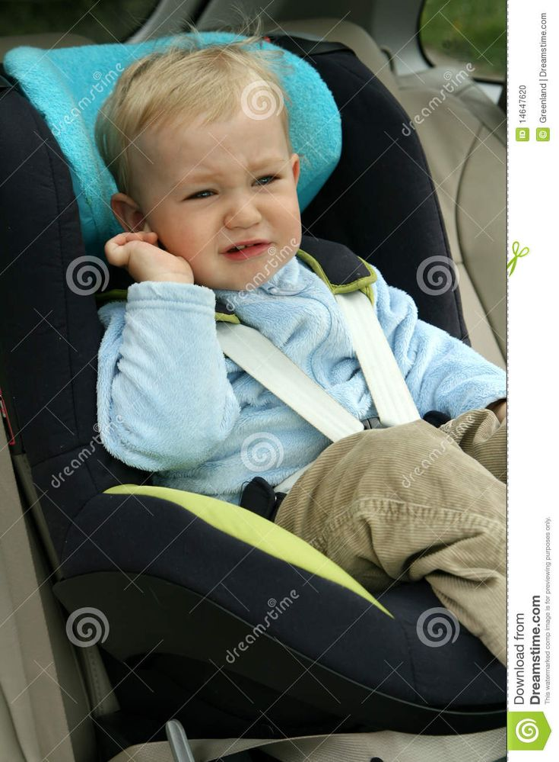
Biases, Common Sense, and Reasonable Efforts
18-month-old is in foster care an hour away from her parents. We put that child in a taxi with strangers for an hour each way 3 x a week.

Slide 69
Biases, Common Sense, and Reasonable Efforts
Why aren’t these and other basic needs for people who are poor a part of reasonable efforts?

Slide 70
Biases, Common Sense, and Reasonable Efforts
> 1994 - Contract With America
>1994 - Three Strikes And You’re Out
> 1996 - AFDC To Tanf
> 1997 - Adoptions And Safe Families Act – a new “reasonable efforts”

Slide 71
Biases, Common Sense, and Reasonable Efforts
ASFA was a pull back from overbroad reasonable efforts.
Washington Post

Slide 72
Biases, Common Sense, and Reasonable Efforts
The law's folly -- requiring social workers to make "reasonable efforts" to send a child back to abusive parents
Washington Post

Slide 73
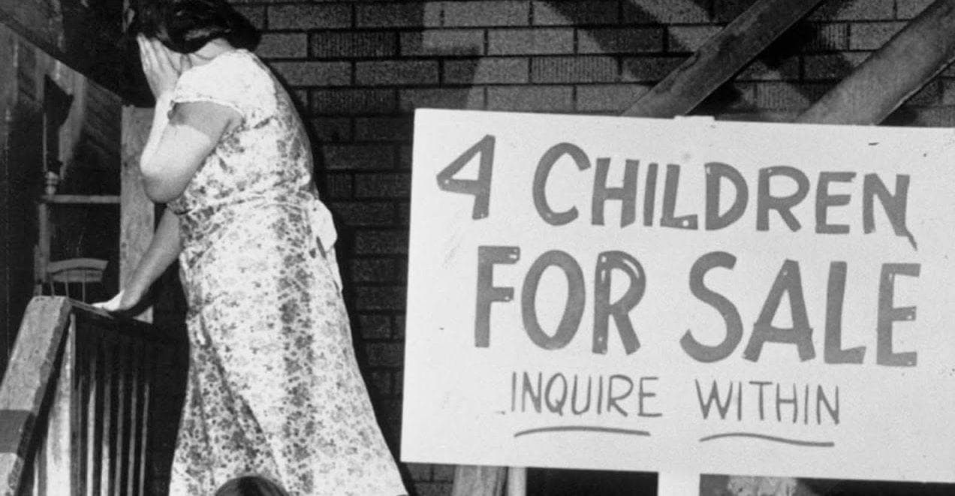
Biases, Common Sense, and Reasonable Efforts
Crack is so addictive that mothers have sold their children so they can get more of it. . .
Sen Mike DeWine

Slide 74
Biases, Common Sense, and Reasonable Efforts
What are our roles?
We can’t perform our roles properly unless understand how our biases, our judgment, and systemic biases color our decisions

Slide 75
Biases, Common Sense, and Reasonable Efforts
Challenge
One thing you can do to lessen poor person bias.

Slide 76
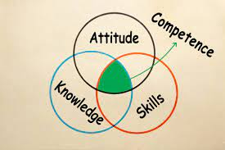
Ethics and Professionalism
Rule 1.1
A lawyer shall provide competent representation to a client. Competent representation requires the legal knowledge, skill, thoroughness and preparation reasonably necessary for the representation.

Slide 77
Ethics and Professionalism
In 2019, Vermont and later Virginia added a comment to rule 1.1

Slide 78
Ethics and Professionalism
A lawyer’s mental, emotional, and physical well-being may impact the lawyer’s ability to represent clients and to make responsible choices in the practice of law.

Slide 79
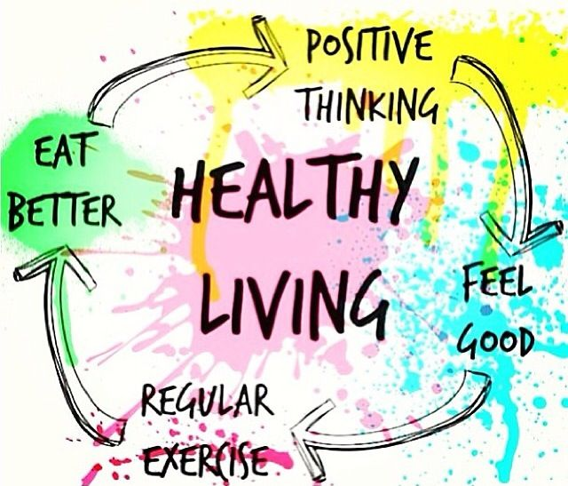
Ethics and Professionalism
Maintaining the mental, emotional, and physical well-being necessary for the representation of a client is an important aspect of maintaining competence to practice law.

Slide 80
Ethics and Professionalism
> Secondary trauma
> Pressure from clients, family, supervisors, judges
> Too much to do; too little time
> Money pressures

Slide 81
Ethics and Professionalism
Give yourself permission to be as healthy as you can be.

Slide 82
Ethics and Professionalism
Challenge
One thing you can do to help yourself.

