Slide 1
This or That: Ethical Conundrums in Child Welfare

Slide 2
Introductions
Tara Hubbard, ICWA Supervising Attorney, Pascua Yaqui Tribe
Ashley Cousineau, ICWA Assistant Attorney General, Pascua Yaqui Tribe
Steve Teske, Deputy Prosecutor, Pascua Yaqui Tribe
Rene Alcoverde, Tohono O’odham

Slide 3
Scenario #1
You represent the Department of Social Services in dependency proceedings. CPS removed a child from the parent’s home, and you have filed a Petition of Child in Need of Protection. When you arrive at court for the Initial Hearing, the parents are present and are unrepresented. You introduce yourself and inform them you represent the Department. They tell you they have no clue what is taking place and they want to know what is going to happen today. How should you respond?
Can you inform them of the Initial Hearing process?
How should you respond if they ask you if they should admit or deny the allegation(s) in the petition?

Slide 4
Scenario #2
You are a judge presiding over a dependency proceeding. The mother is unrepresented. It is alleged in the petition that she left her toddler child with her 6-year-old child while the mother went to work. While away at work, the 6-year-old was busy watching T.V. and playing games and did not notice that the toddler had found a quarter on the floor and picked it up and placed in her mouth and got lodged in her throat causing the toddler to asphyxiate. The child was revived but will suffer permanent and severe neurological problems.
When cross-examining the agency’s fist witness, the mother had trouble phrasing questions and began to make statements. The DCS attorney objected. The mother states she is not a lawyer and doesn’t know how to ask her questions. How do you rule and how would you deliver the ruling?
When it came time for the mother to testify, she shared what somebody else told her who was not present for the trial. The DCS attorney objects on grounds of hearsay. How do you rule and how would you deliver the ruling?
The mother wants to present a document that is a copy of the original but does not know how to introduce it. She wants to hand it to you and ask you to read it. The DCS attorney objects on grounds of improper foundation and on best evidence because it is not the original. How do rule and how would you deliver the ruling?
What strategies or techniques may a judge employ to accommodate an unrepresented person while simultaneously ensuring that the unrepresented person adheres to the same rules of procedure and evidence that are applicable to a litigant represented by an attorney?

Slide 5
Working with Unrepresented Persons: AZ Ethical Rule 4.3
In dealing on behalf of a client with a person who is not represented by counsel, a lawyer shall not state or imply that the lawyer is disinterested. When the lawyer knows or reasonably should know that the unrepresented person misunderstands the lawyer's role in the matter, the lawyer shall make reasonable efforts to correct the misunderstanding. The lawyer shall not give legal advice to an unrepresented person, other than the advice to secure counsel, if the lawyer knows or reasonably should know that the interests of such a person are or have a reasonable possibility of being in conflict with the interests of the client.

Slide 6
Managing Unrepresented Persons: Rule 2.2 Model Code of Judicial Conduct
Impartiality and Fairness:
A judge shall uphold and apply the law,* and shall perform all duties of judicial office fairly and impartially.*
Comment on Rule 2:
[1] To ensure impartiality and fairness to all parties, a judge must be objective and open-minded.
[2] Although each judge comes to the bench with a unique background and personal philosophy, a judge must interpret and apply the law without regard to whether the judge approves or disapproves of the law in question.
[3] When applying and interpreting the law, a judge sometimes may make good-faith errors of fact or law. Errors of this kind do not violate this Rule.
[4] It is not a violation of this Rule for a judge to make reasonable accommodations to ensure pro se litigants the opportunity to have their matters fairly heard.

Slide 7
Scenario #3
Assume same facts in Scenario #1. At the Initial Hearing, the judge explains the parent’s rights to an attorney (assume either a jurisdiction without right to court-appointed attorney or a jurisdiction with right, but parents do not qualify for court-appointed attorney) as well as other rights and after hearing evidence the judge concludes probable cause exists and schedules a pre-trial conference (PTC). After further investigation, CPS discovers some mitigating circumstances and although still maintains the allegations are true and provable, believes it in the best interest of the child to recommend an in-home dependency. Prior to the PTC, can you present the offer for in-home dependency to the parents and negotiate an agreement?
If so, how should you present the offer of settlement to the parents?
What if the parents ask if this is a good idea for them to agree?
What if the parents ask if the same offer is on the table if they continue to deny and the judge rules against them at the adjudication/trial?

Slide 8
Scenario #4
You are assigned to represent sibling group of five. The children range in age from 16 years old to six months old. The case initiated due to concerns of the six-month-old showing signs of suspected non-accidental trauma. The older children, ages 16, 11, 8, and 5, all indicate that they want to return home to their parents. Can you continue to represent all the children? How do you assess the position of the nonverbal child?
What if the victim child is older/verbal and indicates that they do not want to return to his or her parents? Can you continue to represent any of the children?

Slide 9
Scenario #5
Parents come to you for representation in a dependency proceeding alleging the father sexually abused their teenage child. At this junction there are no allegations against the mother, but she does not believe the daughter’s outcry and the mother remains with the father. After further investigation, CPS discovers new evidence that the daughter did make an outcry to the mother about the abuse, and she failed to report it. The attorney for the Department amends the petition to include allegation of failure to protect against the mother. Can you continue to represent both parents?
Assume the daughter never made an outcry to the mother, and the matter was adjudicated, and the daughter found dependent. Prior to the disposition hearing, you receive the report from social services with their recommendations. The recommendation is the child continue as a ward of the Court and in the care and custody of social services. The report states that mother, although a non-offending parent, cannot be considered for placement because she resides with the offending parent. Can you continue to represent both parents?

Slide 10
Conflicts of Interest: AZ Ethical Rule 1.7
(a) Except as provided in paragraph (b), a lawyer shall not represent a client if the representation involves a concurrent conflict of interest. A concurrent conflict of interest exists if: (1) the representation of one client will be directly adverse to another client; or (2) there is a significant risk that the representation of one or more clients will be materially limited by the lawyer's responsibilities to another client, a former client or a third person or by a personal interest of the lawyer.

Slide 11
Child Representation & Diminished Capacity: AZ Juvenile Rule 306(a)(1) & Ethical Rule 1.14
(A) Relationship. The child's attorney must maintain a normal attorney-client relationship with the child in accordance with the rules of professional conduct when the child is capable of directing the representation by expressing the child's objectives.
(B) Diminished Capacity. The child's attorney must determine whether the child has the capacity to make adequately considered decisions pursuant to E.R. 1.14. In making the determination, the attorney should consult the child and may consult other individuals or entities to determine the child's ability to direct the representation. When a child has diminished capacity, the child's attorney must make a good faith effort to determine the child's needs and wishes. The attorney must, as far as reasonably possible, maintain a normal attorney-client relationship with the child.
(C) Substituted Judgment. During any period in which a normal attorney-client relationship is not reasonably possible to maintain, the child's attorney must make a substituted judgment. The attorney must advise the court of the determination of capacity that requires substituted judgment and any subsequent change in that determination. A substituted judgment includes determining what the child would decide if the child was capable of making an adequately considered decision and representing the child in accordance with that determination. The attorney should take direction from the child as the child develops the capacity to direct the attorney.

Slide 12
Scenario #6
You represent the Arizona Department of Child Safety. An In-Home Dependency Petition regarding three children was filed alleging methamphetamine and fentanyl abuse. The children are 3 years old, 5 years old, and 6 years old. After the case is transferred from the investigations unit to the in-home unit, the newly assigned in-home case manager and supervisor call you in frustration, stating that the case should have never been an in-home case. Do you immediately file a Motion for Change of Physical Custody?

Slide 13
Scenario #7
You represent DCS. A supervisor of the county DCS office calls you and says he needs your advice. He proceeds to tell you that a local private child congregate care that often houses foster kids in the custody of the department asked him if he would join the board of directors of the company. He shares that he would like to help them and be involved civically but wanted to make sure it is okay legally and would not land him in trouble. Can you advise him? [See Rule 1.13 (b)]

Slide 14
Organization as a Client: AZ Ethical Rule 1.13
(a) A lawyer employed or retained by an organization represents the organization acting through its duly authorized constituents.
(b) If a lawyer for an organization knows that an officer, employee or other person associated with the organization is engaged in action, intends to act or refuses to act in a matter related to the representation that is a violation of a legal obligation to the organization, or a violation of law that reasonably might be imputed to the organization, and that is likely to result in substantial injury to the organization, the lawyer shall proceed as is reasonably necessary in the best interest of the organization. Unless the lawyer reasonably believes that it is not necessary in the best interest of the organization to do so, the lawyer shall refer the matter to higher authority in the organization, including, if warranted by the circumstances, to the highest authority that can act on behalf of the organization as determined by applicable law.
(c) Except as provided in paragraph (d), if (1) despite the lawyer's efforts in accordance with paragraph (b) the highest authority that can act on behalf of the organization insists upon or fails to address in a timely and appropriate manner an action or refusal to act, that is clearly a violation of law, and (2) the lawyer reasonably believes that the violation is reasonably certain to result in substantial injury to the organization, then the lawyer may reveal information relating to the representation whether or not Rule 1.6 permits such disclosure, but only if and to the extent the lawyer reasonably believes necessary to prevent substantial injury to the organization.

Slide 15
Organization as a Client: AZ Ethical Rule 1.13
(d) Paragraph (c) shall not apply with respect to information relating to a lawyer's representation of an organization to investigate an alleged violation of law, or to defend the organization or an officer, employee or other constituent associated with the organization against a claim arising out of an alleged violation of law.
(e) A lawyer who reasonably believes that he or she has been discharged because of the lawyer's actions taken pursuant to paragraphs (b) or (c), or who withdraws under circumstances that require or permit the lawyer to take action under either of those paragraphs, shall proceed as the lawyer reasonably believes necessary to assure that the organization's highest authority is informed of the lawyer's discharge or withdrawal.
(f) In dealing with an organization's directors, officers, employees, members, shareholders or other constituents, a lawyer shall explain the identity of the client when the lawyer knows or reasonably should know that the organization's interests are adverse to those of the constituents with whom the lawyer is dealing.
(g) A lawyer representing an organization may also represent any of its directors, officers, employees, members, shareholders or other constituents, subject to the provisions of ER 1.7. If the organization's consent to the dual representation is required by ER 1.7, the consent shall be given by an appropriate official of the organization other than the individual who is to be represented, or by the shareholders.

Slide 16
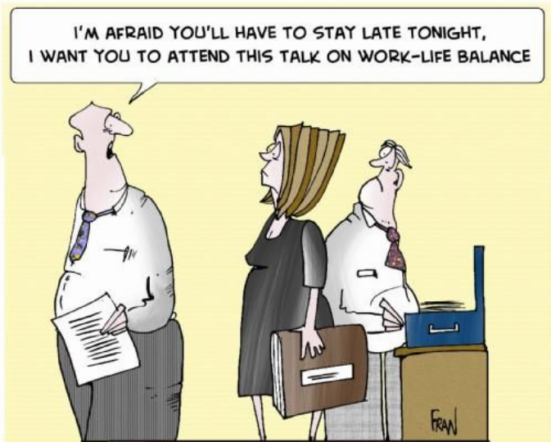
A Word on Work-Life Balance and Effective Advocacy
The Price I Paid For Being A ‘Good Judge’
Hon. Karen Adam, Retired for The National Judicial College
https://www.judges.org/news-and-info/the-price-i-paid-for-being-a-good-judge/

