Slide 1
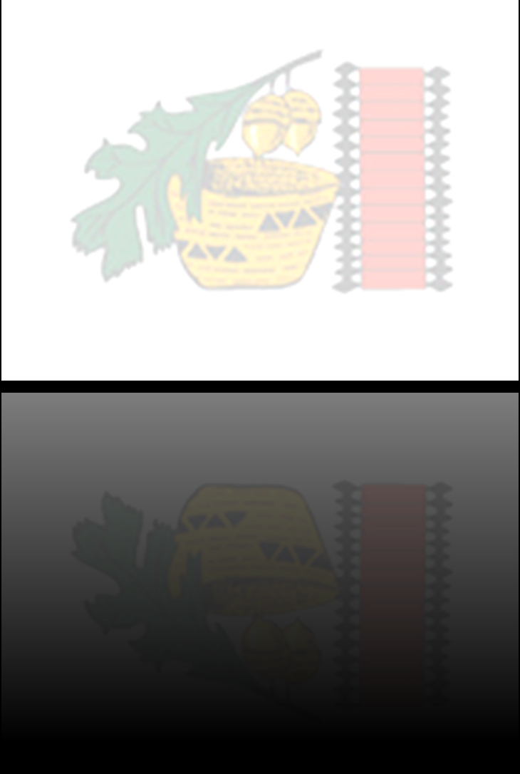
Onikuchi:
Understanding
Domestic & Sexual Violence Within
Tribal Communities

Slide 2
Introductions
Diana Carpenter, M.A., LMFT
Angie Hyde (Tuolumne Me-Wuk), B.A.
Stephanie Beaver-Guzman (Hupa/Yurok), Ed.D.
funded through
United States Department of Justice, Office on Violence Against Women (OVW) Grant No. 2016-CY-AX-0005

Slide 3
Honoring & Building Relation to Land
Land Acknowledgements
Learn more about how to honor Native Land
Toolkit link here
Native Land map & app
https://native-land.ca/

Slide 4
Agenda
Welcome & Context (Diana)
Research & Findings (Stephanie)
Implementing Community Needs (Angie)
Discussion
Q & A

Slide 5
Objectives
Review findings from our community needs assessment regarding sexual and domestic violence
Learn specific implementation strategies
Identify additional way/s to better serve the direct needs of your community
Increase awareness: Learn the significance of a cultural approach to research within tribal communities
Idea Generation: Utilize findings from our research for future funding and program development

Slide 6
Diana Carpenter, M.A., LMFT
Director of Tuolumne Me-Wuk Tribal Council Social Services Department
Welcome
Context of our community
Transition from Frank
Background of this project

Slide 7
Stephanie Beaver-Guzman (Hupa/Yurok), Ed.D.
Tribal Consultant & Primary Researcher
Welcome
Positionality
Community Needs Assessment Process
Share “Findings”, Tables, Data
  Importance of centering our community members voices in this
  Subject vs person
  Importance of cultural awareness

Slide 8

Community Needs Assessment Process
Assessment of role, grant directives
Develop model for Community Needs Assessment
Develop research questions that aligned with parameters of the grant
Create materials
Conduct Qualitative & Quantitative Research
Analyze/Interpret Data
Develop Report

Slide 9
Research Questions
RQ 1: What is the knowledge of male community members regarding the impact of DSV in our tribal community?
RQ 2: What options already exist for male community members to engage in the prevention of DSV – or should exist?
RQ 3: How can/are healthy relationships role modeled for male members of the community as part of preventing DSV?

Slide 10
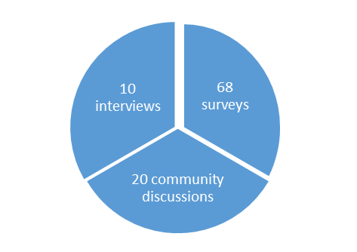
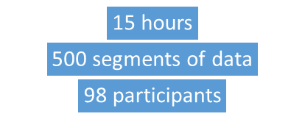
Brief Notes
68 unduplicated surveys
20 informal community interviews/discussions
10 formal individual interviews
55 were asked, 23 agreed, 10 completed
Report: 144 pages
In-depth explanations and details

Slide 11
Demographics
Survey participants:
36 were Native American, 23 White, 6 Hispanic
25 distinct tribal nations represented,
43 identified as Female (63.2 %)
23 identified as Male (33.8 % )
Did not answer the question (3%)
56 identified as Heterosexual
1 identified as Gay
4 identified as Bisexual
3 identified as “other”
Ages ranged from 18 – 83
10 formal interview participants:
8 out of 10 participants identified as Native American
5 female, 5 were male
3 married; 4 single; 1 was separated
4 identified as heterosexual,
3 did not disclose,
1 as Queer,
2 participants’ were omitted
4 community members were justice-involved
4 were never incarcerated
  2 did not apply
7 out of 10 had experienced (DSV)
  1 said they had not experienced DSV.

Slide 12
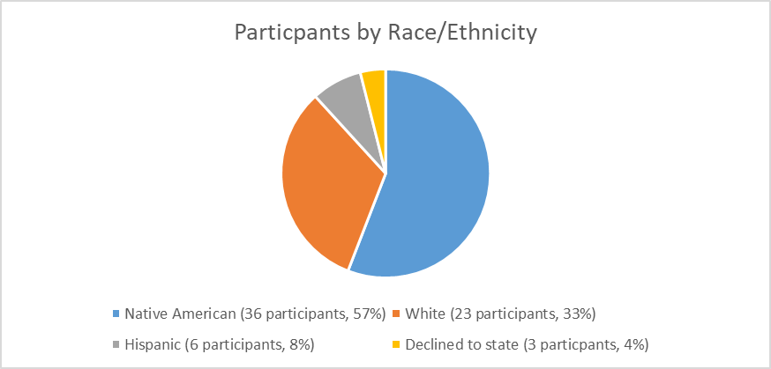
Demographics (cont.)

Slide 13
Report Structure:
Section 1: Process used for the Community Needs Assessment completion
Section 2: Review of research materials
  Section 2.A.: Research Questions
  Section 2.B.: Community Member Survey
  Section 2.C.: Community Interviews

Slide 14
Report Structure:
Section 3: Results
  Section 3.A. Community Member Survey Findings
  Section 3.B Community Interview Findings
    3.B.1: Informal Interviews and Discussions Findings
    3.B.2. Formal Community Member Interview Findings
    3.B.3. Demographic Data
    3.B.4. Process and notations about Individual Community Member Interviews
Section 4: Conclusions & Recommendations

Slide 15
3.B.5. Individual Community Member Feedback by Interview Questions
  Defining Domestic and/or Sexual Violence (DSV).
  DSV Experiences within the community.
  Utilization of Support
  Perceived Causes of DSV.
  Perceived Impacts of DSV.
  Opportunities for Community Prevention, Intervention
  Perceptions of Allies
  Sources of Healing
  Healthy Relationships
  Role models
  Recommendations from Community Members
  Additional Commentary

Slide 16
Community members are the experts
31 sources for learning about healthy relationships
85 total traits of role models provided
36 perceptions about how/ways that their culture is connected to promoting healthy relationships
30 additional comments regarding engaging Native men and boys in the prevention of DSV
6 definitions of DV, 5 definitions of SV
A multitude of truly rich narratives that go beyond these reported numbers
111 perceived causes/contributions of DSV
33 perceived areas of impact of DSV
37 different opportunities for prevention
38 ways that male community members could help in DSV prevention
37 explanations in the ways that males could/not act as potential allies
30 modalities used for healing for DSV

Slide 17
Select Findings
DV is a significant problem
  59% of total survey participants shared they had personally experienced DV, &
  80% knew someone who did.
SV is a significant issue
  35% of total survey participants shared they had personally experienced SV,
  &
  69% knew someone who did.
An overwhelming amount of people (66%) do not get help or use services

Slide 18
Select Findings (cont.)
Females
  73% experienced DV (from surveys)
  83% experienced SV (from surveys)
100% of females interviewed experienced DSV
Males
  27% of males experienced DV (from surveys)
  17% of males experienced SV (from surveys)
75% of males interviewed experienced DSV

Slide 19
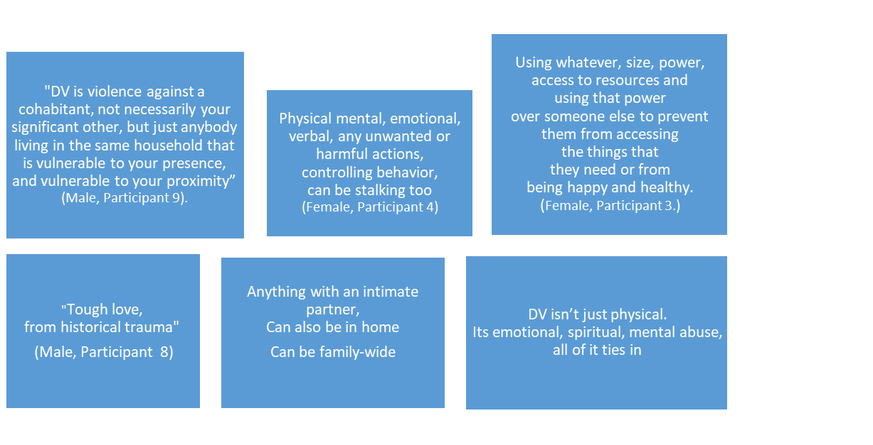
Select Findings (cont.)
Definitions of DV

Slide 20
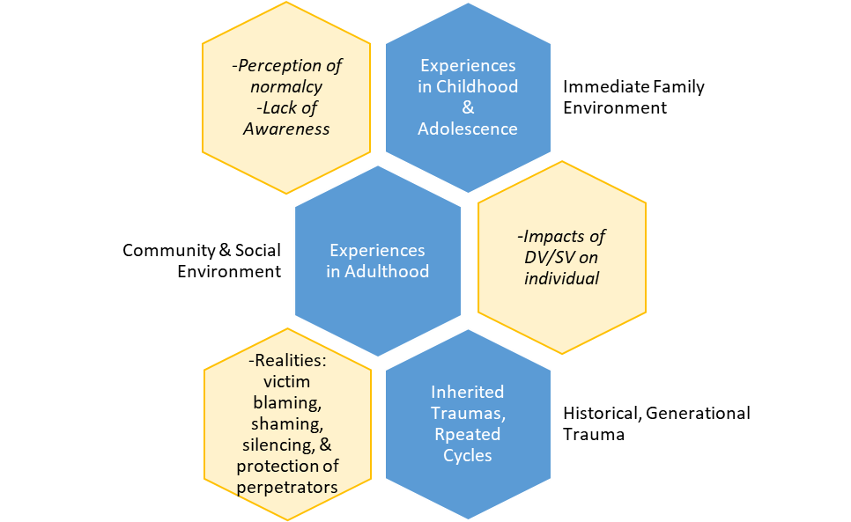
Select Findings (cont.)

Slide 22
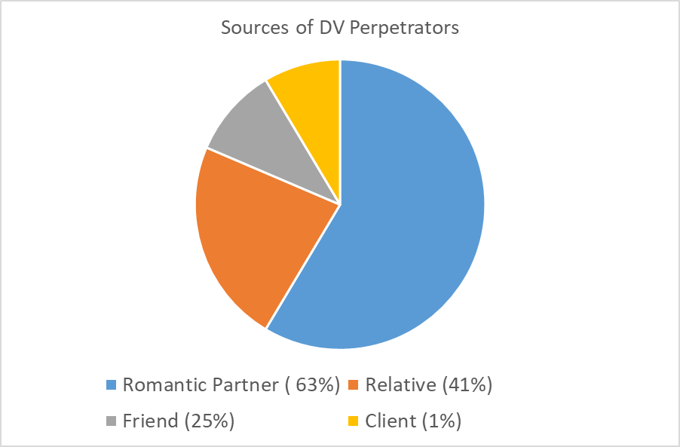
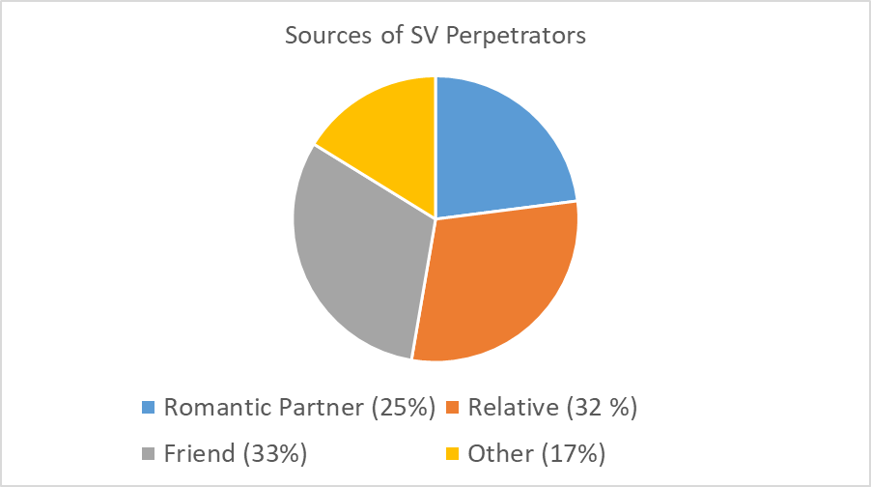
Additional Findings

Slide 23
Perceptions of Domestic and/or Sexual Violence as a local issue
82% of participants rated
Native men/boys experience with DSV
as a serious or very serious issue.
87% of participants rated
Native women/girls experience with DSV
as a serious or very serious issue.

Slide 24
RQ 1: What is the knowledge of male community members regarding the impact of DSV in our tribal community?
All were aware that DSV is a significant problem in our community
Most were not open to formal survey or interview protocol, would only speak about the topic in an informal capacity.
  Cited issues of distrust of government agencies, research itself, referred to recent and historical appropriation and injustices
Male community members have their own experiences regarding this topic
  did not want to talk about females as victims only
  they too have experience of victimization, from both males and females
Common understanding about the multitude of impacts.
  Most sited are repeating cycle, substance use/abuse/addiction as a consequence of experiencing victimization and/or perpetration; mental health issues, deep wounds, silencing

Slide 25
List of areas of impact noted by participants:
Hide your feelings
Generational acceptance of silence
Depression, anxiety, PTSD, self-harm, suicide, personality disorders
Drug and alcohol use, misuse, addiction
Missing and Murdered Indigenous women and girls
Sex work
Family dysfunction, estrangement, loss, losing kids, losing parents to jail, foster care
Homelessness
Incarceration
No respect for self or others
Repeating cycles
Self-esteem, shame, guilt, blame, hatred, pain

Slide 26
RQ 2:What options already exist for male community members to engage in the prevention of DSV- or should exist?
Those that exist:
  Individual behavior to hold self-accountable, personal accountability
  Using voice and space as male to hold others accountable
  Individual counseling to work on self-healing and empowerment
  Working on personal issues of addiction so do not contribute to cycles
  Be role models for others
  Some ceremony and cultural ways of healing, but not enough, not consistent enough, not accessible by all or advertised for all

Slide 27
RQ 2:What options already exist for male community members to engage in the prevention of DSV- or should exist? (cont.)
Should exist:
  More education about accountability
  Education about consent
  Empowerment and leadership development from male role models
  Recognition that females perpetrate to men, and to women; and that men perpetrate to other men, as well as to women
  More direct services
  More ceremony and cultural activities centered on healthy behaviors
  More community events, conferences, where DSV prevention is the center
  Hearing from real people about their experiences of perpetration, healing, empowerment after victimization
  Culturally competent and culturally aware professionals who work with tribal community

Slide 28
What does it mean to be culturally aware?
Do “they” know
  our history?
  colonialism?
  their own biases?
  literature about us?
  not just negative stereotypes about Native people

Slide 29
RQ 3: How can/are healthy relationships role modeled for male members of the community as part of preventing DSV?
We already have many great role models, but not all are identified as formal role models.
  People have their own role models, whereas others have never considered this language.
  Not all participants have role models of healthy behavior.
Criticism of this language, “healthy relationships”-
  prefer healthy behaviors, red flag or dangerous behaviors

Slide 30
RQ 3: How can/are healthy relationships role modeled for male members of the community as part of preventing DSV? (cont.)
Referred to previous class about parenthood/motherhood /fatherhood is sacred,
  cultural based teachings from local community cultural leader and his wife;
  importance of local people who share their realties;
  interest in recurrence of this type of conference

Slide 31
RQ 3: How can/are healthy relationships role modeled for male members of the community as part of preventing DSV? (cont.)
Need for visible and consistent and accessible discussions about factors related to many aspects of DSV;
  such as teens, young adults, adults, older adults regarding healing, prevention, allies, services-
  widespread perception from community that you cannot talk about prevention without offering a space to allow/promote individual healing.
  Many people have experienced victimization themselves and/or perpetration, need to address those core things before can just dive into prevention only.
  Generational needs as well. Women need to be a part of these conversations as well. So do elders, youth, all.

Slide 32
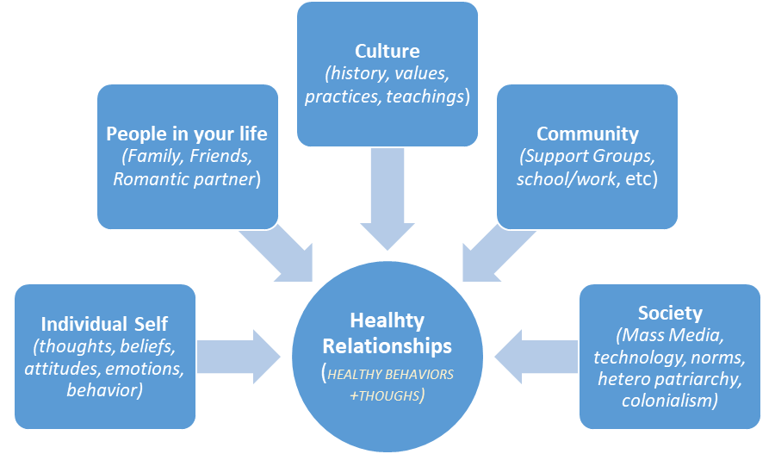
Sources for Learning about Healthy Relationships.

Slide 33
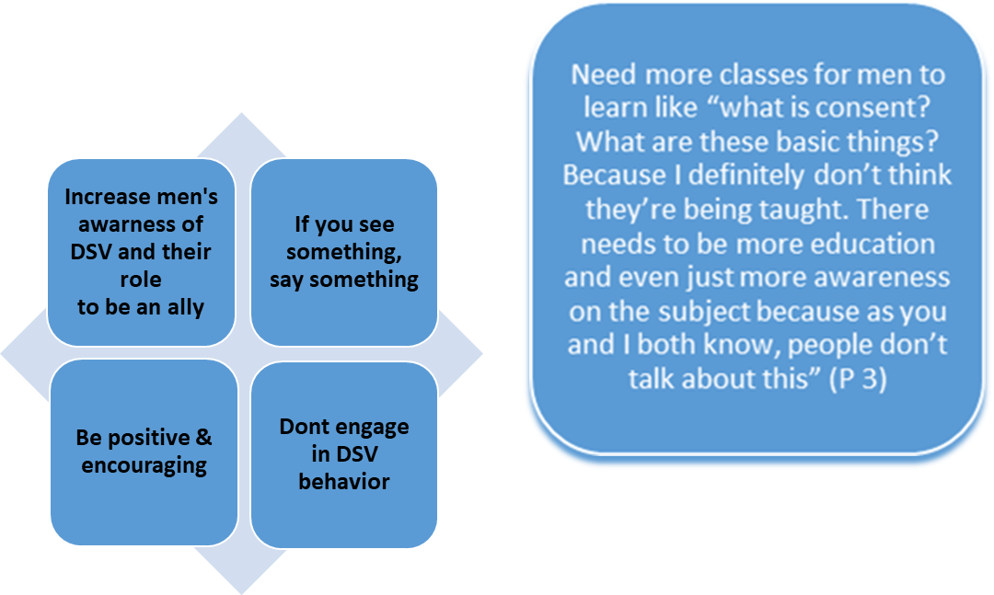
What about allies?

Slide 34
Sources for healing

Slide 35
Vital to consider
Prevention cannot be addressed or discussed in isolation from other concepts
Prevention cannot be addressed without first examining and addressing barriers to seeking support.
Notes:
• Conclusion 4A: Prevention cannot be addressed or discussed in isolation from other concepts such as:
o Evaluating accessibility of direct services
o Cultural competency and awareness of service providers
o Role of local housing limitations for all, including short-term and long-term options, desperate need for DSV shelter, substance abuse treatment and residential treatment locally, group home options locally, transitional housing
o Addressing confidentiality issues and potential role-conflicts living in a small community, as they are barriers to utilization of services
o Addiction and substance abuse support is a distinct but related issue. It is explicitly connected to all aspects of prevention and healing of DSV. All community members identified this factor as one of the most impactful. This is a distinct area that needs to be invested in more locally.
o Mental health and wellness support is also a related issue. It is also explicitly connected to all aspects of prevention and healing of DSV. Although our county and local area offers numerous direct services, there is perception that these are not enough, have long wait times to be seen, and have to be transferred out of the area to receive psychiatric residential support.
o Impact of colonialism even within the local tribal and non-Native community on perceptions of Indigenous people, women, sexuality, silencing of victims and gendered violence towards women
o The social stigma of “telling”, which prevents victims from sharing their stories, disclosing identities of perpetrators, and silencing deep wounds
o Lack of community education about consent, impact of cycles, identifying healthy behaviors
o Lack of discussion or addressing the impact of social media and technology and its relationship to DSV
o Need for mentoring and explicit identification of both male and female role models

Slide 36
Conclusions
Male community members
  are invested in reducing DSV in our local community.
  know a significant amount about DSV.
  believe numerous causes of DSV exist.
  know of many existing options for prevention of DSV.
  Suggested opportunities for prevention
  see themselves as potential allies for victims of DSV, but the ways differ
Numerous aspects of Native history, culture, and values can be and are connected to healthy behaviors.
Numerous sources of positive male role models exist in the community.
“Healthy relationships” as a term are full of challenges and are vague; This is better conceptualized by “healthy behaviors”.

Slide 37
Recommendations
We recommend a multi-pronged approach that provides:
opportunities for personal and group healing
community engagement
increased visibility and awareness
education, and
personal responsibility and accountability.

Slide 38
Recommendations (cont.)
To adequately address DSV prevention, we must discuss and consider other concepts. Some of these concepts include:
evaluating accessibility of direct services,
providing cultural competency and awareness of service providers,
evaluating and prioritizing housing needs
Other factors
Notes:
We also recommend discussing, considering and taking action on:
addressing confidentiality issues and potential role-conflicts living in a small community
addiction and substance abuse support & limitations
mental health and wellness support &N limitations
the impact of colonialism even within the local tribal and non-Native community on perceptions of Indigenous people, women, sexuality
the silencing of victims
gendered violence towards women
challenging the prevention of victims from sharing their stories, disclosing identities of perpetrators, and silencing deep wounds
addressing the lack of community education
encourage discussion about the impact of social media and technology and its relationship to DSV

Slide 39
Recommendations (cont.)
Because DV is a significant problem: as 59% of total survey participants shared they had personally experienced DV, and 80% knew someone who did.
We recommend making this issue a top priority, to pursue funding opportunities immediately, and consider strategic but urgent action.
  romantic partners (63%)
  relatives (41%)
Notes:
We need to offer support, education, prevention and intervention, and healing for those caught in this victim-perpetrator cycle.
individual and community responsibility.

Slide 40
Recommendations (cont.)
We recommend generating awareness of, interest in, and participation in the Missing and Murdered Indigenous Women and Girls (MMIWG) movement.
  Because the most common reported SV perpetrator is from friends (33%), relatives (32%) and romantic partners (25%), we recommend focusing on personal relationships, personal boundaries, personal healing, and empowerment.
  Many are victimized by/are victimizing their own friends, family, and partners.
  This is a complex issue
Notes:
Because SV is also a significant problem in our community (35% experienced SV, and 69% knew someone who did)
We found that most people in the community do not get help (66% have not received services for experiences with DSV). We recommend increasing direct services, awareness of those services, and efforts to challenge social and community norms of silence and stigma.

Slide 41
Angie Hyde (Tuolumne Me-Wuk), B.A. (M.S.W. in progress)
Welcome
Project director through role as Education & Outreach Coordinator

Slide 42
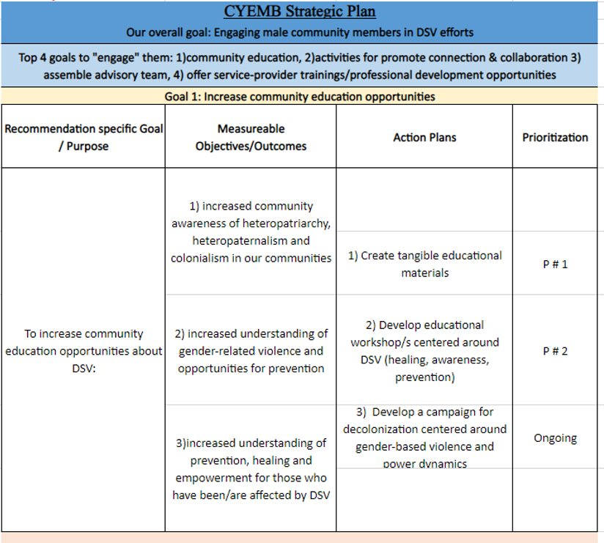
Strategic Plan
Top four goals for the strategic plan:
Increase community education opportunities about DV/SA
Develop & implement connection-building and collaboration-based activities
Assemble an advisory team comprised of community members
Offer trainings for professionals and para-professionals who work within the Native community

Slide 43
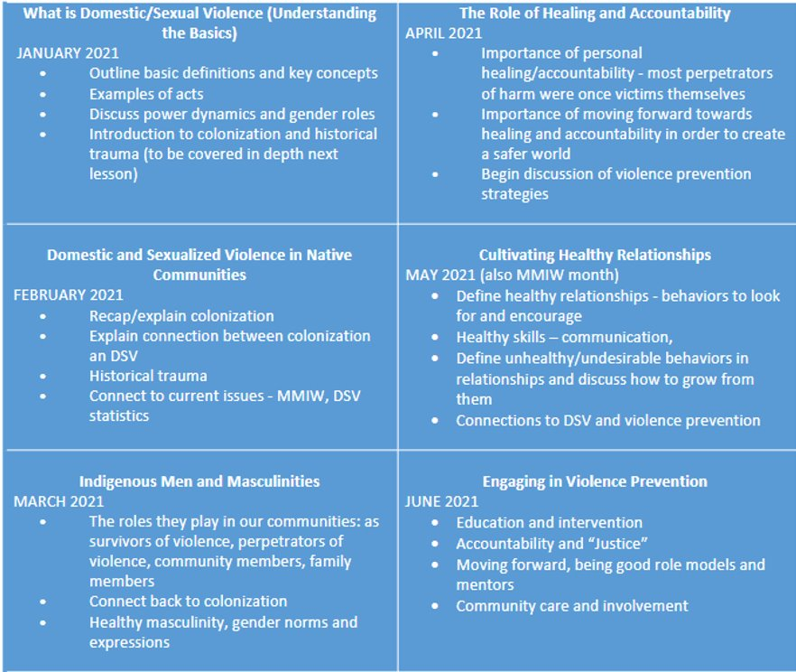
Webinars –
Curriculum and Timeline

Slide 44
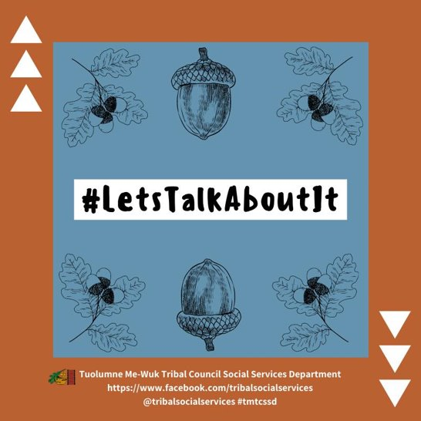
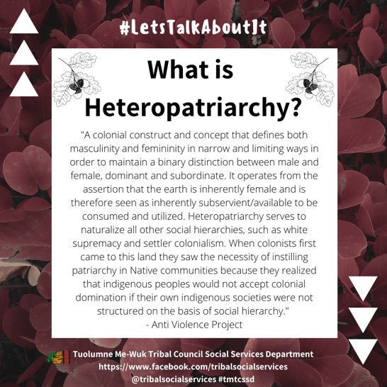
Social Media Campaign - #Lets Talk About It

Slide 45
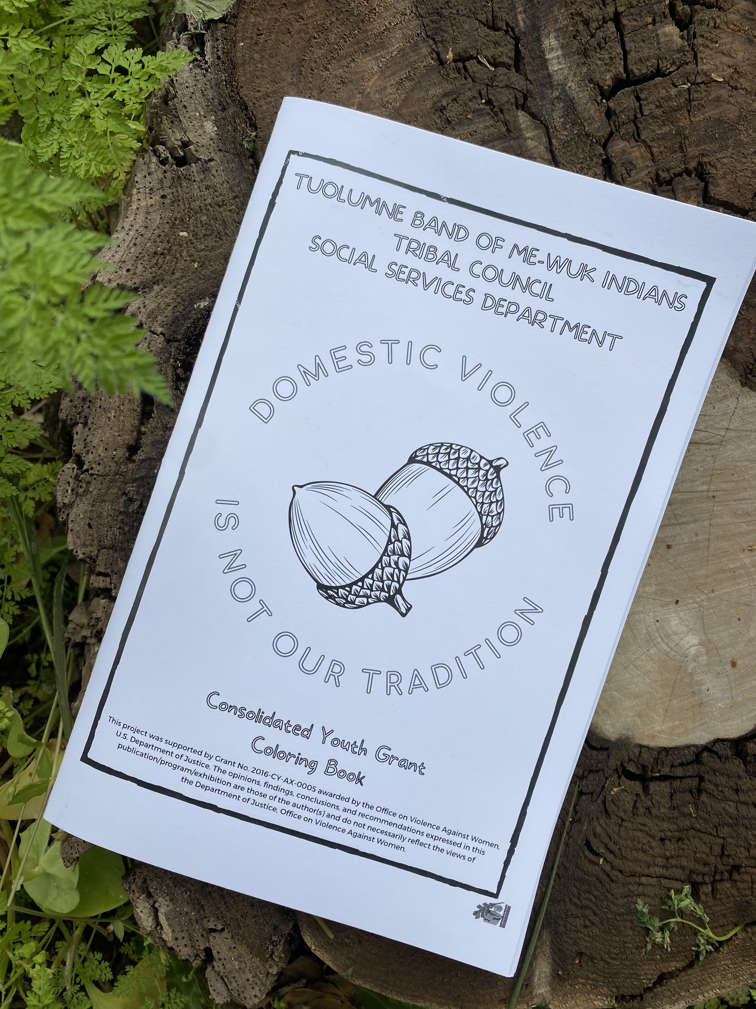
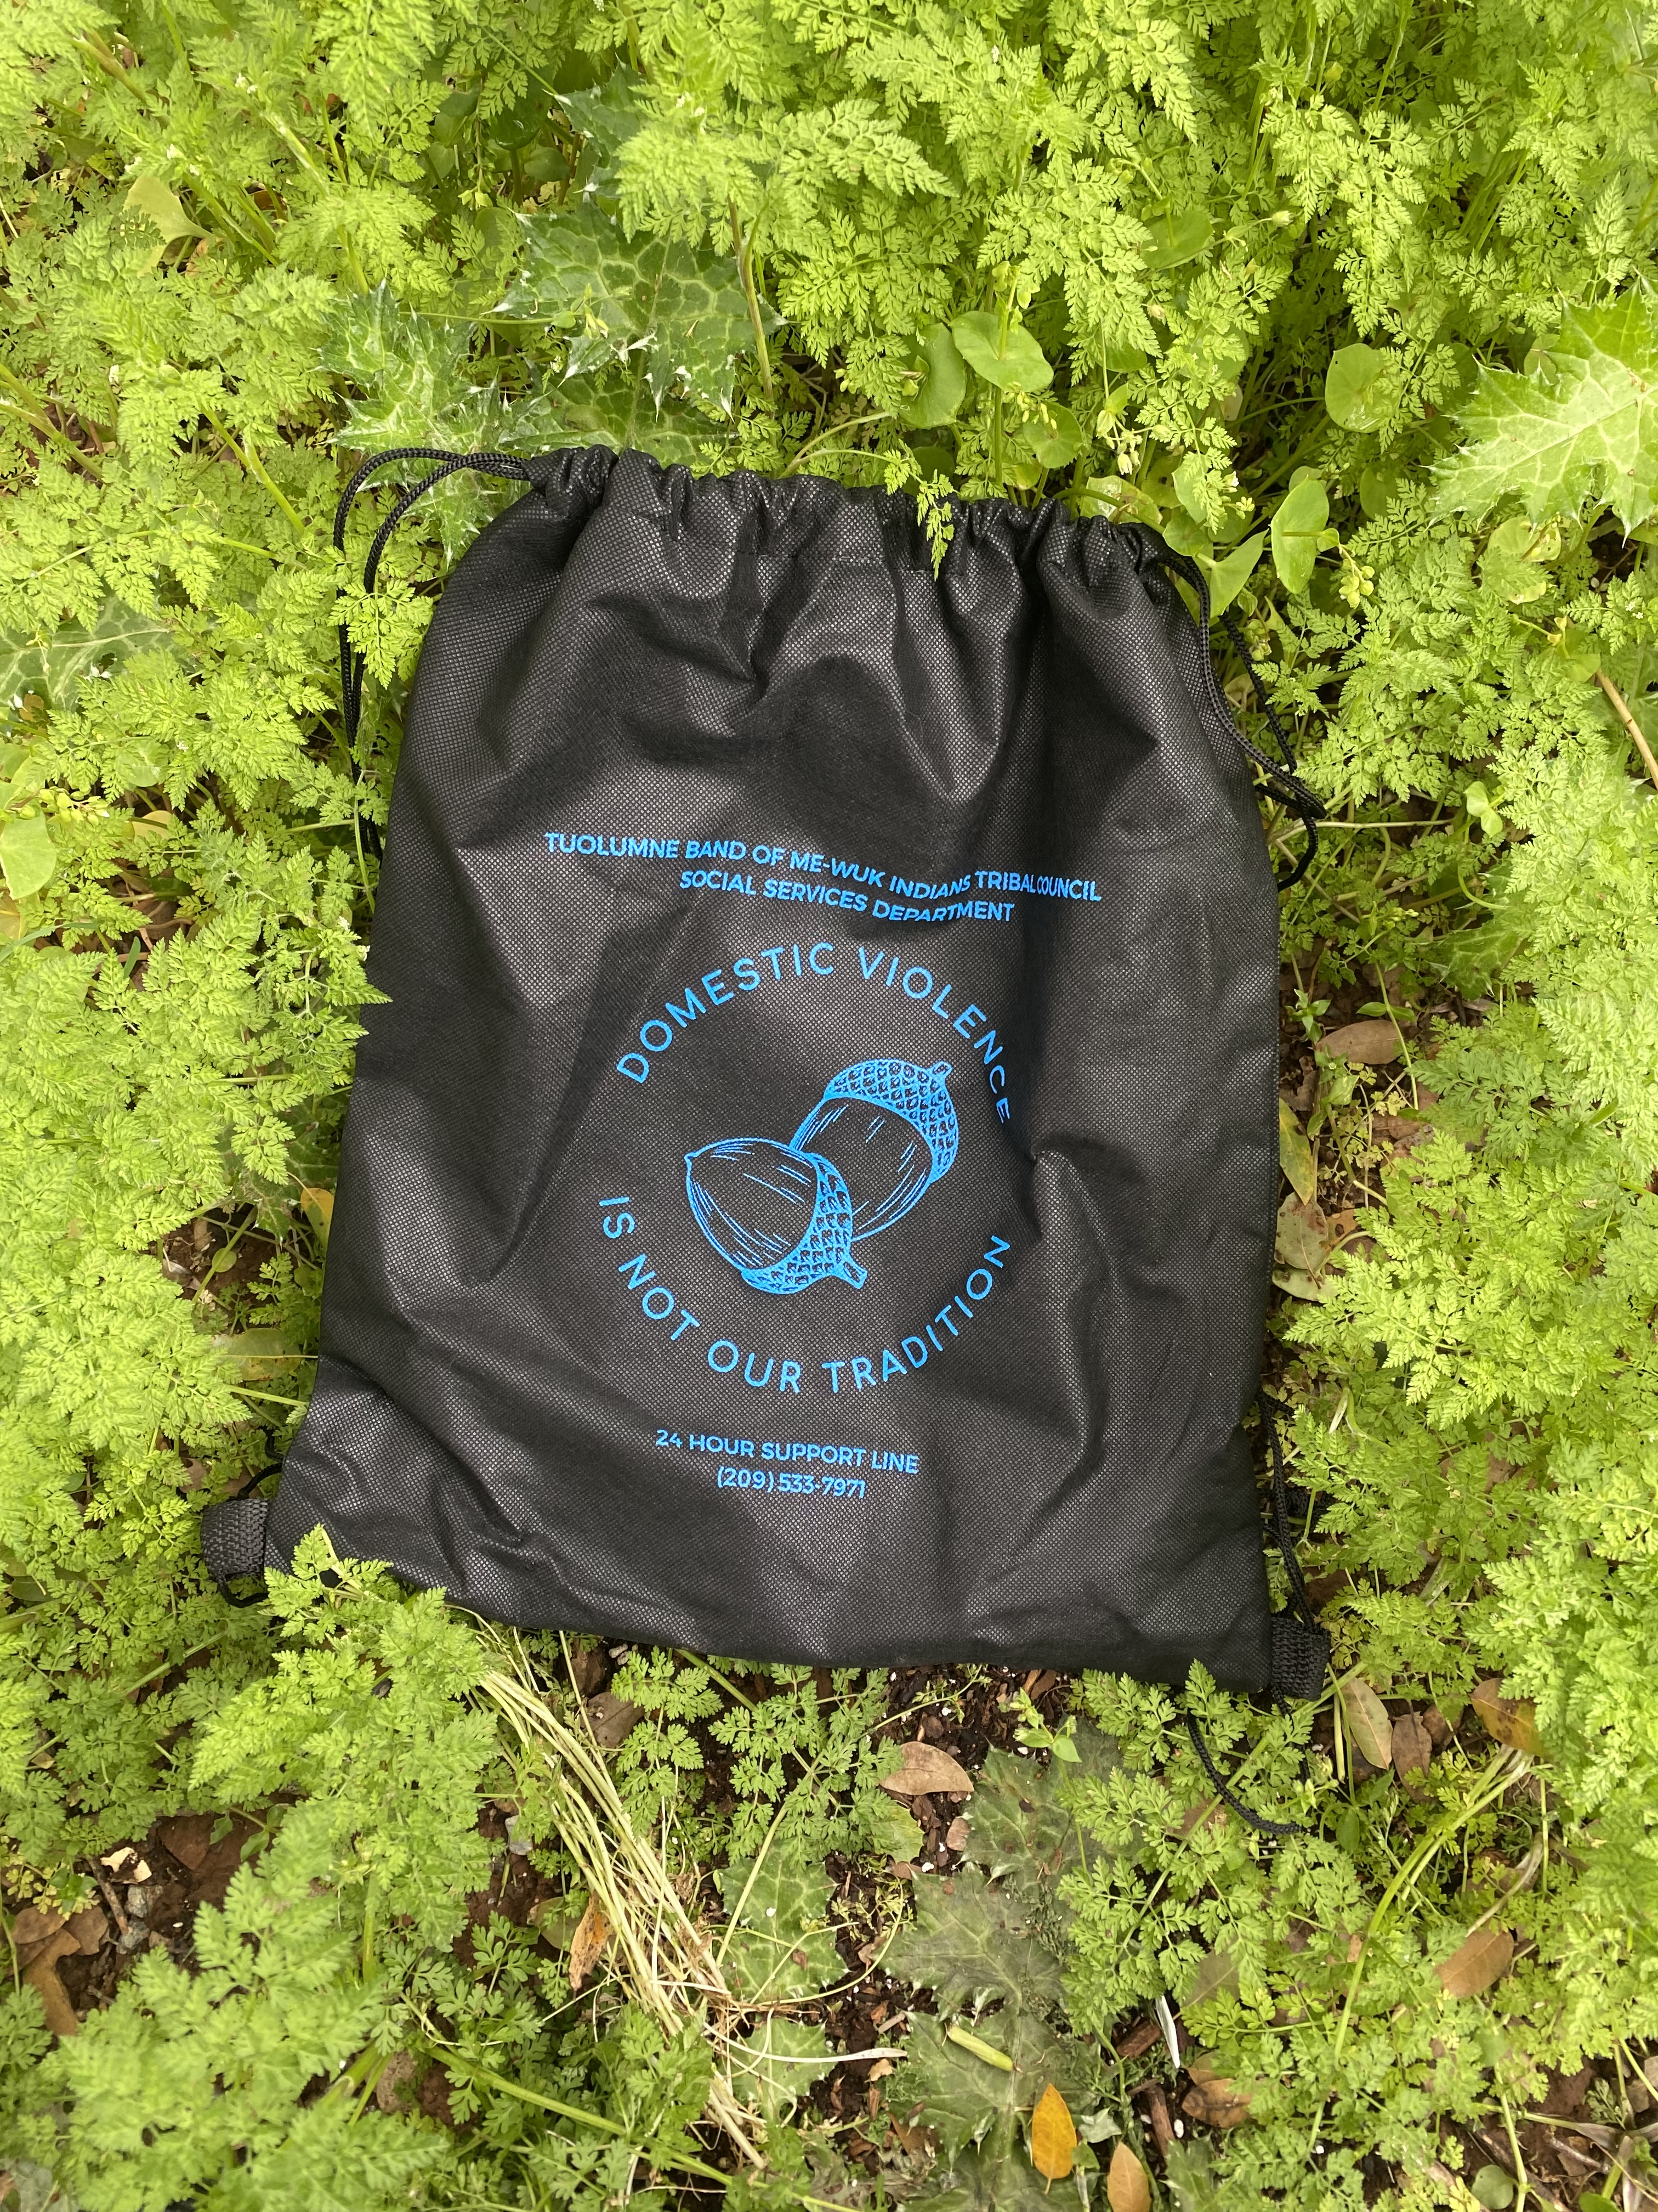
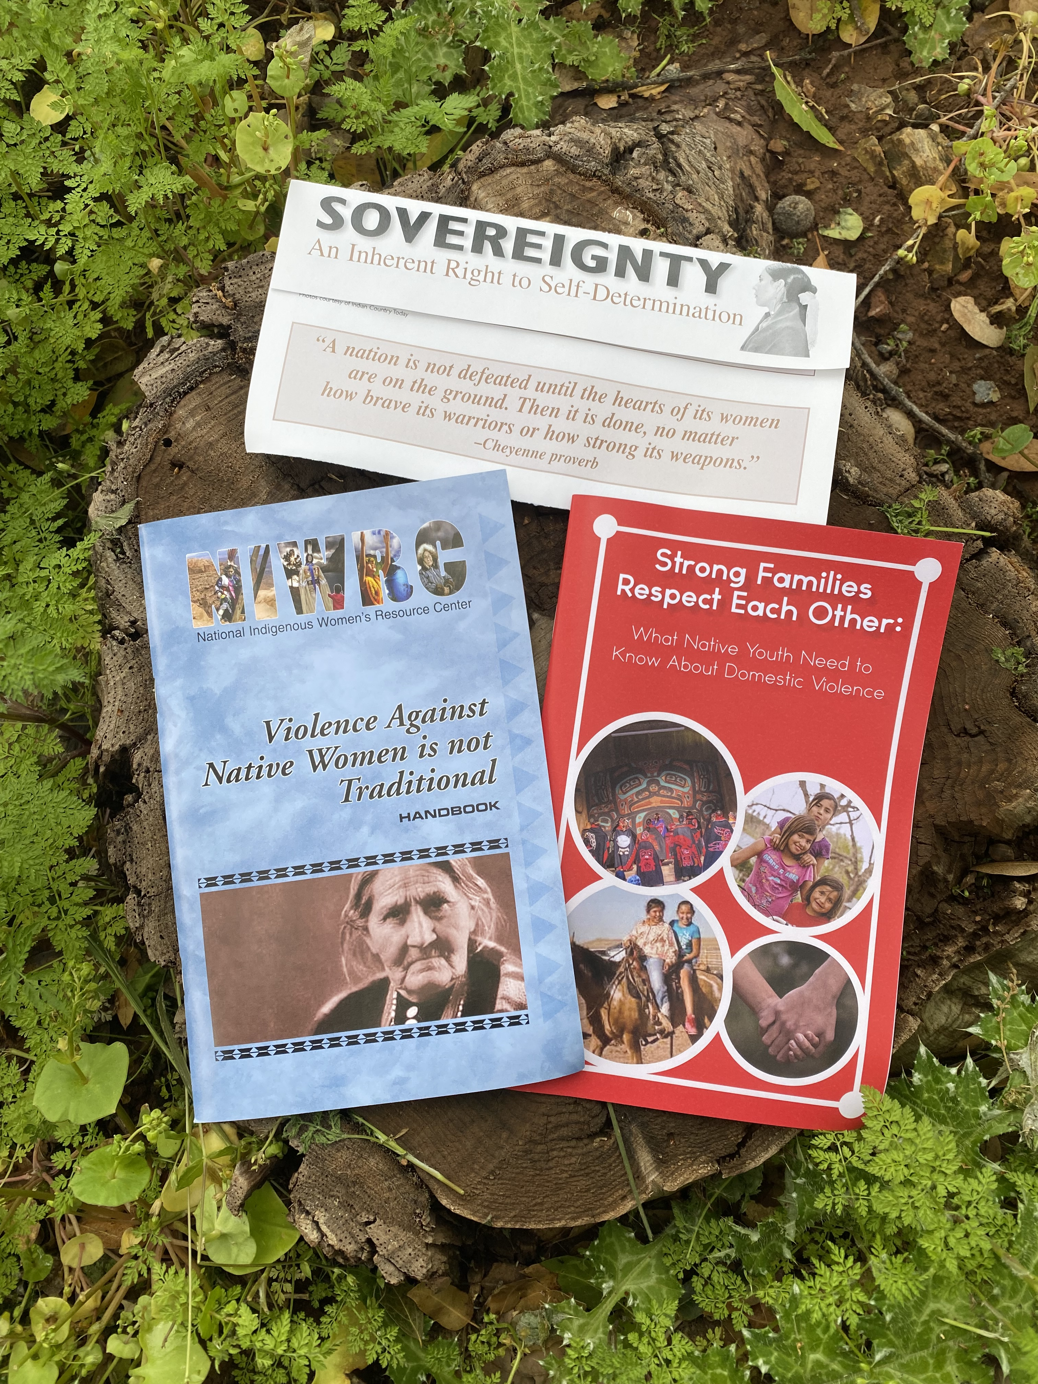
Outreach and Education Materials

Slide 46
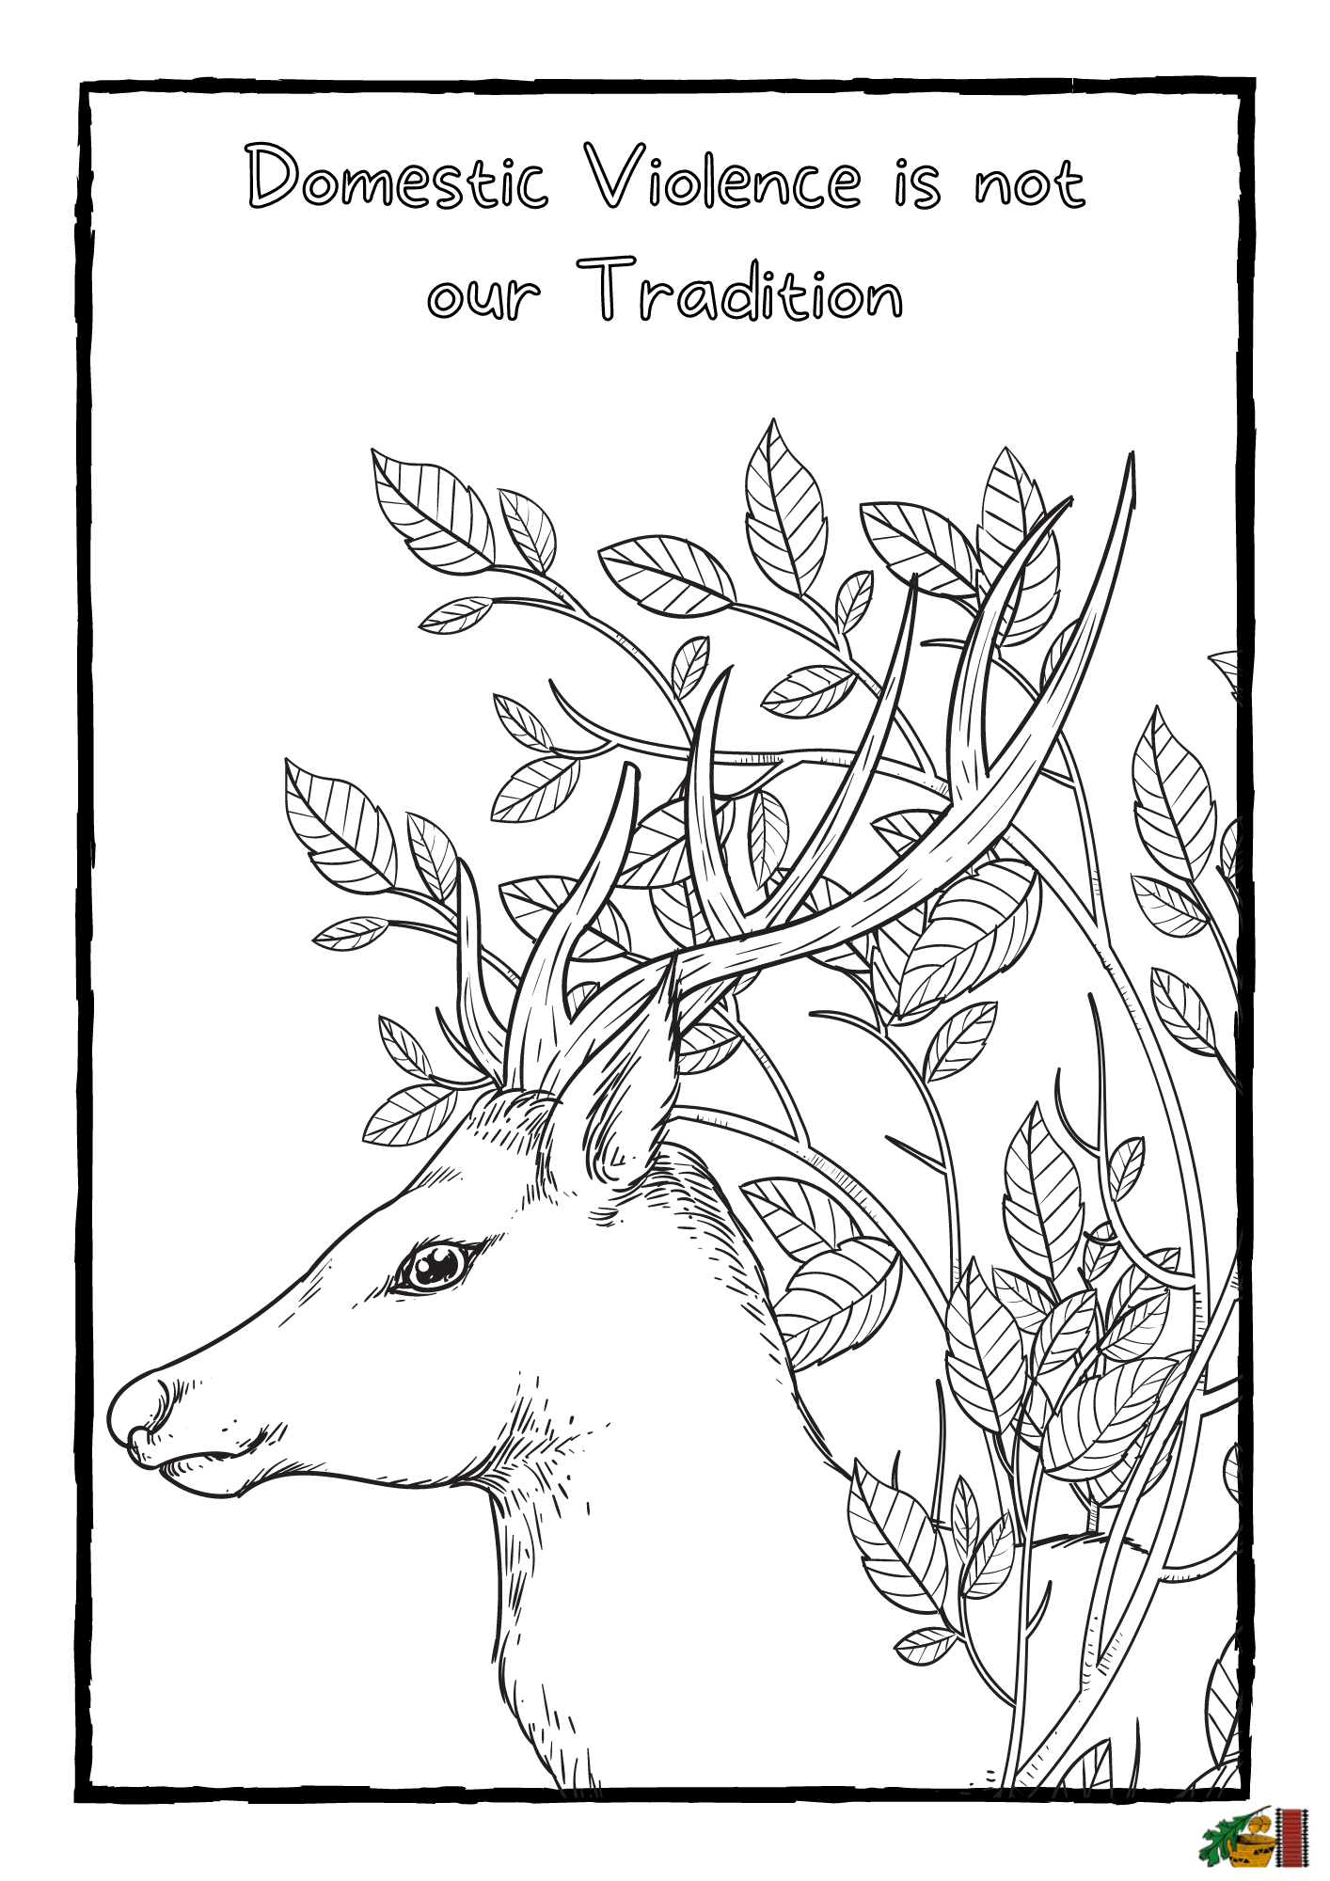
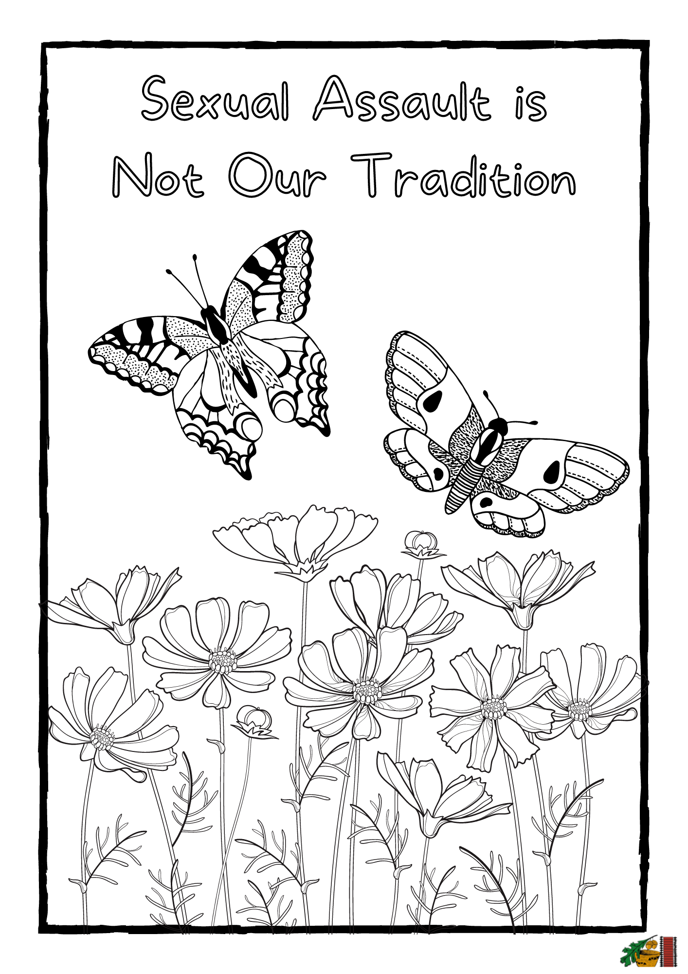

Slide 47
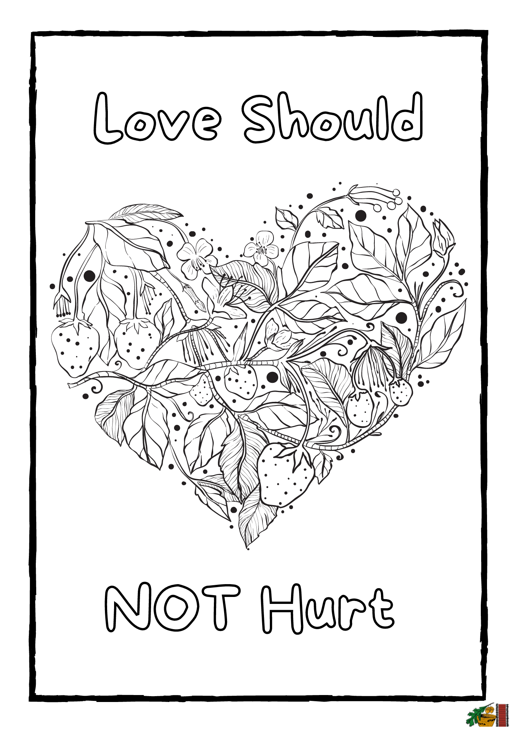
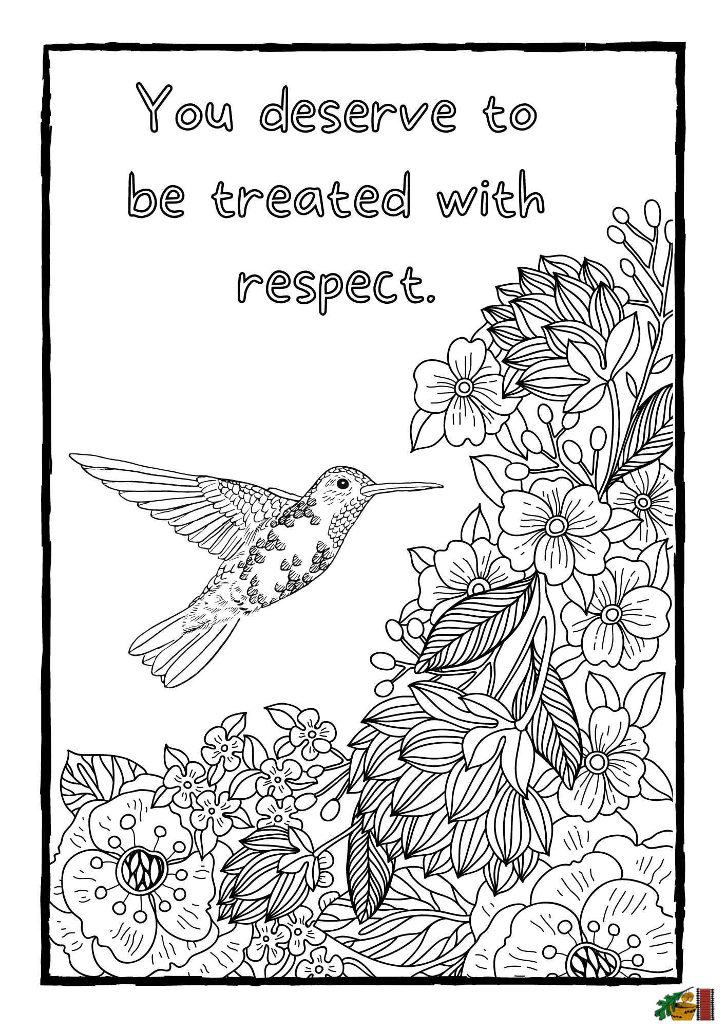

Slide 48
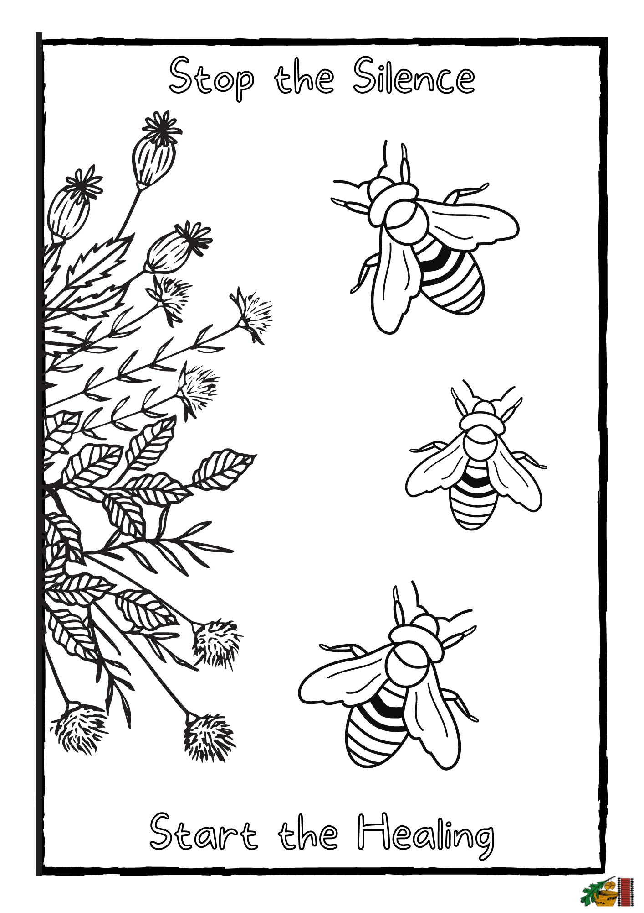
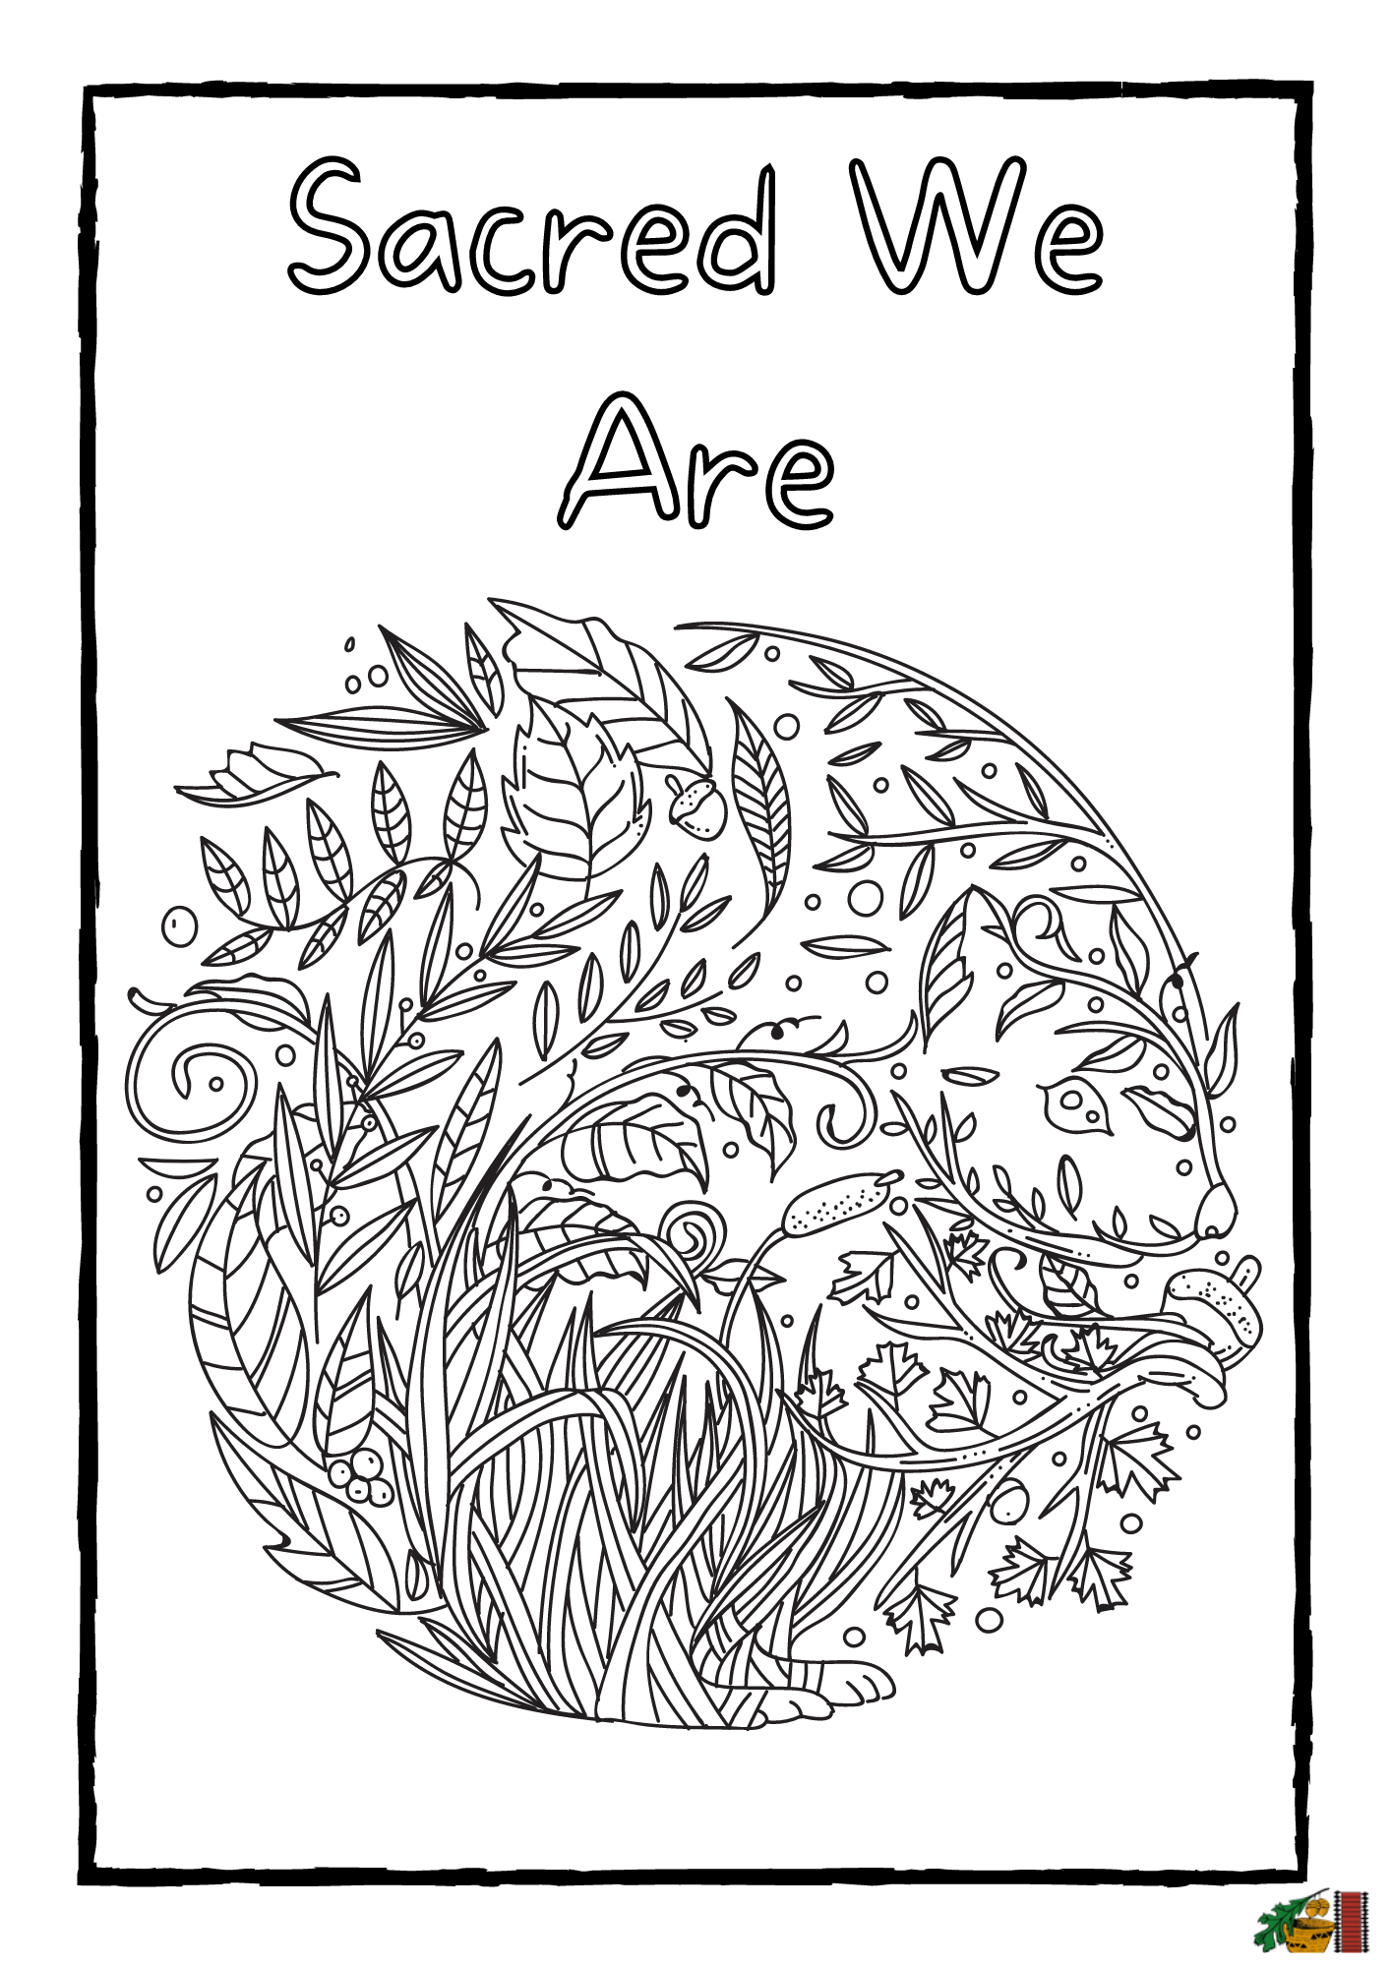

Slide 49
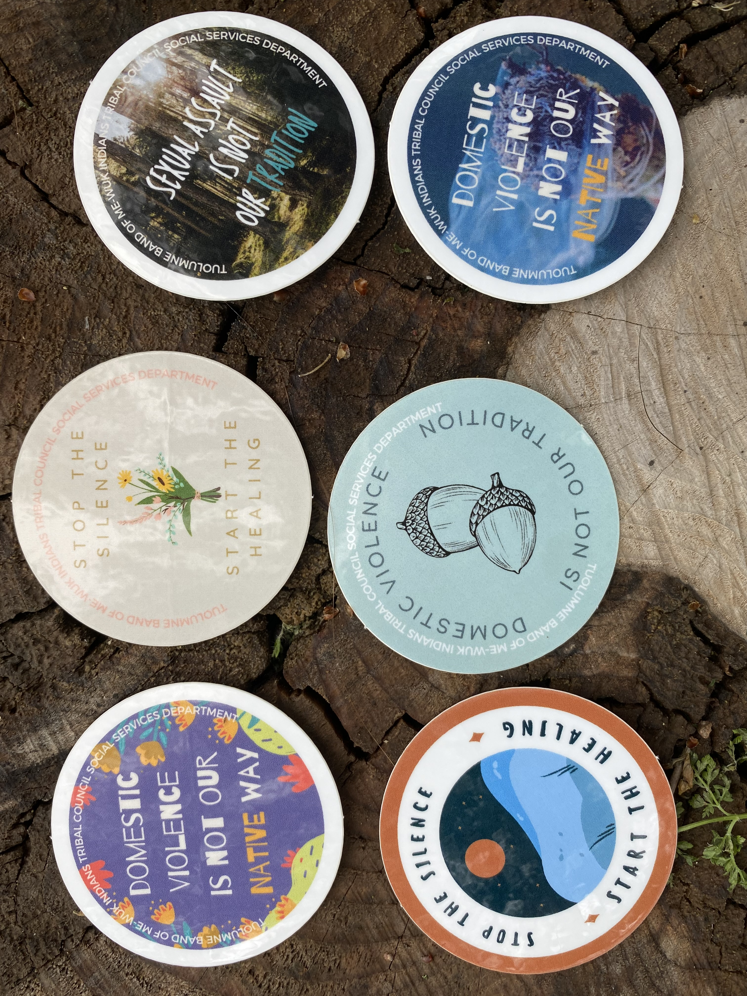
Recommendations
Practices to keep
Practices to change
Timing

Slide 50
Objectives
Review findings from our community needs assessment regarding sexual and domestic violence
Learn specific implementation strategies
Identify additional way/s to better serve the direct needs of your community
Increase awareness: Learn the significance of a cultural approach to research within tribal communities
Idea Generation: Utilize findings from our research for future funding and program development

Slide 51
Discussion & Reflection
What questions do you have?
What has been the biggest take-away for you?
What did you learn?
Has your view of the importance of cultural awareness changed?

Slide 52
Contact Info
Diana Carpenter diana@mewuk.com
Angie Hyde angie.hyde@sjsu.edu
Stephanie Beaver-Guzman beavers@yosemite.edu

